Slide 1
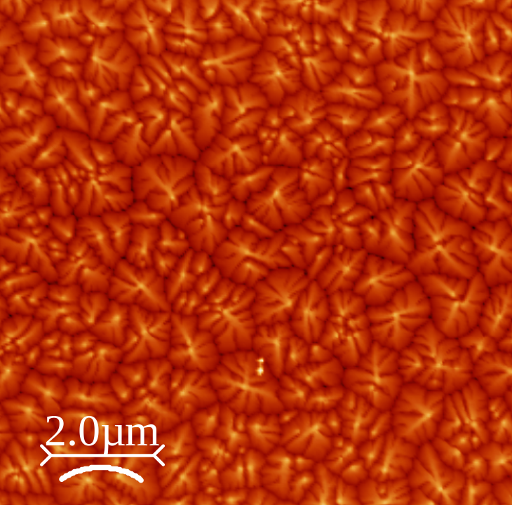
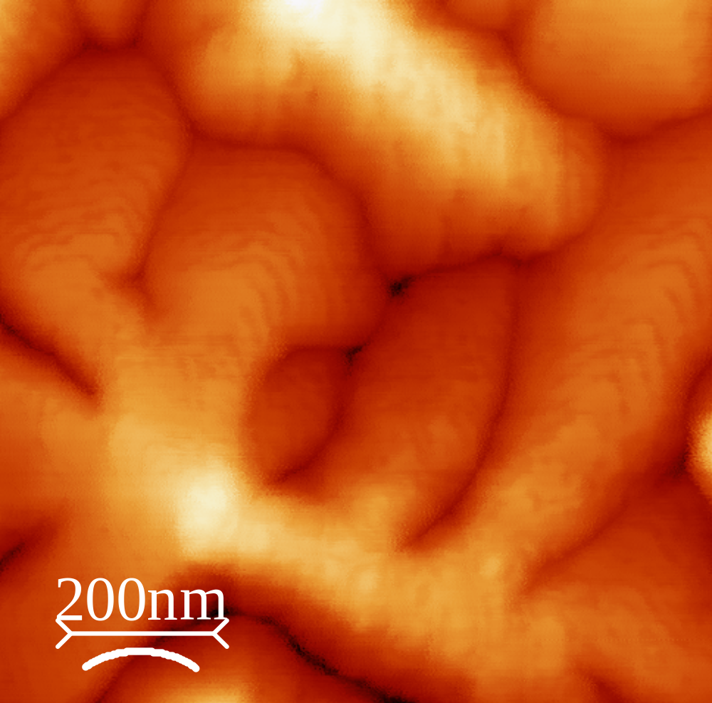
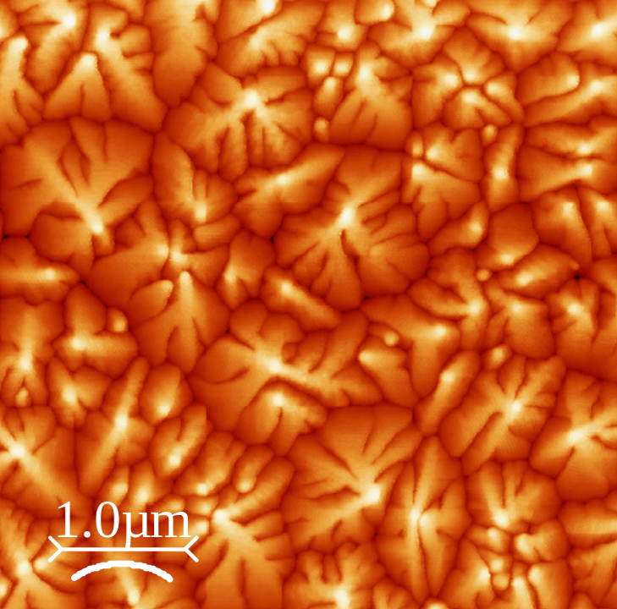
40nm Pentacene on Si₃N₄ Imaged in Clark Hall Dimension 3100 AFM 11/22/05

Slide 2
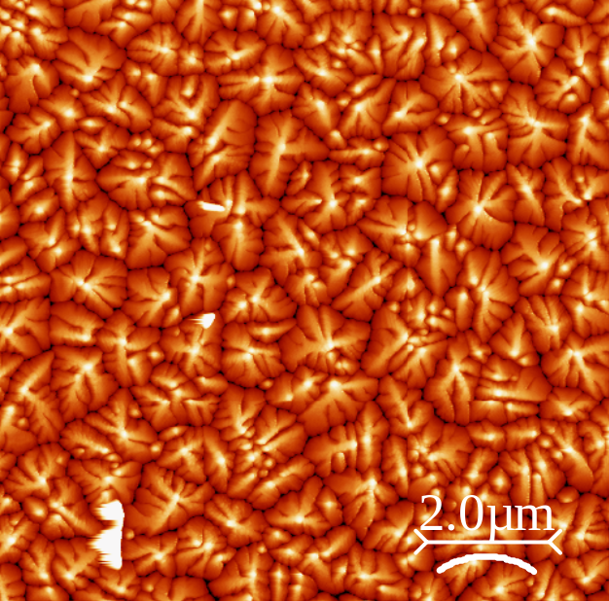
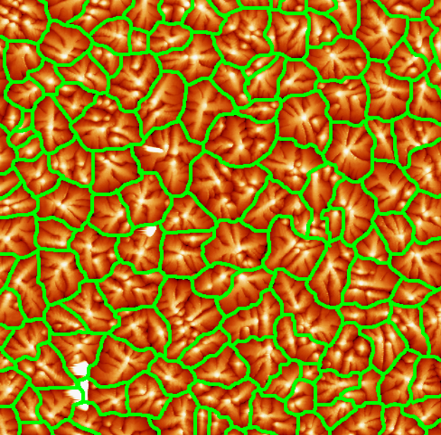
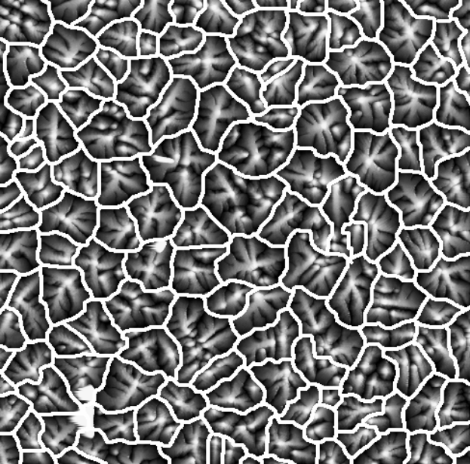
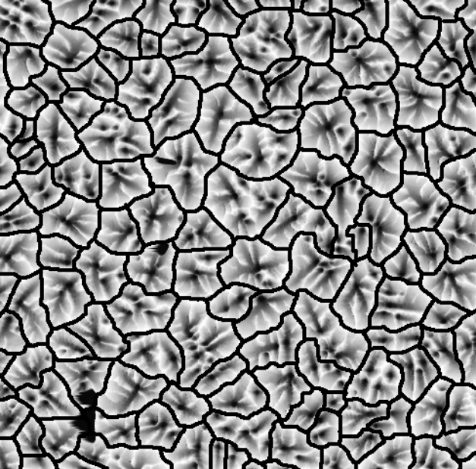
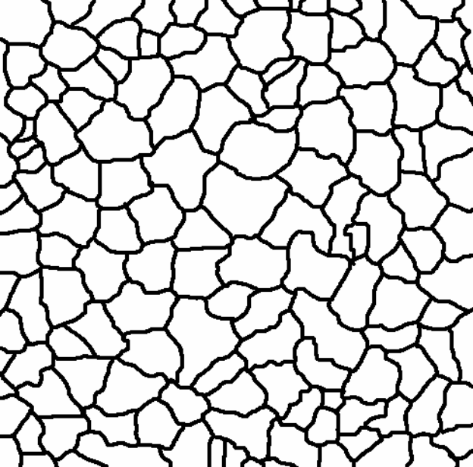
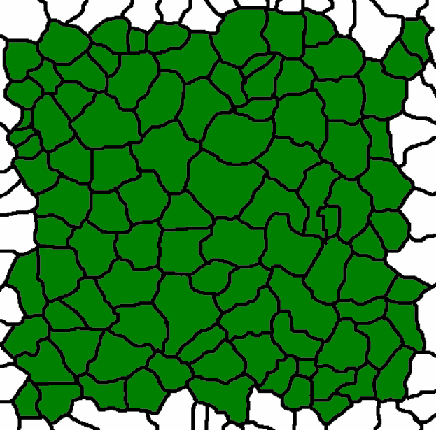
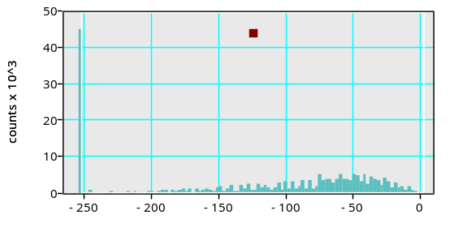
Grain Size Estimation
1. Original image
2. Estimated boundaries drawn in MS paint
3. Converted from RGB to REAL data type (green scale)
4. Inverted
5. Set contrast limits
6. Set threshold to include all but grain boundaries, remove border grains, analyze grains

Slide 3
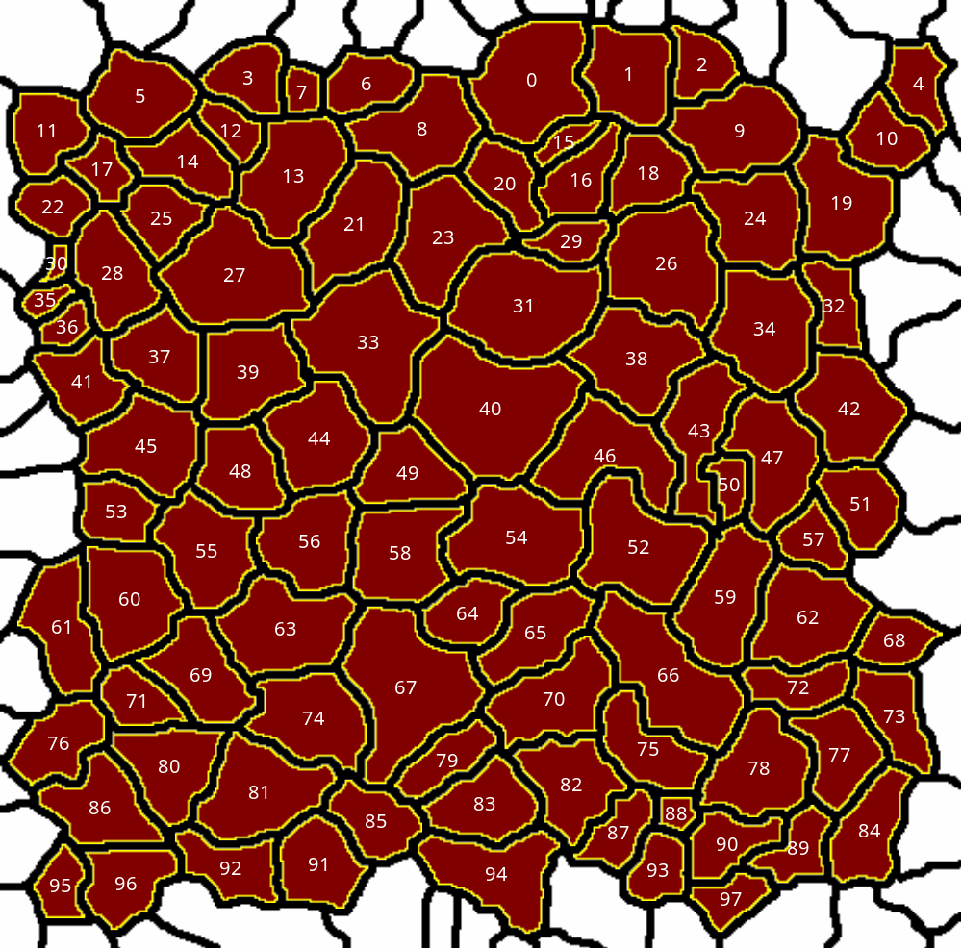
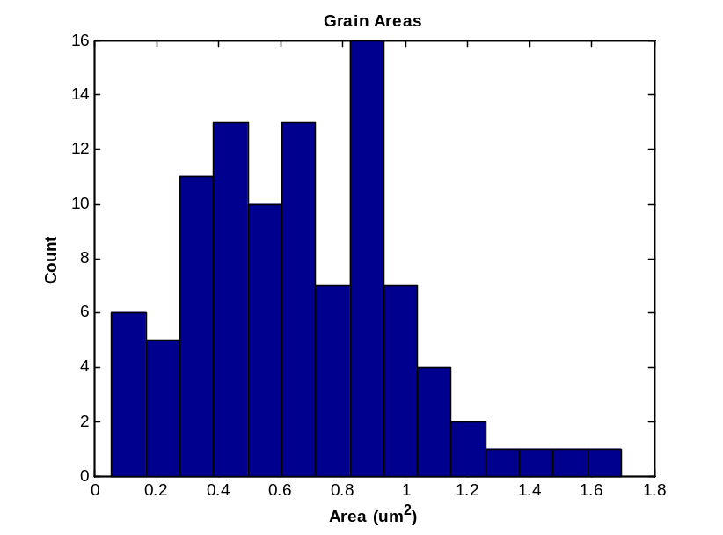
Averages
Area = 0.654µm²
Perimeter = 3.51µm
Circular Diameter = 1.01µm

