Slide 1

tagbase.org
Integrated management and visualization of electronic tag data
with Tagbase
Chi Hin Lam (Tim)
University of Southern California
tagbase.org@gmail.com
Vardis Tsontos
NOAA Southwest Fisheries Science Center
Vardis.Tsontos@noaa.gov

Slide 2
Status Quo of Tag Data Management
Lacking attention
Tough to find funding and support
We manage to squeeze by
Kick the ball over to the manufacturers
Time and effort
Commitment

Slide 3
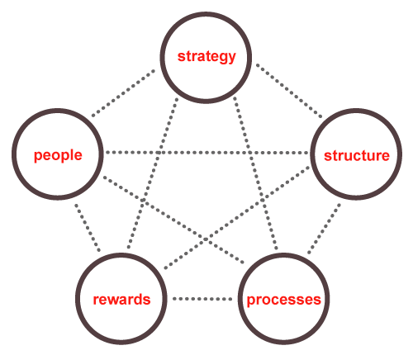
4. Issues
Status quo / Excel
Do it yourself
Turn it over to
the big guys
Tag platforms
Manufacturer
file formats
Software
requirements
Small lab
Organization
Data manager
Long-term data survival
Standards
Protocols for
quality control
Data connectivity
for analysis
Sharing
Accessibility
Outreach

Slide 4
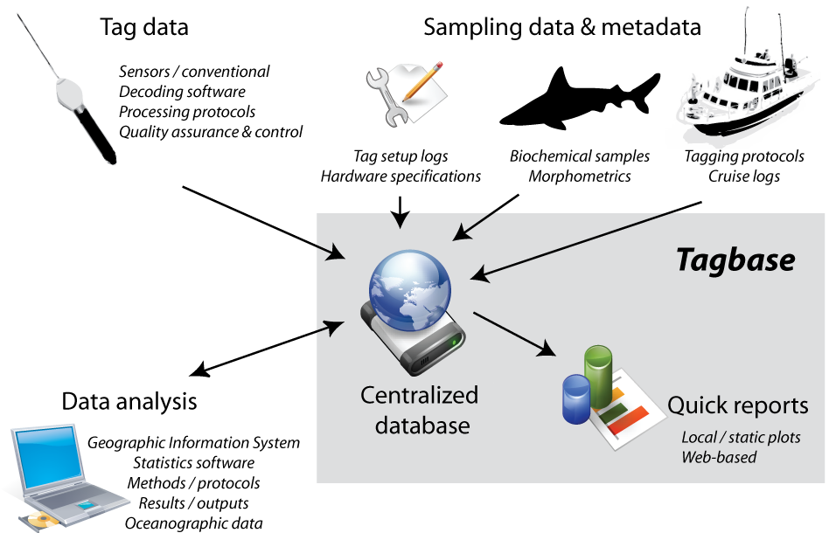
Motivations for Tagbase
Get your hands dirty!
We want you to have more time to interact and analyze your data

Slide 5

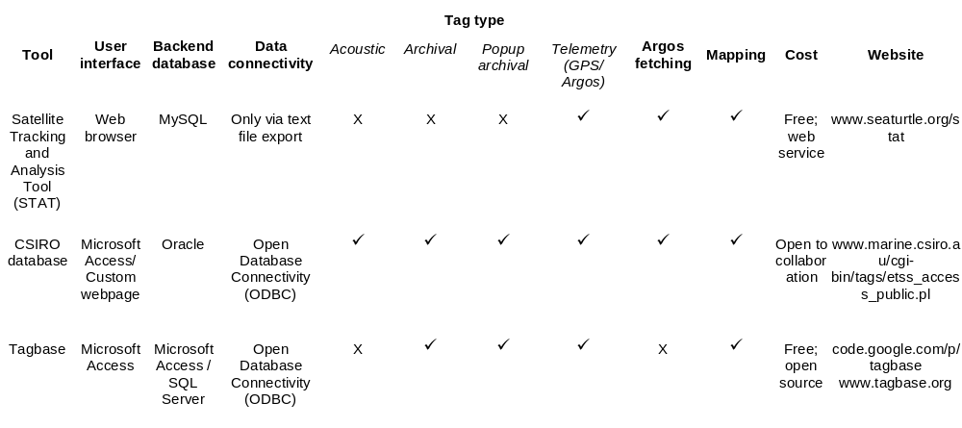
Current solutions
STAT from seaturtle.org
CSIRO database
simple
sophisticated

Slide 6
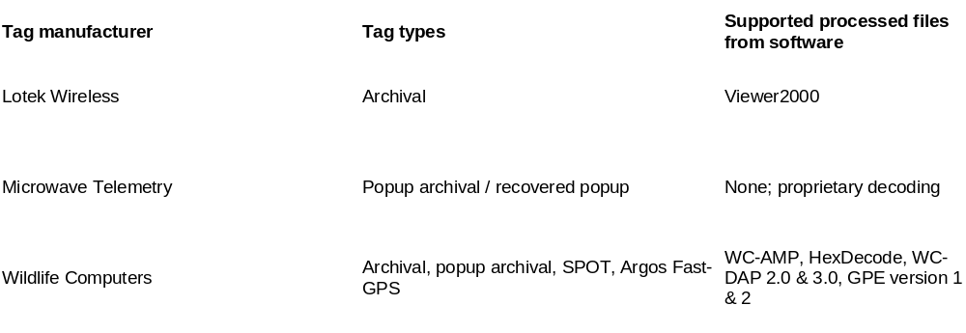
Supported formats
A game of catch-up
Not easy when manufacturers keep changing
Common ones

Slide 7
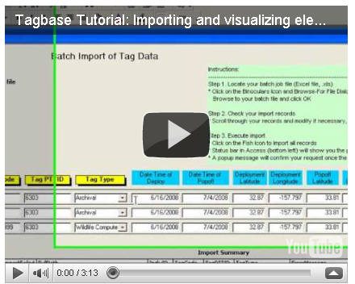
Tagbase demo trailer
Import process
Quick visualization

Slide 8
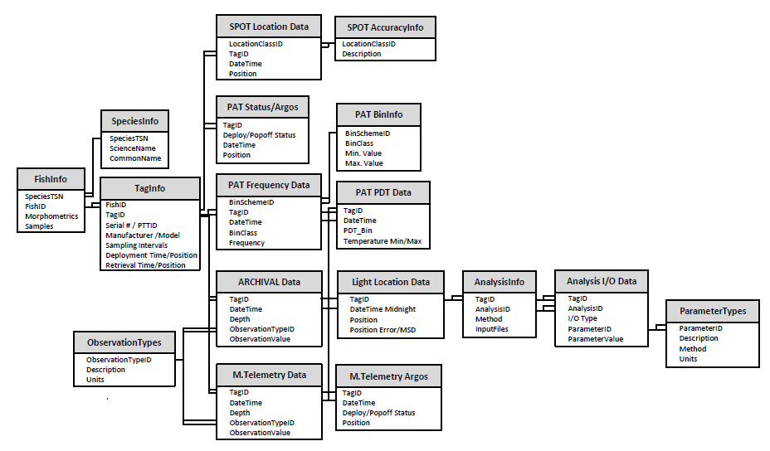
Data model
Tables
  Related
  Unlike spreadsheets
Query
  Reproducible
  Dynamic
Analogous to using Google to search

Slide 9
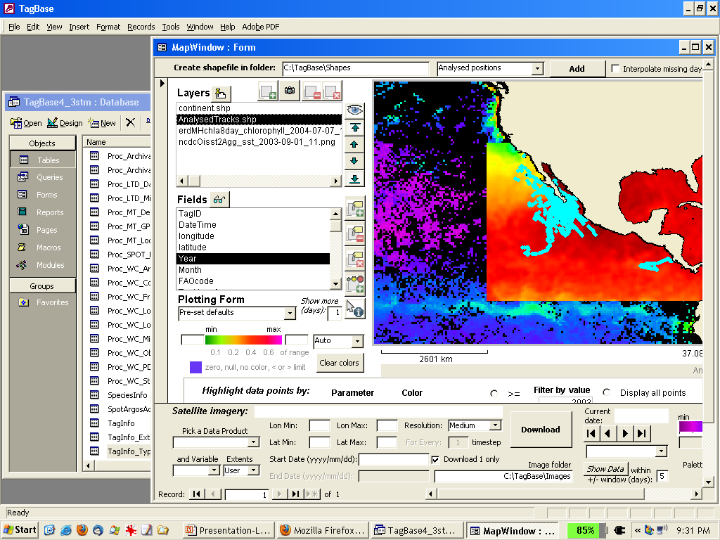
Integrated mapping
Notes:
And to that end, I have help developed another tool using a very basic Microsoft Office tool, Access
Please feel free to contact me later if you want to know more about it

Slide 10
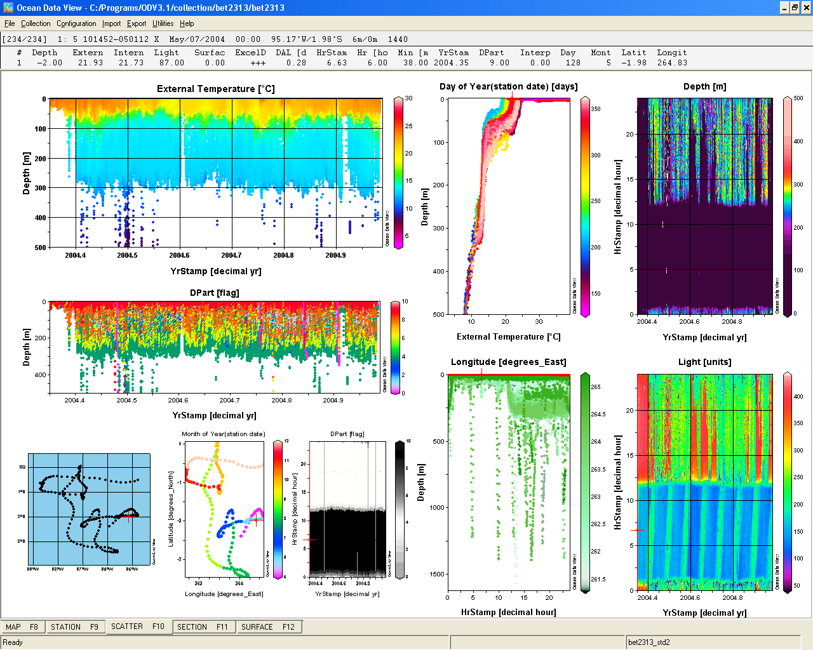
Endless possibilities

Slide 11
the Future
Tagbase is a starter kit
Much room to expand
Our priorities
  Cross platform
  Free, open-source enterprise database e.g. Postgre SQL
  Web interfaces
Small community
Cooperative effort

Slide 12
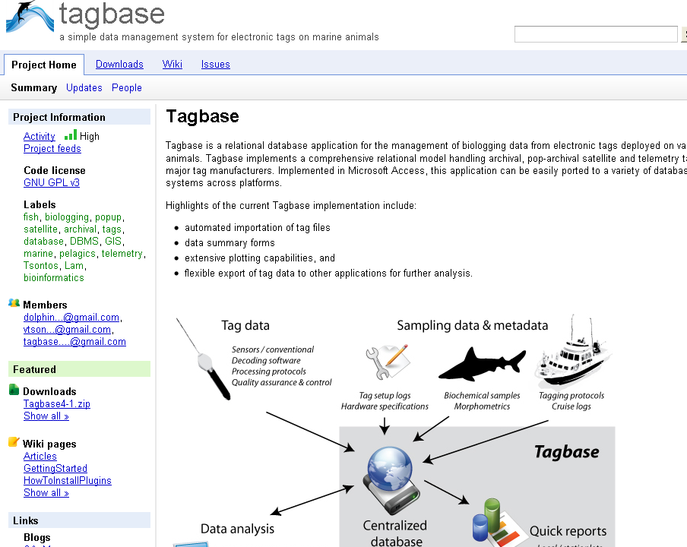
Tagbase.org

Slide 13

Thanks!
NASA Earth Science Fellowship
Pelagic Fisheries Research Program
James Wrath, Suzy Kohin, Heidi Dewar
Kevin Weng, David Itano, Kim Holland, Jeff Muir

