Slide 1
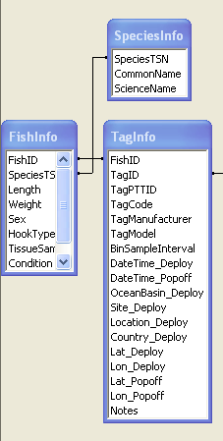
Tagbase Quick Guide to Import
Excel template
(TagBaseBatchJob.xls)
This is a very streamlined file that only contains the most necessary tag information to allow import of data
Metadata
Tables in
TagBase
.xls
or .csv
How metadata tables are set up:
  FishInfo tells you what the bio of your tagged fish
  such as: Length, Hook Type (Will change to Fishing Gear as you suggested)
  TagInfo: tells you the details about your tag. This set up also allows you to have 1 fish carrying multiple tags (related through the FishID field)
  We will address Popoff_Scheduled and DateTime_EndTransmission to this table as you suggested
  TagCode in this table is the tag manufacturer serial number, while TagPTTID is the Argos assigned number, as you probably have noticed. We are aware that some researchers recycle their TagPTTID, so we only require the TagCode to be a unique identifier of your tag.
Automated Import via TagBaseBatchJob.xls
  Not all the metadata are required by the batch job template
  So most of the fields in FishInfo is populated after data import using queries (i.e. a new entry is created for each new fish, flagged by IndivID in the TagBaseBatchJob.xls you have imported, but most fields are empty)
  What I think, for now, we can keep it this way, but we can automate it if we find it too troublesome in long run.

Slide 2
PAT tags
WC_BinInfo
BinID | Bin | BinRange | BinMin | BinMax
1 | 1 | <-1.5 | -999 | 0
1 | 2 | -1.5-5 | 0 | 5
1 | 3 | 5-10 | 5 | 10
1 | 4 | 10-20 | 10 | 20
1 | 5 | 20-40 | 20 | 40
1 | 6 | 40-60 | 40 | 60
1 | 7 | 60-100 | 60 | 100
1 | 8 | 100-150 | 100 | 150
1 | 9 | 150-200 | 150 | 200
1 | 10 | 200-250 | 200 | 250
1 | 11 | 250-350 | 250 | 350
1 | 12 | 350-1000 | 350 | 1000
100 | 1 | <5 | -999 | 5
100 | 2 | 5-7.5 | 5 | 7.5
100 | 3 | 7.5-10 | 7.5 | 10
100 | 4 | 10-12.5 | 10 | 12.5
100 | 5 | 12.5-15 | 12.5 | 15
100 | 6 | 15-17.5 | 15 | 17.5
100 | 7 | 17.5-20 | 17.5 | 20
100 | 8 | 20-22.5 | 20 | 22.5
100 | 9 | 22.5-25 | 22.5 | 25
100 | 10 | 25-27.5 | 25 | 27.5
100 | 11 | 27.5-30 | 27.5 | 30
100 | 12 | 30-60 | 30 | 60
WC_BinInfo: this table contains the binning scheme of the time-at-depth and time-at-temperature worksheets
You can have multiple schemes (12 bins or 14 bins) via different BinIDs
A conversion here is: depth scheme has an ID less than 100, >= 100 for temperature
In the Excel import template, TagBaseBatchJob.xls, use the appropriate BinID for a PAT tag
Start build your own scheme by copying the table on the left to a new spreadsheet

Slide 3
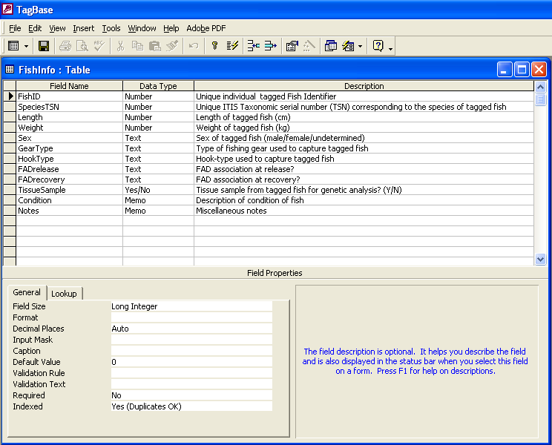
FishInfo table

Slide 4
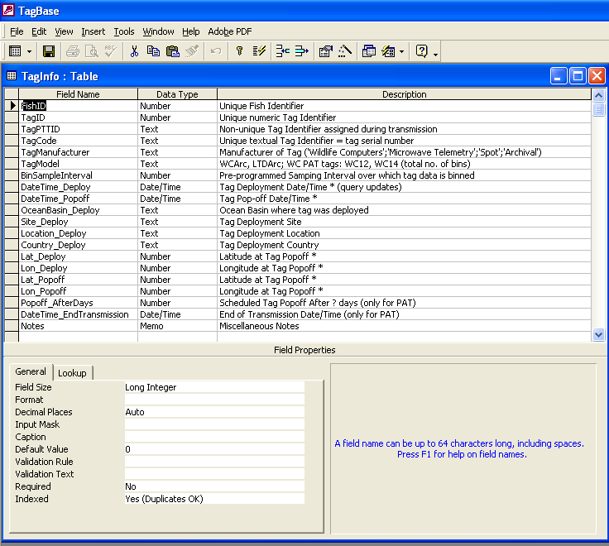
TagInfo table

Slide 5
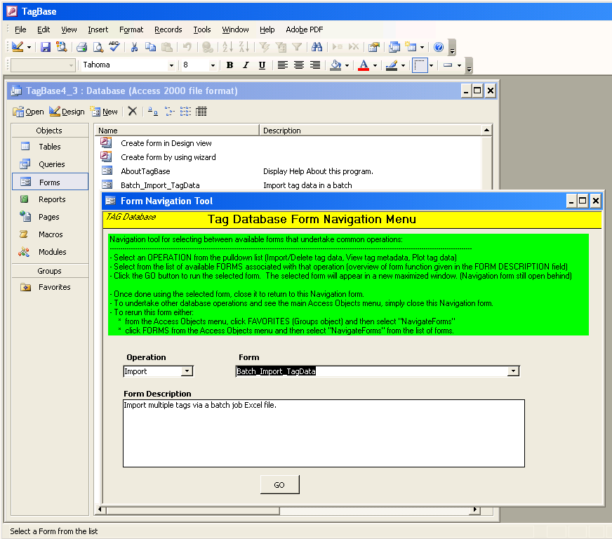
Trying TagBase by importing test files

Slide 6
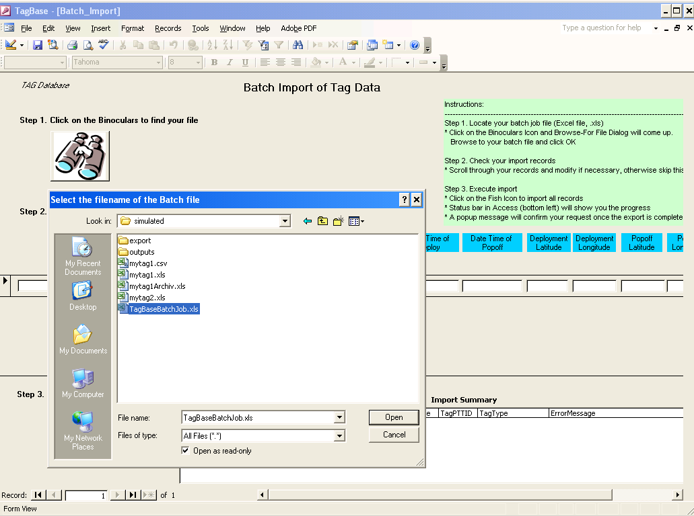
Browse to TagBaseBatchJob.xls file

Slide 7
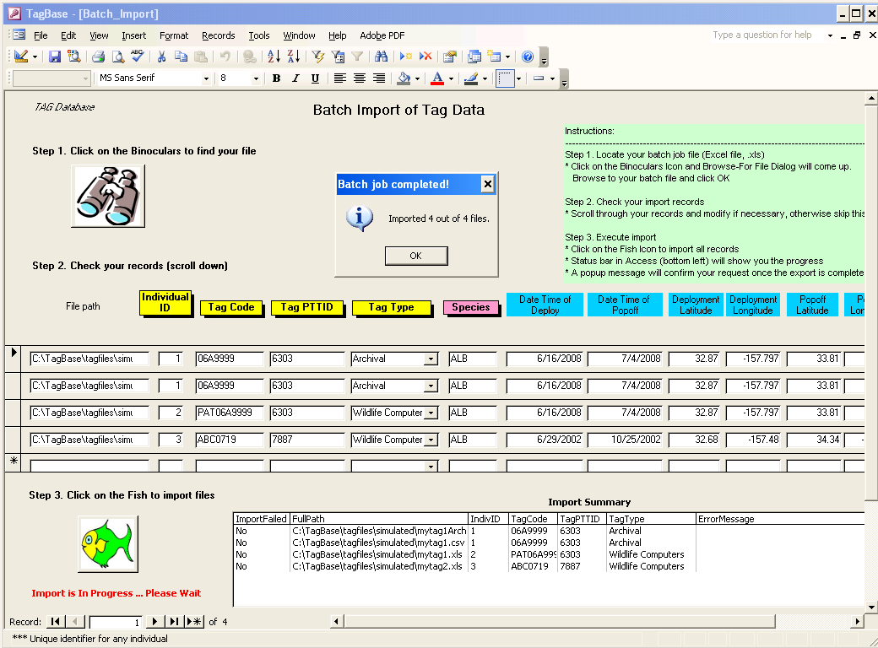
Import successful!

