Slide 1
Building NFC-Enabled
Android® Applications
Jason Weiss
Email: jason.weiss@tagdynamics.com
Twitter: @nfcworkflow

Slide 2
Setting up your Device
Must be a physical ICS or better Android phone with NFC capability
NFC must be turned on in the Settings
Development Mode
  Pre 4.2 should be in plain site
  4.2 or later: Settings, About Device, Build Number
    Tap Build Number 7 times to enable dev mode
    Go back to main settings screen, dev mode is now enabled

Slide 3
Sample App Overview
What are we going to build in our few hours together?
  A single app named “Play Tag”
  Each lab builds atop of the previous lab’s code
  Final app will support being launched when a tag is touched, reading a tag, initializing a tag, writing data to a tag
    We will not be writing any code that locks tags so you can re-use them as development tags after class!

Slide 4
Git the Code
https://github.com/nfcworkflow/andevconnfc
Labs built using the Eclipse IDE

Slide 5
Introductory Code Example
@Override
public void onCreate(Bundle savedInstanceState)
{
super.onCreate(savedInstanceState);
…
nfcAdapter = NfcAdapter.getDefaultAdapter(this);
nfcPendingIntent = PendingIntent.getActivity(this, 0,
new Intent(this, getClass()).addFlags(Intent.FLAG_ACTIVITY_CLEAR_WHEN_TASK_RESET).addFlags(Intent.FLAG_ACTIVITY_SINGLE_TOP), 0);
}
@Override
protected void onNewIntent(Intent intent)
{
…
if (NfcAdapter.ACTION_TAG_DISCOVERED.equals(intent.getAction()))
{
Tag tag = (Tag) intent.getParcelableExtra(NfcAdapter.EXTRA_TAG);
String tagId = HexUtil.bytesToHex(tag.getId());
onNfcTagDiscovered(tag, intent);
}
}
protected void onNfcTagDiscovered(Tag tag, Intent intent)
{
…
}
Initialize NFC
Tag Dispatch System
Extract the Tag and process

Slide 6
Learning Objectives
Formally define NFC
Understand the purpose of NDEF records
Define security concerns and storage limitations
Understand the value of the open source standard, NFC Tag Event, when developing custom enterprise (non-financial) applications

Slide 7
Who is this guy?
Former Chief Software Architect of Tag Dynamics, Inc., a company specializing in NFC driven workflow solutions
Former Chief Software Architect of an NFC company in the UK for 2.5 years
Technical Keynote address at 2nd Annual NFC Developers Forum, Monaco

Slide 8
Android® and NFC
Near Field Communications == NFC
  Oversimplified, a mobile phone can interact with a subset of RFID tags, tags that are NFC-compliant
Android® supports both read and write operations on NFC Tags as of Android 2.3.3 (Gingerbread)
Not every device on Android 2.3 supports NFC
  Most tablets ship without NFC hardware

Slide 9
NFC Tidbits
Frequency: 13.56 MHz
Comms Speed: 106 / 216 / 414 kbps
NFC Forum is your friend
  Over 150 members today
  Free access to most NFC Forum specifications
    Read them!

Slide 10
Tag Dispatch System Overview
Android® NFC applications are built around an Intent driven routing architecture
When the OS encounters a tag, the Tag Dispatch System determines who receives the Intent with the data read from the tag
Routing rules can be static or dynamic
  AndroidManifest.xml
  Inside an Activity implementation
  Multiple options? User is prompted to decide

Slide 11
Enabling the Tag Dispatch System
The user must opt-in to reading NFC tags by turning on NFC inside of the Settings menu
  Most phones default to turning NFC off
The screen must be unlocked
  Touching an NFC-capable phone to a tag while the screen is off or locked has no effect whatsoever
  No known way around this
    Butt Dialing meets Butt Tagging?

Slide 12
AndroidManifest.xml and NFC
Must include NFC uses-permission
  <uses-permission android:name="android.permission.NFC" android:required="true" />
SDK can be API level 9; realistically level 10
  <uses-sdk android:minSdkVersion="10" />
Include uses-feature if app requires NFC
  <uses-feature android:name="android.hardware.nfc" android:required="true" />
If app supports NFC, perform runtime check and omit uses-feature in the manifest
  NfcAdapter.getDefaultAdapter(this) == null, no NFC present

Slide 13
Lab 1: Create an Empty App
Create an empty Android App Project
  Use the defaults in the Eclipse wizard
Update your AndroidManifest.xml to request permission for NFC

Slide 14
RFID Tag Introduction
All RFID tags are not created equal
  RFID has been around since World War II!
Most RFID tags are small, often rectangular or circular in shape, and typically embodied within some type of a sticker
  Active versus Passive
  RF frequency
  ISO, IEC, ASTM, DASH7 Alliance, EPCglobal, and more have standards
Every RFID tag is assigned a serial number when manufactured
  Association between the serial number and an object is inconsequential to the tag itself
  One tag could, contextually, identify different things in different databases

Slide 15
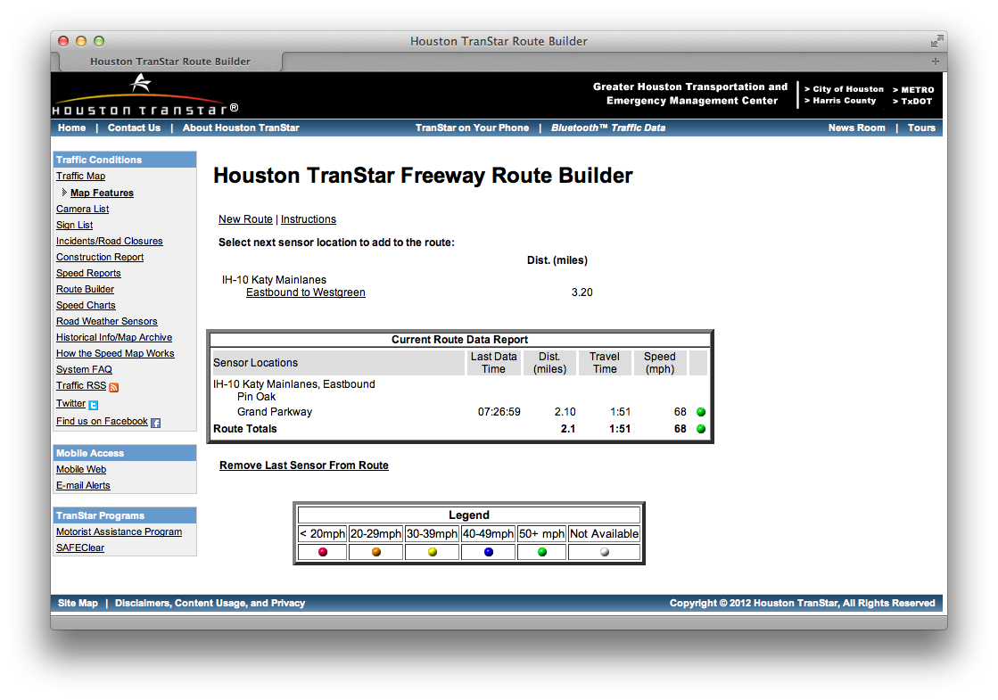
One Tag, Many Uses
Toll road authority issues tags for toll booths
Traffic managers use tags for speed monitoring

Slide 16
NFC Forum Tag Types
NFC Forum publishes compatible tag specifications online
  www.nfc-forum.org/specs/
Type 1 Tag
  Innovision Topaz
Type 2 Tag
  NXP MIFARE Ultralight
  NXP MIFARE Ultralight C
Type 3 Tag
  Sony FeliCa (largely only in Japan)
Type 4 Tag
  NXP DESFire
  NXP SmartMX
Best Bang for the Buck
Powerful, expen$ive

Slide 17
NFC Tag Memory Size / Cost
Type 1 Tag ($)
  96 bytes
Type 2 Tag ($)
  48 bytes / 144 bytes
Type 3 Tag ($$$)
  1, 4, 9 KB
Type 4 Tag ($$ / $$$)
  4KB / 32KB
MIFARE Ultralight as Type 2 Tag
http://www.nxp.com/documents/application_note/1303.pdf
Source: http://www.nfc-forum.org/resources/white_papers/NXP_BV_Type_Tags_White_Paper-Apr_09.pdf

Slide 18
A Word on ISO-14443 A/B
ISO/IEC 14443 is a communication layer
Cannot have NFC Tag Types 1 through 4 without ISO-14443 A/B underneath it
Can have ISO-14443A/B without NFC Tag Types 1 through 4 memory mapping and protocol support above it.
  ISO-14443 A/B support on a data sheet gives absolutely no indication if the tags support the NFC Forum protocols and support read/write operations from an Android® mobile phone!

Slide 19
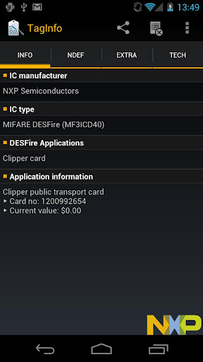
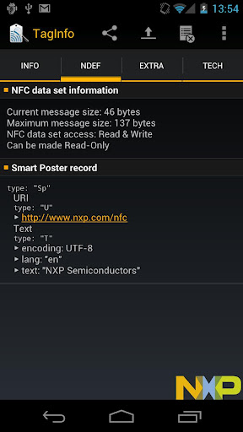
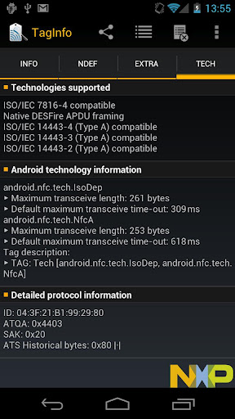
NFC Tags versus RFID Tags
NFC Tags are passive (no battery), and operate at 13.56 MHz (HF, not UHF)
NFC TagInfo in Android Market (NXP Semiconductors)

Slide 20
Lab 2: Install NFC TagInfo
Easiest to search for NXP to get the list of apps
Use the app to inspect the NFC tags in your package
Be sure to look at the different screens
  Does the tag support locking?
  Does the tag have any NDEF records?

Slide 21
Android Tag Dispatch System
Tag Dispatch System is a rules-based system
Build around 3 distinct Intent action values
  ACTION_NDEF_DISCOVERED (most preferred)
  ACTION_TECH_DISCOVERED
  ACTION_TAG_DISCOVERED (least preferred)
You must design your application accordingly
  e.g. a brand new tag (uninitialized) will never show up as an ACTION_NDEF_DISCOVERED action
RFID tag serial number does not affect the Tag Dispatch System

Slide 22
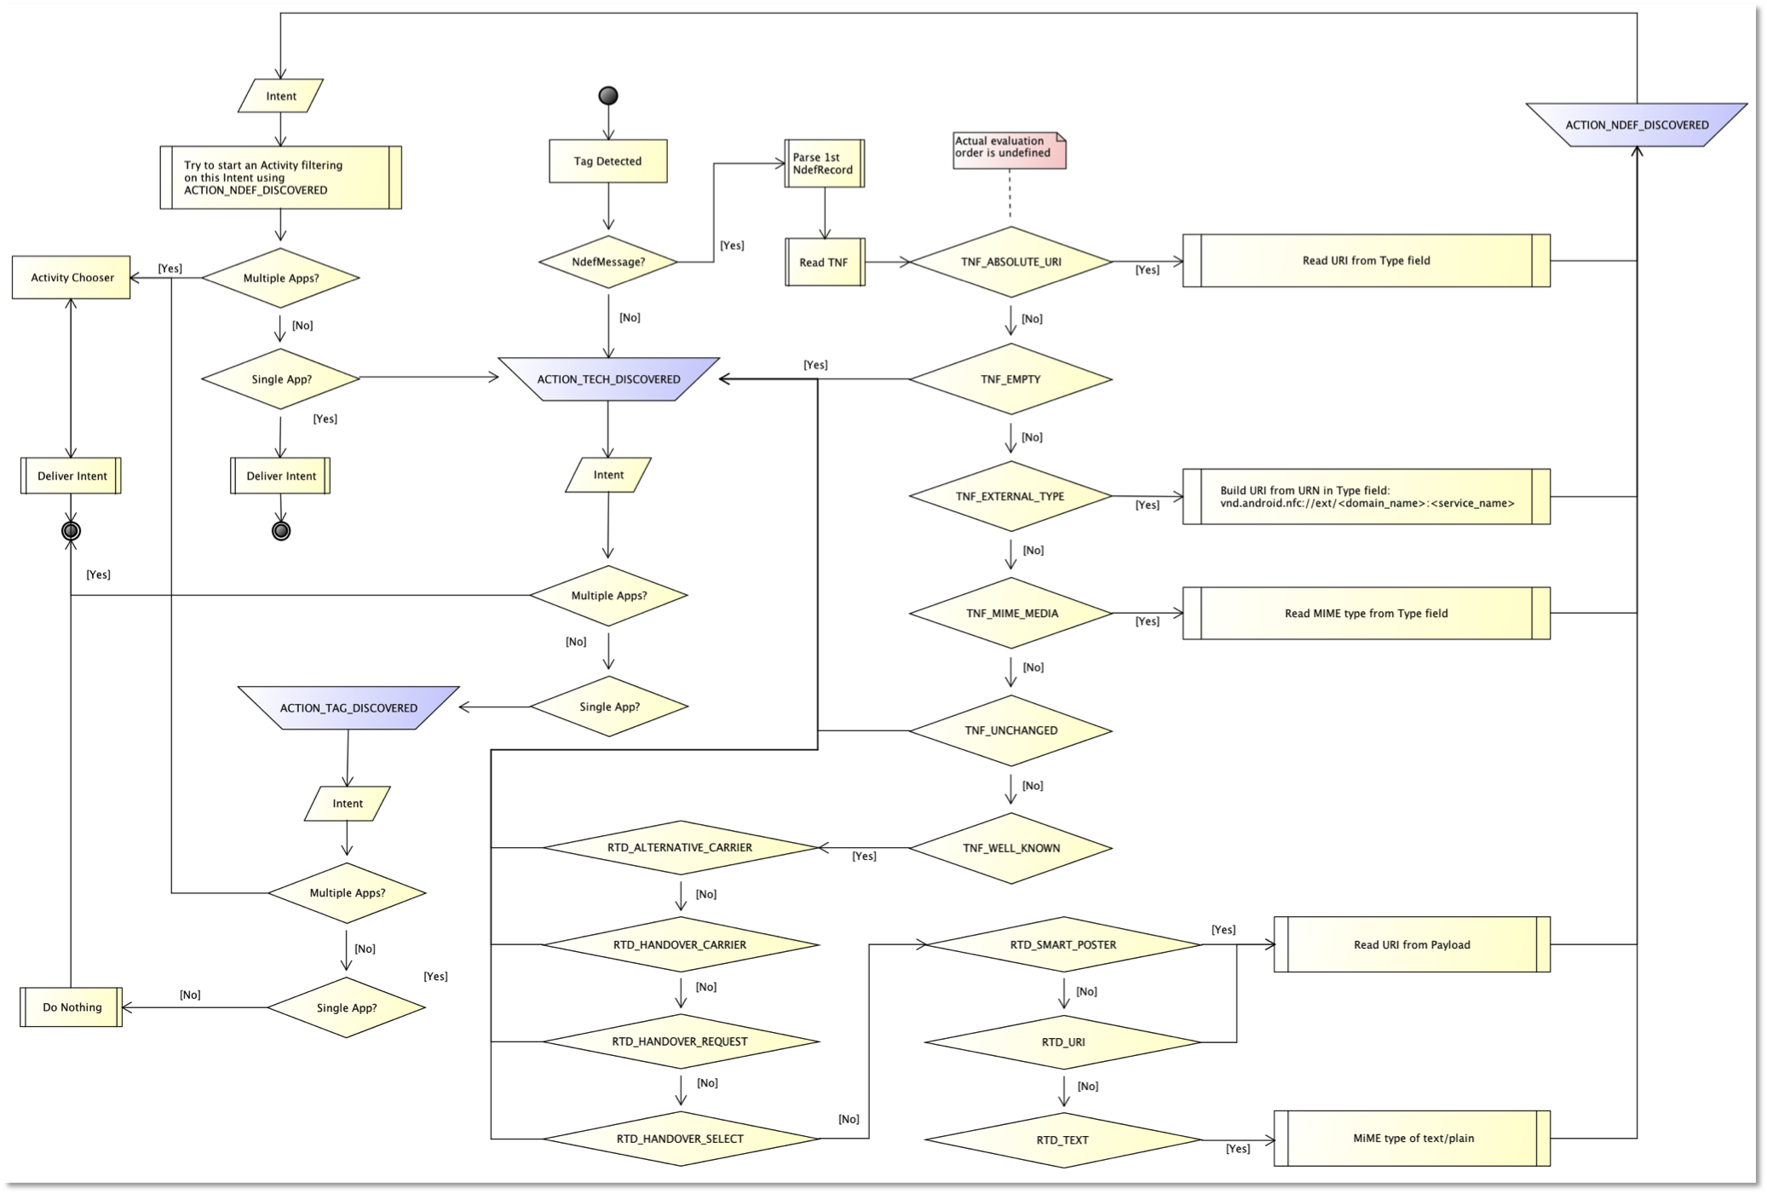
Tag Dispatch System Flowchart
*Full size .png included in the GitHub repository for your reference

Slide 23
Intent.getAction()
If OS cannot find an NDEF record, then it immediately falls back to the most general type of intent
  ACTION_TAG_DISCOVERED
Activity instances should try to filter for a specific NDEF Type Name Format (TNF)
  ACTION_NDEF_DISCOVERED
Regardless of Intent type, can access the manufacturer assigned tag serial number

Slide 24
Android NFC Foreground Dispatch
Revolves around a PendingIntent object
Foreground Dispatch is enabled in onResume() and disabled in onPause()

Slide 25
Foreground Dispatch Gotcha
Remember- Android OS is interrupt driven
  A phone call comes in while running your app
  User switches to another app and comes back
Solution:
  Register foreground dispatch in onResume()if it makes sense in your application context
  Always unregister your foreground dispatch in onPause()
    myNfcAdapter.disableForegroundDispatch(this);

Slide 26
Foreground Dispatch Example
private NfcAdapter nfcAdapter = null;
private PendingIntent nfcPendingIntent = null;
…
@Override
public void onCreate(Bundle savedInstanceState)
{
super.onCreate(savedInstanceState);
nfcAdapter = NfcAdapter.getDefaultAdapter(this);
nfcPendingIntent = PendingIntent.getActivity(this, 0, new Intent(this, getClass())
.addFlags(Intent.FLAG_ACTIVITY_CLEAR_WHEN_TASK_RESET)
.addFlags(Intent.FLAG_ACTIVITY_SINGLE_TOP), 0);
}
@Override
public void onResume()
{
super.onResume();
nfcAdapter.enableForegroundDispatch(this, nfcPendingIntent, filters, null);
}
@Override
public void onPause()
{
super.onPause();
nfcAdapter.disableForegroundDispatch(this);
}
Notes:
Drive home the fact that if the nfcAdapter returned is null, then either the user has disabled NFC or the device does not support NFC

Slide 27
Accessing the Tag Object
  NfcAdatper.EXTRA_TAG
    Mandatory
    Provides a Tag object that a view into the scanned tag
    Tag tag = (Tag) intent.getParcelableExtra(NfcAdapter.EXTRA_TAG);

Slide 28
Processing an NFC Tag Scan
Once the NFC Foreground Dispatch is enabled, scanning an NFC tag will result in an onNewIntent() invocation in the activity
Inspect intent.getAction() for tag details
@Override
protected void onNewIntent(Intent intent)
{
super.onNewIntent(intent);
if (NfcAdapter.ACTION_TAG_DISCOVERED.equals(intent.getAction())) {
Tag tag = (Tag) intent.getParcelableExtra(NfcAdapter.EXTRA_TAG);
onNfcTagDiscoveredDoSomeWorkHere(tag, intent);
}
}

Slide 29
Lab 3: Read an NFC Tag
Enable and disable the Foreground Dispatch System accordingly in the MainActivity.java
Verify the new intent dispatched to your activity is actually an NFC tag discovery
Log out the Tag ID in the LogCat window

Slide 30
NFC Tag Payloads
MIME type or a custom URI is used to identify the payload(s) contained on the tag
NFC Data Exchange Format (NDEF)
  Defined by the NFC Forum to describe different types of tag payloads in a standardized way
  All data written to tags use NDEF records
    Unless you drop down to the bit level and manage the tag in a completely proprietary fashion

Slide 31
NDEF Record
3-bit Type Name Format (TNF)
  Describes how to parse the length field
  Variable Length Type
    Describes the type of record
  Variable Length ID
    Rarely used; arbitrary ID you can assign to the tag
  Variable Length Payload
    Do not assume the full payload is in the first record!

Slide 32
TNF Options
Recommended
Not Recommended
TNF_ABSOLUTE_URI
TNF_EXTERNAL_TYPE
TNF_MIME_MEDIA
TNF_WELL_KNOWN
TNF_UNCHANGED
TNF_EMPTY

Slide 33
Popular TNF
TNF_MIME_MEDIA
TNF_WELL_KNOWN
Custom defined MIME type
  application/x-objectmark
RTD_SMART_POSTER
RTD_URI
  Remember to use URI Identified Coders, listed later in this presentation!
RTD_TEXT

Slide 34
RTD_URI Prefixes
Tags have a limited storage capacity
Why waste 7 bytes with https://, or 26 bytes with ftp://anonymous:anonymous@
NFC Forum URI Record Type Definition provides a set of single-byte values that map to the most popular protocol prefixes
Notes:
createUri(String uri)

Slide 35
RTD_URI Payload Prefix*
0x00 “”
0x01 http://www.
0x02 https://www.
0x03 http://
0x04 https://
0x05 tel:
0x06 mailto:
0x07 ftp://anonymous:anonymous@
0x08 ftp://ftp.
0x09 ftps://
0x0A sftp://
0x0B smb://
0x0C nfs://
0x0D ftp://
0x0E dav://
0x0F news://
0x10 telnet://
0x11 imap:
0x12 rtsp://
0x13 urn:
0x14 pop:
0x15 sip:
0x16 sips:
0x17 tftp:
0x18 btspp://
0x19 btl2cap://
0x1A btgoep://
0x1B tcpobex://
0x1C irdaobex://
0x1D file://
0x1E urn:epc:id:
0x1F urn:epc:tag:
0x20 urn:epc:pat:
0x21 urn:epc:raw:
0x22 urn:epc:
0x23 urn:nfc:
* Per section 3.2.2 of the NFC Forum URI Record Type Definition

Slide 36
NDEF Messages and Records
NdefMessage containts one or more NdefRecord objects
  Again, other formats are supported, but be prepared to operate at the bit-toggling level with a protocol you will have to fully implement from scratch
    See Tag.getTechList() for your starting point
Tag Dispatch System acts on the first NdefRecord in the NdefMessage read from the tag
  First record in the message determines the dispatch for the entire message

Slide 37
Writing: Using NdefRecord
Tag must be in range and discovered in order to write one or more NdefRecords to it
Process Overview:
  Create NdefRecords
  Create NdefMessage
  Put record(s) into message
  Acquire Ndef object from Tag
  Connect
  Write
  Close

Slide 38
Beware the Unformatted Tag!
Tags may appear to be unreadable
Most likely the tag hasn’t been formatted
Application must be prepared to handle this situation by deviating from the Ndef object’s connect, write, close metaphor
Use NdefFormattable object’s connect, format, close metaphor

Slide 39
Formatting Tags
From Google
http://developer.android.com/reference/android/nfc/tech/NdefFormatable.html
  Unfortunately the procedures to convert unformatted tags to NDEF formatted tags are not specified by NFC Forum, and are not generally well-known. So there is no mandatory set of tags for which all Android devices with NFC must support NdefFormatable.

Slide 40
Writing Code Example
protected void onNfcTagDiscovered(Tag tag, Intent intent)
{
// TNF // TYPE // ID // PAYLOAD
NdefRecord r = new NdefRecord(NdefRecord.TNF_WELL_KNOWN, NdefRecord.RTD_TEXT, null, ”My Message".getBytes());
NdefMessage m = new NdefMessage(new NdefRecord[] { r });
Ndef ndef = Ndef.get(tag);
try
{
if (null != ndef)
{
ndef.connect();
ndef.writeNdefMessage(m);
ndef.close();
} else
{
NdefFormatable ndefFormat = NdefFormatable.get(tag);
ndefFormat.connect();
ndefFormat.format(m);
ndefFormat.close();
}
} catch (IOException e)
{
handleException(e, "Unexpected I/O exception writing tag", true);
} catch (FormatException e)
{
handleException(e, "Invalid Format", true);
}
}
Notes:
ndef.makeReadOnly();
ndefFormat.formatReadOnly();

Slide 41
Lab 4: Write an NDEF Record
Add a check box to your layout
When the checkbox is checked, write an NDEF record to the tag
  NdefRecord.TNF_WELL_KNOWN
  NdefRecord.RTD_TEXT
  “Hello Tag”
    Be aware of how much data can be stored on your tag!
Use the NXP Tag Info to verify your message was successfully written to your tag

Slide 42
Filtering NFC Intent Delivery
Filters provide for more granular control over the Tag Dispatching System
  e.g. if you only want to read a specific type of NDEF record, you can filter for it such that the device effectively ignores any other type of tag placed near the scanner
  Useful to bypass an Activity Chooser interaction with the user even if multiple apps have registered a matching Intent Filter

Slide 43
NFC Intent Filtering Options
Inside of AndroidManifest.xml (static)
Inside of an Activity (dynamic)

Slide 44
TNF_WELL_KNOWN Intent Filter
RTD_TEXT
<activity android:name=“.SomeActivity” android:label=“@string/app_name>
<intent-filter>
<action android:name=“android.nfc.action.NDEF_DISCOVERED”/>
<category android:name=“android.intent.category.DEFAULT”/>
<data android:mimeType=“text/plain”/>
</intent-filter>
</activity>
RTD_URI
<activity android:name=“.SomeActivity” android:label=“@string/app_name>
<intent-filter>
<action android:name=“android.nfc.action.NDEF_DISCOVERED”/>
<category android:name=“android.intent.category.DEFAULT”/>
<data android:scheme=“http” android:host=“foo.com” android:pathPrefix=“”/>
</intent-filter>
</activity>

Slide 45
TNF_EXTERNAL_TYPE Intent Filter
Similar in concept to the RTD_URI prefixes, the NFC Forum RTD specification declares that urn:nfc:ext: portion of the URN must be omitted from the NDEF record
Consider this URN:
  urn:nfc:ext:therustedroof.com:fooType
<activity android:name=“.SomeActivity” android:label=“@string/app_name>
<intent-filter>
<action android:name=“android.nfc.action.NDEF_DISCOVERED”/>
<category android:name=“android.intent.category.DEFAULT”/>
<data android:scheme=“vnd.android.nfc” android:host=“ext”
android:pathPrefix=“/therustedroof.com:fooType/>
</intent-filter>
</activity>

Slide 46
Intent NDEF Filter - Manifest
Example of a TNF_MIME_MEDIA filter:
<activity android:name=“.LoginActivity” android:label=“@string/app_name>
<intent-filter>
<action android:name=“android.nfc.action.NDEF_DISCOVERED”/>
<category android:name=“android.intent.category.DEFAULT”/>
<data android:mimeType=“application/x-tagspective-badge”/>
</intent-filter>
</activity>

Slide 47
Intent NDEF Filter - Code
IntentFilter[] filters;
nfcAdapter = NfcAdapter.getDefaultAdapter(this);
nfcPendingIntent = PendingIntent.getActivity(this, 0,
new Intent(this, getClass())
.addFlags(Intent.FLAG_ACTIVITY_CLEAR_WHEN_TASK_RESET)
.addFlags(Intent.FLAG_ACTIVITY_SINGLE_TOP), 0);
IntentFilter tagDetected = new IntentFilter(NfcAdapter.ACTION_NDEF_DISCOVERED);
try
{
tagDetected.addDataType(MIME_OPTAG);
} catch (MalformedMimeTypeException e)
{
e.printStackTrace();
}
filters = new IntentFilter[] { tagDetected };
nfcAdapter.enableForegroundDispatch(this, nfcPendingIntent, filters, null);

Slide 48
Tech List Driven Intent
If design relies on ACTION_TECH_DISCOVERED instead of the ACTION_NDEF_DISCOVERED
  Must create 1 or more tech-list XML declarations
  All entries in the list must match
    One entry doesn’t match, no longer a candidate activity

Slide 49
Tech List Driven Intent (con’t)
<resources xmlns:xliff=“urn:oasis:names:tc:xliff:document:1.2”>
<tech-list>
<tech>android.nfc.tech.MifareClassic</tech>
<tech>android.nfc.tech.NdefFormatable</tech>
<tech>android.nfc.tech.NfcA</tech>
</tech-list>
</resources>
-------
<activity … >
<intent-filter>
<action android:name=“android.nfc.action.TECH_DISCOVERED”/>
</intent-filter>
<meta-data android:name=“android.nfc.action.TECH_DISCOVERED”
android:resource=“@xml/my_nfc_tech_filter”/>
</activity>

Slide 50
Lab 5: Filter for RTD_TEXT
Add a new Only Read RTD_TEXT Tags checkbox to the UI
Define an ACTION_NDEF_DISCOVERED filter linked to an RTD_TEXT
  Hint: filter.addDataType(“text/plain”)
Be sure to differentiate actions properly in your onNewIntent() routine
Think carefully about how/where you invoke nfcAdapter.enableForegroundDispatch()

Slide 51
Reading: NfcAdatper Intent Extras
  NfcAdapter.EXTRA_NDEF_MESSAGES
    Optional
    Provides an array of NdefMessage objects found on the scanned tag
    Parcelable[] rawMsgs =
    intent.getParcelableArrayExtra(NfcAdapter.EXTRA_NDEF_MESSAGES);
    //Check to see if rawMsgs is null, meaning no NDEF records found
    NdefMessage[] msgs = new NdefMessage[rawMsgs.length];
    //for loop to cast each Parcelable to NdefMessage

Slide 52
Reading the Tag Data
Tag may contain an NdefMessage[]
Each NdefMessage may contain an NdefRecord[]
Each NdefRecord provides access to the record ID, the TNF, the variable type, and the raw payload bytes

Slide 53
Reading an RTD_TEXT Record
Parcelable[] rawMsgs = intent
.getParcelableArrayExtra(NfcAdapter.EXTRA_NDEF_MESSAGES);
for (Parcelable p : rawMsgs) {
NdefMessage msg = (NdefMessage) p;
NdefRecord[] records = msg.getRecords();
for (NdefRecord record : records) {
String myTxtMsg = new String(record.getPayload());
Log.i(DEBUG_MAIN_ACTIVITY, myRtdTextMsg);
}
}

Slide 54
Lab 6: Reading RTD_TEXT Record
Add logic to extract and log your RTD_TEXT record that you wrote to the tag in Lab 4

Slide 55
Android Application Records
Proprietary
Introduced in Ice Cream Sandwich
Goal: Increase the odds that your application is started when your NFC tag is scanned
  Tag Dispatch System behavior is modified; if no installed app defines a matching intent filter, then the phone sends the user to the Android Market to download the application defined by the AAR

Slide 56
Tactile Feedback
Consider integrating the free MOTIV UHL
  http://tinyurl.com/andevconNFC
Consider integrating audio
  Different audio for read versus write
Give the user app preferences to turn feedback on or off during a tag scan

Slide 57
A note on security
Only Type 4 tags can realistically support encryption
Consider flipping the read-only byte on your tags to make them read-only, or you risk someone coming along and replacing your content with a porn hyperlink
Hackers have demonstrated the ability to intercept the communication between the tag and the phone
  http://hackaday.com/tag/mifare/

Slide 58
Secure Element
Secure Payment, etc.
Formally beyond the scope of this session
Example of an “other protocol” that isn’t NDEF
  Application Protocol Data Unit
See APDU commands in ISO 7816-4
  http://www.cardwerk.com/smartcards/smartcard_standard_ISO7816-4.aspx

Slide 59
Summary
We introduced NFC
We presented the different types of NFC tags
We analyzed the Tag Dispatch System
We reviewed code for reading and writing tags
We introduced NDEF Messages and NDEF Records for storing data on a tag

