Slide 1
Opening the Black Box of Graph Neural Networks
Comparing 1-GNN and 1-2-GNN through generated explanations
Master's thesis defense
MUTAG · PROTEINS

Slide 2
Why this thesis?
Neural networks make great decisions — but they don't tell us why.
Two networks can reach the same accuracy on the same dataset…
…and yet have completely different ideas of what each class actually looks like.
If we only look at accuracy, we miss this. We never see what the model has actually learned.
Goal: open the box. Force each model to show us its own picture of each class, then compare.

Slide 3
Graphs and Graph Neural Networks
A graph = nodes connected by edges. Many real things are graphs.
Examples in this thesis:
• Molecules — atoms (nodes), bonds (edges)
• Proteins — secondary-structure pieces, connected by sequence and 3-D distance
Task: classify the whole graph.
– Is this molecule mutagenic?
– Is this protein an enzyme?
How a GNN works (intuition):
• Every node holds a small vector
• Each round, a node looks at its neighbours and updates its own vector
• After a few rounds, all node vectors are pooled into a single graph vector
• That graph vector is fed to a classifier

Slide 4
1-GNN vs. 1-2-GNN
What does each architecture pay attention to?
1-GNN — the standard model
1-2-GNN — also looks at pairs
Each node only looks at its direct neighbours.
• Cheap and fast
• Powerful enough for most tasks
• Limited: there are graph structures it provably cannot tell apart (e.g. two triangles vs. one hexagon — every node looks the same locally)
Does the 1-GNN step, then adds a second step over PAIRS of nodes.
• A pair carries info about both nodes AND whether they are connected
• Provably more expressive — can tell apart triangles vs. hexagons
• Cost: pairs grow as N², so it is much slower and memory-hungry
Message passing on nodes:
Message passing on pairs:
h(v) ← σ( h(v) · W₁ + Σᵤ∈N(v) h(u) · W₂ )
h(u,v) ← σ( h(u,v) · W₃ + Σ pair-neighbours h(·,·) · W₄ )

Slide 5
The question this thesis asks
The 1-2-GNN can see more structure than the 1-GNN.
On our datasets, both reach (almost) the same test accuracy.
So: are they actually learning the same thing?
Same answer on a multiple-choice exam doesn't mean the two students reasoned the same way.
Same accuracy on the test set doesn't mean the two models built the same idea of each class.

Slide 6
GIN-Graph: ask the model to draw its prototype
The trick: reverse-engineer the model.
Random noise
z ~ 𝒩(0, I)
Generator MLP
trainable
Graph
G̃ = (Ã, X̃)
G̃ = Generator(z) , z ~ 𝒩(0, I)
The generator is rewarded when its graph G̃:
1. is confidently classified as the target class by the frozen classifier
2. looks realistic (a small adversary discriminator polices this)
Total generator loss:
ℒ = (1−λ) · ℒ_GAN + λ · ℒ_GNN + ℒ_reg
realism class-specificity size & node-type

Slide 7
The pipeline
1. Train classifier
Train a 1-GNN and a 1-2-GNN on the dataset.
Each one becomes a frozen “target”.
2. Train generator
For every (model × class) pair, train a GIN-Graph generator.
4 datasets × 2 classes × 2 models = 8 generators.
3. Sample graphs
Generate 1000 graphs from each generator.
This is the model's prototype population.
4. Compare
Compare against real data, and let each model classify the OTHER model's prototypes.

Slide 8
Two datasets
MUTAG — small molecules
PROTEINS — protein structures
• 188 molecules
• 7 atom types (C, N, O, F, I, Cl, Br)
• Classes: Mutagen / Non-Mutagen
• Up to 28 atoms per graph
• 1113 proteins
• 3 secondary-structure types (Helix, Sheet, Coil/Turn)
• Classes: Enzyme / Non-Enzyme
• Up to 620 nodes; we cap generation at 50
Test accuracy:
MUTAG 1-GNN 89.5 % 1-2-GNN 89.5 %
PROTEINS 1-GNN 79.8 % 1-2-GNN 78.9 %

Slide 9
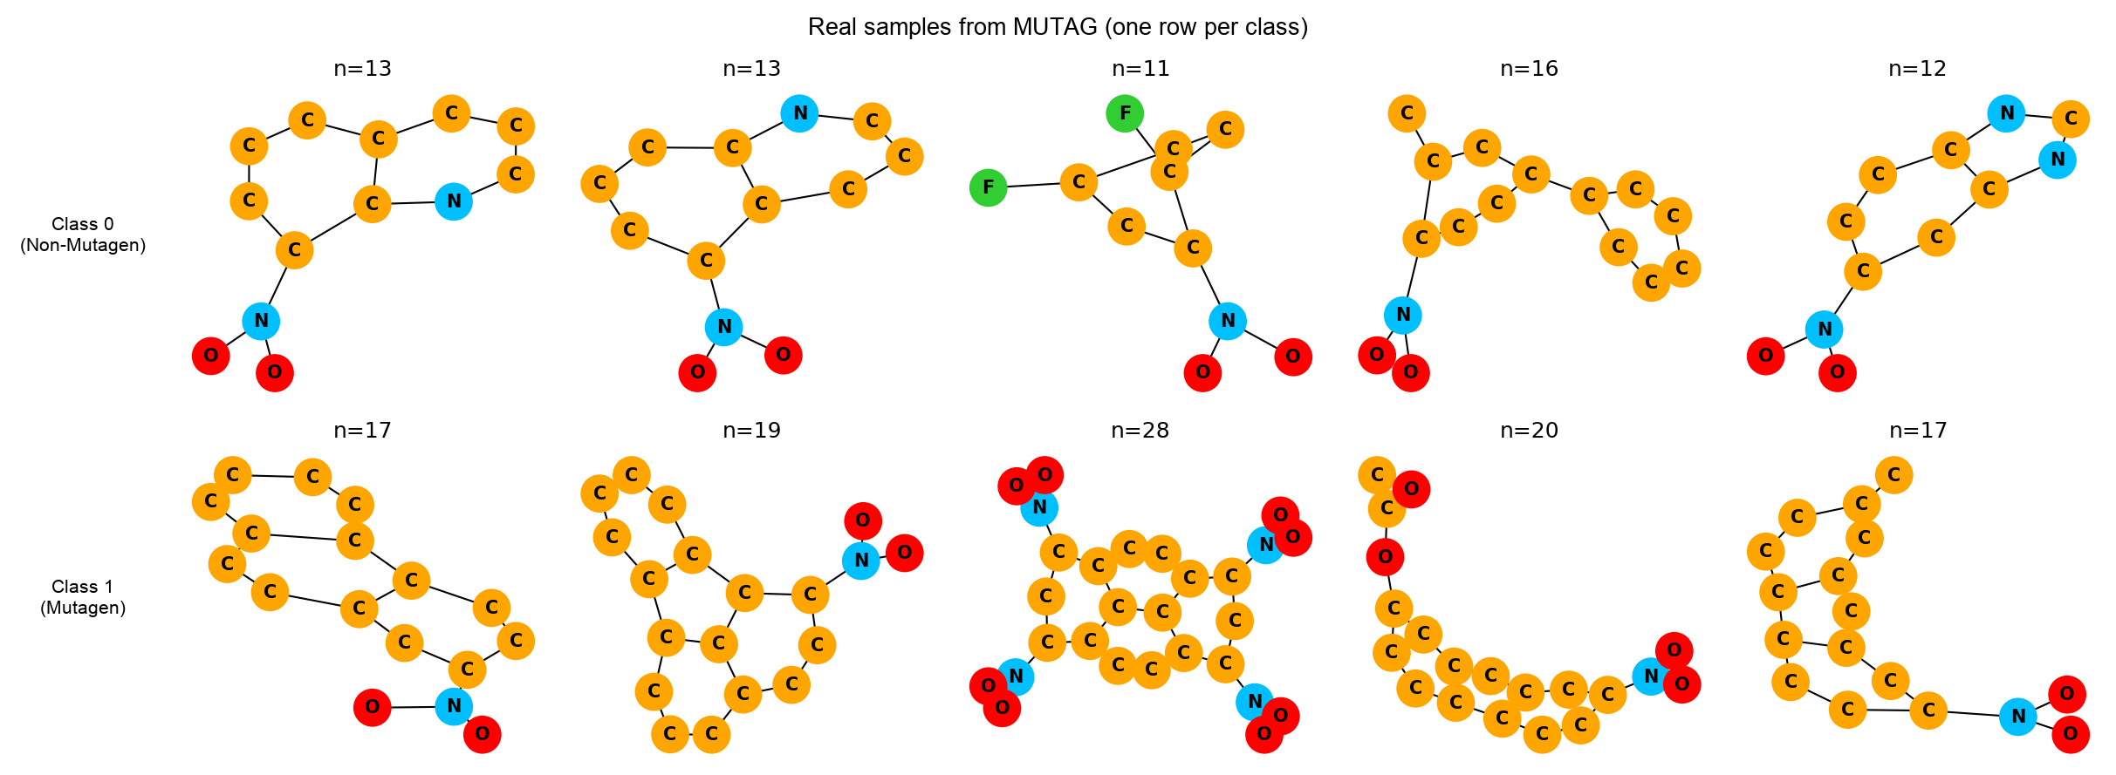
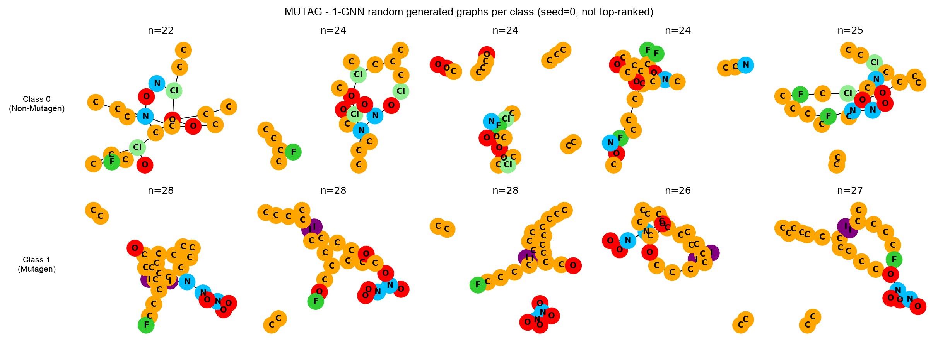
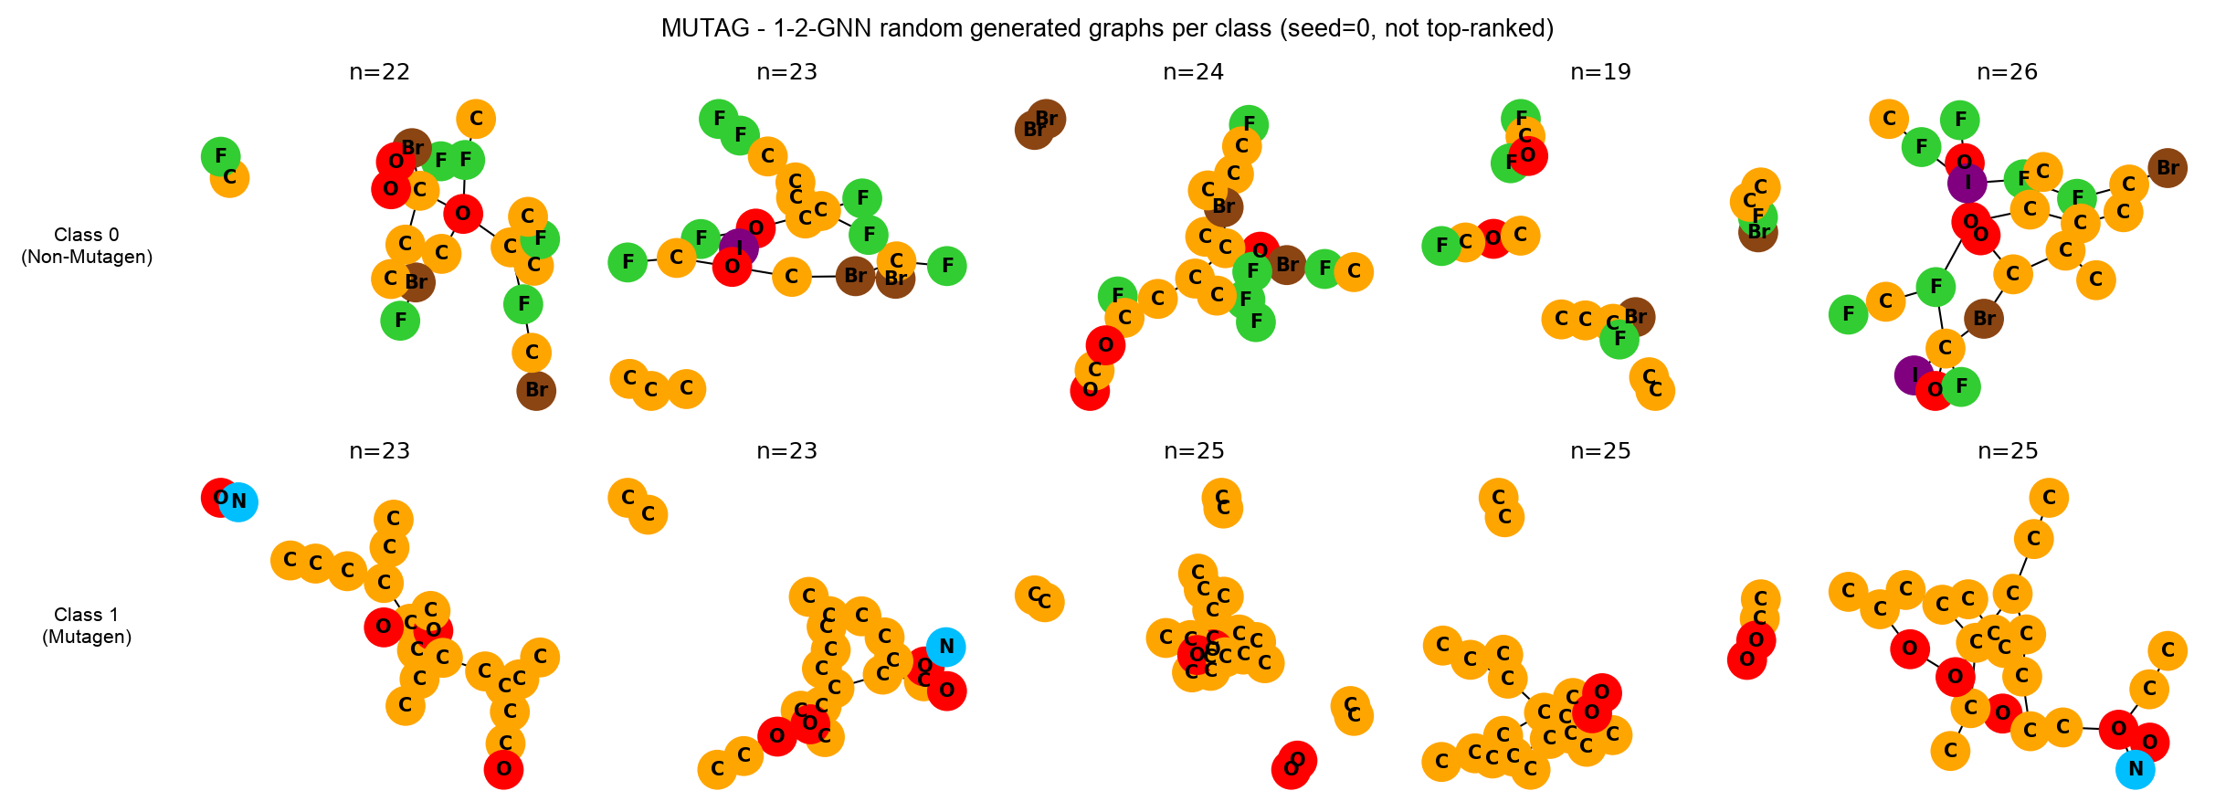
MUTAG — real vs. generated
What does each model think a molecule looks like?
Real molecules (from the dataset)
Generated by the 1-GNN
Generated by the 1-2-GNN

Slide 10
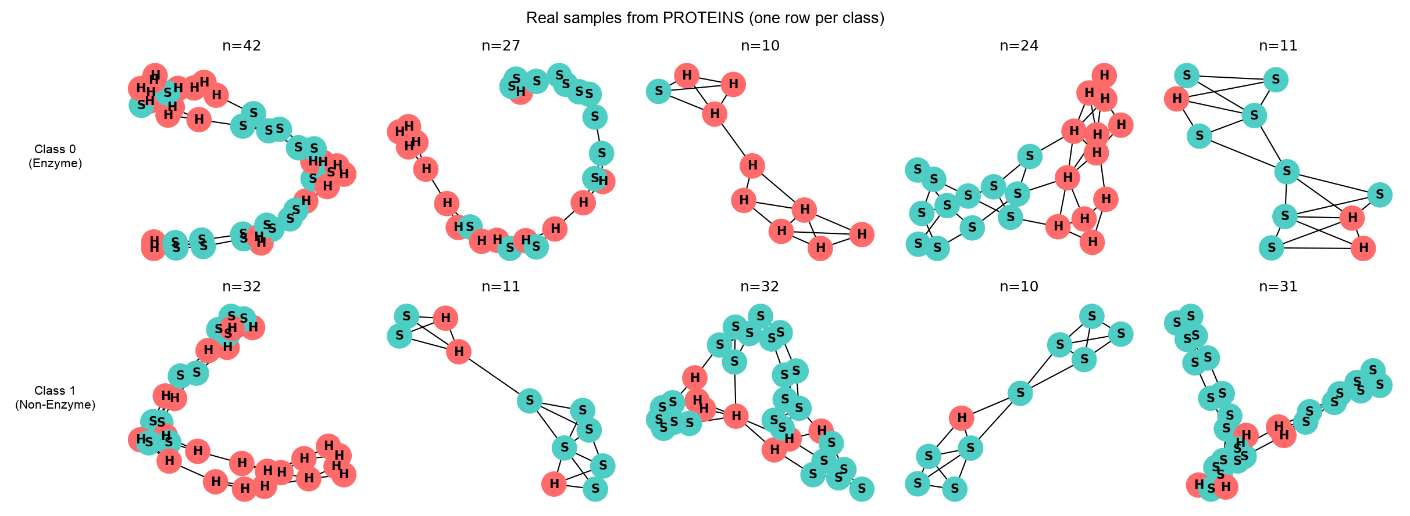
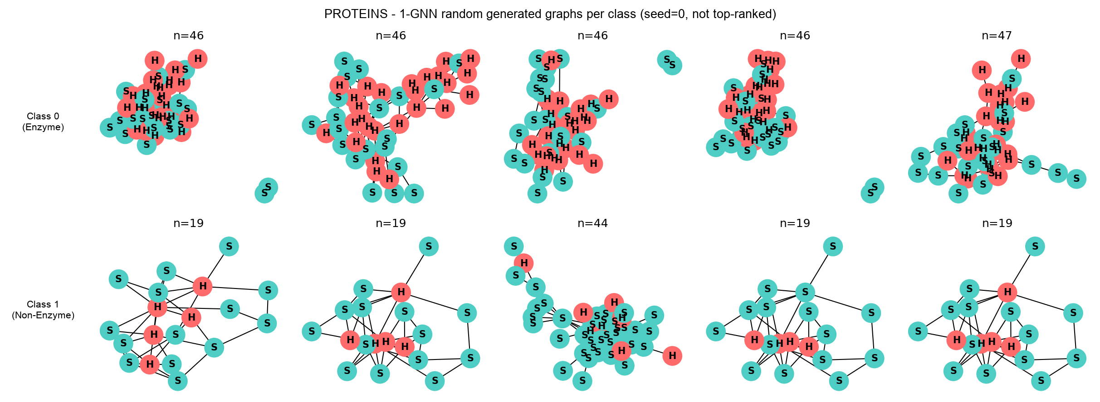
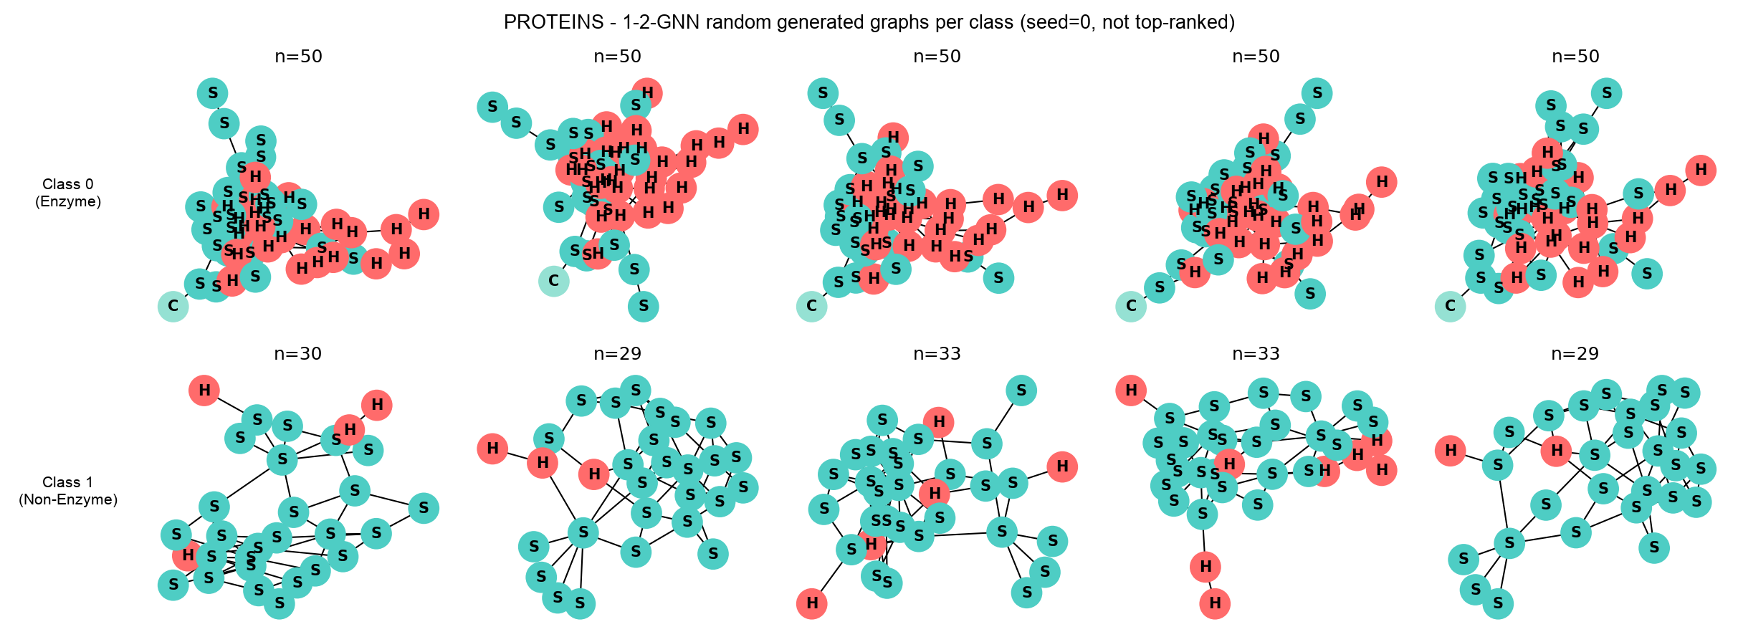
PROTEINS — real vs. generated
Same comparison, very different structure
Real proteins (from the dataset)
Generated by the 1-GNN
Generated by the 1-2-GNN

Slide 11
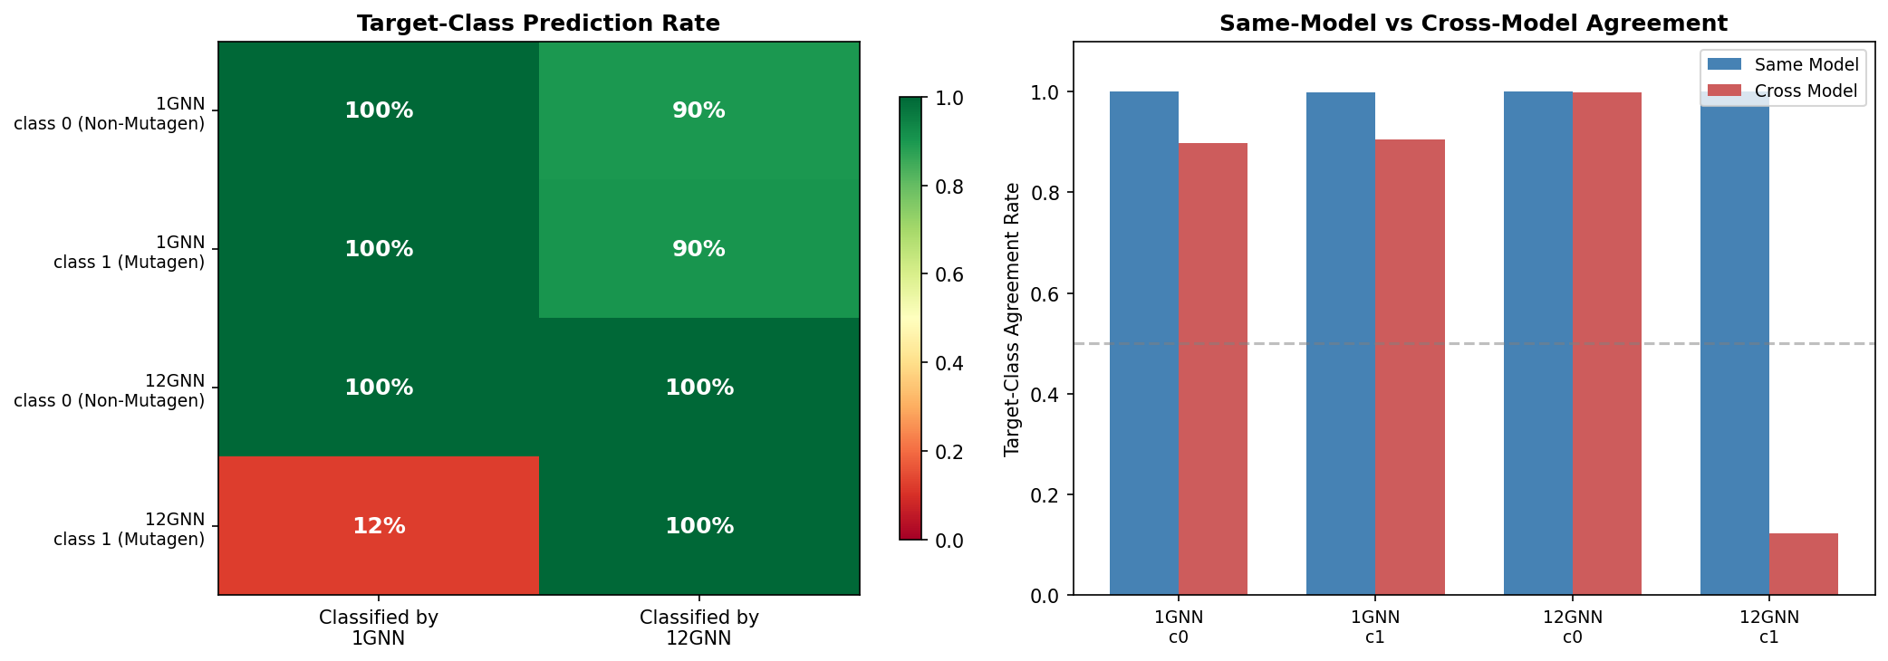
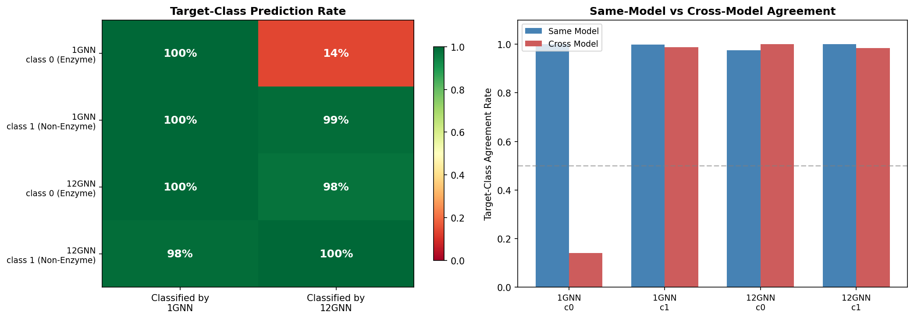
Headline result: cross-classification
Does each model accept the OTHER model's prototypes?
MUTAG
PROTEINS
Each model accepts almost all of its OWN generated graphs.
But in one specific class per dataset, the other model rejects them almost entirely:
MUTAG, Mutagen class: 1-GNN accepts only 12 % of the 1-2-GNN's prototypes.
PROTEINS, Enzyme class: 1-2-GNN accepts only 14 % of the 1-GNN's prototypes.

Slide 12
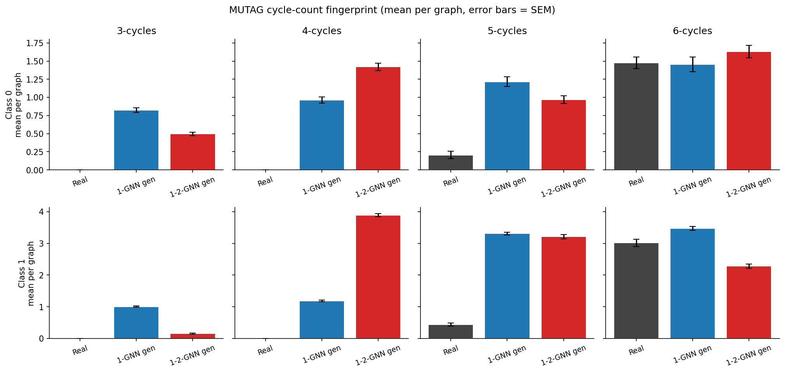
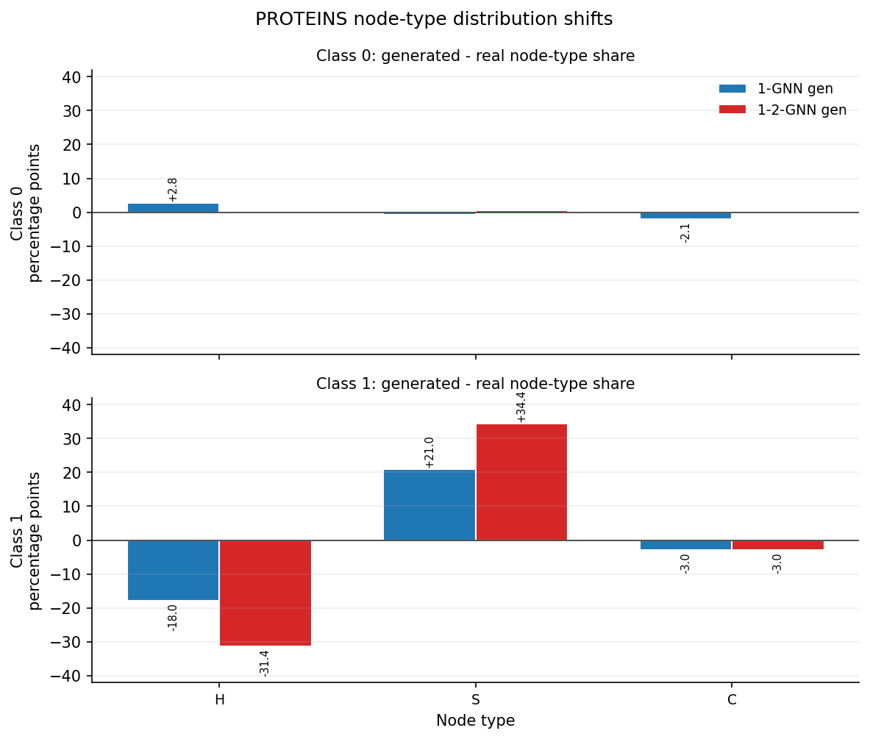
What drives the disagreement?
MUTAG: triangles · PROTEINS: too many sheets
MUTAG — the theory-aligned signal
The 1-2-GNN produces clearly fewer triangles than the 1-GNN.
This is exactly the kind of structure that pair-level message passing can detect — and 1-WL cannot.
PROTEINS — Sheet-heavy prototype
The 1-2-GNN's Non-Enzyme prototype is ~89 % Sheet (real data: ~56 %).
It exaggerates the structural pattern it has learned to associate with the class.

Slide 13
Conclusion
Same accuracy does not mean the same understanding.
• On both MUTAG and PROTEINS the two architectures hit (almost) the same test accuracy.
• Yet the prototypes they produce are systematically different — in atoms, edges, and cycles.
• In one specific class per dataset, each model strongly rejects the other's prototypes.
• The MUTAG triangle result is the cleanest theory-aligned signal: pair-level message passing changes which structures the model treats as evidence.
Take-away: higher-order message passing changes the prototype — not whether the model is more correct.
Accuracy hides this. Generated explanations make it visible.
Thank you — questions?

