Slide 1
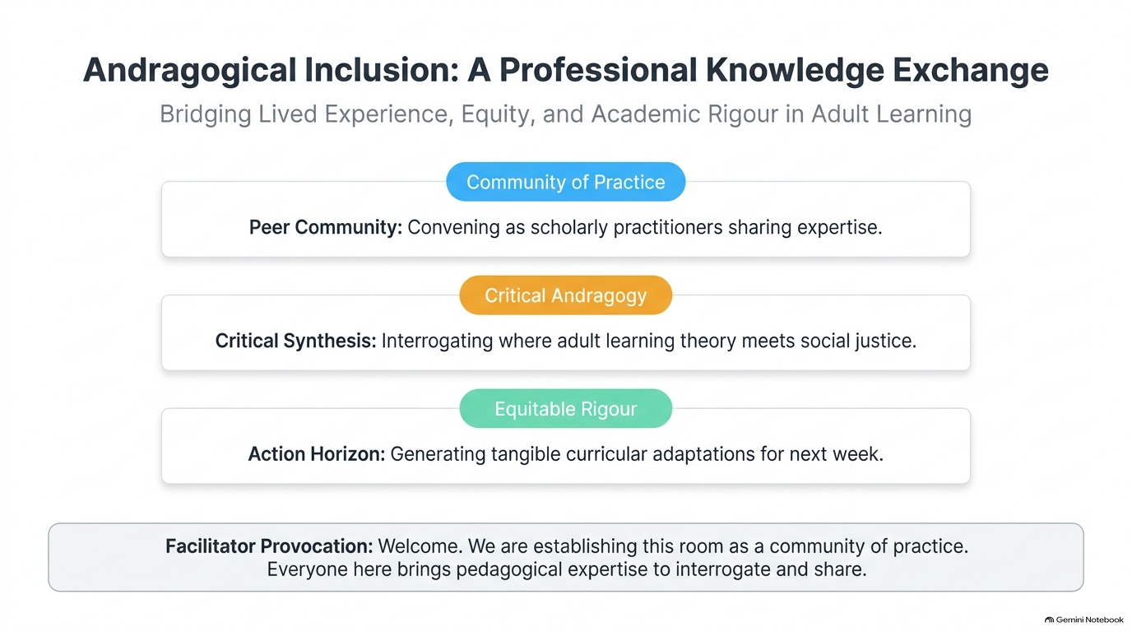
Notes:
Welcome colleagues. Emphasise that this room holds decades of front-line pedagogical wisdom. We are not delivering a deficit-model training session; we are interrogating institutional assumptions together to elevate learning for every adult.

Slide 2
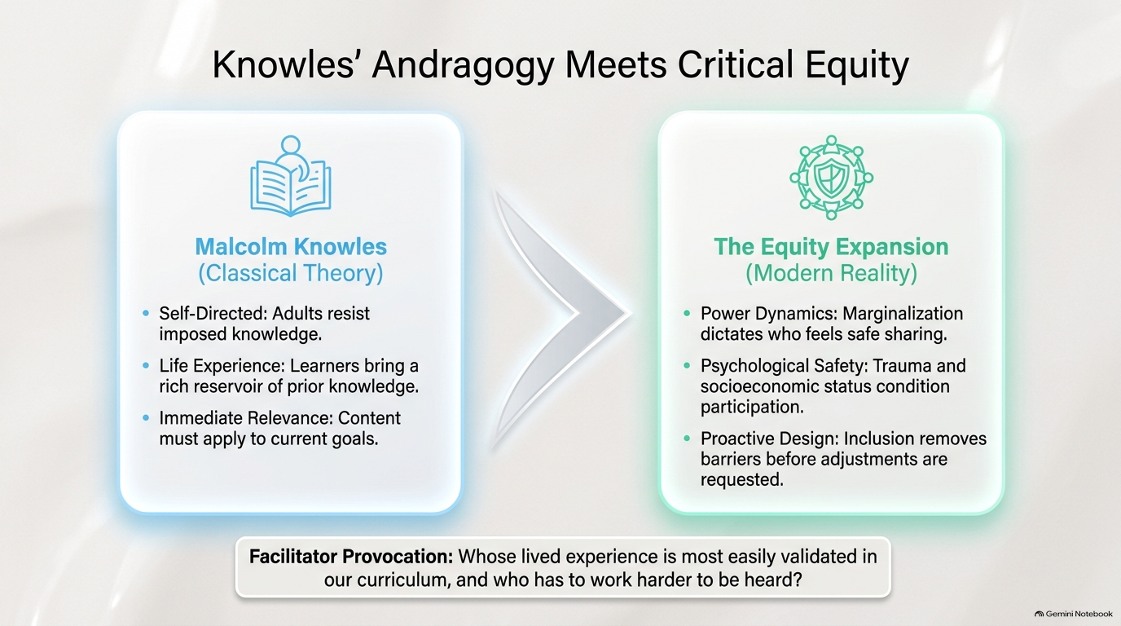
Notes:
Knowles assumed an unencumbered, autonomous adult. In reality, mature students carry socioeconomic precarity, systemic microaggressions, or past academic scarring. We must design psychological safety intentionally.

Slide 3
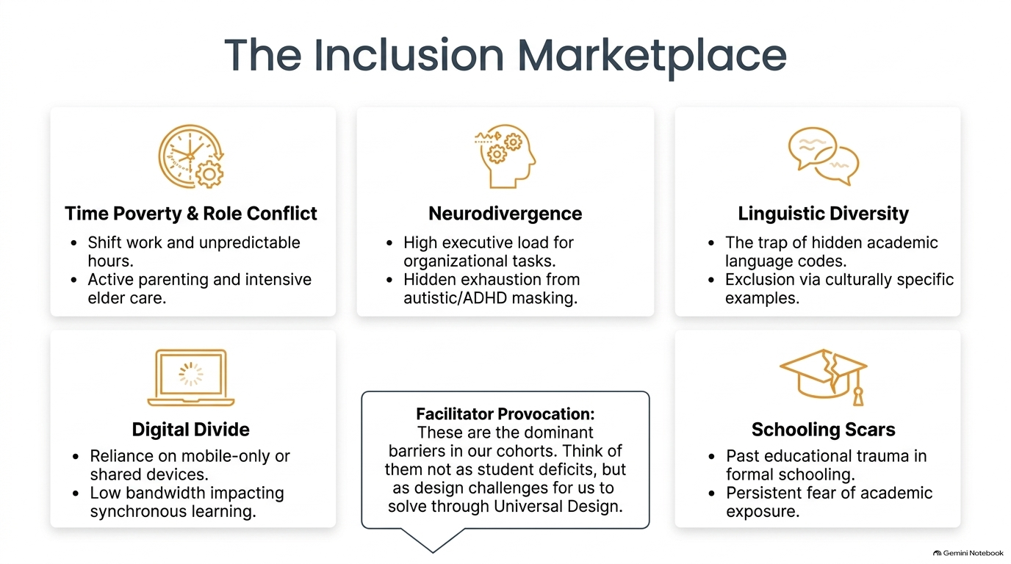
Notes:
Frame these not as student deficits, but as structural interfaces. Every barrier represents an institutional design friction that thoughtful pedagogy can alleviate.

Slide 4
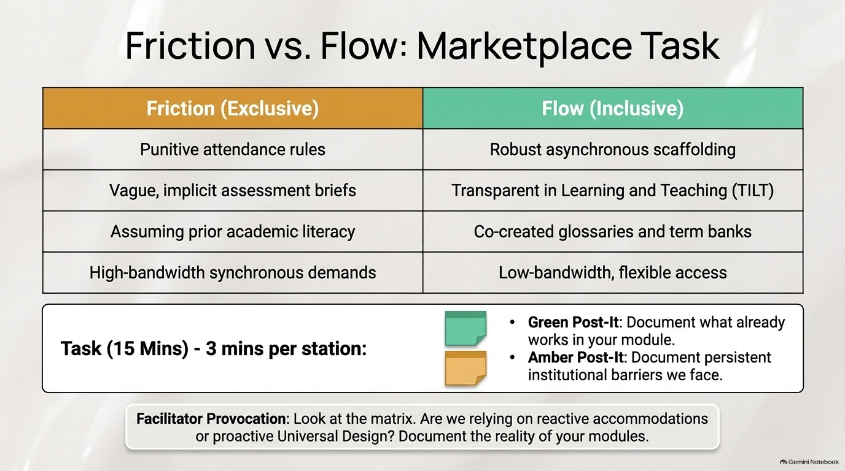
Notes:
Encourage radical candour. Green notes celebrate practical frontline genius; Amber notes pinpoint where university policies or assumptions create unnecessary roadblocks.

Slide 5
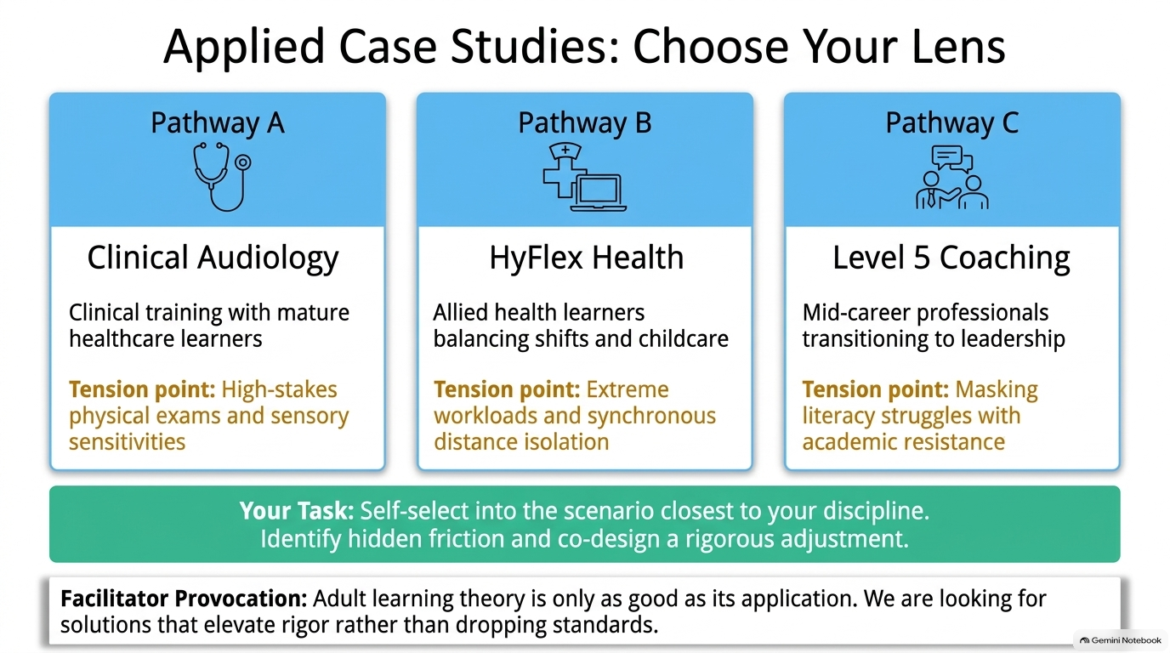
Notes:
Choice in professional development mirrors choice in adult learning. Give participants autonomy to select the challenge that directly stretches their domain expertise.

Slide 6
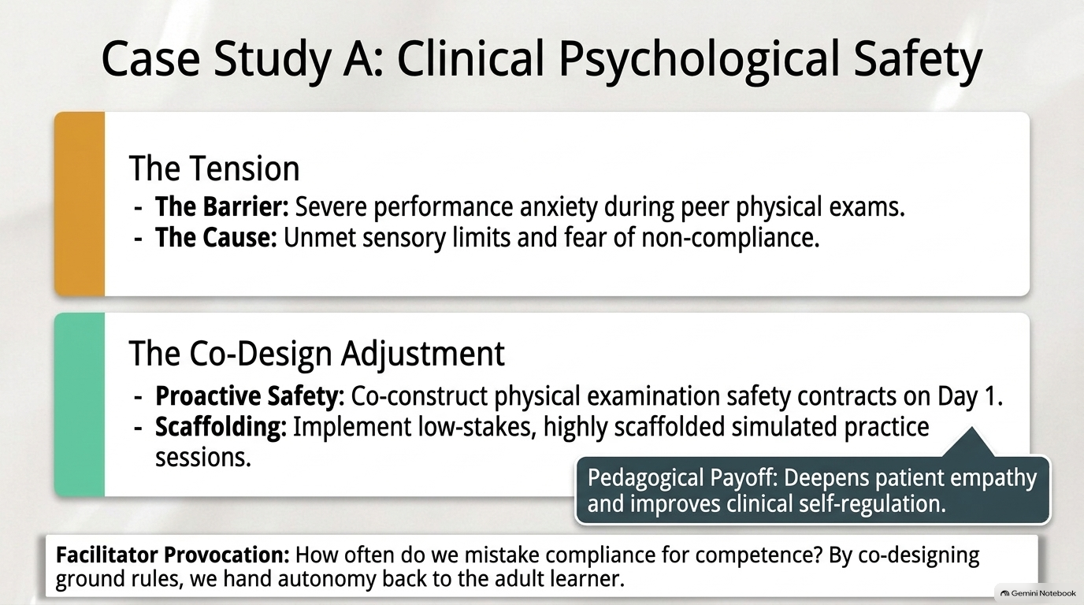
Notes:
Provocation: How do we move from compliance-based classroom management to professional self-regulation in high-stakes practicals?

Slide 7
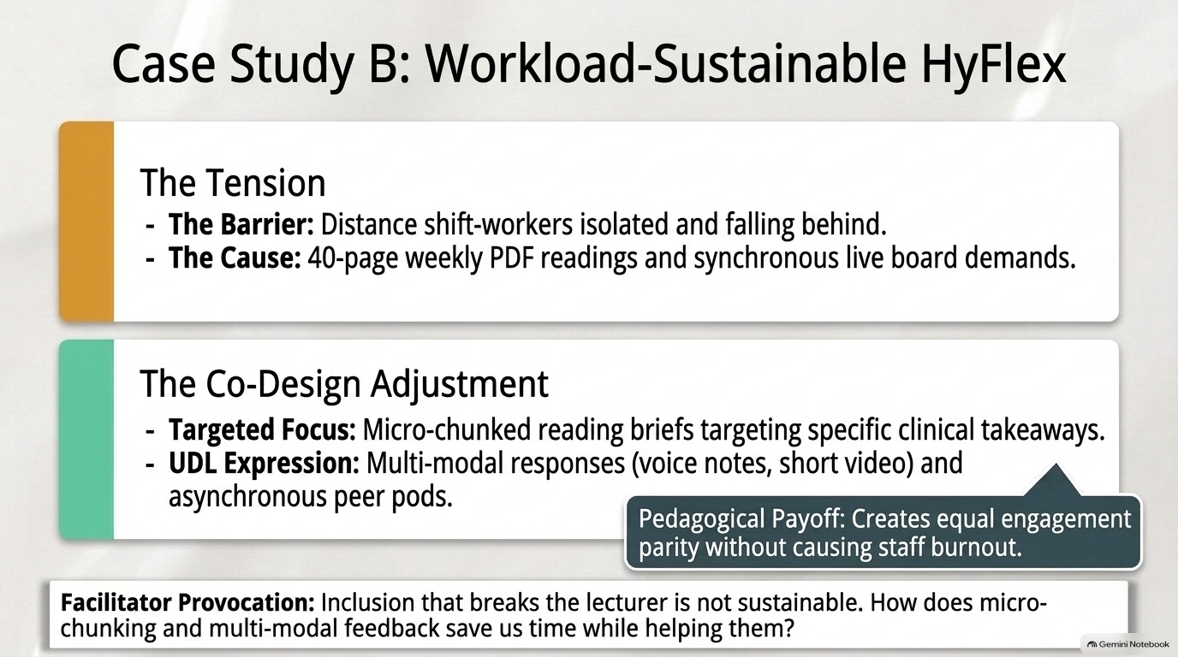
Notes:
Provocation: How can we offer genuine temporal flexibility without creating unsustainable 60-hour working weeks for faculty?

Slide 8
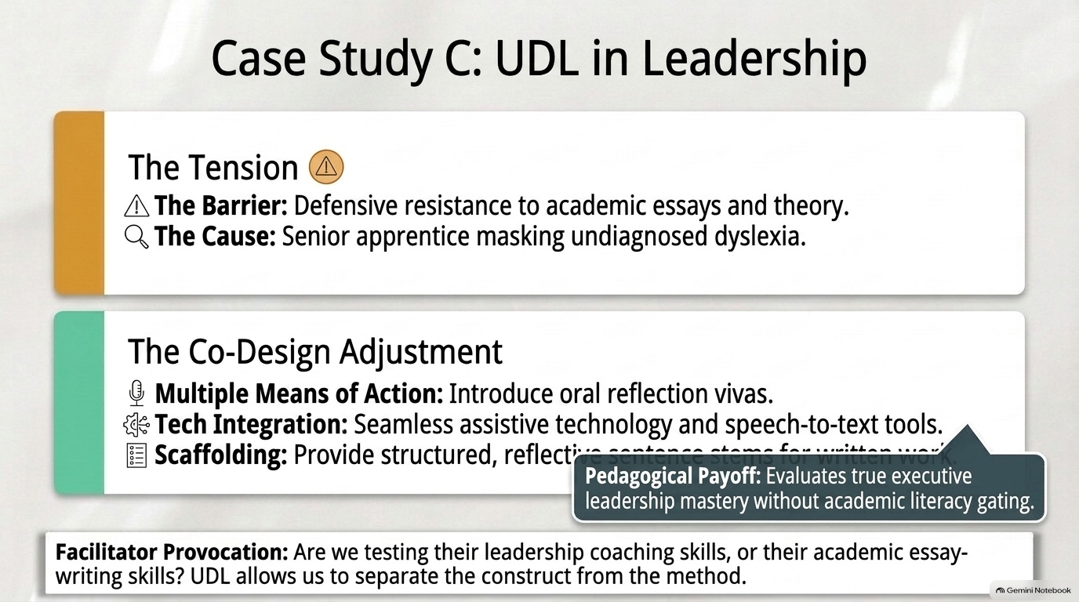
Notes:
Provocation: Does academic rigour live in the 3,000-word written essay, or does it live in the depth of critical evaluation demonstrated?

Slide 9
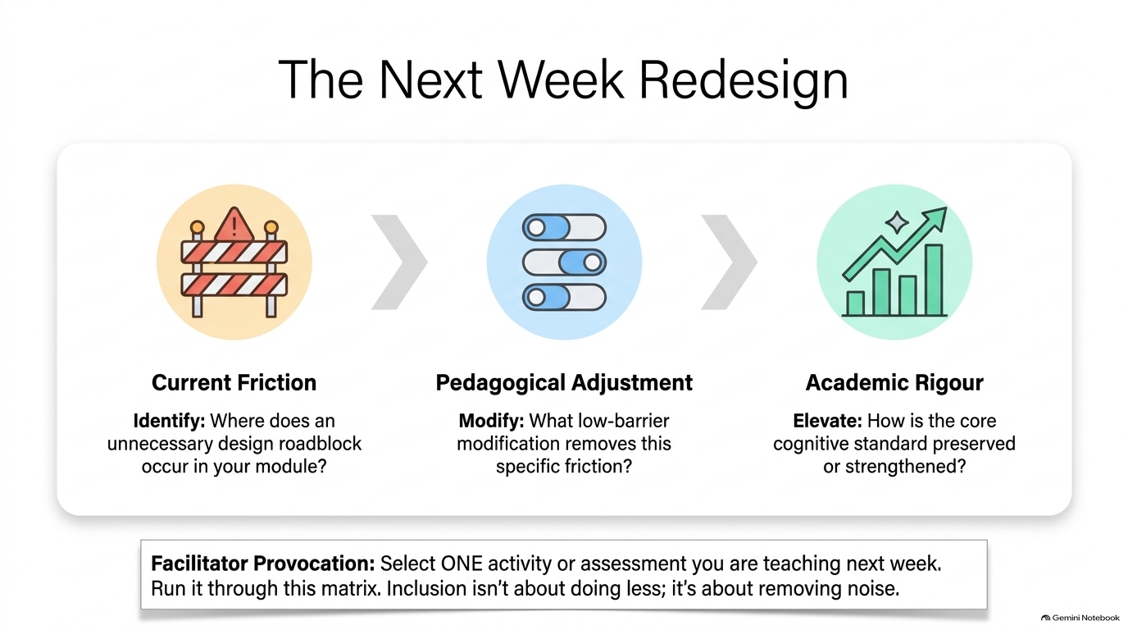
Notes:
No one leaves with abstract theory. This slide bridges professional dialogue into immediate classroom operational change.

Slide 10
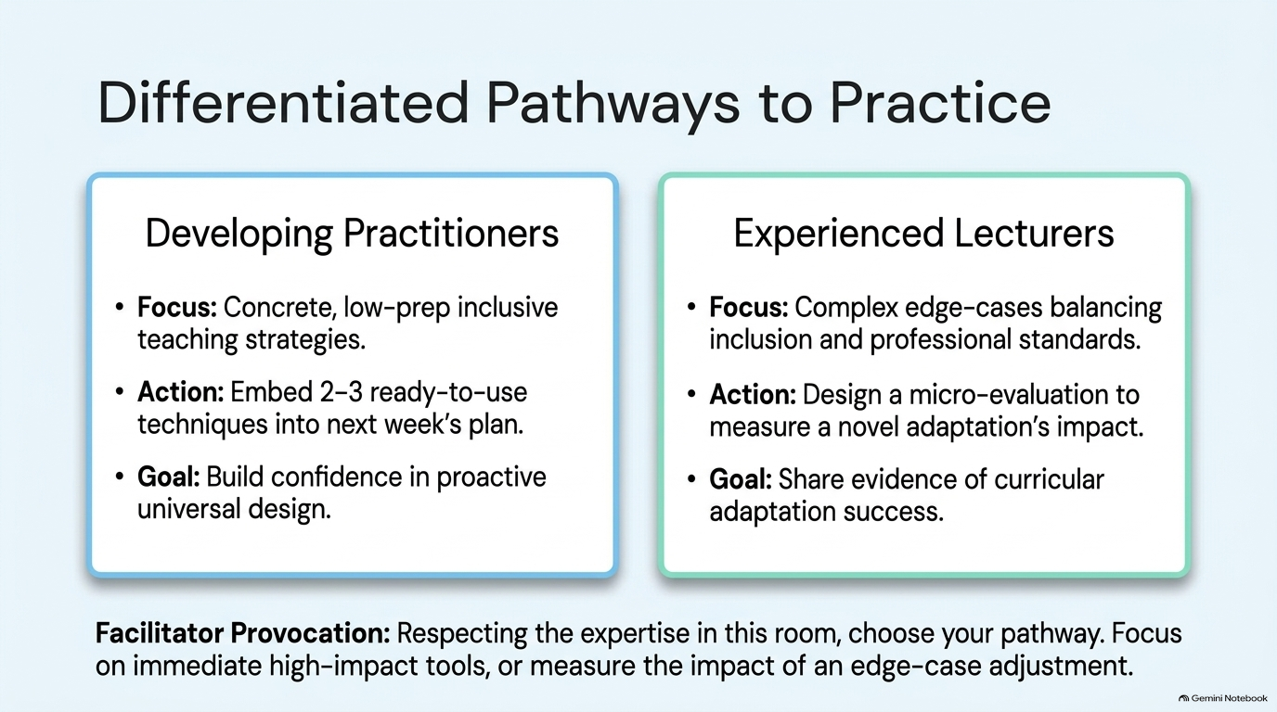
Notes:
Highlight that experienced teachers need space to wrestle with complex edge cases, while newer colleagues benefit from immediate, high-leverage procedural templates.

Slide 11
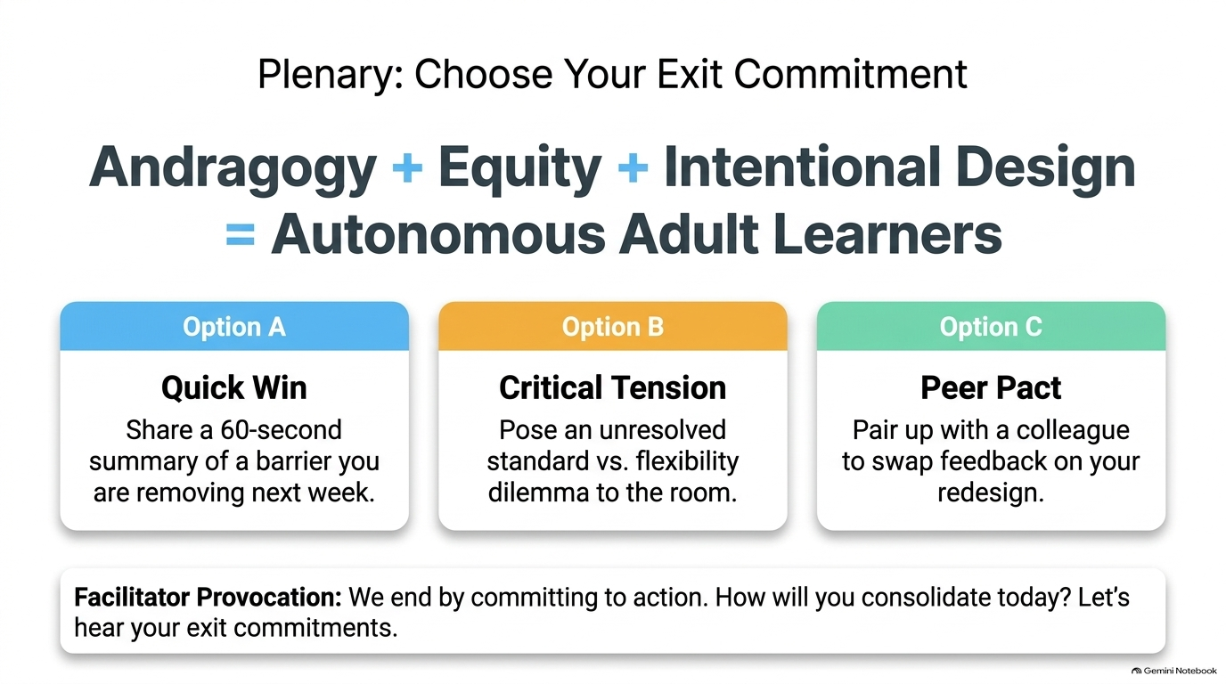
Notes:
Thank colleagues for their vulnerability and expertise. Remind everyone that inclusive andragogy is not an endpoint or checklist—it is an ongoing scholarly discipline practiced in community.

