Slide 1
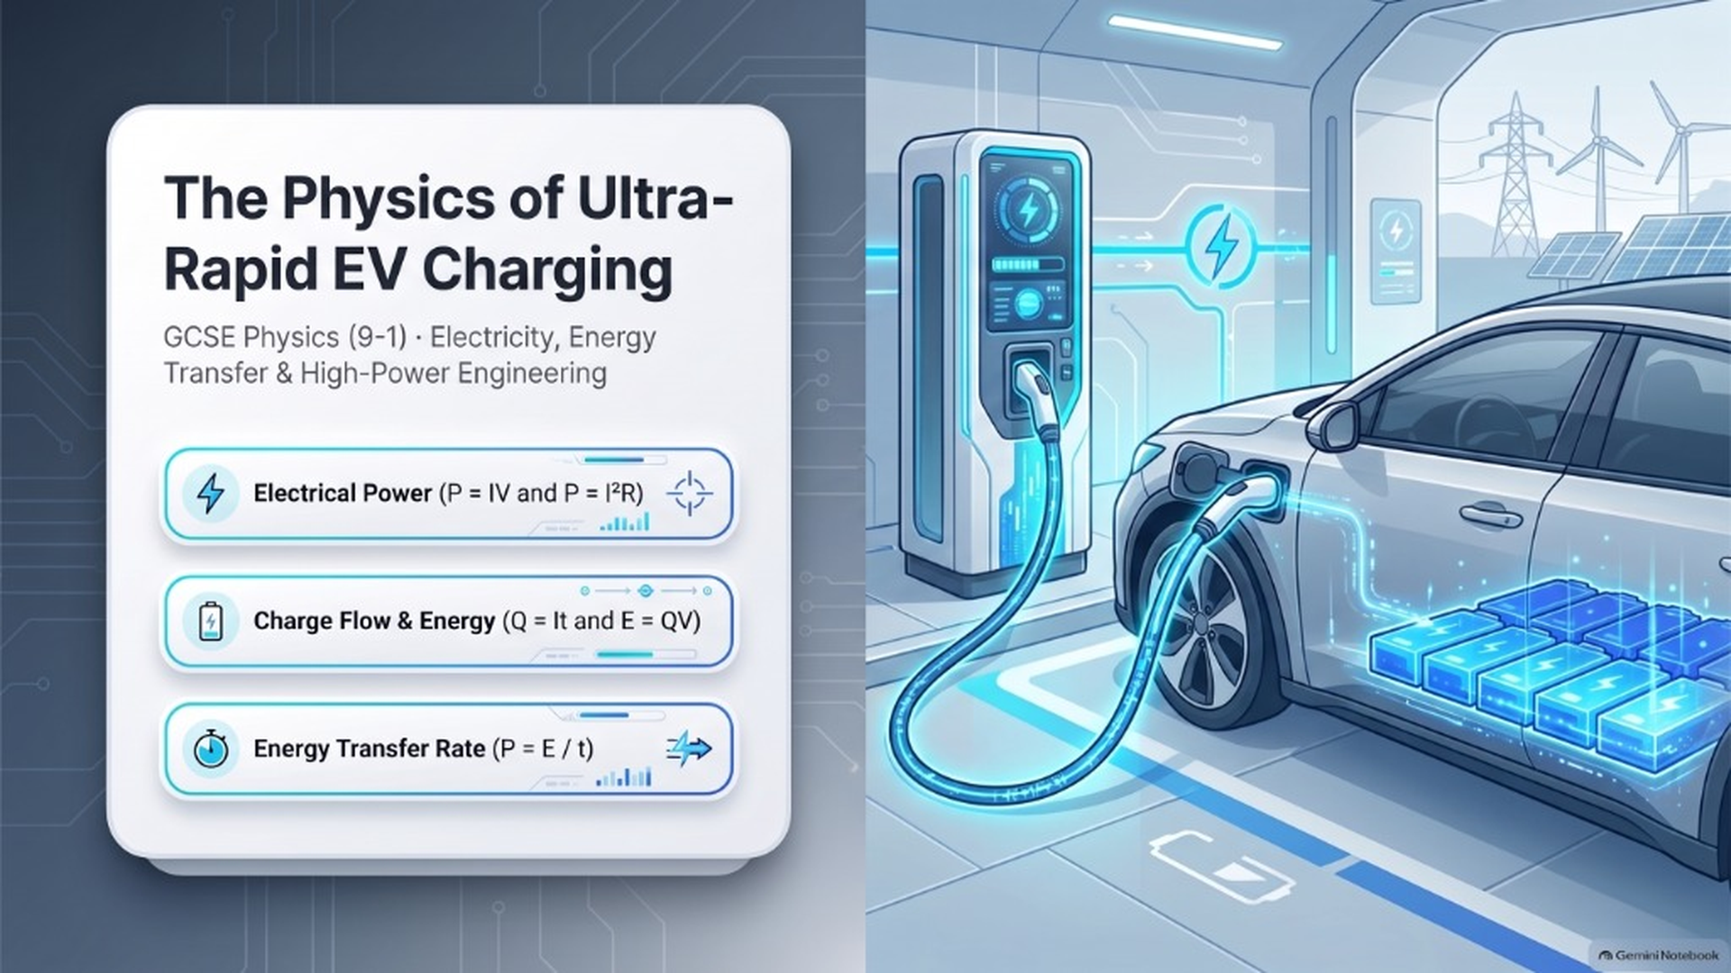
Notes:
[Slide 1: Title & Hook]
Title: The Physics of Ultra-Rapid EV Charging
GCSE Physics (9-1) · Electricity, Energy Transfer & High-Power Engineering
Core topics covered:
• Electrical Power (P = IV and P = I²R)
• Charge Flow & Energy (Q = It and E = QV)
• Energy Transfer Rate (P = E / t)

Slide 2
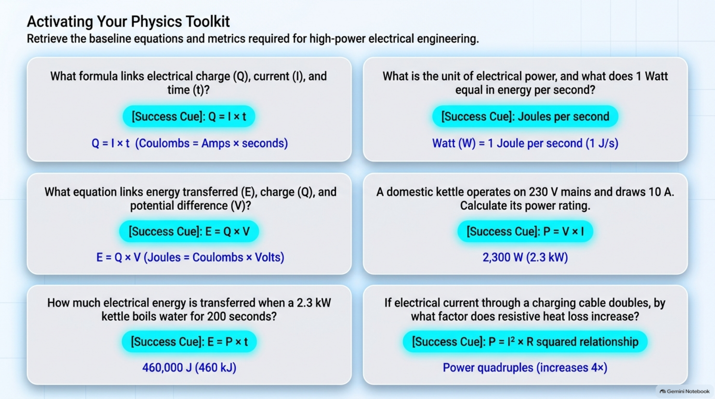
Notes:
[Slide 2: Activating Your Physics Toolkit (6-Question Grid)]
Starter Activity: Knowledge Retrieval Practice (6-Question Grid)
Questions & Answers:
1. What formula links electrical charge (Q), current (I), and time (t)?
→ Answer: Q = I × t (Coulombs = Amps × seconds)
2. What is the unit of electrical power, and what does 1 Watt equal in energy per second?
→ Answer: Watt (W) = 1 Joule per second (1 J/s)
3. What equation links energy transferred (E), charge (Q), and potential difference (V)?
→ Answer: E = Q × V (Joules = Coulombs × Volts)
4. A domestic kettle operates on 230 V mains and draws 10 A. Calculate its power rating.
→ Answer: P = V × I = 230 V × 10 A = 2,300 W (2.3 kW)
5. How much electrical energy is transferred when a 2.3 kW kettle boils water for 200 seconds?
→ Answer: E = P × t = 2,300 W × 200 s = 460,000 J (460 kJ)
6. If electrical current through a charging cable doubles, by what factor does resistive heat loss increase?
→ Answer: Power quadruples (increases 4×, since P = I²R has a squared relationship)

Slide 3
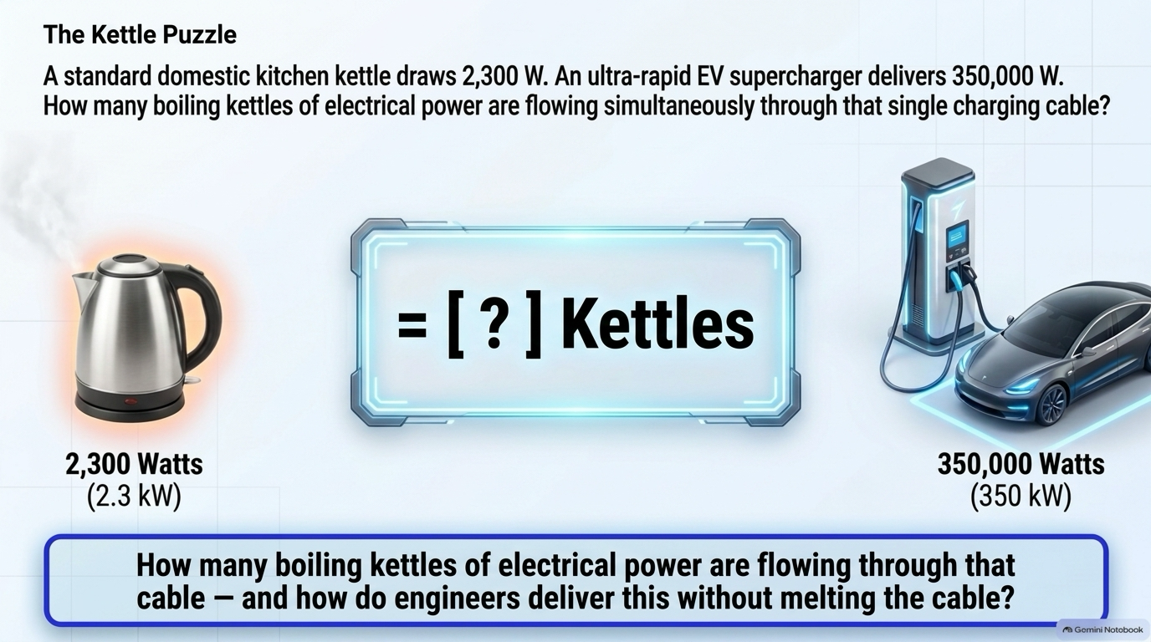
Notes:
[Slide 3 [Build 1]: The Kettle Puzzle (Question Posed)]
The 60-Second Hook: The Kettle vs. The Supercharger (~152 Kettle Puzzle)
Prompt:
A standard kitchen kettle draws 2,300 W. An ultra-rapid EV supercharger delivers 350,000 W.
How many boiling kettles of electrical power are flowing simultaneously through that single charging cable?
Calculation:
350,000 W ÷ 2,300 W ≈ 152.17 → ~152 Simultaneous Boiling Kettles!
Mission:
How do engineers deliver the power of 152 kettles through a single handheld cable without melting it or destroying the battery?

Slide 4
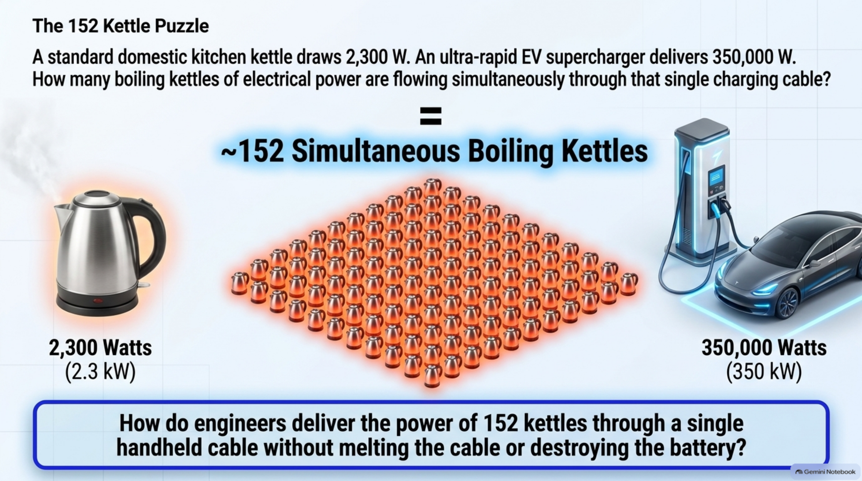
Notes:
[Slide 3 [Build 2]: The 152 Kettle Puzzle (~152 Simultaneous Kettles Answer Reveal)]
The 60-Second Hook: The Kettle vs. The Supercharger (~152 Kettle Puzzle)
Prompt:
A standard kitchen kettle draws 2,300 W. An ultra-rapid EV supercharger delivers 350,000 W.
How many boiling kettles of electrical power are flowing simultaneously through that single charging cable?
Calculation:
350,000 W ÷ 2,300 W ≈ 152.17 → ~152 Simultaneous Boiling Kettles!
Mission:
How do engineers deliver the power of 152 kettles through a single handheld cable without melting it or destroying the battery?

Slide 5
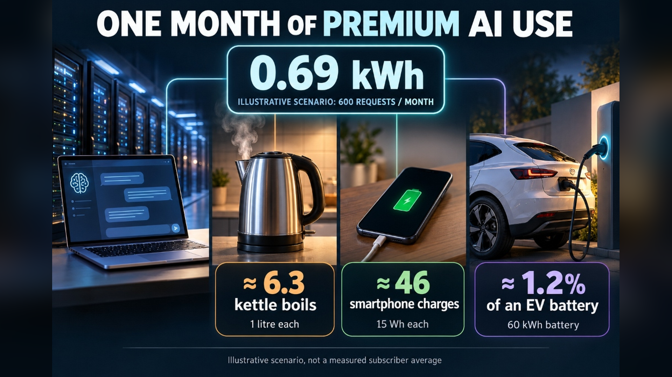
Notes:
[Slide 4: Energy in Perspective (AI Queries vs Kettles vs EV)]
Energy in Perspective: From AI Queries to Boiling Kettles & EV Batteries
Comparative Energy Demands:
• 1 AI query: ~0.0003 kWh (1 kJ)
• Boiling 1 domestic kettle: ~0.11 kWh (400 kJ)
• 600 AI requests per month: ~0.69 kWh
• Typical EV full battery charge: ~60–75 kWh (equivalent to boiling ~600 kettles)

Slide 6
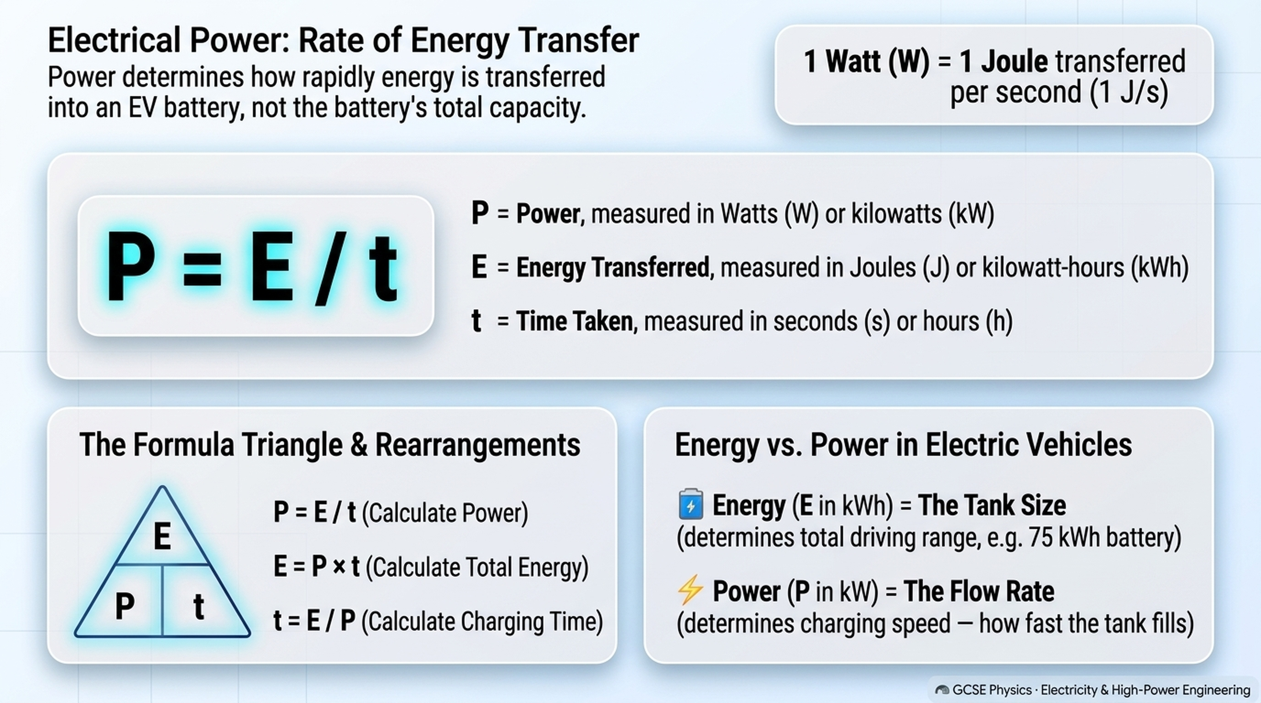
Notes:
[Slide 5 [Build 1]: Electrical Power Formula Explained (P = E / t)]
Fundamental Formula: Power as Rate of Energy Transfer (P = E / t)
1. Formula Breakdown:
• P = E / t (Power in Watts = Energy transferred in Joules ÷ Time taken in seconds)
• 1 Watt (W) = 1 Joule per second (1 J/s)
• Formula Triangle: E on top; P and t on bottom (P = E/t, E = P × t, t = E/P)
• EV Analogy: Energy (kWh) is the battery tank size; Power (kW) is the pump flow rate.
2. Student Calculation Task (75 kWh Battery):
• Scenario 1 (3-Pin): P = 75 kWh ÷ 32.6 h ≈ 2.3 kW (2,300 W)
• Scenario 2 (Wallbox): P = 75 kWh ÷ 10.1 h ≈ 7.4 kW (7,425 W)
• Scenario 3 (Rapid DC): P = 75 kWh ÷ 0.5 h = 150 kW (150,000 W)
3. Critical Question: Are the battery graphics accurate?
• Flaw: The battery graphics showing 5%, 50%, and 95% are physically misleading.
• Rationale: The times given (32.6 h, 10.1 h, 30 min) represent the duration needed for each charger to fully charge the SAME 75 kWh battery to 100%. Showing low vs high percentages mistakenly implies that a slower charger only fills a battery to 5%, confusing charging speed (rate of power transfer) with the final state of charge!

Slide 7
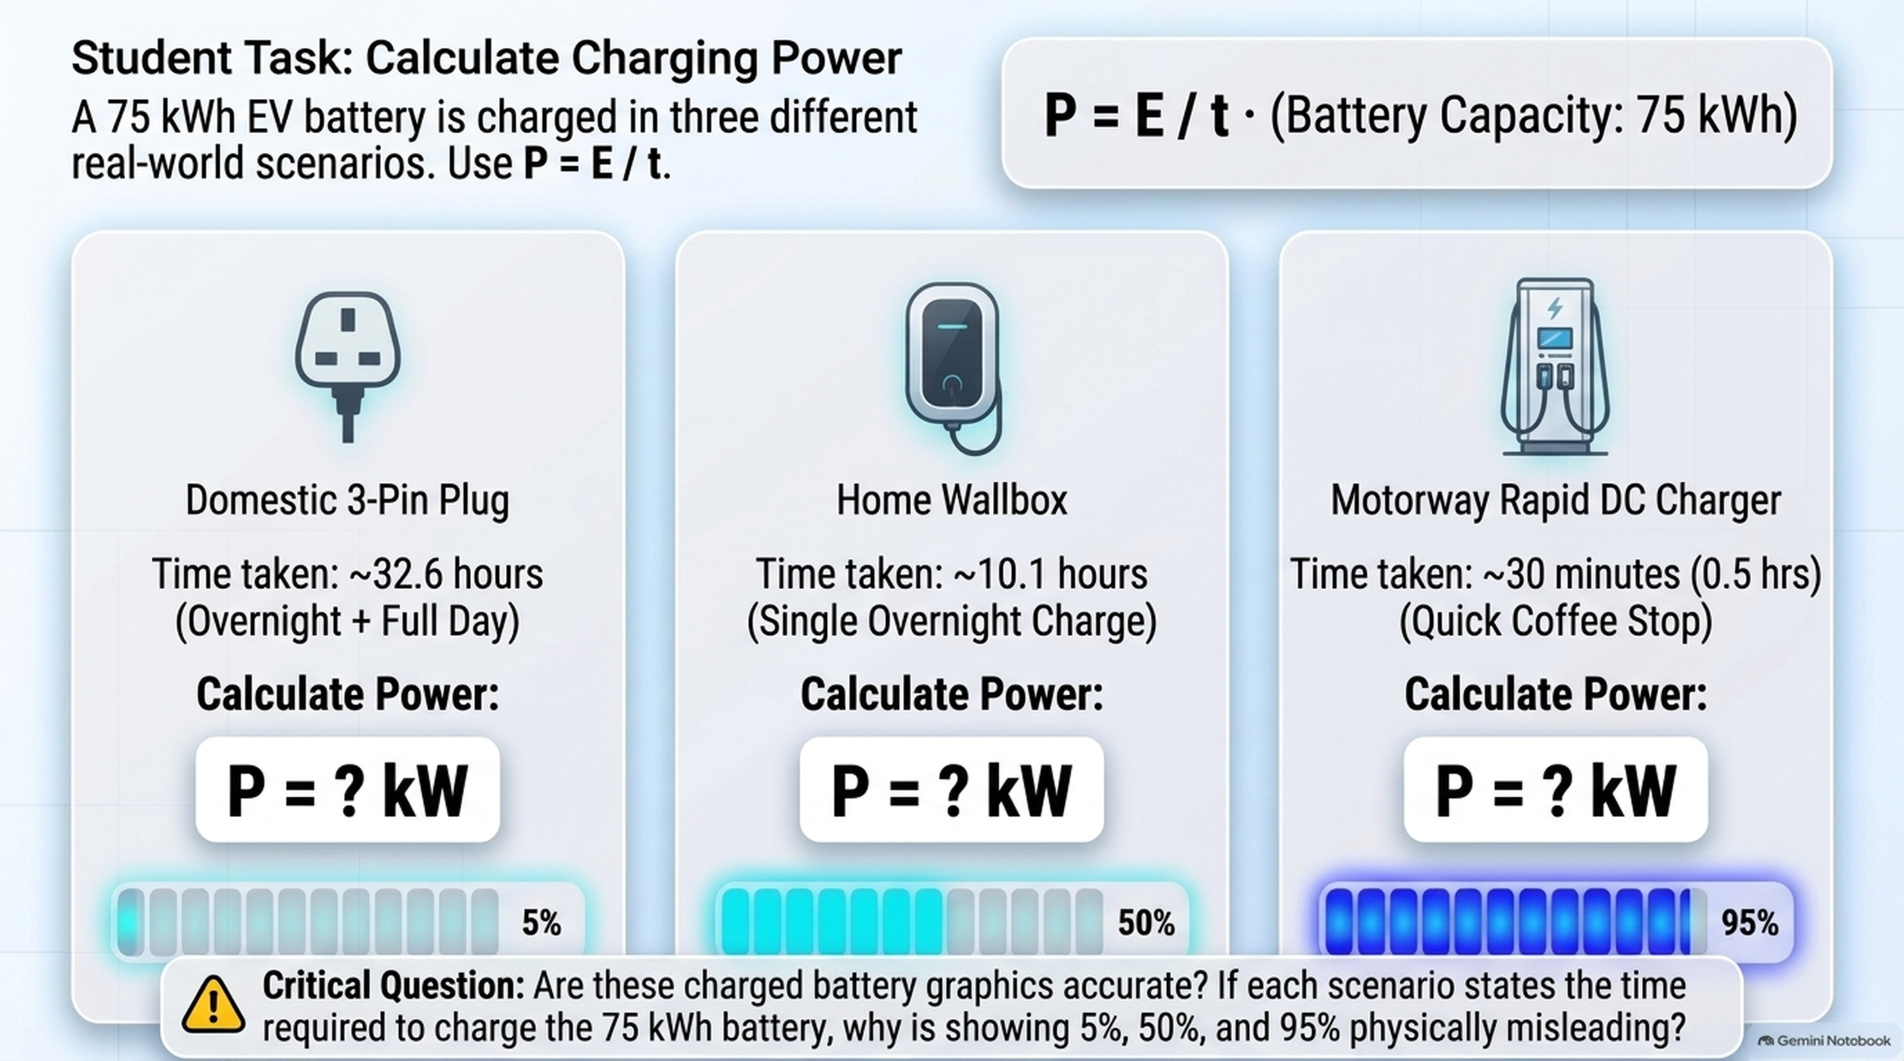
Notes:
[Slide 5 [Build 2]: Student Task — Calculate Power for 3 Scenarios & Check Battery Graphics]
Fundamental Formula: Power as Rate of Energy Transfer (P = E / t)
1. Formula Breakdown:
• P = E / t (Power in Watts = Energy transferred in Joules ÷ Time taken in seconds)
• 1 Watt (W) = 1 Joule per second (1 J/s)
• Formula Triangle: E on top; P and t on bottom (P = E/t, E = P × t, t = E/P)
• EV Analogy: Energy (kWh) is the battery tank size; Power (kW) is the pump flow rate.
2. Student Calculation Task (75 kWh Battery):
• Scenario 1 (3-Pin): P = 75 kWh ÷ 32.6 h ≈ 2.3 kW (2,300 W)
• Scenario 2 (Wallbox): P = 75 kWh ÷ 10.1 h ≈ 7.4 kW (7,425 W)
• Scenario 3 (Rapid DC): P = 75 kWh ÷ 0.5 h = 150 kW (150,000 W)
3. Critical Question: Are the battery graphics accurate?
• Flaw: The battery graphics showing 5%, 50%, and 95% are physically misleading.
• Rationale: The times given (32.6 h, 10.1 h, 30 min) represent the duration needed for each charger to fully charge the SAME 75 kWh battery to 100%. Showing low vs high percentages mistakenly implies that a slower charger only fills a battery to 5%, confusing charging speed (rate of power transfer) with the final state of charge!

Slide 8
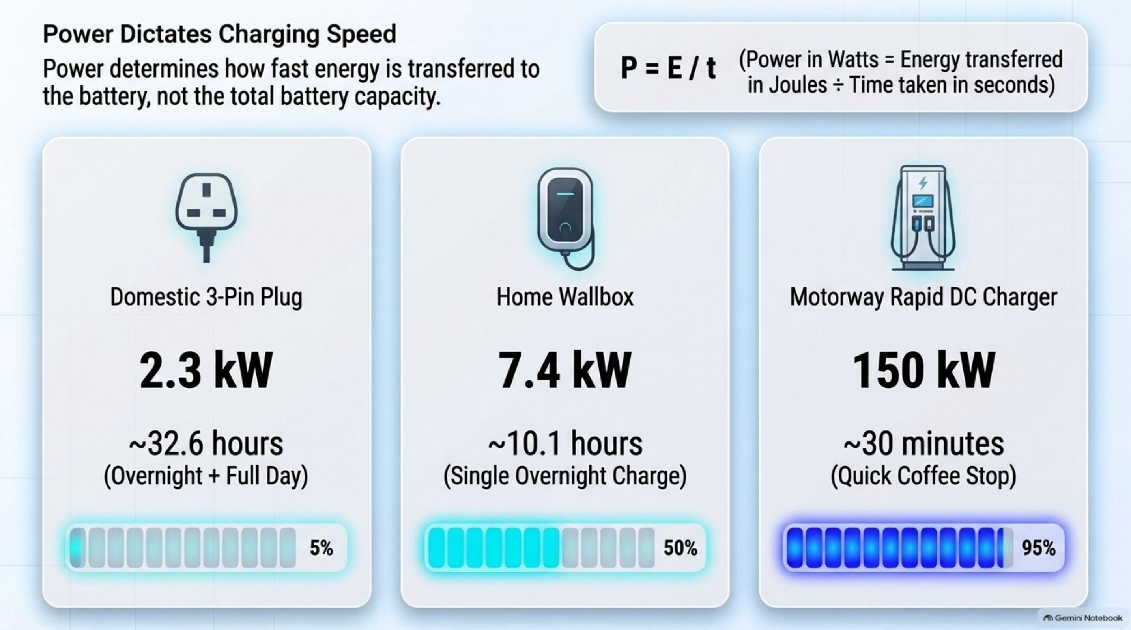
Notes:
[Slide 5 [Build 3]: Power Dictates Charging Speed (Calculated Solutions & Graphic Flaw Reveal)]
Fundamental Formula: Power as Rate of Energy Transfer (P = E / t)
1. Formula Breakdown:
• P = E / t (Power in Watts = Energy transferred in Joules ÷ Time taken in seconds)
• 1 Watt (W) = 1 Joule per second (1 J/s)
• Formula Triangle: E on top; P and t on bottom (P = E/t, E = P × t, t = E/P)
• EV Analogy: Energy (kWh) is the battery tank size; Power (kW) is the pump flow rate.
2. Student Calculation Task (75 kWh Battery):
• Scenario 1 (3-Pin): P = 75 kWh ÷ 32.6 h ≈ 2.3 kW (2,300 W)
• Scenario 2 (Wallbox): P = 75 kWh ÷ 10.1 h ≈ 7.4 kW (7,425 W)
• Scenario 3 (Rapid DC): P = 75 kWh ÷ 0.5 h = 150 kW (150,000 W)
3. Critical Question: Are the battery graphics accurate?
• Flaw: The battery graphics showing 5%, 50%, and 95% are physically misleading.
• Rationale: The times given (32.6 h, 10.1 h, 30 min) represent the duration needed for each charger to fully charge the SAME 75 kWh battery to 100%. Showing low vs high percentages mistakenly implies that a slower charger only fills a battery to 5%, confusing charging speed (rate of power transfer) with the final state of charge!

Slide 9
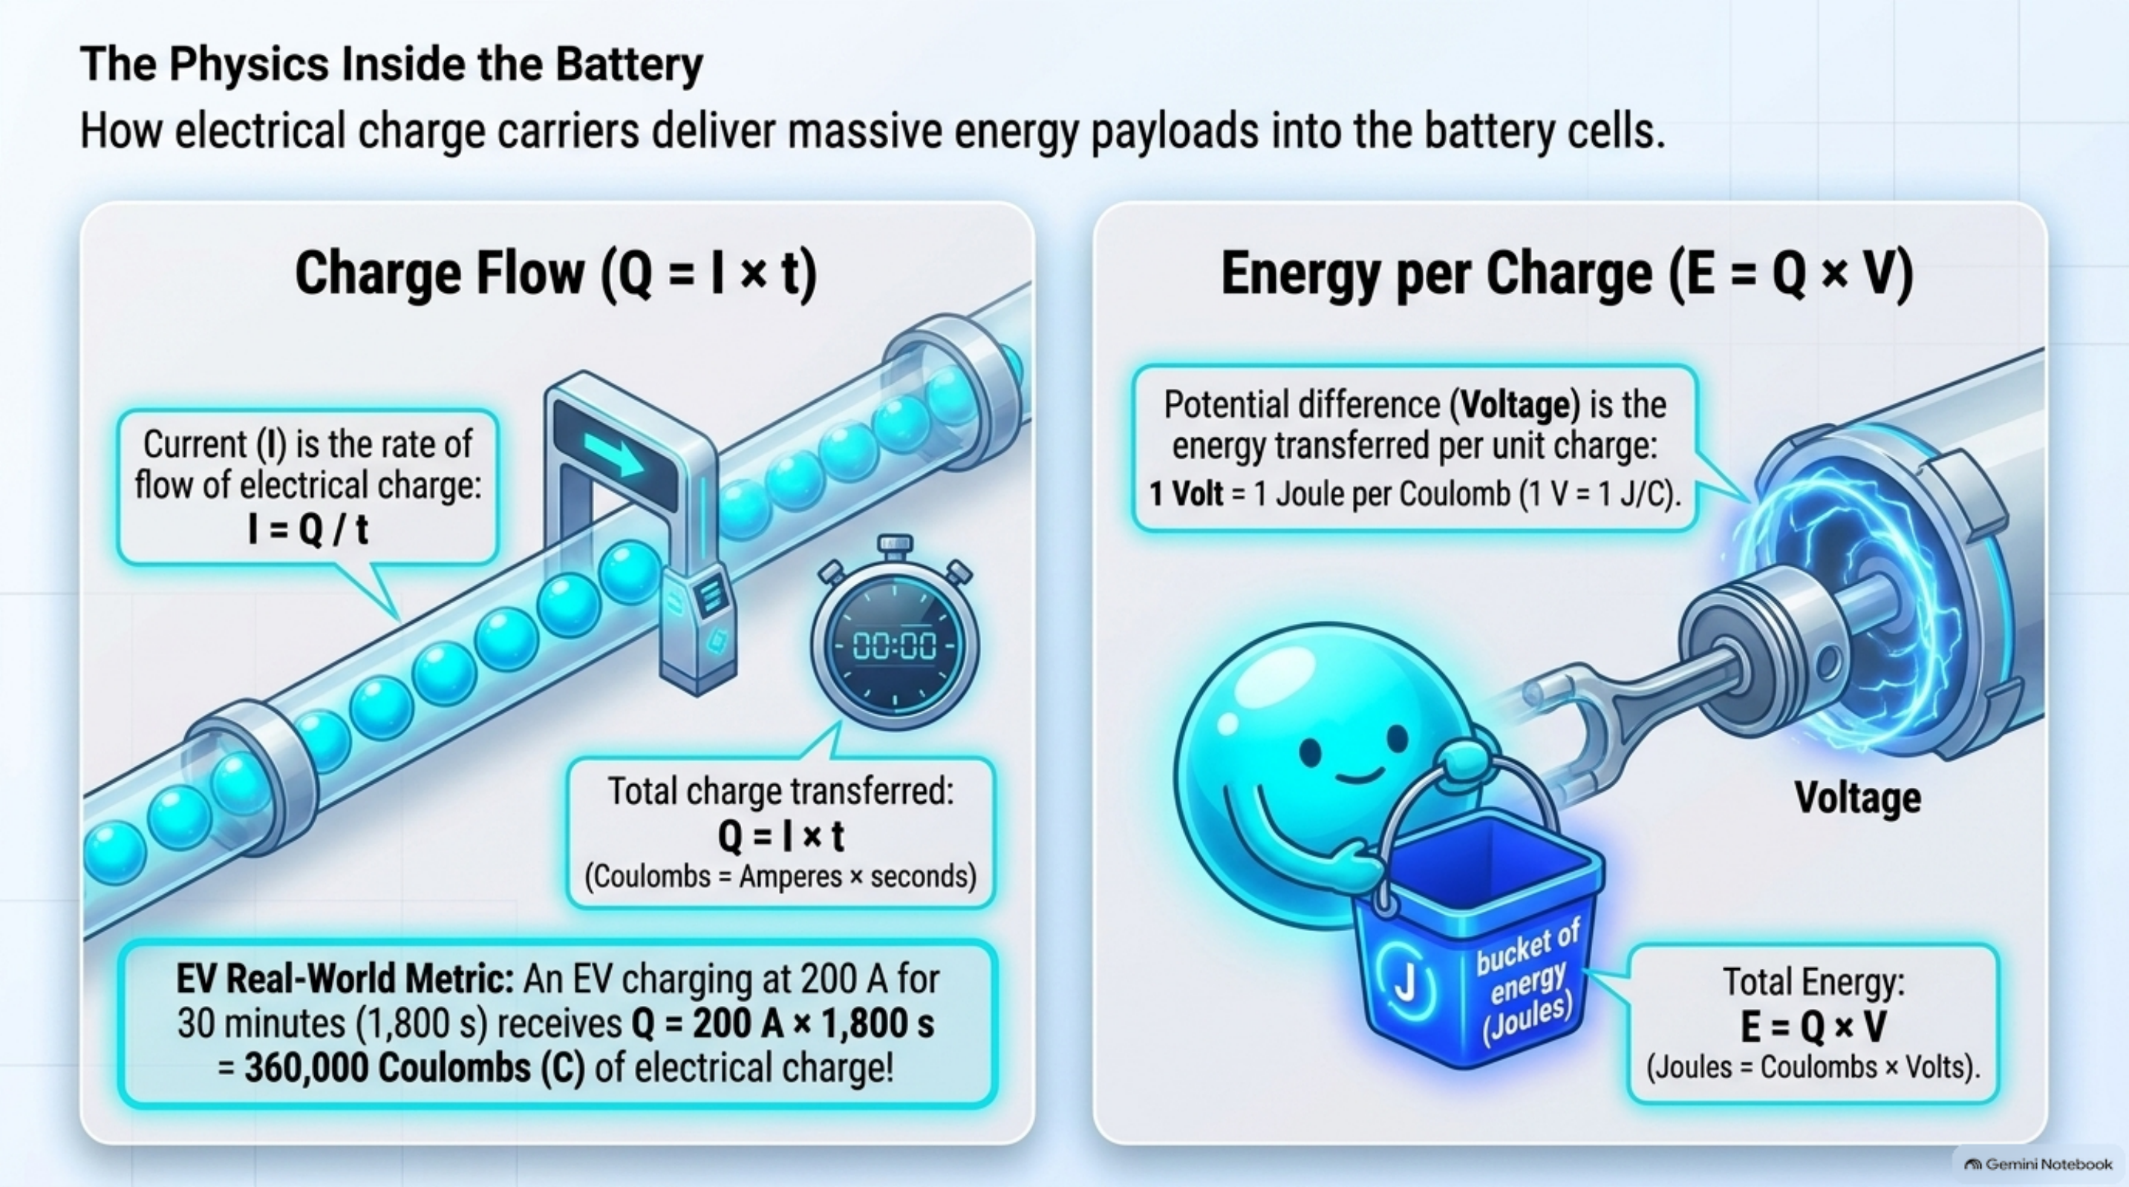
Notes:
[Slide 6 [Build 1]: Charge Flow (Q = It) & Energy per Charge (E = QV)]
The Physics Inside the Battery: Charge Flow (Q = It) & Energy (E = QV)
1. Charge Flow: Q = I × t
• At 200 A for 30 minutes (1,800 s): Q = 200 × 1,800 = 360,000 Coulombs (C)
2. Energy per Charge: E = Q × V
• At 400 V: E = 360,000 C × 400 V = 144,000,000 J (144 MJ or 40 kWh)
3. Synthesis proof linking to power:
• E = Q × V = (I × t) × V = I × V × t
• P = E / t = I × V

Slide 10
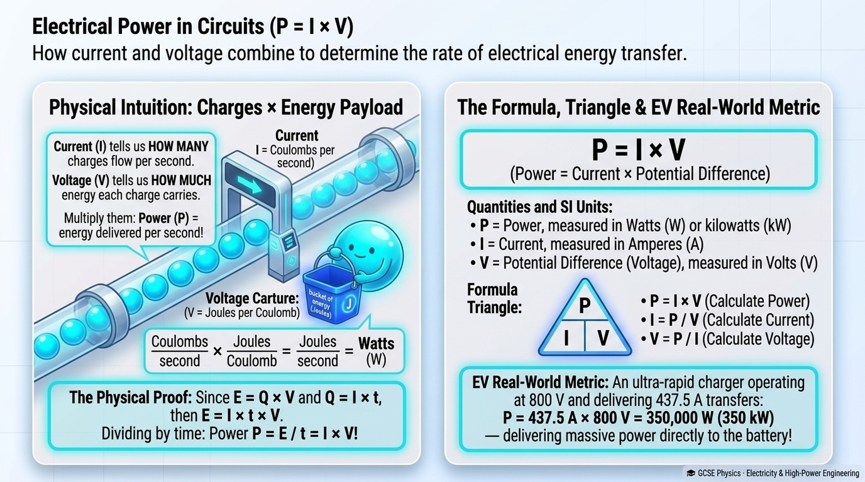
Notes:
[Slide 6 [Build 2]: Electrical Power in Circuits (P = I × V)]
The Physics Inside the Battery: Charge Flow (Q = It) & Energy (E = QV)
1. Charge Flow: Q = I × t
• At 200 A for 30 minutes (1,800 s): Q = 200 × 1,800 = 360,000 Coulombs (C)
2. Energy per Charge: E = Q × V
• At 400 V: E = 360,000 C × 400 V = 144,000,000 J (144 MJ or 40 kWh)
3. Synthesis proof linking to power:
• E = Q × V = (I × t) × V = I × V × t
• P = E / t = I × V

Slide 11
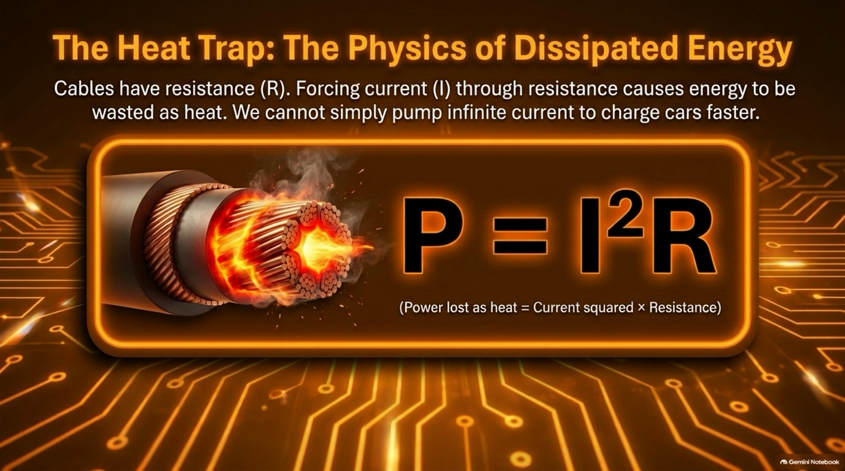
Notes:
[Slide 7 [Build 1]: The Heat Trap Formula (P = I²R)]
The Heat Trap: The Physics of Dissipated Energy (P = I²R)
Core Concept:
Cables have internal resistance (R). Forcing heavy current through resistance generates wasted thermal dissipation.
The Squared Effect:
• P = I²R
• Doubling current (2×) increases heat dissipation by 4× (2²).
• Tripling current (3×) increases heat dissipation by 9× (3²).
Engineers cannot simply pump infinite current through copper cables.

Slide 12
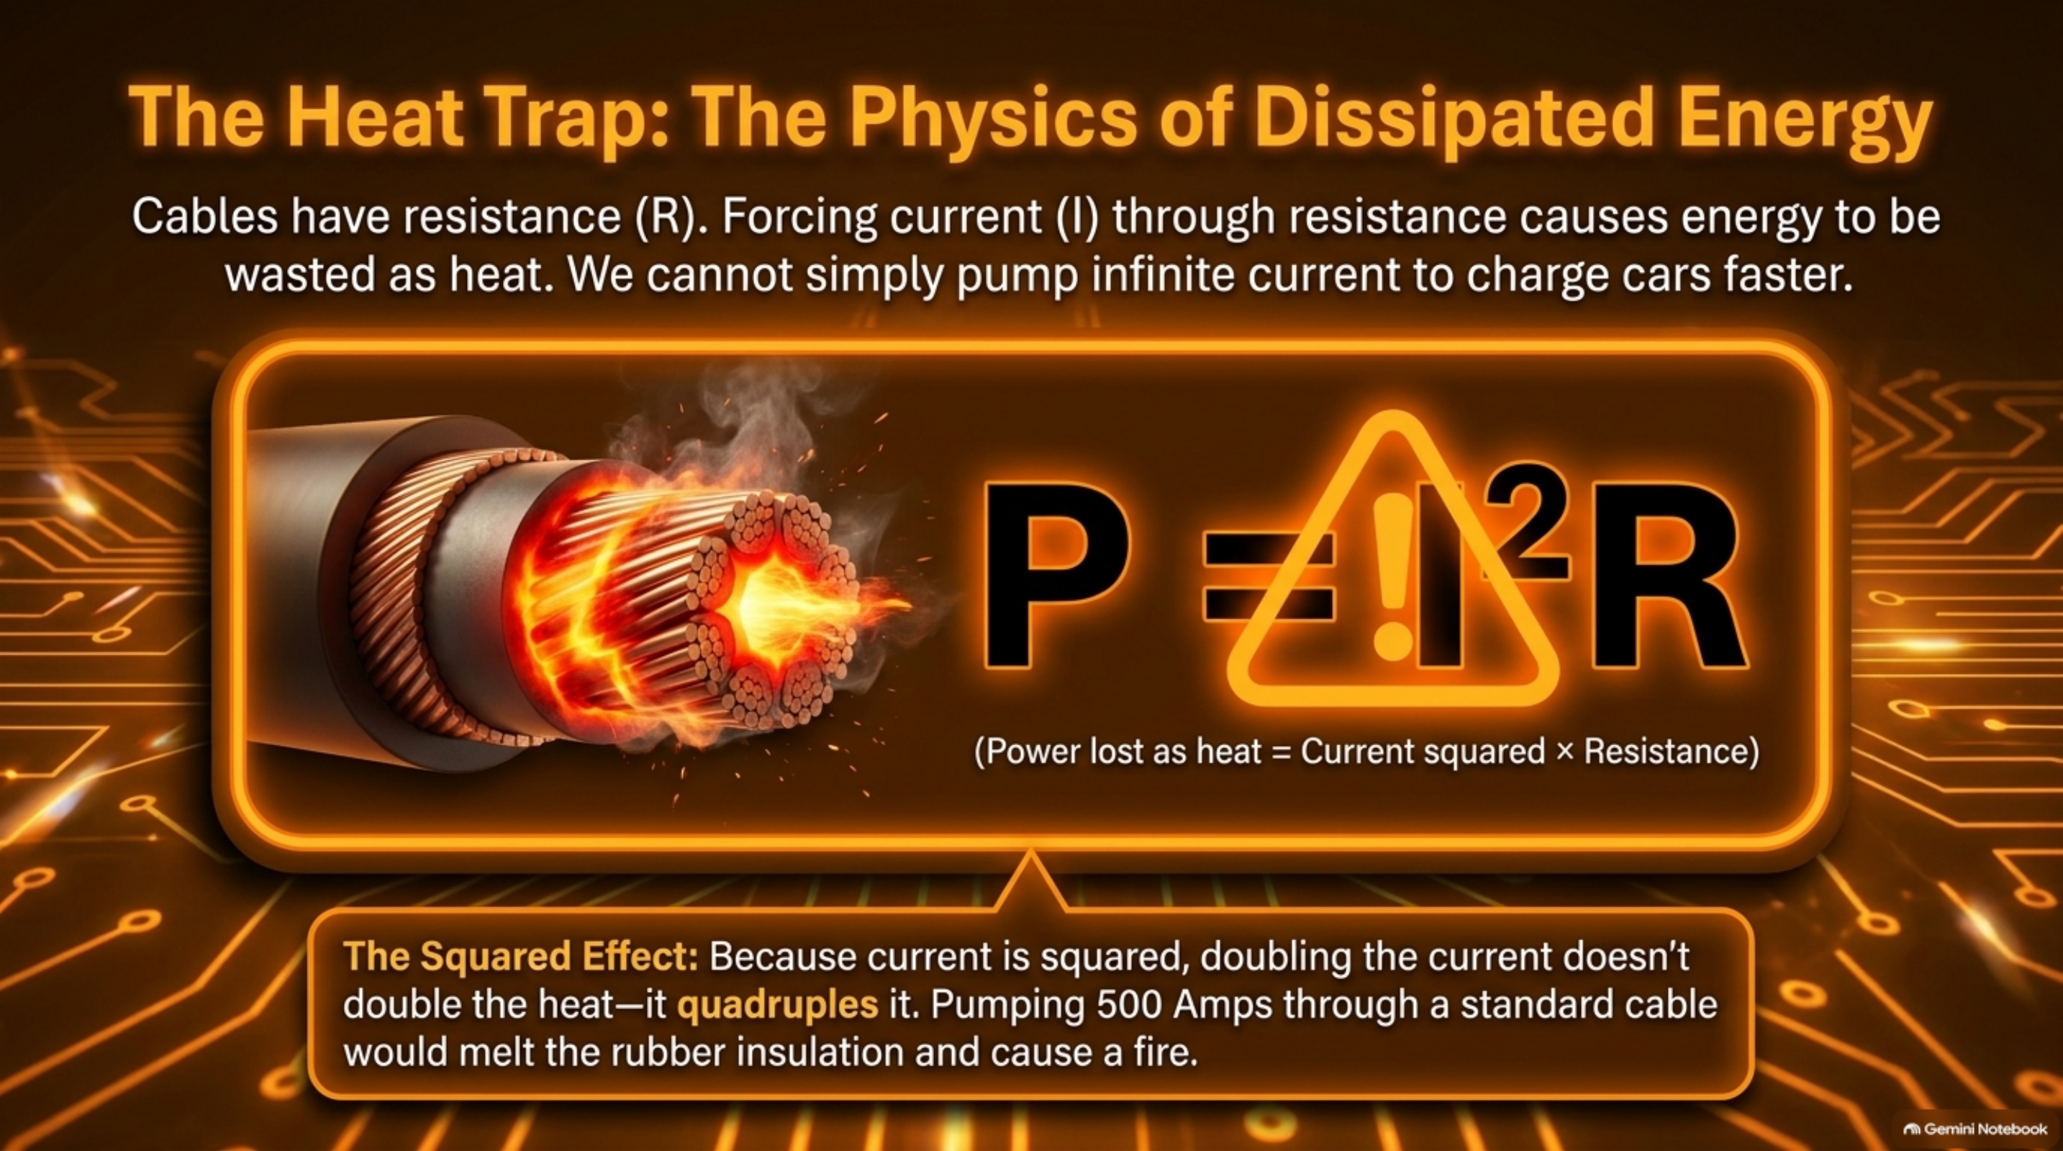
Notes:
[Slide 7 [Build 2]: The Heat Trap Warning Callout (Squared Resistance Dissipation)]
The Heat Trap: The Physics of Dissipated Energy (P = I²R)
Core Concept:
Cables have internal resistance (R). Forcing heavy current through resistance generates wasted thermal dissipation.
The Squared Effect:
• P = I²R
• Doubling current (2×) increases heat dissipation by 4× (2²).
• Tripling current (3×) increases heat dissipation by 9× (3²).
Engineers cannot simply pump infinite current through copper cables.

Slide 13
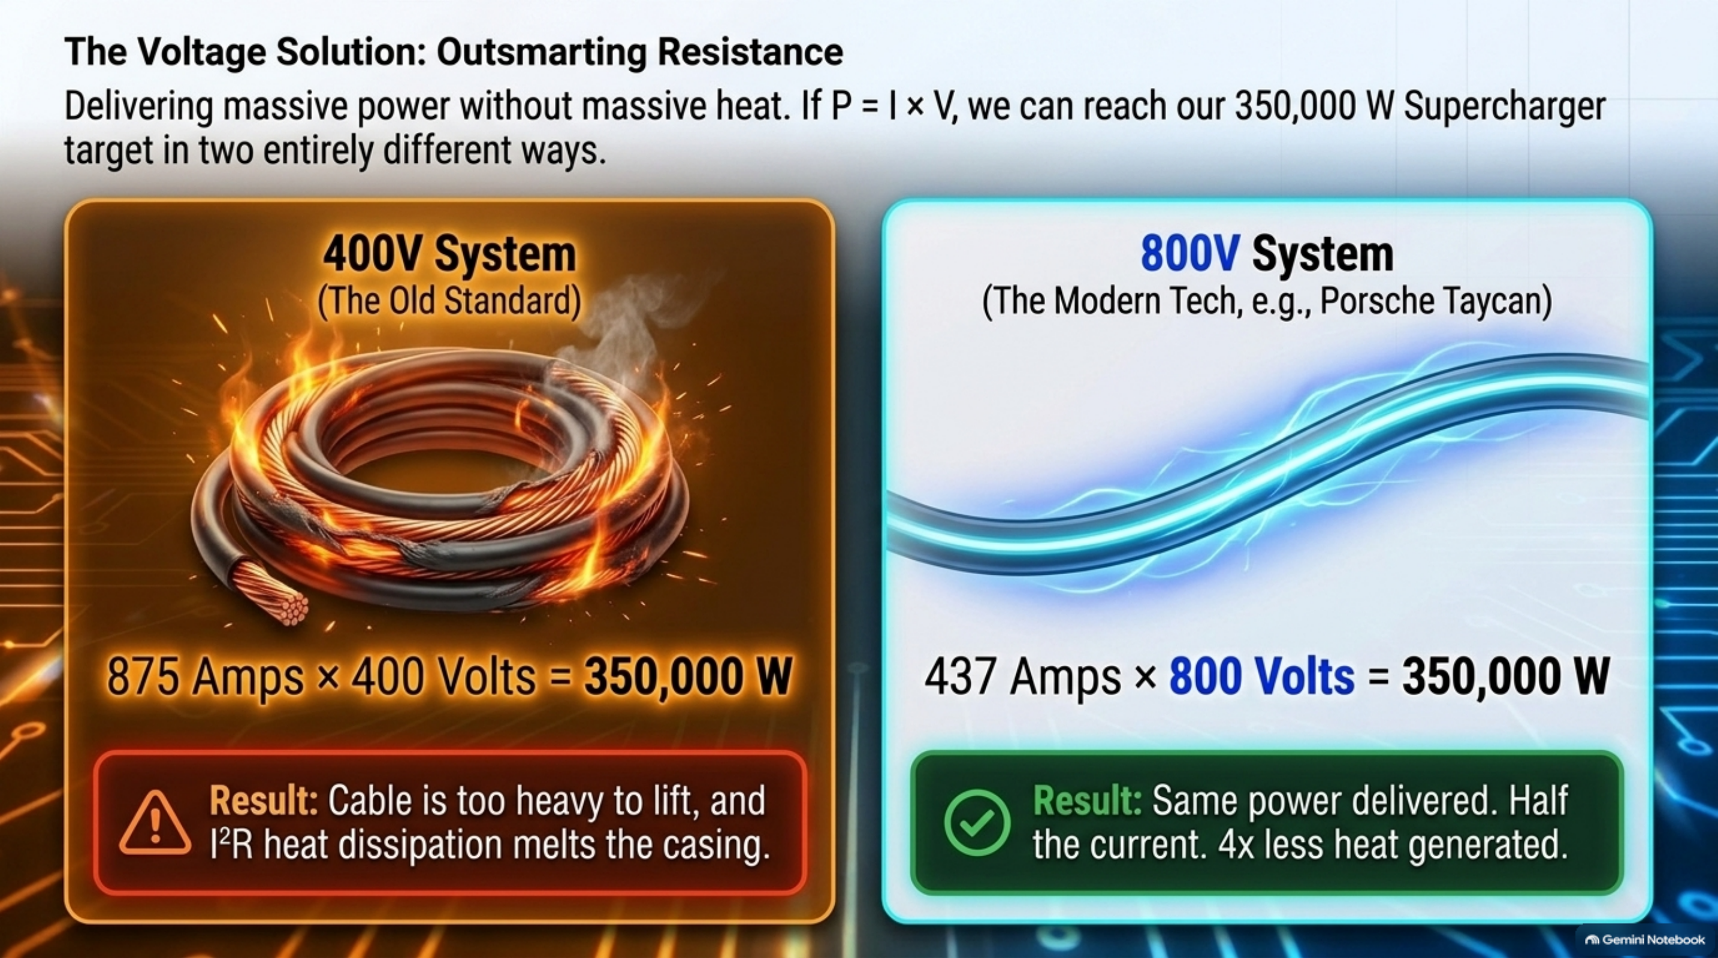
Notes:
[Slide 8: The Voltage Solution (Outsmarting Resistance: 400V vs 800V)]
The Voltage Solution: Outsmarting Resistance (400V vs. 800V)
Delivering 350 kW without melting the cable:
• Option A: Crank Current (I) → Cable becomes dangerously heavy and overheats.
• Option B: Boost Voltage (V) → Why modern performance EVs use 800 V architectures.
Worked example at 150 kW:
• At 230 V: I = 150,000 ÷ 230 = 652 A (hazardous heat loss)
• At 800 V: I = 150,000 ÷ 800 = 187.5 A (safe, lightweight, manageable cable)

Slide 14
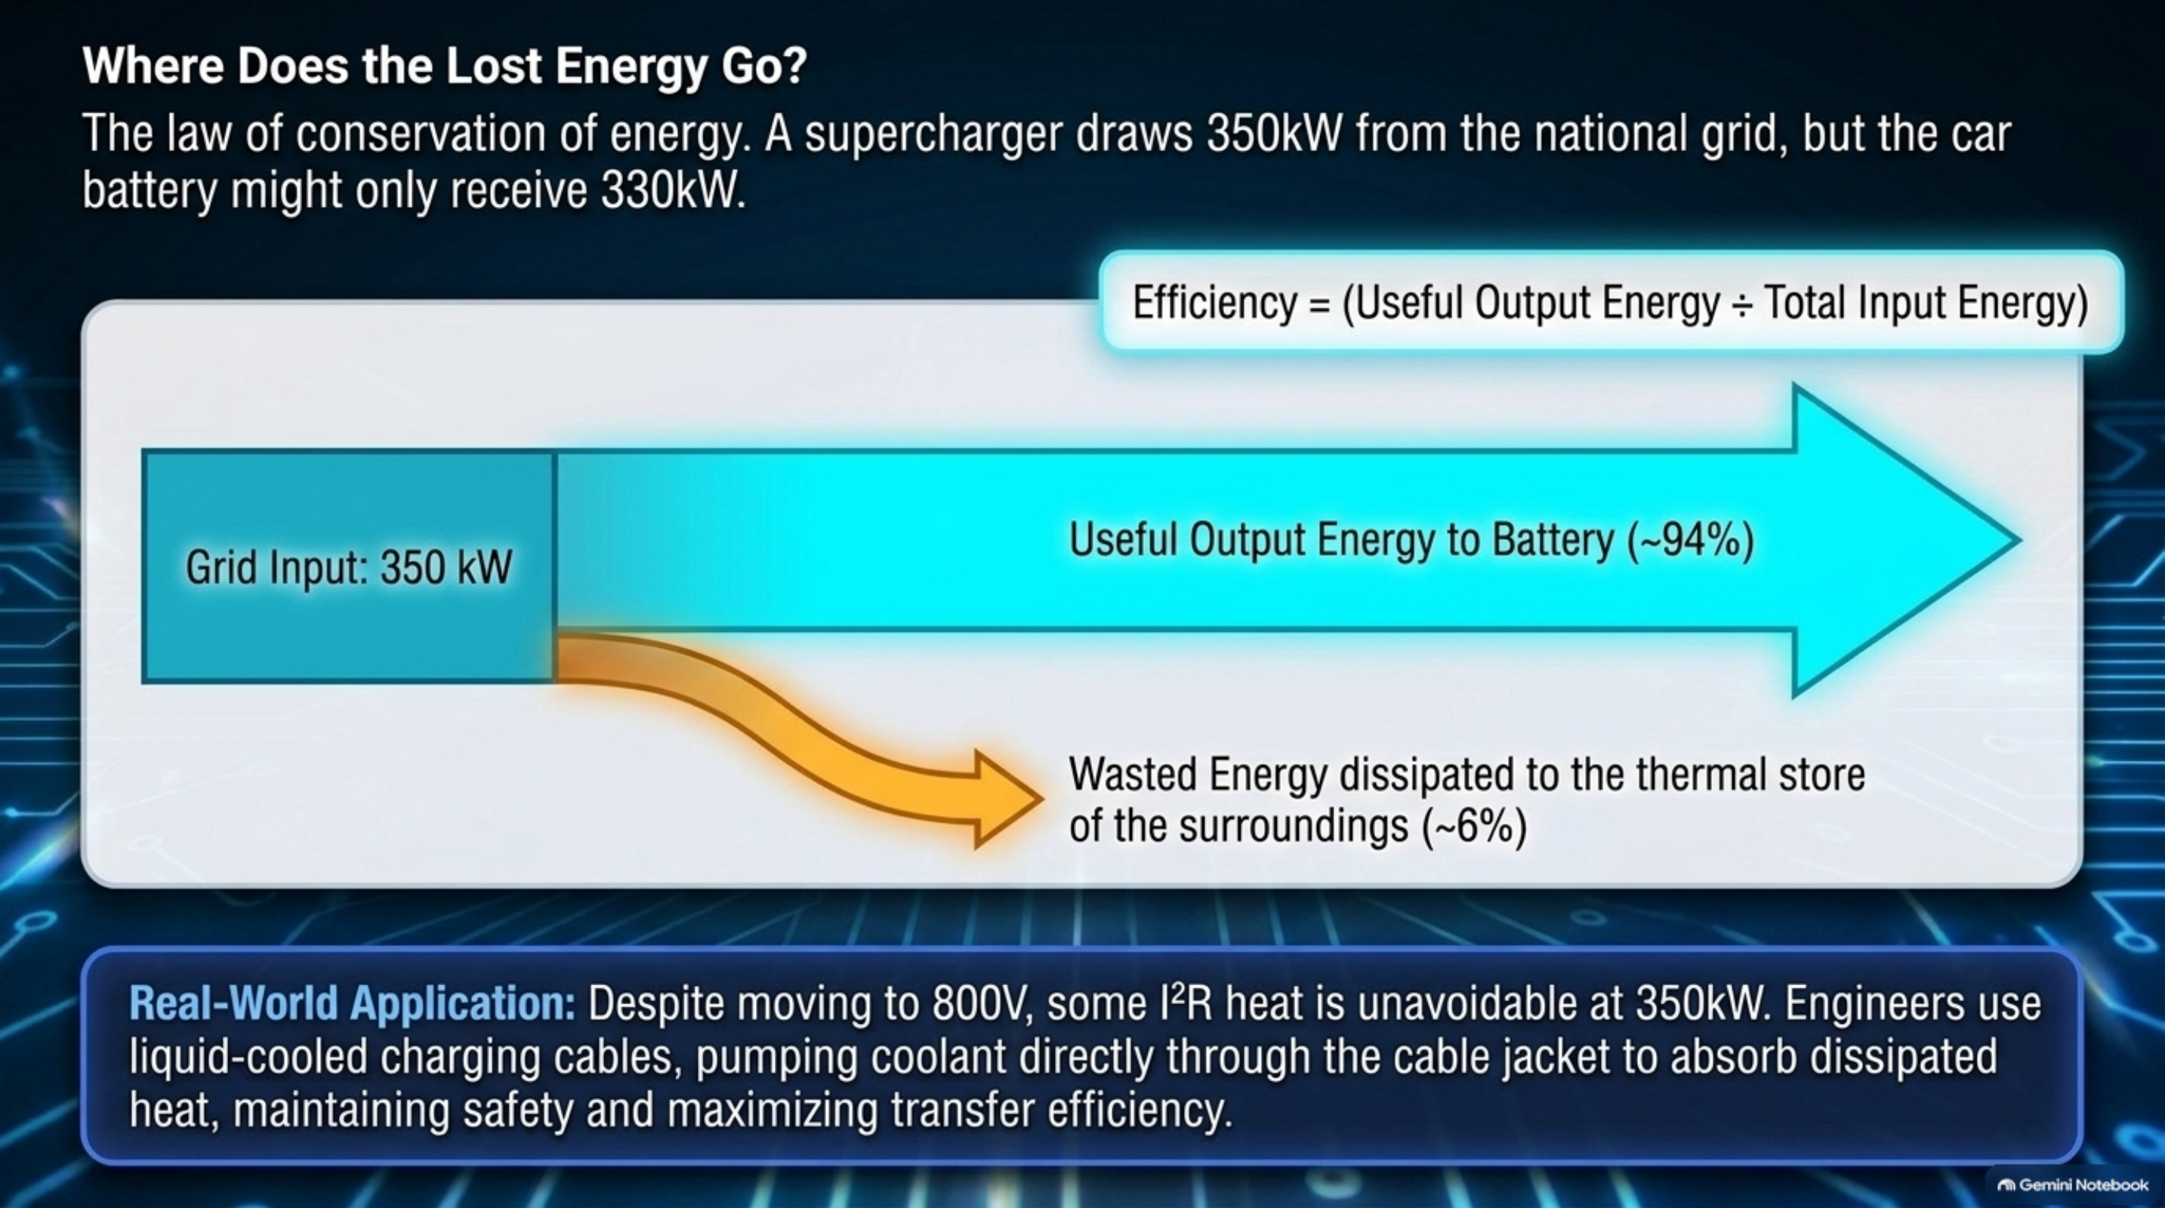
Notes:
[Slide 9: Where Does the Lost Energy Go? (Sankey Diagram & Cable Cooling)]
Where Does the Lost Energy Go? (Sankey Diagram & Cable Cooling)
Key Concepts:
• Conservation of energy: Input power = Useful battery storage + Dissipated thermal energy.
• Active liquid cooling: Dialectric coolant channels circulating inside the charging cable to absorb resistive heat.

Slide 15
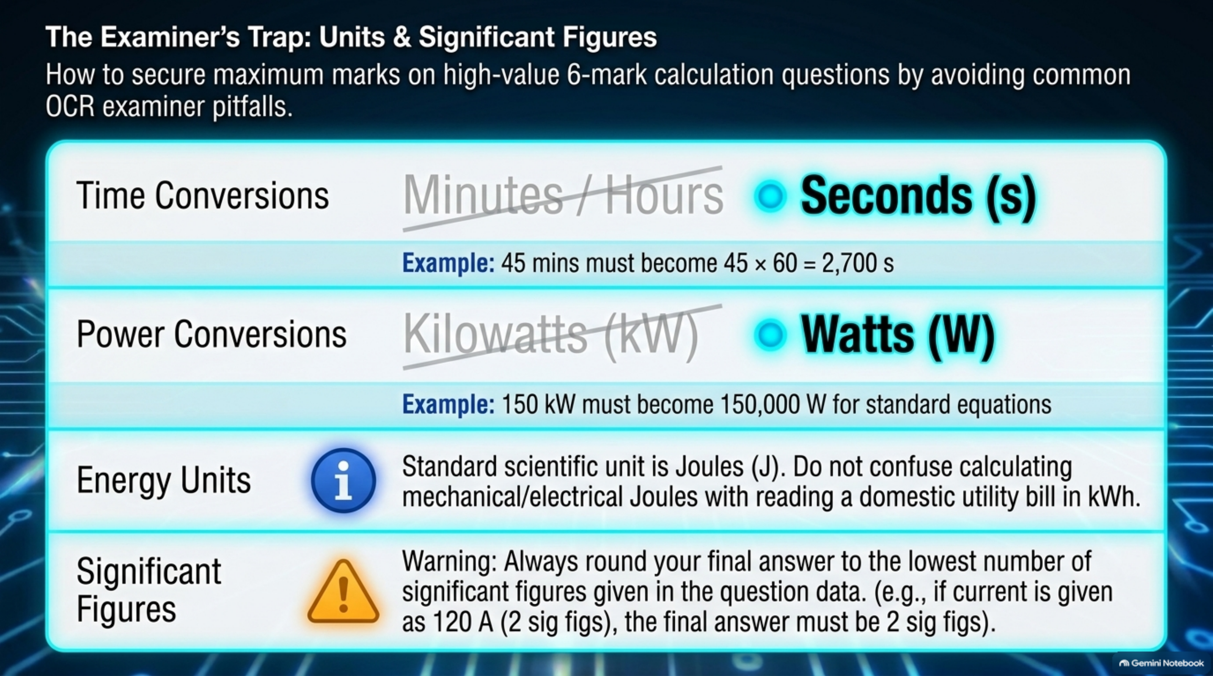
Notes:
[Slide 10: The Examiner's Trap (Units & Significant Figures)]
The Examiner's Trap: Units & Significant Figures
High-Value Calculation Pitfalls:
1. Time: Convert minutes/hours into seconds (s) before calculating energy.
2. Prefixes:
• kW = 1,000 W
• MW = 1,000,000 W
• kJ = 1,000 J
• MJ = 1,000,000 J
3. Significant Figures: Round only at the very final stage to match question precision.

Slide 16
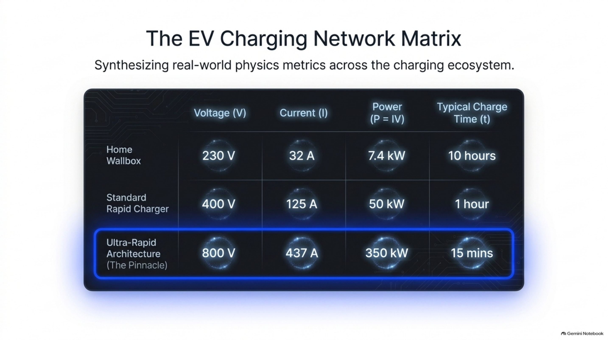
Notes:
[Slide 11: The EV Charging Network Matrix]
The EV Charging Network Matrix: Voltage, Current, Power & Time
Comprehensive ecosystem synthesis comparing:
• Domestic 3-Pin (230 V, 10 A, 2.3 kW)
• Home Fast Wallbox (230 V / 400 V, 32 A, 7.4 kW / 22 kW)
• Commercial Rapid DC (400 V, 125 A, 50 kW)
• Motorway Ultra-Rapid DC (800 V, 350 A–500 A, 150–350 kW)

Slide 17
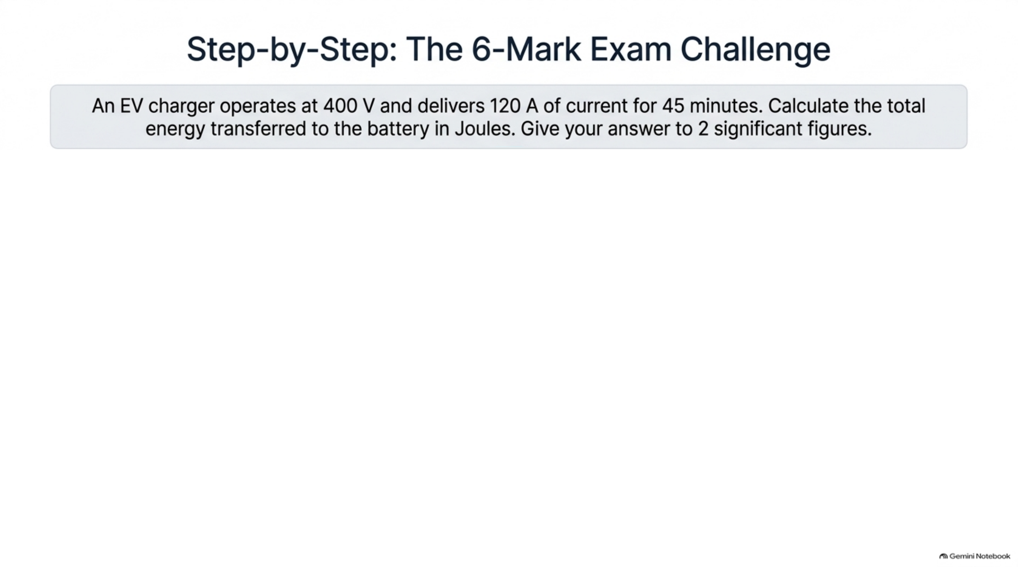
Notes:
[Slide 12 [Step 1]: The 6-Mark Challenge Prompt (Question & Parameters)]
Step-by-Step: The 6-Mark Exam Challenge (Interlocking Formulas)
Problem:
An EV charger operates at 400 V and delivers 120 A of current for 45 minutes. Calculate total energy transferred in Joules. Give answer to 2 significant figures.
Step-by-Step Solution:
• Step 1 (Trap - Time Conversion): t = 45 min × 60 s/min = 2,700 s
• Step 2 (Power Formula): P = I × V = 120 A × 400 V = 48,000 W (48 kW)
• Step 3 (Energy Formula): E = P × t = 48,000 W × 2,700 s = 129,600,000 J
• Step 4 (Significant Figures): 129,600,000 J = 1.3 × 10⁸ J (or 130,000,000 J to 2 s.f.)

Slide 18
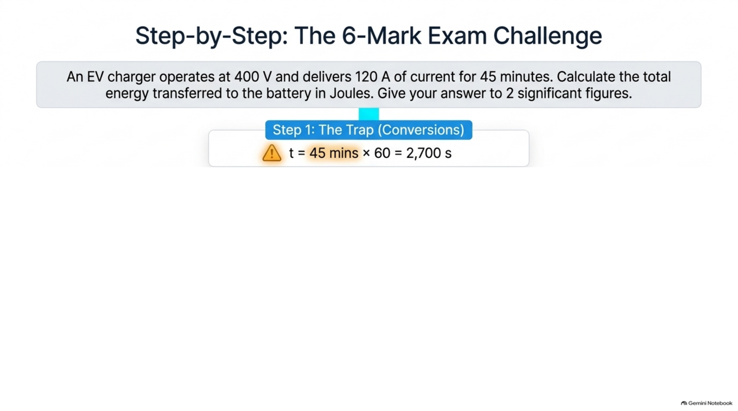
Notes:
[Slide 12 [Step 2]: Time Conversion Trap (45 min = 2,700 s)]
Step-by-Step: The 6-Mark Exam Challenge (Interlocking Formulas)
Problem:
An EV charger operates at 400 V and delivers 120 A of current for 45 minutes. Calculate total energy transferred in Joules. Give answer to 2 significant figures.
Step-by-Step Solution:
• Step 1 (Trap - Time Conversion): t = 45 min × 60 s/min = 2,700 s
• Step 2 (Power Formula): P = I × V = 120 A × 400 V = 48,000 W (48 kW)
• Step 3 (Energy Formula): E = P × t = 48,000 W × 2,700 s = 129,600,000 J
• Step 4 (Significant Figures): 129,600,000 J = 1.3 × 10⁸ J (or 130,000,000 J to 2 s.f.)

Slide 19
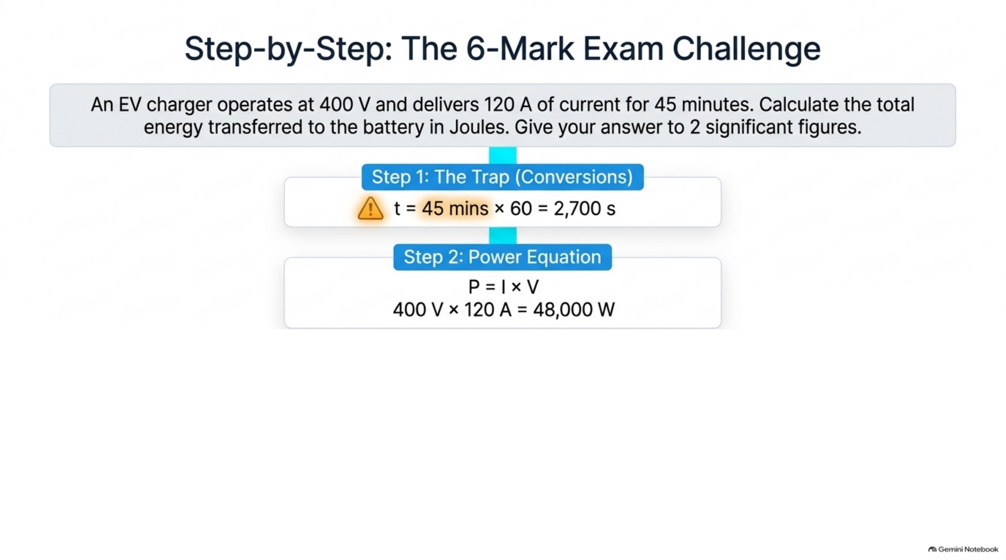
Notes:
[Slide 12 [Step 3]: Power Equation (P = I × V = 48,000 W)]
Step-by-Step: The 6-Mark Exam Challenge (Interlocking Formulas)
Problem:
An EV charger operates at 400 V and delivers 120 A of current for 45 minutes. Calculate total energy transferred in Joules. Give answer to 2 significant figures.
Step-by-Step Solution:
• Step 1 (Trap - Time Conversion): t = 45 min × 60 s/min = 2,700 s
• Step 2 (Power Formula): P = I × V = 120 A × 400 V = 48,000 W (48 kW)
• Step 3 (Energy Formula): E = P × t = 48,000 W × 2,700 s = 129,600,000 J
• Step 4 (Significant Figures): 129,600,000 J = 1.3 × 10⁸ J (or 130,000,000 J to 2 s.f.)

Slide 20
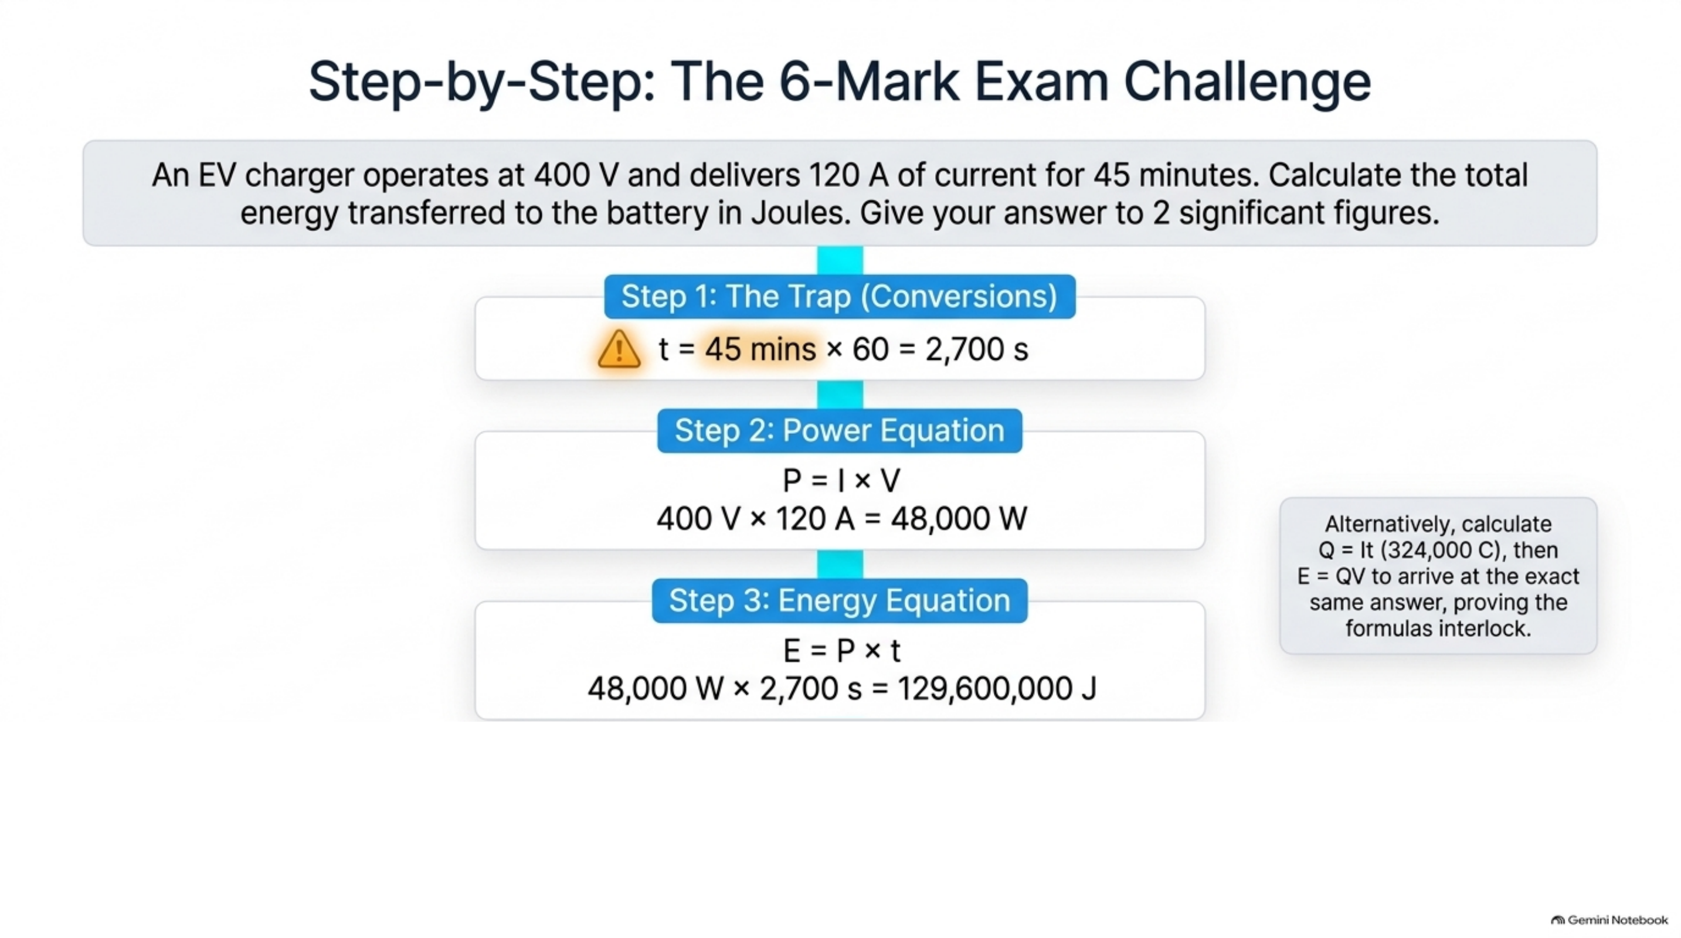
Notes:
[Slide 12 [Step 4]: Energy Equation (E = P × t = 129,600,000 J)]
Step-by-Step: The 6-Mark Exam Challenge (Interlocking Formulas)
Problem:
An EV charger operates at 400 V and delivers 120 A of current for 45 minutes. Calculate total energy transferred in Joules. Give answer to 2 significant figures.
Step-by-Step Solution:
• Step 1 (Trap - Time Conversion): t = 45 min × 60 s/min = 2,700 s
• Step 2 (Power Formula): P = I × V = 120 A × 400 V = 48,000 W (48 kW)
• Step 3 (Energy Formula): E = P × t = 48,000 W × 2,700 s = 129,600,000 J
• Step 4 (Significant Figures): 129,600,000 J = 1.3 × 10⁸ J (or 130,000,000 J to 2 s.f.)

Slide 21
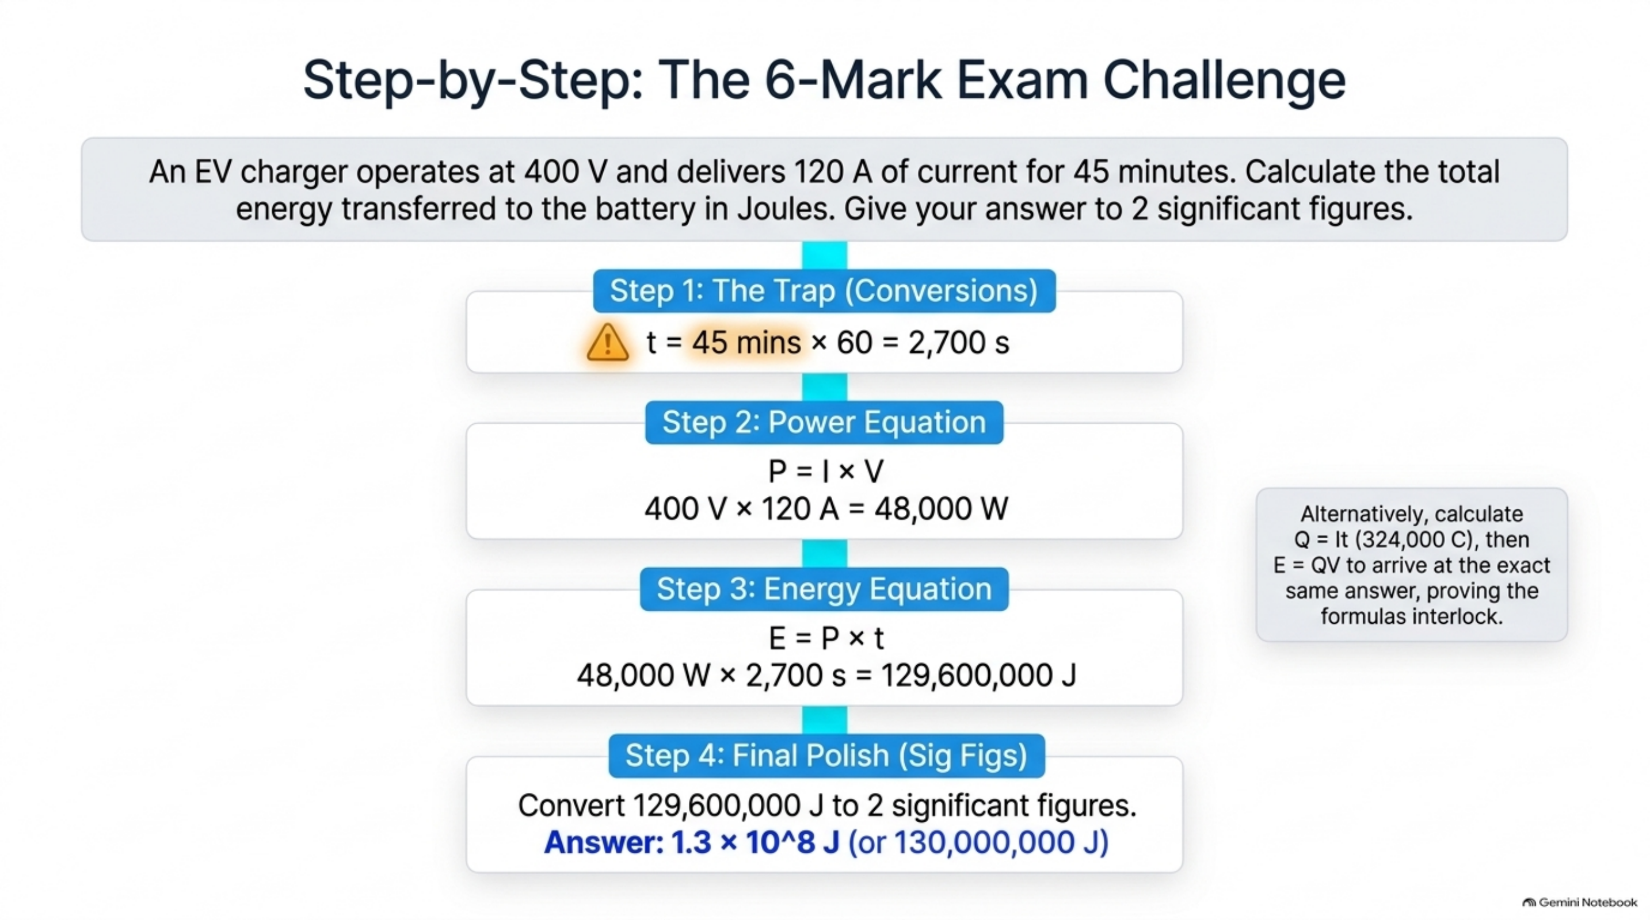
Notes:
[Slide 12 [Step 5]: Final Significant Figures Polish (1.3 × 10⁸ J Answer)]
Step-by-Step: The 6-Mark Exam Challenge (Interlocking Formulas)
Problem:
An EV charger operates at 400 V and delivers 120 A of current for 45 minutes. Calculate total energy transferred in Joules. Give answer to 2 significant figures.
Step-by-Step Solution:
• Step 1 (Trap - Time Conversion): t = 45 min × 60 s/min = 2,700 s
• Step 2 (Power Formula): P = I × V = 120 A × 400 V = 48,000 W (48 kW)
• Step 3 (Energy Formula): E = P × t = 48,000 W × 2,700 s = 129,600,000 J
• Step 4 (Significant Figures): 129,600,000 J = 1.3 × 10⁸ J (or 130,000,000 J to 2 s.f.)

Slide 22
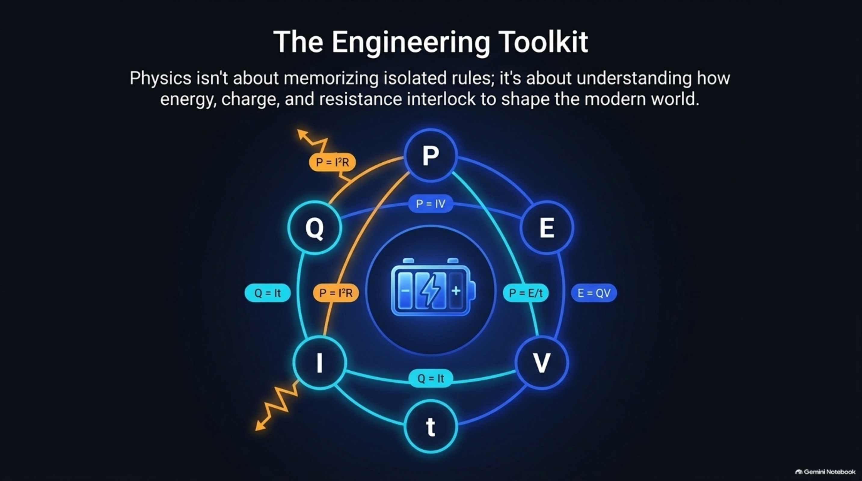
Notes:
[Slide 13: The Engineering Toolkit (Synthesis Equation Map)]
The Engineering Toolkit: Interlocking Equation Synthesis Map
Final consolidation map showing how the fundamental equations connect:
• Q = I × t
• E = Q × V
• P = I × V
• P = I² × R
• P = E / t

