Slide 1
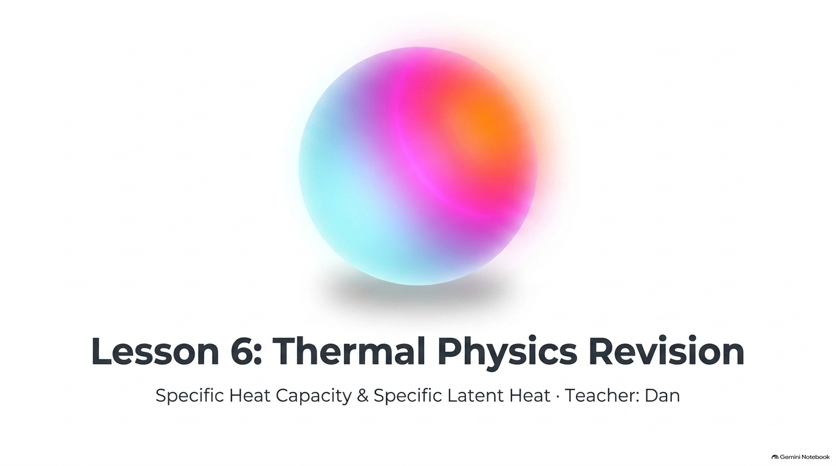
Notes:
Lesson 6: Thermal Physics Revision — Specific Heat Capacity & Latent Heat
Welcome to Lesson 6: Thermal Physics Revision. Today we bring together Specific Heat Capacity (Lesson 5) and Specific Latent Heat (Lesson 4) so students can confidently distinguish between temperature changes within a single state and state changes at constant temperature.

Slide 2
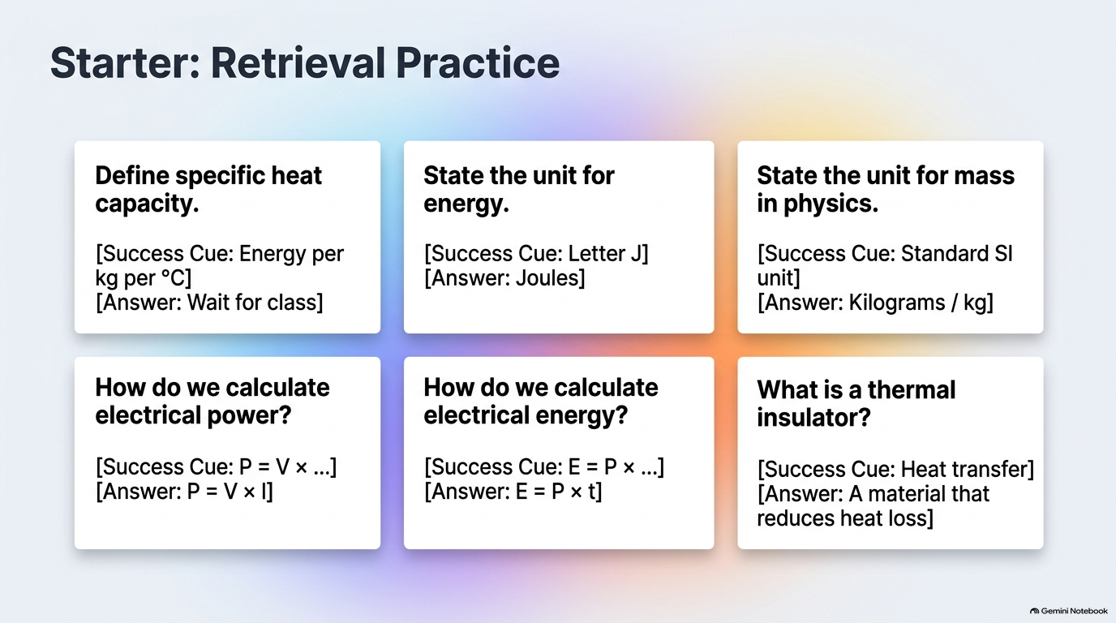
Notes:
Starter: Retrieval Practice
Give students 3 minutes on mini-whiteboards to answer all 6 retrieval prompts using the Success Cues. Click each cell to reveal the answer once the class holds boards up.

Slide 3
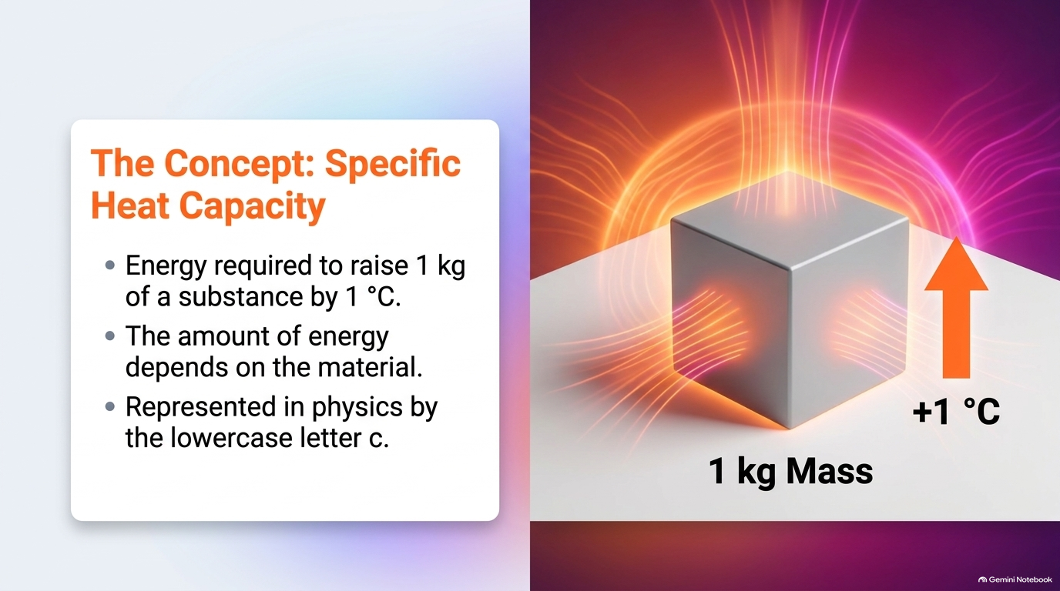
Notes:
Core Concept: Specific Heat Capacity
Contrast 1 kg of copper (c = 385 J/kg°C, heats up rapidly) with 1 kg of water (c = 4200 J/kg°C, requires over 10× more energy per 1 °C rise). Emphasise the three parts of the definition: 1 kg mass, 1 °C temperature rise, energy in Joules.

Slide 4
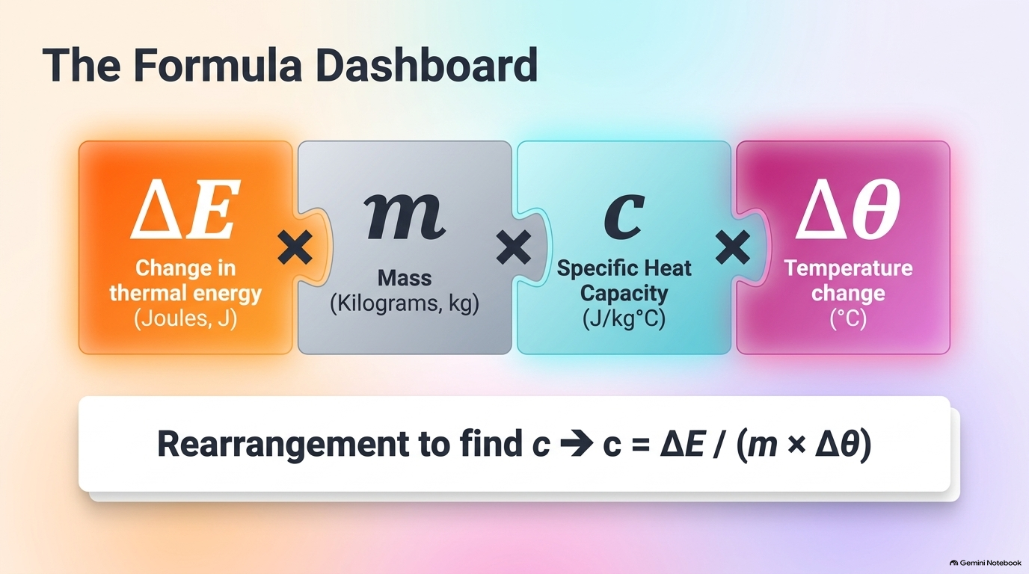
Notes:
Quantifying Thermal Storage: ΔE = m × c × Δθ
Walk through every symbol and unit in ΔE = m × c × Δθ. Remind students to convert grams to kilograms before substituting and to calculate Δθ = final temperature − initial temperature.

Slide 5
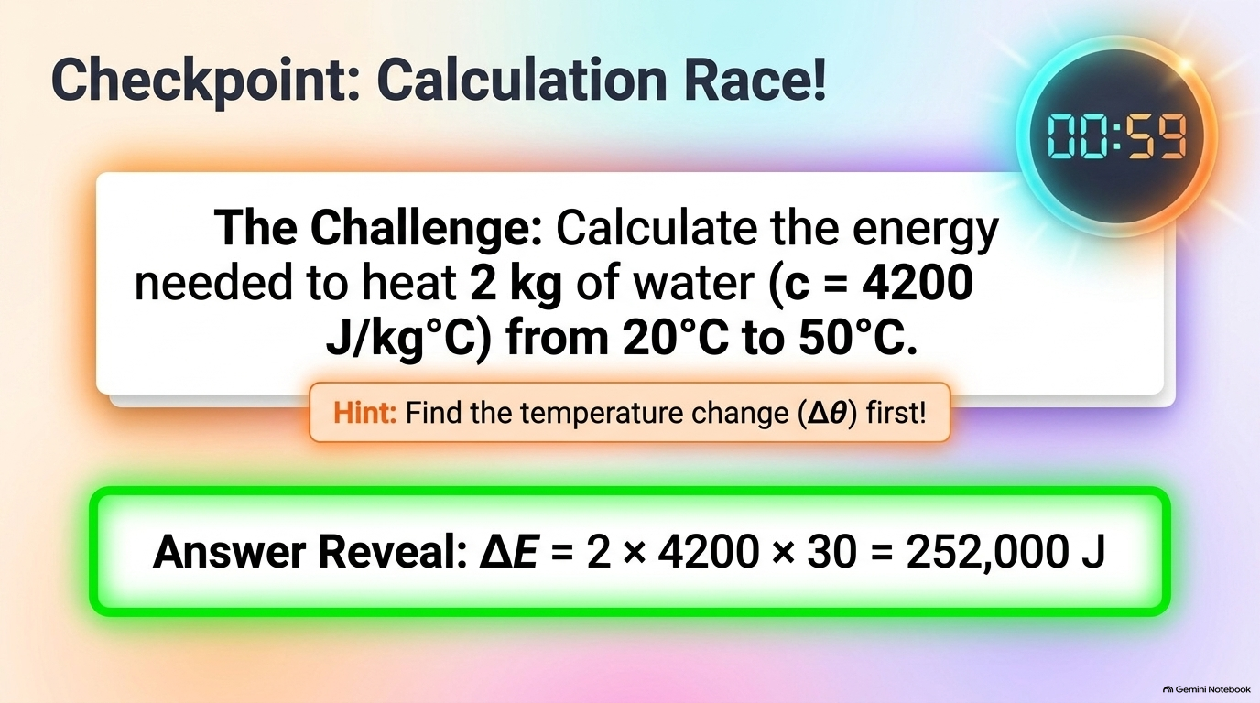
Notes:
Checkpoint: Calculation Race! (Specific Heat Capacity)
60-second calculation sprint! Students find Δθ = 50 − 20 = 30 °C first, then multiply ΔE = 2 × 4200 × 30 = 252,000 J (252 kJ). Click the blurred green reveal bar when ready.

Slide 6
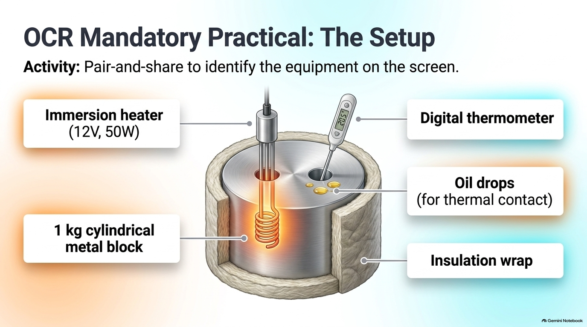
Notes:
OCR Mandatory Practical: Apparatus Setup
Review the required practical circuit and apparatus: 1 kg insulated metal block with two drilled holes, electric immersion heater, thermometer with a drop of oil/water for thermal contact, ammeter in series, voltmeter in parallel, and stopwatch.

Slide 7
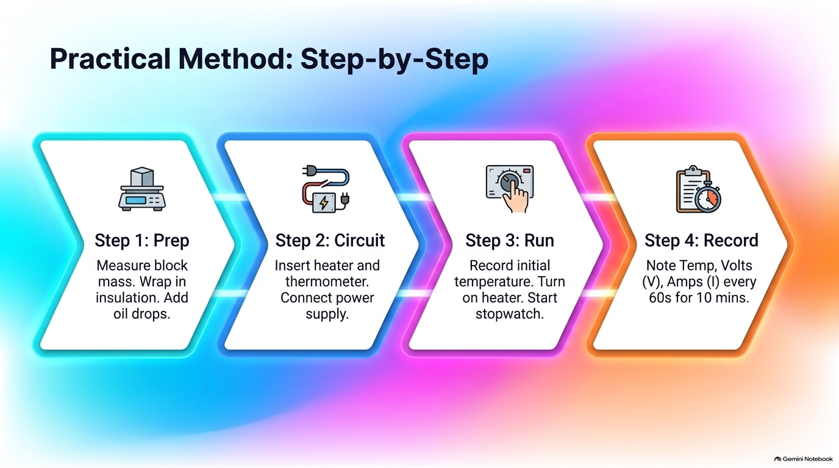
Notes:
Practical Method: Step-by-Step
Check the 4 core steps for 6-mark exam method questions: (1) Measure mass with top-pan balance, (2) Insulate block & record initial temp, (3) Switch on heater & start stopwatch, recording V and I, (4) Record temperature every 60 s for 10 minutes.

Slide 8
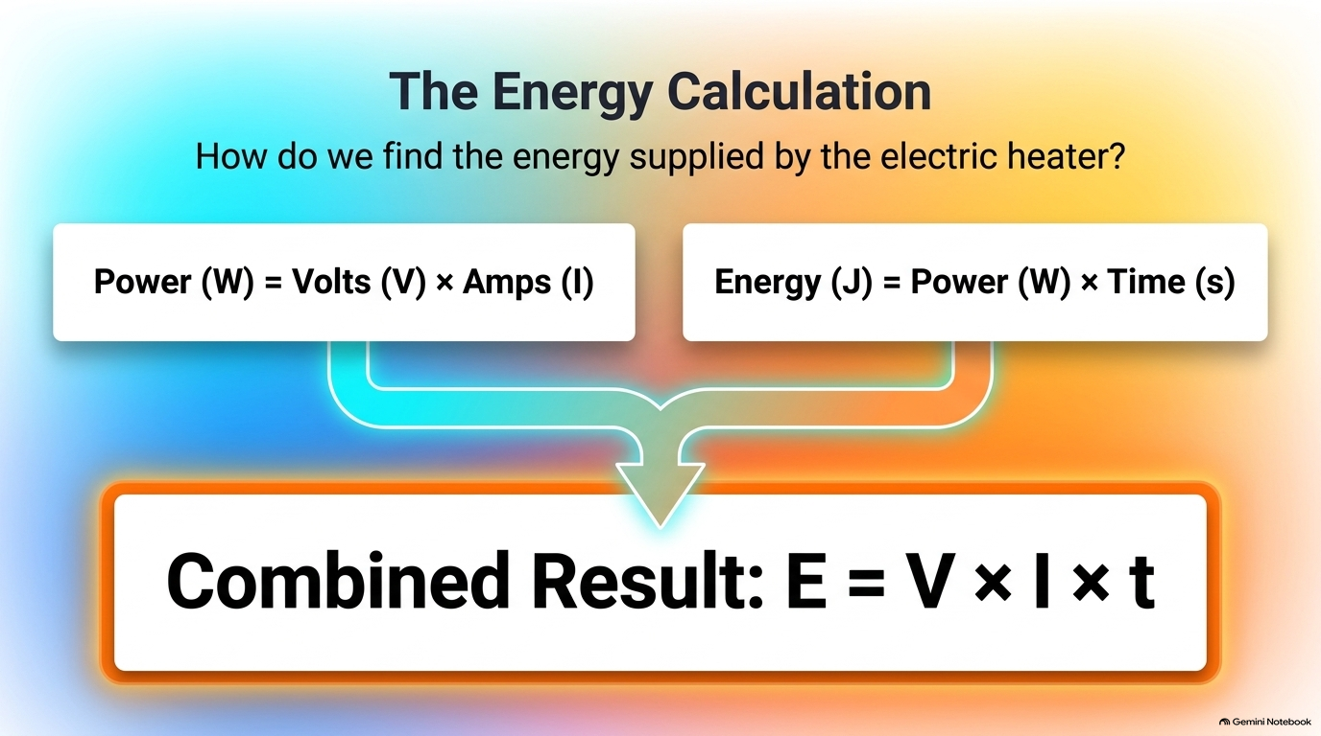
Notes:
Calculating Energy Supplied: E = V × I × t
Connect electrical power P = V × I with E = P × t to form E = V × I × t (with time strictly in seconds!). Then rearrange c = ΔE / (m × Δθ).

Slide 9
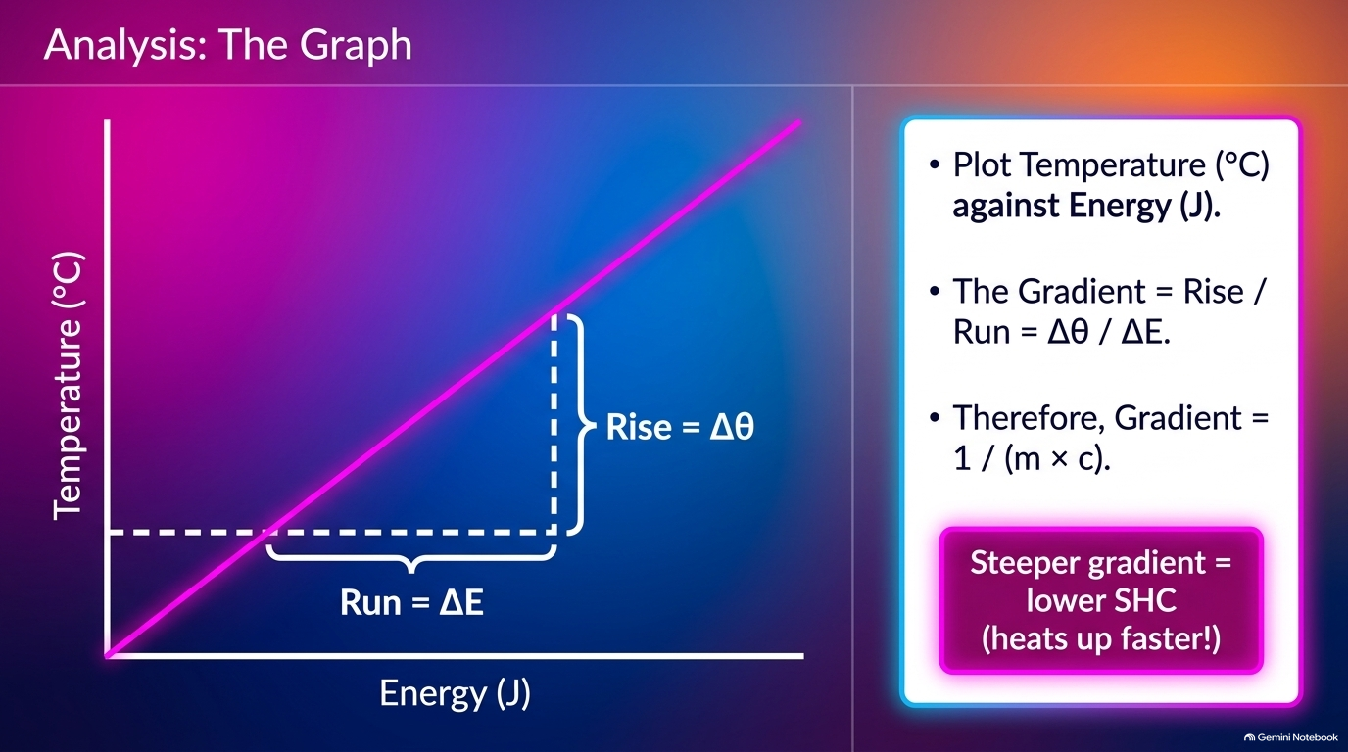
Notes:
Analysing Practical Data: Temperature vs Energy Graph
Highlight why the initial section curves (heater warming up) and why we use the linear steady gradient Δθ / ΔE: gradient = 1 / (m × c), so c = 1 / (m × gradient).

Slide 10
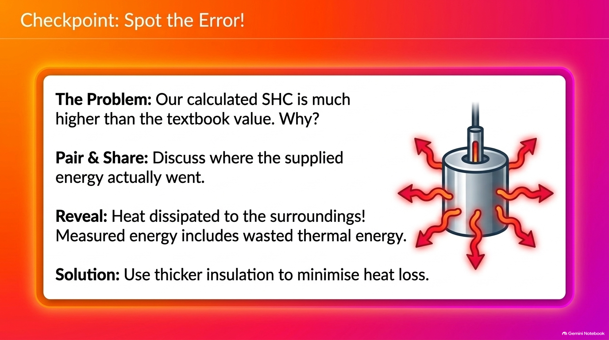
Notes:
Checkpoint: Spot the Practical Error!
Pair & Share: Why is the experimental SHC higher than the textbook value? Reveal 1: Heat escapes to the surroundings, so ΔE measured > ΔE stored in block (or Δθ is smaller than expected). Reveal 2: Wrap thicker insulation and add a lid.

Slide 11
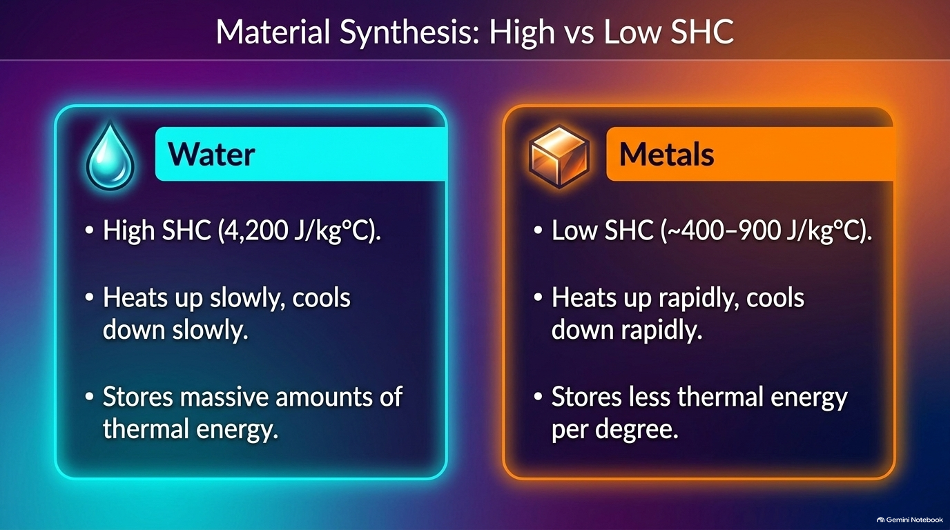
Notes:
Material Synthesis: High SHC vs Low SHC
Compare High SHC materials (water, storage heater bricks — slow to warm, store huge thermal energy) with Low SHC materials (copper saucepans, soldering irons — rapid temperature response).

Slide 12
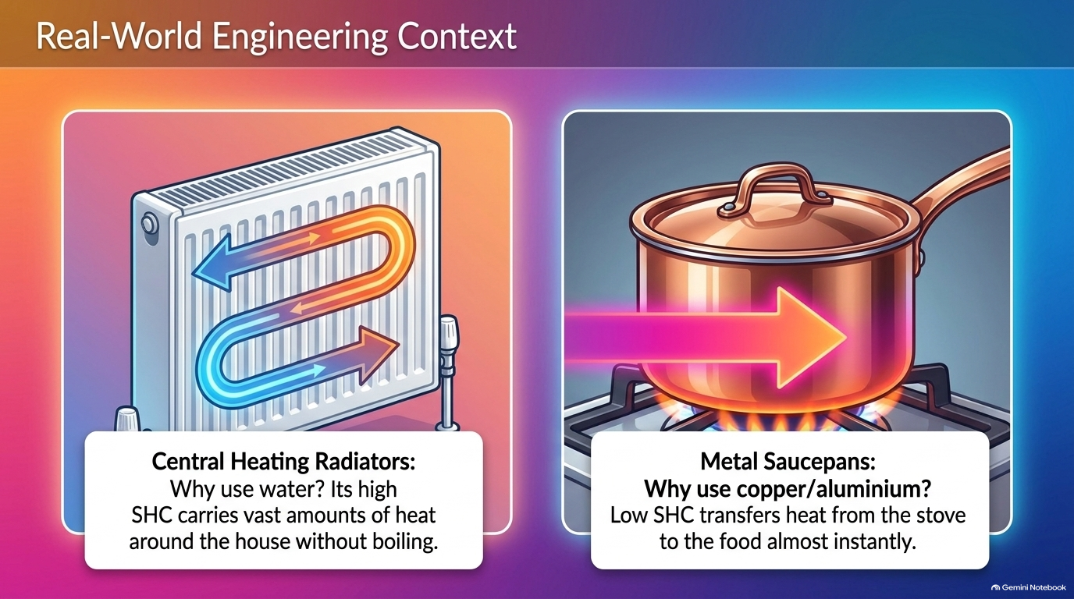
Notes:
Real-World Context: Engineering Thermal Storage
Apply SHC to car engine coolants/radiators (water absorbs large ΔE without boiling) and night storage heaters (high-SHC concrete bricks heated with cheap off-peak electricity release warmth slowly all day).

Slide 13
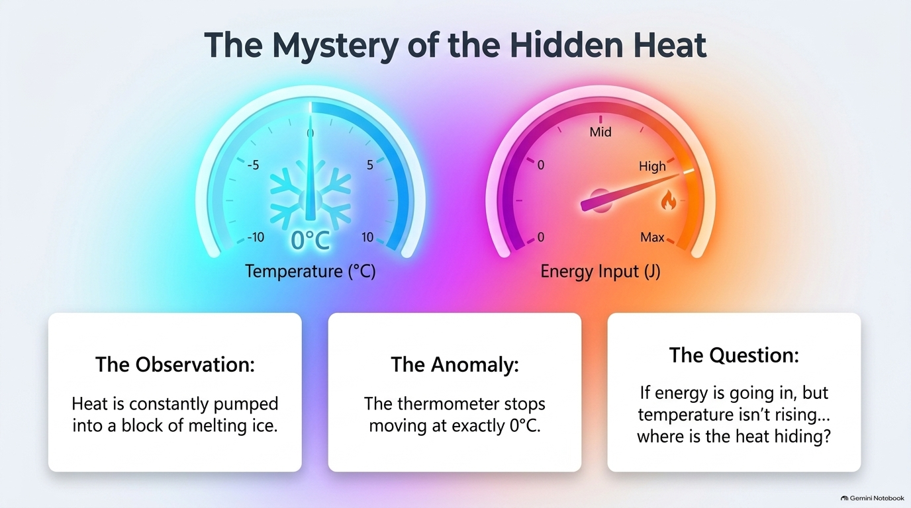
Notes:
Part 2 — The Mystery of the Hidden Heat
Transition from Specific Heat Capacity to Specific Latent Heat! Pose the anomaly: when we keep pumping thermal energy into melting ice at 0 °C, why does the thermometer stop rising?

Slide 14
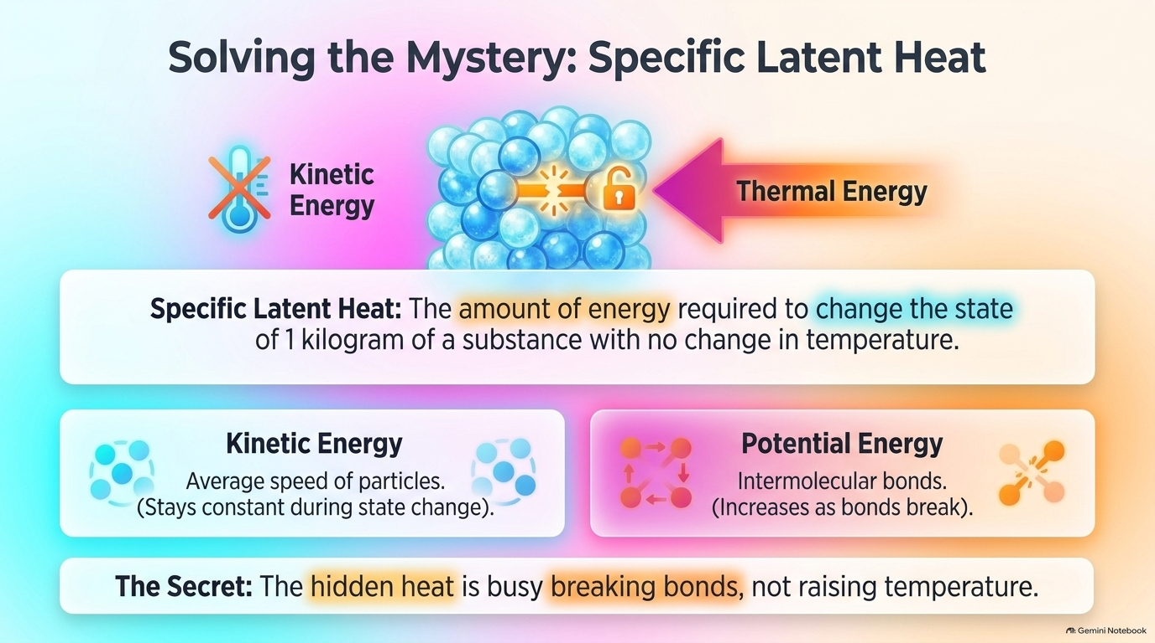
Notes:
Solving the Mystery: Specific Latent Heat
Crucial exam distinction: during a change of state, average Kinetic Energy (and therefore temperature) stays constant, while Potential Energy increases as energy weakens or breaks intermolecular bonds.

Slide 15
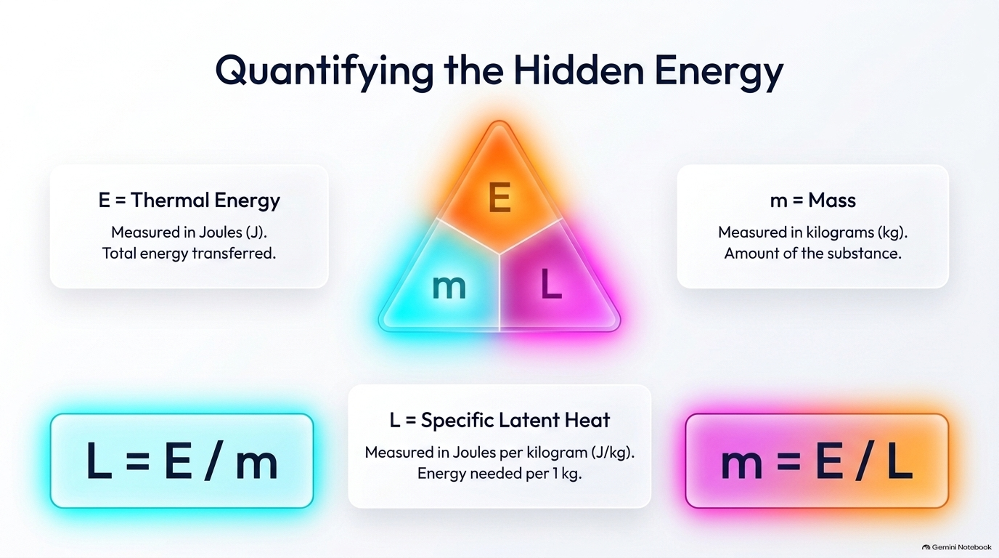
Notes:
Quantifying the Hidden Energy: E = m × L
Notice there is NO Δθ in E = m × L because temperature does not change during a state change! Check units carefully: L is measured in J/kg (not J/kg°C).

Slide 16
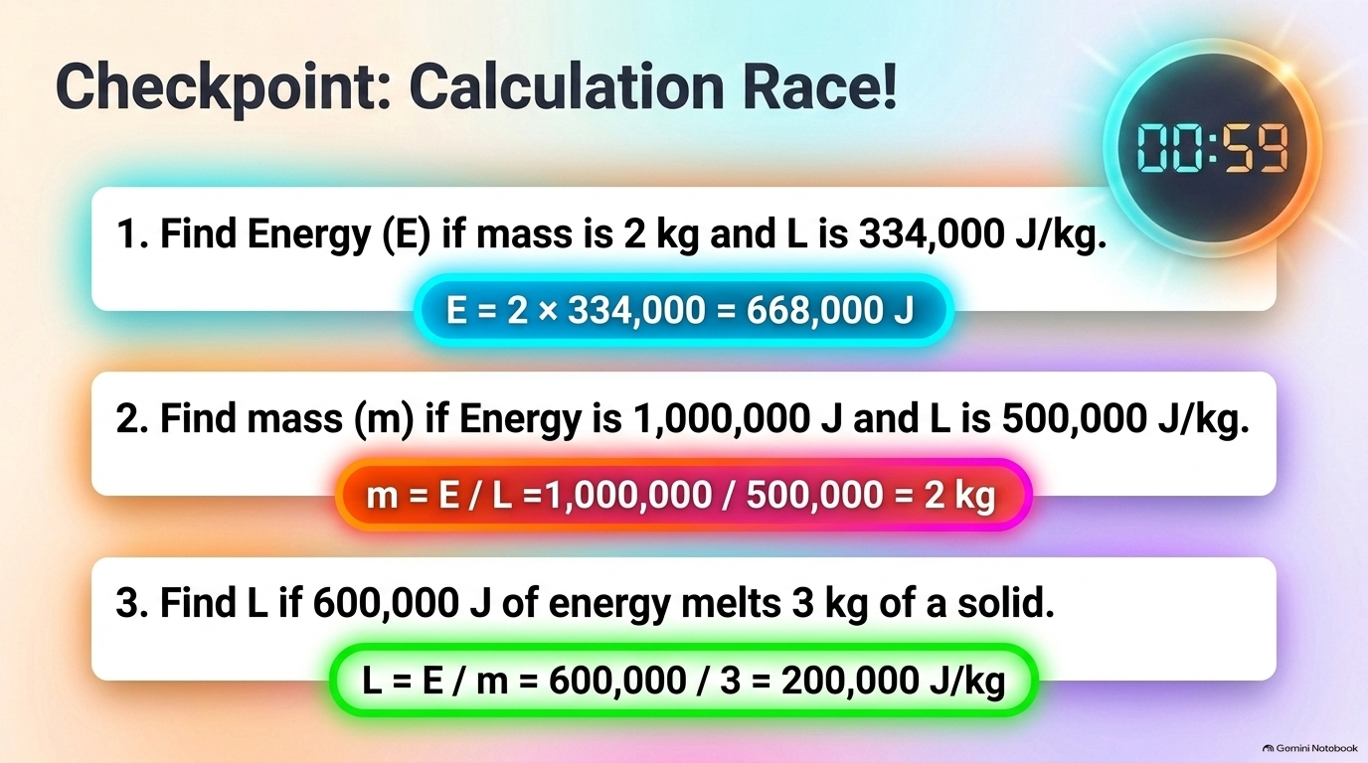
Notes:
Checkpoint: Calculation Race! (Specific Latent Heat)
60-second fluency check across all three rearrangements of E = m × L: (1) E = 668,000 J, (2) m = 2 kg, (3) L = 200,000 J/kg. Click each blurred neon bar to reveal.

Slide 17
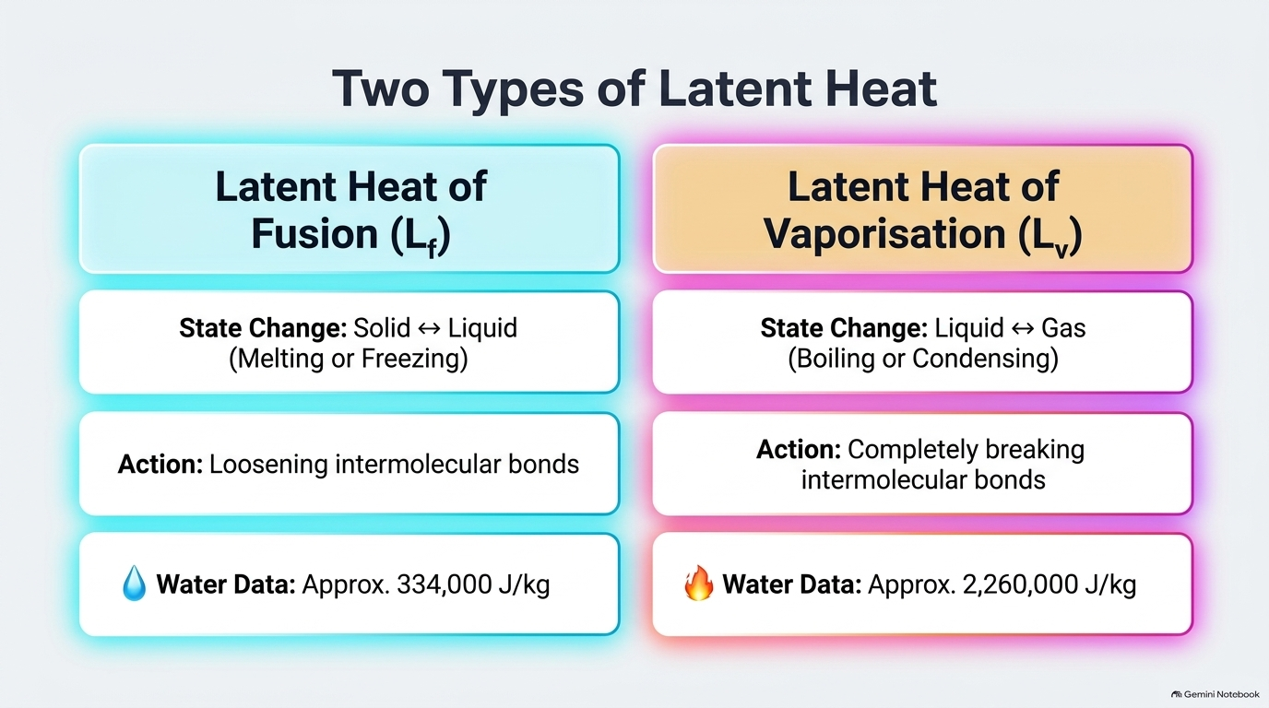
Notes:
Two Types of Latent Heat: Fusion (Lf) vs Vaporisation (Lv)
Distinguish Specific Latent Heat of Fusion (solid ↔ liquid, loosening bonds, 334,000 J/kg for water) from Specific Latent Heat of Vaporisation (liquid ↔ gas, completely breaking bonds, 2,260,000 J/kg for water).

Slide 18
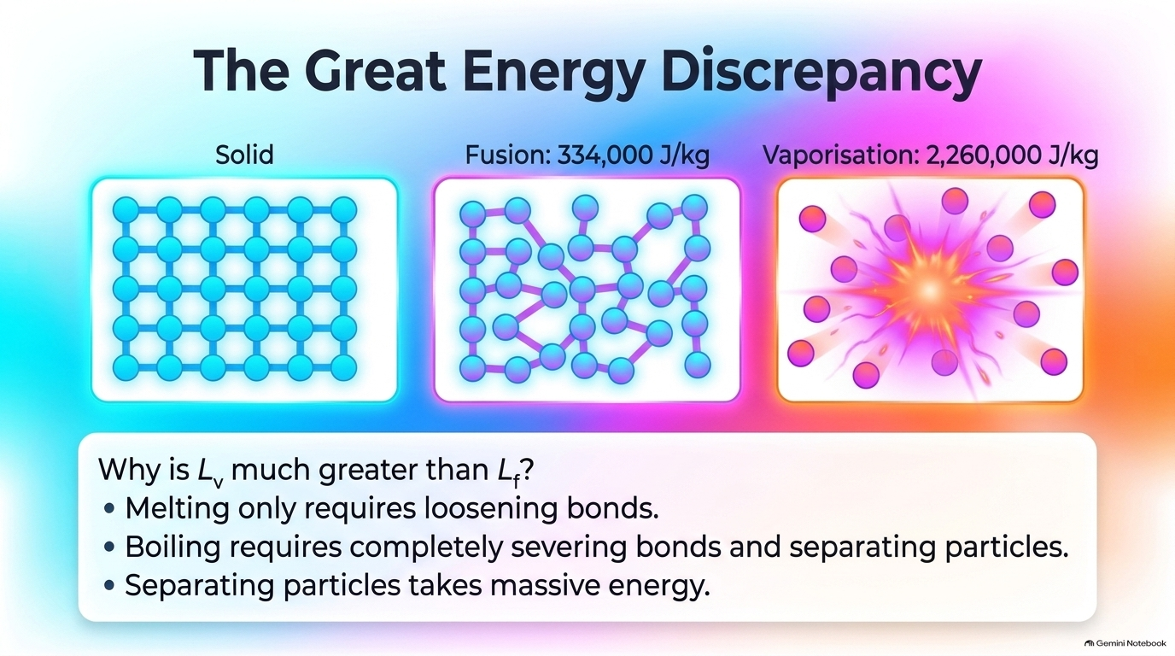
Notes:
The Great Energy Discrepancy: Why Lv > Lf
Explain why Lv is nearly 7× larger than Lf for water: melting only loosens rigid lattice bonds so particles can slide past one another, whereas boiling completely severs intermolecular attractions and pushes particles far apart against atmospheric pressure.

Slide 19
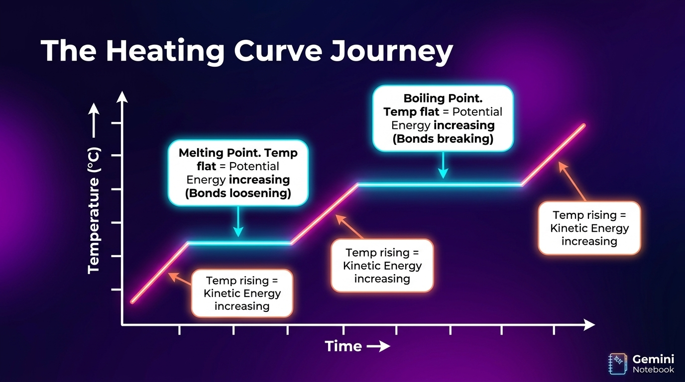
Notes:
The Heating Curve Journey: Kinetic vs Potential Energy
Connect both lessons on one graph! Sloped segments = single state, kinetic energy rising, use ΔE = mcΔθ. Flat plateaus = state change, potential energy rising while temp stays flat, use E = mL.

Slide 20
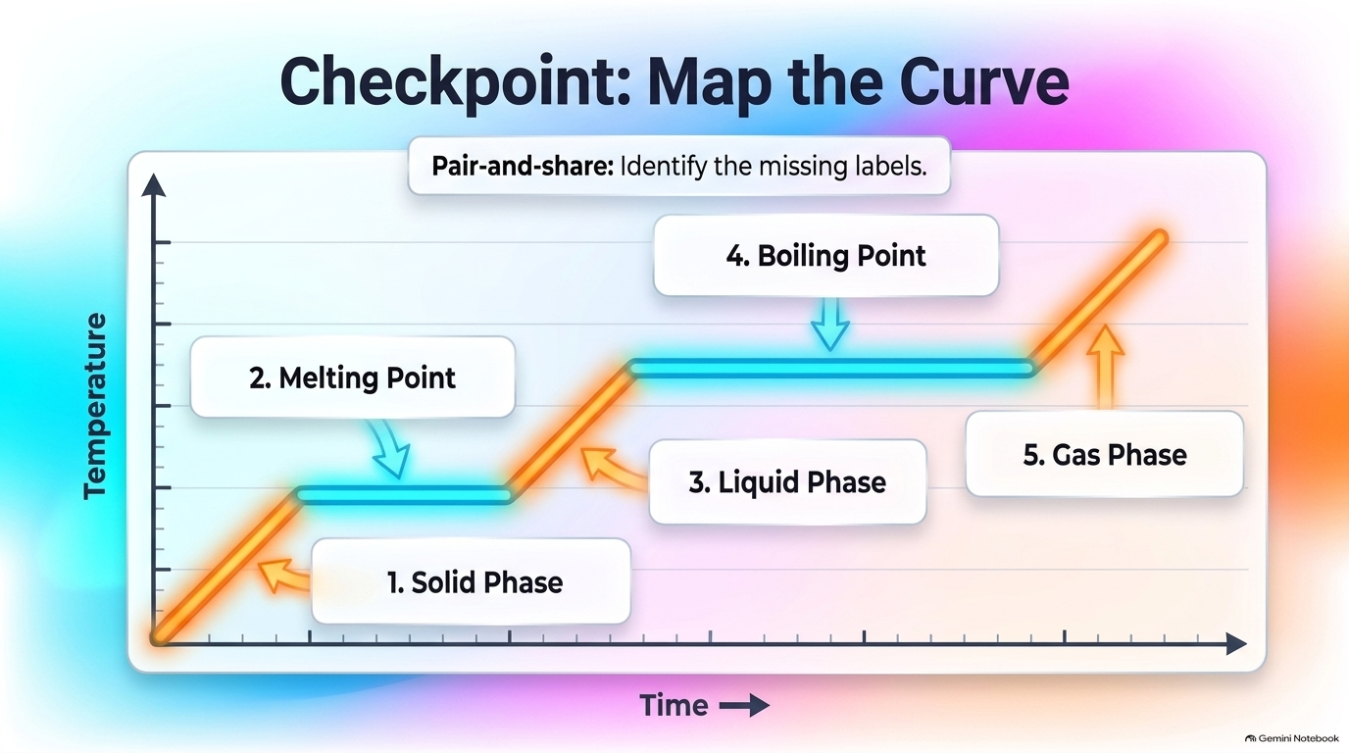
Notes:
Checkpoint: Map the Heating Curve
Pair-and-share checkpoint: students identify all 5 stages (1. Solid Phase, 2. Melting Point, 3. Liquid Phase, 4. Boiling Point, 5. Gas Phase) and state which equation applies to each region. Click each label to unblur.

Slide 21
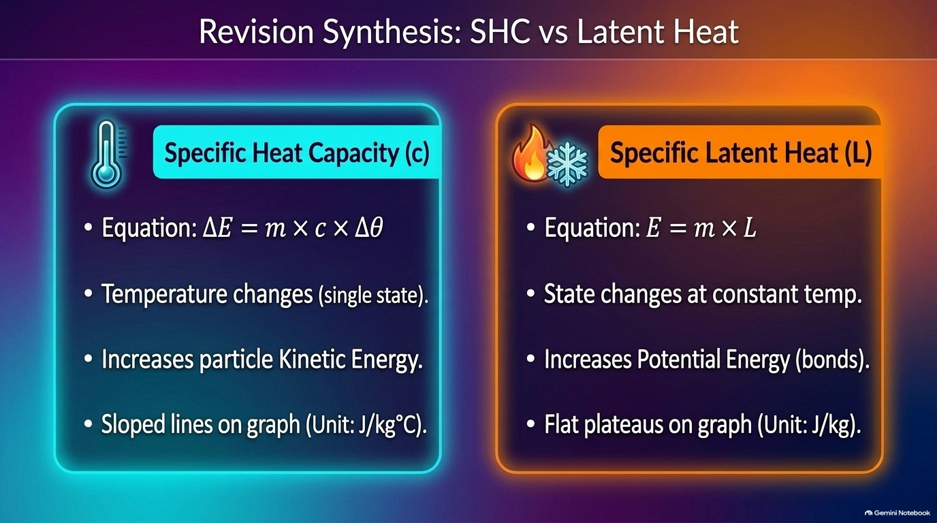
Notes:
Revision Synthesis: Specific Heat Capacity vs Specific Latent Heat
Master side-by-side comparison table for exam revision: SHC (ΔE = mcΔθ, J/kg°C, temperature changes, kinetic energy store, sloped graph lines) vs Latent Heat (E = mL, J/kg, state changes at constant temperature, potential energy store, flat graph plateaus).

Slide 22
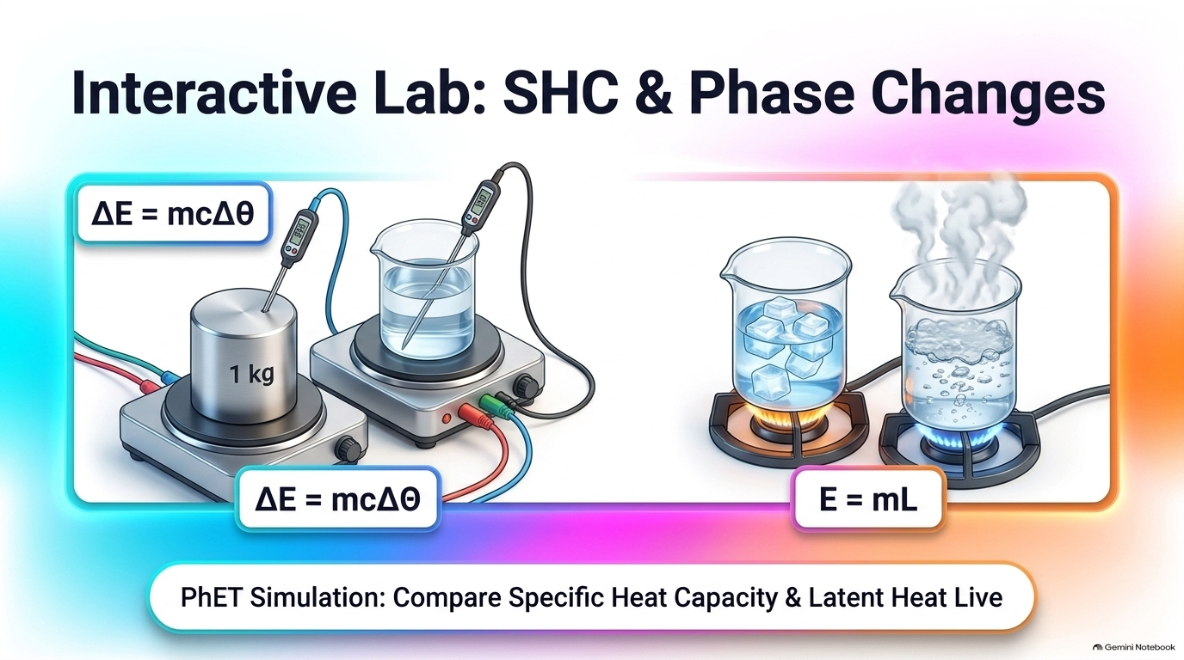
Notes:
Interactive Lab: Specific Heat Capacity & Phase Changes
Launch the embedded PhET Energy Forms and Changes simulation. Link heaters, place thermometers on iron/brick vs water/olive oil, enable Energy Symbols, and demonstrate both rapid heating of low-SHC metals and constant-temperature boiling of water.

Slide 23
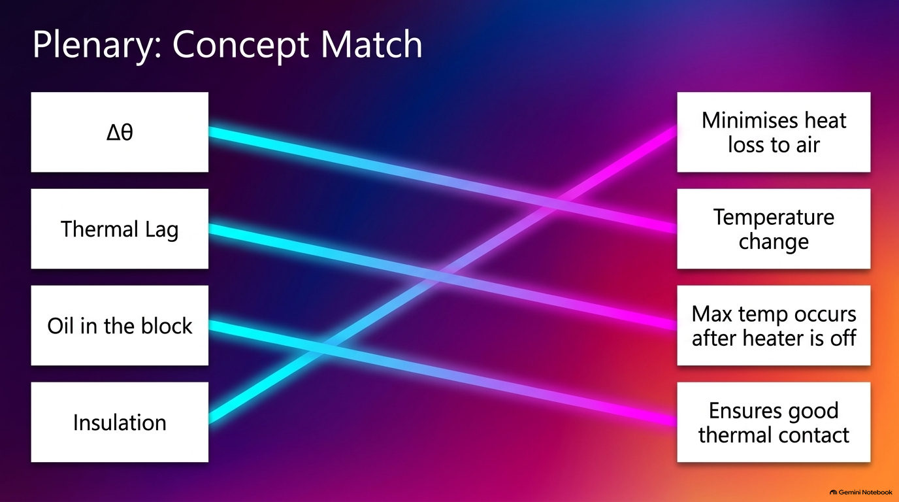
Notes:
Plenary Part 1: SHC Practical Concept Match
Review the 4 core SHC & Mandatory Practical links: High SHC → slow heat/high storage; Low SHC → fast heat/saucepans; Insulation → reduces heat loss; E = V × I × t → electrical energy supplied to heater.

Slide 24
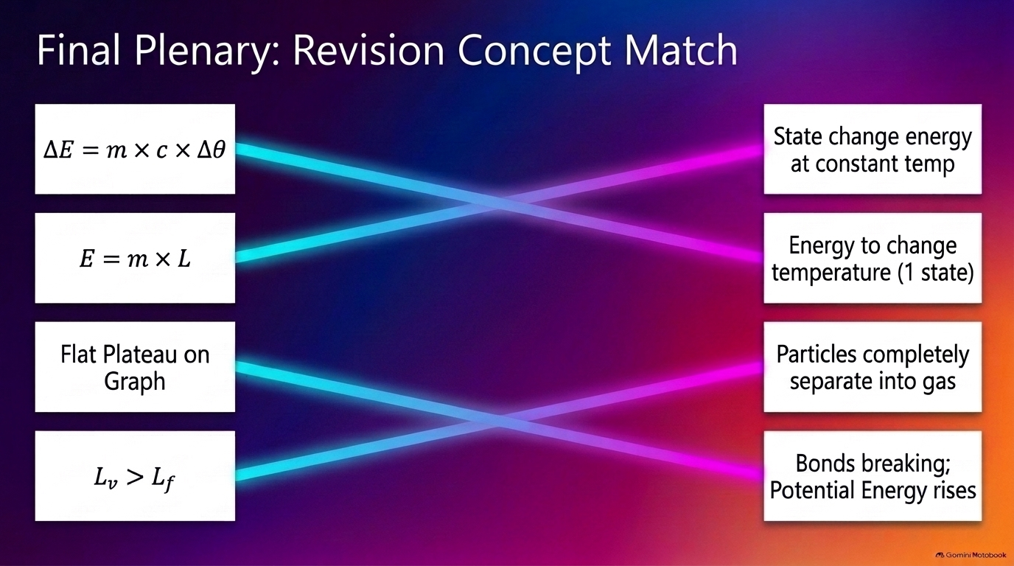
Notes:
Final Plenary: Combined Thermal Physics Concept Match
Exit-ticket synthesis across both lessons: ΔE = mcΔθ ↔ single-state temperature change; E = mL ↔ constant-temperature state change; Flat plateau ↔ bonds breaking & potential energy rising; Lv > Lf ↔ particles completely separating into a gas.

