Slide 1
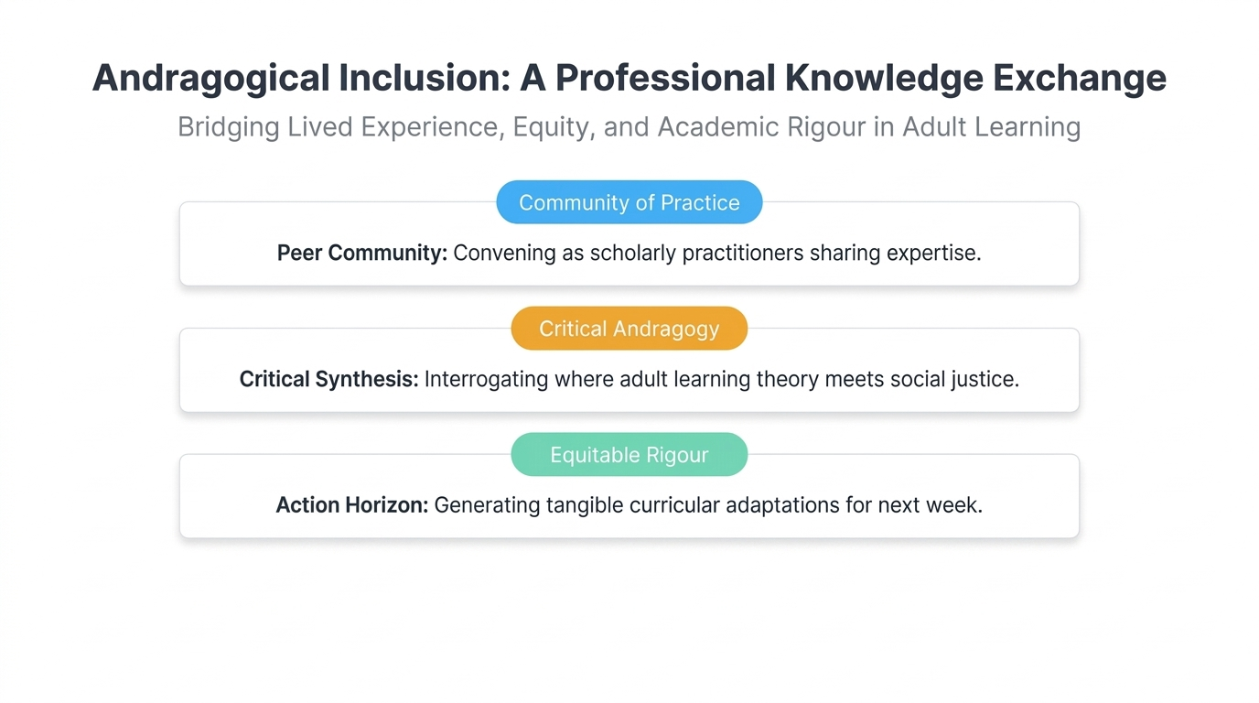
Notes:
Andragogical Inclusion: A Professional Knowledge Exchange
Welcome colleagues. Emphasise that this room holds decades of front-line pedagogical wisdom. We are not delivering a deficit-model training session; we are interrogating institutional assumptions together to elevate learning for every adult.

Slide 2
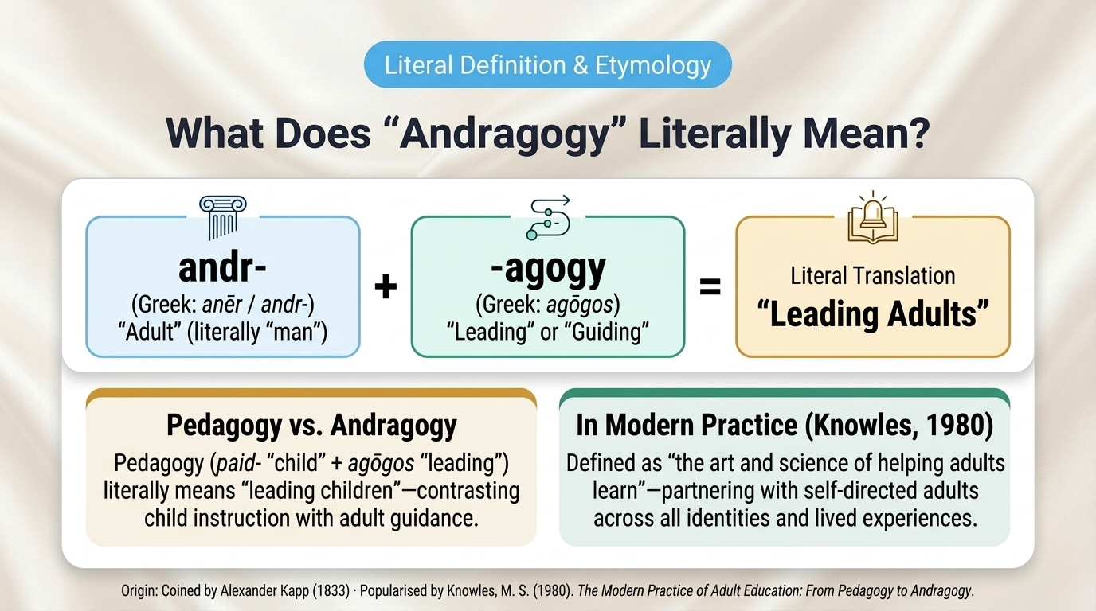
Notes:
What Does “Andragogy” Literally Mean?
Unpack the literal Greek etymology immediately after our plain-English red-pen translation on Slide 1: 'andr-' (from Greek anēr/andr-, meaning 'adult' or literally 'man') + '-agogy' (agōgos, 'leading' or 'guiding') literally translates to 'leading adults'—coined by Alexander Kapp (1833) in direct contrast to 'pedagogy' (paid- 'child' + agōgos 'leading' = 'leading children'). Note too the critical equity point embedded in the literal root 'man': modern inclusive andragogy (Knowles, 1980) must intentionally serve adults across all identities and lived realities.

Slide 3
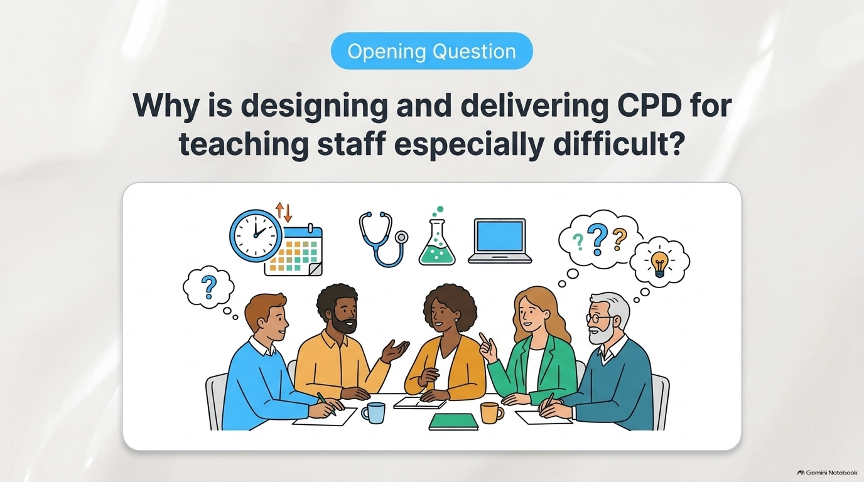
Notes:
Opening Question: Why is designing and delivering CPD for teaching staff especially difficult?
Invite brief paired or whole-room reflections. Teaching staff are themselves expert adult learners juggling acute time poverty, diverse disciplinary cultures, and varied career stages—which means generic, top-down compliance training immediately alienates the room.

Slide 4
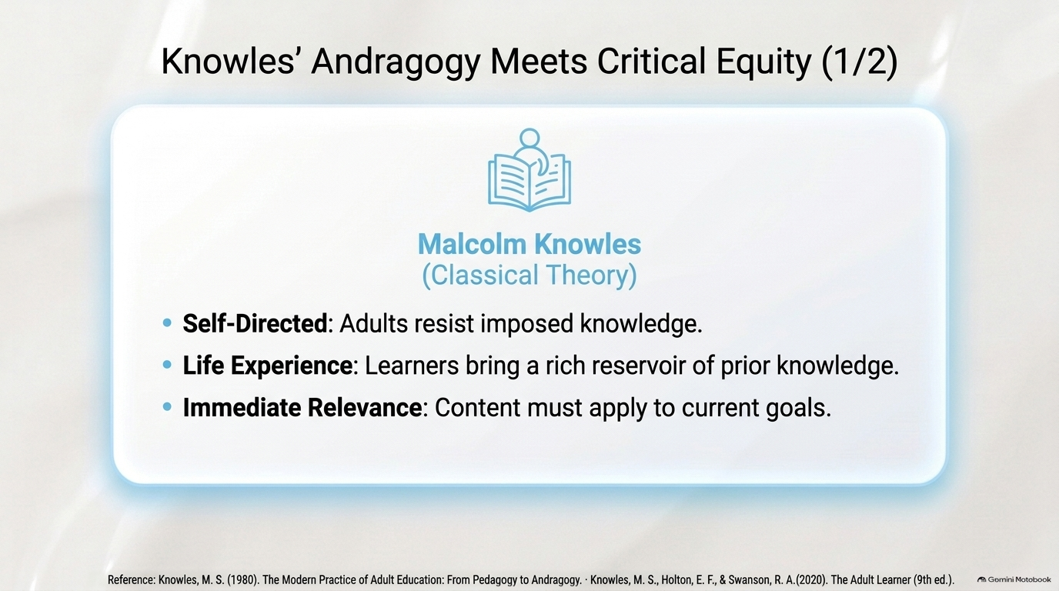
Notes:
Knowles’ Andragogy Meets Critical Equity (1/2) — Malcolm Knowles (Classical Theory)
Knowles’ classical theory of andragogy centres on three pillars—and our own staff CPD feedback illustrates each one:
1. Self-Direction & Learner Autonomy: “Would like more time to talk and share experience.” / “Open forum to share struggles in the role.” / “Talked about what we need, relevant, current.” — Key message: There was a clear preference for greater participant-led discussion, peer sharing and opportunities for staff to shape CPD around identified needs.
2. Life Experience & Prior Knowledge: “Nothing new.” / “Take into account prior knowledge.” / “We are doing things quite well already.” / “Some elements did not offer additional learning as I already do these.” — Key message: CPD did not always sufficiently recognise, build upon or extend participants’ existing knowledge and professional expertise.
3. Immediate Relevance & Practical Application: “I would like to have more examples… Maybe using real-life case studies.” / “Not hugely engaging… would be better as a half-day CPD with more practical elements.” — Key message: Staff wanted more practical activity, authentic examples and case studies, with content more closely connected to immediate workplace challenges.
Reference: Knowles, M. S. (1980). The Modern Practice of Adult Education: From Pedagogy to Andragogy. · Knowles, M. S., Holton, E. F., & Swanson, R. A. (2020). The Adult Learner (9th ed.).

Slide 5
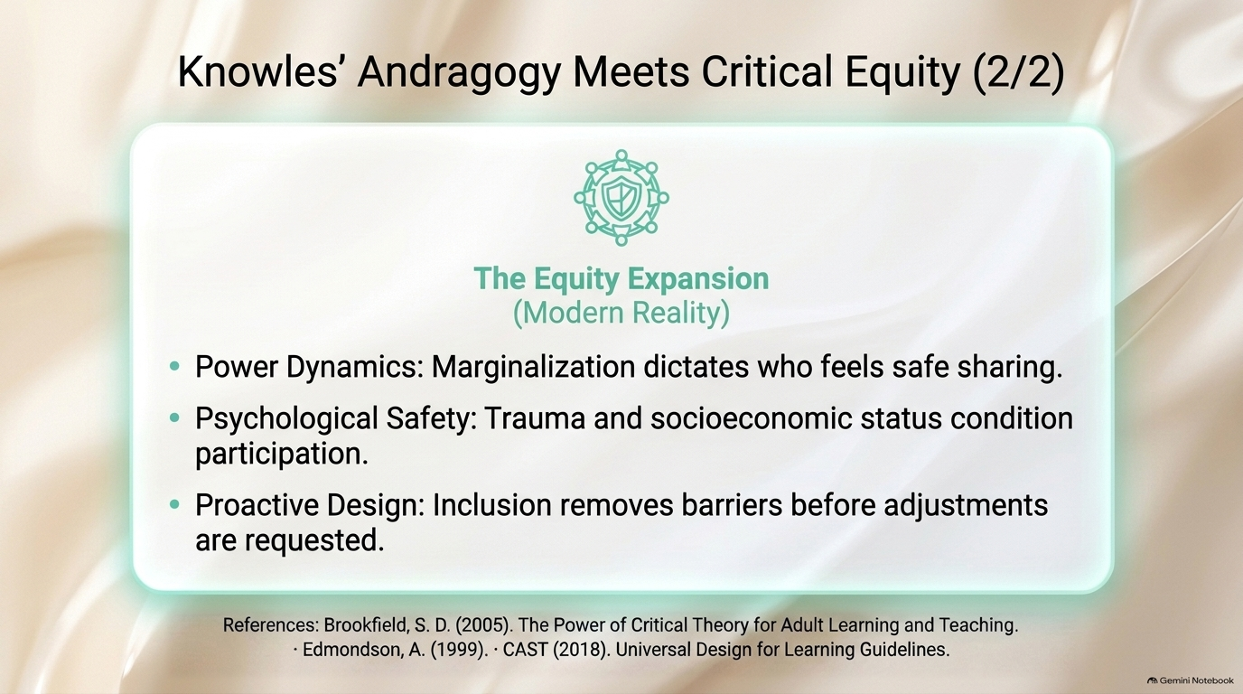
Notes:
Knowles’ Andragogy Meets Critical Equity (2/2) — The Equity Expansion (Modern Reality)
Knowles assumed an unencumbered, autonomous adult. In modern reality, power dynamics dictate who feels safe sharing (Brookfield, 2005), trauma and socioeconomic precarity condition participation and psychological safety (Edmondson, 1999), and proactive inclusive design must remove barriers before adjustments are requested (CAST, 2018).

Slide 6
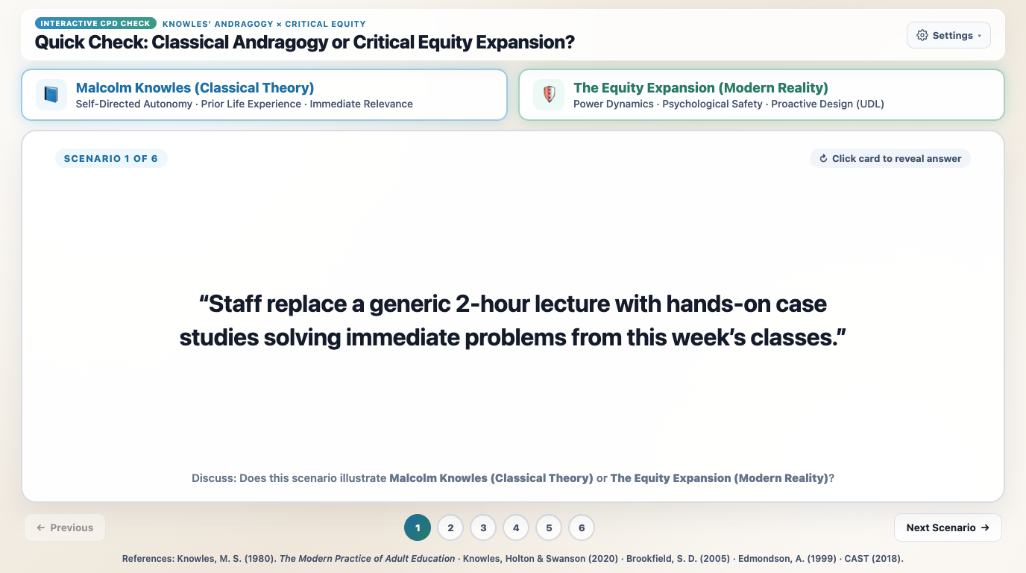
Notes:
Quick Check: Classical Andragogy or Critical Equity Expansion?
Run this 2-minute interactive check with CPD attendees. In Mode 1 (Lens Classifier), invite tables or the whole room to classify each of the 6 teaching scenarios into either Malcolm Knowles' Classical Andragogy or The Equity Expansion, then click 'Check Answers' to unpack the academic rationale. Optionally switch to Mode 2 (Diagnostic Quiz) to test applied redesign decisions.

Slide 7
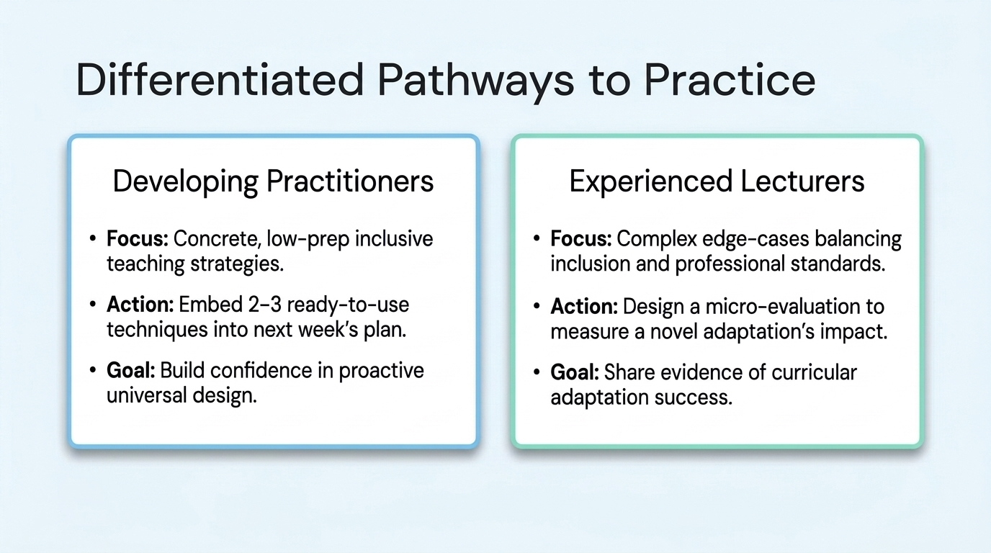
Notes:
Differentiated Pathways to Practice
Highlight that experienced teachers need space to wrestle with complex edge cases, while newer colleagues benefit from immediate, high-leverage procedural templates.

Slide 8
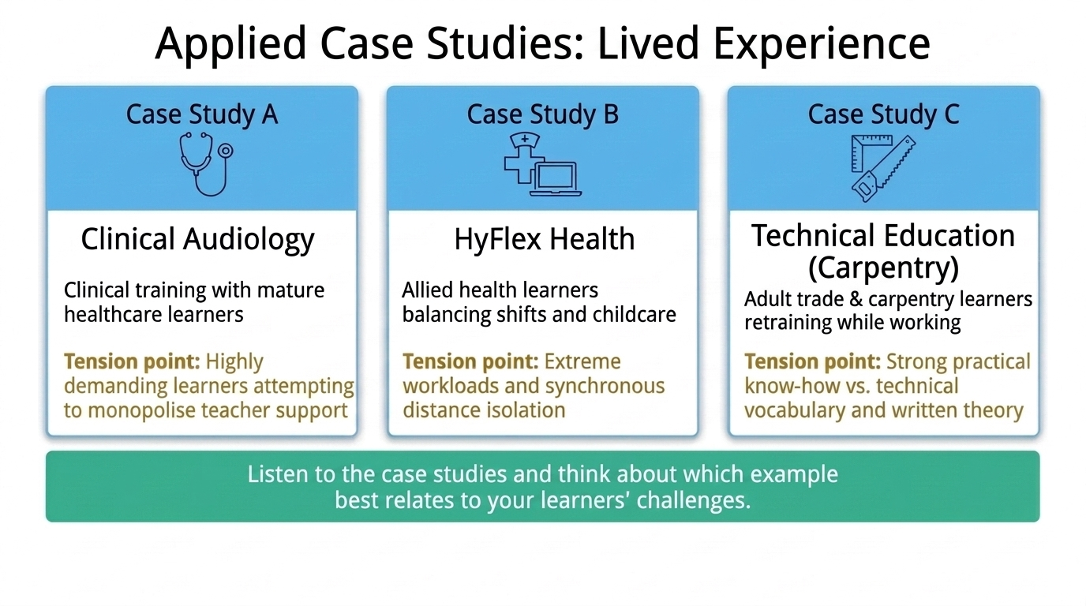
Notes:
Applied Case Studies: Lived Experience
Invite colleagues to listen to the three lived-experience case studies—Clinical Audiology, HyFlex Health, and Technical Education (Carpentry)—and reflect on which scenario best mirrors their own learners' challenges.

Slide 9

Notes:
Case Study A (1/4): Making a Cohort
Case Study A (1/4): Introduce the clinical audiology and health professions cohort-building protocol ('Making a cohort'), designed to establish psychological safety and peer belonging from Day 1.

Slide 10
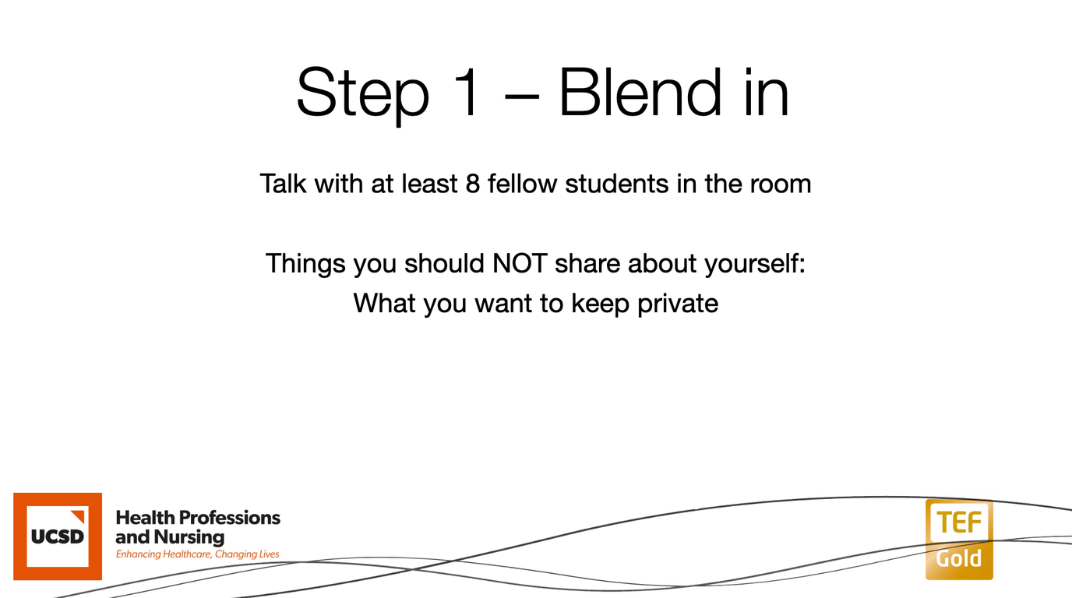
Notes:
Case Study A (2/4): Step 1 – Blend In
Case Study A (2/4): Step 1 – Blend in. Learners speak with at least 8 fellow students in the room while explicitly protecting personal boundaries ('Things you should NOT share about yourself: What you want to keep private').

Slide 11
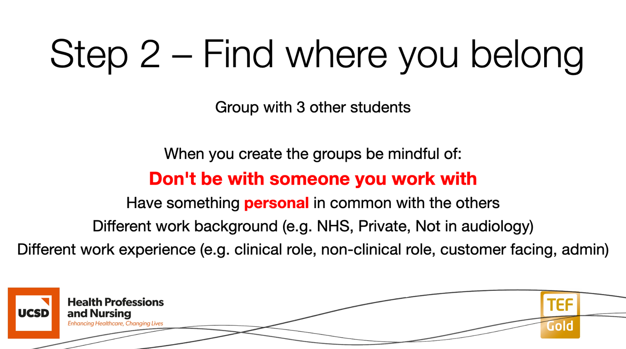
Notes:
Case Study A (3/4): Step 2 – Find Where You Belong
Case Study A (3/4): Step 2 – Find where you belong. Learners form groups of 4 with colleagues they do not work with, finding something personal in common while intentionally mixing work backgrounds (NHS, Private, Not in audiology) and roles (clinical, non-clinical, customer-facing, admin).

Slide 12
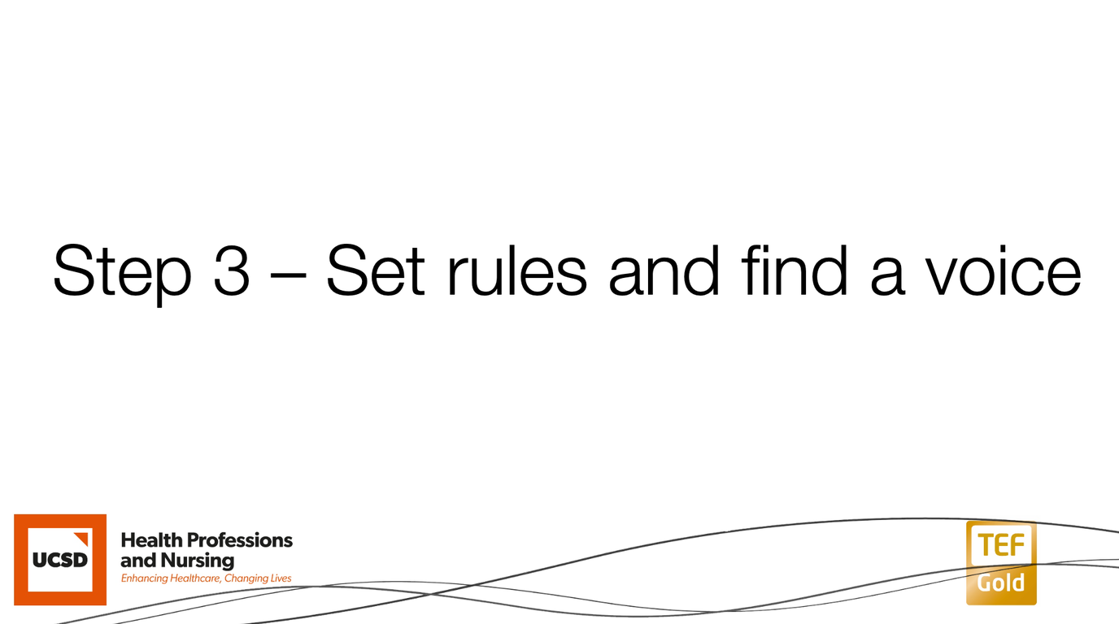
Notes:
Case Study A (4/4): Step 3 – Set Rules and Find a Voice
Case Study A (4/4): Step 3 – Set rules and find a voice. Groups co-construct their shared ground rules and establish an equitable voice within the cohort before high-stakes clinical and academic activities begin.

Slide 13
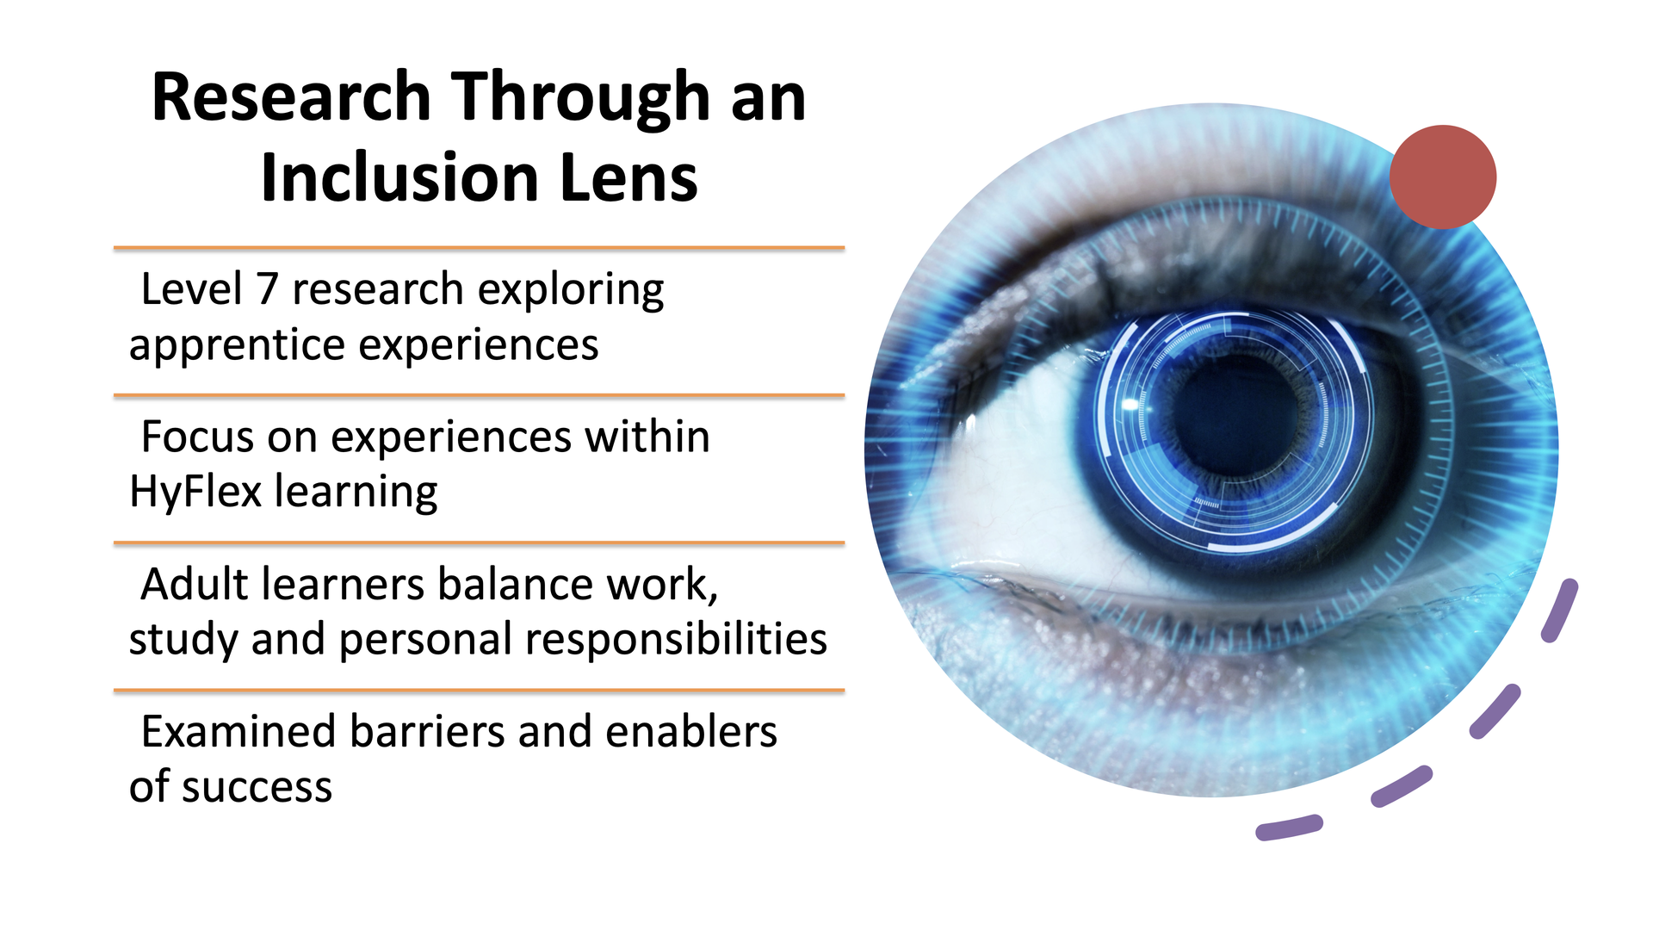
Notes:
Case Study B (1/6): Research Through an Inclusion Lens
Summarise methodology, participants and purpose. Explain the inclusion lens and adult learner context.

Slide 14
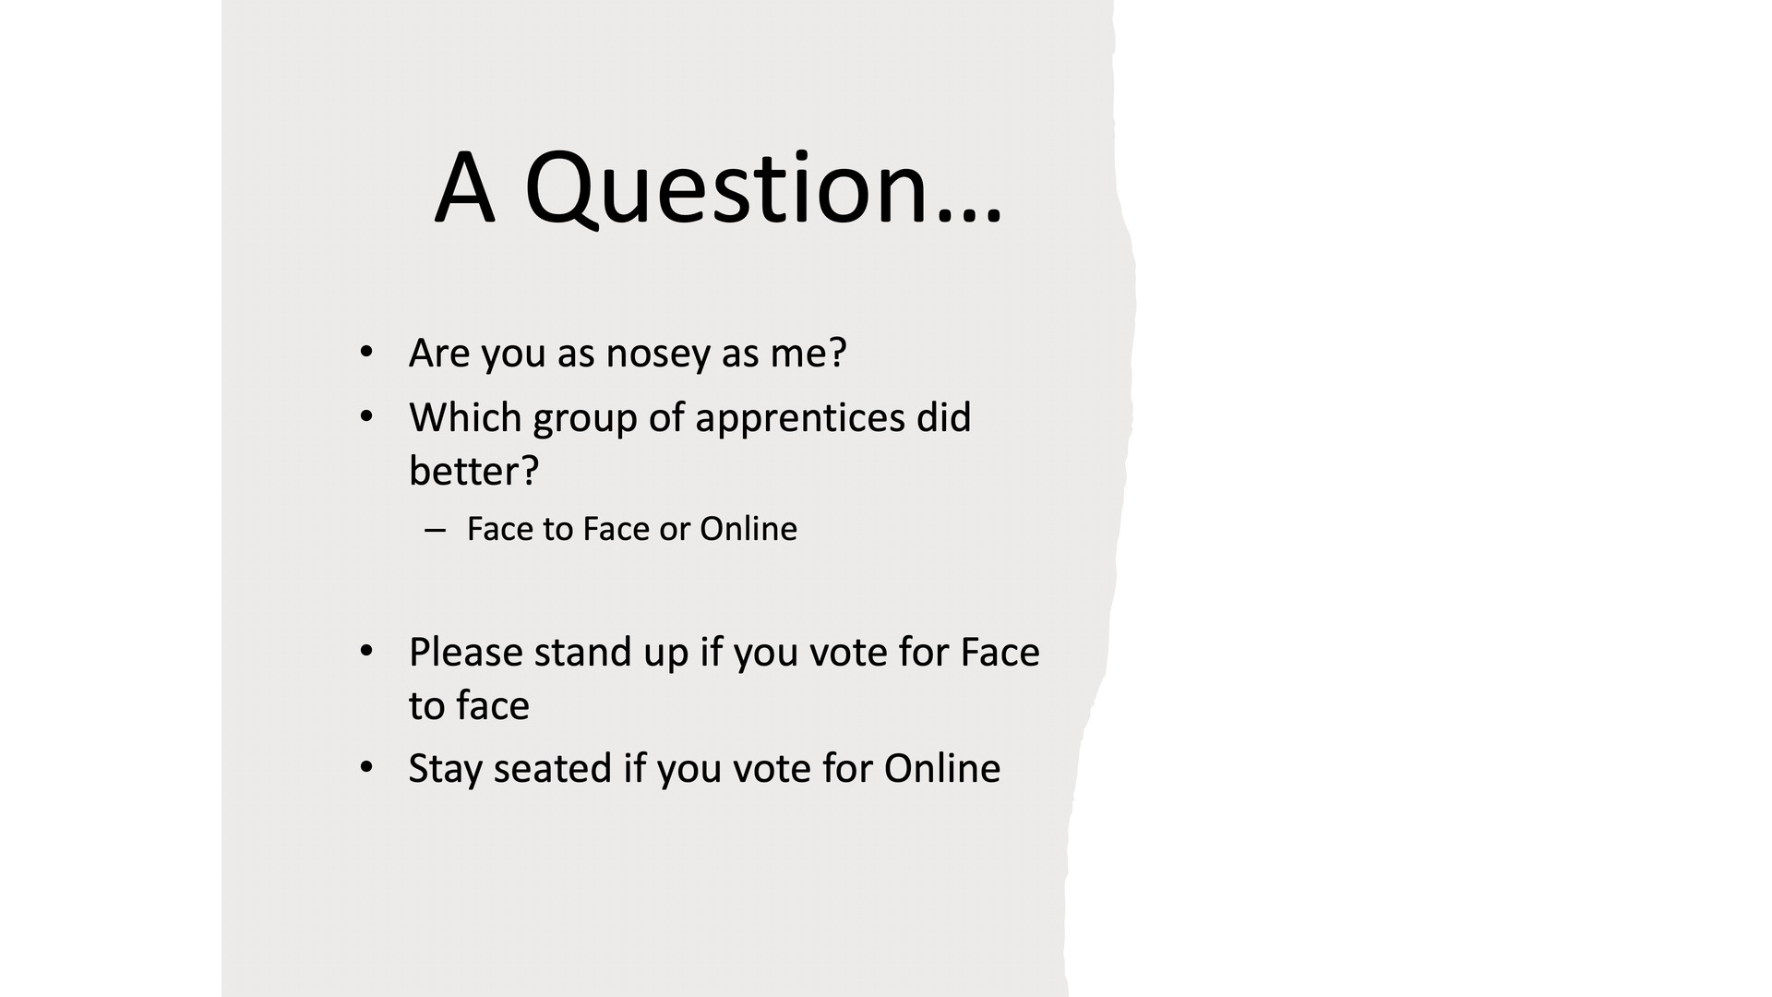
Notes:
Case Study B (2/6): A Question… Face to Face or Online?
Invite the room to vote physically: stand up if you think Face-to-Face apprentices performed better, or stay seated if you think Online apprentices performed better.

Slide 15
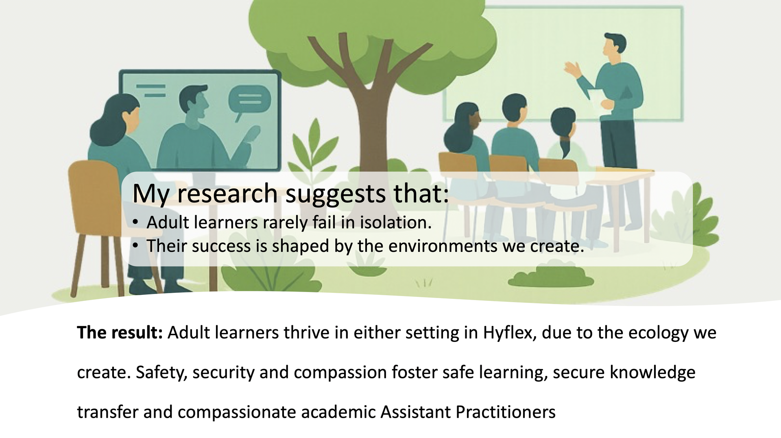
Notes:
Case Study B (3/6): Research Findings — Learning Environments & Ecology
Share the core research finding: adult learners rarely fail in isolation—their success is shaped by the environments we create. In HyFlex, adult learners thrive in either modality when safety, security, and compassion anchor the learning ecology.

Slide 16
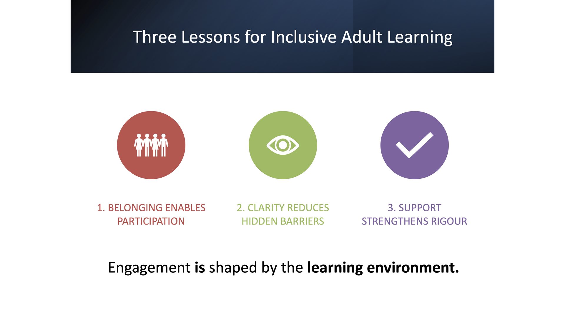
Notes:
Case Study B (4/6): Three Lessons for Inclusive Adult Learning
Discuss belonging, clarity and support. Emphasise these are conditions that enable participation and success. From interview, establish a connection, ask questions beyond the standard (are there children at home, who is able to support you at work and at home, are you prepared for what is about to happen?). Be clear on expectations in the learning environment, particularly online (noise), formal/informal support, anxieties, community of learning ('sharing is caring, safe space and room to grow'), and academic rules and regulations.

Slide 17
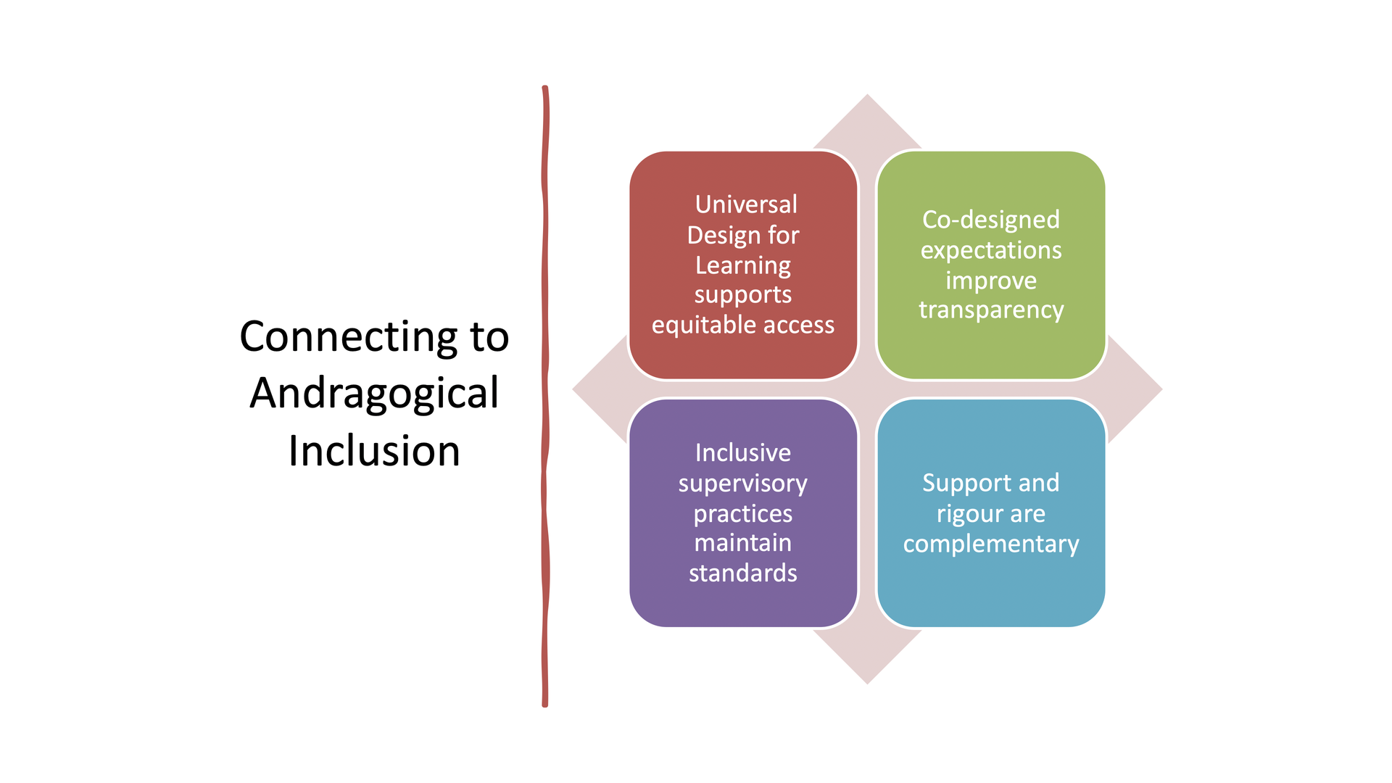
Notes:
Case Study B (5/6): Connecting to Andragogical Inclusion
Link findings to UDL, HyFlex approaches and co-designed norms. Highlight equity without compromising standards.

Slide 18
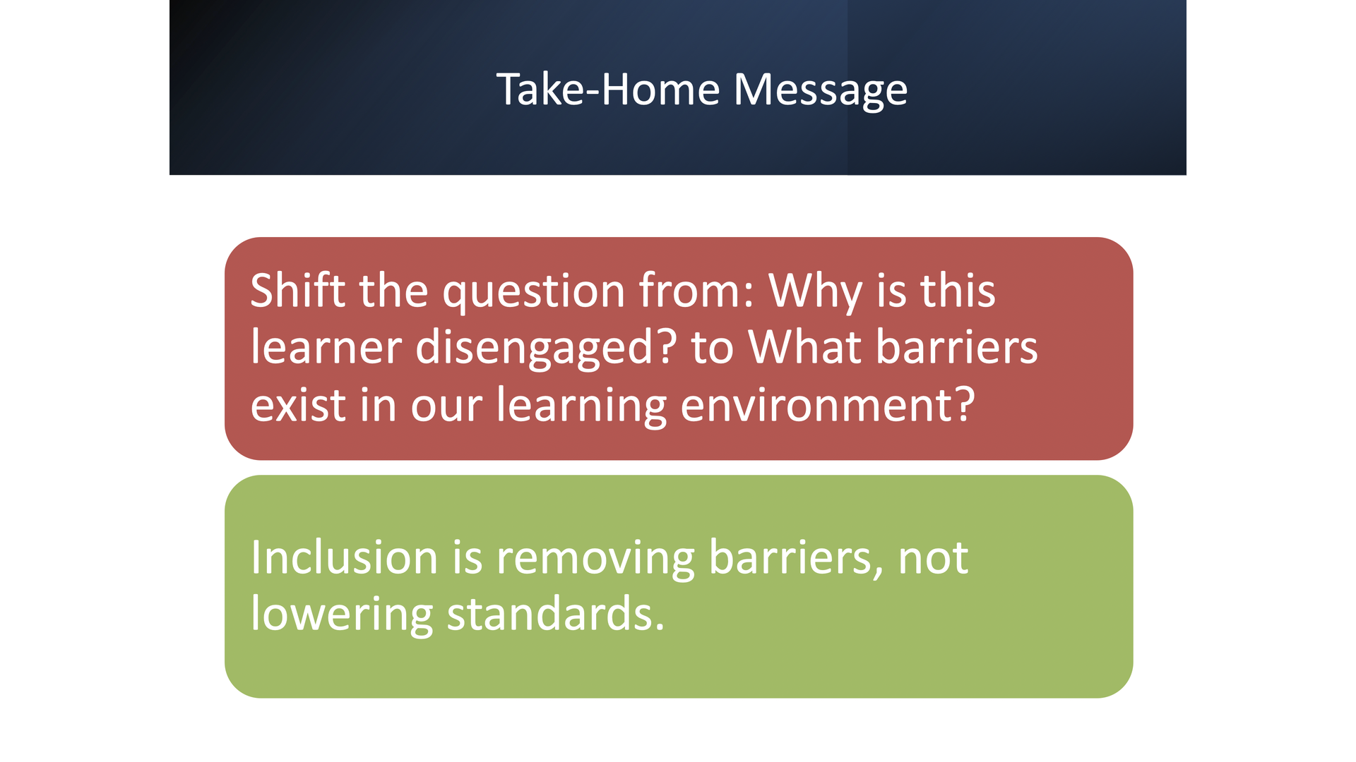
Notes:
Case Study B (6/6): Take-Home Message
Leave audience with reflective questions and a strong concluding message about inclusion and academic rigour: shift from 'Why is this learner disengaged?' to 'What barriers exist in our learning environment?' Inclusion is removing barriers, not lowering standards.

Slide 19
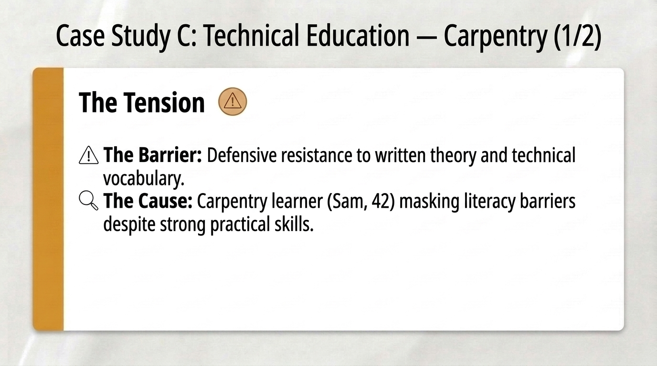
Notes:
Case Study C: Technical Education — Carpentry (1/2) — The Tension
Case Study C (Part 1): Examine how adult trade and carpentry learners like Sam (42), who possess strong tacit workshop mastery, may mask technical literacy barriers behind resistance to written theory.

Slide 20
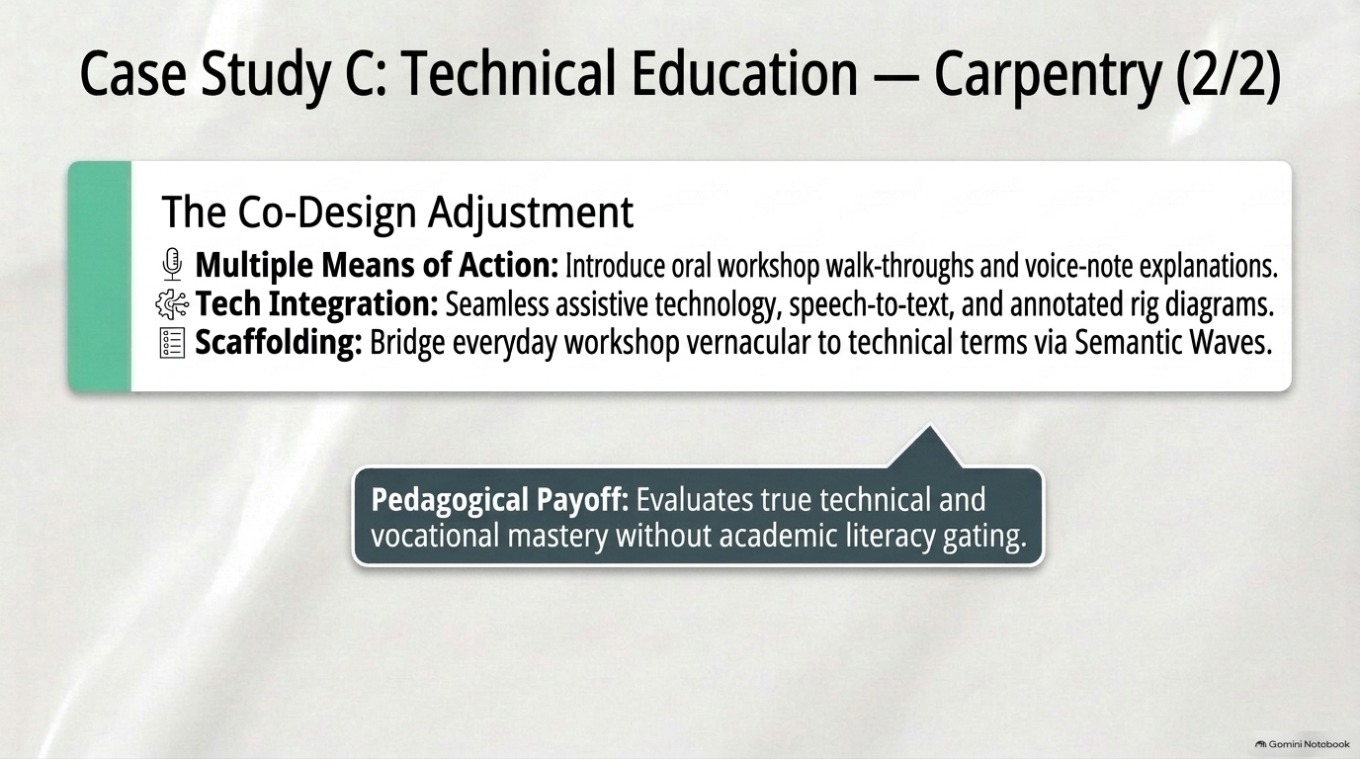
Notes:
Case Study C: Technical Education — Carpentry (2/2) — Co-Design & Payoff
Case Study C (Part 2): Separating technical competence from immediate written prose—via oral rig walk-throughs, assistive speech-to-text, and Semantic Wave scaffolding—evaluates true vocational mastery rigorously.

Slide 21
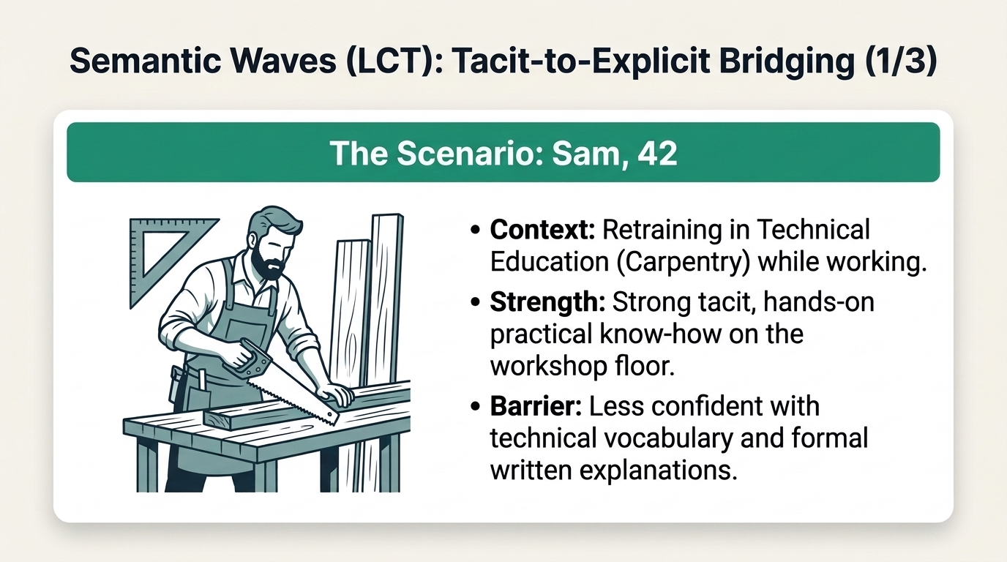
Notes:
Semantic Waves (LCT): Tacit-to-Explicit Bridging (1/3) — The Scenario: Sam, 42
Semantic Waves (Part 1/3): Introduce Sam (42), an experienced adult retraining in Technical Education (Carpentry) while working. Highlight the contrast between his strong tacit workshop mastery and his lower confidence with technical vocabulary and formal written explanations.

Slide 22
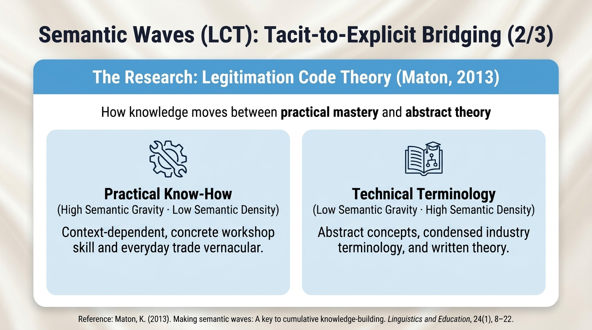
Notes:
Semantic Waves (LCT): Tacit-to-Explicit Bridging (2/3) — Legitimation Code Theory (Maton, 2013)
Semantic Waves (Part 2/3): Unpack Karl Maton's (2013) Legitimation Code Theory (LCT)—contrasting Practical Know-How (high semantic gravity, low semantic density) with Technical Terminology (low semantic gravity, high semantic density).

Slide 23
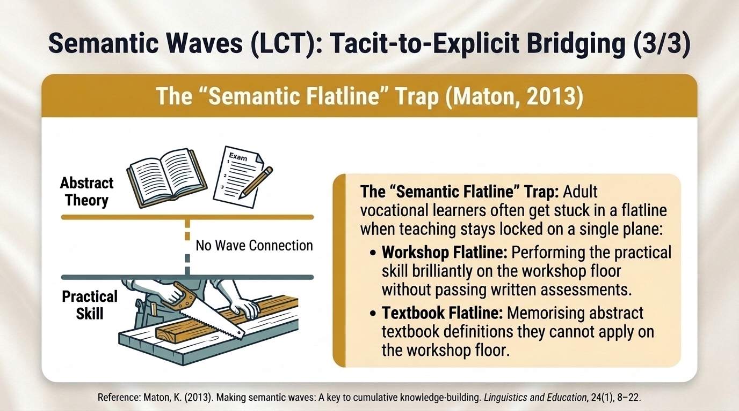
Notes:
Semantic Waves (LCT): Tacit-to-Explicit Bridging (3/3) — The “Semantic Flatline” Trap
Semantic Waves (Part 3/3): Examine the 'Semantic Flatline' Trap—where teaching remains locked on one plane with no wave connecting Abstract Theory and Practical Skill. Learners get caught either in a Workshop Flatline (performing the practical skill brilliantly without passing written assessments) or a Textbook Flatline (memorising abstract definitions they cannot apply on the workshop floor).

Slide 24
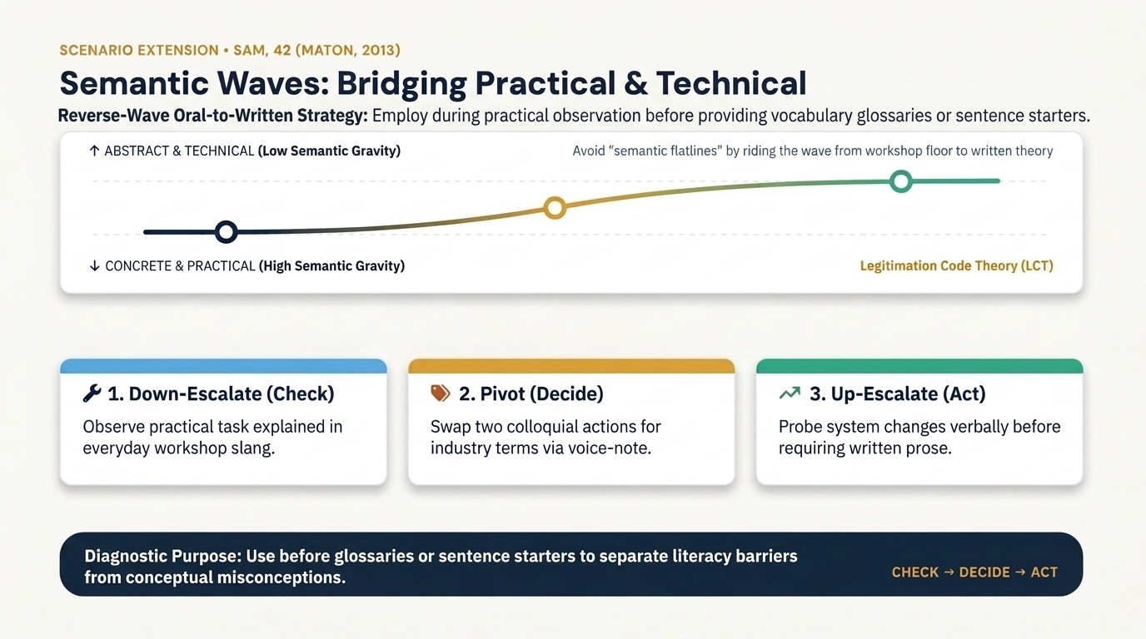
Notes:
Semantic Waves: Bridging Practical & Technical
Walk through the visual Semantic Wave progression for Sam (42), employed during practical observation before handing out vocabulary glossaries or sentence starters: starting with high semantic gravity on the workshop floor (1. Down-Escalate / Check), pivoting via voice-note concept mapping (2. Pivot / Decide), and climbing to abstract transfer (3. Up-Escalate / Act) to separate literacy barriers from conceptual misconceptions.

Slide 25
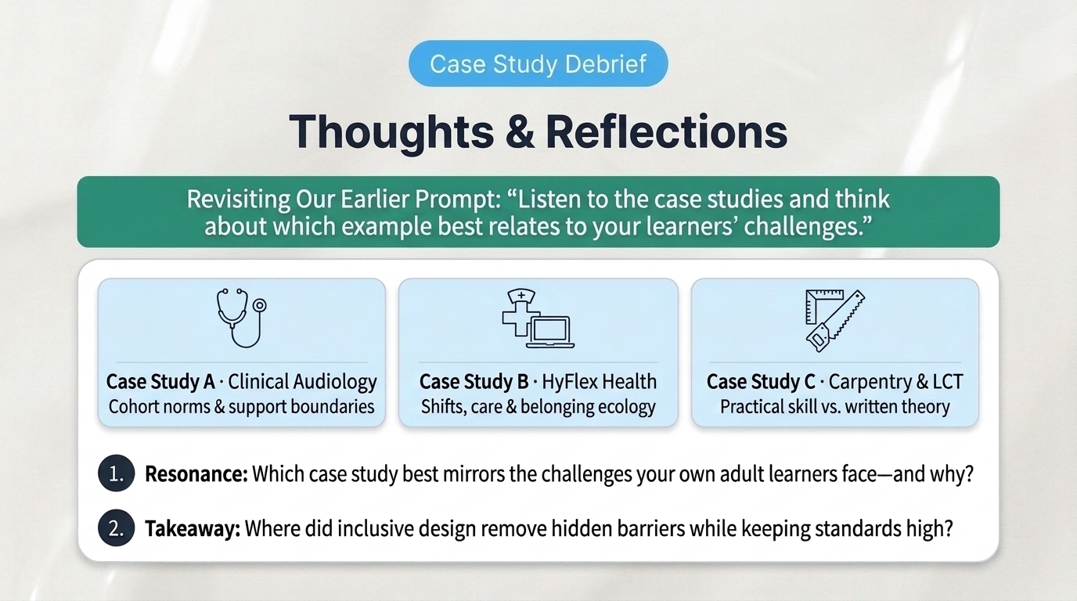
Notes:
Thoughts & Reflections — Case Study Debrief
Pause for a 3–5 minute paired or whole-room reflection closing the loop on Slide 8's listening prompt ('Listen to the case studies and think about which example best relates to your learners' challenges.'). Invite colleagues to share which lived-experience scenario—Clinical Audiology, HyFlex Health, or Technical Education (Carpentry & Semantic Waves)—resonated most with their own cohort, and how barriers were removed while keeping academic and professional standards high. Use their reflections as a natural bridge into the 5 Core Adult Learner Barriers.

Slide 26
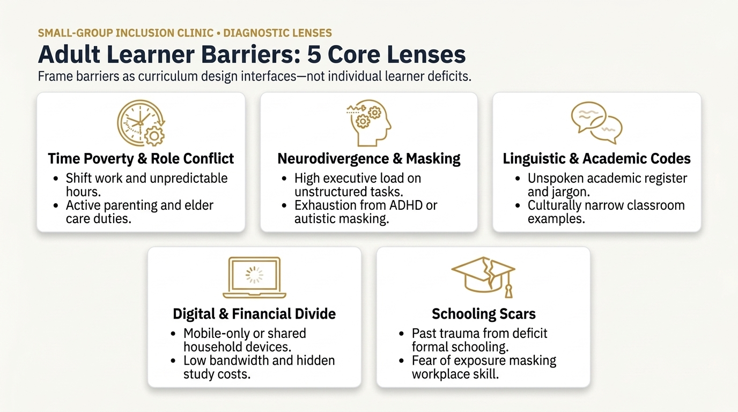
Notes:
Adult Learner Barriers: 5 Core Lenses
Introduce these five diagnostic lenses before launching the 8-staff Inclusive Design Clinic. Emphasise that adult learners rarely experience just one barrier in isolation—and every barrier is an institutional or pedagogical interface we can redesign rather than an individual student deficit.

Slide 27
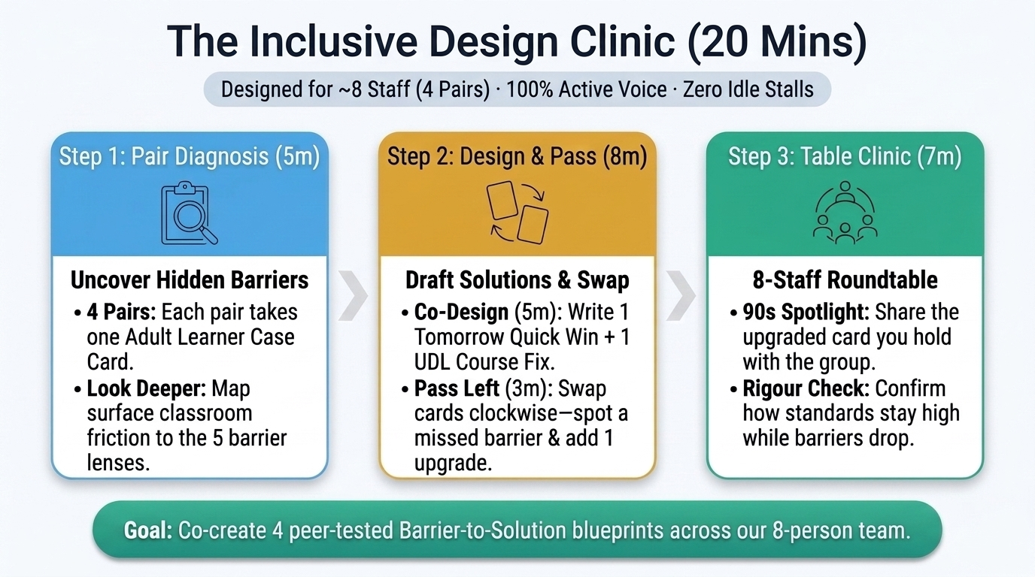
Notes:
The Inclusive Design Clinic (20 Mins · ~8 Staff Protocol)
Explain why we use an Inclusive Design Clinic instead of a station marketplace for a cohort of ~8 staff: 4 pairs (adaptable to 3 pairs or pairs + 1 triad if 6–9 attend) ensures 100% active dialogue with nobody left standing alone at a flipchart stall. Walk through the 3 timings: 5 mins Pair Diagnosis, 8 mins Co-Design + Clockwise Pass ('Fresh Eyes Upgrade'), and 7 mins Whole-Table Roundtable.

Slide 28
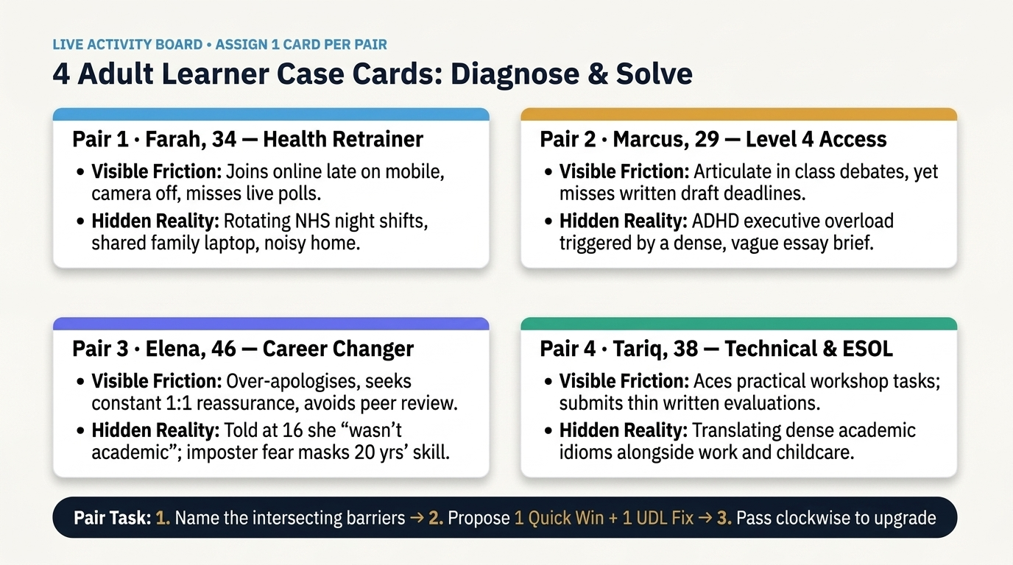
Notes:
4 Adult Learner Case Cards: Diagnose & Solve
Keep this slide projected throughout the 20-minute Inclusive Design Clinic so all 4 pairs can work directly from screen (using A4/A3 folded sheets or two-colour sticky notes). Cue the room at 5 minutes ('Start drafting your Tomorrow Quick Win + UDL Fix'), at 10 minutes ('Pass your sheet clockwise—spot one missed barrier and add one fresh upgrade'), and at 13 minutes ('Begin our 8-person Roundtable—90 seconds per pair').

Slide 29
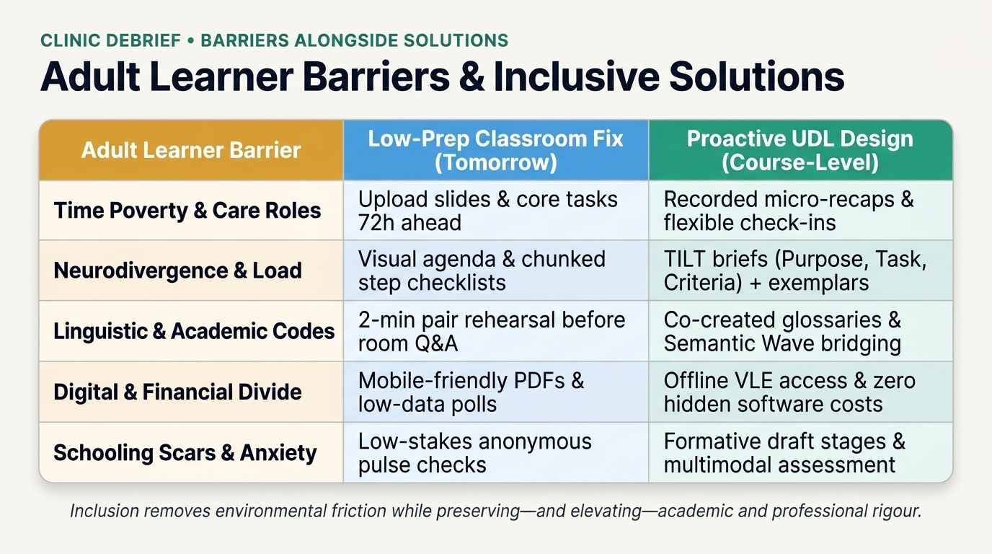
Notes:
Adult Learner Barriers & Inclusive Solutions
Use this reference matrix during or immediately after the 8-person Roundtable to validate the solutions colleagues generated and fill any gaps across the 5 barrier domains. Highlight the distinction between low-prep adjustments any tutor can implement tomorrow morning and proactive UDL course-design features.

Slide 30
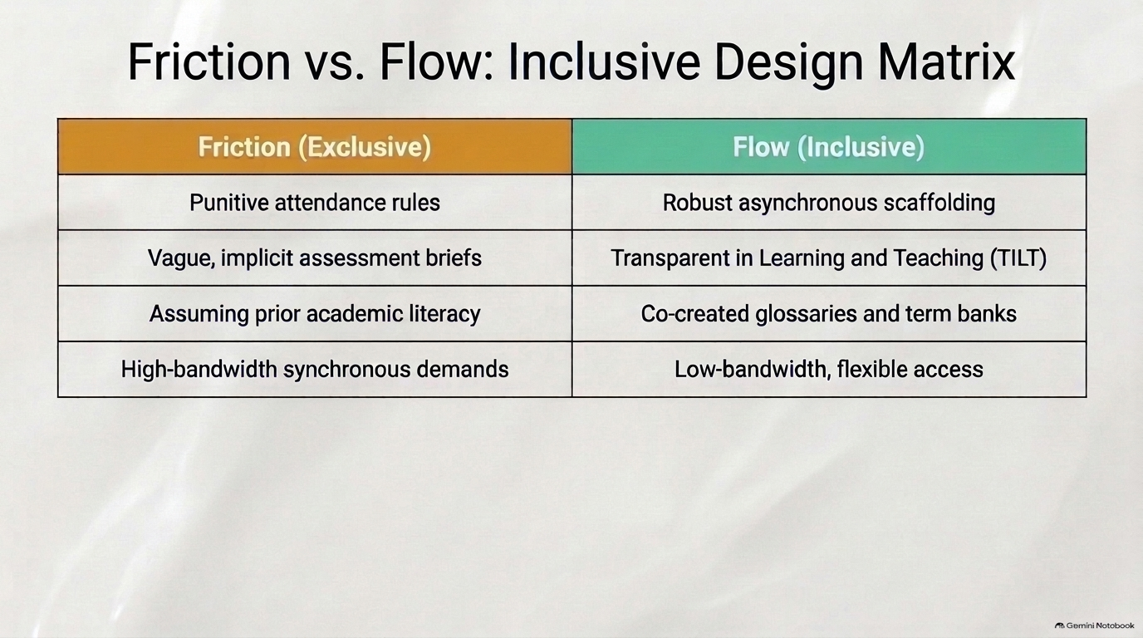
Notes:
Friction vs. Flow: Inclusive Design Matrix
Synthesise the side-by-side contrast between exclusive institutional friction and inclusive pedagogical flow as you transition from the 8-staff Inclusive Design Clinic into individual Next Week Redesign commitments.

Slide 31
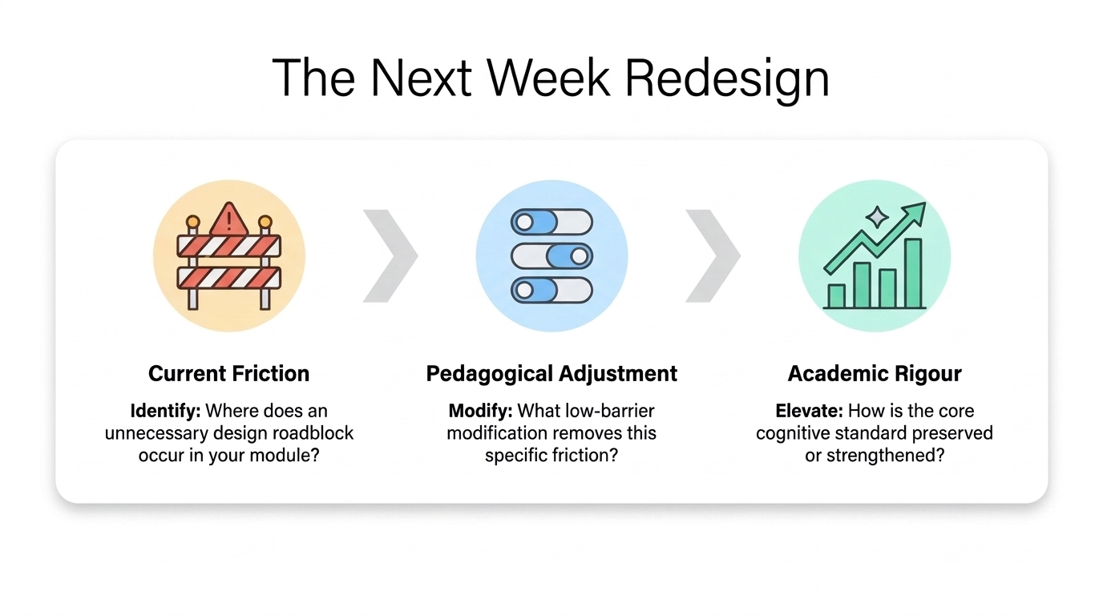
Notes:
The Next Week Redesign
No one leaves with abstract theory. This three-step redesign sequence bridges today's professional dialogue directly into next week's teaching.

Slide 32
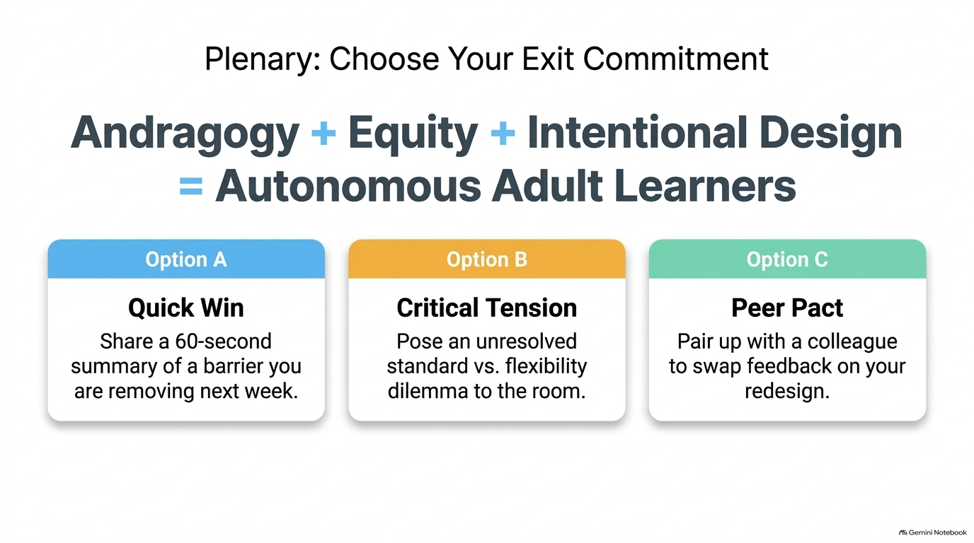
Notes:
Plenary: Choose Your Exit Commitment
Thank colleagues for their vulnerability and expertise. Remind everyone that inclusive andragogy is not an endpoint or checklist—it is an ongoing scholarly discipline practiced in community.

