Slide 1

Computer Systems Protection and Security
Security paper presentation

Slide 2

Chrome Extensions: Threat Analysis and Countermeasures
Presenters:
Spyros anastasiou
Angelos toumasis

Slide 3
PROBLEM STATEMENT
Why 'Chrome’ extension?’
Is current Chrome extension architecture good enough?
Easy to launch malicious extensions:
It is a difficult task to sanitize rapidly increasing extensions in Google Chrome Web Store with slow reviewing process
Users are free to download/install extensions from many (known/unknown) host servers
Strong incentive for attackers. Harvest sensitive content in web pages
or modify web search content
Notes:
1 -> Chrome has built-in security model for browser architecture and extension
2 -> Particularly with the consideraIon of malicious extensions

Slide 4
CONTRIBUTIONS
The Paper:
Demonstrates several attacks with malicious 'Chrome’ extensions through experimental implementation
Does security analysis of the permission model of Chrome 'extension’ (With the assumption of malicious extensions)
Proposes security enhanced extension permission model and enforcement mechanism – Following the principles of least privilege and separaIon of privilege in more strict way

Slide 5
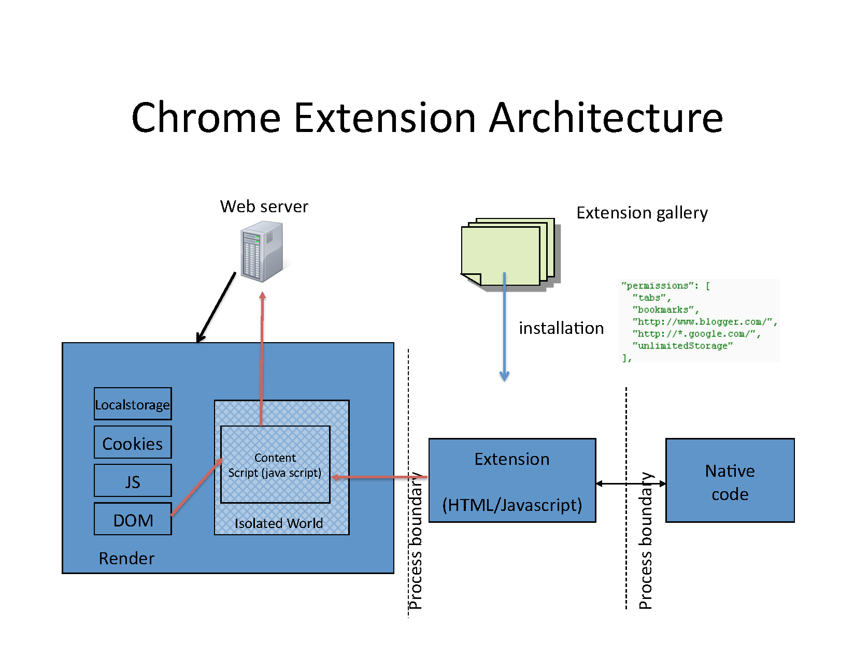

Slide 6
Chrome Extension Security Model
1. Least Privilege
Pre-defined permission set (e.g., To access web sites, browser tab, bookmarks, history, …)
Each extension declares permissions required
User authorizes permissions at installaIon Ime

Slide 7
Chrome Extension Security Model
2. Privilege SeparatIon
Different permissions for different components of extension
Content script can interact with web content, not browser modules
Extension core has more privileges, but insulated from web pages

Slide 8
Chrome Extension Security Model
3. Strong isolation
Same origin policy
Each extension has unique origin
Accessing other origins requires cross-site permissions
Inject content script requires cross-site permissions
Process-level isolation: extension core runs in separated process from renderer and browser
Within a renderer process, content script runs in isolated world from JavaScript of web page

Slide 9
Chrome Extension Trust Model
The main trust model of Chrome extension assumes trusted but buggy extensions
Not malicious web pages
Therefore the security objectives are mainly for restricting web pages to access browser resources via extensions and confine the damage propagation if possible

Slide 10
Experimental attacks
The Researchers of the Paper developed a malicious extension as a bot
from Chrome 7 to the latest
does email spamming, DDoS, and phishing attacks easily
Through attacking web pages
Receive commands from bot master with built-in update mechanism of Chrome extension
No security check for update

Slide 11
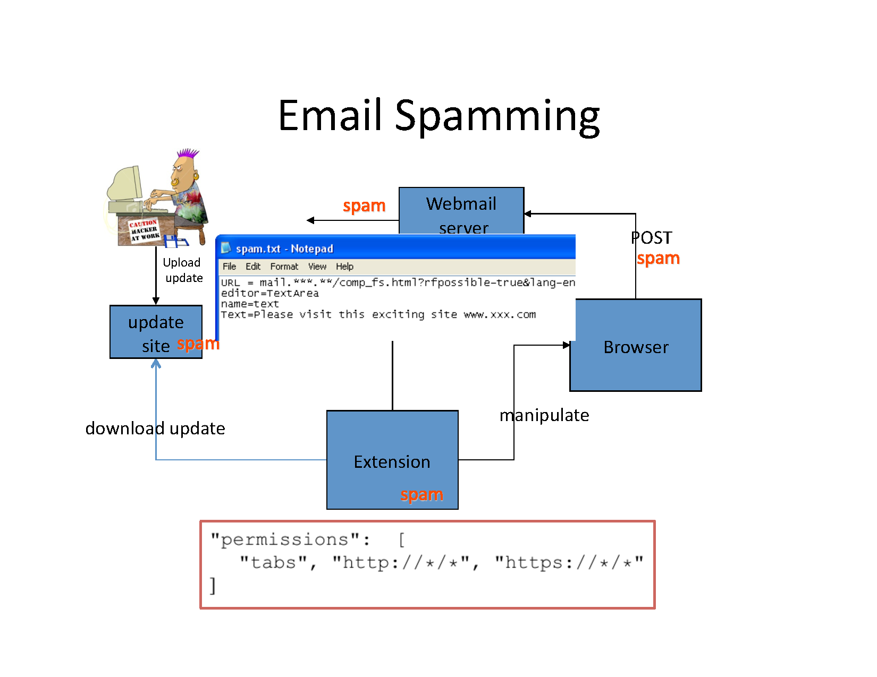

Slide 12
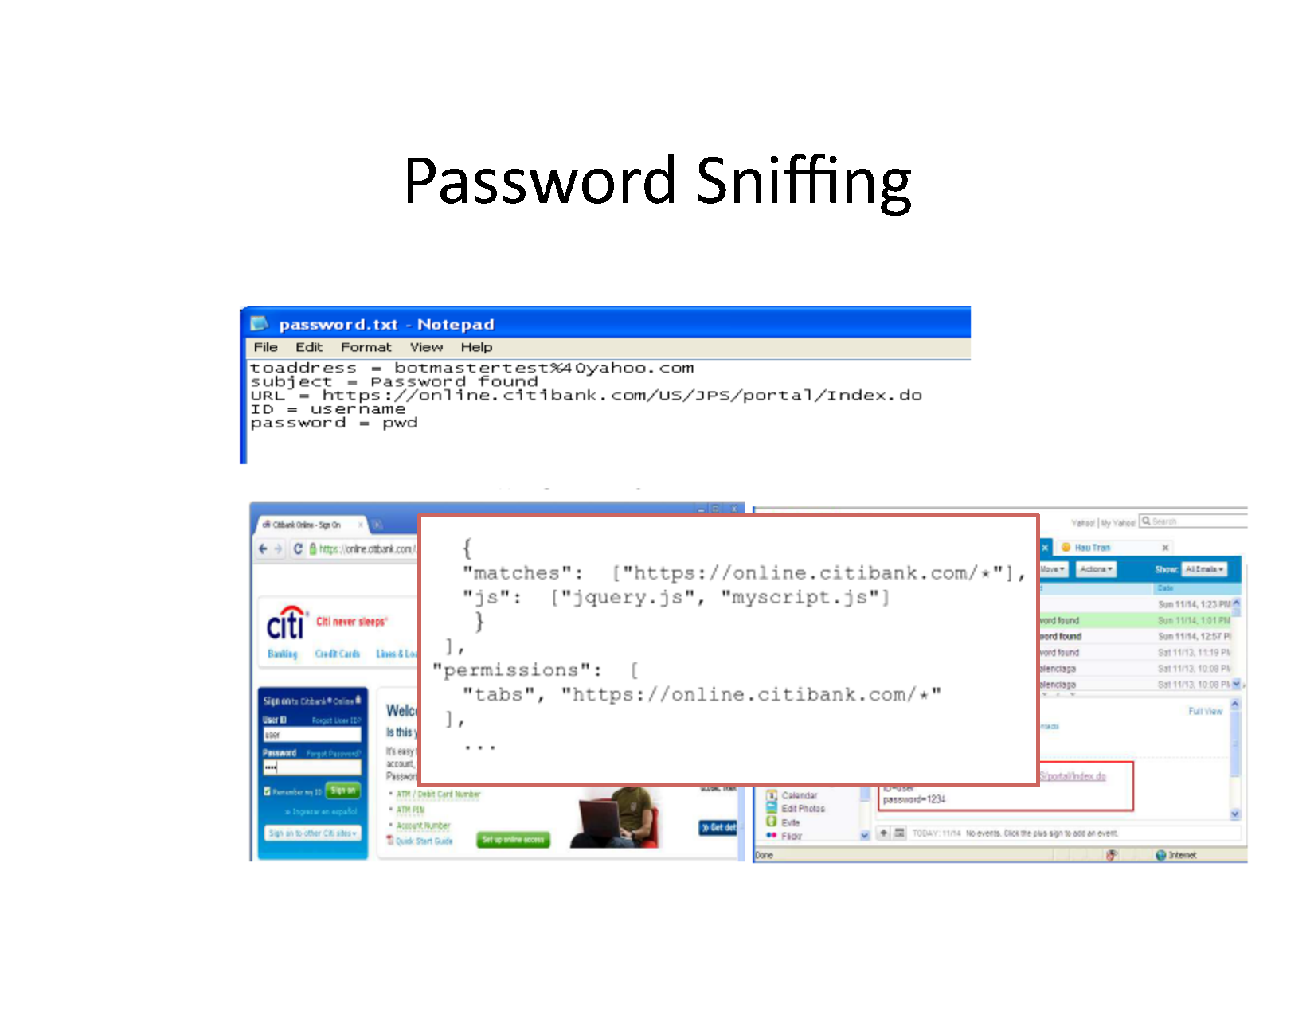

Slide 13
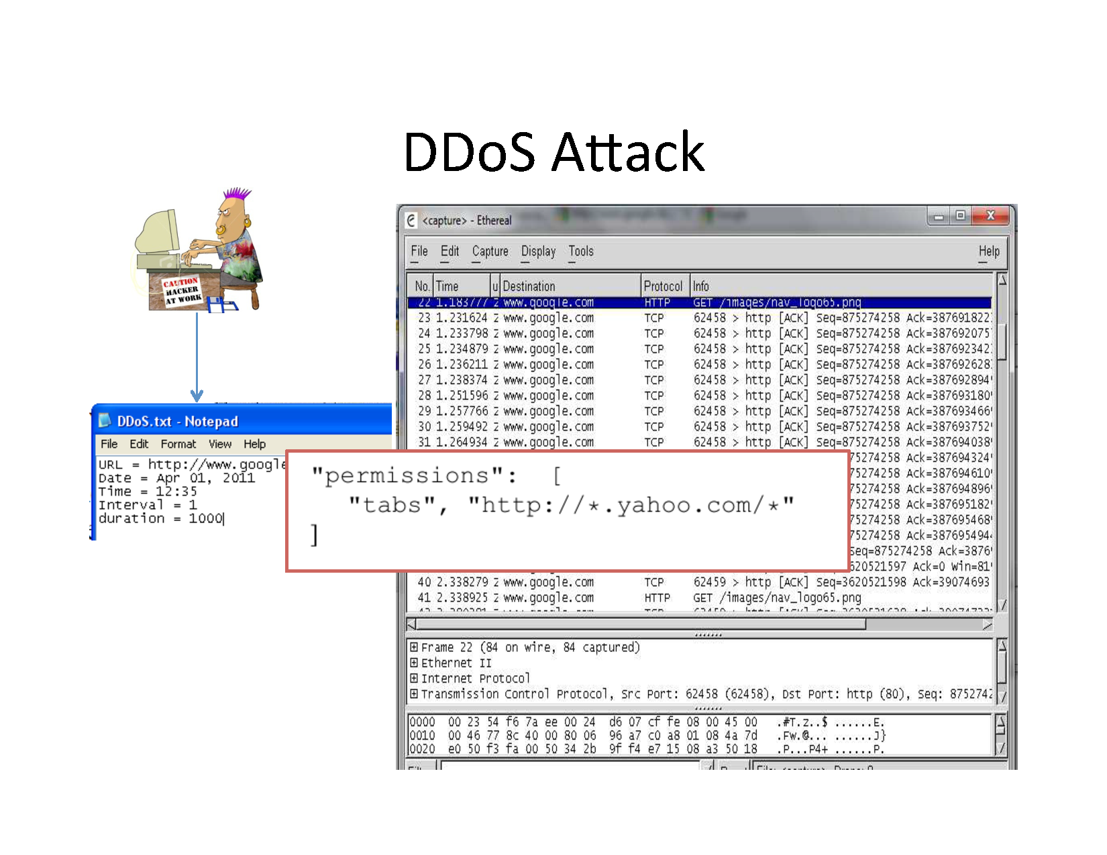

Slide 14
Security Analysis
• Trust Model:
We assume browser kernel and plugins are trustworthy
Sandbox mechanism provided by OS works well
Native code for extensions is sandboxed
Web apps are trusted
• Threat model: malicious extensions
Extension core
Content scripts

Slide 15
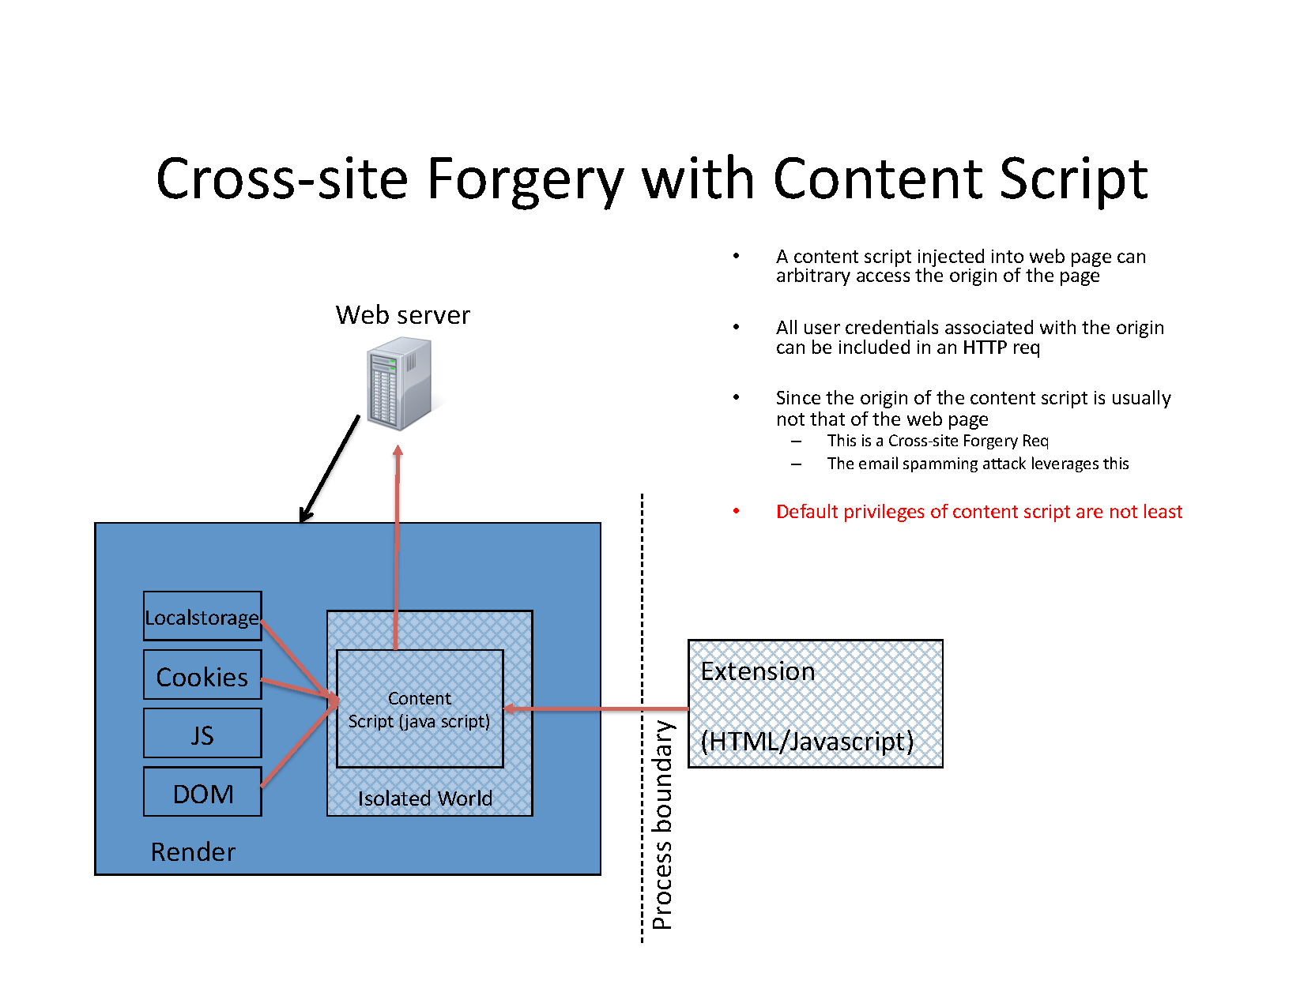

Slide 16
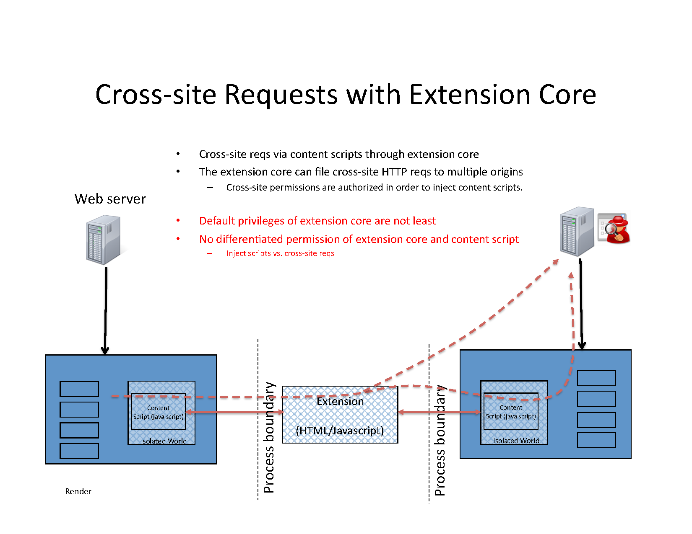

Slide 17
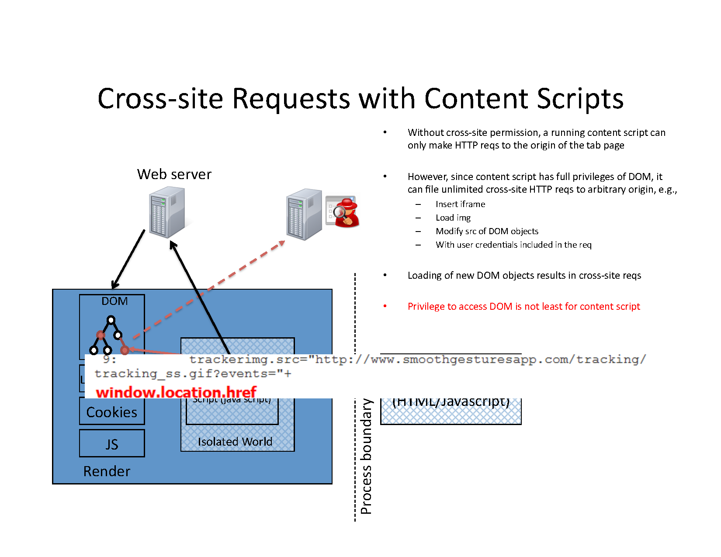

Slide 18
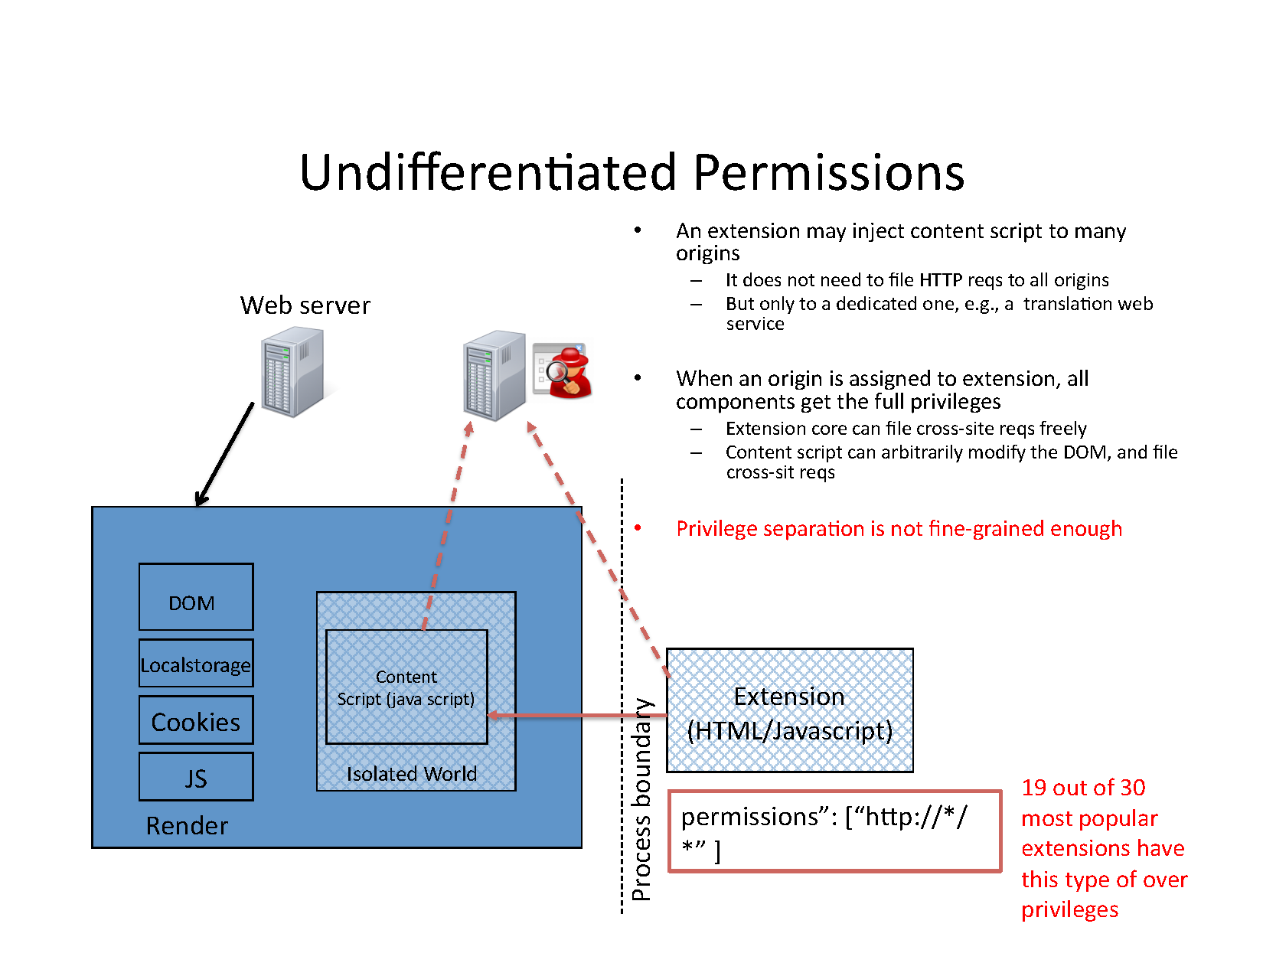

Slide 19
Security Enhanced Chrome Extensions
Micro-privilege management
Differentiate DOM elements with sensitivity

Slide 20
Micro-privilege Management
Fine-grained permission differentiation for extension core and content script
Seperation of Permissions from different components
Least Default Privileges
Content script cannot introduce new origin to DOM
no HTTP requirement to tab origin

Slide 21
Example Permission Spec for a translation extension

Slide 22
Differentiating DOM Elements
To further reduce possible sensitive data leakage by content script , DOM elements can be differentiated with sensitivity levels
Web App developer can identify sensitive information in a web page :
-High level data : only can flow to web origin
-Medium level data : may flow to authorized origins
-Low level (default ) :can flow to any origin
Extension develop can specify permissions accordingly:
- High for username/password , Medium for other user info ,Low for others

Slide 23
Implementation
Implementation of the micro-privilege management and spec.
A helper extension for DOM sensitivity , which :
-Identify and label sensitive DOM elements
-Re-write DOM elements properties ( according to configurable dictionary )
-Chrome enforces permission check based on extension manifest

Slide 24
EvaluatIons

Slide 25
Evaluation
From the 30 most popular extensions of Google Extension Gallery
- 24 of them have granted network access
- 19 of them request higher privileges than necessary
The implementation changes their spec in order to reduce privileges
Also blocks all experimental attacks on the bot extension

Slide 26
Conclusions
Demonstrated spamming , phishing and DDoS attacks with implemented
Chrome extensions
Analyzed the permissions model that causes these problems
Proposed security enhanced permission model and enforcement for
Chrome extension architecture :
Micro-privileged permission management and spec
Differentiate content script’s permission with DOM sensitivity levels

Slide 27

QUESTIONS?

Slide 28
THANK YOU!

