Slide 1
REINVENTING NEW ERA ON THE RELATIONS BETWEEN IRAN (IRI) AND TANZANIA AS AN OPPORTUNITY: A CASE OF BALOCHI COMMUNITY
PROF EGINALD PIUS MIHANJO

Slide 2
REALITY OF TZ IRAN RELATION
HISTORIOGRAPHICAL NARRATIVES, DEBATES, NOTES, SOURCES MANY
BUT CONFIRMS IRANIAN HAVE SPIRITUAL BLOOD TIES/ RELATIONS WITH TANZANIANS SINCE CENTURIES BACK
THIS IS UNDISPUTABLE, A REALITY – ARE TANZANIANS WITH IRANIAN TIES
CONNECT PERSIAN, SHIRAZI, BALUCHI
THIS IS AN OPPORTUNITY, FOR USE, USE IT FOR PEOPLE CENTRED ECONOMIC REVOLUTION, DEVELOPMENT, LIBERATION

Slide 3
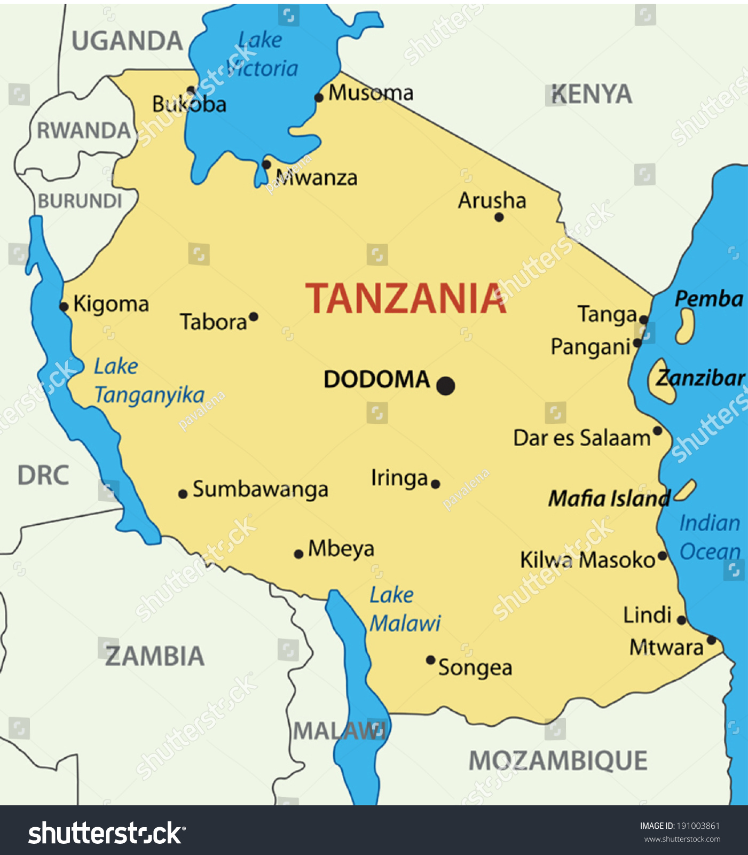
TZ - IRAN PEOPLE CENTERED TIES CORRIDOR MAP

Slide 4
OUR RELATIONS STRATEGIC TOOLKIT - PEOPLE CENTRIC
OVER 1000 YRS COOPERATION
OPPORTUNITIES
CHALLENGES
CLOSE TIES
SPIRITUAL , BROTHERLY – BLOOD TIES
HISTORICAL, CULTURAL,
SOCIAL
ECONOMIC PARTNERSHIP TOOL
REVOLUTONARY IDEOLOGY MOBILATION TOOL
TANGA
PANGANI
BAGAMOYO
KILWA
LINDI
MIKINDANI
TABORA – LAKE VICTORIA CORRIDOR
KIGOMA – UJIJI – LAKE TANGANYIKA CORRIDOR
MBEYA
IRINGA
LAKE NYASA CORRIDOR

Slide 5
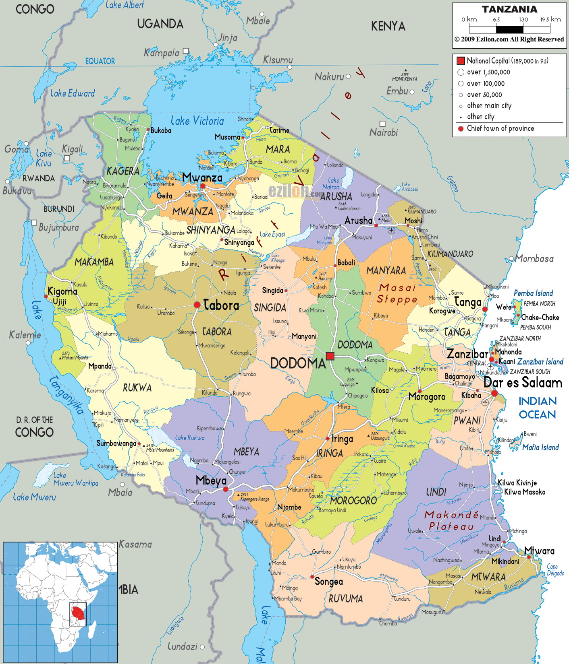
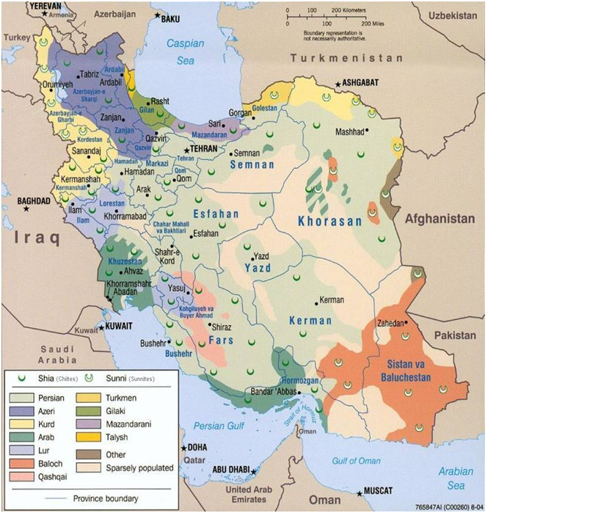
IRI – TZ RELATIONS TOOLING KIT
TANZANIA
IRAN
CULTURAL
HISTORICAL
POLITICAL
SOCIAL
ECONOMIC

Slide 6
RETOOLING RELATIONS INTO FUTURISTIC STRATEGIC OPPORTUNITY
RELATIONS HAVE TO BE RETOOLED AS OPPORTUNITY NOW
ERA OF COMPETITIVE CAPTALIST IMPERIALIST NON POLAR WORLD
OPPORTUNITY FOR AFRICA PEOPLE TO UNITE & PARTNER/WORK WITH WEAK TO ACHIEVE ECONOMIC LIBERATION – SOUTH SOUTH
THE FUTURE LIES IN FOCUSING SUCH OPPORTUNITIES
ECONOMIC REVOLUTION STEMS FROM PEOLE CENTRIC CONNECTION OPTION AND PARTNERSHIPS
FIND PEOPLE MOBILIZATIONAL IDEOLOGY FOR REVOLUTIONARY TIES UNIFYING IDEOLOGIES ARE LIFEBLOOD OF NATIONS DEVELOPMENT – ISLAM, UJAMAA JUST LIKE WESTERN WORLD THE IDEOLOGY OF WESTERN DEMOCRACY

Slide 7
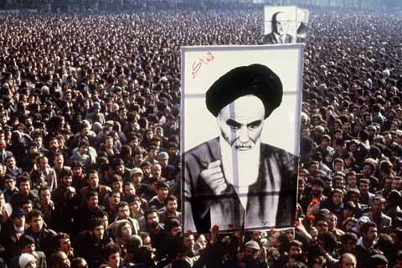
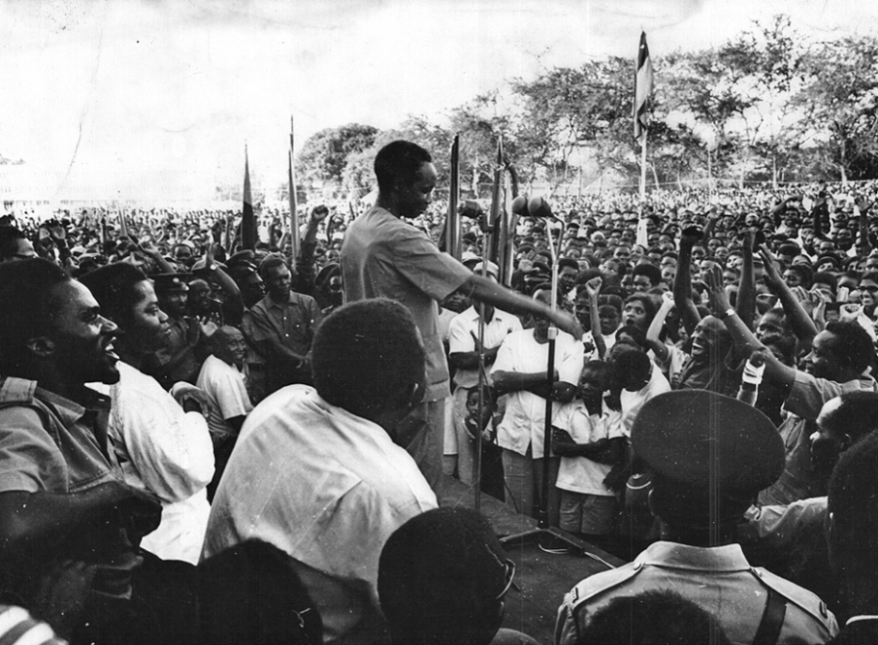
CEREMMONIAL SYMBOLISM CENTRES UNIFYING IDEOLOGY
ISLAM - AYATOLLAH KHOMEINI
UJAMAA – MWL NYERERE
MAGUFULIPHILIA - TANZAPHILIA

Slide 8
AVOID DECEPTIONS SOFT POWER
IRAN TO TANZANIA OFFER AN OPPORTUNITY FOR PEOPLE CENTRIC ECONOMIC LIBERATION
ACHIEVING ECONOMIC LIBERATION FOR THE WEAK REQUIRES THE WEAK/SOUTH PARTNERSHIP IN STRATEGIES
REQUIRES CHANGE OF PARADIGM GET OUT OF BOX
AGAINST CAPITALIST IMPERIALIST DECEPTION PROPAGANDA STRATEGIES/MACHINATION VS REVOLUTIONARY MOBILAZATION TOOLS – BE IT IDEOLOGICAL, RELIGIOUS, CULTURAL, HISTORICAL
MAINTAIN - UNITY OF PURPOSE

Slide 9
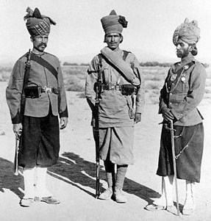
CASE OF THE BALOCHI AS AN OPPORTUNITY
PERSIANS, SHIRAZI, BALOCHI, BALUCHI FACTOR LONG HISTORY
BALOCHI FACTOR – HAS FAR REACHING EXTENSION OVER TANZANIA – ZANZIBARVAND INTERIOR MAINLAND TANZANIA
AS MILITARY FORCE, POLITICAL ADMINISTRATOR, WITH LONG LASTING SOCIAL ECONOMIC IMPACT
PROVIDE THE MILITARY THE BALOCHI – ZANZIBAR, TABORA - MBEYA CORRIDOR

Slide 10
HISTORY NARRATIVE
1821 SULTAN SEYYID SAID BIN SULTAN AL BUSAIDI HIRED AN IRANIAN FLEET TO INVADE THE ISLAND AND PORT STATES OF EAST AFRICA
FLEET COMPOSED MOSTLY OF BALOCH AND SINDHI/CUTCHI MERCENARIES FEW ARAB, PERSIAN AND PATHAN OFFICERS
MOST OF THESE AND THEIR FAMILIES FROM IRAN AND INDIA, SETTLED IN THE COASTAL TOWNS AROUND FORTS
NEWLY BUILT CAMPS - SAA-TEENI OUTSIDE ZANZIBAR CITY, FORT JESUS IN MOMBASA AND THE BALOCH CAVALLERY IN ZANZIBAR CITY AT SITE OF PRESENT HAILE SELASSIE SCHOOL

Slide 11
CONTD
EXPANSION OF ZANZIBAR TRADE AND POLITICAL INFLUENCE IN THE INTERIOR MADE BALOCH SQUADRONS PENETRATE TABORA AND KIGOMA ON LAKE TANGANYIKA
IN 1873, HALF OF THE SULTAN’S 3000 ZANZIBARI TROOPS ENGAGED IN THE WAR IN UNYANYEMBE AGAINST THE NYAMWEZI RULER CHIEF MIRAMBO WERE BULUSHI (BALOCH) AND SHIHIRI (HADRAMI) MERCENARIES

Slide 12
CONTD
BALOCH SOLDIERS JOINED TRADE CARAVANS AS GUARDS, REACHED CONGO WITH TRADER TIPPU TIP - HAMED BIN MUHAMMAD AL-MURJEBI,
HAS UNDER HIS COMMAND 1600 ARMED MEN IN HIS CARAVANS AND DEPOTS, FREEMEN AND SLAVES
TIPPU TIP BECAME THE FIRST AND ONLY ZANZIBARI GOVERNOR OF THE COPPER PROVINCE OF KATANGA - SHABA PROVINCE - IN EASTERN CONGO
BECAME ALSO THE FIRST BELGIAN GOVERNOR OF KATANGA FOR A SHORT TIME AFTER THE EUROPEAN SCRAMBLE OF AFRICA WAS CONCLUDED IN 1890

Slide 13
CONTD
KNOWN AS BULUSHI (PL. MABULUSHI) SPOKE SWAHILI MIX BALOCHI AND SWAHILI, BALOCH SETTLERS INTERMARRIED WITH OTHER MUSLIMS OF EAST AFRICA OF DIVERSE ETHNIC ORIGIN AND ADOPTED SWAHILI
BALOCH HOUSEHOLDS RECEIVED NEW ARRIVALS FROM THEIR OLD COUNTRY, THE IRANIAN BALUCHISTAN, PRESERVES ‘BALOCH’ IDENTITY
GERMAN ADMINISTRATION FURTHER SPREAD BALOCHI - USED THEM, SWAHILI, ARABS, MUSLIM IN THEIR ADMINISTRATION - LIWALI

Slide 14
BALOCHI LEGACIES AND OPPORTUNITY
CULTURAL HISTORICAL RELATIONS CONNECTED WELL INTO SOCIAL POLITICAL ECONOMIC LIFE – SWAHILIZATION, ISLAMIZATION TO TRADE ECONOMIC VENTURE AND POLITICAL CLASS TO POST COLONIAL PERIOD
DESPITE BRITISH POLICIES AND POST INDEPENDENCE AFRICANIZATION STAYED AS TANZANIANS ECONOMICALLY VISIBLE SUCH AS MR. ROSTAM AZIZ ESPECIALLY IN TABORA, USANGU, NJOMBE

Slide 15
STRATEGIC OPPORTUNITY
USE THIS TO CONNECT THE PEOPLE OF THE TWO COUNTRIES INTO MEANINGFUL DEVELOPMENT ARCHITECTURE
IDENTIFY THEM AT GRAASSROOT COMMUNITY LEVEL ESPECIALLY THE YOUNG GENERATION AND CONNECT THEM IN ECONOMIC VENTURE WITH IRANIAN RELATIONS – ECONOMIC, TECHNOLOGICAL, KNOWLEDGE BASE VENTURE
APRIL 2007 AS CFR – DSP MEETING IN IRAN - GOVERNMENT, MUNICIPAL AND CHAMBER OF COMMERCE OFFICIALS AIMED AT THIS OPENING UP
DEPUTY MIN OF FOREIGN RELATIONS, HON. DR. M. MOHAMMAD
DIRECTOR OF AFRICAN AND ARAB STUDIES HE AMBAS GHADRI; DIRECTOR OF INSTITUTE OF POLICY AND INTERNATIONAL STUDIES (IPIS) DR. SEYED RASOUL MOUSAVI
CHAMBER OF COMMERCE IN SHIRAZ

Slide 16
SUM UP
TAKE NATIONAL INTERESTS GOALS CLOSER
TAPE THE STRATEGIC ADVANTAGES OF LONG HISTORICAL RELATIONS INTO PEOPLE CENTRIC ECONOMIC, TECHNOLOGICAL AND KNOWLEDGE BASE ADVANTAGE
TAKE ADVANTAGE OF THE GEOPOLITICAL POSITIONING OF ONE ANOTHER TO BENEFIT FROM THE GEOGRAPHIC STRATEGIC OPPORTUNITIES

Slide 17
CONCLUSION
IT IS NOT TOO LATE, IT IS RATHER TIMELY, TAKE CHARGE OF HISTORICAL OPPORTUNITY
PUT IT AMONG THE YOUTH AS A STRATEGIC REVOLUTIONARY MOVE AGAINST COUNTER REVOLUTIONARIES FOR CONTINUED MANTAINANCE OF OF HISTORICAL CULTURAL BLOOD RELATIONS
THANK YOU
ASANTE SANA

