Slide 1
FILM FESTIVAL GUIDELINES IN GSC CIRCUIT
(updated Aug 14, 2019)

Slide 2

BACKGROUND INFO- FILM FESTIVALS IN GSC CIRCUIT
The GSC International Screens , located exclusive in GSC Mid Valley, GSC Pavilion KL, GSC 1 Utama (New Wing), GSC Gurney Plaza Penang and GSC Paradigm JB are the first of its kind in Malaysia to be dedicated to the screening of alternative contents as listed below
Non-mainstream, foreign language films
Film festivals (feature films)
Anime
Other alternative contents ( ie music concerts, sports games, cyber games, etc)
The first GSC International Screens was launched at GSC Mid Valley on Dec 2, 1999 with the main objective to cater to the every growing sophistication of the movie going audience by providing an alternative programming in the form of award-nominated and award-wining non-mainstream films in all languages.
The target profile of the GSC International Screens range from students to adults, comprising middle to upper income group, made up of mostly locals but also including expatriates. Apart from having gained a reputation for bringing quality films to the Malaysian audience, it has also carved a niche market for itself amongst discerning views.

Slide 3






Role Film Festivals in GSC circuit
GSC plays a significant role in stimulating greater awareness of the arts and bridging cultures through its GSC International Screens, which exclusively screen foreign language films and hosts international film festivals.
GSC has partnered with foreign embassies since 2001 to bring work of international filmmakers to Malaysia and is the only local cinema chain to consistently hold annual international film festivals in its circuit.
(Ref 2017 – GSC hosted a total of 8 film festival and in 2019 – a total of 9 film Festivals.
Amongst these popular film festivals: le French Festival, Japanese Film Festival and European Union Film Festival ( paying film festival) and free to public film festivals ( Thai Film Festival, Czech Republic Film Festival, Iranian Film Festival, Hungarian Film Festival, Korean Film Festival and Latin American Film Festival).

Slide 4
Key Role -Main Organisers Embassies/Cultural Arms for Film Festivals
Bringing in the original feature movie contents and arranging for licensing of the Theatrical rights to screen in Malaysia. To ensure these movies are not screening concurrently with free or paid TV, in other channels like iflix, Netflix, Dimsum etc same time as the film festival duration.
Submission of movies to Malaysian Censorship Board for approval
Obtaining written approval of the owners/distributors of film festival movies to be screened in GSC for festival’s purpose and allow edits/manual censorship for such movies as required by the Board
Fully responsible for any liabilities whatsoever for the screening of film festival movies and will indemnify GSC against any action/proceedings commenced against and liabilities penalties or fines incurred by GSC in connection with the film festival screening
Delivering/Transportation of the original DCP, Blu-ray/DVD of the movies to participating GSC cinemas
Arranging for personnel for manual blocking (where applicable)
Organising the press conference/launches/opening function
Design and printing of film festival collaterals including the costs (print/electronic, etc), with GSC branding
Media tie-ups (where applicable, for paying film festivals)
Note: Full details will be listed in the agreement, which must be signed off by both parties before the FF commences.

Slide 5
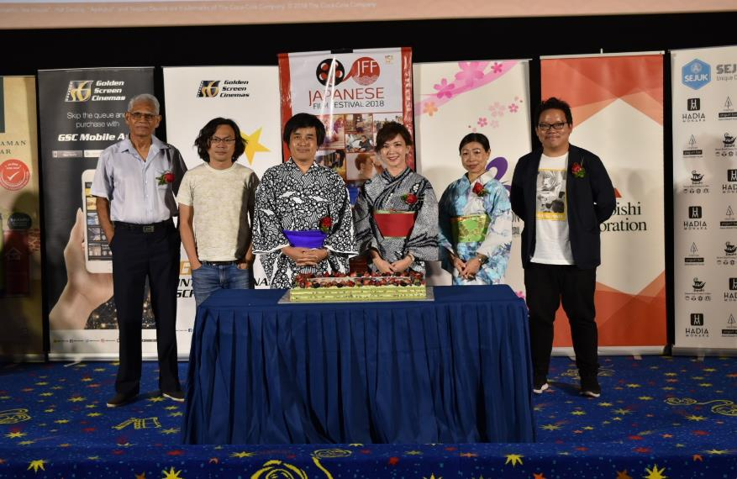


Key Role - GSC for Film Festivals
Official Venue partner
Co-ordination of the Film Festival screenings in participating cinemas
Booking of Film Festival halls (for press conference/launches/free public screenings where applicable)
Assist in film festival posters/backdrop/buntings in cinema.

Slide 6
GUIDELINES FOR FILM FESTIVALS IN GSC CIRCUIT
MOVIES
No of Movies : 5 titles(min) , max 20 – 25 titles
But does not including movies with limited screenings ie those with 4/5 screenings ,
i.e. min 1 screening per region (KL, Penang, Johor, Kuching, Kota Kinabalu).
LOCATIONS – to exclude LED Onyx Hall (cannot accommodate manual blocking)
Klang Valley ( GSC Pavilion KL, Mid Valley, 1 Utama, NU Sentral)
Penang (GSC Gurney Plaza)
Johor (GSC Paradigm JB)
Sarawak (GSC CityONE Megamall)
Sabah (GSC Suria Sabah)

Slide 7
GUIDELINES FOR FILM FESTIVALS IN GSC CIRCUIT
DURATION – subject to Embassy budget/resources
Option 1 : 4 days (Thurs till Sunday), capitalize on the weekend peak
Option 2: 7 days ( Thurs till Wed), follow movie week
Option 3: 11 days ( Thurs till following Sunday)
Subject to no of titles, Min 1 -2 titles per weekday, 4-5 titles per weekend/public holiday
TICKET PRICING OPTIONS
Free to public, recommended for new film festivals to drive initial awareness. Main Organiser to pay for hall rental via GSC Sales & Promotions
Special ticket pricing/Wed pricing, to drive more admission (JFF/EUFF)
Follow GSC Prevailing Ticket pricing, 50/50 sharing basis after tax (le French Festival)
Note: prevailing surcharges applies for digital 3D, Dolby Atmos/Dbox/4DX, etc.

Slide 8
GUIDELINES FOR FILM FESTIVALS IN GSC CIRCUIT
GSC’s contribution for Film Festival
Hall for Press Conference (subject to hall availability & booking)
Hall sponsorship (2 sessions including a morning 10 am movie preview screening and basic PA system)
Venue: GSC Mid Valley (central location for KL/PJ media), Hall size 130 seats or below
GSC Publicity channels ( subject to booking /availability)
GSC Mobile App/In-Box
GSC website – movie info, showtimes, general info, contest, free ticket redemption, etc
GSC social media – Facebook/Twitter/Instagram updates and boostings
GSC e-mailer – monthly generic mailer (month end) and dedicated International Screens (mid week)

Slide 9
GUIDELINES FOR FILM FESTIVALS IN GSC CIRCUIT
Cont :GSC Publicity channels ( subject to booking /availability)
GSC Digital TV screens ( for film Festival trailers and posters)
GSC online space in selected mainstream media
GSC giant videowall in Mid Valley Megamall and Paradigm JB
Note: A detailed timeline checklist /POSM requirements will be emailed out by GSC once main organizer has confirmed the dates, venue, duration, no of movies for the film festivals.

Slide 10
GUIDELINES FOR FILM FESTIVALS IN GSC CIRCUIT
REQUIREMENTS FROM GSC
Embassy endorsement - Film Festivals must be supported/associated with Embassy in Malaysia via active participation by Embassy or letter of support from Embassy. Otherwise the standard corporate hall rental rates will apply instead of special distributors/film festival rates
On-Ground activity -Main organisers are encouraged to bring in movie cast, director/producer to grace Film Festival event
Conduct film related workshops
Conduct telephone interview with producer/director/movie cast
Invites to media/influencers with interest in film festival contents for PC, launch, events
Film Festival Reach - Extend film festival beyond Klang Valley locations (to Penang, Johor, Kuching, Kota Kinabalu)

Slide 11
GUIDELINES FOR FILM FESTIVALS IN GSC CIRCUIT
REQUIREMENTS FROM GSC (continuation)
Film format – Digital Cinema Package or DCP (at least 60%).
DCP– 1 copy, can be ingested/tested in participating cinemas with ample lead time or 1 each per location for concurrent screenings
Currently cinema format ie either Scope (1: 2.35) or Flat (1: 1.85)
Blu–ray/DVD, to provide one copy per location, to test ahead of public screenings.
For example , if there is 4 participating location in KV, to provide 4 Blu-rays.
Ref: Malaysian Bluray code Region A /DVD code Region 3 – 16 x 9 format
GSC digital projectors do no accommodate Academy (Letterbox) format –this was used for the older movies form the 60s era.
Movies in DCP format must be sent to participating GSC cinemas not later than 14 working days in advance for ingestion/downloading onto GSC servers and testing of KDM (key digital master in allocated halls

Slide 12
GUIDELINES FOR FILM FESTIVALS IN GSC CIRCUIT
REQUIREMENTS FROM GSC (continuation)
If time/budget permits, to consider preview/review screenings for media/influencers
Film Festival movie selections criteria to include the follow :
For movies that has not been screened in Malaysia before, otherwise the prevailing GSC corporate hall rental rates apply.
Must not be screening concurrent in paid TV/Astro channels/Netflix/iflix etc during film festival duration
Film Festival video trailers in DCP format or DVD (backup), not in ai or other computer format. These must be tested during rehearsals in full, to incl English subtitles .
Embassies to share full details of FF movies (use GSC template sample), incl language of movies, country origin. GSC Programming will cross check info provided for programming code.

Slide 13
GUIDELINES FOR FILM FESTIVALS IN GSC CIRCUIT
REQUIREMENTS FROM GSC (continuation)
Redemption exercise - For any redemption exercise (in-season passes or free FF movie tickets), Embassies/GSC to implement a coupon systems or snapshot of FF logo/visual/article to verify the redemption exercise in the cinemas.
Censorship - Main organizer to extend a copy of the censorship cert/report with recommended cuts to GSC, to cross check the actual movie duration ,classification for showtimes programming and backup copy for manual blocker .
Censorship cert must be for the same format as per public screenings. Alternatively to get Censorship Board covering letter for public screening format.
Manual Blockers - Film Festival organizer to hire or recruit volunteers for manual blocking (only for the movies with censored scenes as listed in censorship report.
Logistics – to allocate min 4 days lead time for courier/transportation from KL–Pg-JB-Kuching-Kota Kinabalu.

Slide 14
GUIDELINES FOR FILM FESTIVALS IN GSC CIRCUIT
REQUIREMENTS FROM GSC (continuation)
Actual Turnout – Cinema team to do a headcount during screening proper (free to public format vs redemption nos
In-Season passes – for paying FF movies, will be valid for movies with at least 1 screening per region (KL/Penang/Johor Bahru/Kuching/Kota Kinabalu). In the case where there is only 2 screenings for the said title in 5 regions, this movie will not be included for the in-season pass. GSC will inform on total in-season passes to be printed (based on no of screenings/hall capacity)
Main organizer/Embassy – must provide paid manual blockers/volunteers with a copy of the censorship report (with detailed list of the scene/duration to be censored). A copy of the list of manual blockers details (name, IC or Passport number, mobile no) to be extended to GSC one week prior FF commences for cinema info/execution.
Notification letter – suggest main organizer to extend a courtesy letter to inform Wisma Putra on the Film Festival

Slide 15
GUIDELINES FOR FILM FESTIVALS IN GSC CIRCUIT
REQUIREMENTS FROM GSC (continuation)
Invitation to Film Festival launch/PC – recommend to extend invite to
Chairman/ Deputy Chairman of Censorship Board
Mall Management team (refer to the list from GSC)
Film Festival partners/sponsors
Media, etc
Film Festival Exclusivity – to GSC cinema locations only.

Slide 16
FILM FESTIVAL CATEGORY

Slide 17
Film Festival Category 1
(Iranian Film Festival, Czech Republic Film Festival, Hungarian Film Festival, Korean Film Festival, etc)
CATEGORY 1 – “FREE TO PUBLIC” FORMAT
Recommended for first time film festival in Malaysia, to get initial buy-in/awareness
Main organisers/Embassies to pay for hall rental at special distributor rates (subject to hall booking & availability)
GSC will review Film Festival movie selection and avoid overlapping of film festival at participating cinemas within same period. Minimum – 5 titles
Sponsorship of GSC MV Hall (130 seats and below, morning session 10am-2pm) (2 sessions to include a movie preview screening)
Film Festival button production- design by organizer, production cost by GSC
Exposure in GSC digital channels –website, social media, in participating cinemas
GSC Facebook boosting – Film Festival trailer/posters (range RM2k), to review duration of Film festival, no of titles, no of participating GSC locations/regions, etc

Slide 18
Film Festival Category 2
(2018 15th Japan Film Festival, 19th European Film Festival )
CATEGORY 2 – Special discounted FF ticket pricing (JFF/EUFF) since 2004
Discounted ticket pricing for general public ie 2018 RM8.50 for JFF & EUFF
Main organizer/Embassy waives ticket share to enable a lower ticket for public to drive more admission. Net ticket price (after tax goes to GSC).
GSC will review Film Festival movie selection and avoid overlapping of film festival at participating cinemas within same period. Min 10 – 20 titles.
Sponsorship of GSC MV Hall (130 seats and below, morning session 10 am-2pm) (2 sessions to include a movie preview screening)
Min locations – 3-4 regions (Klang Valley, Penang, Johor Bahru, East Malaysia)
Film Festival button production- design by organizer, production cost by GSC
Exposure in GSC digital channels– website, social media, in participating cinemas
GSC Facebook boosting – Film Festival trailer/posters (range RM3.5k), to review duration of Film festival, no of titles, no of participating GSC locations/regions, etc

Slide 19
Film Festival Category 3
(2018 17th French Film Festival in PKL, MV, 1U, GPP, PJB, KK )
CATEGORY 3 – based Prevailing GSC ticket pricing (FFF) since 2002
Film Festival ticket pricing will be based on prevailing GSC ticket pricing .
Main organizer/Embassy and GSC will agree on a 50/50 net ticket sharing (minus entertainment tax).
GSC will review Film Festival movie selection and avoid overlapping of film festival at participating cinemas within same period. Min 10 – 20 titles.
Sponsorship of GSC MV Hall (130 seats and below, morning session 10 am-2pm) (2 sessions to include a movie preview screening)
Min locations – 3-4 regions (Klang Valley, Penang, Johor Bahru, East Malaysia)
Film Festival button production- design by organizer, production cost by GSC
Exposure in GSC digital channels –website, social media, in participating cinemas
GSC Facebook boosting – Film Festival trailer/posters (range RM3.5k), to review duration of Film festival, no of titles, no of participating GSC locations/regions, etc

Slide 20


