Slide 1
FUTURISTIC OUTLOOK OF STRATEGIC PARTNERSHIP BETWEEN IRAN - ISLAMIC REPUBLIC OF IRAN AND EAST AFRICA WITH SPECIAL ATTENTION TO TANZANIA
PROF EGINALD PIUS MIHANJO

Slide 2
SECTIONNS
SITUATING PRESENTATION
IRI EA TANZANIA SITUATION & PARADIGMATIC SHIFT
PRESENTISM STRATEGIC UTILITY
FUTURISTIC STRATEGICALLY FOR SOUTH SOUTH PARTNERSHIP COMPETITIVE ADVANTAGE
CONCLUSION

Slide 3
SITUATING PRESENTATION
TANZANIA IRAN RELATIONS REAL –
PEOPLE HISTORICAL CULTURAL
FRIENDLY SOUTH TO SOUTH NATION STATE
ANTI CAPITALIST IMPERIALIST HARD – SOFT POWER MACHINATIONS
PRESENTED IN MANY OCCASION ACADEMIC FORUMS FROM 2007

Slide 4
RECENT FORUMS
SHIRAZ – EAST AFRICA RELATIONS: A STRATEGIC CASE OF ZANZIBAR - SUZA, JANUARY 2015
RELATIONS BETWEEN ISLAMIC REVOLUTION OF IRAN AND TANZANIA – DSM, JANUARY 2015
THE ROLE OF ISLAMIC REVOLUTION OF IRAN (IRI) ON GLOBAL PEACE AFTER REVOLUTION: TANZANIA RELATIONS – DSM, 2016
STRATEGIC HISTORICAL LINK FOR COMPETITIVE ADVANTAGE: TANZANIA – IRAN RELATIONS IN THE 21 CENTURY – UDSM, APRIL 2018

Slide 5
IRI EA TANZANIA SITUATION & PARADIGMATIC SHIFT
AT PRESENT CONJUNCTURE THESE RELATIONS ARE RECOGNIZED BUT NOT WELL ARTICULATED
AT NATION STATE LEVEL STILL FRIENDLY BUT NOT SOUNDING
AT PEOPLE CENTRED LEVEL THE HISTORICAL CULTURAL CONNECTIONS EXIST BUT NOT REAL PRACTICED
A GENERAL FEAR FROM COLONIAL CAPITALIST IMPERIALIST PARADIGM – A SYNDROME OF WEAKENING THE WEAK FROM A PEOPLE CENTRED ECONOMIC REVOLUTION
A CHANGE OF PARADIGM FOR AFRICA, EAST AFRICA, ESPECIALLY TANZANIA IS NEEDED – ALONG IRI LINE

Slide 6
PRESENTISM STRATEGIC UTILITY
AT PRESENT THE 5TH PHASE GOVT VISION IS TO STAGE AN PEOPLE CENTRED ECONOMIC REVOLUTION MUCH NEEDED FOR ECONOMIC DEVELOPMENT
NYERERE CENTRIC PEOPLE CENTRED DEVELOPMENT NEEDS VIGOUR, MOBILIZATION REVOLUTIONARY SPIRIT NATION WIDE
AN APPROACH IRANIAN DID THOUGH HISTO-CULTURAL ROOTS OF ISLAM SUCCESSFUL DEFEATED IMPERIALIST MACHINATION
OUR ATTEMPT THROUGH THE SAME PARADIGM – UJAMAA NA KUJITEGEMEA WAS NOT SUCCESSFUL BY IMPERIALIST PETTY BOURGEOIS PLATFORM INFILTRATION
A PEOPLE CENTRED SOUTH SOUTH PARTNERSHIP – IRAN GIVEN THE HISTORICAL CULTURAL CONNECTION WILL OFFER A PRACTICAL RETOOLING KIT AND VIGOUR

Slide 7
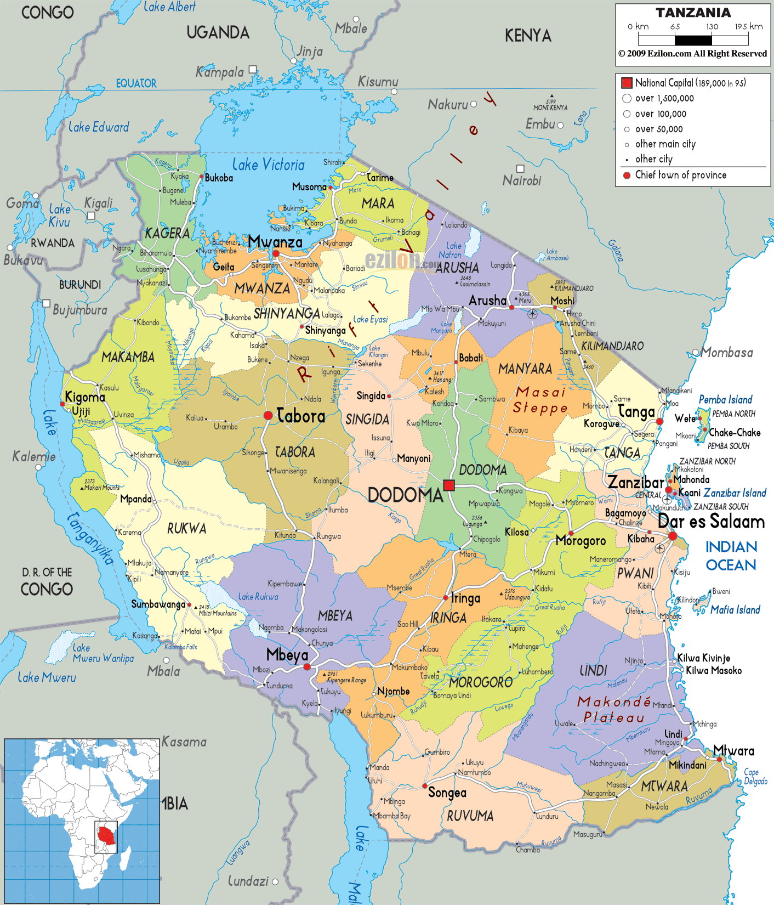
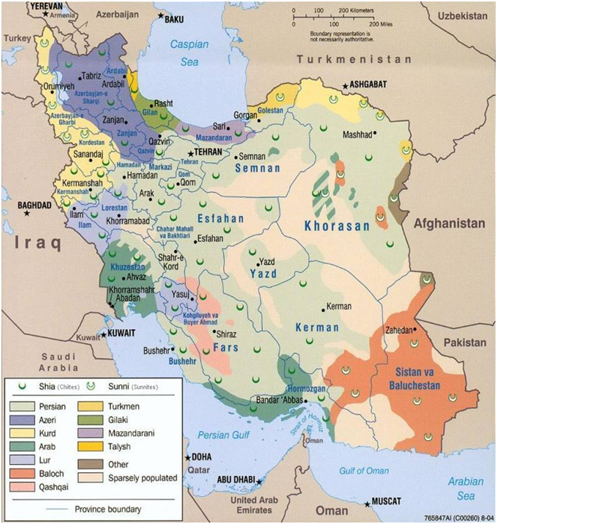
IRI – TZ RELATIONS TOOLING KIT
TANZANIA
IRAN
CULTURAL
HISTORICAL
POLITICAL
SOCIAL
ECONOMIC

Slide 8
OUR RELATIONS STRATEGIC TOOLKIT - PEOPLE CENTRIC
OVER 1000 YRS COOPERATION
OPPORTUNITIES
CHALLENGES
CLOSE TIES
SPIRITUAL , BROTHERLY – BLOOD TIES
HISTORICAL, CULTURAL,
SOCIAL
ECONOMIC PARTNERSHIP TOOL
REVOLUTONARY IDEOLOGY MOBILATION TOOL
TANGA
PANGANI
BAGAMOYO
KILWA
LINDI
MIKINDANI
TABORA – LAKE VICTORIA CORRIDOR
KIGOMA – UJIJI – LAKE TANGANYIKA CORRIDOR
MBEYA
IRINGA
LAKE NYASA CORRIDOR

Slide 9
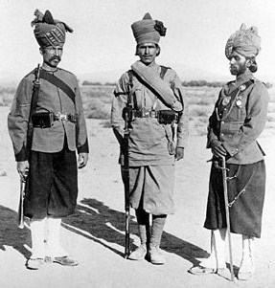
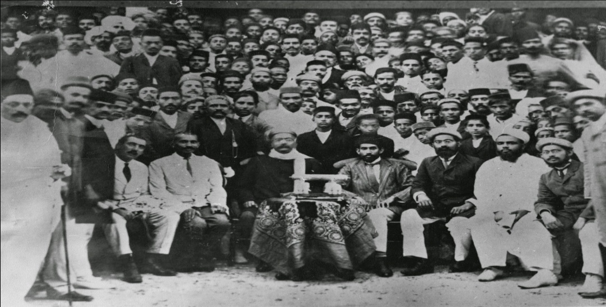
REALITY OF RELATIONS
PROVIDE THE MILITARY THE BALOCHI – ZANZIBAR, TABORA - MBEYA CORRIDOR
SHIRAZI ELITE CLASS, PART OF MONARCHY POLITICAL CLASS IN ZANZIBAR

Slide 10
RELATIONS: HISTORICAL PRESENTISM
1821 SULTAN SEYYID SAID HIRED AN IRANIAN FLEET CONSISTING MOSTLY BALOCH TO INVADE THE ISLAND
IN 1873, HALF OF THE SULTAN’S 3000 ZANZIBARI TROOPS ENGAGED IN THE WAR IN UNYANYEMBE AGAINST NYAMWEZI CHIEF MIRAMBO WERE BULUSHI (BALOCH) AND SHIHIRI (HADRAMI) MERCENARIES

Slide 11
RELATIONS: PEOPLE CENTRIC
CULTURE: IRAN CULTURAL INFLUENCES – ARISTOCRATIC LIFESTYLES PERSIAN ITEMS - CHEREHANI, KARKHANA
IDENTITY OF THE SHIRAZI PEOPLE IN ZANZIBAR
RELIGION: SUNNI IN EARLY ISLAMIC PERIOD; SHIA ITHNAASHERI PRESENCE IN SWAHILI/SHIRAZI - INTERMARRIAGE
LINGUISTIC: IRAN LINGUISTIC INFLUENCES IN SWAHILI WORDS ESP MILITARY FROM BALOCHI – JEMEDARI, SINGE, AFANDE, BUNDUKI, HABEDARI (ARABIC-PERSIAN-TURKIC)

Slide 12
WHY PROMOTE STRATEGIC PARTNERSHIP
STRATEGIC PARTNERSHIP – SOUTH-SOUTH
ALTERNATIVE DEVELOPMENT MODEL - PEOPLE CENTRIC
POOR DEVELOPMENTAL MODEL
INTERNAL NON WESTERN/EASTERN
UNIFYING IDEOLOGY SIGNIFICANCE CEREMMONIAL CENTRE – UJAMAA vs ISLAM

Slide 13
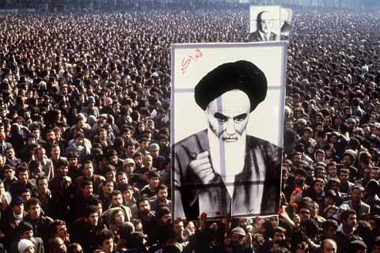
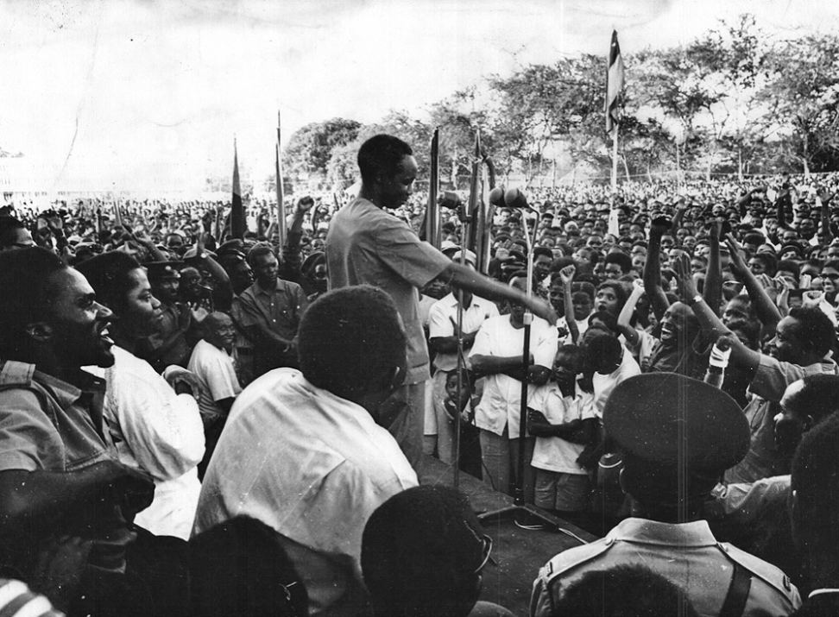
CEREMMONIAL SYMBOLISM CENTRES UNIFYING IDEOLOGY
ISLAM - AYATOLLAH KHOMEINI
UJAMAA – MWL NYERERE
MAGUFULIPHILIA - TANZAPHILIA

Slide 14
OUR COMMON ROOTS TO STRATEGIC PARTNERSHIP
SIGNIFICANT STRATEGIC HISTORICAL , GEOPOLITICAL LOCATION
LONG SOUTH SOUTH NON ALIGNED GROUP
SUPPORT EACH OTHER IN SITUATION OF STRESS – ISOLATION GLOBALLY – UJAMAA, ISLAMIST IDEOLOGY - WAR,
SOUTH SOUTH PARTNER SINCE REVOLUTION - RUBADA

Slide 15
STRATECIC PARTNERNING POTENTIAL HEAVYWEIGHTS
IRI – REGIONAL TERRAIN
TZ REGIONAL TERRAIN
IRI POWER IN PERSIAN GULF
DRIVER OF CHANGE IN MIDDLE EAST, THE STANS, SOUTHERN CENTRAL EASTERN EUROPE
POWER IN ISLAMIC STATES
DRIVER OF SOUTH - SOUTH COOPERATION
DRIVER INDEPENDENT NATIONAL DEVELOPMENT
POWER BALANCE PERSIAN-MIDDLE EAST GLOBAL GEOPOLITICS, COLD WAR, POST COLD WAR
EAC STATES
SADC STATES
GREAT LAKES REGION
COMESA
AU
SOUTH – GLOBAL STATES

Slide 16
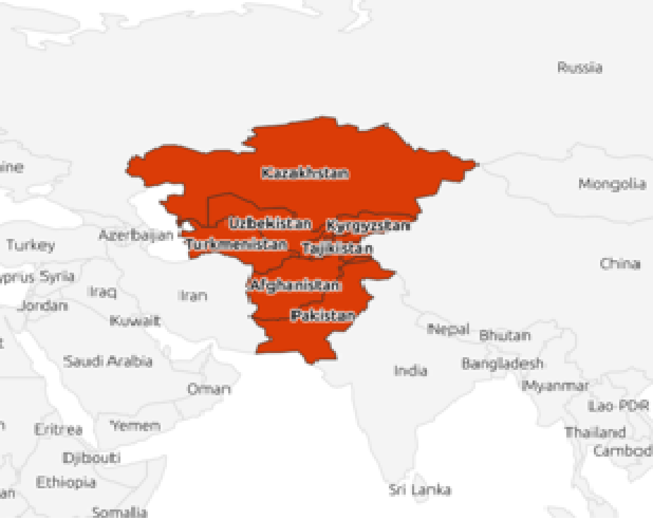
IRAN INVESTMENT OTLOOK
INTO STANS

Slide 17
THE STANS
IRAN IS SITUATED IN VOLATILE BUT RICH PERSIAN GULF
HAS MANY ADVANTAGES - INFLUENCE IN STANS COUNTRIES, RUSSIA, CENTRAL AND EASTERN EUROPE AND THE MIDDLE EAST.
STANS INCLUDES AFGHANISTAN, KAZAKHSTAN, KYRGYZSTAN, PAKISTAN, TAJIKISTAN, TURKMENISTAN AND UZBEKISTAN
SOME FORMER USSR, A ZONE OF CONTENTION OF INTEREST.
IRAN - GOLESTAN, KHUZESTAN AND KURDISTAN

Slide 18
FUTURISTIC STRATEGIC SOUTH SOUTH PARTNERSHIP FOR COMPETITIVE ADVANTAGE
ERA OF COMPETITIVE IMPERIALIST NON POLAR WORLD
OPPORTUNITY FOR AFRICA PEOPLE TO UNITE AND PARTNER/WORK WITH WEAK TO ACHIEVE ECONOMIC LIBERATION
THE FUTURE LIES IN FOCUSING SUCH OPPORTUNITIES
ECONOMIC REVOLUTION STEMS FROM PEOLE CENTRIC CONNECTION OPTION AND PARTNERSHIPS

Slide 19
CONCLUSION
IRAN TO EAST AFRICA ESPECIALLY TANZANIA OFFER AN OPPORTUNITY FOR PEOPLE CENTRIC ECONOMIC LIBERATION
ACHIEVING ECONOMIC LIBERATION FOR THE WEAK REQUIRES BOTH THE WEAK/SOUTH PARTNERSHIP IN STRATEGIES AND IN CHANGE OF PARADIGM AGAINST CAPITALIST IMPERIALIST DECEPTION STRAGIES/MACHINATION ON REVOLUTIONARY MOBILAZATION TOOLS – BE IT IDEOLOGICAL, RELIGIOUS, CULTURAL, HISTORICAL – UNITY OF PURPOSE BE MANTAINED

Slide 20
UNIFYING IDEOLOGIES ARE LIFEBLOOD OF NATIONS DEVELOPMENT – ISLAM, UJAMAA JUST LIKE WESTERN WORLD THE IDEOLOGY OF WESTERN DEMOCRACY TZ IRAN PRIDE STEMS FROM OUR HISTORY - INCULCATES NATION PRIDE, PROMOTES NATIONAL INTERESTS AND INTENSIFIES SOLIDARITY OVER 1000 YEARS TIES MUST BUILT TRUST IN DIPLOMACY, COOPERATION IS OUR STRATEGIC PARTNERSHIP SPRING BOARD PEOPLES CONNECTIVITY MUST OPEN ECONOMIC REVOLUTION AND DEVOLOPMENT
THANK YOU
ASANTE SANA

