Slide 1
Strengthening the HE Area of Muslim Developing Countries
Asian Cultural Dialogues
Mashhad, Iran
January 14th, 2018

Slide 2
Networking Together
Three fundamental issues
Philosophy of Islam – approach to God
How does learning take place – guidance given in the Al-Qur’an – implementing the guidance to deliver learning in today’s classrooms
How can the Al-Qur’an feed and enrich modern science

Slide 3
1. Approach to God
Two points of view
God is created for our service OR
We have been created to serve God
Which is the Islamic point of view?

Slide 4
How can I fulfill my purpose?
Approach anything/anyone including God to
serve self
Needs
Who/what am I?
Vicegerent
God
Shift
Self
What is my Purpose?
Receive
Guidance from God
Materialism
Corruption

Slide 5
Reference – Al-Qur`an
Then see such a one who takes as his god his own vain desire? Allah has knowing (him as such) left him astray and sealed His hearing and his heart (and understanding) and put a cover on his sight. Who then will guide him after Allah (has withdrawn Guidance)? Will you not then receive warning? [45.23]

Slide 6
2. How does learning take place?
References from the Al-Qur’an

Slide 7

How does learning take place?
Brain
Brain
Ear
Ear
Lecture
Sounds?
Videos?
OPTIONAL?
SAME?
Meaning
Human
Monkey
Questions
Q. What?
Q. How?
If so, how should effective learning be implemented?
Q. Apply?

Slide 8
وَعَلَّمَ آدَمَ الْأَسْمَاءَ كُلَّهَا ثُمَّ عَرَضَهُمْ عَلَى الْمَلَائِكَةِ فَقَالَ أَنْبِئُونِي بِأَسْمَاءِ هَؤُلَاءِ إِنْ كُنْتُمْ صَادِقِينَ
And He taught Adam the names, all of them; then he presented them to the angels, and said, "Tell Me the names of these, if you are sincere.” (2:31)
وَعَلَّمَ آدَمَ الْأَسْمَاءَ كُلَّهَا ثُمَّ عَرَضَهُمْ عَلَى الْمَلَائِكَةِ فَقَالَ أَنْبِئُونِي بِأَسْمَاءِ ه
قَالَ يَا آدَمُ أَنْبِئْهُمْ بِأَسْمَائِهِمْ فَلَمَّا أَنْبَأَهُمْ بِأَسْمَائِهِمْ قَالَ أَلَمْ أَقُلْ لَكُمْ إِنِّي أَعْلَمُ غَيْبَ السَّمَاوَاتِ وَالْأَرْضِ وَأَعْلَمُ مَا تُبْدُونَ وَمَا كُنْتُمْ تَكْتُمُونَ
He said, "O Adam, tell them their names." And when he told them their names, He said, "Did I not tell you that I know the secrets of the heavens and the earth, and that I know what you reveal and what you conceal” (2:33)

Slide 9
3. What do Neurons contain?
Reference:
How did God teach Moses to
face Pharaoh? [20.17 – 20.28]

Slide 10
Science of Learning {1}
“You are born with at least 100 billion brain cells, called neurons…Your personal neurological network grows more and more massive with synapses connecting the neurons with each new piece of information learned…” {1}
{1} https://www.envisionexperience.com/blog/the-science-of-learning-how-the-brain-learns
What can neurons contain? – Ayat 2.31

Slide 11
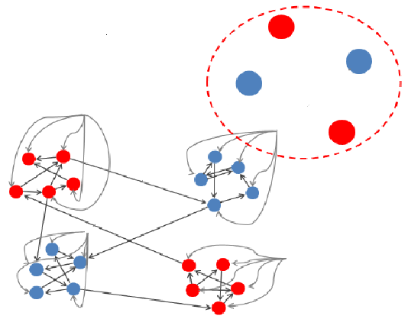
Neuron Clusters – Data Centers?
20.17 “And what is that in your right hand, O Moses?”
20.18 “He said, "It is my rod: on it I lean..(other uses)”
Ayat
20.24
20.19 “(Allah) said "Throw it O Moses!’”
6
20.20 “He threw it…It was a snake.”
Meeting with God
20.21 “(Allah) said, "Seize it and fear not…
Ayat 20.17
20.24 “"Go to Pharaoh…”
1
Ayat
20.21
Pharaoh
5
Aaron
Ayat 20.18
Moses’ Existing Neuron Clusters
2
Ayat
20.19
Ayat
20.20
3
Rod
4
Snake
Would God’s conversation with Moses follow a pattern?

Slide 12
Way Forward?
Network, work together:
Examine approach to God, introduce Islamic approach in curricula
Introduce teaching methodology based on guidance given in the Al-Qur’an
Support the development of modern science using Revelation – adopt a question based approach to deriving knowledge from the Al-Qur’an.

