Slide 1
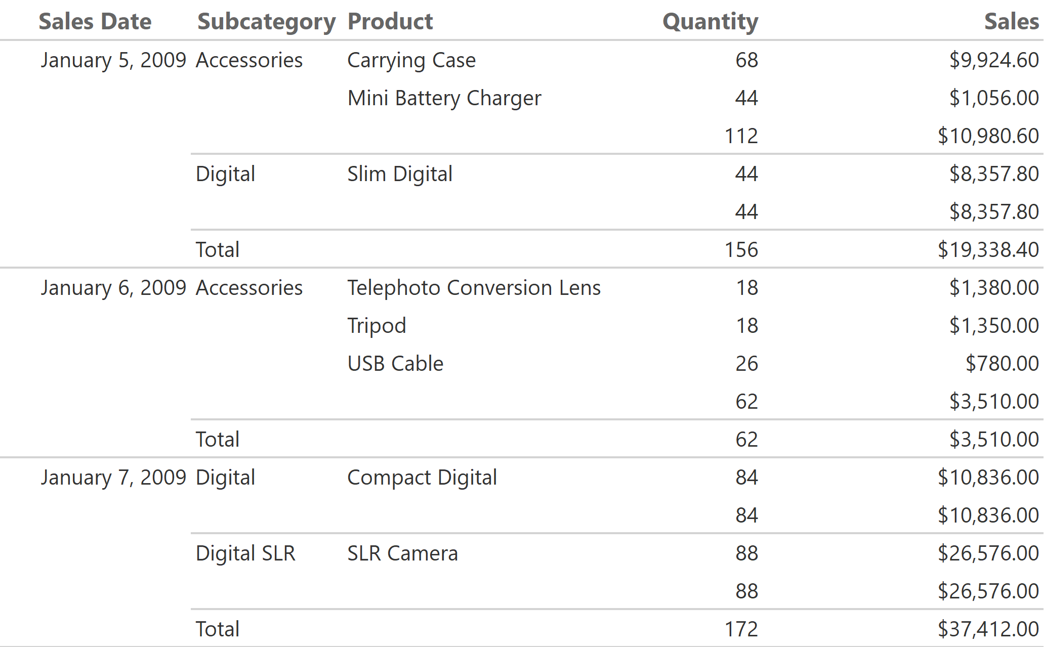
Product Sales
5/1/2018 9:53:26 AM

Slide 2
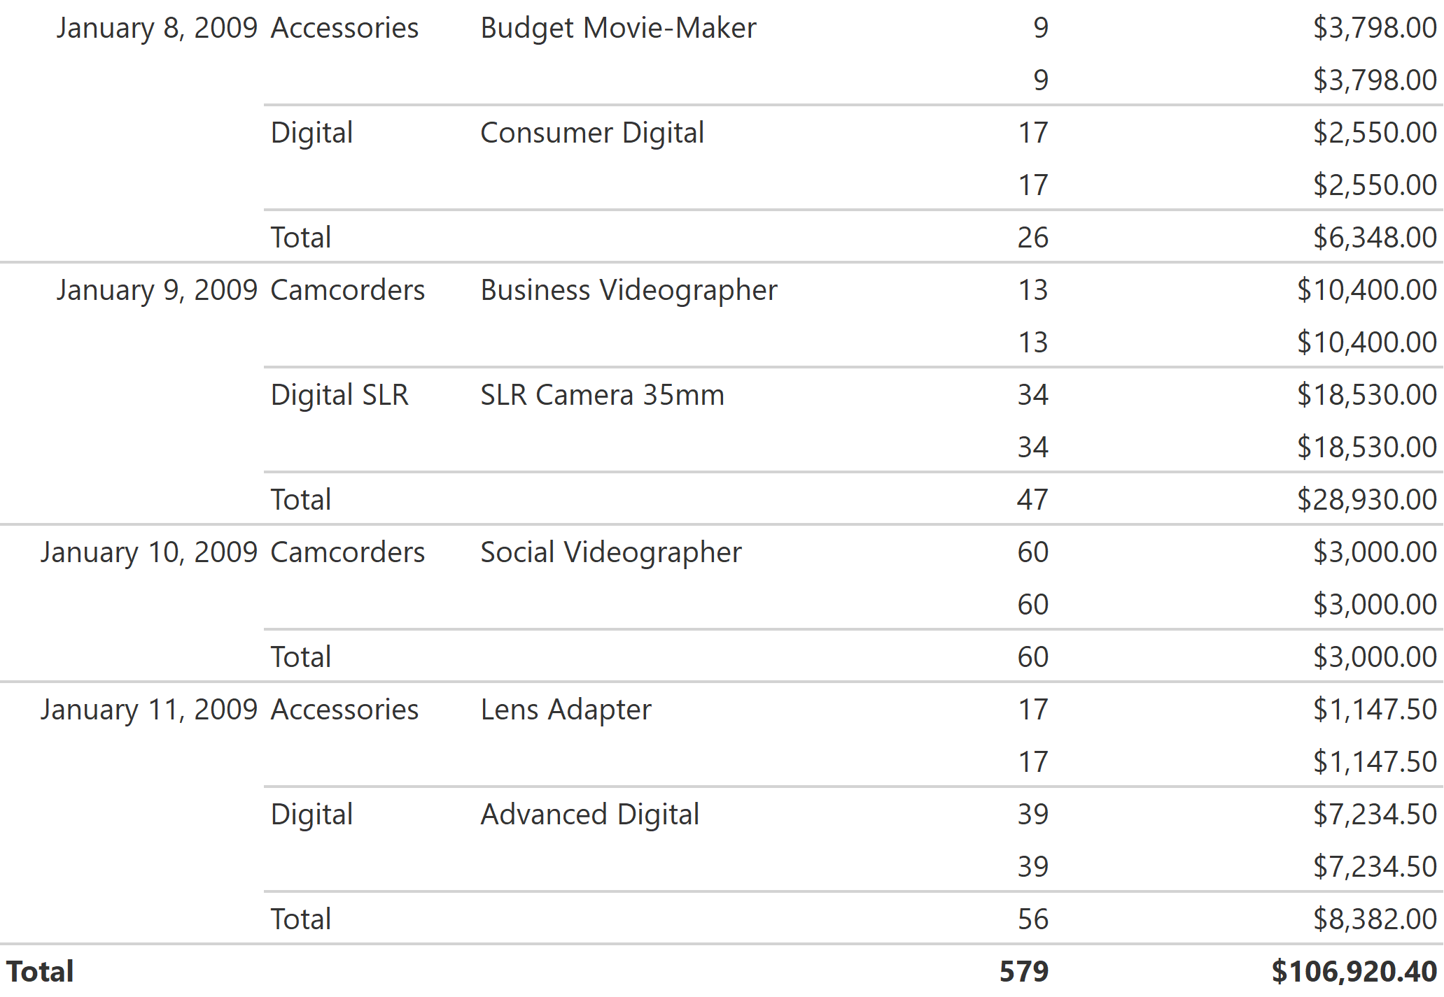
5/1/2018 9:53:26 AM

