Slide 1
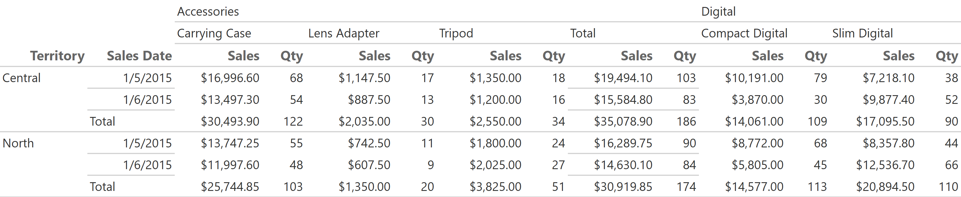
Sales by Territory, Subcategory, and Day
5/1/2018 11:36:46 AM

Slide 2
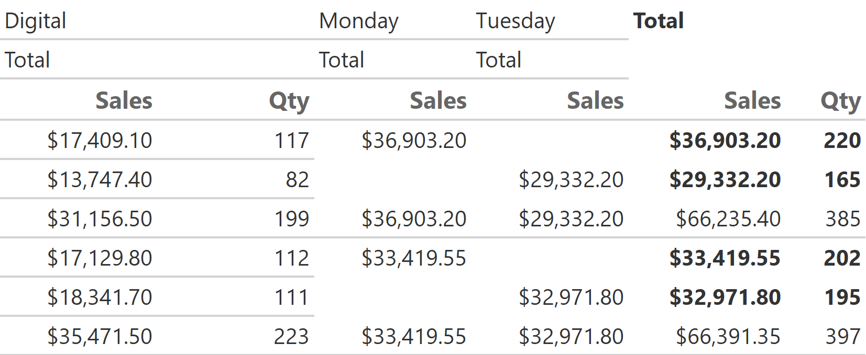
Sales by Territory, Subcategory, and Day
5/1/2018 11:36:46 AM

Slide 3
Sales by Territory, Subcategory, and Day
5/1/2018 11:36:46 AM

Slide 4
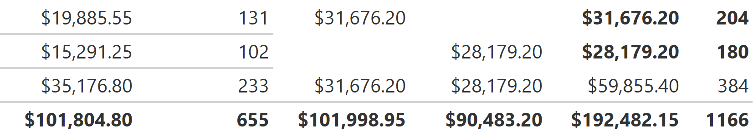
Sales by Territory, Subcategory, and Day
5/1/2018 11:36:46 AM

