Slide 1
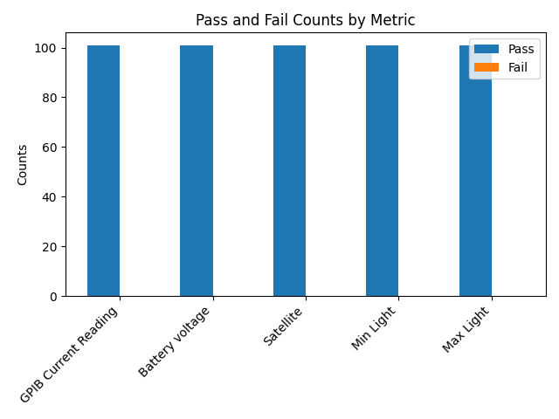
Metric | GPIB Current Reading | Battery voltage | Satellite | Min Light | Max Light
Quantity | 101 | 101 | 101 | 101 | 101
Pass % | 100.00% | 100.00% | 100.00% | 100.00% | 100.00%
Fail % | 0.00% | 0.00% | 0.00% | 0.00% | 0.00%
Pass | 101 | 101 | 101 | 101 | 101
Fail | 0 | 0 | 0 | 0 | 0

Slide 2
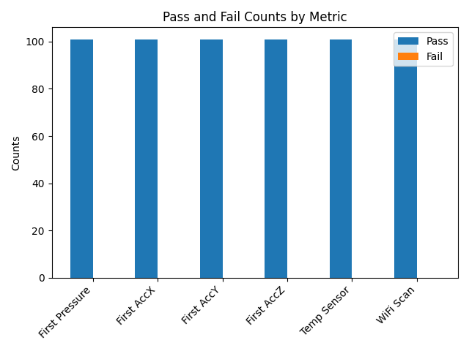
Metric | First Pressure | First AccX | First AccY | First AccZ | Temp Sensor | WiFi Scan
Quantity | 101 | 101 | 101 | 101 | 101 | 101
Pass % | 100.00% | 100.00% | 100.00% | 100.00% | 100.00% | 100.00%
Fail % | 0.00% | 0.00% | 0.00% | 0.00% | 0.00% | 0.00%
Pass | 101 | 101 | 101 | 101 | 101 | 101
Fail | 0 | 0 | 0 | 0 | 0 | 0

Slide 3
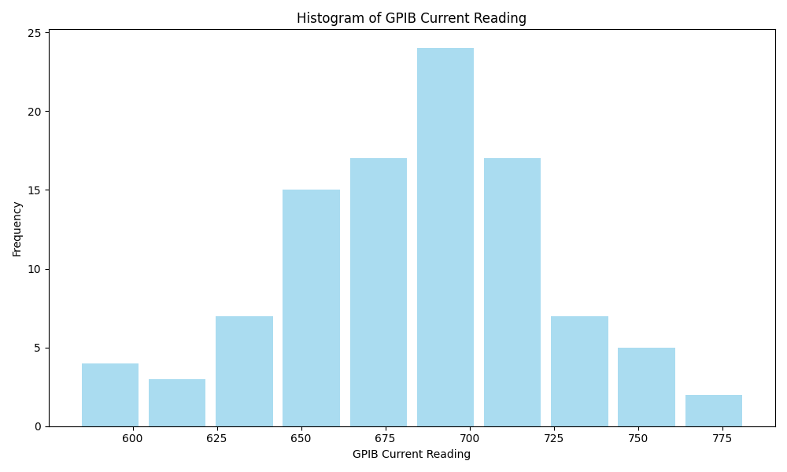
Metric | GPIB Current Reading
Count | 101
Mean | 683.60
Std | 39.42
Min | 583.39801
Max | 782.401978

Slide 4
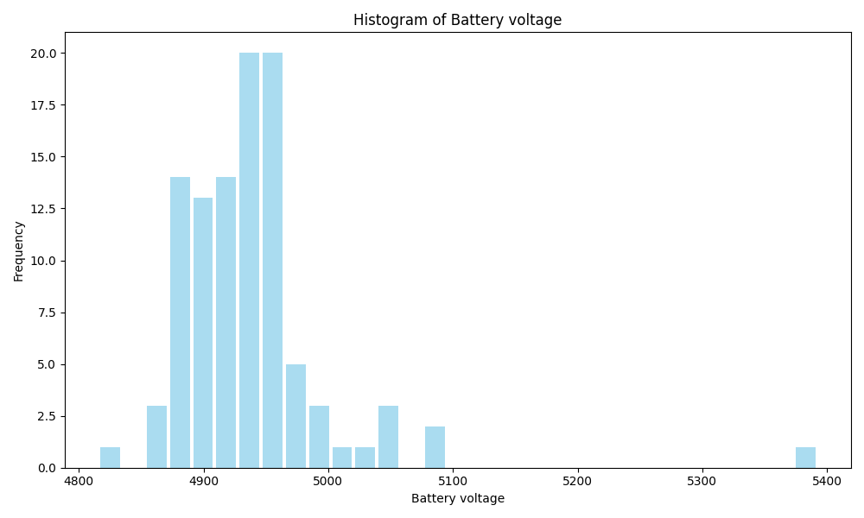
Metric | Battery voltage
Count | 101
Mean | 4938.34
Std | 64.67
Min | 4816
Max | 5392

Slide 5
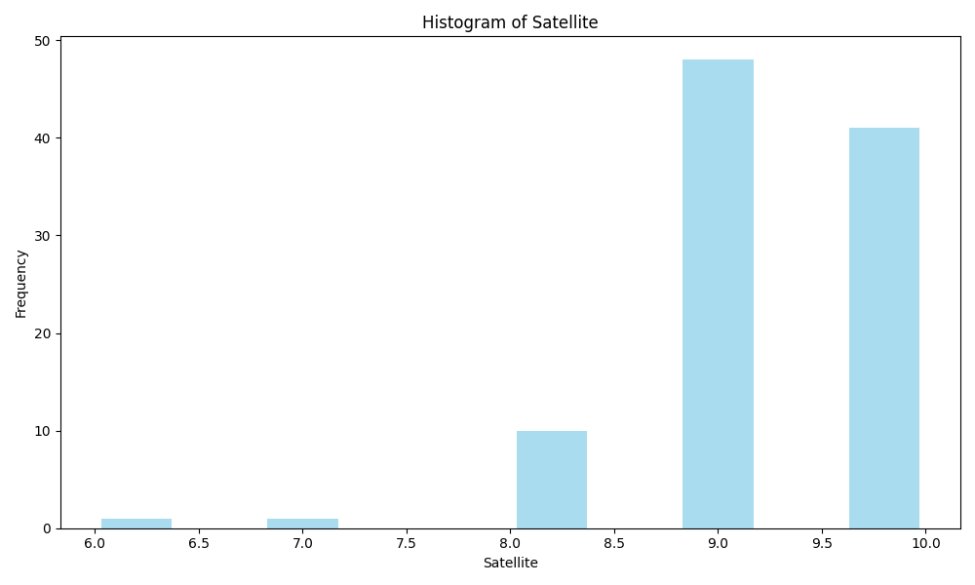
Metric | Satellite
Count | 101
Mean | 9.26
Std | 0.75
Min | 6
Max | 10

Slide 6
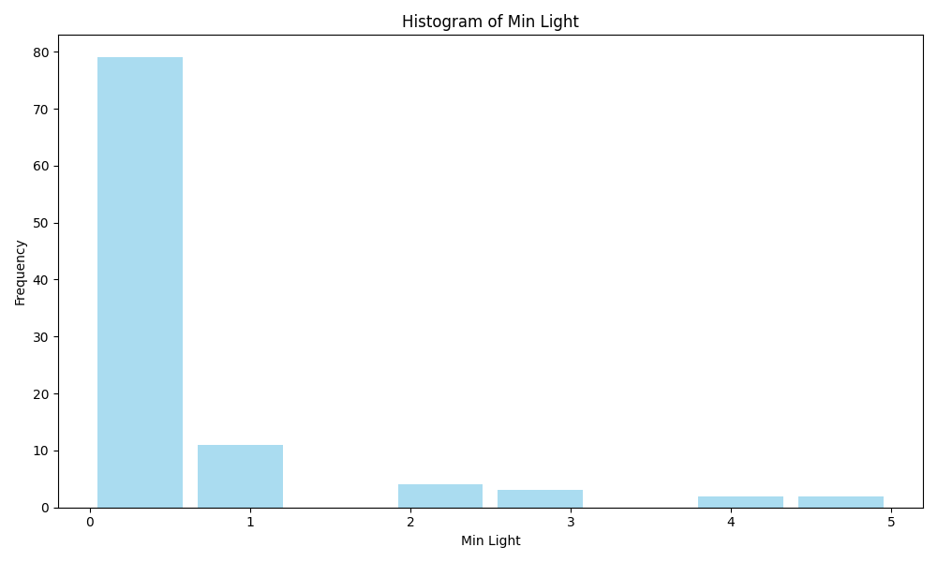
Metric | Min Light
Count | 101
Mean | 0.46
Std | 1.07
Min | 0
Max | 5

Slide 7
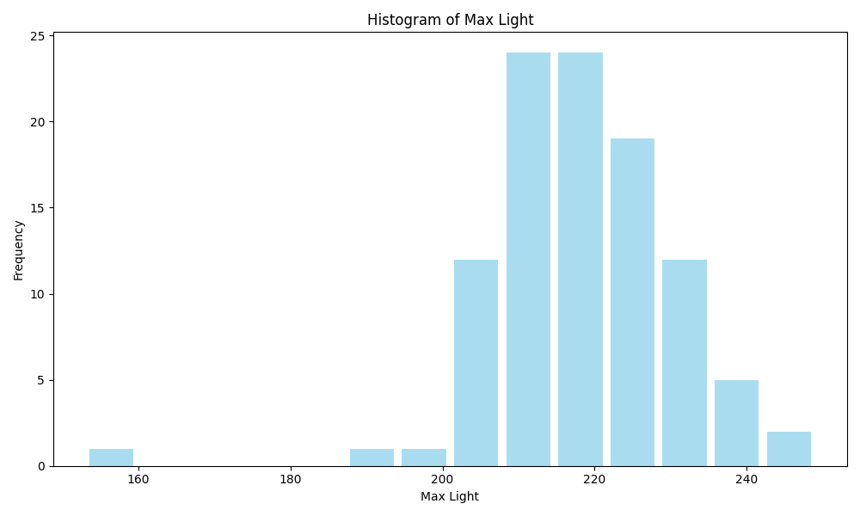
Metric | Max Light
Count | 101
Mean | 218.33
Std | 12.57
Min | 153
Max | 249

Slide 8
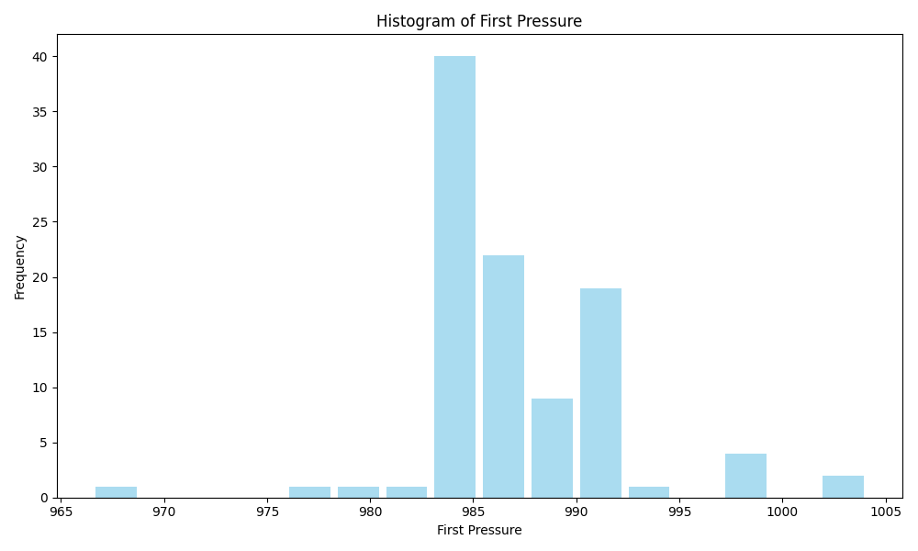
Metric | First Pressure
Count | 101
Mean | 987.15
Std | 4.75
Min | 966.49
Max | 1004.11

Slide 9
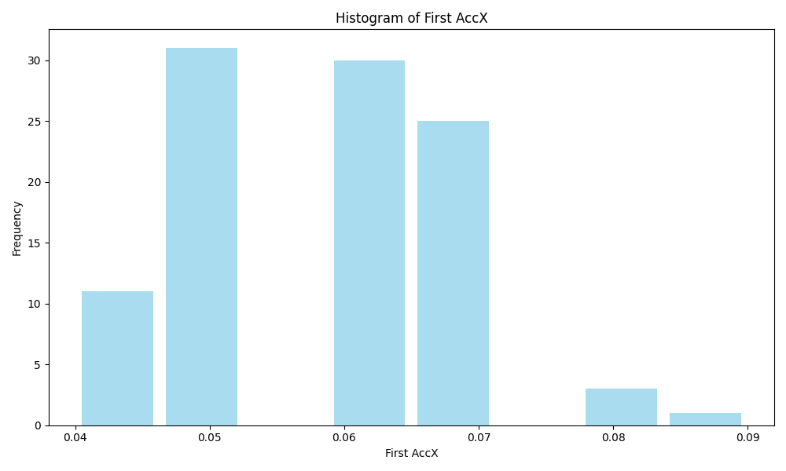
Metric | First AccX
Count | 101
Mean | 0.06
Std | 0.01
Min | 0.04
Max | 0.09

Slide 10
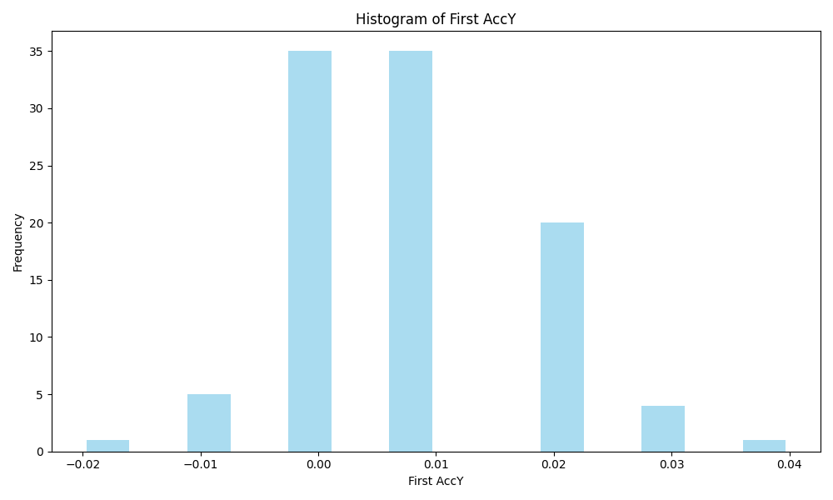
Metric | First AccY
Count | 101
Mean | 0.01
Std | 0.01
Min | -0.02
Max | 0.04

Slide 11
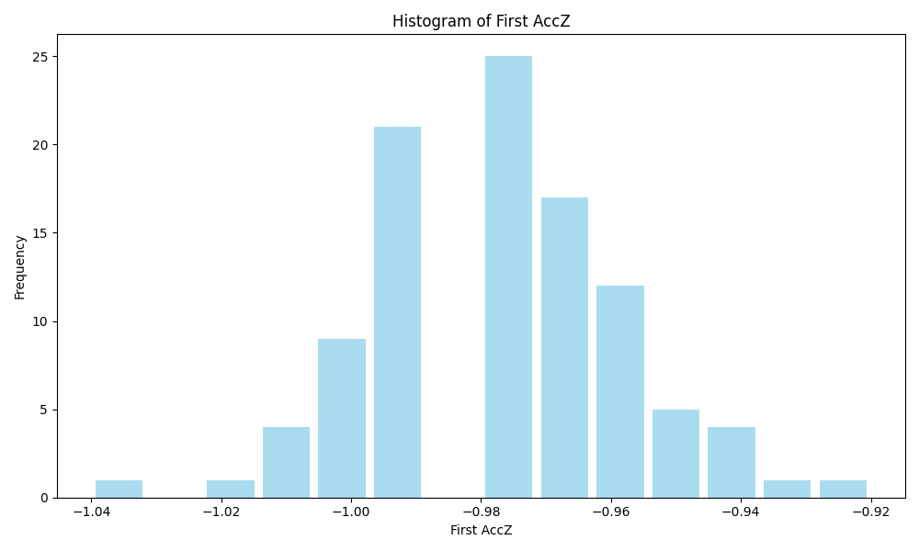
Metric | First AccZ
Count | 101
Mean | -0.98
Std | 0.02
Min | -1.04
Max | -0.92

Slide 12
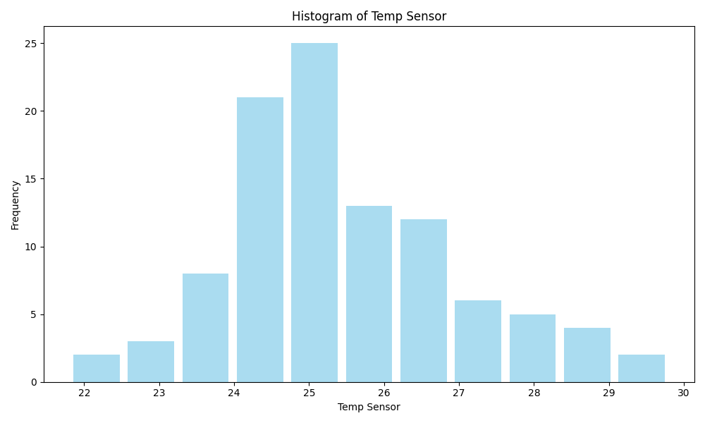
Metric | Temp Sensor
Count | 101
Mean | 25.45
Std | 1.54
Min | 21.8
Max | 29.8

Slide 13
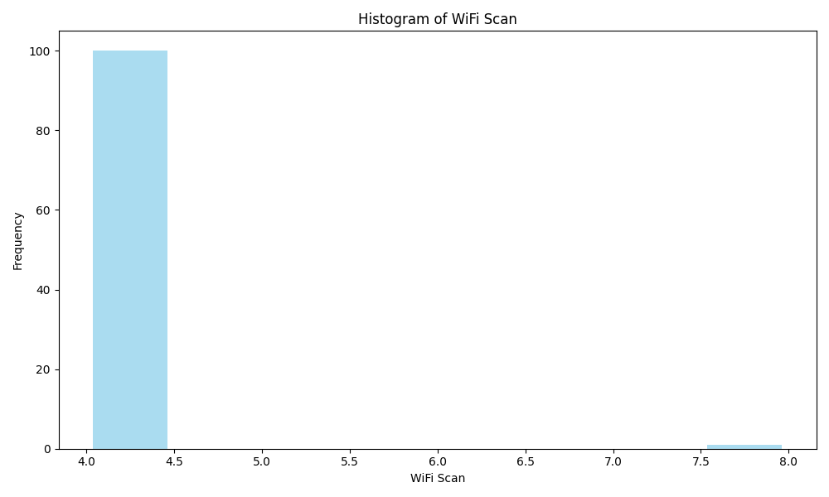
Metric | WiFi Scan
Count | 101
Mean | 4.04
Std | 0.40
Min | 4
Max | 8

