Slide 1

Institute of Aeronautical Engineering
(Autonomous)
Department of Electronics and Communication Engineering
TOPIC:- An IOT-based Sustainable Energy Monitoring and Alert System with Billing Integration
Supervisor
Dr. V Padmanabha Reddy
Professor
Team Members
19951A04N5 – B Manoj Reddy
19951A04K2 – M Uday Ganesh Reddy
19951A04J1 - R Sunny

Slide 2
Introduction
In the present-day society, the increasing demand for energy, coupled with the pressing need to address environmental concerns, has made sustainable living a critical priority.
Residential buildings, being one of the major contributors to energy consumption and carbon emissions, play a significant role in shaping a sustainable future.
In light of this, there is an urgent need to develop innovative solutions that enable homeowners to monitor and optimize their energy usage while promoting environmental consciousness.
The present scenario calls for a comprehensive and integrated approach to address the challenges of energy management and environmental sustainability in residential settings.
Homeowners require tools that not only provide real-time information about their energy consumption but also offer insights into their indoor environment.
This information empowers them to make informed decisions, reduce their ecological footprint, and create a more sustainable living space

Slide 3
Statement of The Problem
Despite the increasing availability of energy monitoring systems, traditional approaches often lack real-time data, comprehensive insights, and user-friendly interfaces.
Users are often unable to monitor their energy consumption and make informed decisions to optimize their usage patterns. Additionally, limited environmental sensing capabilities restrict homeowners' understanding of indoor temperature and humidity levels, leading to potential discomfort and inefficient energy utilization.
To address these challenges, this project aims to develop an embedded system that integrates energy monitoring, load control, environmental sensing, and cloud connectivity.
By leveraging the power of embedded systems, real-time operation, and IoT technologies, this project seeks to provide users with accurate, real-time data on energy consumption, load status, temperature, and humidity.
The project aims to empower homeowners to optimize their energy usage, reduce costs, and create a sustainable living environment.

Slide 4
Significance of the Research
To address these challenges, this project aims to develop an embedded system that integrates energy monitoring, load control, environmental sensing, and cloud connectivity.
By leveraging the power of embedded systems, real-time operation, and IoT technologies, this project seeks to provide users with accurate, real-time data on energy consumption, load status, temperature, and humidity.
The project aims to empower homeowners to optimize their energy usage, reduce costs, and create a sustainable living environment.
The outcomes of the project demonstrate the practical and tangible results that can be achieved through the successful implementation of the project, providing users with valuable information and tools to monitor and manage their energy consumption and environmental conditions effectively.

Slide 5
Literature Review
While several energy monitoring and environmental sensing systems exist in the market, there are still notable research gaps that this project aims to address. These gaps can be identified as follows:
Limited Integration of Energy Monitoring and Environmental Sensing
Lack of Real-Time Data and Visualization
Threshold Monitoring and Alerting Mechanisms
By addressing these research gaps, this project aims to contribute to the field of energy monitoring, environmental sensing, and embedded system design.
The proposed system aims to address the constraints associated with current solutions by integrating energy monitoring, load control, environmental sensing, cloud connectivity, and real-time data visualization. Through these advancements, homeowners can make more informed decisions, optimize their energy usage, and create sustainable living environments.

Slide 6
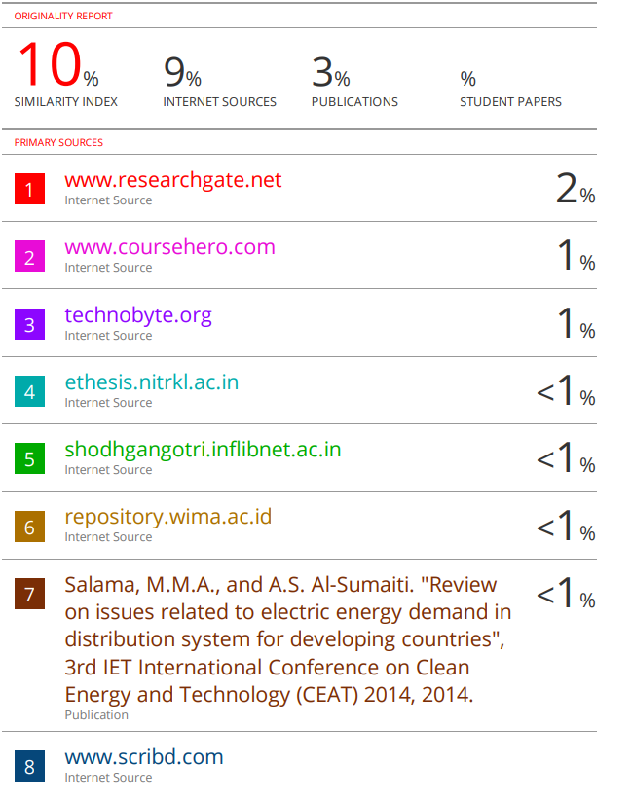
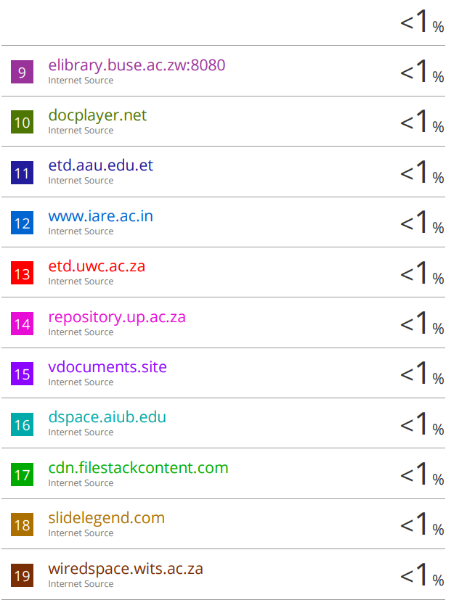
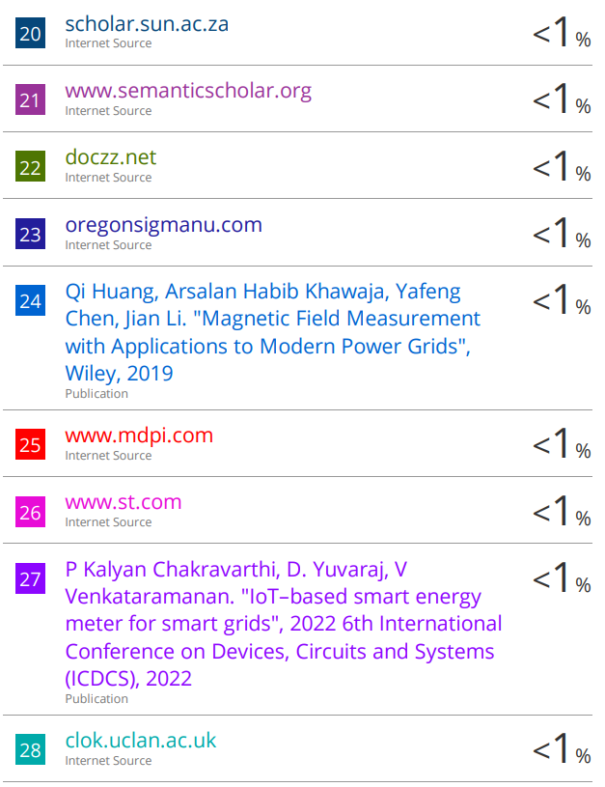
Data Collection

Slide 7
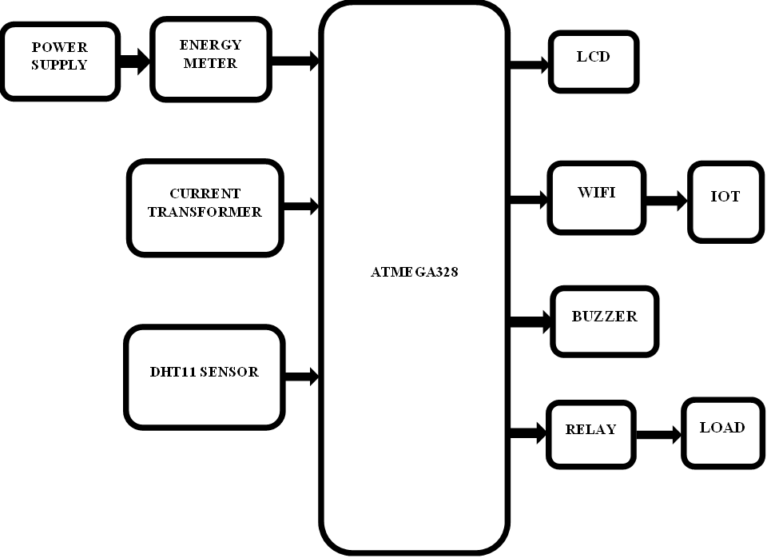
Advancements
The IOT-based energy management system is proposed to monitor household or industry-level energy consumption and provide a detailed analysis of it.
The system is designed to generate comprehensive electricity consumption reports, and seamlessly transmit the data to the cloud for user access and monitoring.
A humidity sensor has also been incorporated in the system, which measures the humidity level of the surrounding environment.
The proposed system is one step ahead of all the existing systems with this feature. The system is meticulously engineered to ensure that the user gets notified based on the humidity and temperature levels.

Slide 8
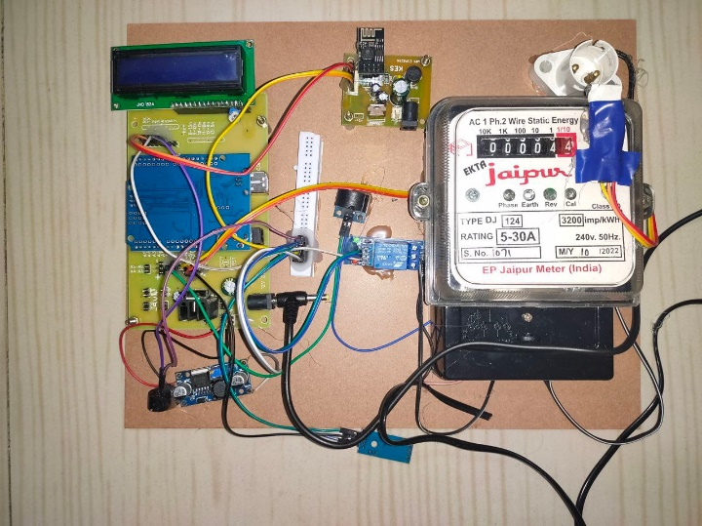
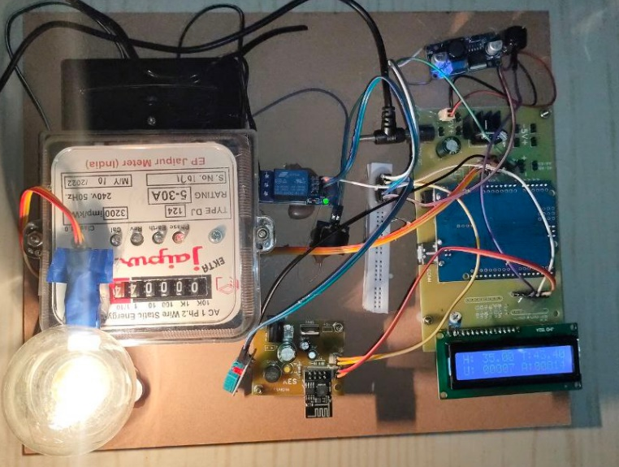
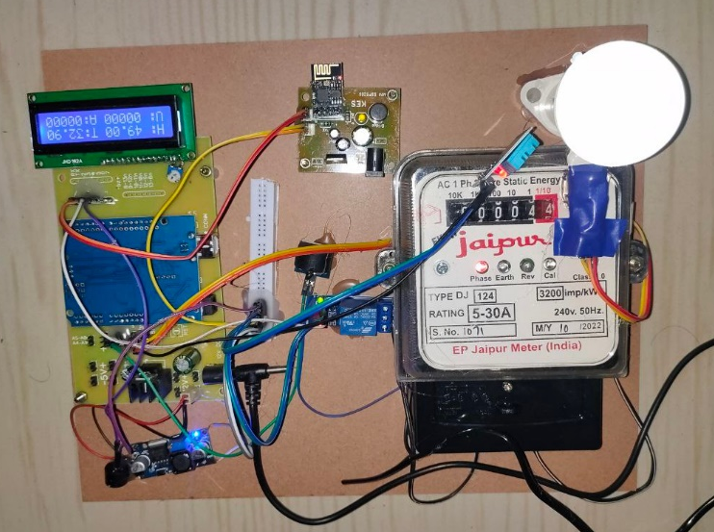
Results and Analysis
Figure 5.1: Fully developed system
Figure 5.3: 3W load
Figure 5.2: 100W load
Figure 5.1 shows the implemented system that was tested to evaluate its performance in real-world conditions.
Figure 2 showcases the connection of a 100W load to the energy monitoring and management system.
This setup allows the system to monitor and analyze the energy consumption of the 100W load accurately.
Figure 3 presents the connection of a 3W load to the energy monitoring and management system.
It demonstrates the wiring arrangement, illustrating the connection between the 3W load and the kit.

Slide 9
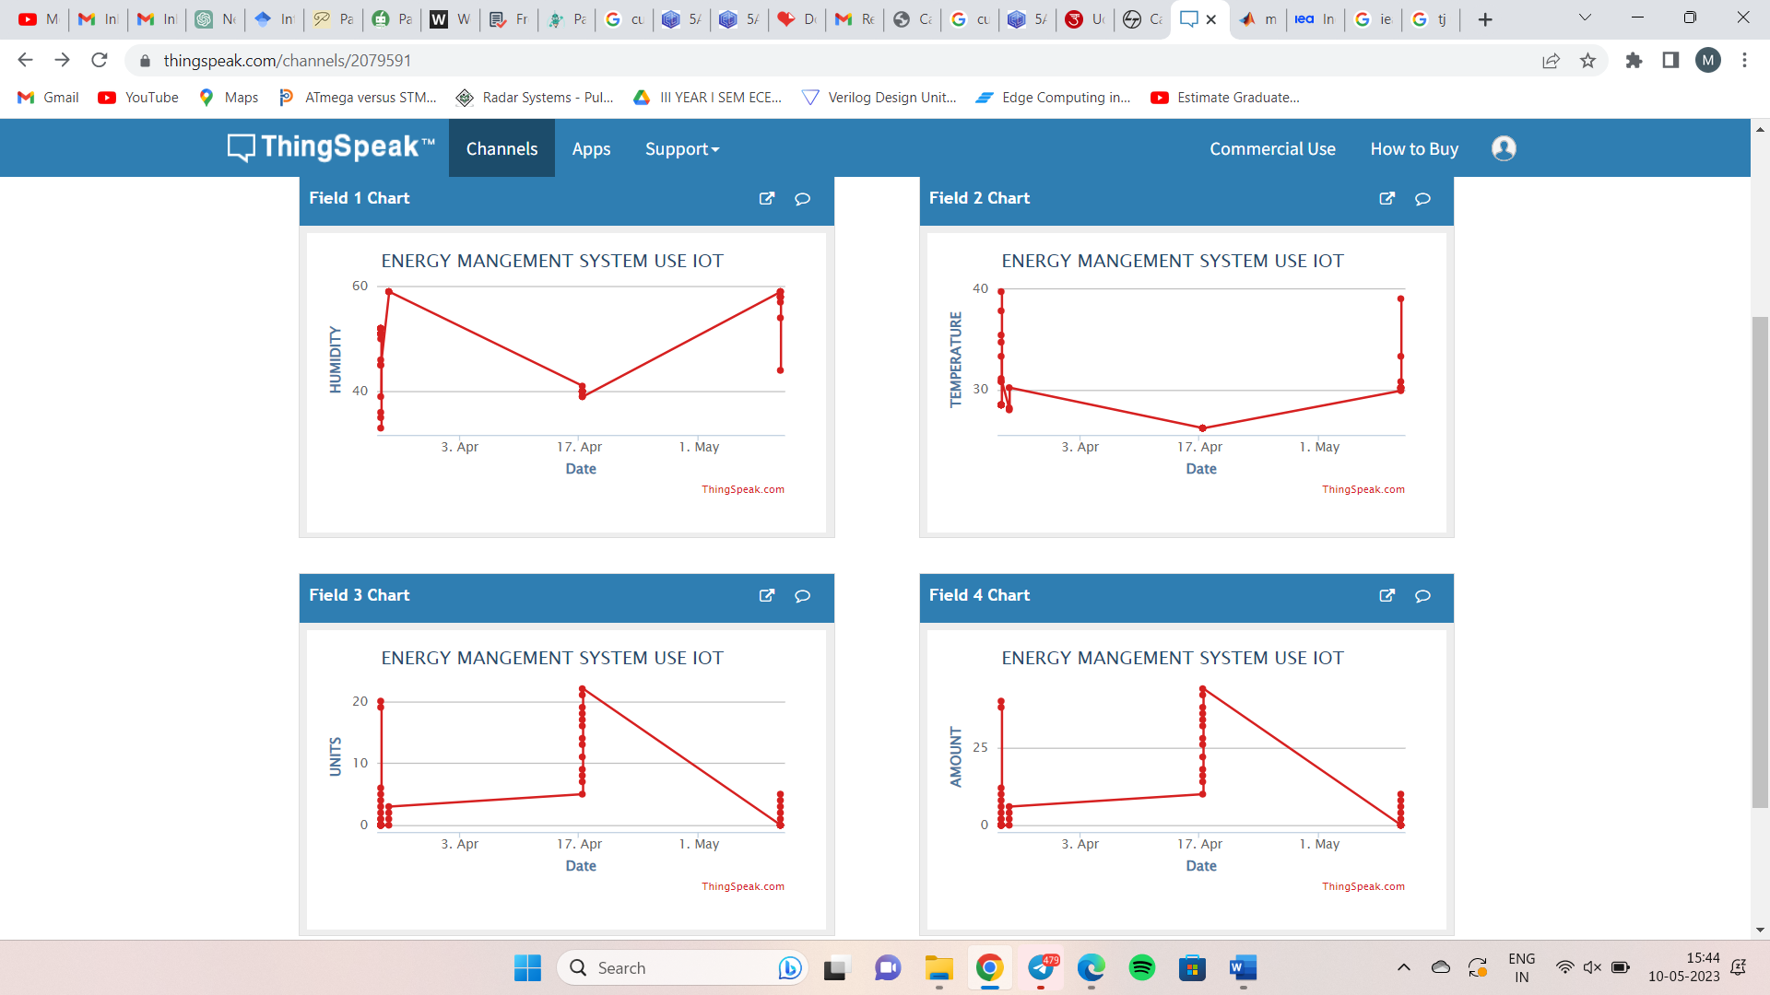
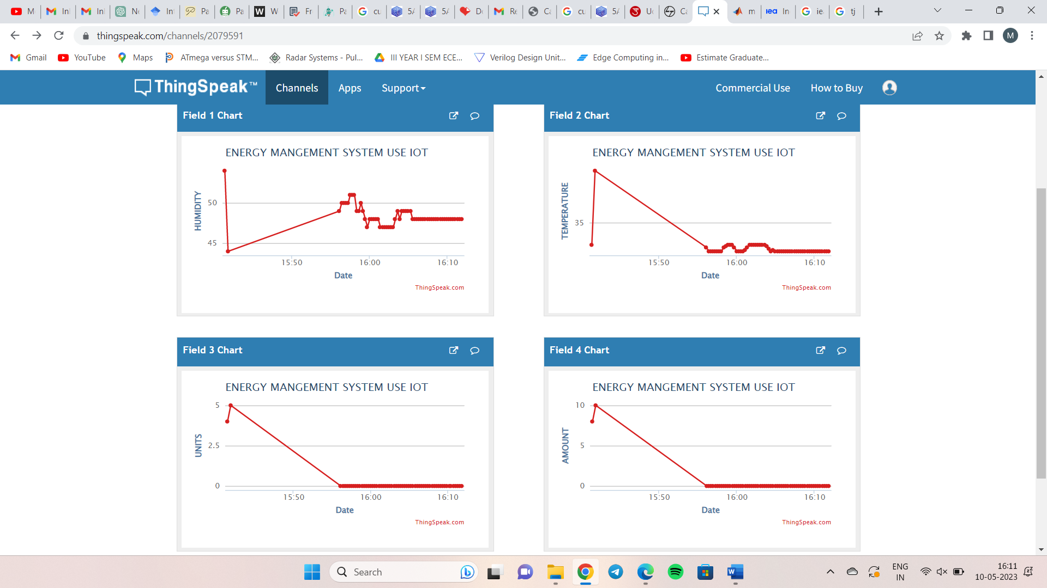
Results and Analysis
Figure 5.4 presents the analysis of the 100W load. The figure displays the humidity levels recorded during the monitoring period, ranging between 40 to 60.
Additionally, it shows the temperature levels, which remain consistently high, varying between 35 to 40 degrees.
This figure provides valuable insights into the humidity and temperature conditions associated with the operation of the 100W load, enabling further analysis and interpretation of its energy consumption patterns.
Figure 5.5 showcases the hygrometer analysis results of the 3W load. The figure depicts the recorded humidity levels during the monitoring period, which remain relatively constant between 45 to 50.
It also illustrates the temperature levels, which remain stable around 33 degrees.
This figure offers an overview of the humidity and temperature characteristics associated with the operation of the 3W load, facilitating the examination and understanding of its energy consumption behavior.
Figure 5.4: DHT11 Analysis of 100W load
Figure 5.5: DHT11 Analysis of 3W load

Slide 10
Results and Analysis
Figure 5.6 depicts the energy consumption analysis of the 100W load. The figure illustrates the units consumed over a specific period of time.
The graph reveals a rapid increase in units consumed within a short duration, indicating a higher energy consumption rate associated with the 100W load.
Figure 5.7 represents the energy consumption analysis of the 3W load. The figure showcases the units consumed over the monitoring period.
In this graph, the units consumed remain constant at zero, indicating that the 3W load does not consume any significant energy during the observed time frame.
Figure 5.6: Energy consumption analysis of 100W load
Figure 5.7: Energy consumption analysis of 3W load

Slide 11
Results and Analysis
Table 5.1: Tabular analysis of 100W load
Time | Humidity | Temperature | Units | Amount
10:08:07 UTC | 59 | 29.9 | 0 | 0
10:08:23 UTC | 59 | 30 | 0 | 0
10:08:40 UTC | 59 | 30.1 | 0 | 0
10:08:56 UTC | 59 | 30.2 | 0 | 0
10:09:13 UTC | 58 | 30.2 | 0 | 0
10:09:30 UTC | 58 | 30.2 | 0 | 0
10:09:45 UTC | 58 | 30.2 | 0 | 0
10:10:12 UTC | 58 | 30.2 | 1 | 2
10:10:36 UTC | 58 | 30.2 | 2 | 4
10:11:01 UTC | 57 | 30.8 | 3 | 6
10:11:25 UTC | 54 | 33.3 | 4 | 8
10:11:50 UTC | 44 | 39 | 5 | 10
Table 5.1 presents the real-time data for the 100W load in tabular form. It includes columns for temperature, humidity, units consumed, and amount.
Each row represents the values recorded at 15-second intervals, providing a detailed overview of the data captured by the system.
Figure 5.8 represents an Excel bar chart displaying the real-time data for the 100W load.
The chart showcases the variations in temperature, humidity, units consumed, and amount for every 15 seconds.
The y-axis illustrates the corresponding values, while the x-axis denotes the time intervals.
Figure 5.8: Excel analysis of 100W load

Slide 12
Results and Analysis
Table 5.2: Tabular analysis of 3W load
Time | Humidity | Temperature | Units | Amount
10:30:50 UTC | 48 | 32.8 | 0 | 0
10:31:07 UTC | 48 | 32.9 | 0 | 0
10:31:23 UTC | 47 | 33.1 | 0 | 0
10:31:40 UTC | 47 | 33.3 | 0 | 0
10:31:56 UTC | 47 | 33.3 | 0 | 0
10:32:13 UTC | 47 | 33.3 | 0 | 0
10:32:30 UTC | 47 | 33.3 | 0 | 0
10:32:46 UTC | 47 | 33.3 | 0 | 0
10:33:03 UTC | 47 | 33.3 | 0 | 0
10:33:19 UTC | 48 | 33.3 | 0 | 0
10:33:36 UTC | 49 | 33.3 | 0 | 0
10:33:52 UTC | 48 | 33.2 | 0 | 0
Table 5.2 exhibits the real-time data for the 3W load in a tabular format. Similar to Table 5.1, it includes columns for temperature, humidity, units consumed, and amount, with each row representing the values recorded at 15-second intervals.
Figure 5.9 shows an Excel bar chart displaying the real-time data for the 3W load. The chart showcases the variations in temperature, humidity, units consumed, and amount for every 15 seconds.
The y-axis represents the corresponding values, while the x-axis denotes the time intervals. There is no power consumption for this case.
Figure 5.9: Excel analysis of 3W load

Slide 13
Conclusion
This project successfully developed an integrated energy monitoring and environmental sensing system for residential homes. It leveraged embedded system technology to achieve real-time monitoring of electricity consumption, temperature, and humidity levels.
Key features included data visualization, cloud connectivity, and threshold-based alerts for optimized energy usage. The ESP8266 Wi-Fi module improved data transmission speed and accuracy, while the ThingSpeak cloud platform enabled remote access to data.
The user-friendly interface, LED display, and graphical representations enhanced usability. Threshold-based alerts with a buzzer indication system provided timely notifications.
Overall, this project contributes to energy conservation and sustainability by empowering homeowners to actively monitor and optimize their energy usage

Slide 14
Future Scope
The successful implementation of this project opens up exciting avenues for future enhancements. One potential area for further exploration is the integration of machine learning algorithms. By leveraging machine learning, the system can automatically detect consumption patterns and identify energysaving opportunities.
Advanced data analytics techniques, such as data clustering and predictive modeling, can also provide deeper insights into energy consumption trends and patterns. Another area of interest for future development is the integration of renewable energy sources.
This enables comprehensive analysis and optimization of self-sufficiency.
Additionally, developing a dedicated mobile application companion to the project enhances user convenience, allowing for easy monitoring of energy consumption, real-time alerts, and access to comprehensive analytics and recommendations on smartphones or tablets.
These potential future enhancements have the potential to further advance energy monitoring and management systems, empowering users to optimize their energy usage, reduce costs, and promote sustainability.

Slide 15
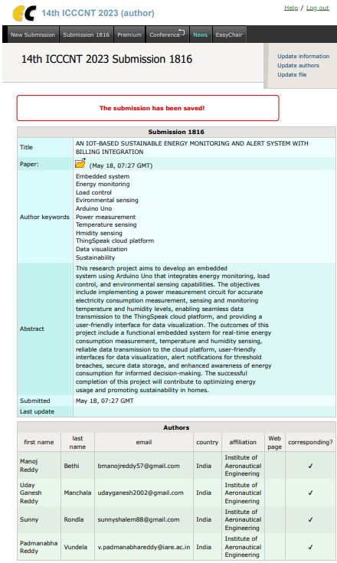
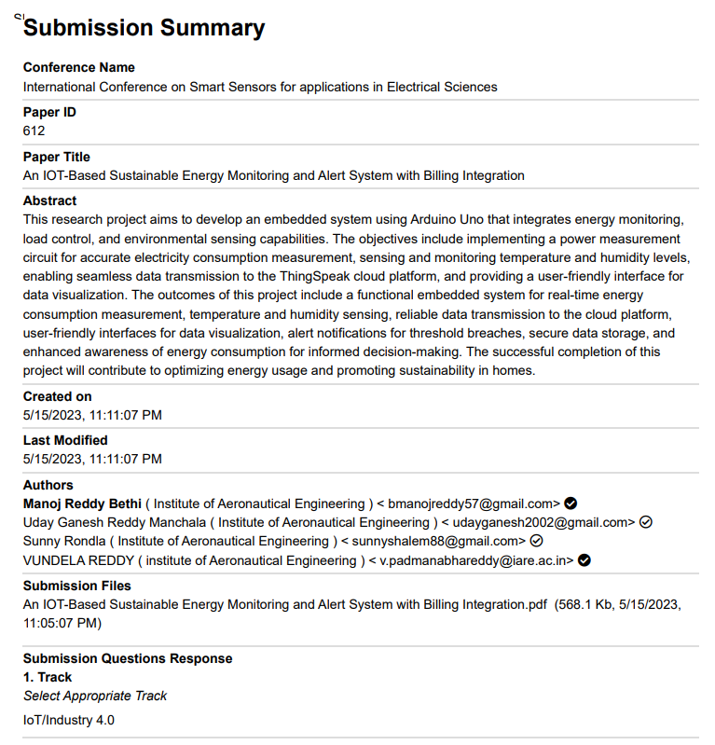
List of Publications

Slide 16


