Slide 1
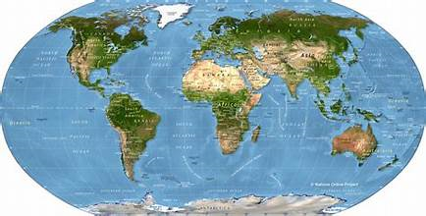
ENVIRONMENT POLUTION

Slide 2
INTRODUCTTION
Enivironment pollution is define as the contamination of the physical and biological components if the arth/atmosphere system to such asan exent that normal environmental processes are adversely affected.

Slide 3
Type of pollution
There are four types of pollution:
Air pollution
Water pollution
Noise pollution
Land pollution

Slide 4
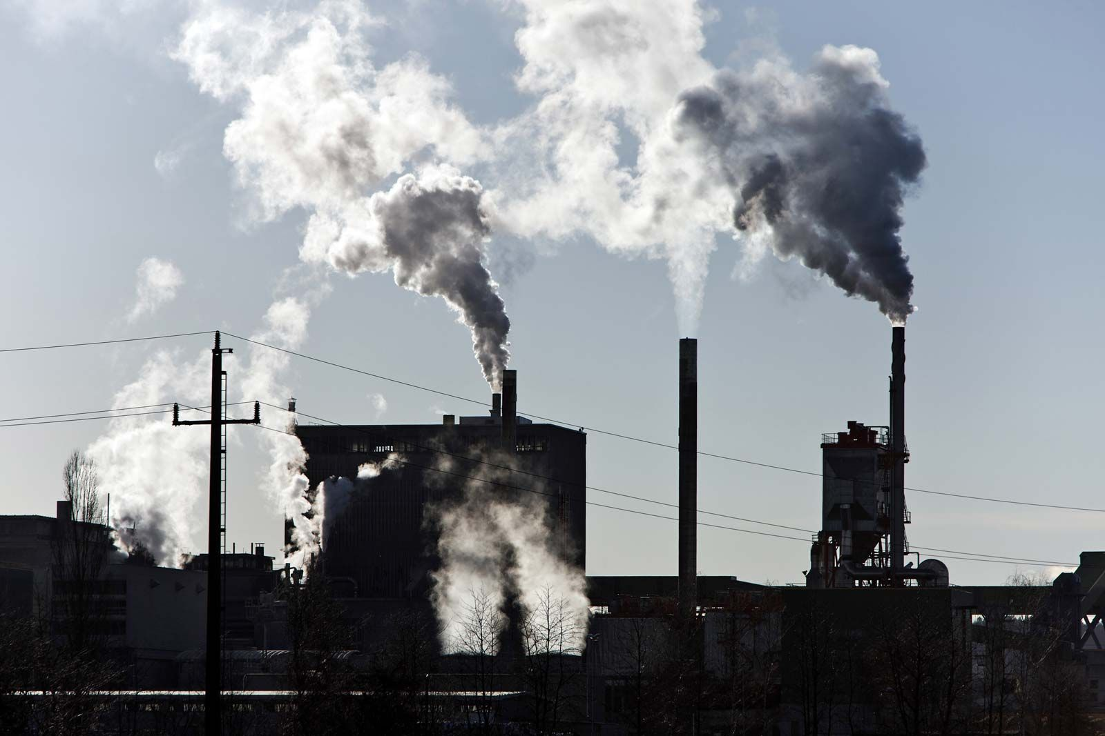
Air pollution
What is atmosphere
Atomosphere is the life blanket of the earth.
It is therefor essential that we know more about the atomosphere and the ways in which it is polluted.

Slide 5
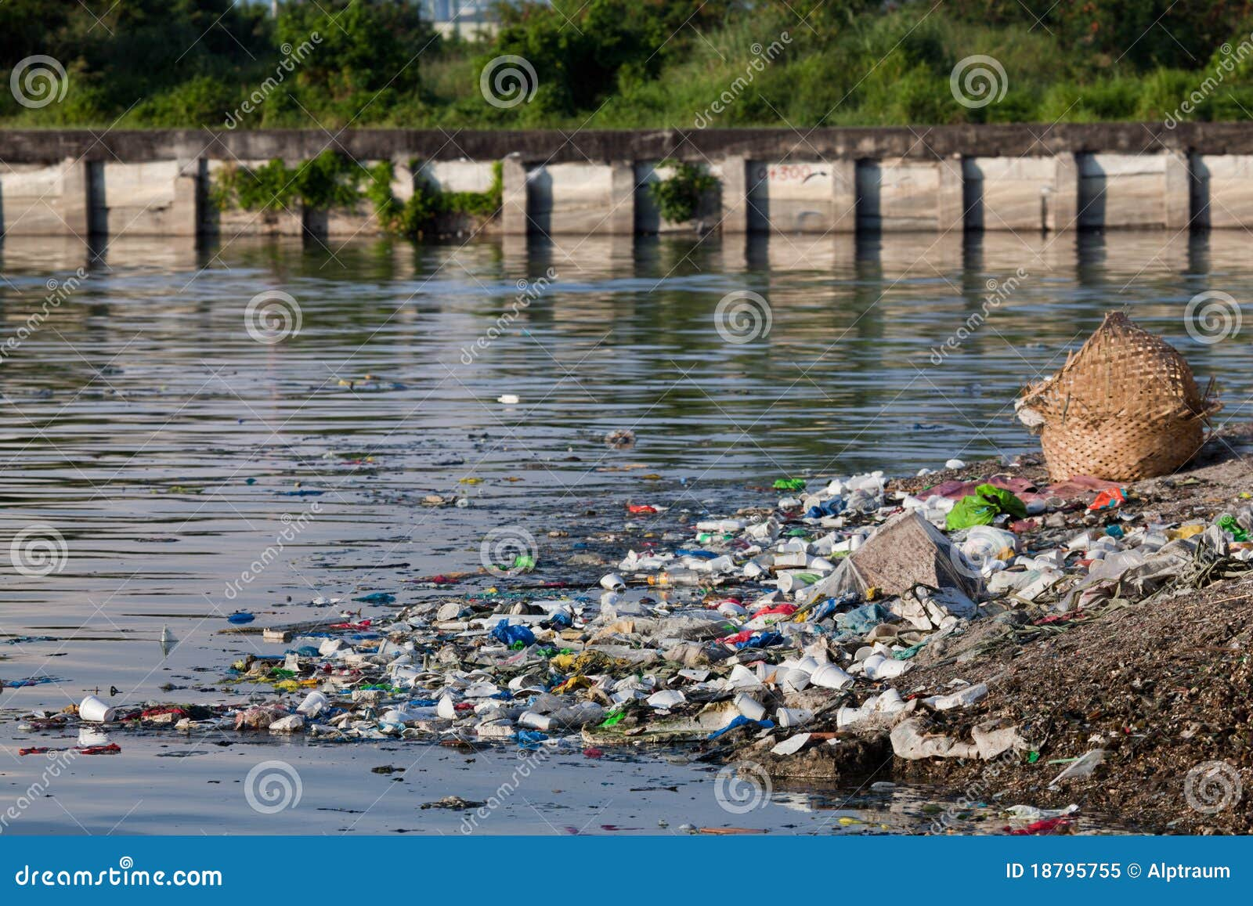
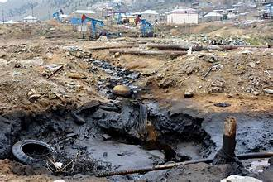
Water pollution & Land pollution
Any physical (tempreture, oxygen),chemical (mercurey) or biological(disease,sewage) change to water that adversely affects its use by alive being.
Land pollution
One fourth of the area covered by land.
Land is a earth which is occupied by people for shelter,occupation,etc.

Slide 6
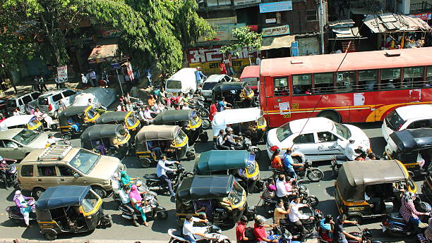
Noise polution
Noise pollution is the unpleasant and undesirable sound which leads to discomfort in human beings.
Type of noise pollution
Transport noise
Neighborhood noise
Industrial noise

Slide 7
Thank you all

