Slide 1
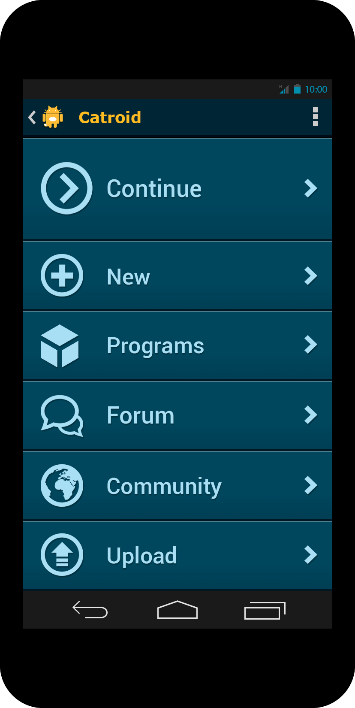
Startscreen

Slide 2
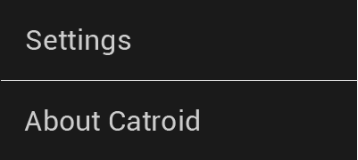
Startscreen

Slide 3
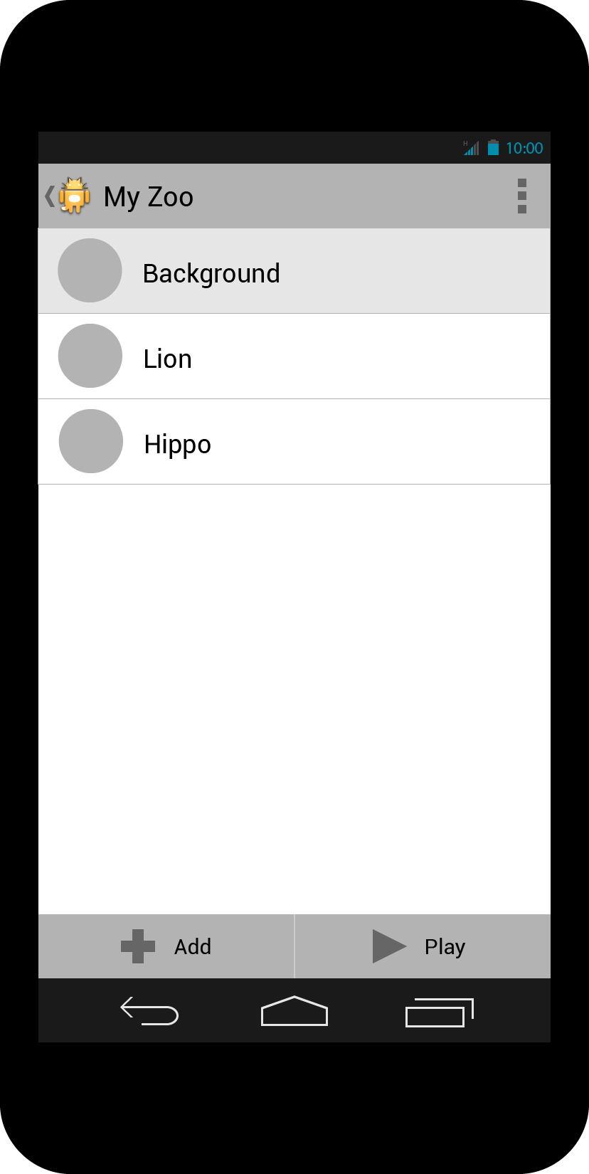
Program

Slide 4
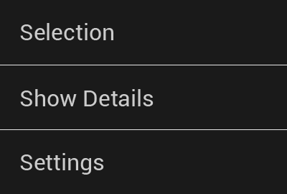
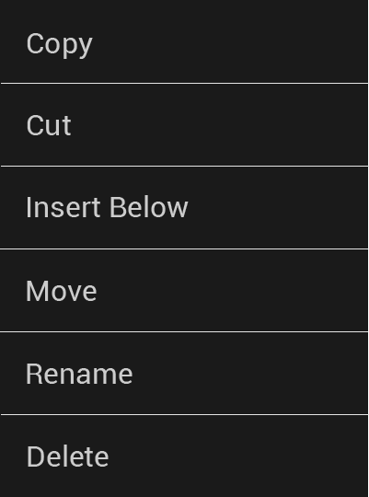
Program
(Longpress menu)
Add object
Play project

Slide 5
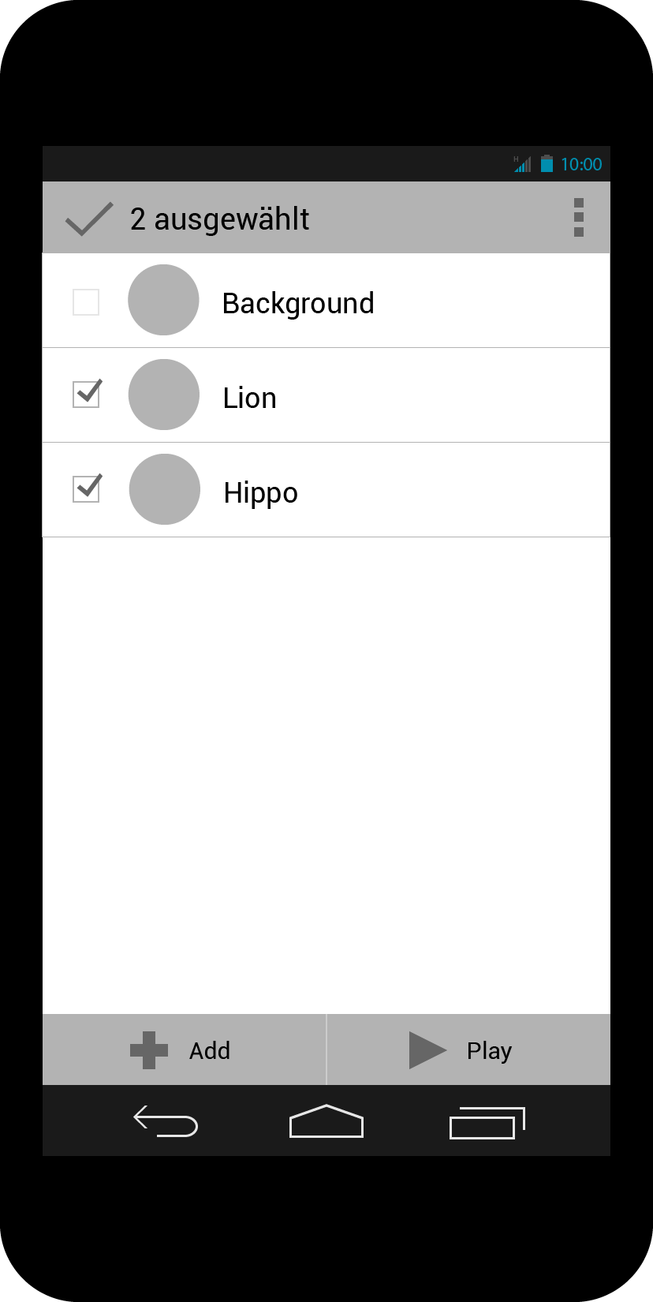
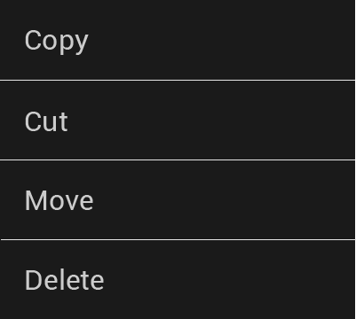
Project (Selection)
Overlfow entries:
Copy
Cut
Insert Below (one)
Move
Rename (one)
Delete
If only one list element is selected, ‚Insert Below‘ and ‚Rename‘ appear in the overflow menu.
The sequence of the overflow menu entries is important.

Slide 6
Program
Show Details
Shows detailed information of a list item.
To reduce complexity, details are hidden by default.

Slide 7
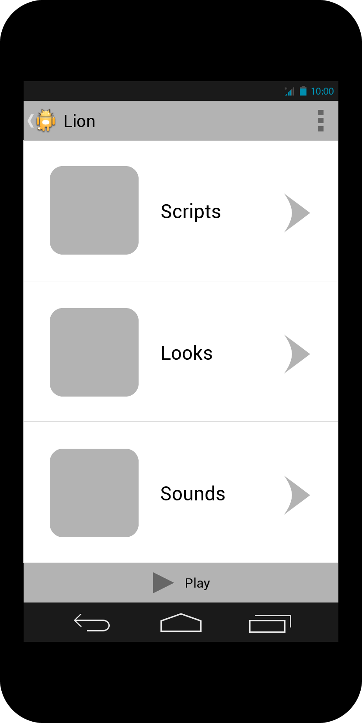
Tap on an object

Slide 8

Tap on an object
Play project

Slide 9
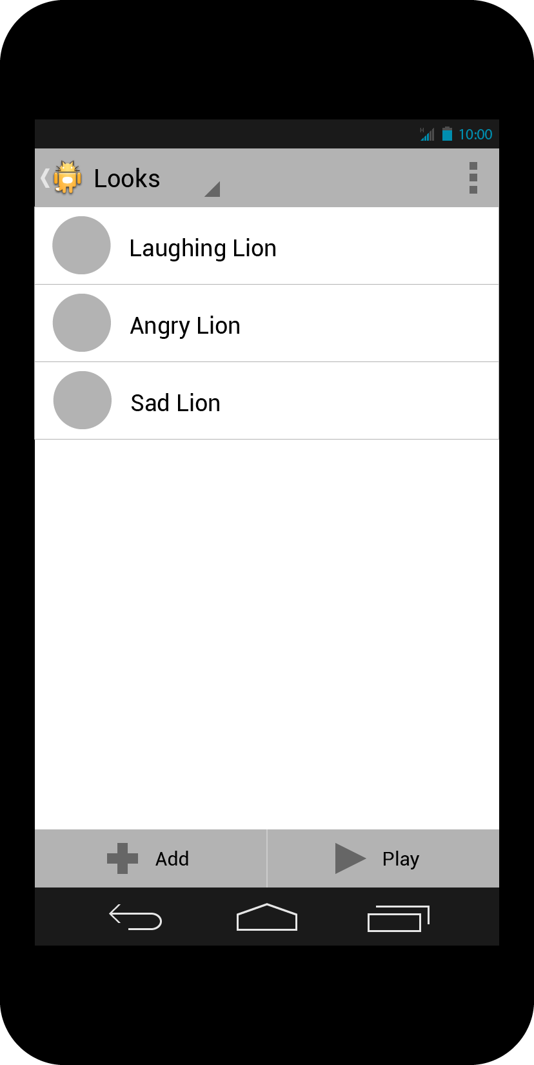
Looks
Interface Functionality
Overflow
Longpress
Add
Play
(Multiple) Selection
work exactly like on program screen
Spinner: Quick change between Scripts, Looks and Sounds.
A tap on a costume opens a context menu for selection of graphics apps (Paintroid, etc.)

Slide 10
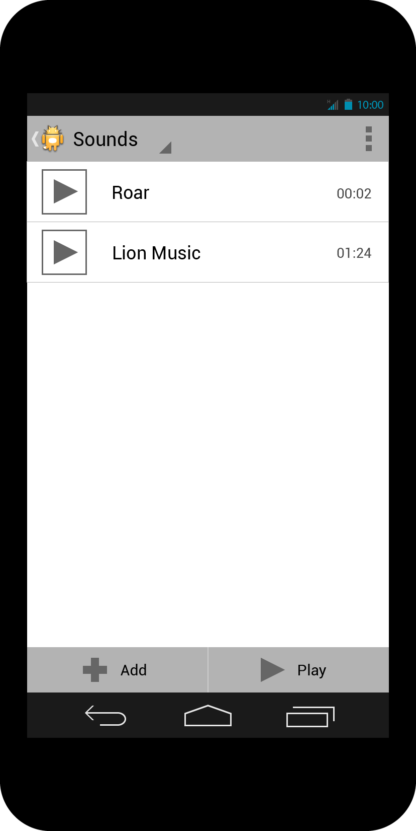
Sounds
Interface Functionality
Overflow
Longpress
Add
Play
(Multiple) Selection
work exactly like on program screen
Spinner: Quick change between Scripts, Looks and Sounds.
A tap on a sound starts the sound player.

Slide 11

Sounds (Play/Pause)
Play sound

Slide 12
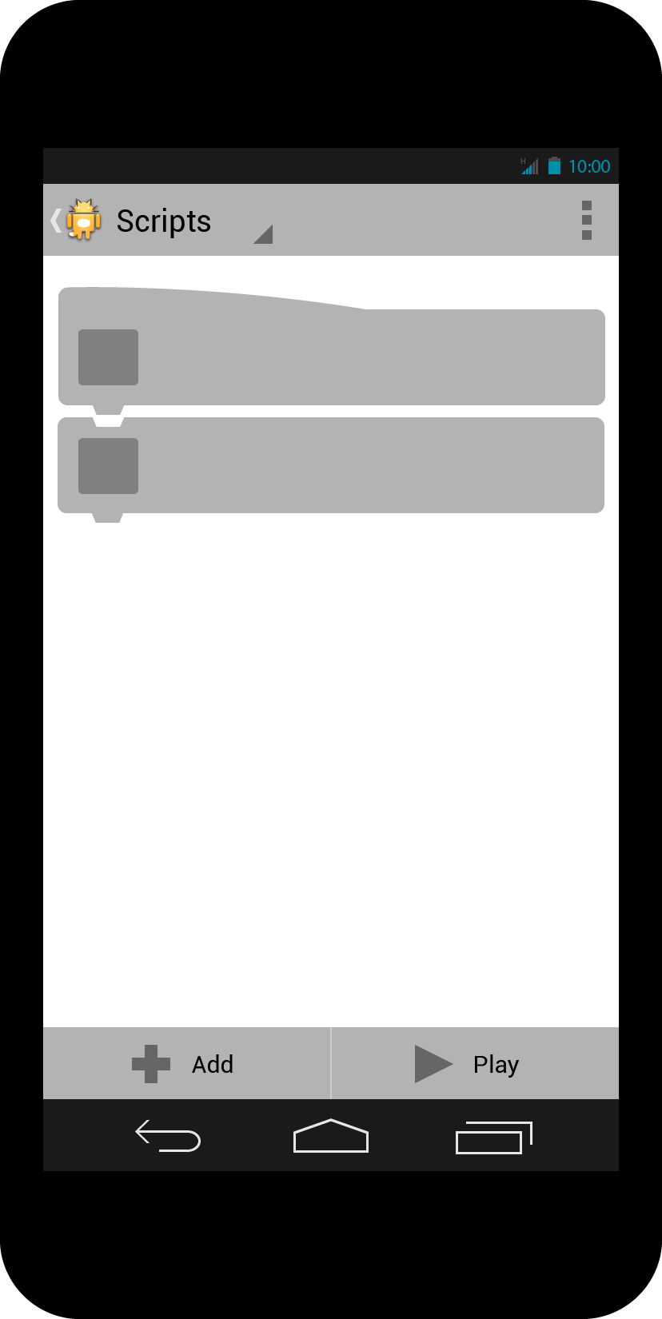
Scripts
Interface Functionality
Overflow
Add
Play
(Multiple) Selection (smart)
work exactly like on program screen
(Multiple) Selection: After first item is selected, illogical combinations are disabled.
Spinner: Quick change between Scripts, Looks and Sounds.
A tap on a brick opens its context menu.
Longpress on a brick activates moving functionality.

Slide 13
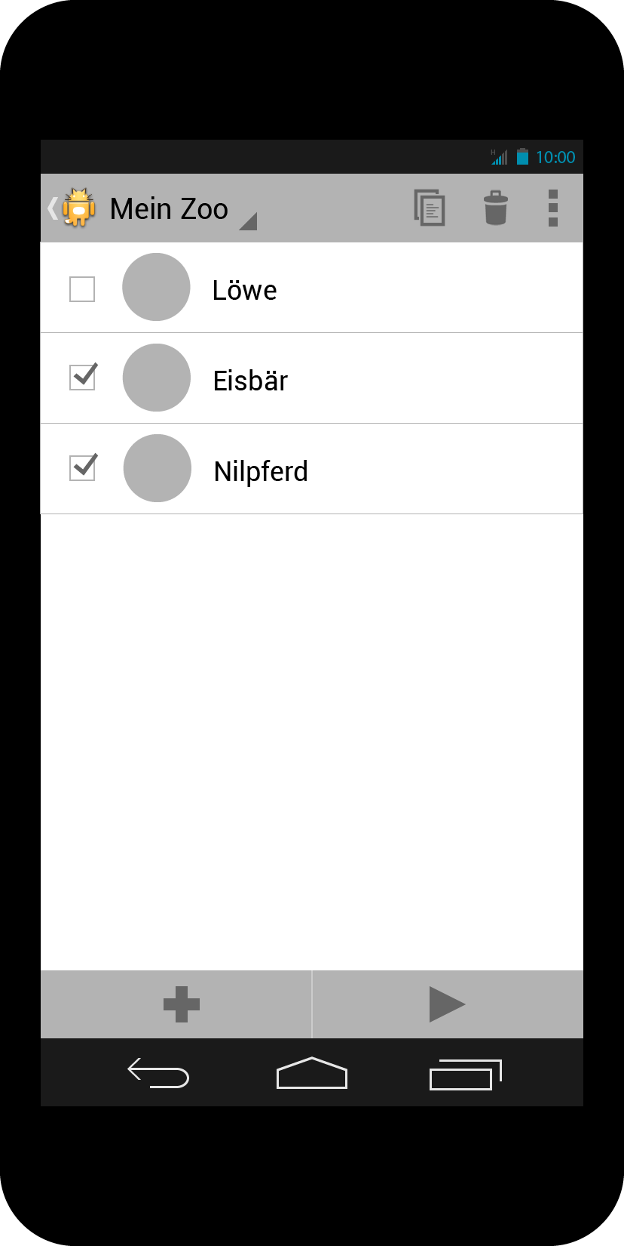
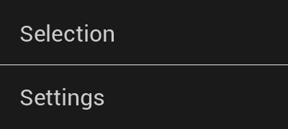
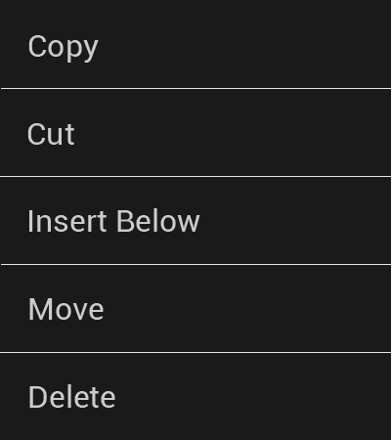
Scripts (Interactive Area)
The interactive area should be a consistent area on each brick where one could touch to open context menu or move brick. (Represented by a texture)

