Slide 1
C
Security Fundamentals
CIAP Framework
I
Confidentiality · Integrity · Availability · Proof
A
P
All labs must be performed in isolated, authorized environments only

Slide 2
The CIAP Framework
Four pillars of Information Security — most attacks threaten at least one
C
I
A
P
Confidentiality
Integrity
Availability
Proof
Only authorised parties can access information
Data cannot be tampered or altered
Systems accessible when needed
Actions traced and verified
"Can someone see it who shouldn't?"
"Can someone change it undetected?"
"Can someone block access?"
"Can someone deny doing it?"

Slide 3
C
Confidentiality
In this section:
What confidentiality is and why it matters
Authentication: verifying who you are
Authorization: controlling what you can do
Common attacks and how to defend against them

Slide 4
CONFIDENTIALITY
Confidentiality: Keep Secrets Secret
"Only people you explicitly choose can see the data — everyone else is locked out, even if they can reach the system."
This is enforced through encryption, access controls, and authentication — working together.
🔒
🛡️
🔐
🌐
Encryption
Access Controls
Authentication
Network Segmentation
Scrambles data so only key holders can read it — useless to anyone without the key
Rules that define which users can see or modify which resources
Verifying identity before granting any access at all
Isolating sensitive systems so they cannot be reached by unauthorised parties

Slide 5
CONFIDENTIALITY
Real Example: T-Mobile Breach 2021
What happened
Data stolen
Why it matters
How to prevent it
• Hackers compromised a router
• Accessed 100+ internal servers
• Reached customer PII database
• Names, dates of birth
• Social Security Numbers
• Driver's licence information
• Sold on the dark web afterwards
• 50 million people affected
• Data used for identity theft
• Multiple T-Mobile breaches before this
• Encrypt stored data (cleartext was readable)
• Network segmentation
• Monitor for anomalous access patterns
• Patch all internet-facing systems

Slide 6
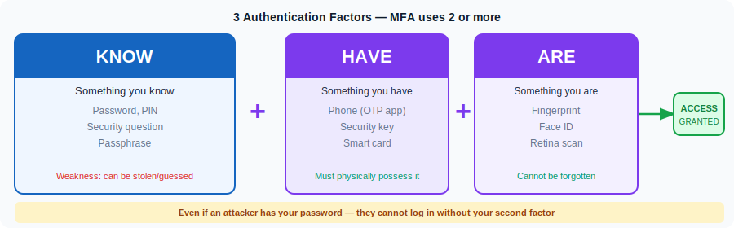
CONFIDENTIALITY
Authentication: Who Are You?
"Authentication is the process of verifying the identity of a user before granting any access."

Slide 7
CONFIDENTIALITY
Authentication Vulnerabilities
🔨 Brute Force
Try every possible password until correct. Mitigated by: account lockout after N failed attempts, rate limiting, CAPTCHA.
🔁 Credential Stuffing
Take leaked username/password pairs from one breach and try them on other sites. Works because 65% of people reuse passwords.
💥 Broken Authentication
Logic flaws in the login code let attackers bypass it entirely — e.g. manipulate session cookies, skip password check, reset token flaws.

Slide 8
CONFIDENTIALITY
Authorization: What Can You Do?
"Authorization defines what an authenticated user is allowed to do. It always comes AFTER authentication."
🔐 Authentication
🛡️ Authorization
"Are you who you say you are?"
Verify identity — password, MFA, biometrics
Result: you are let INTO the system
"What are you allowed to do inside?"
Check roles, permissions, policies
Result: you can access only YOUR resources
Bank example: Authentication = you log in. Authorization = you can see YOUR account only — not every other customer's account. Both are essential — one without the other is a vulnerability.

Slide 9
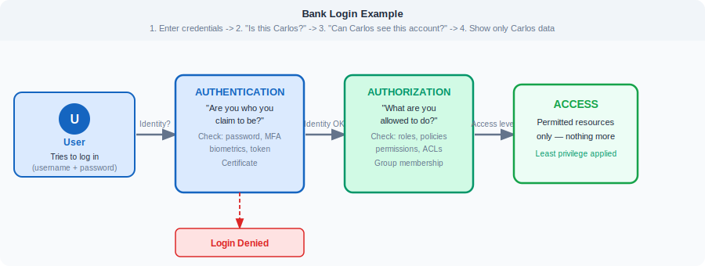
CONFIDENTIALITY
Authentication -> Authorization -> Access
The complete flow — from login request to accessing a specific resource:

Slide 10
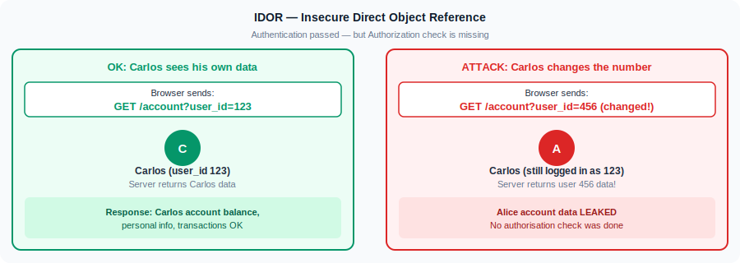
CONFIDENTIALITY
Authorization Attack: IDOR
IDOR = Insecure Direct Object Reference. Authentication worked — but authorization check was missing.
Fix: on EVERY request, check that the requesting user owns the resource they are asking for. Never trust IDs from the URL without verifying ownership.

Slide 11
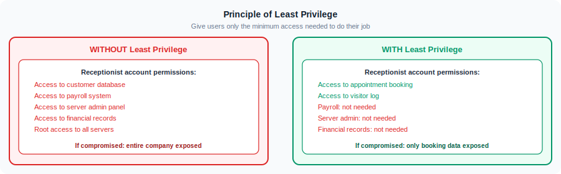
CONFIDENTIALITY
Principle of Least Privilege
"Give users only the minimum access they need to do their job — and nothing more."
Why it matters: limits blast radius. If an account is compromised, the attacker can only access what that account was allowed to access. A receptionist account should never have database admin rights.

Slide 12
LAB 1 — Confidentiality
Authentication & Authorization Bypass
Credential Stuffing Awareness
> Visit haveibeenpwned.com with a test email address
> Observe: how many breaches, which data types exposed
> grep -c "" /usr/share/wordlists/rockyou.txt # 14 million passwords
> head -20 /usr/share/wordlists/rockyou.txt # see real leaked passwords
> python3 -c "print(14344392/1000/60, 'minutes to try all at 1000/sec')"
> Discuss: why does MFA defeat credential stuffing completely?
Connect theory to real-world credential attacks

Slide 13
☕
BREAK
Coming up: Integrity — Encryption · Hashing · Cracking

Slide 14
I
Integrity
In this section:
Symmetric vs Asymmetric encryption — how and when to use each
TLS/HTTPS: how the two types work together
Hashing step by step — with live examples
Hash cracking: dictionary attacks and Hashcat

Slide 15
INTEGRITY
Integrity: Detect Any Tampering
"Data is only what the owner intends — no tampering, no corruption, no unauthorised changes."
A system has integrity when the information it stores is only that which the owner intends to store.
Real Example: WhisperGate Wiper — January 2022 (Ukraine)
Stage 1: Overwrites the Master Boot Record with a fake ransomware message. Stage 2: Downloads malware that overwrites files permanently — making them unrecoverable.
→ Integrity violated. All data destroyed. Cannot simply "reboot" to recover.
How integrity is protected:
# Hashing
✍️ Digital Signatures
📋 Version Control
✔️ Checksums
Fingerprint of data — any change produces a completely different hash
Cryptographic proof the data came from a specific person and was not changed
Every modification tracked — who changed what and when
Quick hash comparison to verify file integrity after download

Slide 16
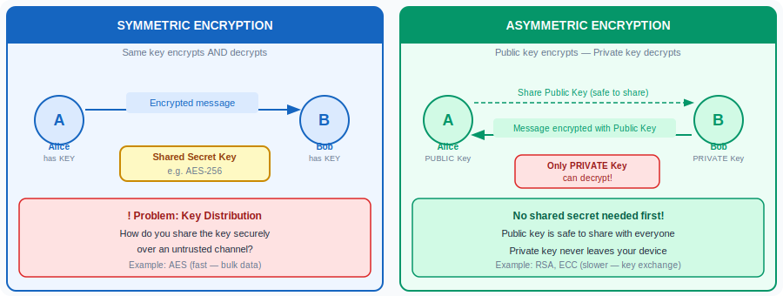
INTEGRITY
Symmetric vs Asymmetric Encryption
Two approaches to encryption — each with strengths and weaknesses:

Slide 17
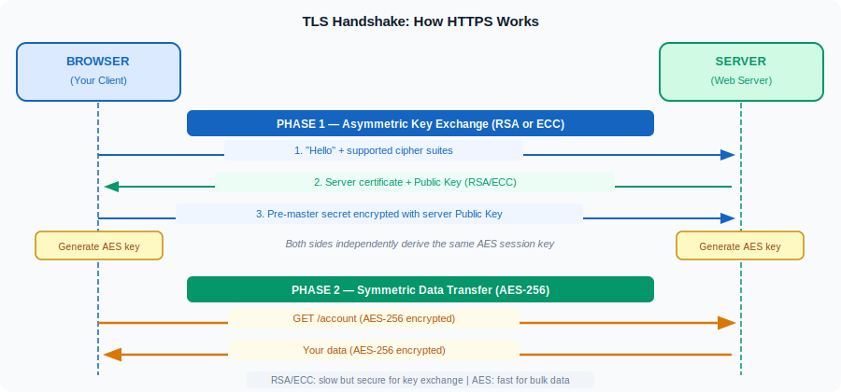
INTEGRITY
How HTTPS / TLS Works
HTTPS uses BOTH types — asymmetric for handshake, symmetric for data. Best of both worlds.

Slide 18
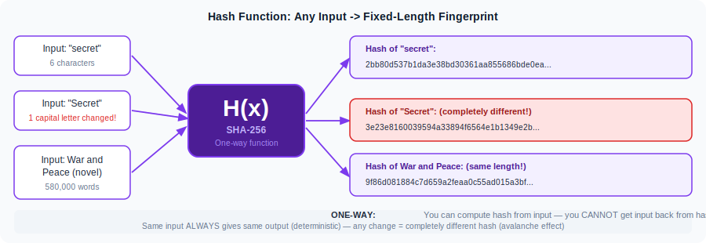
INTEGRITY
Hashing: The One-Way Fingerprint
A hash function takes any input and produces a fixed-length fingerprint. It is ONE-WAY — you cannot reverse it.
This is not encryption! You cannot "decrypt" a hash. To find the original value you must try inputs until the hash matches — that is cracking.

Slide 19
INTEGRITY
Step 1: Hashing a Password — The Command
Run this in Kali Linux terminal:
$ echo -n "password123" | sha256sum
Output:
ef92b778bafe771e89245b89ecbc08a44a4e166c06659911881f383d4473e94f -
📏 Fixed length
🔄 Deterministic
🧪 Try yourself
SHA-256 always outputs exactly 64 hex characters, regardless of input length
"password123" will ALWAYS produce the same hash — run it twice and check
Now run it in your terminal. The output must exactly match the hash above

Slide 20
INTEGRITY
Step 2: Change One Character — See What Happens
The avalanche effect: changing even 1 character produces a completely different hash.
$ echo -n "password123" | sha256sum
ef92b778bafe771e89245b89ecbc08a44a4e166c06659911881f383d4473e94f
Change the "1" to a "2":
$ echo -n "password124" | sha256sum
23b2d03a1bb6e97024b8e1d45b14d3abe15a71c4ac0f9c3e0c2a45b70b2cbf4
Completely different hash — even though input changed by only 1 character.
This means: if you hash a file and the hash changes → the file was modified. Integrity check passed/failed.

Slide 21
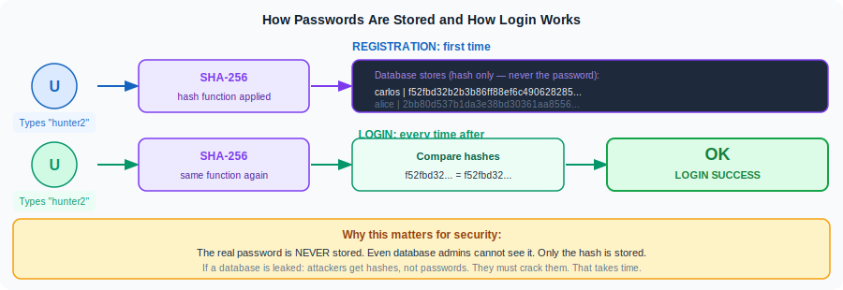
INTEGRITY
Step 3: How Passwords Are Stored
Websites never store your actual password — only its hash. Here is why that matters:

Slide 22
INTEGRITY
Step 4: Not All Hash Algorithms Are Equal
Algorithm choice is critical. Weak algorithms can be cracked in seconds:
MD5 (128-bit)
SHA-1 (160-bit)
SHA-256 (256-bit)
bcrypt (Variable)
BROKEN
DEPRECATED
SECURE
BEST FOR PASSWORDS
Collision attacks known. Do NOT use for security. Cracked in milliseconds.
Collision found 2017 (SHAttered attack). Legacy only.
Current standard. Used in TLS certificates, Git, Bitcoin, HMAC.
Intentionally slow — GPU-resistant. Salted automatically. Use for login systems.
echo -n "hello" | md5sum
echo -n "hello" | sha1sum
echo -n "hello" | sha256sum
python3 -c "import bcrypt; print(bcrypt.hashpw(b'hello', bcrypt.gensalt()))"

Slide 23
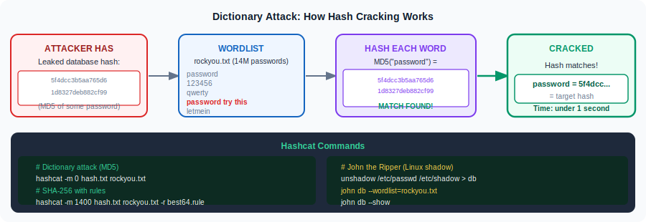
INTEGRITY
Hash Cracking Step 1: The Dictionary Attack
Cracking does not reverse the hash — it re-hashes common words until one matches.

Slide 24
INTEGRITY
Hash Cracking Step 2: Hashcat Commands
Start with a simple target — then increase difficulty:
1. Create a target hash
echo -n "password123" | sha256sum | cut -d' ' -f1 > hash.txt
cat hash.txt
We are cracking our own known hash — to learn the process
2. Dictionary attack (SHA-256)
hashcat -m 1400 hash.txt /usr/share/wordlists/rockyou.txt
Mode 1400 = SHA-256. rockyou.txt has 14 million real leaked passwords
3. Rule-based attack (mutations)
hashcat -m 1400 hash.txt rockyou.txt -r /usr/share/hashcat/rules/best64.rule
Rules add mutations: P@ssword, password1, PASSWORD, etc
4. Check results
hashcat -m 1400 hash.txt --show
See what was cracked and how fast

Slide 25
INTEGRITY
Hash Cracking Step 3: Why Password Length Matters
Increasing password LENGTH adds exponential cracking time. Complexity only adds polynomial time.
GPU vs CPU cracking speed:
Cracking time — 62 character set:
Algorithm | GPU (RTX 3090) | CPU (i9)
MD5 | 68,185 MH/s | 450 MH/s
SHA-1 | 21,528 MH/s | 298 MH/s
SHA-256 | 9,276 MH/s | 134 MH/s
Password length | GPU time (SHA-256)
5 chars ("hello") | Under 1 second
8 chars ("welcome1") | About 6 hours
10 chars | About 2.8 years
12+ chars (passphrase) | Millions of years
Key insight:
"correcthorsebatterystaple" (4 words, no special chars) is harder to crack than "P@ssw0rd!" (8 chars, complex).
Password policy recommendation: require length (12+ chars) over complexity. Use a passphrase.

Slide 26
LAB 2 — Integrity
Hashing · Encryption · Hash Cracking
A
B
OpenSSL — Hash live
Hashcat — Crack a hash
> echo -n "hello" | sha256sum
> echo -n "hellO" | sha256sum # spot the difference!
> openssl enc -aes-256-cbc -in file.txt -out enc.bin
> openssl enc -d -aes-256-cbc -in enc.bin -out dec.txt
> sha256sum file.txt dec.txt # verify they match
> echo -n "password123" | sha256sum > hash.txt
> hashcat -m 1400 hash.txt /usr/share/wordlists/rockyou.txt
> Try an 8-char mixed password — observe time
> hashcat -m 1400 hash.txt wordlist -r best64.rule
See hashing and symmetric encryption live
Feel the difference between algorithms

Slide 27
☕
BREAK
Coming up: Availability — DDoS · Backups · Ransomware · Proof

Slide 28
A
Availability
In this section:
What availability means and what threatens it
DDoS attacks: types and how they work
Mitigation strategies for DDoS
Backups: Full, Incremental, Differential — and the 3-2-1 rule

Slide 29
AVAILABILITY
Availability: Keep Systems Running
"The property of being accessible and usable upon demand by an authorised entity." — ISO/IEC 27000:2018
A system is available if authorised users can reach it when they need to. An attacker who blocks access has violated availability.
Real Example: Viasat Satellite Attack — 24 February 2022
AcidRain wiper malware knocked out Ukrainian military satellite internet at the exact moment Russia invaded. VPN misconfiguration allowed initial access. Thousands of modems permanently destroyed.
What threatens availability:
🌊 DDoS Attacks
💀 Ransomware
⚠️ Hardware Failure
🏚️ Natural Disasters
Flood of traffic overwhelms servers, making them unreachable for legitimate users
Encrypts all files — users cannot access their own data until ransom paid (or backup restored)
Single point of failure with no redundancy means total outage
Fires, floods, power cuts — physical destruction of infrastructure

Slide 30
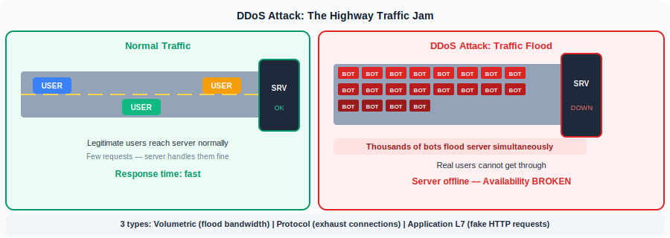
AVAILABILITY
DDoS: The Highway Traffic Jam
"A DDoS attack is like a traffic jam clogging the highway — legitimate traffic cannot get through."
Botnet: thousands of infected "zombie" devices all controlled by the attacker. Each sends traffic — together they flood the server.

Slide 31
AVAILABILITY
DDoS Types and Mitigation
🌊 Volumetric
Flood all available bandwidth. DNS amplification, UDP floods.
Defence: CDN / Anycast — distribute load across global nodes
⚙️ Protocol (L3/L4)
Exhaust server connection tables. SYN flood overwhelms TCP state.
Defence: SYN cookies, firewall tuning
📱 Application (L7)
Expensive HTTP requests — looks like real traffic, exhausts app server.
Defence: Rate limiting + WAF + CAPTCHA
Key challenge: Over-filtering also damages availability.
Blocking too aggressively during a DDoS also blocks your legitimate customers. Security controls themselves can threaten availability — always balance.

Slide 32
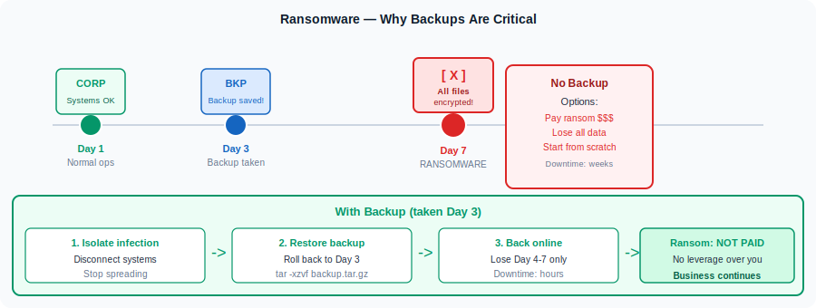
AVAILABILITY
Backups: Your Defence Against Ransomware
"A backup is a point-in-time copy of data. If data is lost or corrupted — you restore from the backup."
3-2-1 Rule: Keep 3 copies · On 2 different media types · With 1 copy offsite — always test your restore process!

Slide 33
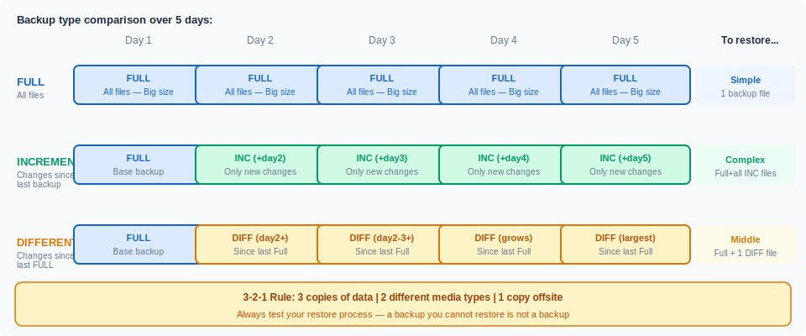
AVAILABILITY
Backup Types: Full · Incremental · Differential
Choose the type based on your recovery time, storage budget, and how often data changes:

Slide 34
LAB 3 — Availability & Proof
Backup Drill · Responder · Digital Signatures
A
B
C
Backup & Restore
Responder — NTLM capture
Digital Signatures
> tar -czvf backup.tar.gz /var/www/html
> rm -rf /var/www/html # simulate data loss
> tar -xzvf backup.tar.gz -C / # restore
> sha256sum backup.tar.gz # verify integrity
> Try without backup — appreciate the difference
> sudo responder -I eth0 -rdw
> From Windows VM: connect to \\KaliIP\share
> Observe NTLMv2 hash captured
> hashcat -m 5600 hash.txt rockyou.txt
> This breaks Confidentiality AND Availability
> openssl genrsa -out private.pem 2048
> openssl rsa -in private.pem -pubout -out pub.pem
> echo "Transfer 500 EUR" > msg.txt
> openssl dgst -sha256 -sign private.pem -out sig.bin msg.txt
> openssl dgst -sha256 -verify pub.pem -signature sig.bin msg.txt
> Change "500" to "5000" — re-verify — watch it fail
Feel the value of backups under pressure
See availability attack leading to credential theft
Create and verify a digital signature

Slide 35
P
Proof / Accountability
In this section:
Authenticity: verifying that an entity is who it claims to be
Non-repudiation: you cannot deny performing an action
How digital signatures provide both properties

Slide 36
PROOF
Authenticity & Non-repudiation
🆔 Authenticity
✍️ Non-repudiation
"The entity is what it claims to be — not an impostor."
"You cannot deny having performed an action."
• HTTPS certificate: proves you're on the real bank website
• SSH key: proves the server is who you expect
• Prevents: identity spoofing, phishing, man-in-the-middle
• Email digital signature: "Carlos sent this — he cannot deny it"
• Blockchain: permanent, immutable public record
• Audit logs: timestamped, tamper-evident trail
How Proof is implemented in practice:
Digital Signatures
PKI / Certificates
Audit Logs
Blockchain
Private key signs, public key verifies. Proves origin and detects tampering in one step.
Certificate Authority vouches for identity. Foundation of HTTPS and code signing.
Every action timestamped and linked to a user identity. Legal admissibility.
Immutable distributed ledger — once written, cannot be changed or denied.

Slide 37
Balancing the CIAP Framework
Confidentiality
Attacks:
Defence:
C
Credential stuffing · Brute force · Broken auth · IDOR
Encryption · MFA · Access controls · Segmentation
Integrity
Attacks:
Defence:
I
WhisperGate wiper · Data tampering · Log deletion · SQL injection
Hashing · Digital signatures · Version control · Input validation
Availability
Attacks:
Defence:
A
DDoS (volumetric/protocol/L7) · Ransomware · Hardware failure
Rate limiting · WAF · CDN · Redundancy · 3-2-1 Backups
Proof
Attacks:
Defence:
P
Identity spoofing · Repudiation · Audit log tampering · Deepfakes
Digital signatures · PKI/Certificates · Tamper-evident audit logs
Security controls that are too strict can themselves threaten availability. Always balance.

Slide 38
QUIZ — Question 1
1. You receive an email from "bank@secure-login.baank.com" asking for your password. Which CIAP pillar does this attack target?
A) Integrity
B) Confidentiality
C) Availability
D) Proof

Slide 39
QUIZ — Question 2
2. A wiper malware overwrites all files on a hospital server. Which TWO pillars are violated?
A) Confidentiality + Proof
B) Availability + Confidentiality
C) Integrity + Availability
D) Proof + Integrity

Slide 40
QUIZ — Question 3
3. Which property of the CIA triad does having a reasonable password length policy help protect?
A) Integrity
B) Confidentiality
C) Availability
D) Proof

Slide 41
QUIZ — Question 4
4. Bank Corp has a form on their website. The code that processes form submissions doesn't sanitize certain parameters. This enables any user to change values stored in tables on a SQL database. As a result, the user can change the amount of money that they have in their accounts. This is an example of a breach of which CIA triad property?
A) Integrity
B) Confidentiality
C) Availability
D) Proof

Slide 42
C
I
A
P
Confidentiality
Integrity
Availability
Proof
Questions?
"What was the most surprising thing you learned today?"

Slide 43
Thank You ☺

