Slide 1

Analysis and Sysnthesis of Algorithms
Design of Algorithms (DA)
Programming Project II
Delivery Truck Pallet Packing Optimization
Project done by:
André Barros Siqueira
Leonor Alexandra Costa Azevedo
Tiago Alexandre de Boaventura Nunes
up202300449
up202304040
up202304047
Departamento de Engenharia Informática (DEI) / Departamento de Ciências de Computadores (DCC)
Faculdade de Engenharia da Universidade do Porto (FEUP) / Faculdade de Ciências da Universidade do Porto (FCUP)

Slide 2
Class Diagram
There were no classes created in this project.
The information about pallets were stored in two vectors of integers, named values and weights, and each of the pallets’ information can be found in the position corresponding to its index minus one.
The only information about the truck that we needed for the algorithms was its maximum capacity, and it was recorded in an integer variable called capacity, and the number of pallets associated with this problem, stored in an integer variable called n_pallets.
2

Slide 3
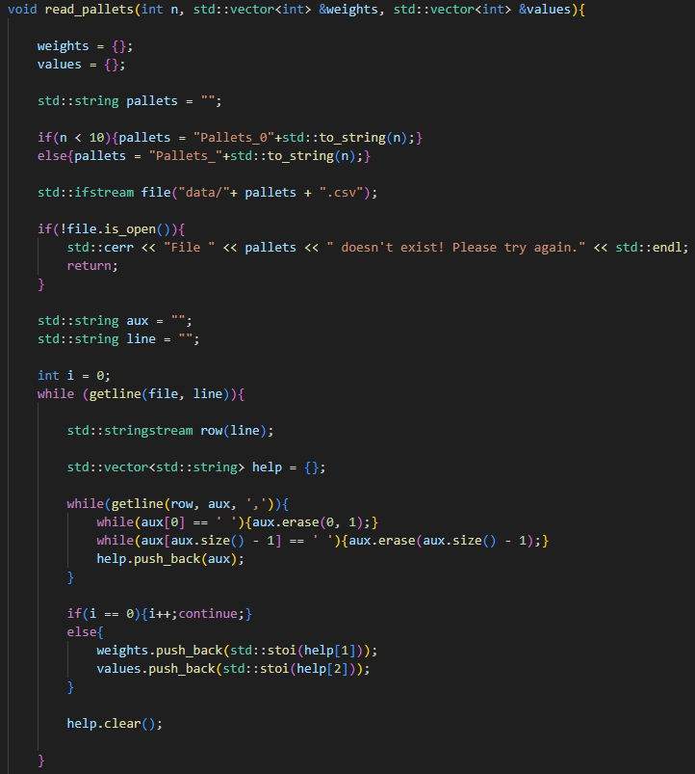
Reading Dataset
Both the functions to read the information about the truck and the information about the pallets are in the file read_files.cpp and are called in the function ask_pallets of the main.cpp file.
Those functions calculate the name of the file to read based on the number of the problem and are equipped to deal with the inexistence of those files, avoiding causing an error and ending the program in that case.
After correctly opening the file, the functions iterate through its lines and store the values in the variables mentioned in the prior slide, given by reference through the function arguments. Both the functions can distinguish elements from the lines if they are separated by commas, even if those commas are surrounded by spaces.
3

Slide 4
Exhaustive (Brute-Force) Approach
Both the functions to read the information about the truck and the information about the pallets are in the file read_files.cpp and are called in the function ask_pallets of the main.cpp file.
3

Slide 5
Dynamic Programming Approach
With Arrays
Both the functions to read the information about the truck and the information about the pallets are in the file read_files.cpp and are called in the function ask_pallets of the main.cpp file.
3

Slide 6
Dynamic Programming Approach
With Maps
Both the functions to read the information about the truck and the information about the pallets are in the file read_files.cpp and are called in the function ask_pallets of the main.cpp file.
3

Slide 7
Approximation Algorithms (Greedy Approach)
Both the functions to read the information about the truck and the information about the pallets are in the file read_files.cpp and are called in the function ask_pallets of the main.cpp file.
3

Slide 8
Integer Linear Programming Algorithm
In a truck with maximum capacity W, n possible pallets, and value and weight pallet values in vectors v and w respectively, where item i’s value = v[i-1] and its weight = w[i-1], the problem in standard form can be given as:
max v[0] * x1 + v[1] * x2 + … + v[n-1] * xn
subject to:
w[0] * x1 + w[1] * x2 + … + w[n-1] <= W
x1 <= 1
x2 <= 1
…
xn <= 1
x1, x2, … , xn >= 0
However, we need to solve ties if they arise. If two solutions have the same total value, we choose the one that has less items and if they both have the same quantity of items, we choose the ones with lower index.
As such, we will add penalties for bigger sizes and bigger indexes, but small enough that it doesn’t interfere in the final value. So, the function we want to maximize is instead given by:
max (v[0] – sizePenalty – 1 * indexPenalty) * x1 + … + (v[n-1] – sizePenalty – n * indexPenalty) * xn
3

Slide 9

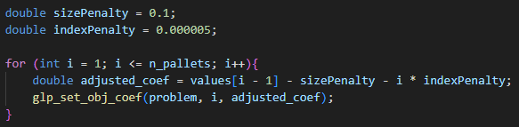
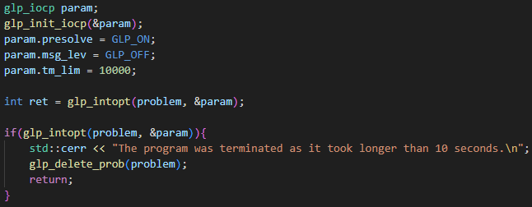
Integer Linear Programming
To help us with this algorithm, we used the ILP solver GLPK, recommended in the regent’s ILP powerpoint.
The GLPK accepts the declaring of variables as binary and each variable’s lower and upper bound, sparing us the work of inputting all n constraints of type xi <= 1.
The size penalty is bigger than the index penalty because it is the first tiebreaker, and so it has priority over the latter.
This is the minimum value of indexPenalty possible. It starts to interfere in the final value when n_pallets >= 200000, by which value this algorithm already takes an insurmountable amount of time.
The Integer Linear Programming algorithm, like all the other in our project, stops running after 10 seconds without reaching the solution, at which point prints a warning to the console and goes back to the choosing menu.
3

Slide 10
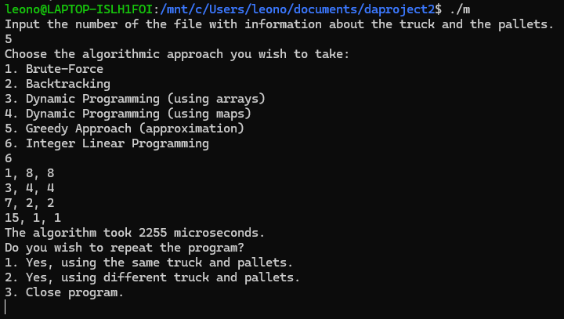
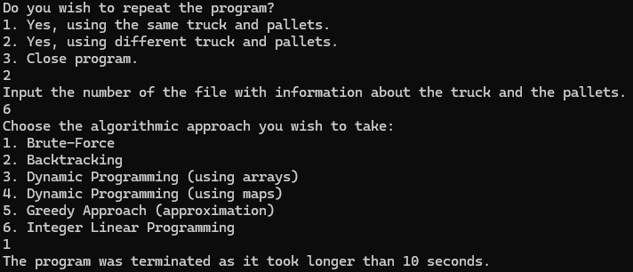
User Interface
The user interface asks for the number of the files with information about the truck and the pallets and then the algorithm you would like to use. Then, it outputs the list of pallets that would be the solution according to the chosen algorithm and the time it took.
After the algorithm finishes running, you are offered the choice to run again with the same dataset, run again with another dataset or exit the program.
When an algorithm takes longer than 10 seconds to compute, it is interrupted, and you are taken back to the choice menu with an accompanying message and no result.
11

Slide 11
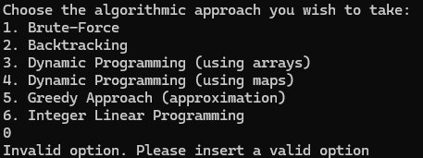
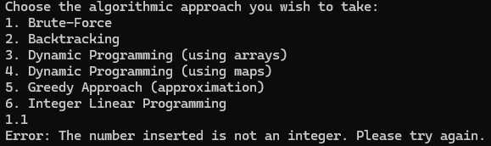
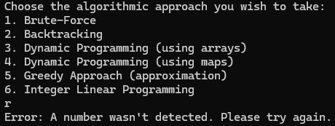
User Interface: Error Handling
The user interface is also equipped to handle user input errors without ending abruptly the program.
Inputting options/files that do not exist
Inputting non-integers
Inputting non-numbers
After all these errors you are simply prompted to input your choice once again, the program does not terminate.
Even when inputting the options the second time, like when reading new datasets, the errors are caught and handled the same.
11

Slide 12
Highlight and Main Difficulty
13

Slide 13
Participation of each Group Member
In our Project, the tasks were roughly divided as such:
André:
Responsible for Documentation;
Leonor:
Development of Integer Linear Programming;
Error handling in the user interface;
Making the presentation support documents;
Tiago:
Development of brute force algorithm;
Development of backtracking algorithm;
Development of dynamic programming algorithms with both arrays and maps;
Development of greedy algorithm;
Development of file reading functions;
Development of user interface.
14

Slide 14
How to Compile
Due to the external program we are using for the ILP (the GLPK), the code cannot be compiled simply by running g++ after unzipping. As such, if you don’t already have GLPK installed system-wide, you will need to run the following commands on your terminal, in our project folder:
tar xzf glpk-5.0.tar.gz
cd glpk-5.0
./configure
make
sudo make install
On Window’s wsl, this was enough to then compile the code. However, in Ubuntu you might need to also run:
sudo lpgkp usr/local/lib
And, to compile the code, you will need to add the flag –lglpk, as such:
g++ -o main main.cpp .lglpk
If everything went smoothly, you can now run the executable.
11

Slide 15
Analysis and Sysnthesis of Algorithms
Design of Algorithms (DA)
Programming Project II
Delivery Truck Pallet Packing Optimization
Project done by:
André Barros Siqueira
Leonor Alexandra Costa Azevedo
Tiago Alexandre de Boaventura Nunes
up202300449
up202304040
up202304047
Departamento de Engenharia Informática (DEI) / Departamento de Ciências de Computadores (DCC)
Faculdade de Engenharia da Universidade do Porto (FEUP) / Faculdade de Ciências da Universidade do Porto (FCUP)

