Slide 1

Analysis and Sysnthesis of Algorithms
Design of Algorithms (DA)
Programming Project II
Delivery Truck Pallet Packing Optimization
Project done by:
André Barros Siqueira
Leonor Alexandra Costa Azevedo
Tiago Alexandre de Boaventura Nunes
up202300449
up202304040
up202304047
Departamento de Engenharia Informática (DEI) / Departamento de Ciências de Computadores (DCC)
Faculdade de Engenharia da Universidade do Porto (FEUP) / Faculdade de Ciências da Universidade do Porto (FCUP)

Slide 2
Class Diagram
There were no classes created in this project.
The information about pallets were stored in two vectors of integers, named values and weights, and each of the pallets’ information can be found in the position corresponding to its index minus one.
The only information about the truck that we needed for the algorithms was its maximum capacity, and it was recorded in an integer variable called capacity.
2

Slide 3
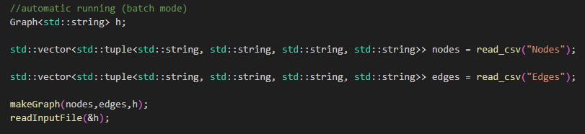
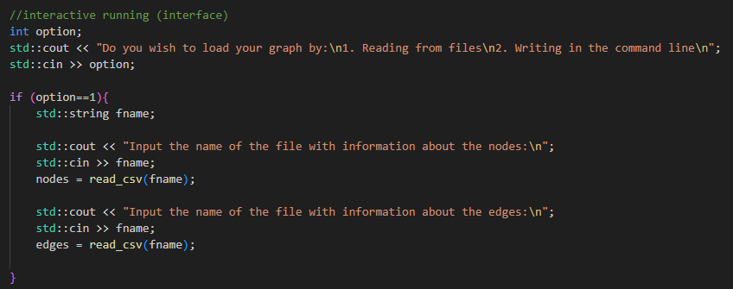
Reading Dataset
Batch mode automatically reads the Nodes and Edges csv files and from them generates the intended Graph. Then, it reads the input.txt and places the result in the output.txt, all files from the data folder.
In the interface, you can specify which files you would like to use to form the graph. Either files present in the data folder, or values typed directly into the terminal.
3

Slide 4
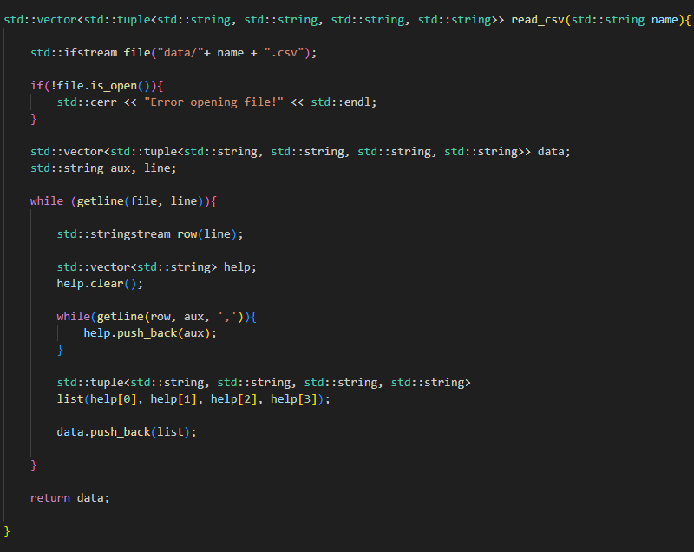
Reading Dataset
The read_csv function is used to read the csv files and return their information in a vector of tuples.
This function takes a single string as an argument – the name of the intended csv file – and opens it. After sucessfully opening it, the function will traverse every line of the file, storing each of the values of each line (separated by comas) in an auxiliary vector.
As both csv files have 4 different types of values, we know this auxiliary vector will always be of size 4 each iteration, and so we can grab its contents to create the tuple that will be pushed back into the main vector. When the whole file has been read, the function returns said vector.
4

Slide 5
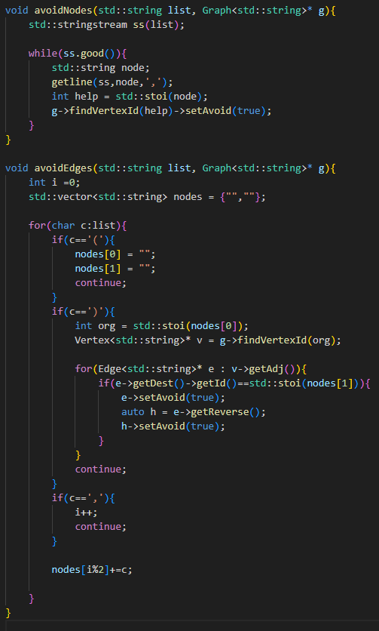
Building the (Restricted) Graph
The functions that treat the “Avoid” Restrictions are present in the same file as the MakeGraph function.
Function recieves the list of Nodes that we need to avoid, as a string, as well the already built Graph. As long as the string isn’t empty, the function reads its contents, ignoring the commas that separate the Vertexes IDs, and setting the Attribute “Avoid” of said Vertexes to true.
Function recieves the list of Edges that we need to avoid, as a string, as well the already built Graph. As long as the string isn’t empty, the function reads its contents, storing the Vertex values inside of the parenthesis in an auxiliary vector and ignoring any commas. This vector stores both Origin and Destination of the Edge, setting the Attribute “Avoid” of both it and its Reverse Edge to true.
5

Slide 6
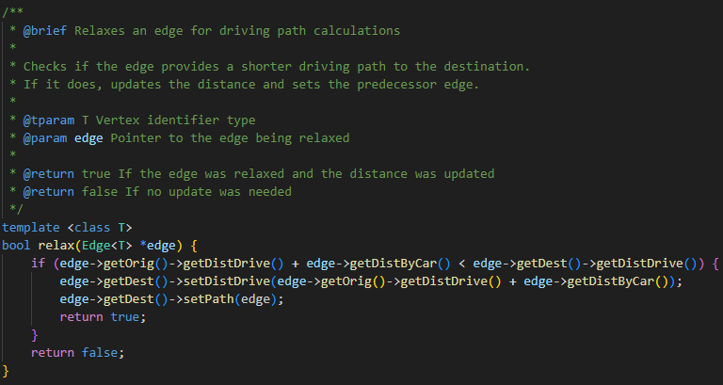
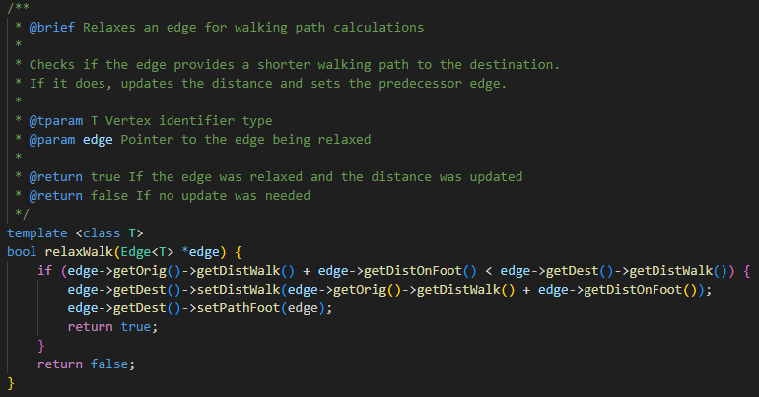
Implemented Algorithms: Edge Relaxation
Both relax and relaxWalk functions work in the same way: given an Edge, they averiguate if the distance of the current path being taken is shorter or not than the current distance of the Edge, relative to the origin. If it is shorter, it updates said distance and returns true. Otherwise, it does nothing and returns false.
As they’re both very simple functions with only trivial getters and setters built-in and an if condition, both relax and relaxWalk have Time Complexity of: θ(1).
6

Slide 7
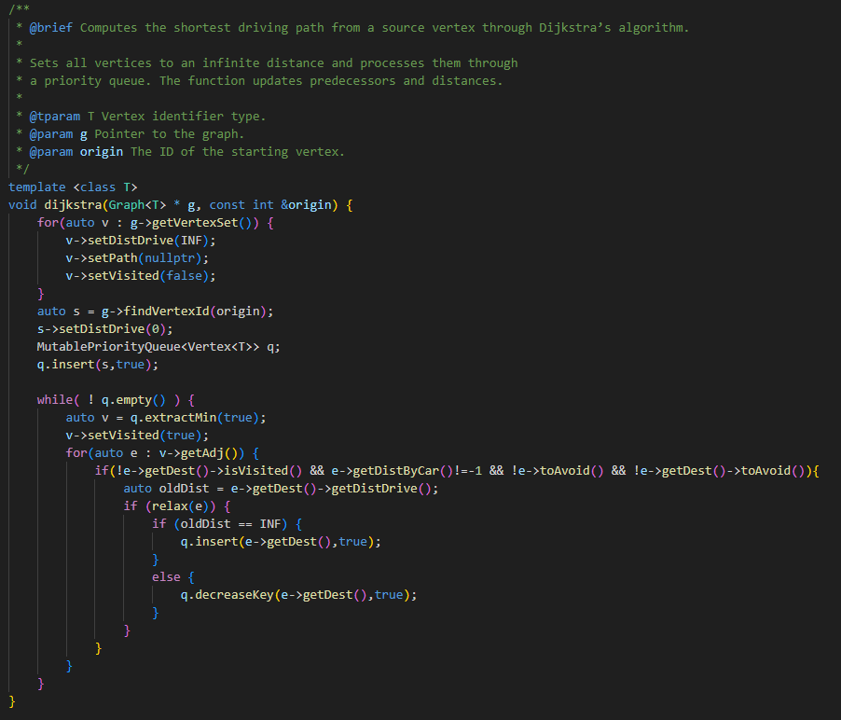
Implemented Algorithms: Dijkstra
The Dijkstra algorithm we use for the driving mode is extremely similar to the one provided in class. The only diferences are:
An extra line inside the set-up for that places “Visited” as false;
Extra conditions in the if inside the second for to guarantee that the node hasn’t been visited, the path is traversable by car and that neither this edge nor its destination are set as “toAvoid”.
Seeing how these are very trivial changes with no complexity interference, we can conclude that the Time Complexity of this Dijkstra remains the same as the one studied in the classes, being: O((V + E) log V)
7

Slide 8
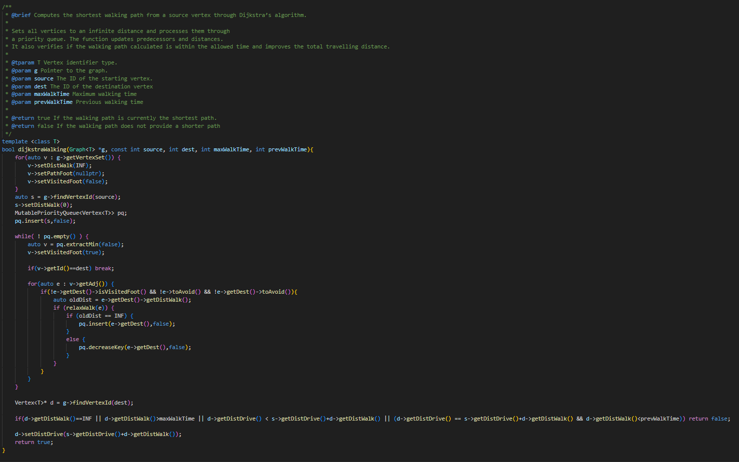
Implemented Algorithms: DijkstraWalking
Once again, the developed Algorithm is very similar to the previous Dijkstra. The diferences this one presents are found both in the getters and setters it uses (since this Dijkstra focuses on walking, it uses the walking attributes as opposed to the driving ones).
The other main difference is the return type – bool. If it finds a better path than the previous it returns true, otherwise false.
Finally, since these are extremely minor changes to the algorithm that do not affect complexity, the time complexity is still O((V + E) log V).
8

Slide 9
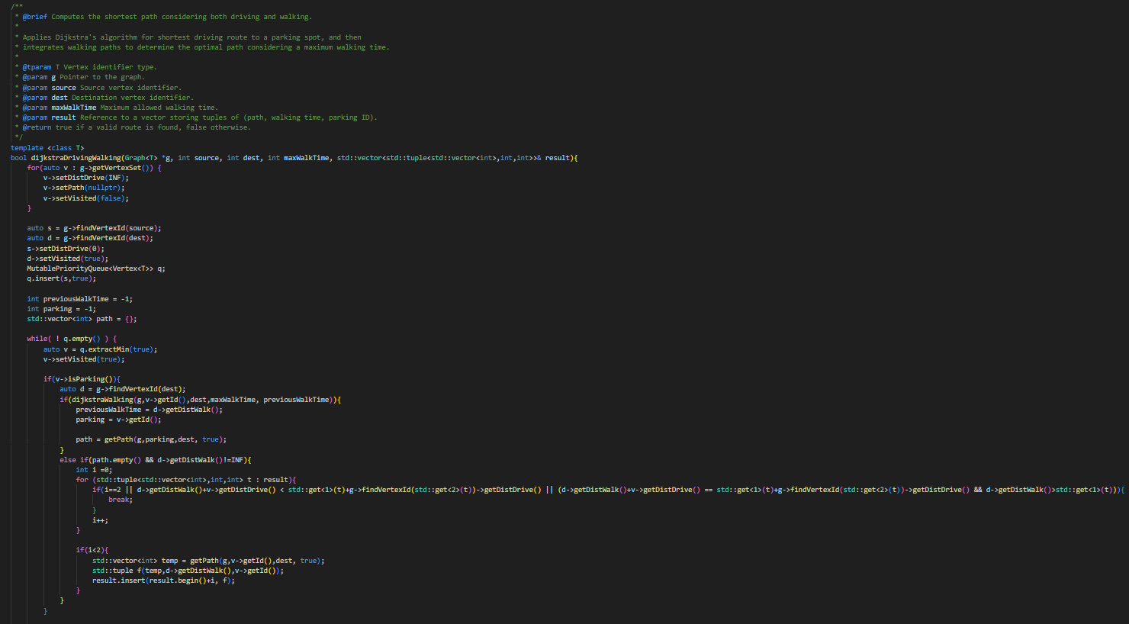
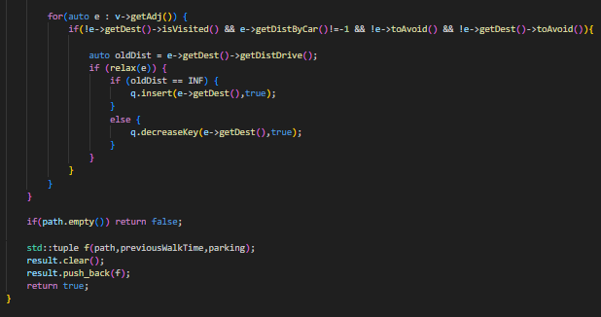
Implemented Algorithms: DijkstraDrivingWalking
The Final Dijkstra Algorithm is the most complex one. As we can see, it can call upon the DijkstraWalking algorithm, which makes it more complex than the others.
In the worst case, the DijkstraWalking function analyses every node V-1 times. The DijkstraDrivingWalking has the normal complexity of the other Dijkstras thanks to the first for, however, it also adds the complexity of the DijkstraWalking algorithm V-1 times.
This means that the Algorithm has a complexity of
O( (E + V) log V) + ( (V – 1) (E + V) log V) ). Each parcel of the sum represents a part of the algorithm: The first parcel represents the first for of the function while the second parcel describes the complexity of calling the DijkstraWalking function V-1 times. In the end, the final Time Complexity will be:
O( (V + E) log V (1 + V – 1) ) = O(V (E + V) log V).
9

Slide 10
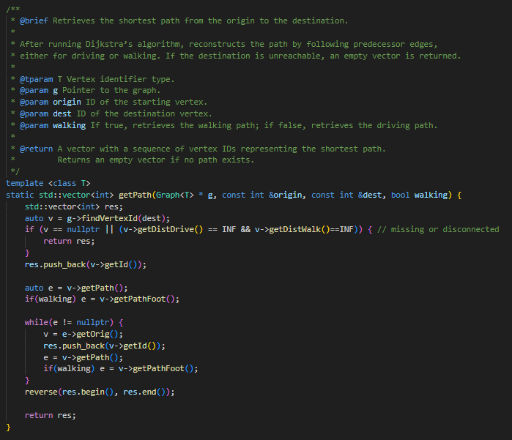
Implemented Algorithms: GetPath
Moving on to a simpler function, the getPath function simply traverses the path taken from the origin node to the destination node, push backing the Id of the nodes present in that path to a vector that it will later return.
As such, seeing as how paths typically traverse nodes once, the worst case is having a path that contains every node in the Graph, i.e., O(V).
10

Slide 11
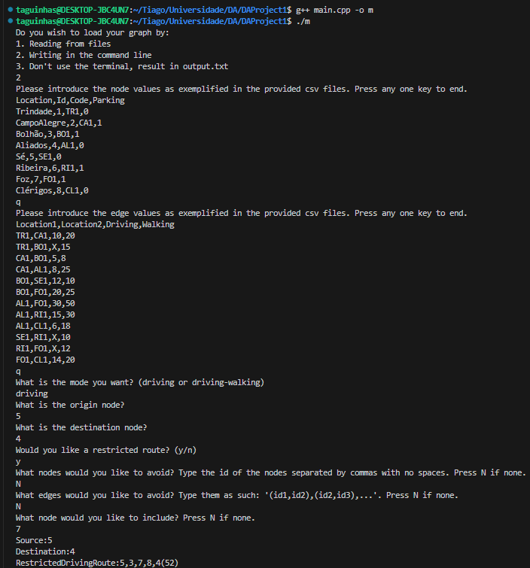
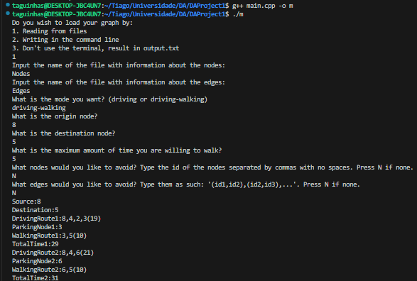
User Interface
As it was asked of us for this project, the information about the nodes and edges can be loaded either by reading the given datasets, or even new ones created inside the data folder, or alternatively the information about the graph can be given by written lines in the terminal, as these two examples illustrate.
11

Slide 12
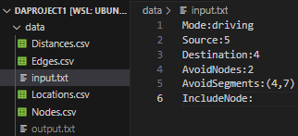
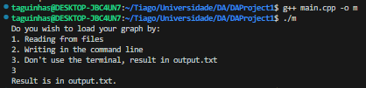
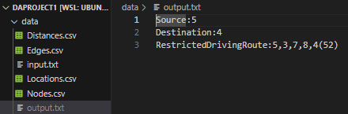
User Interface
The third option allows the program to run without any terminal interference, by placing the required info in the input.txt file, following the same pattern given in the examples. The result will be placed at the output.txt file, inside the data folder. This option always uses the “Edges.csv” and “Nodes.csv” files to create the Graph, so if you wish to use a different graph than the one present in these files, you must first change them accordingly.
Even if other options are selected in the terminal, the program still reads the input.txt and produces its output.txt.
12

Slide 13
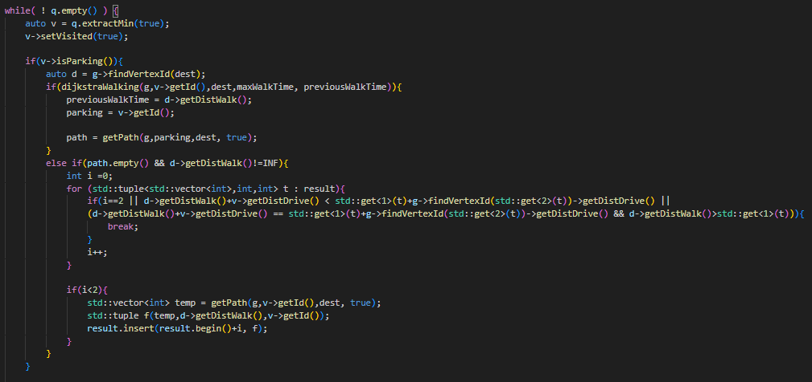
Highlight and Main Difficulty
The highlight of this project was the development of the DijkstraWalkingDriving function, particularly the part of the function in which we call upon de DijkstraWalking function.
Similarly, both this and the implementation of the Approximate Solution were the most difficult parts to develop in this project.
13

Slide 14
Participation of each Group Member
In our Project, the tasks were roughly divided as such:
André:
Development of first Dijkstra;
Responsible for Documentation;
Leonor:
Development of Environmentally-Friendly Route and Restricted Route Planning;
Development of Interface;
Responsible for altering the graph.h and mutablePriorityQueue.h;
Tiago:
Development of Best Alternative Route and Restricted Route Planning;
Development of functions responsible for file reading;
Responsible for making the Presentation documents.
14

Slide 15
Additional Information
Our algorithms may repeat in the same path edges or nodes.
For example, given a simple graph like this one, say we want the shortest path from A to C while including node B, the path given will be A→B→A→C, this is, the shortest path, repeating the A<->B edge.
Another case where we may repeat edges is for parking spots. When we want to go from 1 to 4 with walking included and 3 is the only node with a parking spot, the drive path will be 1→2→3 and the walking will be 3→2→4, meaning the 2<->3 edge is repeated.
B
3
(P)
10
A
30
C
1
2
4
10
15

Slide 16
Analysis and Sysnthesis of Algorithms
Design of Algorithms (DA)
Programming Project I
Individual Route Planning Tool
Project done by:
André Barros Siqueira up202300449
Leonor Alexandra Costa Azevedo up202304040
Tiago Alexandre de Boaventura Nunes up202304047
Departamento de Engenharia Informática (DEI) / Departamento de Ciências de Computadores (DCC)
Faculdade de Engenharia da Universidade do Porto (FEUP) / Faculdade de Ciências da Universidade do Porto (FCUP)

