Slide 1
ALLOTROPE
DPPA CFO Visual Explainer — Case Study
Hourly Matching, Price Mechanics & FMP Cancellation Effect
May 2026

Slide 2
What the Web App Shows
A factory-facing teaching tool for Vietnam synthetic DPPA settlement
Interactive 24-hour profile chart
Factory load vs solar generation overlap with tariff bands (off-peak, standard, peak)
Real-time strike price, market price / FMP, DPPA charge, and loss factor sliders
Click any hour to inspect the settlement walkthrough: EVN payment + developer CfD
Three synthetic scenarios: Load > Gen, Load = Gen, Load < Gen
Mermaid cancellation flow diagram showing how FMP terms cancel out
2,100
1,700
523
Strike Price (VND/kWh)
Market Price / FMP (VND/kWh)
DPPA Charge (VND/kWh)
Confidential — For Internal Use by Allotrope & Key Partners — Not for Further Circulation

Slide 3
01
Daily Load & Solar Profile
Confidential — For Internal Use by Allotrope & Key Partners — Not for Further Circulation

Slide 4
Three Synthetic Scenarios
Same price inputs; only the hourly load and solar profiles differ
Scenario | Label | Daytime Load Range | Peak Solar | Risk Highlight
A | Load > Gen | 5,200 – 6,100 kWh | 4,200 kWh @ 12:00 | High shortfall → retail tariff exposure
B | Load = Gen | 3,900 – 4,700 kWh | 4,700 kWh @ 12:00 | Best match → minimal shortfall / excess
C | Load < Gen | 3,100 – 3,600 kWh | 6,200 kWh @ 12:00 | Overgeneration → settlement quantity risk
Confidential — For Internal Use by Allotrope & Key Partners — Not for Further Circulation

Slide 5
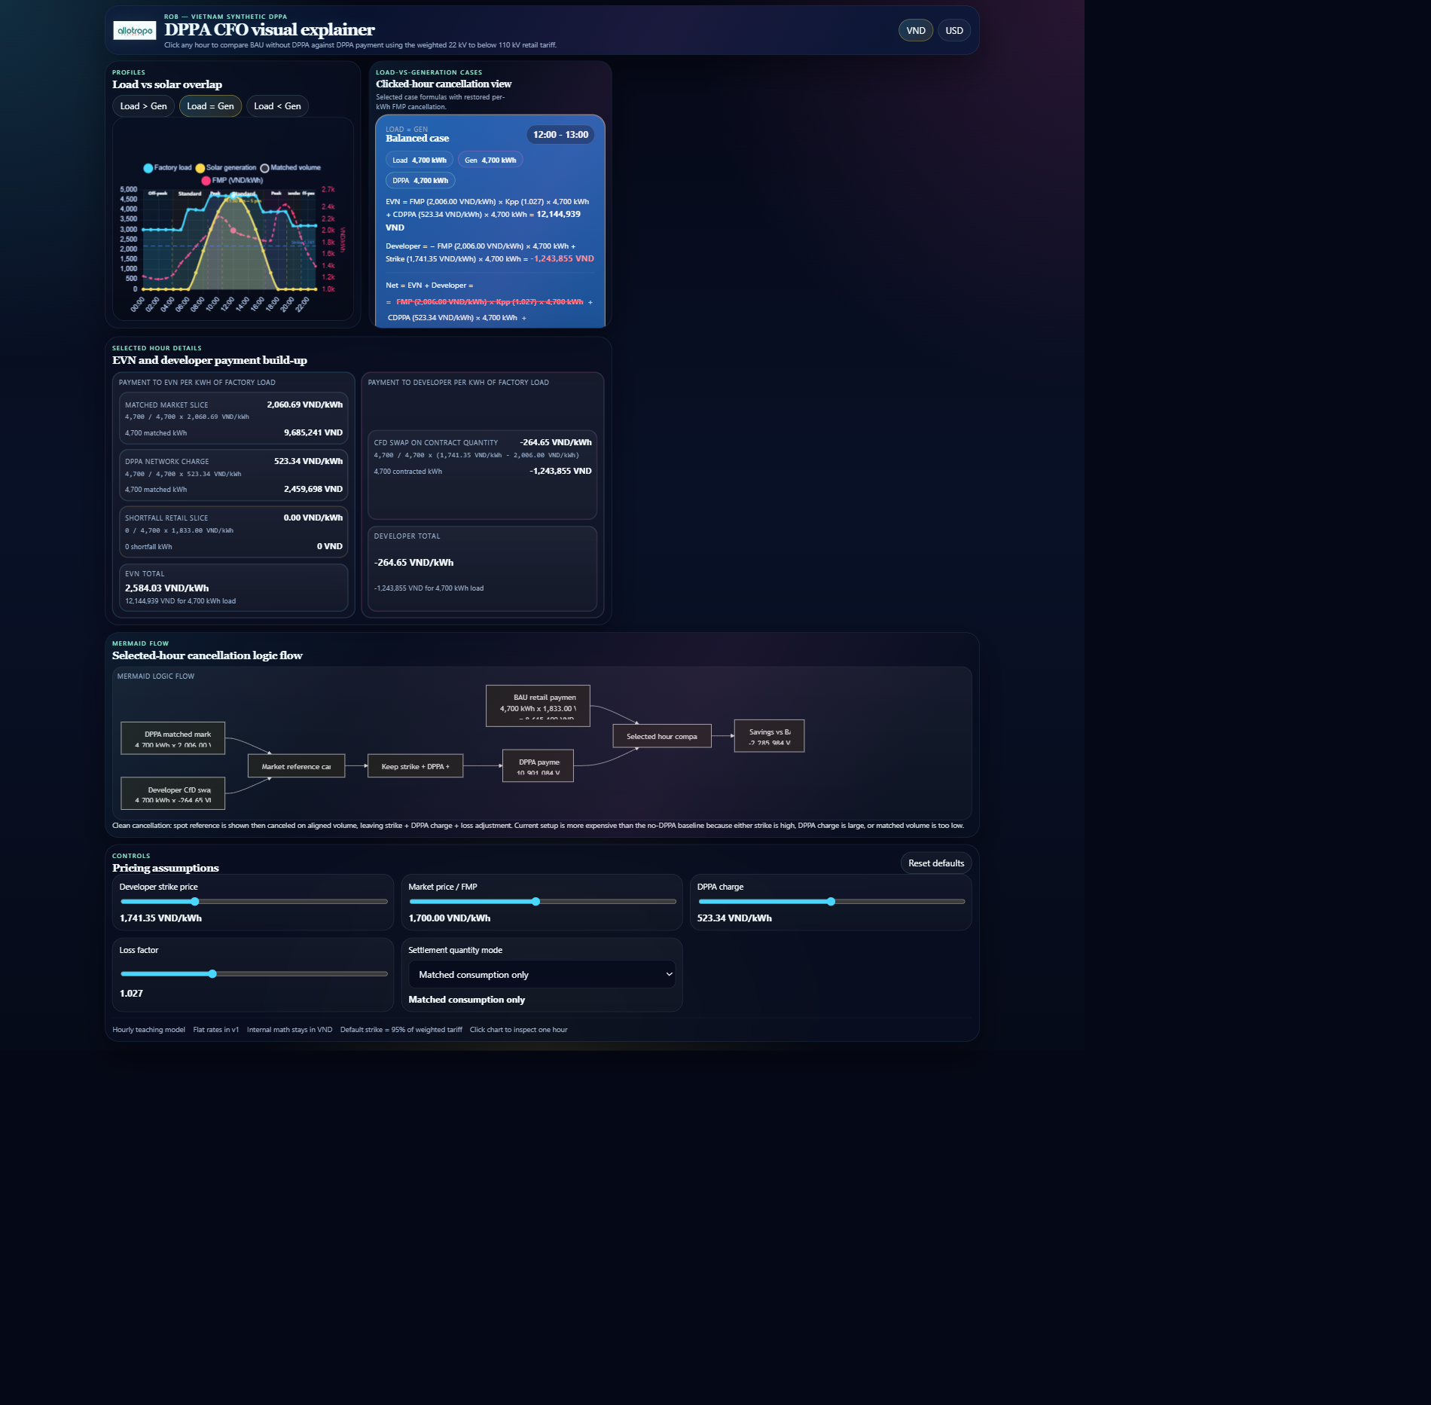
Load vs Solar Overlap — Scenario B (Balanced)
Factory load (cyan), solar generation (amber), matched volume (white), FMP curve (magenta)
Confidential — For Internal Use by Allotrope & Key Partners — Not for Further Circulation

Slide 6
02
Hour-by-Hour Matching
Confidential — For Internal Use by Allotrope & Key Partners — Not for Further Circulation

Slide 7
Matching, Shortfall & Excess
The three volume concepts that drive every settlement interval
Matched volume = min(Load, Generation)
Shortfall = max(Load - Generation, 0) → bought at retail tariff
Excess = max(Generation - Load, 0) → not credited to factory under matched-mode settlement
Contract quantity (matched mode) = matched volume
Contract quantity (generation mode) = generation volume → overgeneration risk
33.1k
58.2k
0
Scenario B — Daily Matched kWh
Scenario B — Daily Shortfall kWh
Scenario B — Daily Excess kWh
Confidential — For Internal Use by Allotrope & Key Partners — Not for Further Circulation

Slide 8
03
Per-Hour Settlement Arithmetic
Confidential — For Internal Use by Allotrope & Key Partners — Not for Further Circulation

Slide 9
Settlement Walkthrough — 12:00 (Balanced Hour)
Scenario B | Load 4,700 kWh | Solar 4,700 kWh | Perfect match | FMP 1,836 VND/kWh
Component | Formula | Amount (VND)
EVN Market | 4,700 kWh × 1,836 × 1.027 | 8,866,517
EVN DPPA Charge | 4,700 kWh × 523.34 | 2,459,698
EVN Retail Shortfall | 0 kWh × 2,100 | 0
EVN Total | Market + DPPA + Retail | 11,326,215
Developer CfD | 4,700 kWh × (2,100 − 1,836) | 1,240,800
Net DPPA Payment | EVN Total + Developer | 12,567,015
BAU Retail Baseline | 4,700 kWh × 2,100 | 9,870,000
Savings vs BAU | BAU − DPPA | −2,697,015
Confidential — For Internal Use by Allotrope & Key Partners — Not for Further Circulation

Slide 10
Settlement Walkthrough — 07:00 (Shortfall Hour)
Scenario B | Load 4,000 kWh | Solar 833 kWh | Shortfall 3,167 kWh | FMP 1,496 VND/kWh
Component | Formula | Amount (VND)
EVN Market | 833 kWh × 1,496 × 1.027 | 1,280,293
EVN DPPA Charge | 833 kWh × 523.34 | 435,942
EVN Retail Shortfall | 3,167 kWh × 2,100 | 6,650,700
EVN Total | Market + DPPA + Retail | 8,366,935
Developer CfD | 833 kWh × (2,100 − 1,496) | 503,132
Net DPPA Payment | EVN Total + Developer | 8,870,067
BAU Retail Baseline | 4,000 kWh × 2,100 | 8,400,000
Savings vs BAU | BAU − DPPA | −470,067
Confidential — For Internal Use by Allotrope & Key Partners — Not for Further Circulation

Slide 11
Settlement Walkthrough — 12:00 (Excess / Overgen Hour)
Scenario C | Load 3,600 kWh | Solar 6,200 kWh | Excess 2,600 kWh | FMP 1,836 VND/kWh
Component | Formula | Amount (VND)
EVN Market | 3,600 kWh × 1,836 × 1.027 | 6,782,251
EVN DPPA Charge | 3,600 kWh × 523.34 | 1,884,024
EVN Retail Shortfall | 0 kWh × 2,100 | 0
EVN Total | Market + DPPA + Retail | 8,666,275
Developer CfD (matched mode) | 3,600 kWh × (2,100 − 1,836) | 950,400
Net DPPA Payment | EVN Total + Developer | 9,616,675
BAU Retail Baseline | 3,600 kWh × 2,100 | 7,560,000
Savings vs BAU | BAU − DPPA | −2,056,675
Note: In generation-mode settlement, contract quantity = 6,200 kWh → CfD rises to 1,636,800 VND. Factory pays more despite excess solar.
Confidential — For Internal Use by Allotrope & Key Partners — Not for Further Circulation

Slide 12
04
The FMP Cancellation Effect
Confidential — For Internal Use by Allotrope & Key Partners — Not for Further Circulation

Slide 13
Why FMP Mostly Cancels Out
The key insight for CFOs: effective cost converges to Strike + DPPA charge, not FMP
Total cost per matched kWh (ignoring loss factor):
EVN Market + EVN DPPA + CfD
= (Q × FMP) + (Q × C_DPPA) + Q × (Strike − FMP)
= Q × FMP + Q × C_DPPA + Q × Strike − Q × FMP
= Q × Strike + Q × C_DPPA
The FMP terms cancel exactly when contract quantity equals matched volume.
Loss factor adds a tiny residual: FMP × (Kpp − 1)
Shortfall hours break the clean cancellation because retail tariff replaces the strike on unmatched kWh.
Overgeneration breaks it because contract quantity exceeds matched volume.
2,623
2,670
Implied Cost / kWh (Strike + DPPA)
With Loss Factor @ Avg FMP
Confidential — For Internal Use by Allotrope & Key Partners — Not for Further Circulation

Slide 14
05
Scenario Comparison — Daily Totals
Confidential — For Internal Use by Allotrope & Key Partners — Not for Further Circulation

Slide 15
Daily Settlement: All Three Scenarios
Matched-mode settlement. Same price parameters; different solar capacity and load shape.
Metric | Scenario A Load > Gen | Scenario B Load = Gen | Scenario C Load < Gen
Daily Load (kWh) | 116,100 | 91,300 | 75,100
Solar Generation (kWh) | 35,100 | 33,100 | 43,600
Matched Volume (kWh) | 35,100 | 33,100 | 33,100
Shortfall (kWh) | 81,000 | 58,200 | 42,000
Excess (kWh) | 0 | 0 | 10,500
Total DPPA Cost (VND) | 232,947,000 | 180,654,000 | 149,043,000
BAU Retail Cost (VND) | 243,810,000 | 191,730,000 | 157,710,000
Savings vs BAU (VND) | 10,863,000 | 11,076,000 | 8,667,000
Blended Price (VND/kWh) | 2,006 | 1,981 | 1,983
Confidential — For Internal Use by Allotrope & Key Partners — Not for Further Circulation

Slide 16
Key Takeaways for Factory CFOs
Decision-oriented conclusions from the DPPA CFO calculator case study
01 FMP mostly cancels
The CfD and EVN market charge nearly offset. Effective cost converges to Strike + DPPA charge — not FMP. FMP risk is hedged by design.
02 Match rate drives value
Solar that closely tracks daytime load maximises matched kWh and minimises high-cost shortfall hours. Overbuilding creates settlement risk.
03 Settlement mode matters
Matched-mode is safest. Generation-mode or allocated-mode can expose the factory to paying CfD on unconsumed energy.
04 Loss factor is small but real
At 1.027, the loss factor adds ~2.7% to the EVN market component. It is not enough to change the investment decision.
05 Shortfall is your biggest cost swing
Every unmatched kWh is charged at the full retail tariff (2,100 VND/kWh). Shape the solar array to your load curve.
Confidential — For Internal Use by Allotrope & Key Partners — Not for Further Circulation

Slide 17
ALLOTROPE
Questions & Next Steps
Live CFO calculator: https://dppa-case.web.app
Contact: Allotrope VC Research | May 2026

