Slide 1
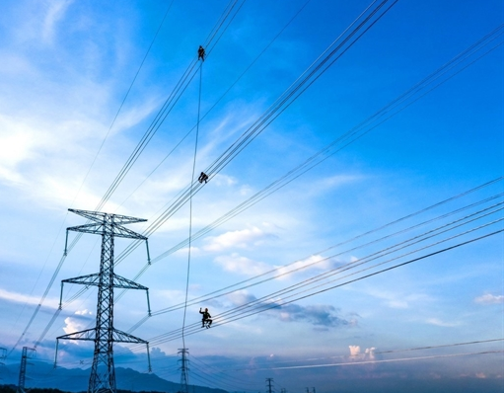



Session 4.4: Off-Site Solutions: Addressing DPPA Pricing Concerns

Slide 2


About the 2026 Update
Current repo: CFO calculator, tested settlement engine, formula docs, and workshop readiness analysis
35
3
tests passing
factory profiles
The reference deck explained why DPPA buyers worry about market price. This update uses the current repository to show the actual settlement mechanics behind that concern. Updated storyline: • FMP and CFMP remain visible buyer concerns • Hourly matched quantity is the cost driver • The CfD cancels much of the FMP exposure on matched kWh • Settlement quantity mode determines overgeneration risk Current app status: 35 tests passing, three synthetic profiles, default matched-mode settlement.
5
0
pricing inputs
critical gaps

Slide 3
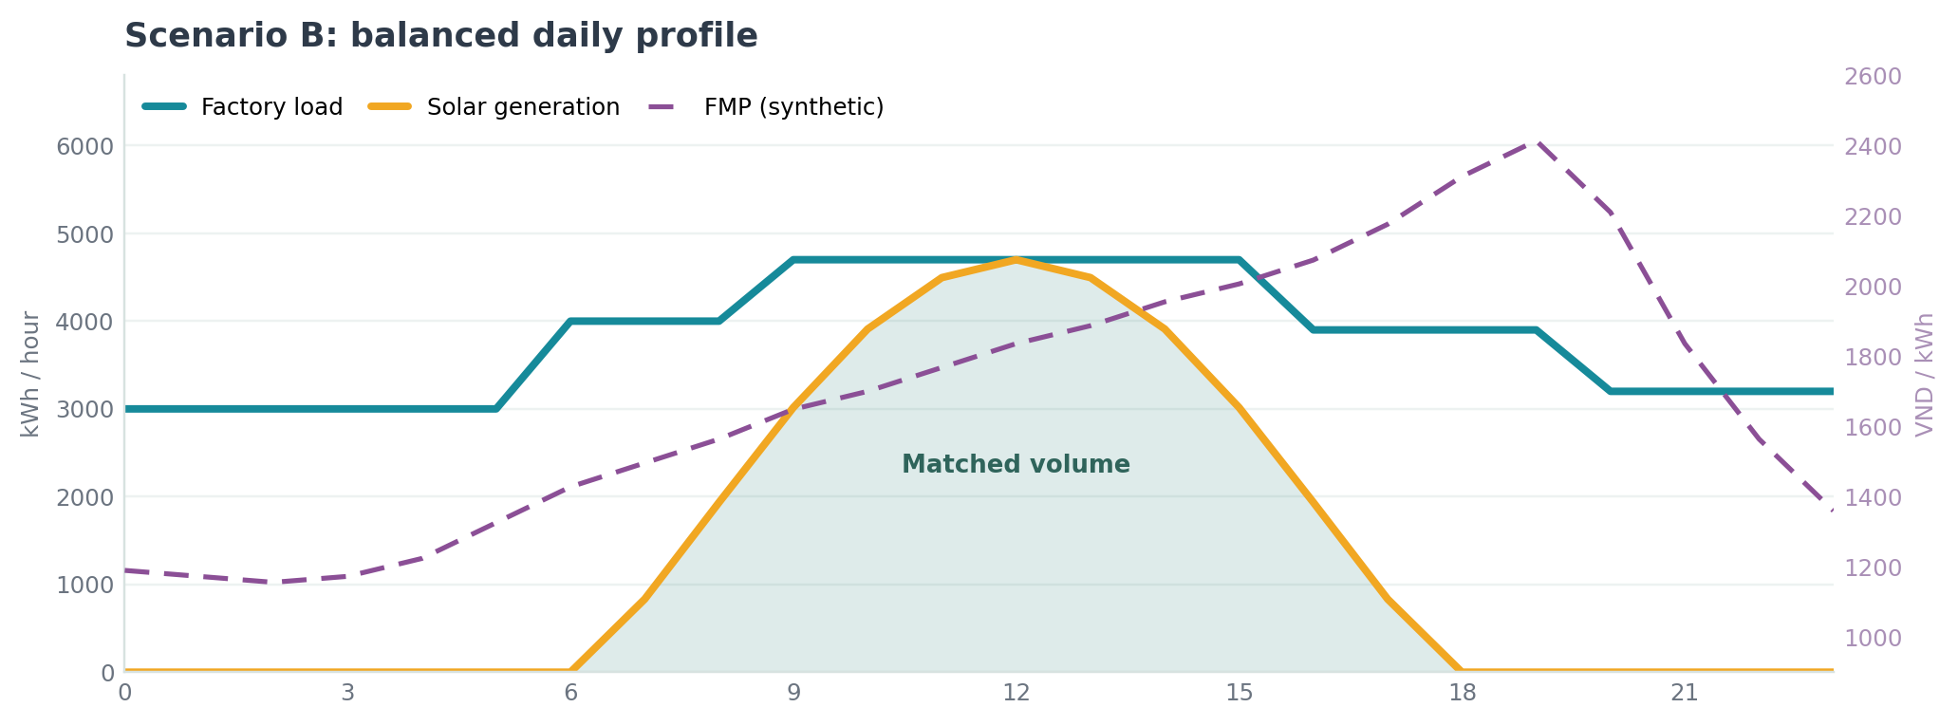
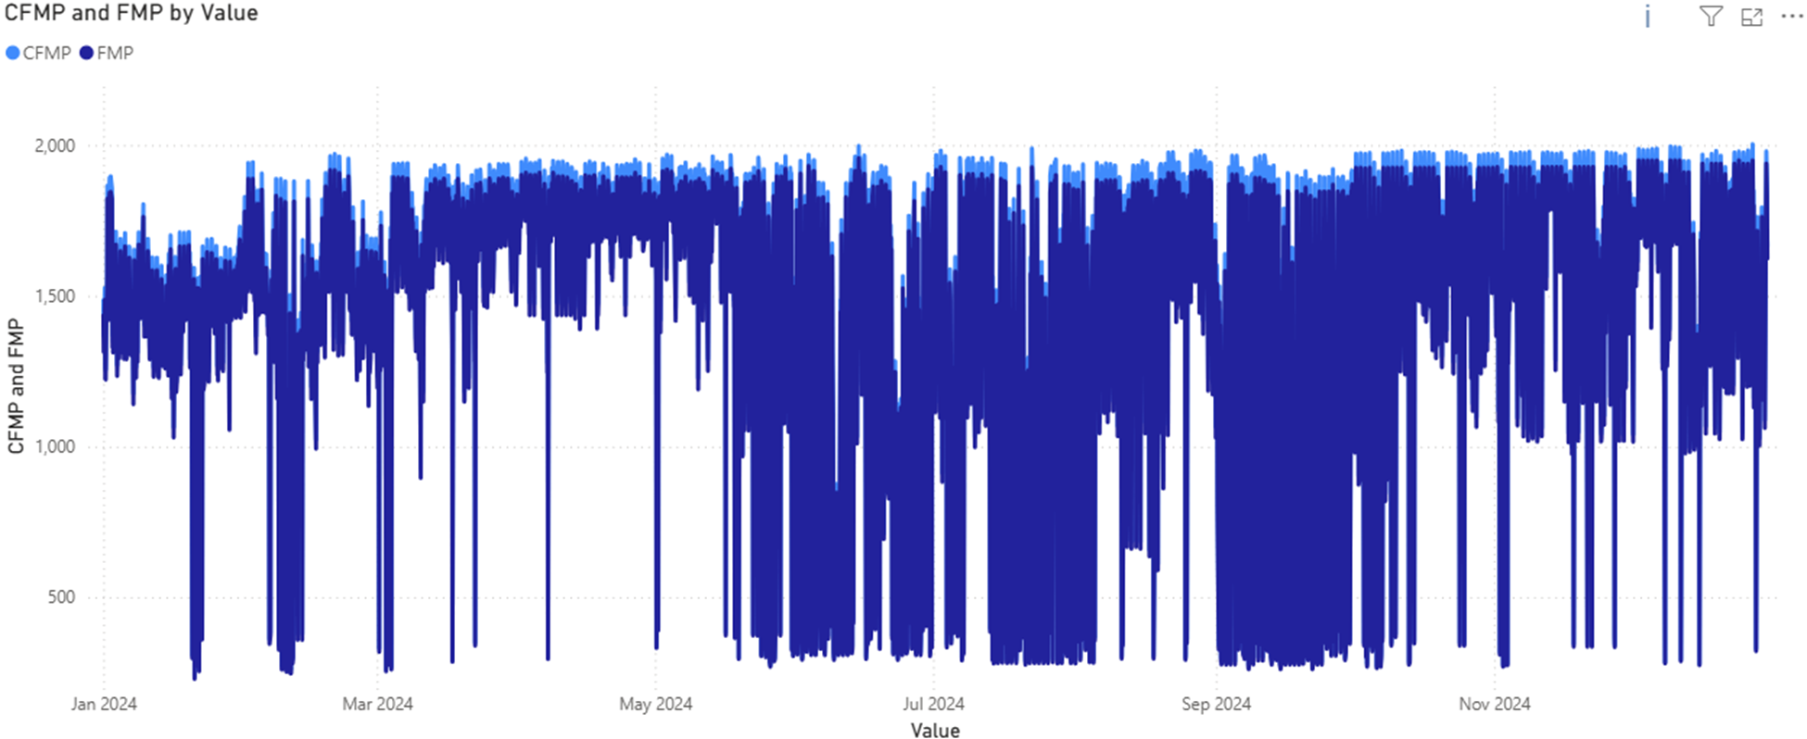
Understanding Market Price
Spot market price remains the visible buyer concern, but the current calculator shows where it truly affects cost

Slide 4
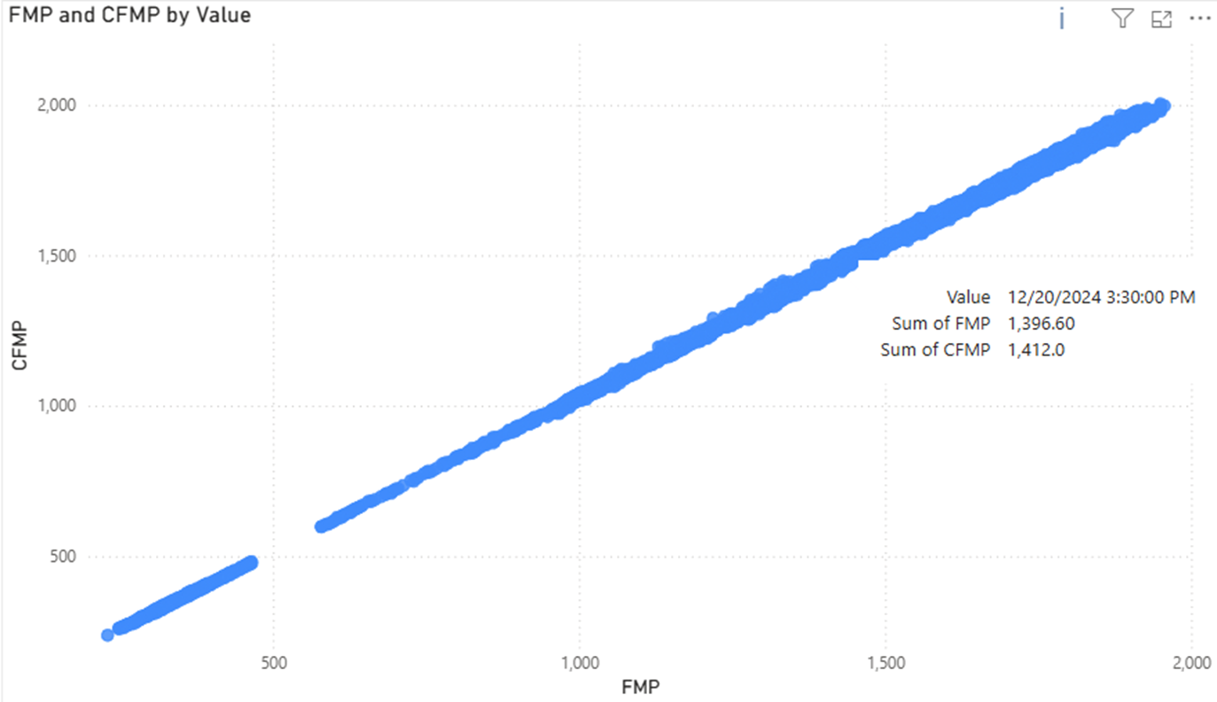
Understanding Market Price
Matched quantity, not headline FMP, drives the buyer's DPPA cost exposure
2,100
523.34
1.027263
Strike price Pc
DPPA charge C_DPPA
Loss factor Kpp
VND/kWh
VND/kWh
dimensionless
FMP stays visible in the EVN market charge and the developer CfD.
On matched kWh those FMP terms offset — cost collapses toward Strike + DPPA charge.
Shortfall and excess volumes are what break the clean cancellation.

Slide 5
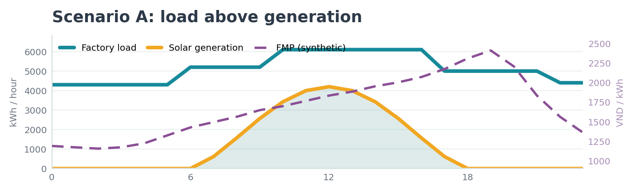
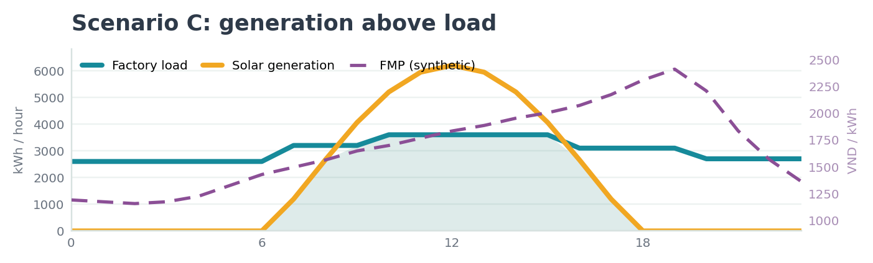
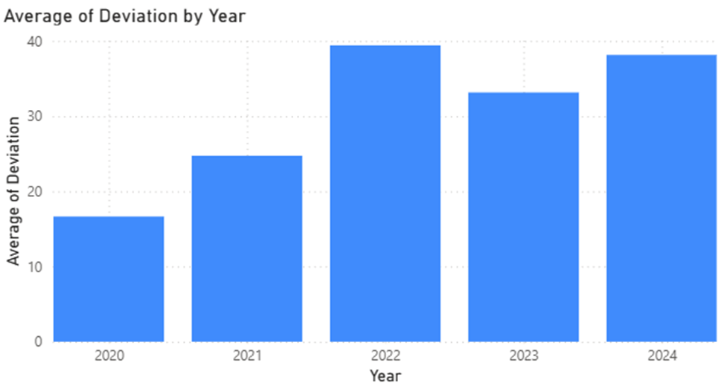
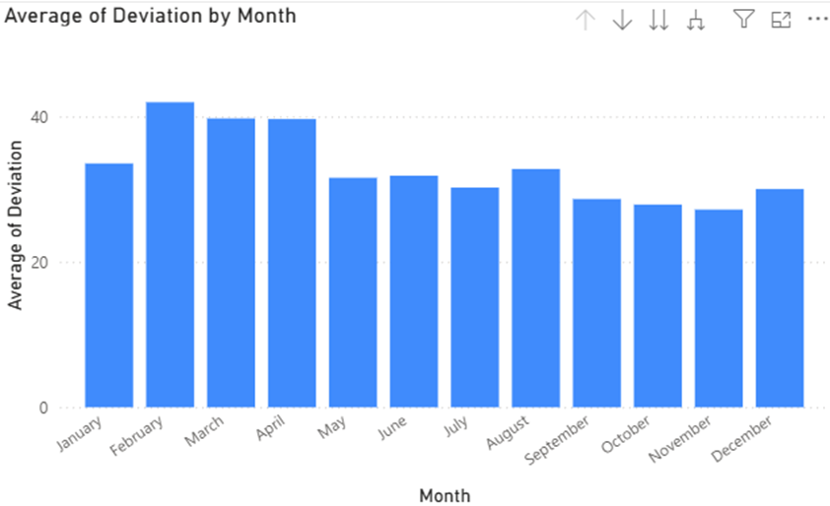
Understanding Market Price
The repo uses a synthetic daily FMP curve to teach price sensitivity without hiding the settlement logic.

Slide 6


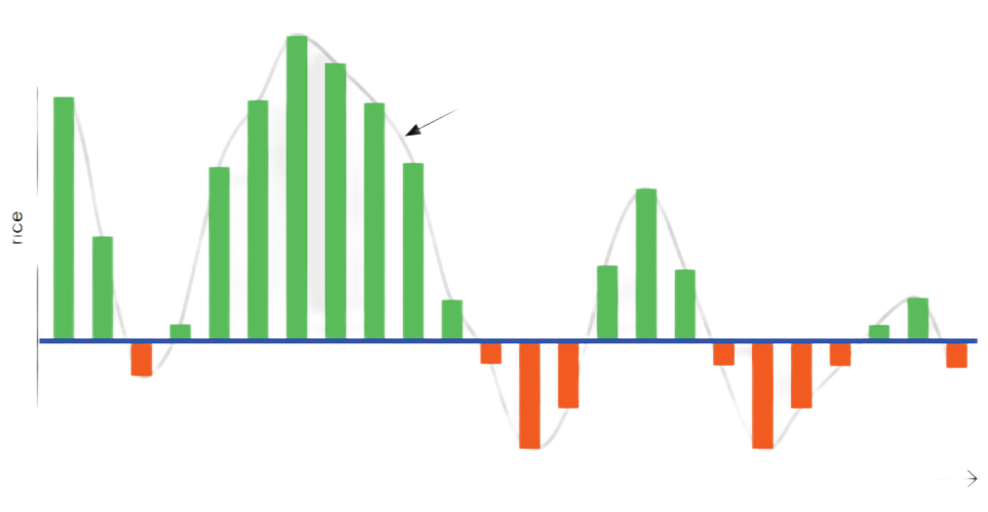


Payment Mechanisms
EVN market = Matched kWh × FMP × Kpp
Buyer cost = EVN market + DPPA charge + retail shortfall + developer CfD
Developer CfD = Contract quantity × (Strike − FMP)
DPPA service charge = Matched kWh × C_DPPA
FMP reference inside EVN bill
Retail shortfall = (Load − matched kWh) × retail tariff
Strike price − spot market

Slide 7
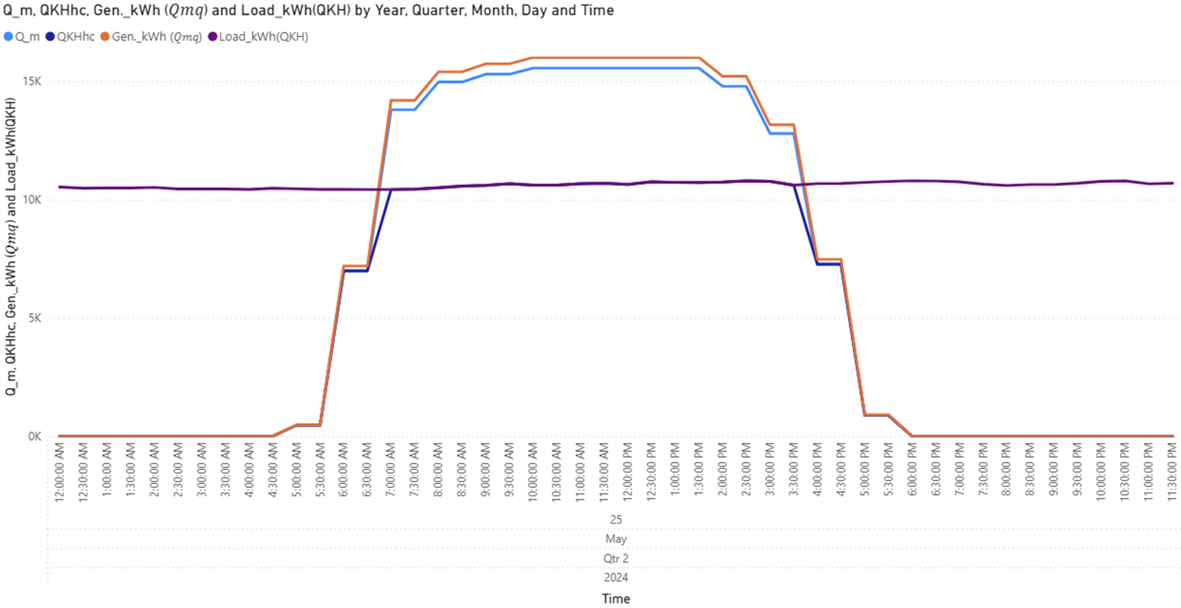
Diurnal Profile
Accurate allocation of QKHhc is critical for determining DPPA cost settlement

Slide 8
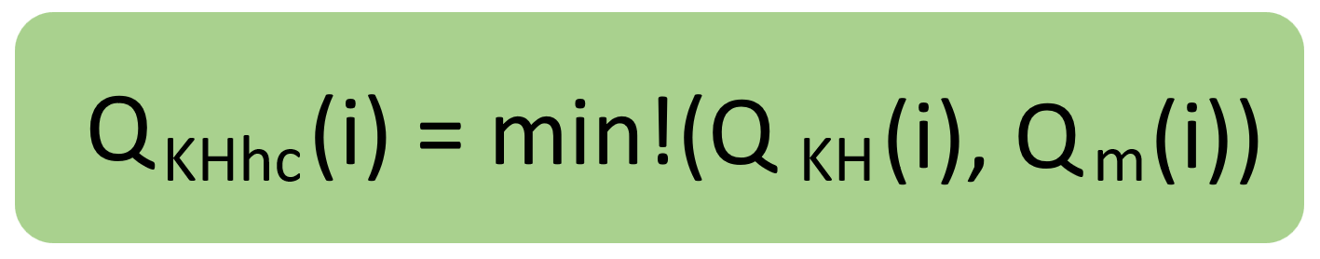
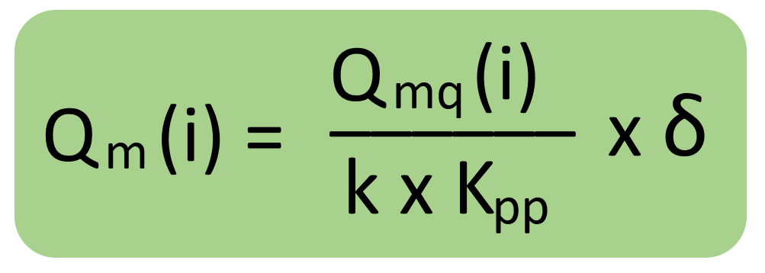
QKHhc is the key factor in all DPPA cost calculations: buyers must calculate it accurately.
Matched volume
Shortfall
Excess
QKHhc(i) = min(QKH(i), Qm(i))
max(QKH(i) − Qm(i), 0)
max(Qm(i) − QKH(i), 0)
Matched mode: contract quantity equals matched energy.
Generation mode: contract quantity equals renewable generation, so excess solar can still create CfD exposure.
Allocated mode: contract quantity follows the allocation in the contract.
Buyer implication: negotiate the quantity definition before debating a headline strike price.

Slide 9
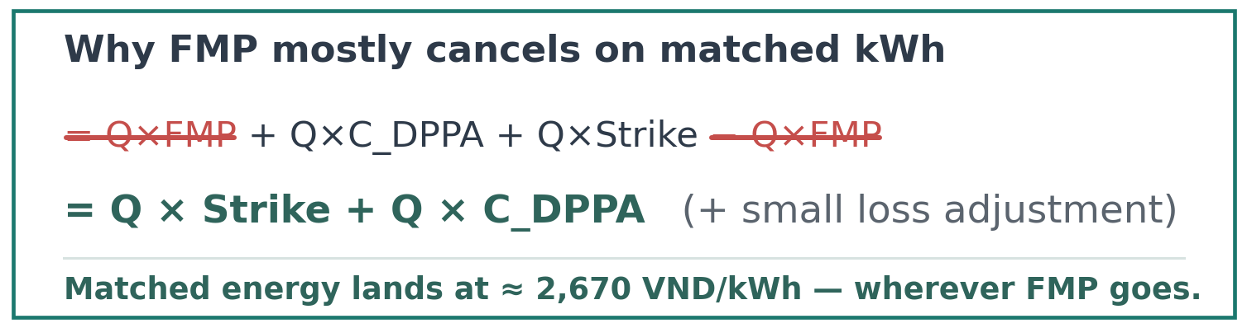

Payment Mechanism under the CFD
Strike price determines financial settlement through CFD, converting market price volatility into predictable financial flows
Pc(i): committed strike price at settlement cycle i.
FMP(i): hourly market reference price (synthetic in the teaching model).
Qca(i): contract quantity — default app mode equals matched volume.

Slide 10
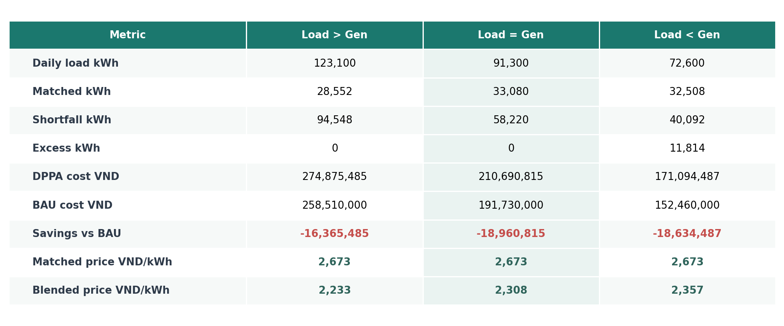
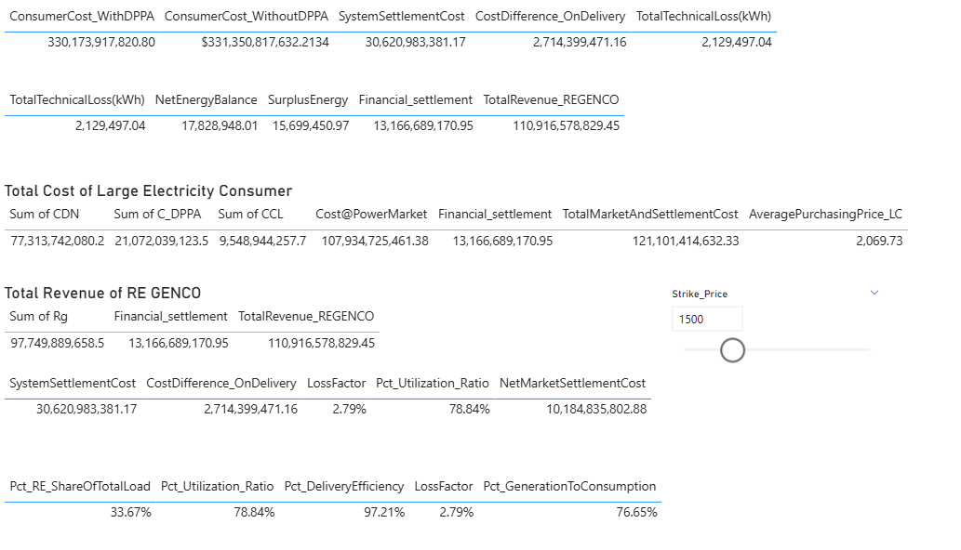
Quantify DPPA Costs to Assess Feasibility & Negotiate RE Supply
Feasibility analysis enables buyers to compare DPPA against traditional procurement with confidence

Slide 11

Session 4.5: Preparing for DPPA Implementation

Slide 12

Interactive Exercise: DPPA Scenario Analysis (~60 minutes)
Use the CFO calculator to test one factory load profile against three questions: • How much load is matched by renewable generation? • Which hours create retail shortfall exposure? • Which settlement quantity mode is acceptable before negotiating strike price? Start with the balanced profile, then compare Load > Gen and Load < Gen.

Slide 13
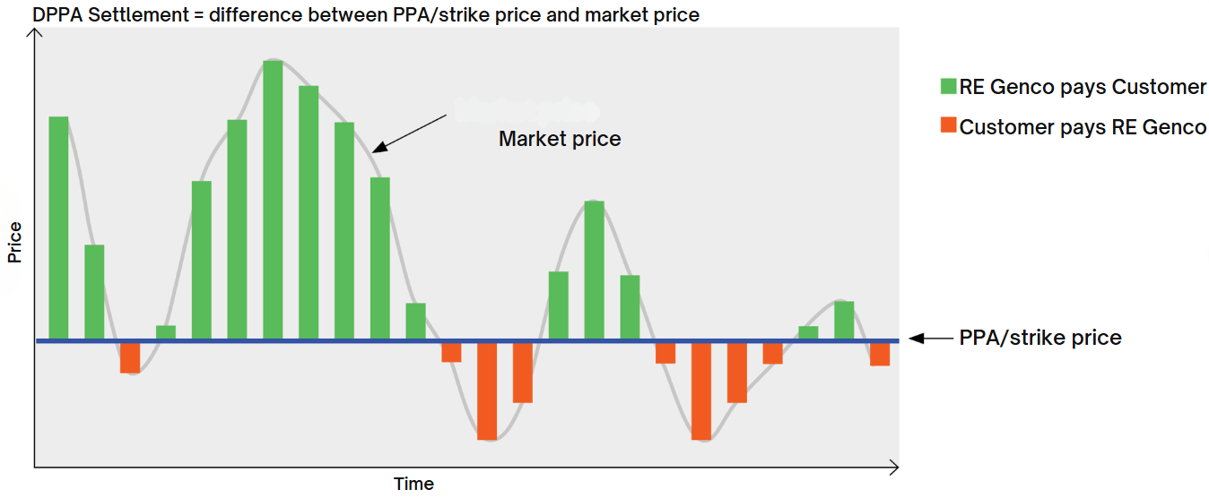
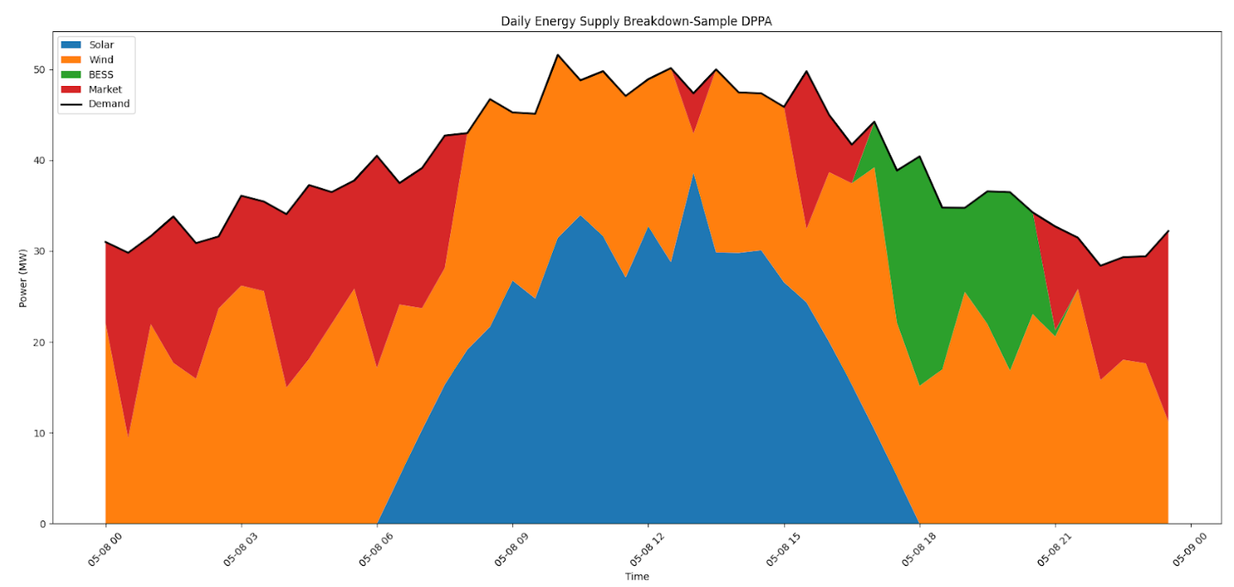
Scenario DPPA Negotiation
Your factory is located in Northern Vietnam, within an industrial park, and is currently purchasing electricity from an EVN-subsidiary or industrial park electricity retailer. Annual demand is 150 GWh. Determine the essential conditions for proceeding with an appropriate DPPA arrangement: • Electricity retailer • Optimal renewable energy source • Required capacity and load match • DPPA contract duration • Settlement quantity mode • Risk allocation for shortfall and excess
Scenario DPPA Negotiation

