Slide 1


PACTA + TRISK: Transition-Risk Analytics
for Vietnamese Banks
Notes:
Welcome and introductions. This deck presents our PACTA + TRISK analytics stack for Vietnamese banks navigating Decision 263 and transition-risk compliance.
Key message: We offer an integrated, open-source, no-licensing-fee solution that takes a bank from GHG inventory through portfolio alignment to borrower-level stress testing and IFRS S2 disclosure.
Synthetic data disclaimer: All case-study results in this deck use illustrative synthetic data — not actual portfolio results.

Slide 2


Agenda
The Problem | Our Approach | Case Study | Next Steps
Notes:
Walk through the four-part agenda:
1. The Problem — Decision 263 mandates and the analytical gap
2. Our Approach — Three-layer compliance stack (PCAF, PACTA, TRISK)
3. Case Study — Vietnam bank demo with synthetic data
4. Next Steps — How to engage and timeline

Slide 3

Our Solution: Three-Layer Compliance & Risk Stack
Layer | Tool | Purpose
1. Measure | PCAF | GHG inventory
2. Align | PACTA | Portfolio alignment
3. Stress | TRISK | Borrower stress
4. Disclose | IFRS S2 | Board reporting
Notes:
Frame the challenge: Decision 263/QĐ-TTg (signed July 2024) requires banks to:
- Report GHG emissions from financed activities
- Set reduction targets aligned with Vietnam's NDC (43.5% conditional by 2030)
- Develop transition plans for high-carbon borrowers
The problem: Most Vietnamese banks lack the analytical tools to quantify portfolio alignment or borrower-level financial stress under transition scenarios.
Ask: 'How is your bank currently assessing transition risk for your loan portfolio?'

Slide 4

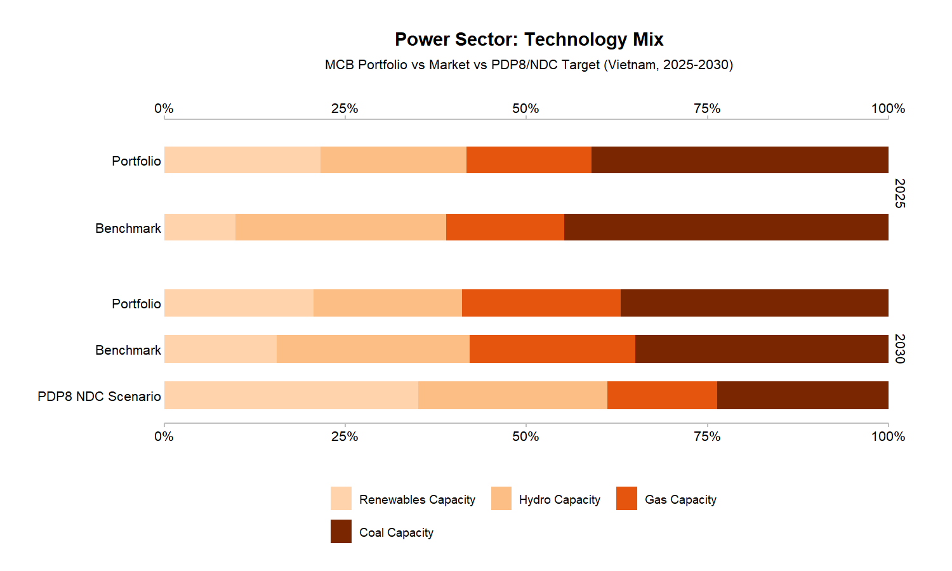
PACTA: Portfolio Alignment Assessment
Develop portfolio alignment reports using open-source R packages
Market-share method for power and automotive
Coal 28% above PDP8 target
SDA method for cement and steel emission intensity
Renewables 15% below 2030 trajectory
43 loans, 25 trillion VND synthetic portfolio across power, automotive, cement, steel, and coal mining sectors
Custom PDP8 scenario from Vietnam Power Development Plan 8
Open-source R packages, no licensing fees
Company-level results enable borrower-specific engagement
Scenario comparison: PDP8 vs IEA NZE vs Vietnam NDC
1,500+ institutions globally
Time to first results: 1-3 months
Notes:
Present the four-layer stack:
- Layer 1 PCAF: Measure — GHG inventory for Scope 1, 2, and 3 (financed and non-financed)
- Layer 2 PACTA: Align — Portfolio alignment against PDP8, NDC, and IEA NZE scenarios
- Layer 3 TRISK: Stress — Borrower-level NPV and PD impact under transition scenarios
- Layer 4 IFRS S2: Disclose — TCFD/ISSB-compliant reporting outputs
Key differentiator: All layers use open-source R packages (r2dii.*, pacta.loanbook, trisk.model) with no licensing fees. The stack is modular — banks can adopt one layer or all four.

Slide 5
The Challenge: Decision 263 & Transition Risk
THE CHALLENGE
WHAT BANKS NEED
3
SLL Support
Decision 263/QD-TTg mandates GHG quotas for thermal power, steel, and cement from 2025. Banks must assess borrower transition risk, but lack analytical tools to quantify portfolio alignment or borrower-level financial stress under Paris-aligned scenarios.
Vietnamese banks need an integrated analytics stack that measures portfolio alignment with PDP8/NDC targets, quantifies borrower-level NPV and PD impact under transition scenarios, and produces disclosure-ready outputs for IFRS S2 and TCFD.
Notes:
PACTA deep-dive:
- Market-share method for power and automotive sectors
- Sectoral Decarbonization Approach (SDA) for cement and steel
- Fuzzy matching with manual review for Vietnamese company names
- Custom PDP8 scenario interpolation from Vietnam's Power Development Plan 8
Synthetic demo results: 43-loan portfolio (~$1B USD) shows coal capacity 28% above PDP8 target and renewables 15% below 2030 trajectory.
Emphasize: Company-level results enable borrower-specific engagement, not just portfolio-level averages.

Slide 6
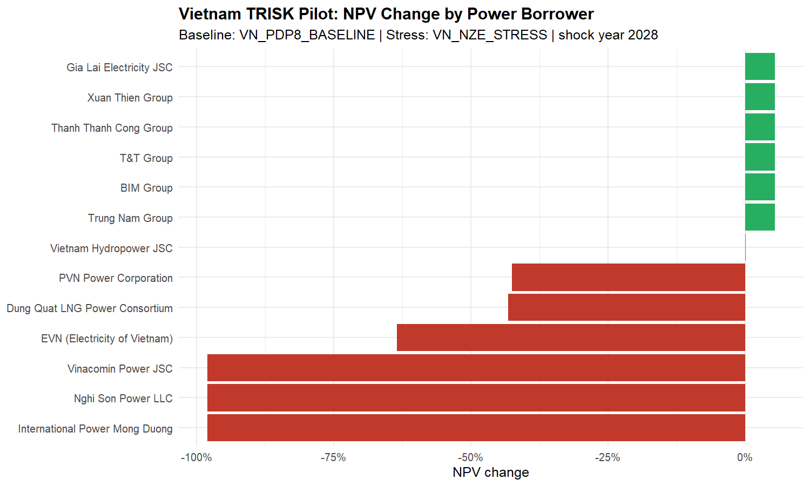
TRISK: Borrower-Level Transition Stress Testing
Quantify borrower-level NPV and PD impact under transition scenarios
Power: Coal-heavy borrowers show -12% to -18% NPV change
Exportable: CSV, HTML reports, interactive dashboard
Cement: BF/BOF mills face -8% to -14% NPV impact
Results update instantly, no recomputation needed
Steel: EAF routes outperform BF/BOF by 6-10pp
Sensitivity: shock year, discount rate, market passthrough
Priority ranking: alignment gap + NPV change + exposure
Scenario Builder: drive five TRISK levers in real time
Covers all three Decision 263 sectors
Open-source R package (trisk.model) on CRAN
Notes:
TRISK deep-dive:
- DCF-based NPV modeling for each borrower's physical assets
- Merton-model PD estimation under transition stress
- Five configurable levers: shock year, discount rate, risk-free rate, market passthrough, carbon-price family
- Sensitivity analysis built into the Scenario Builder dashboard page
Key finding: Coal-heavy borrowers show -12% to -18% NPV change under NZE-aligned stress, while renewable-focused borrowers benefit from transition tailwinds (+8% NPV).
Emphasize: Results update instantly — no recomputation needed when levers change.

Slide 7
Engagement Offer & 2026 Roadmap
Phase 1: Data intake and loanbook normalization (BYOL)
Phase 2: PACTA portfolio alignment with real borrower data
Phase 3: TRISK stress testing and borrower ranking
Phase 4: IFRS S2 disclosure package and board-ready report
Timeline: 6-9 months from data receipt to final deliverables.
All analytics are open-source with no licensing fees.
We welcome the opportunity to discuss how this analytics stack can support your bank's transition-risk management and Decision 263 compliance.
Notes:
Case study: Power sector alignment
- Synthetic MCB portfolio: 43 loans across power, automotive, cement, steel, coal
- Power mix: Coal 28%, Gas 12%, Hydro 10%, Solar 8%, Wind 5%
- PDP8 target: Coal phase-down, renewables must triple by 2030
- Gap: Coal capacity 28% above target; renewables 15% below
Point to the alignment overview chart: Red bars = misaligned, green bars = aligned.
Disclaimer reminder: This is illustrative synthetic data. Real bank results will differ based on actual loanbook composition.

Slide 8

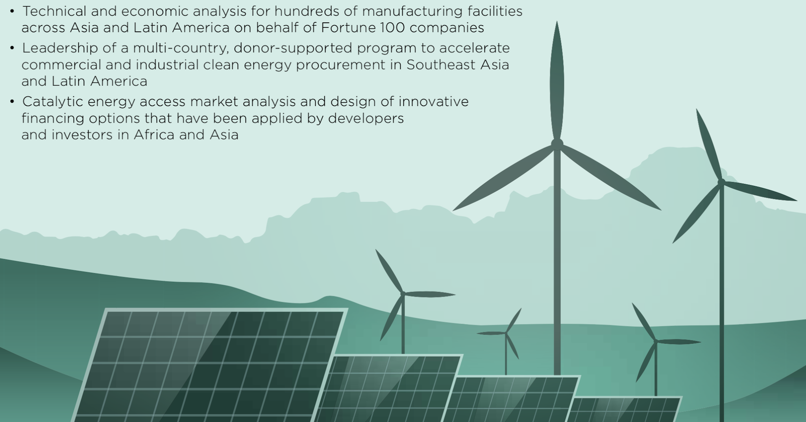
Tung Ho, tah@allotropepartners.com
Hang Tran, httt@allotropepartners.com
Allotrope VC | GTB Vietnam
Notes:
Case study: TRISK borrower stress rankings
- Priority score combines alignment gap, NPV change, and exposure weight
- Top stressed borrowers: Coal-heavy names (Vinh Tan, Duyen Hai, Mong Duong) show highest NPV decline and PD increase
- Renewable-focused borrowers (Trung Nam, BIM) benefit from transition tailwinds
Point to the three charts:
1. Priority score ranking (top 10)
2. PD change by borrower
3. Coal stranded risk visualization
Key insight: One-size engagement fails. Borrower-specific data enables targeted transition planning.

Slide 9
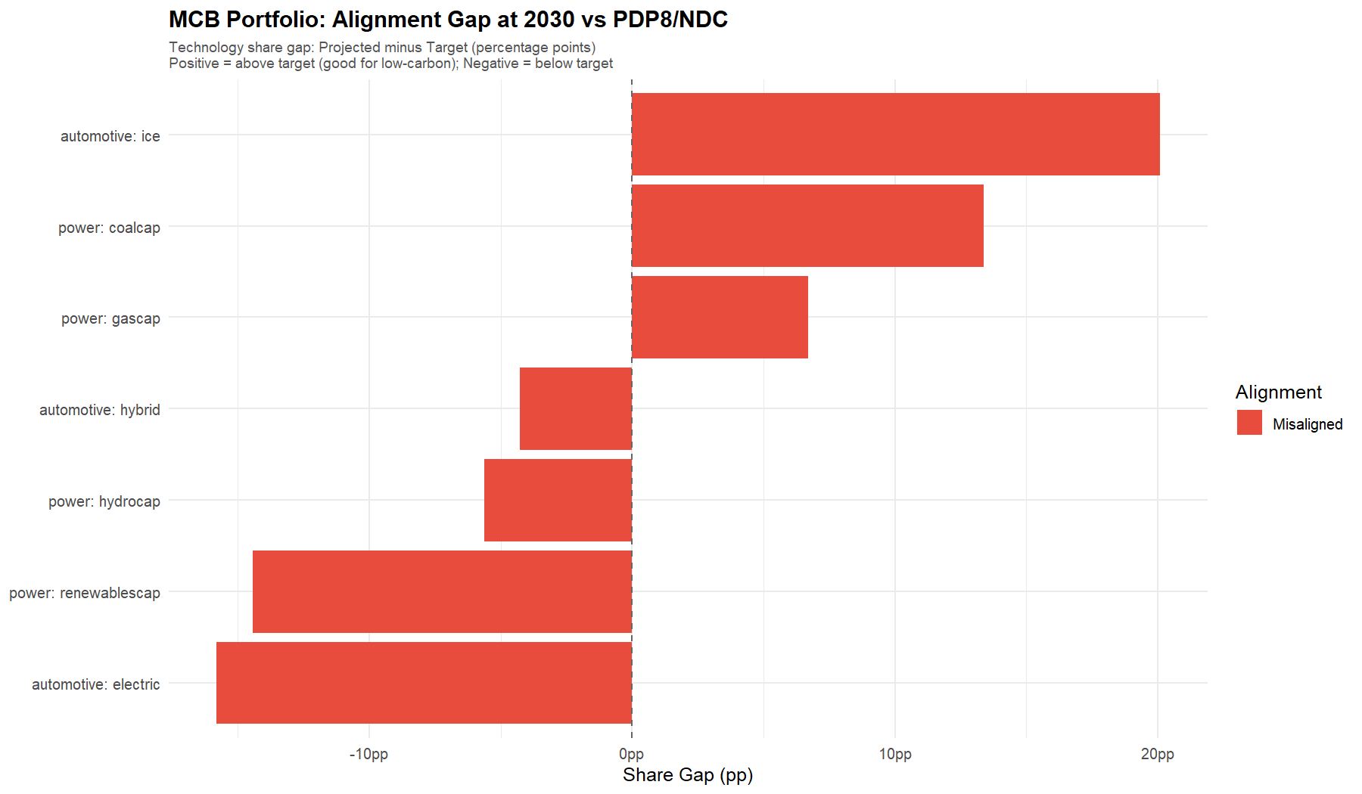
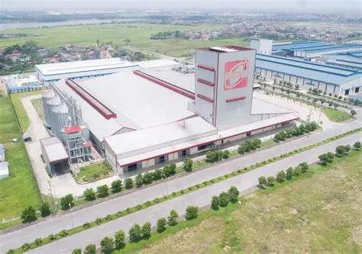
Case Study: Vietnam Bank Demo - Power Sector Alignment
Metric | Value
Portfolio | 43 loans, ~$1B USD synthetic
Power Mix | Coal 28%, Gas 12%, Hydro 10%, Solar 8%, Wind 5%
PDP8 Target | Coal phase-down, renewables 3x by 2030
Gap | Coal +28% above target; renewables -15% below
Notes:
Five key takeaways from the case study:
1. Coal Stranded Risk: 28% of portfolio coal capacity exceeds PDP8 phase-down trajectory. BOT plants face cliff-edge decline post-PPA expiry (~2035).
2. Renewables Gap: Solar and wind capacity must triple to align with PDP8.
3. Borrower Heterogeneity: NPV impact ranges from -18% (coal) to +8% (renewables).
4. Decision 263 Readiness: Three-layer stack addresses all requirements.
5. Interactive Exploration: Live dashboard with Scenario Builder.
Ask: 'Which of these findings resonates most with your current portfolio concerns?'

Slide 10
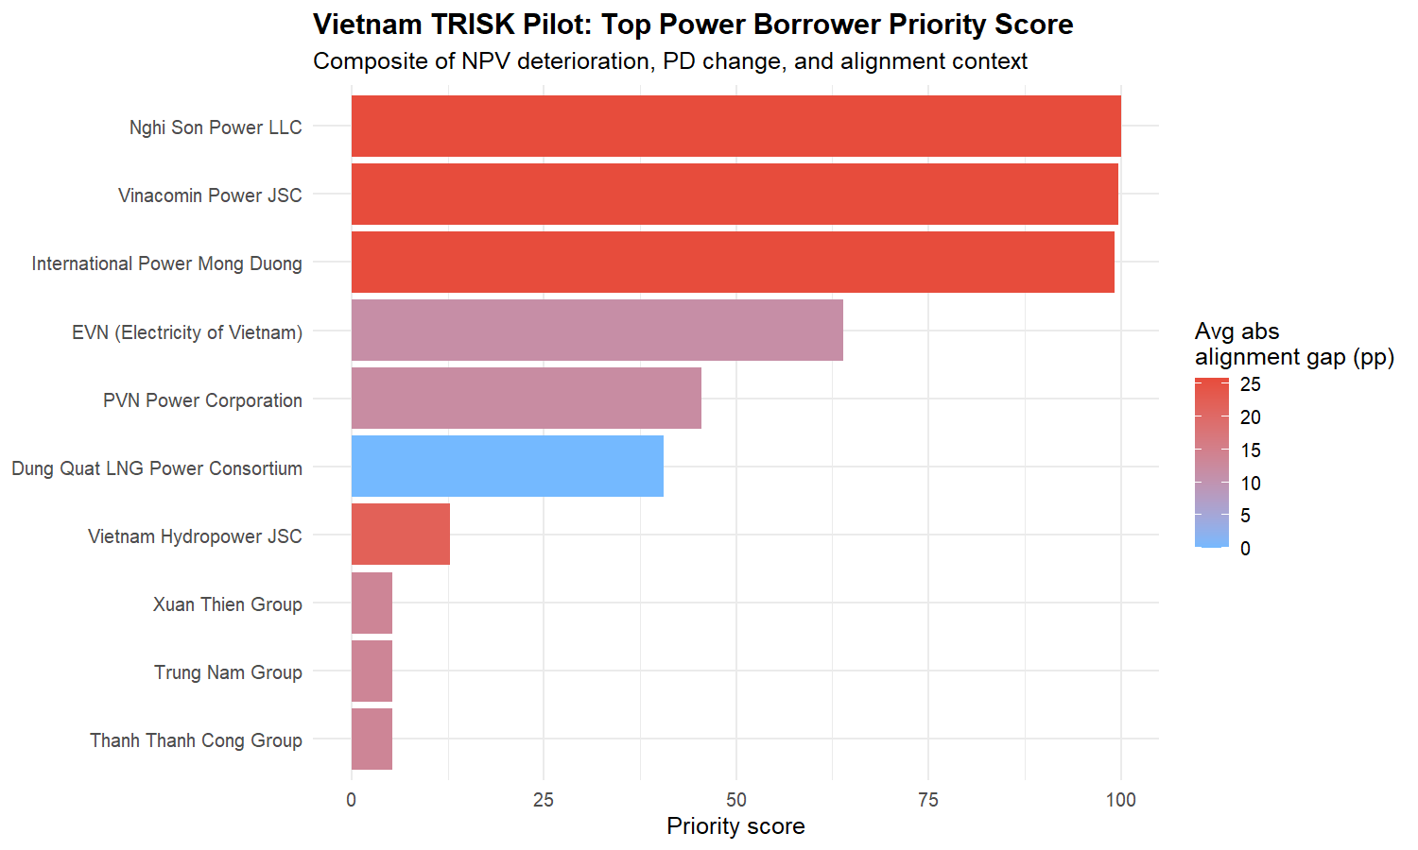
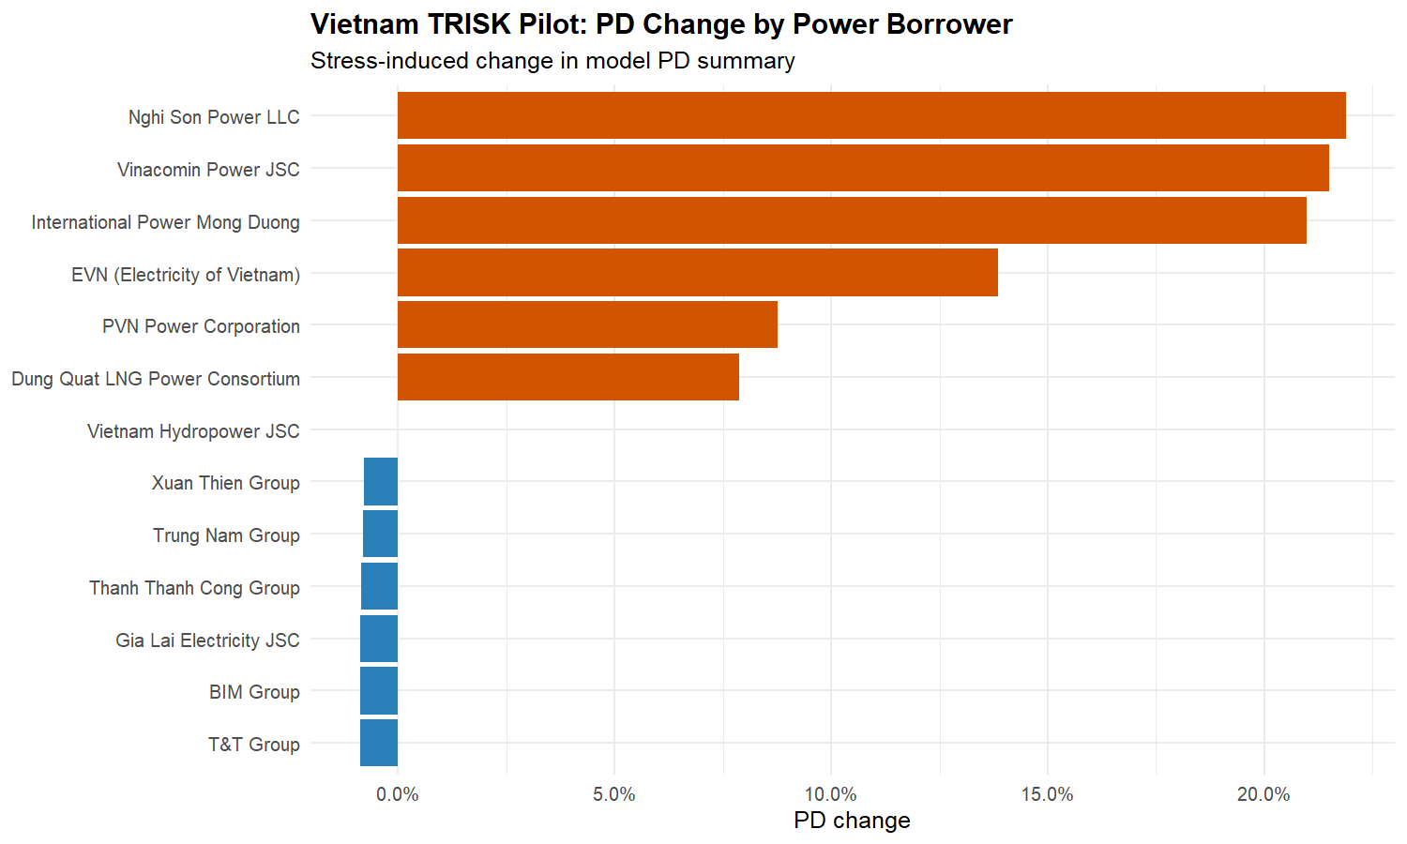
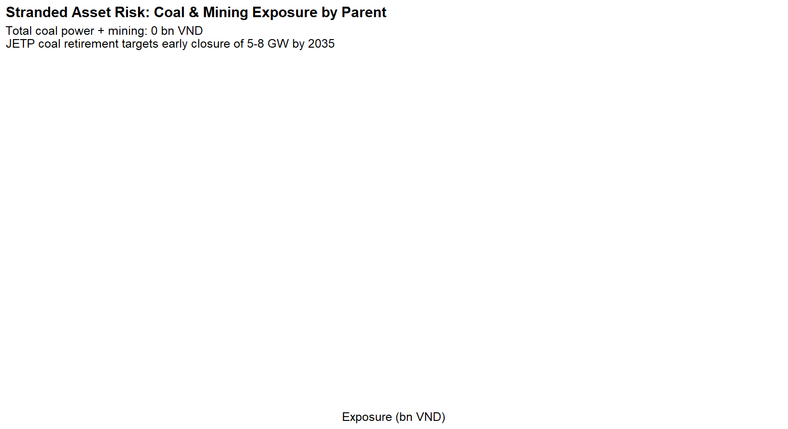
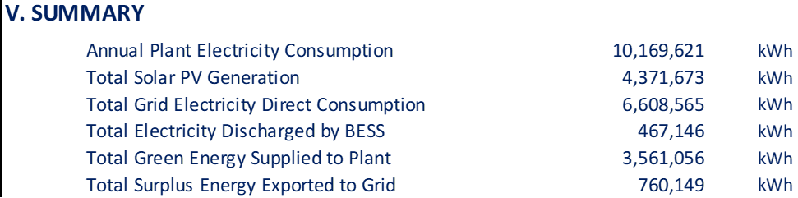
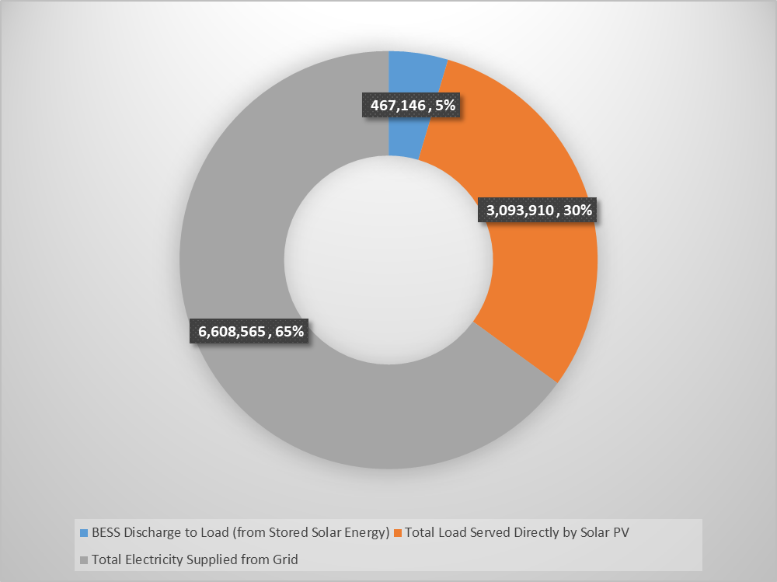
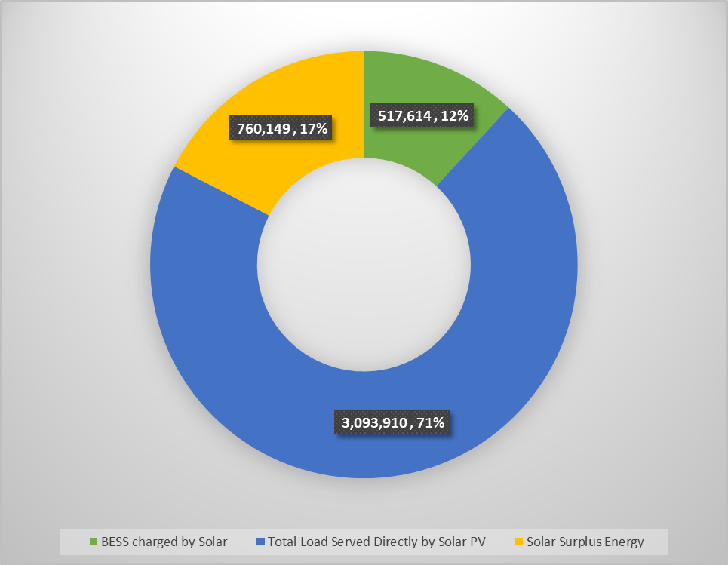
Case Study: TRISK Borrower Stress Rankings
TRISK ranks borrowers by financial stress severity. Coal-heavy names (Vinh Tan, Duyen Hai, Mong Duong) show highest NPV decline and PD increase. Renewable-focused borrowers (Trung Nam, BIM) benefit from transition tailwinds.
Illustrative / synthetic data - not actual portfolio results.
Priority Score (Top 10)
PD Change by Borrower
Notes:
Compliance value proposition:
- Decision 263: GHG inventory (PCAF), reduction quotas (PACTA alignment), transition plans (TRISK stress testing)
- TCFD: Four-pillar disclosure (Governance, Strategy, Risk Management, Metrics & Targets)
- ISSB IFRS S2: Climate-related financial disclosures
Point to the three charts:
- Cement SDA: Emission intensity vs. 2030 NDC targets
- Steel SDA: BF/BOF vs. EAF route comparison
- Coal trajectory: Phase-down pathway vs. current exposure
Key message: Our stack produces board-ready outputs that satisfy all three frameworks simultaneously.

Slide 11





Case Study: Key Findings & Takeaways
Coal Stranded Risk
Renewables Gap
Borrower Heterogeneity
Decision 263 Readiness
Interactive Exploration
28% of portfolio coal capacity exceeds PDP8 phase-down trajectory. BOT plants face cliff-edge decline post-PPA expiry (~2035).
Renewables buildout is 15% below 2030 target. Solar and wind capacity must triple to align with PDP8.
NPV impact ranges from -18% (coal-heavy) to +8% (renewable-focused). One-size engagement fails.
Three-layer stack (PCAF, PACTA, TRISK) addresses all Decision 263 requirements: inventory, quotas, and reduction plans.
Live dashboard with Scenario Builder lets bank teams explore levers in real time. Downloadable HTML reports and CSV exports.
Notes:
Live dashboard demonstration:
- 7-page Streamlit app deployed at pactavn.streamlit.app
- PACTA Alignment page: Sector-level KPIs, interactive charts, downloadable CSVs
- TRISK Risk page: Borrower stress rankings with sensitivity controls
- Scenario Builder page: Drive the five TRISK levers in real time
- Reports page: Inline HTML reports with download buttons
- Methodology page: PACTA/TRISK framing with citations
- Outputs page: Engagement letters and disclosure pack generation
Offer to do a live demo if time permits. The dashboard is publicly accessible for exploration.

Slide 12
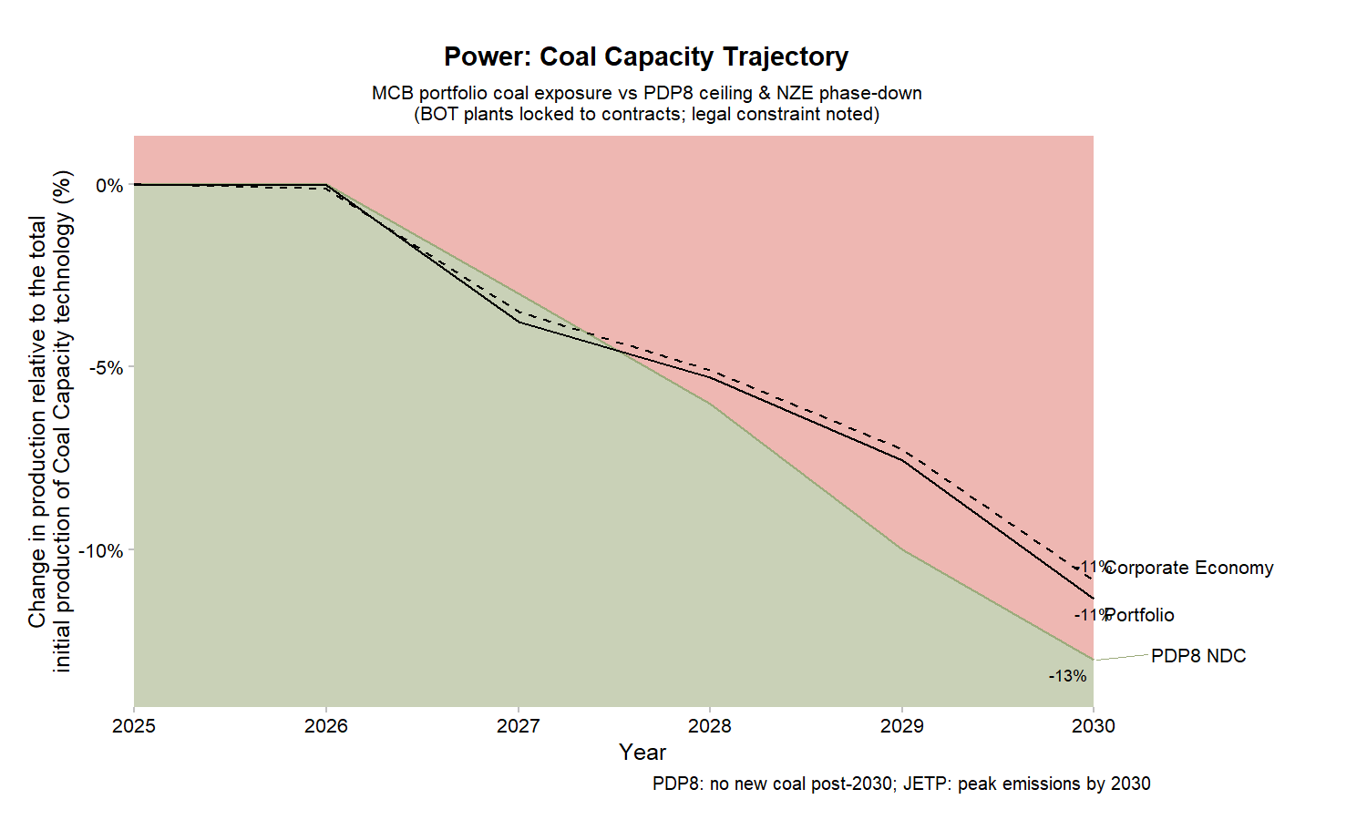
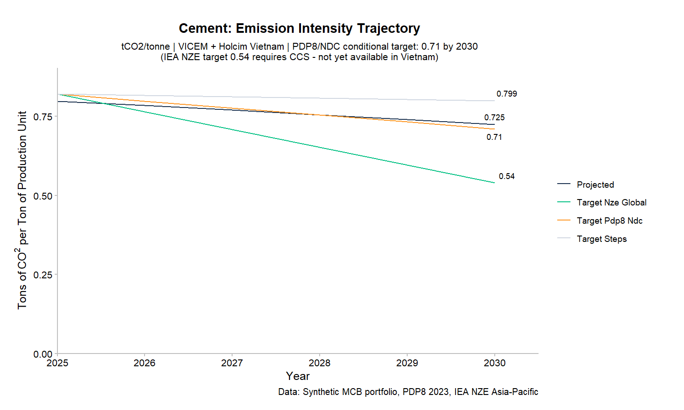
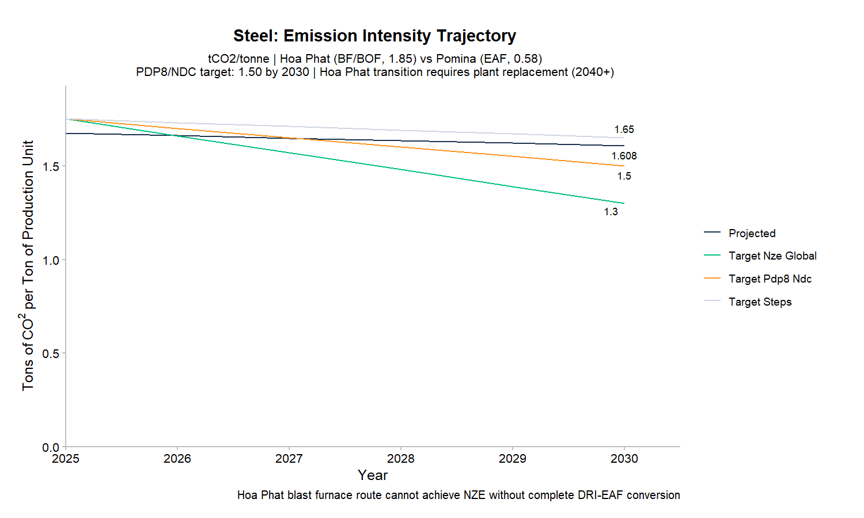

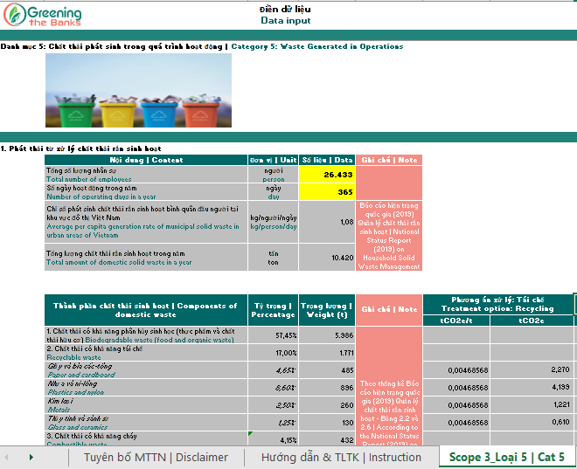

Compliance Value: Decision 263 / TCFD / ISSB
Coal trajectory vs. PDP8 phase-down pathway
Cement & Steel SDA: Emission intensity vs. 2030 NDC targets
Notes:
Engagement offer:
- Phase 1: BYOL (Bring Your Own Loanbook) — 2-4 weeks
- Phase 2: PACTA alignment with real borrower data — 4-6 weeks
- Phase 3: TRISK stress testing and borrower ranking — 3-4 weeks
- Phase 4: IFRS S2 disclosure package and board-ready report — 2-3 weeks
Total timeline: 6-9 months from data receipt to final deliverables.
Emphasize: All analytics are open-source with no licensing fees. The only cost is our consulting time for data intake, validation, and report generation.

Slide 13
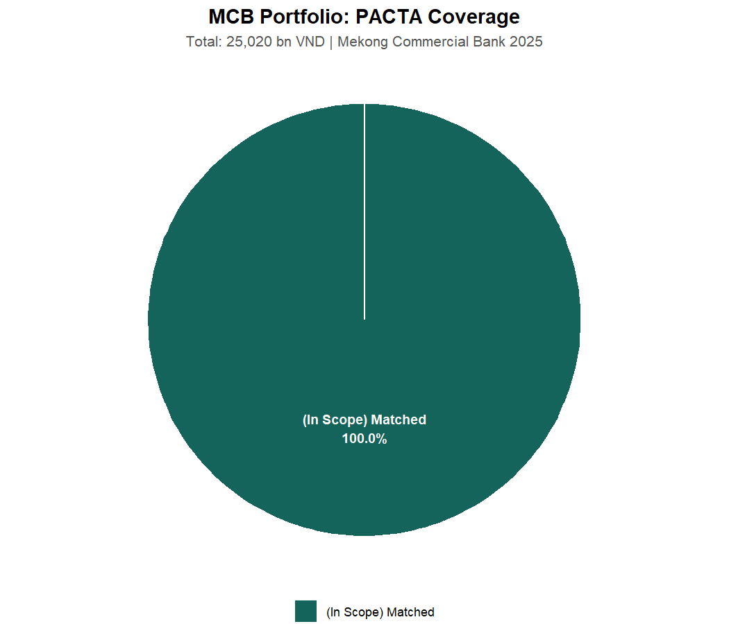
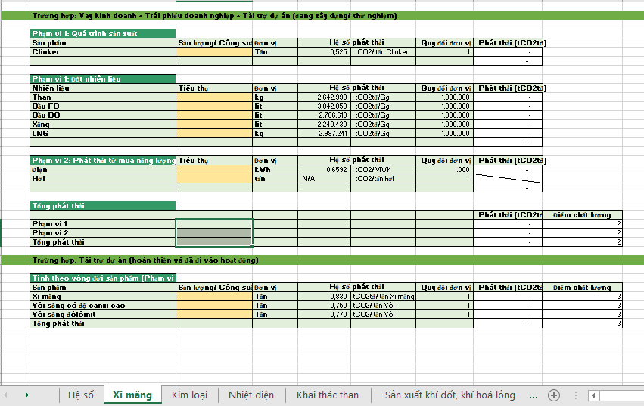


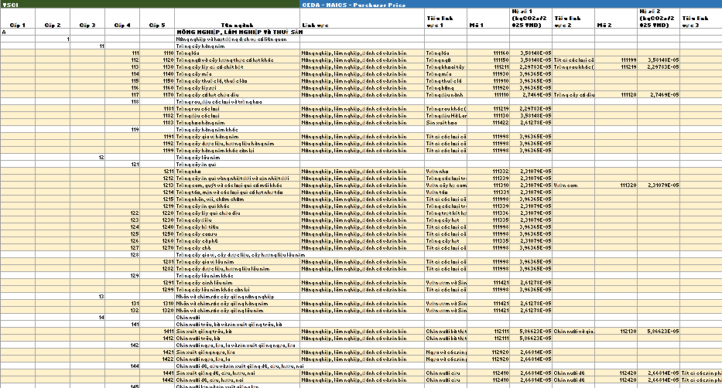
Live Dashboard: Interactive Portfolio Exploration
Scenario Builder: Drive the five TRISK levers in real time
TRISK Risk: Borrower stress rankings with sensitivity controls
Notes:
Proposed next steps:
1. Share loanbook template for BYOL intake validation (we provide the template)
2. Identify Decision 263 borrower subset for priority analysis (top 20 by exposure)
3. Schedule technical workshop with risk and ESG teams (half-day session)
4. Define scenario preferences (PDP8, NDC, IEA NZE — we support all three)
5. Agree on reporting language and disclosure timeline
We are ready to begin Phase 1 upon receipt of loanbook data.
Synthetic demo is available for immediate internal training — no data required.

Slide 14
Proposed Next Steps
1. Share loanbook template for BYOL intake validation
2. Identify Decision 263 borrower subset for priority analysis
3. Schedule technical workshop with risk and ESG teams
4. Define scenario preferences (PDP8, NDC, IEA NZE)
5. Agree on reporting language and disclosure timeline
We are ready to begin Phase 1 upon receipt of loanbook data.
Synthetic demo available for immediate internal training.
Notes:
Open the floor for questions:
- Methodology: PACTA matching, TRISK modeling, scenario selection
- Data requirements: Loanbook format, ABCD sources, scenario files
- Implementation timeline: Phase durations, dependencies, parallelization
- Cost structure: Consulting fees vs. open-source licensing
- Integration: How outputs feed into existing risk and ESG workflows
Be prepared to discuss:
- Vietnamese company name matching challenges (diacritics, VSIC codes)
- BOT coal plant contractual lock-in (PPA expiry dates)
- VinFast production assumptions (base vs. conservative case)

Slide 15
Questions & Discussion
We welcome questions on methodology, data requirements, implementation timeline, or any aspect of the PACTA + TRISK analytics stack.
Notes:
Contact information:
- Tung Ho: tah@allotropepartners.com (technical lead)
- Hang Tran: httt@allotropepartners.com (engagement lead)
Allotrope VC | GTB Vietnam
Thank the audience for their time and express enthusiasm for potential collaboration.
Leave-behind: This deck (PDF or PPTX), the synthetic demo dashboard URL, and the BYOL intake template (if requested).

