Slide 1


PACTA + TRISK
Transition-Risk Analytics for Vietnamese Banks
Notes:
Cover. Pitch a continuation of the GTB Vietnam engagement: an integrated PACTA + TRISK analytics stack for transition-risk management and Decision 263 compliance. All figures shown are illustrative / synthetic.

Slide 2


Agenda
1 The challenge: Decision 263 & transition risk
2 Our solution: a three-layer compliance stack
3 PACTA portfolio alignment
4 TRISK borrower stress testing
5 Vietnam-bank case study & live dashboard
6 Engagement offer, roadmap & next steps
Notes:
Walk the arc: problem -> approach -> methods -> case study -> offer.

Slide 3

Our Solution: A Three-Layer Compliance & Risk Stack
Layer | Capability | Output
Measure & Align | PCAF financed emissions | Scope 1/2/3 inventory
 | PACTA vs PDP8 / NDC / NZE | Technology-share alignment gaps
Stress & Disclose | TRISK borrower stress | NPV & PD impact per borrower
 | IFRS S2 / TCFD reporting | Board-ready disclosure pack
 | Open-source R stack | No licensing fees
Notes:
Four capabilities, one pipeline: measure, align, stress, disclose. Each layer feeds the next; all open-source.

Slide 4

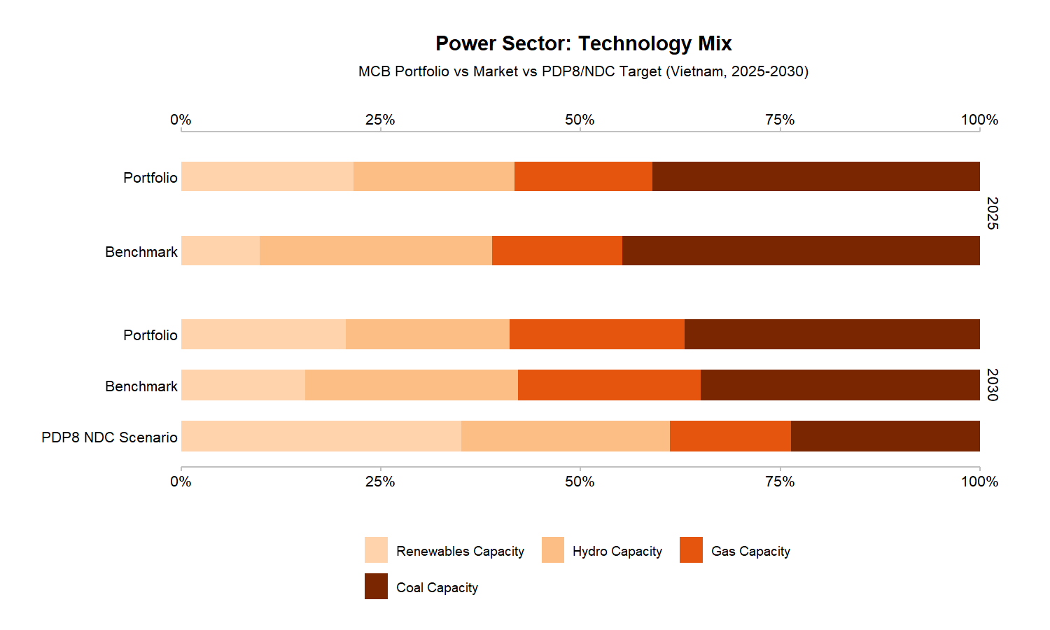
PACTA: Portfolio Alignment Assessment
Match the loanbook to asset-level company data and compare technology mix against Vietnam's targets.
Market-share method for power & automotive
Coal 28% above PDP8 target
SDA method for cement & steel intensity
Renewables 15% below 2030 trajectory
Synthetic MCB portfolio: 43 loans, 25 trillion VND across power, automotive, cement, steel and coal mining.
Custom PDP8 scenario from Vietnam's PDP8
Open-source R packages — no licensing fees
Company-level results enable borrower-specific engagement
Scenario comparison: PDP8 vs IEA NZE vs Vietnam NDC
Methodology used by 1,500+ institutions globally
Time to first results: 1–3 months
Notes:
PACTA answers 'is the portfolio on a Paris-aligned path?' The power tech-mix chart shows coal above and renewables below the PDP8/NDC path. Illustrative / synthetic data.

Slide 5
The Challenge: Decision 263 & Transition Risk
THE CHALLENGE
WHAT BANKS NEED
Decision 263/QD-TTg mandates GHG quotas for thermal power, steel and cement from 2025. Banks must assess borrower transition risk — but lack tools to quantify portfolio alignment or borrower-level financial stress under Paris-aligned scenarios.
An integrated analytics stack that measures portfolio alignment with PDP8/NDC targets, quantifies borrower NPV and PD impact under transition scenarios, and produces disclosure-ready outputs for IFRS S2 and TCFD.
Notes:
Why now: Decision 263 turns transition risk into a compliance obligation with quotas. Banks need quantification, not just narrative.

Slide 6
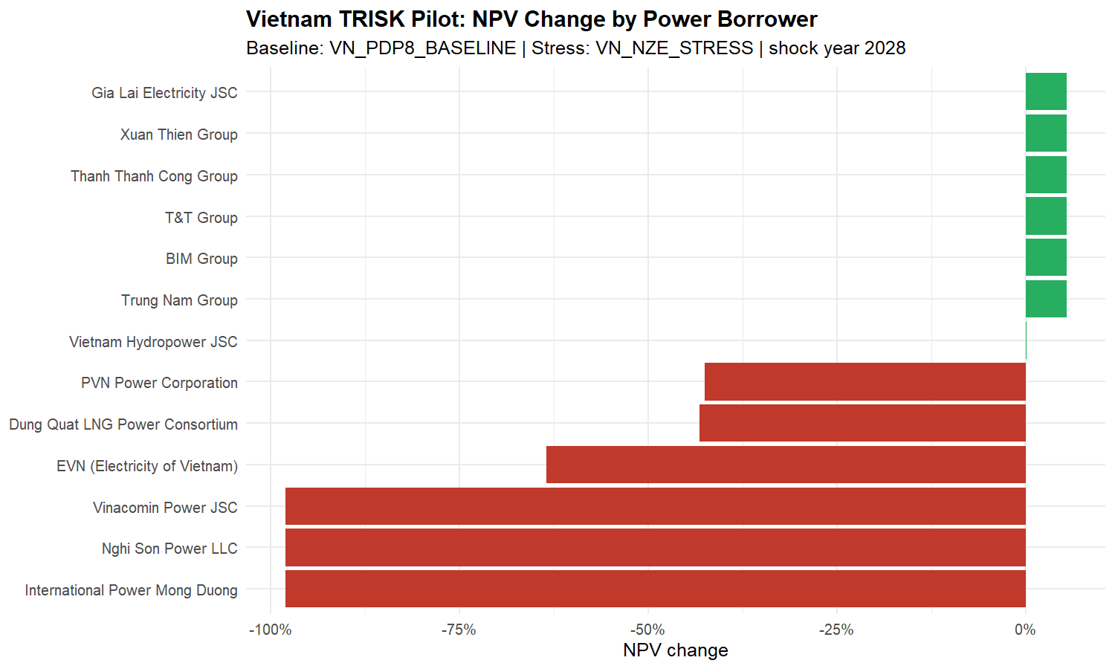
TRISK: Borrower-Level Transition Stress Testing
Quantify each borrower's NPV and PD impact under transition scenarios using DCF and Merton-based credit models.
Power: coal-heavy borrowers −12% to −18% NPV
Exportable: CSV, HTML reports, dashboard
Cement: BF/BOF mills −8% to −14% NPV
Results update instantly — no recomputation
Steel: EAF routes outperform BF/BOF by 6–10pp
Sensitivity: shock year, discount rate, passthrough
Priority ranking: alignment gap + NPV + exposure
Scenario Builder drives five TRISK levers live
Covers all three Decision 263 sectors
Open-source R package (trisk.model)
Notes:
TRISK converts alignment gaps into credit impact: NPV change and PD shift per borrower. Coal names fall hardest; renewables benefit. Illustrative / synthetic data.

Slide 7
Engagement Offer & 2026 Roadmap
Phase 1 Data intake & loanbook normalisation (BYOL)
Phase 2 PACTA portfolio alignment on real borrower data
Phase 3 TRISK stress testing & borrower ranking
Phase 4 IFRS S2 disclosure pack & board-ready report
Timeline: 6–9 months from data receipt to final deliverables. All analytics are open-source with no licensing fees. We welcome the opportunity to discuss how this stack supports your transition-risk management and Decision 263 compliance.
Notes:
The ask: a phased 6–9 month engagement starting from a loanbook intake. Open-source means no licence lock-in.

Slide 8

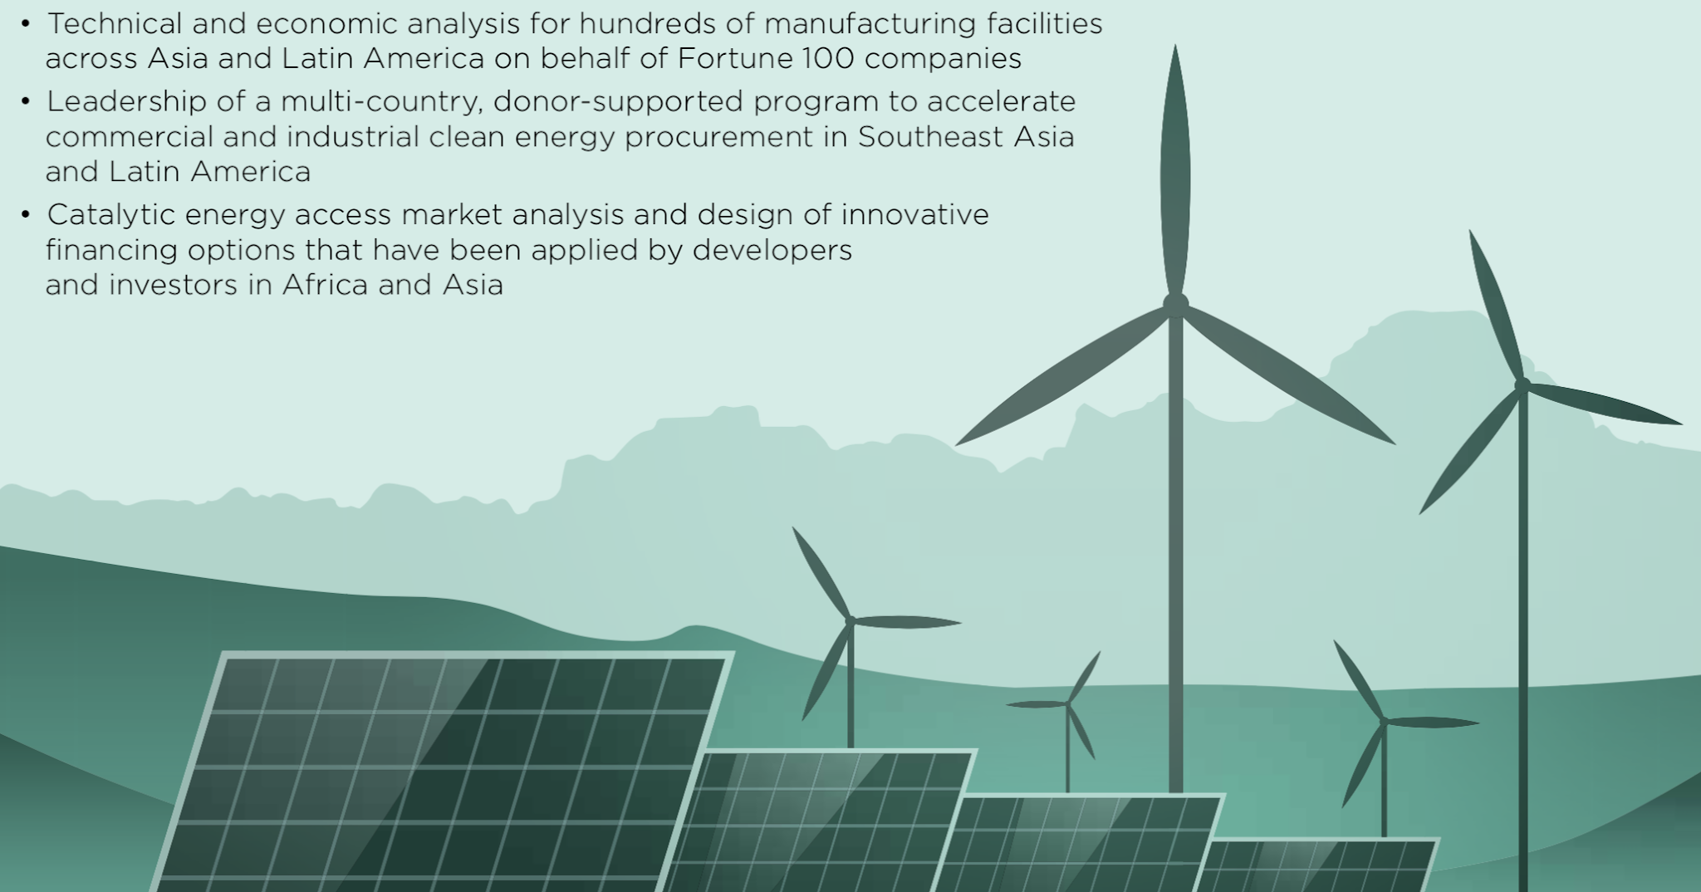
Tung Ho — tah@allotropepartners.com
Hang Tran — httt@allotropepartners.com
Allotrope VC | Greening the Banks Vietnam
Notes:
Contact slide. Offer to scope a workshop with the risk and ESG teams.

Slide 9
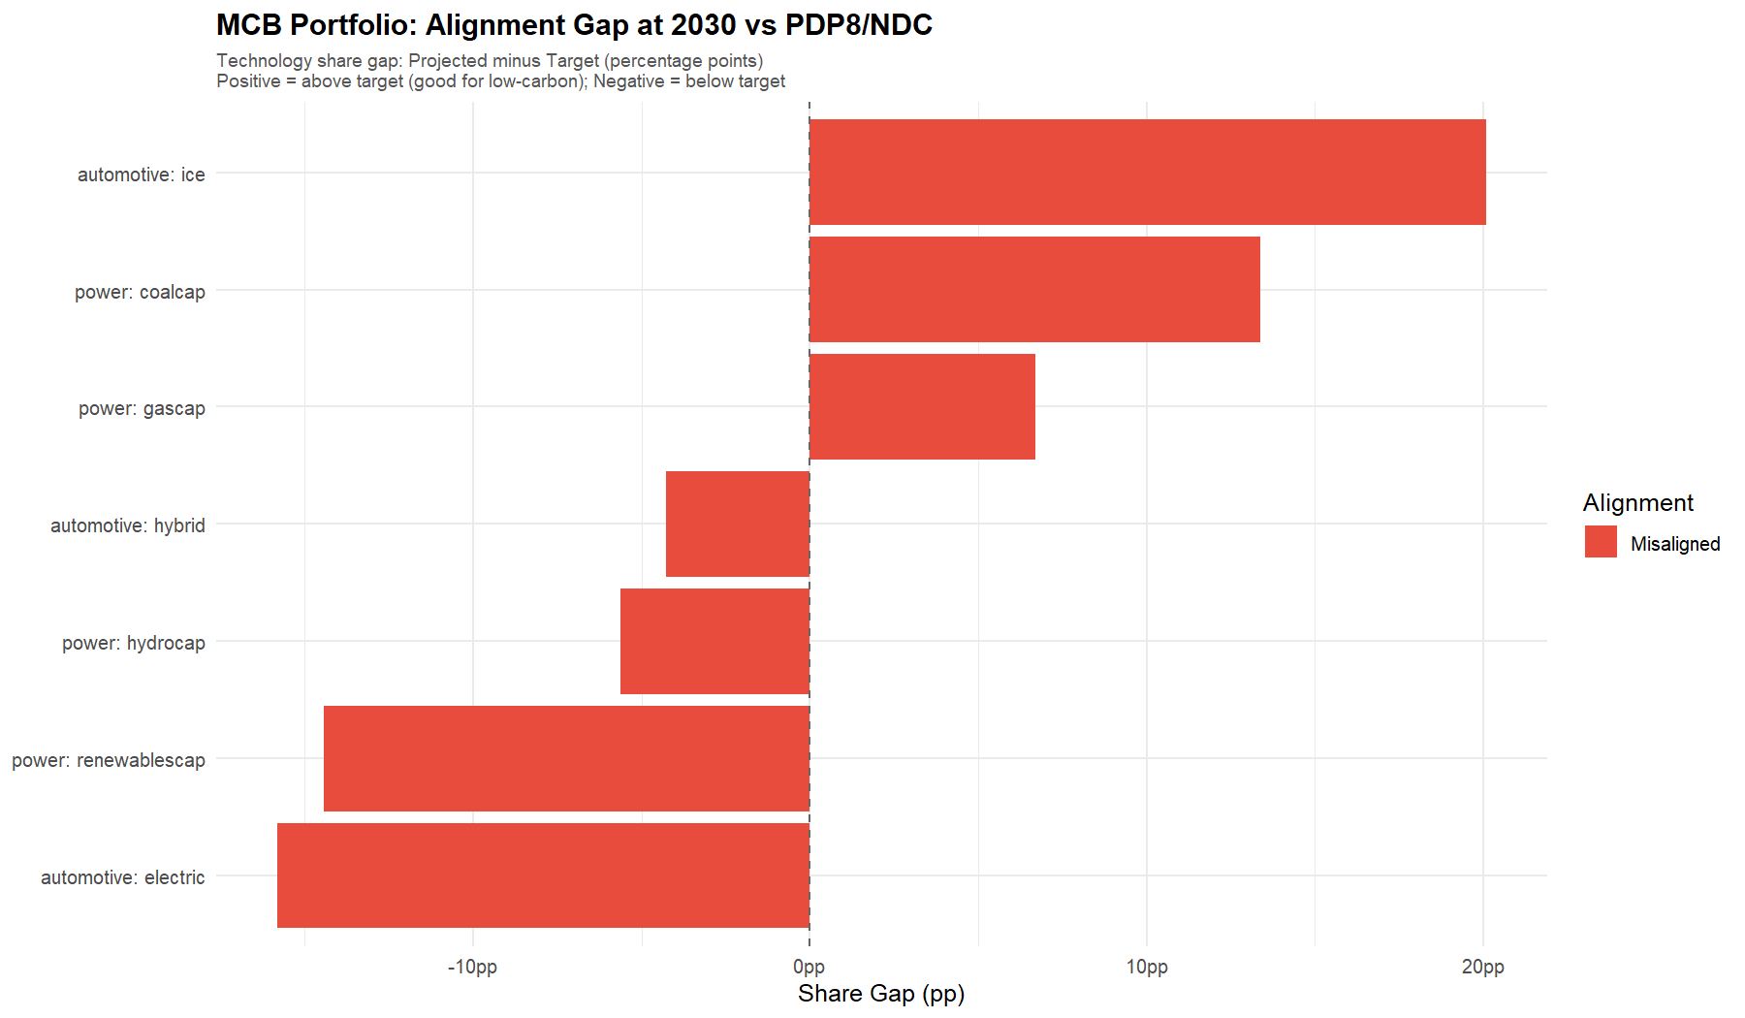

Case Study: Vietnam-Bank Demo — Power Sector Alignment
Metric | Value
Portfolio | 43 loans · 25 tn VND (synthetic)
Sectors | Power, cement, steel
Power mix | Coal 28% · Gas 12% · Hydro 10%
 | Solar 8% · Wind 5%
PDP8 target | Coal phase-down; renewables 3× by 2030
Alignment gap | Coal +28% above; renewables −15% below
Method | PACTA market-share (power)
Scenarios | PDP8 · Vietnam NDC · IEA NZE
Output | Company-level alignment results
Data | Illustrative / synthetic
Notes:
Worked example on the synthetic MCB loanbook. The alignment-gap chart ranks technologies by distance from target. Illustrative / synthetic data.

Slide 10
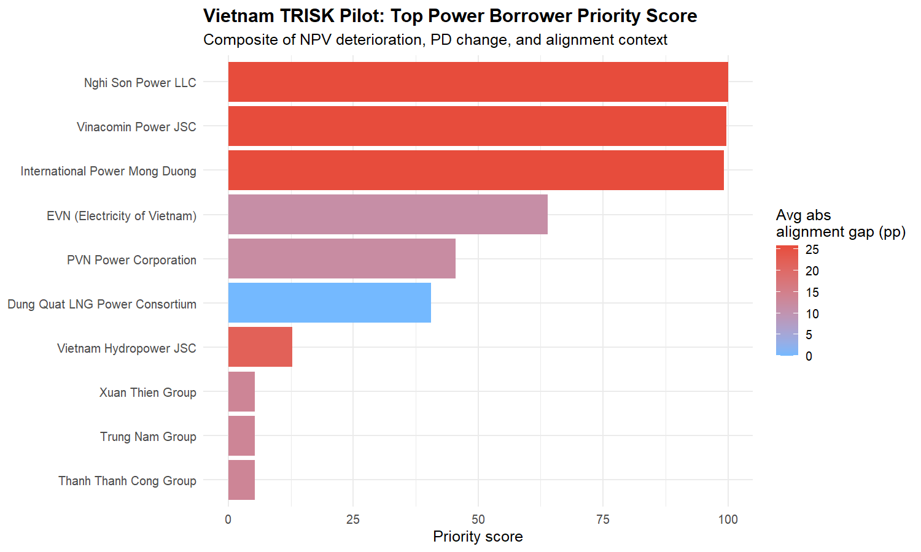
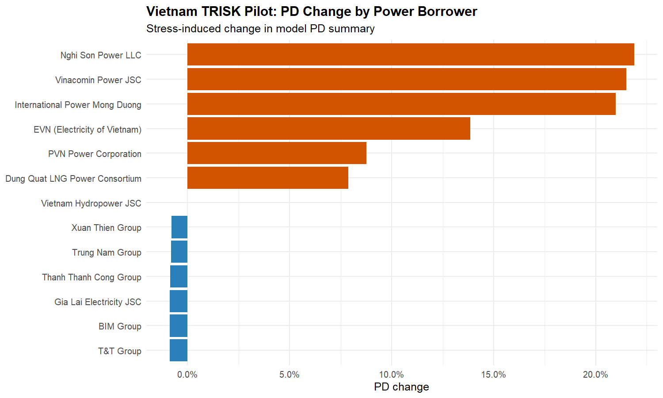
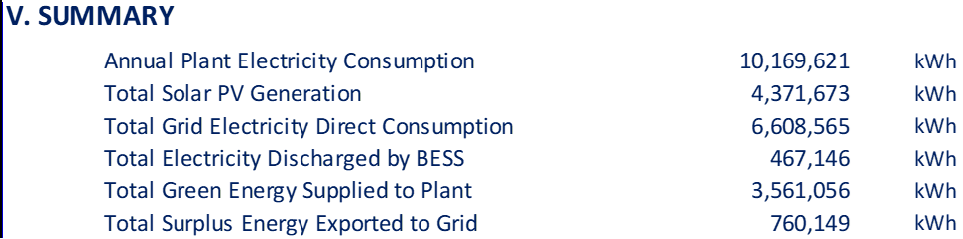
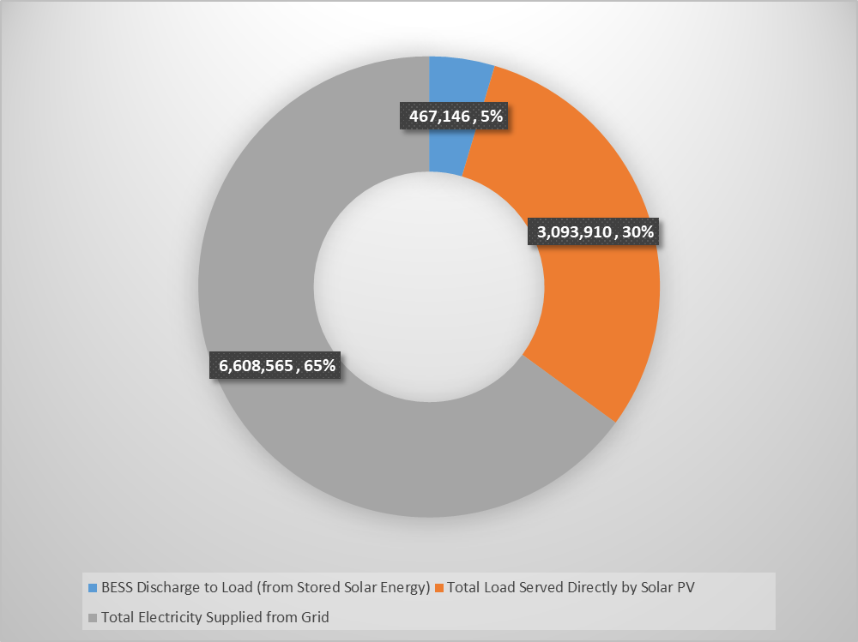
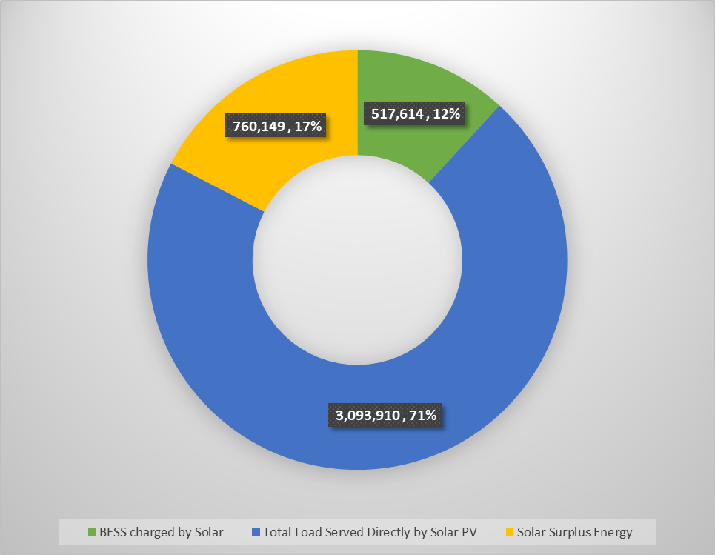
Case Study: TRISK Borrower Stress Rankings
TRISK ranks borrowers by financial stress under transition scenarios. Coal-heavy names (Vinh Tan, Duyen Hai, Mong Duong) show the steepest NPV decline and PD increase; renewable-focused borrowers (Trung Nam, BIM) gain transition tailwinds.
Illustrative / synthetic data — not actual portfolio results.
Priority score — top 10 borrowers
PD change by borrower
Notes:
Two views of the same borrowers: priority score and PD change. The point: one-size engagement fails — you need borrower-level data.

Slide 11





Case Study: Key Findings & Takeaways
Coal Stranded Risk
Renewables Gap
Borrower Heterogeneity
Decision 263 Readiness
Interactive Exploration
28% of portfolio coal capacity exceeds the PDP8 phase-down trajectory; BOT plants face a cliff after PPA expiry (~2035).
Renewables buildout is 15% below the 2030 target — solar and wind must roughly triple to align with PDP8.
NPV impact spans −18% (coal-heavy) to +8% (renewable-focused). Borrower-level data is essential.
The PCAF → PACTA → TRISK stack covers all Decision 263 requirements: inventory, quotas and reduction plans.
A live dashboard with Scenario Builder lets bank teams explore levers in real time, with HTML and CSV exports.
Notes:
Five takeaways. Land the headline: transition risk is concentrated, measurable and borrower-specific — and this stack makes it auditable.

Slide 12
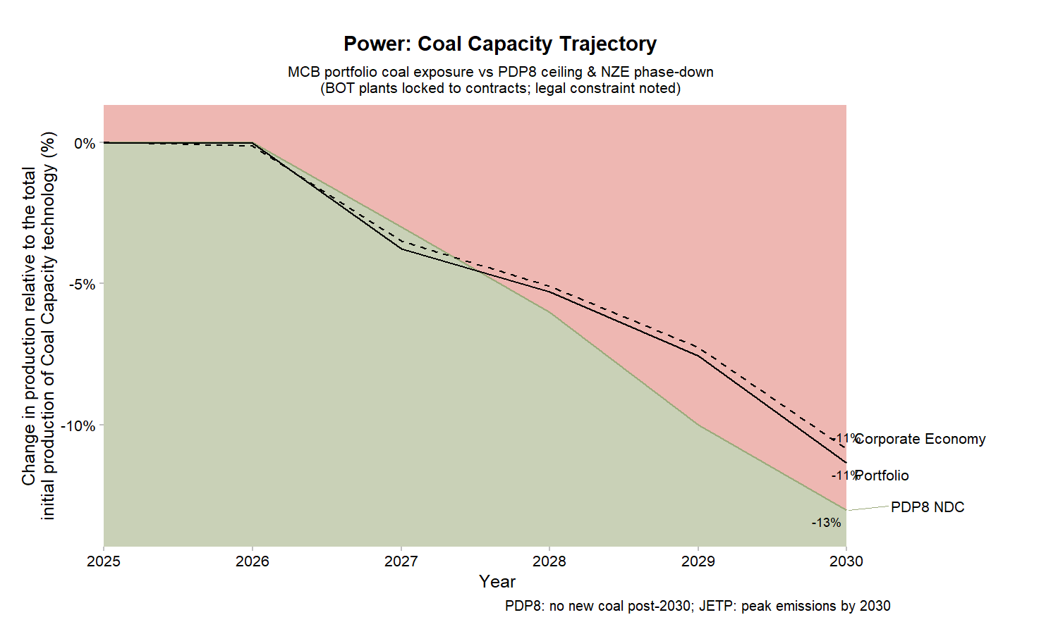
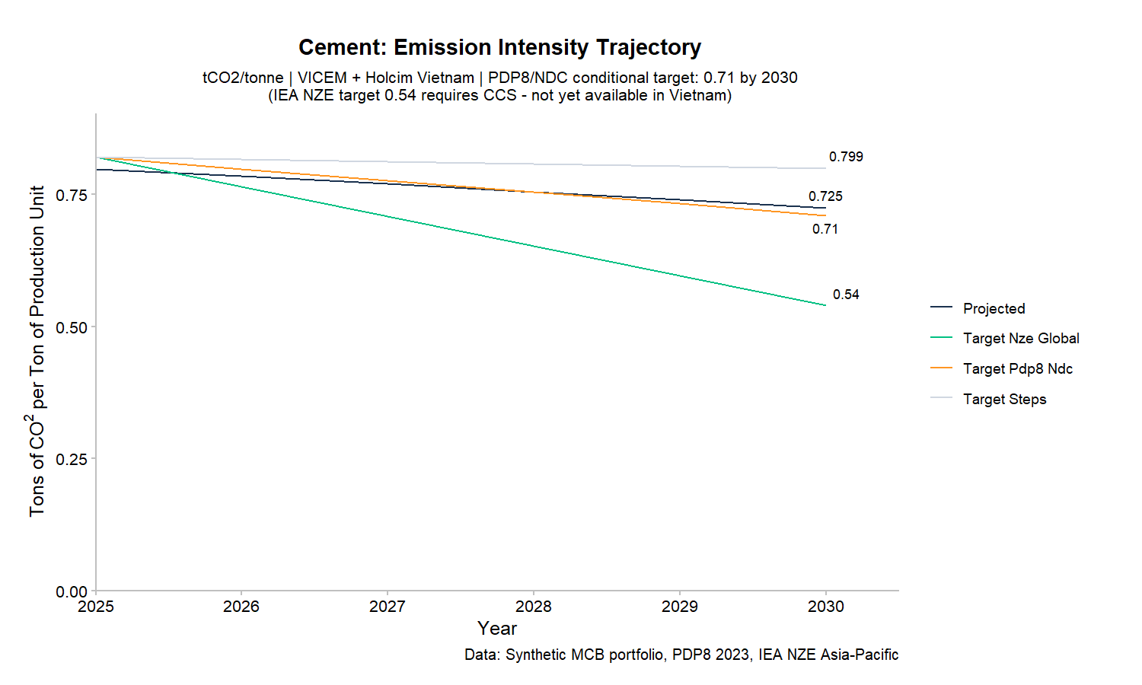
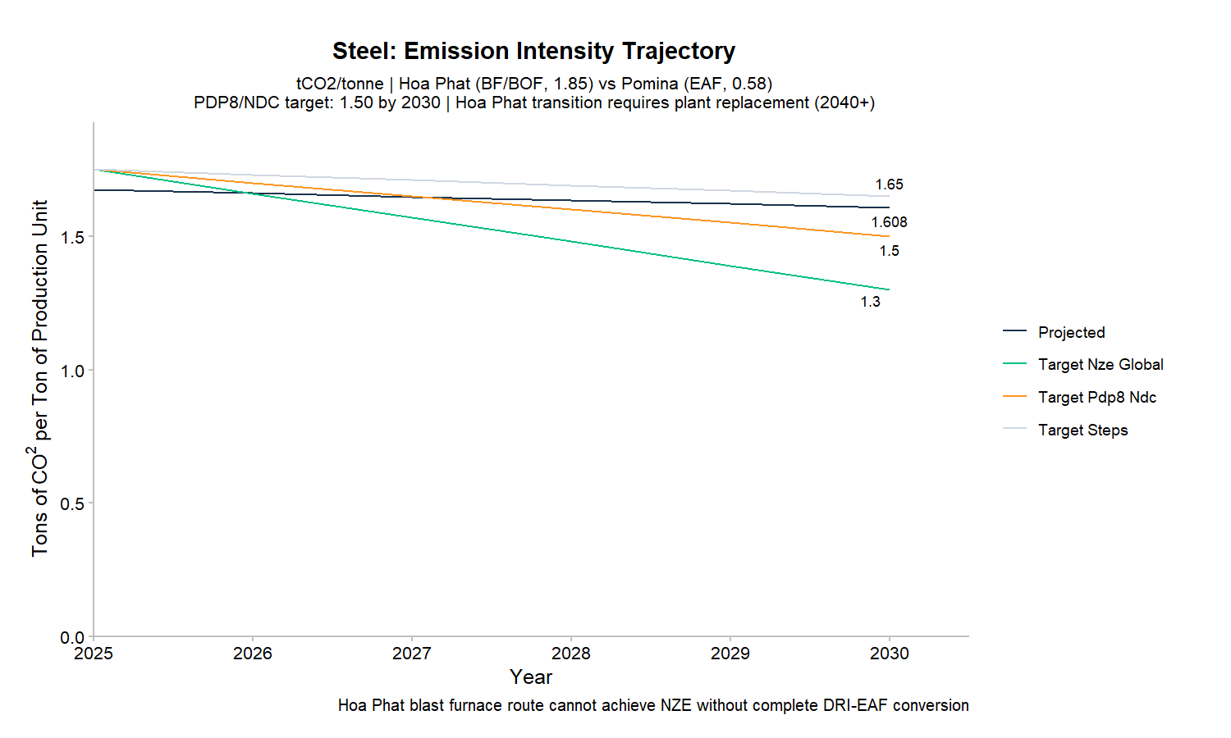

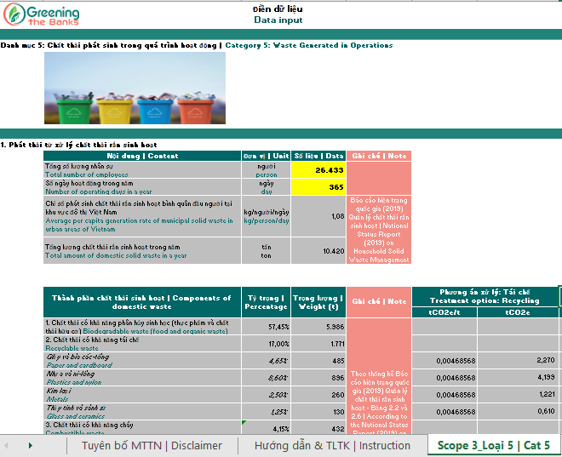

Compliance Value: Decision 263 / TCFD / ISSB
Coal trajectory vs. PDP8 phase-down
Cement & Steel SDA: emission intensity vs. 2030 NDC targets · synthetic data
Notes:
Compliance is the strongest 'why now'. The same engine outputs map directly to Decision 263, TCFD and IFRS S2 / ISSB. Synthetic data.

Slide 13
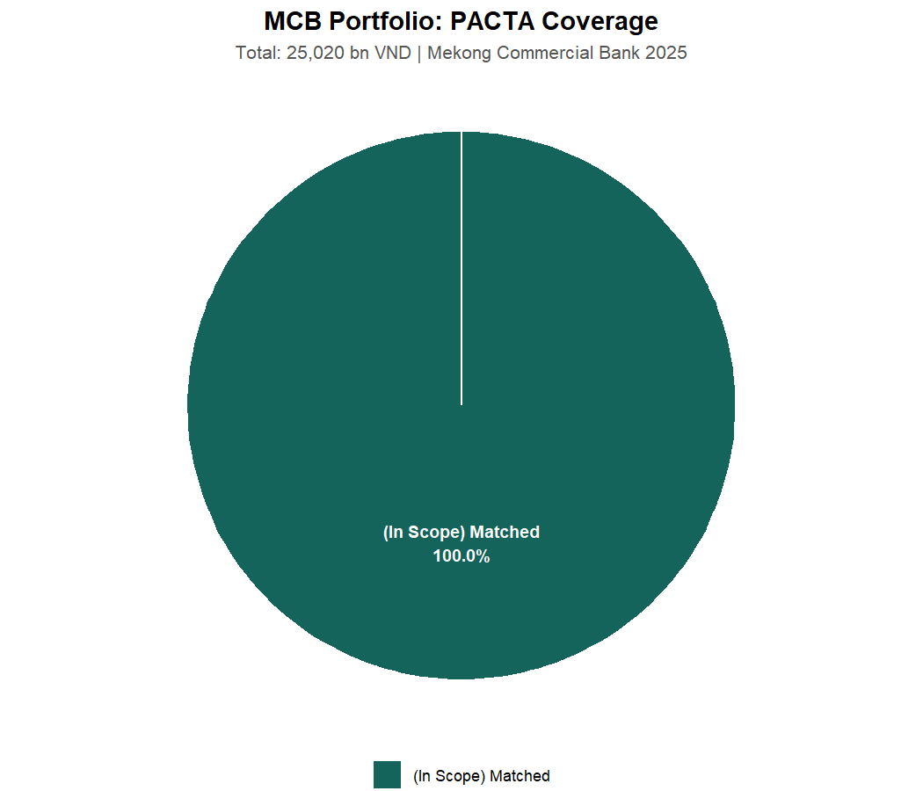

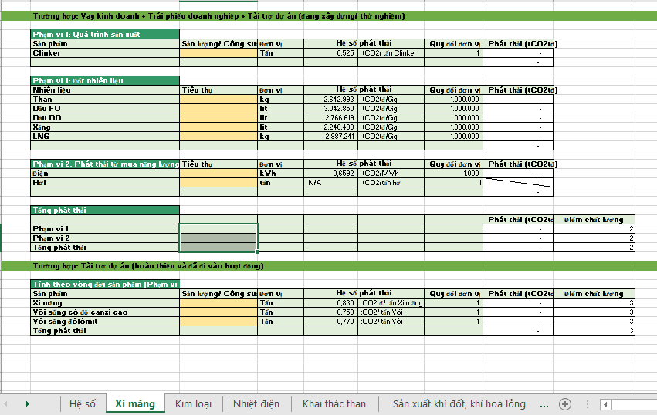

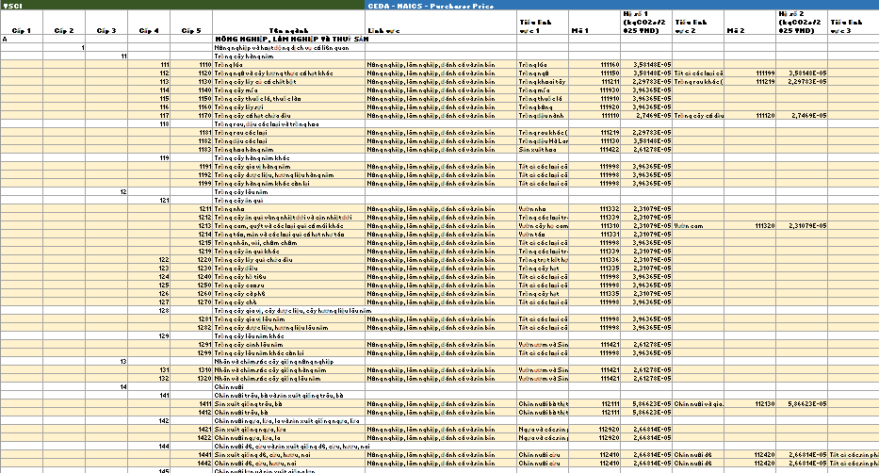
Live Dashboard: Portfolio Analytics at a Glance
Synthetic data
Coverage & alignment
Borrower NPV impact
Notes:
The dashboard is the leave-behind: bankers explore coverage, alignment and borrower stress interactively. Synthetic demo data.

Slide 14
Proposed Next Steps
1. Share the loanbook template for BYOL intake validation
2. Identify the Decision 263 borrower subset for priority analysis
3. Schedule a technical workshop with risk & ESG teams
4. Agree scenario preferences (PDP8, NDC, IEA NZE)
5. Align on reporting language & disclosure timeline
Ready to begin Phase 1 on receipt of loanbook data. A synthetic demo is available now for internal training.
Notes:
Concrete next actions, all low-commitment, to keep momentum after the meeting.

Slide 15
Questions & Discussion
We welcome questions on methodology, data requirements, implementation timeline, or any aspect of the PACTA + TRISK analytics stack.
Notes:
Open the floor. Common questions: data needs, accuracy of synthetic vs. real, timeline, and how outputs map to Decision 263.

