Slide 1
NLP
Seyed Mostafa Ahmadi

Slide 2
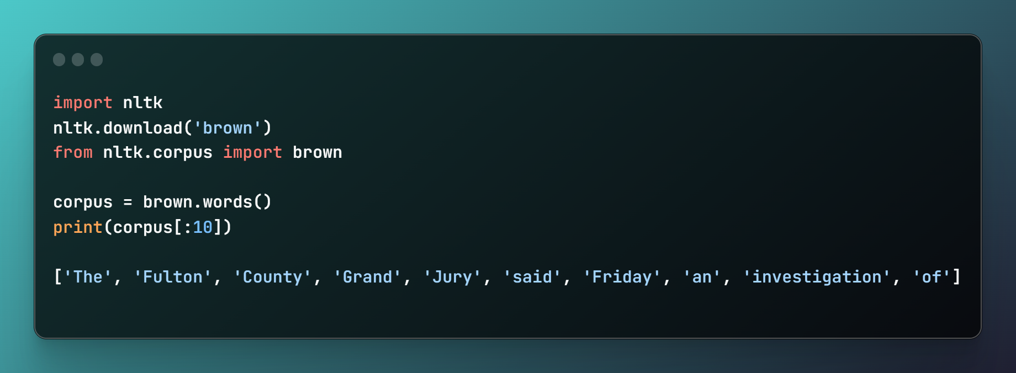
How to use NLTK Corpus ?

Slide 3
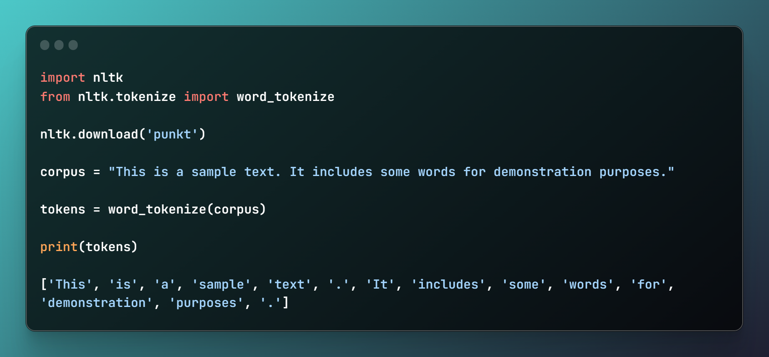
Tokenization

Slide 4
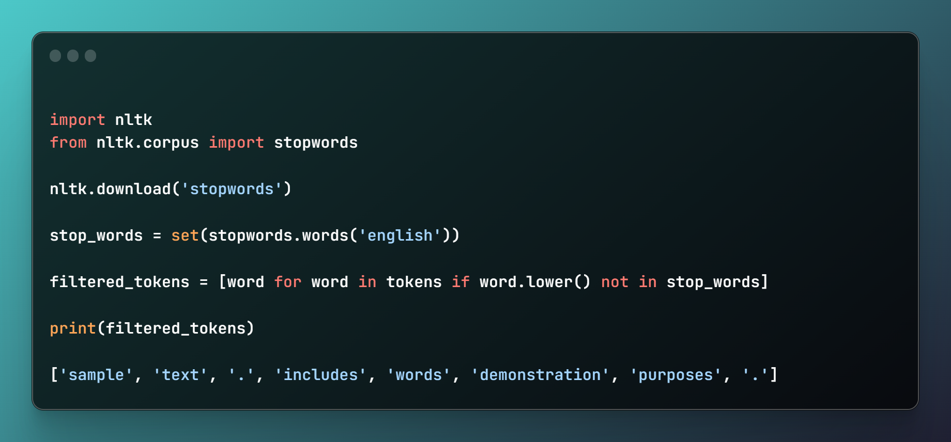
Normalization

Slide 5
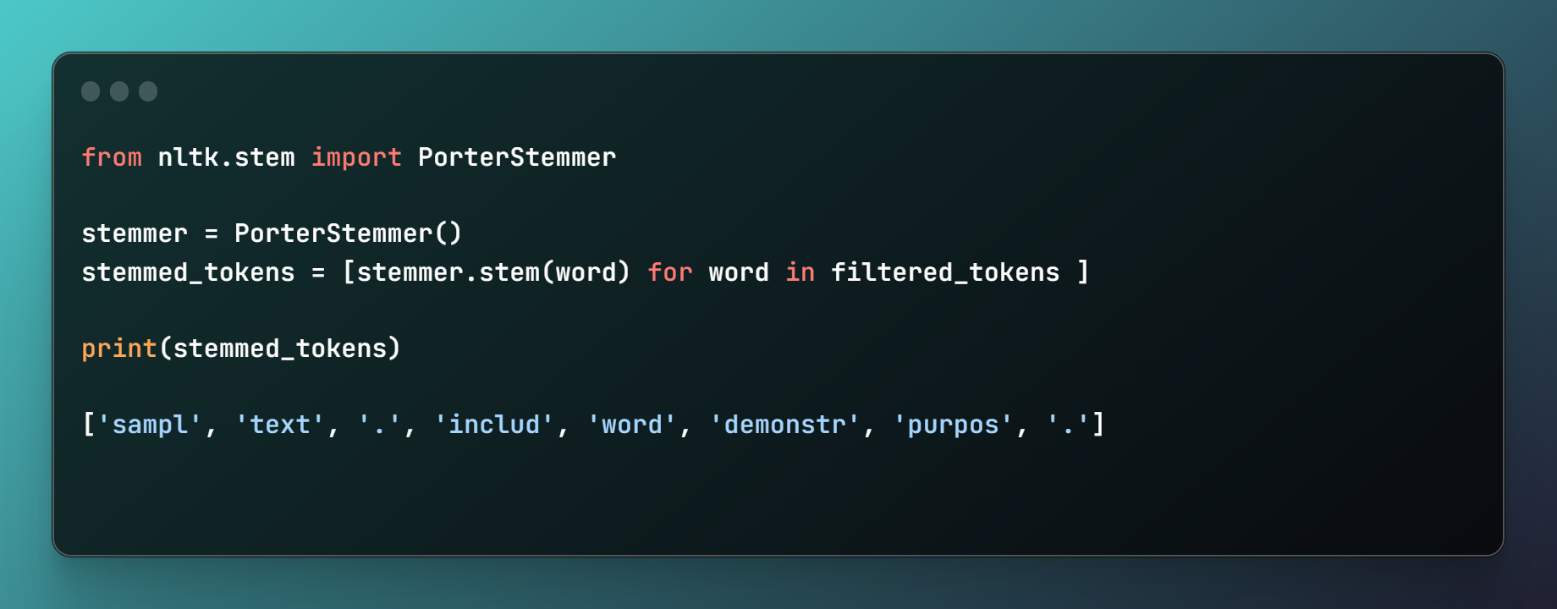
Stemming

Slide 6
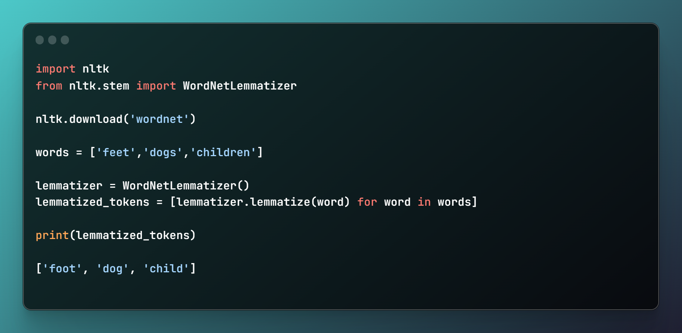
Lemmatization

Slide 7
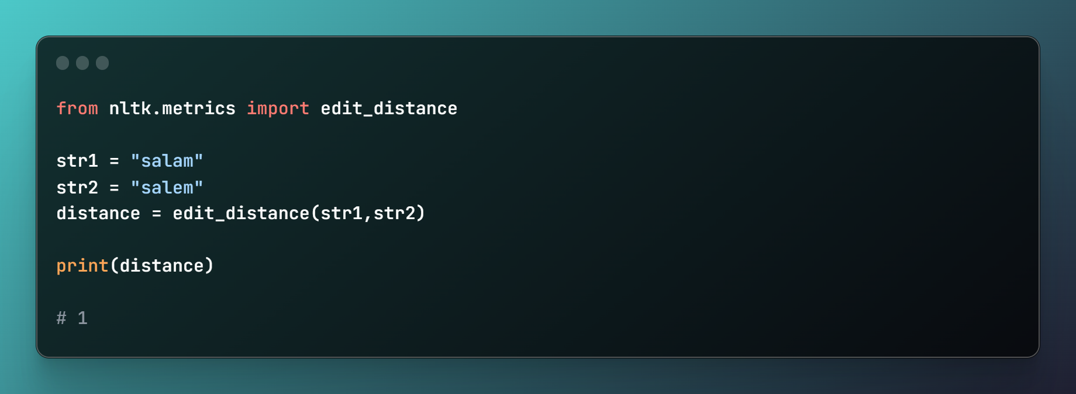
Distance calculation

Slide 8
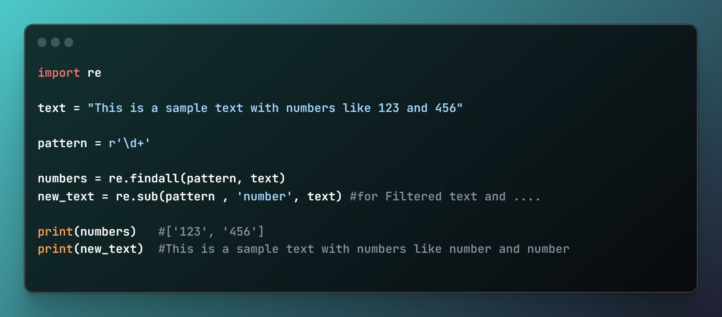
Text preprocessing

Slide 9
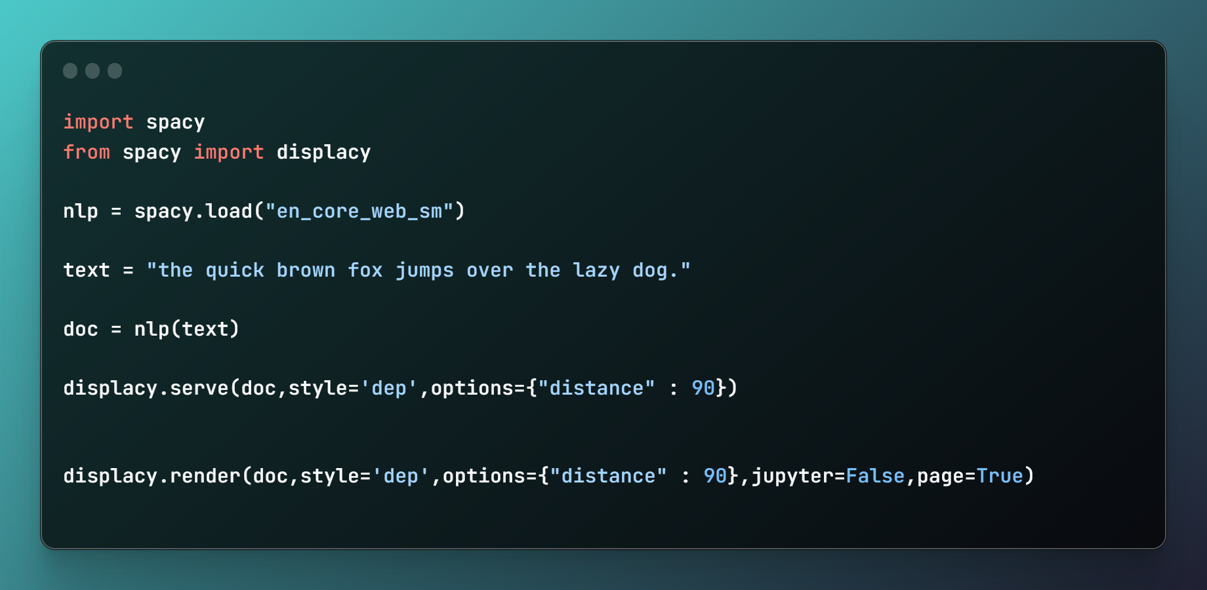
Dependency Parsing

Slide 10
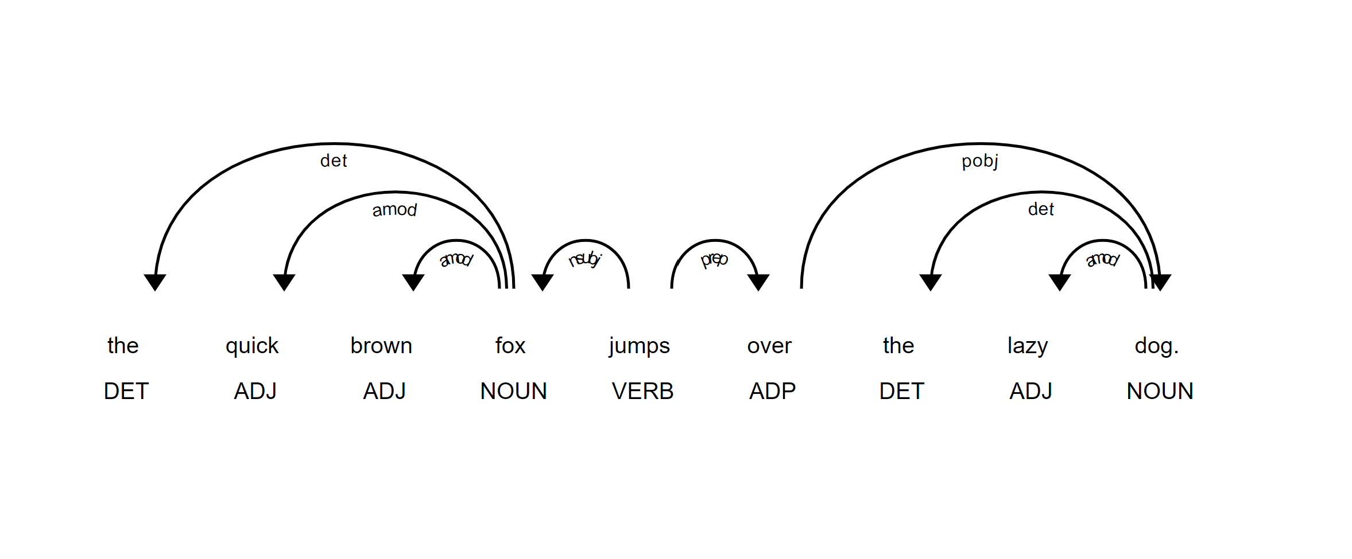
Dependency Parsing

Slide 11
با تشکراز توجه شما !
tah3in@gmail.com

