Slide 1

dePsypher
Developed By:
Hamnah Khalid 237888
Muhammad Haris 217735
Shifa Shariq 211686
Taha Abdullah 213818

Slide 2
Work Distribution
Parser:
Hamnah Khalid
Taha Abdullah
GUI and Presentation:
Muhammad Haris
Shifa Shariq

Slide 3
The choices we made..
The Dataset
Wikipedia articles
To actually implement a “web” search engine
More suitable to extend in future
To explore how web searching actually works

Slide 4
The Language
Python
High-level, programmer-friendly language
Provides various modern libraries
Syntax- less coding

Slide 5
Database Language
SQLite
Easy to integrate with Python
SQLite3 module used instead of “pymysql” and “mysqlconnector”
No need of local host, works on a single server

Slide 6
Python Modules
BeautifulSoup
Easily pulls data from HTML and XML files
Compatible to work with parsers for navigating and modifying parse trees

Slide 7
nltk
Natural Language Toolkit
Easy-to-use interface
Variety of text-processing libraries

Slide 8
Lemmatizing over Stemming
Stemming partitions the word, doesn’t return the root word
Lemmatizer takes into account the context information i.e. part of speech
Returns valid root words

Slide 9
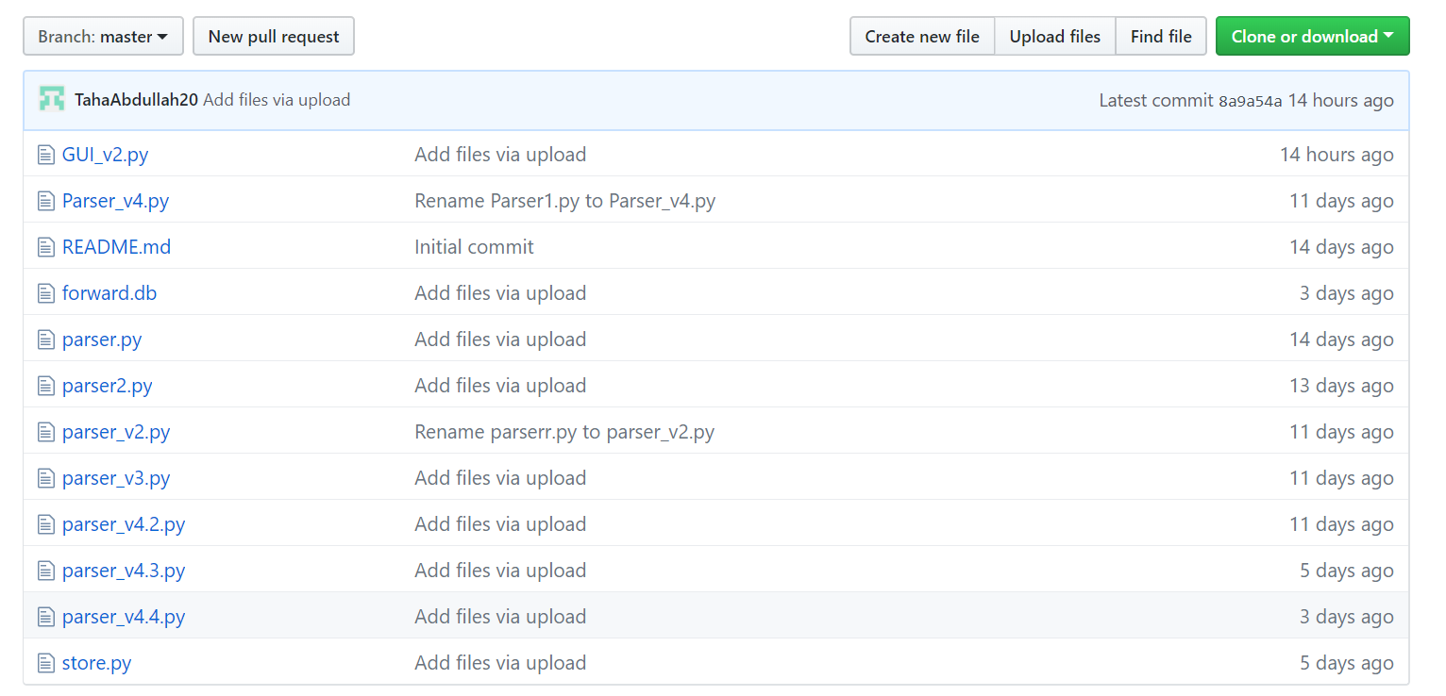
Commit History

Slide 10
THANK YOU!

