Slide 1
Tic Tac Toe Game in C-Language
BY:
Taha Ahmed Mallick CT-183
Abdul Raheem Sheikh CT-192
Maryum Mairaj CT-170
Team Name:
QuantumCoders

Slide 2
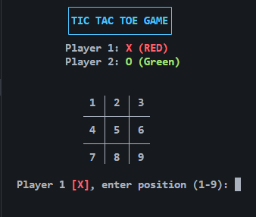
Introduction
This project is a simple Tic Tac Toe game written in the C language. It allows two players to take turns marking spaces on a 3×3 grid with ‘X’ and ‘O’. The goal is to form a line horizontally, vertically, or diagonally. The program displays the board after each move and checks for a winner or a draw. It uses concepts like arrays, loops, conditional statements, and user input to control the game.

Slide 3
Step 1 – Code Setup
At the beginning, the stdio.h header file is included to use functions like printf() and scanf() for input and output. Then stdlib.h is included for the system() function, using which we clear the screen. Then windows.h library is only included when it detects it is a windows machine, we use this library to set windows console to UTF-8 encoding so that grid can be presented neatly which is made up of Unicode characters. The array board[9] stores the game cells, each cell labeled 1 to 9. These numbers are replaced by ‘X’ or ‘O’ when players make their moves. Other arrays store winning patterns to check for results later in the program. This setup forms the base structure of the game.

Slide 4
Step 2 – Main Function Flow
The main function controls the overall game flow. The variable player tracks whose turn it is, and mark holds either ‘X’ or ‘O’; corresponding to the player. The while(1) loop runs infinitely until the game ends. Each time, the board is printed using print_board(), and the player enters their move. If the input is valid then that box is marked otherwise a flag is raised and using continue statements same player is asked to input his position again, until done correctly.

Slide 5
Step 3 – Marking and Checking for Win
Once the player chooses a valid box, that cell in the array is updated with their mark. Then the program calls check_win() to see if the current move completes any winning line. If yes, the game ends showing a winner message. If all boxes are filled without a winner, the game is declared a draw. This part is where the game logic works to decide the result.

Slide 6
Functions in our programs…
print_board()
check_win()

Slide 7
Display Board Function
This function is responsible for displaying the 3×3 grid to the players. It clears the screen and prints the board after every move and uses colors to make it visually clear which boxes are marked by which player. If a player wins, it highlights the winning line. This function keeps the players informed about the game’s status. It uses loops to efficiently print the board and marks X as red and O as green, while if a winning pattern is found then it colors it with blue.

Slide 8
Win Checker
This function checks all 8 possible winning combinations: three rows, three columns, and two diagonals. It compares the symbols in each line to see if they are the same. If yes, it returns 1, meaning a win. If the board is full and no winner is found, it returns -1 for a draw. Otherwise, it returns 0 to continue as normal.

Slide 9
Conclusion
This Tic Tac Toe game is a perfect example of how to use arrays, loops, functions, and conditions in C programming. It also teaches how to manage player turns, validate user input, and display results interactively. By studying this program, beginners can improve their logical thinking and understand how small programs combine to create complete games. This game also eliminates the need to use paper and pen and makes it easier to play it again and again.

