Slide 2
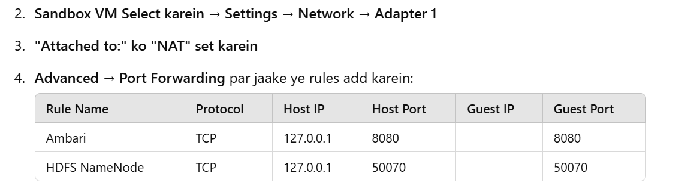

Slide 3
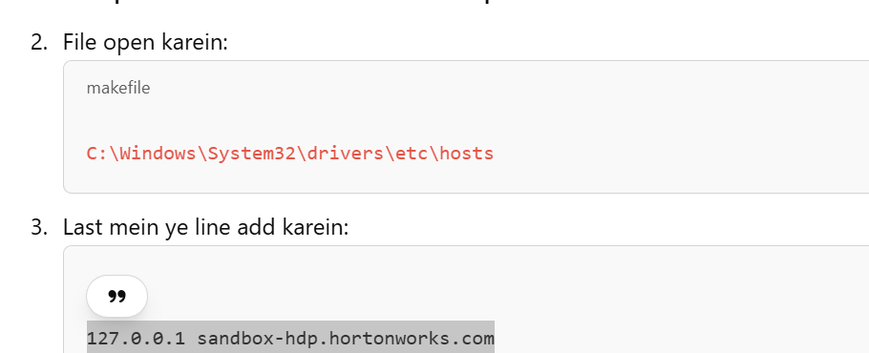
✅ Solution (Windows Users ke liye): Notepad ko Administrator Mode mein Open karein.

Slide 4
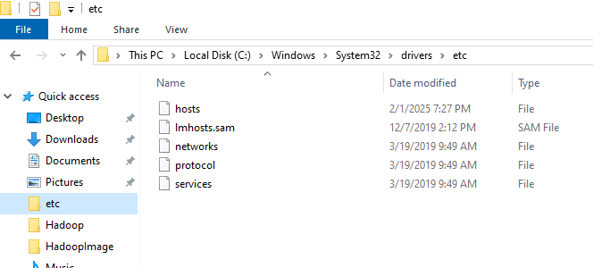

Slide 5
go to this localtion
C:\Windows\System32\drivers\etc
add this lines to host file
#
127.0.0.1 localhost
::1 localhost
0.0.0.0 edf.eset.com
0.0.0.0 expire.eset.com
127.0.0.1 sandbox-hdp.hortonworks.com

Slide 6
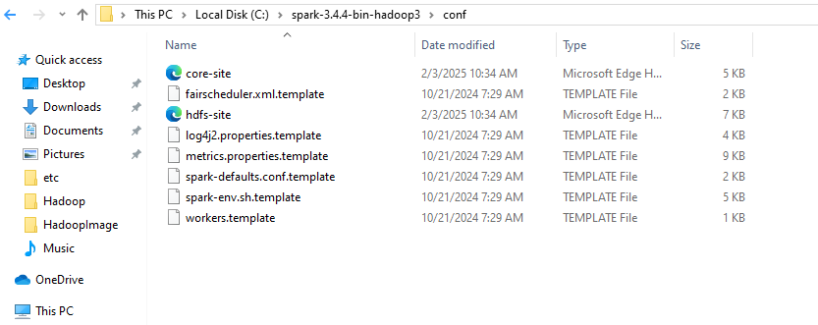
Dwonload config files from ambari and paste into the spark to connect with spark

