Slide 1
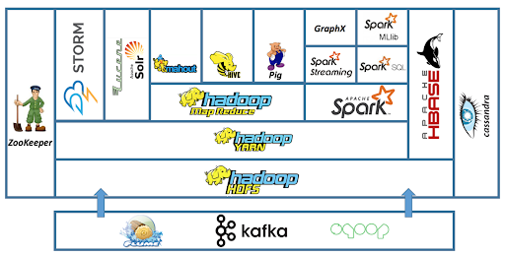
Hadoop Ecosystem

Slide 2
Services
HDFS:
Distributed storage system for storing large datasets.
YARN:
Manages resource allocation and job scheduling across the cluster.
MapReduce:
Framework for batch processing of data.
Hive:
SQL-like querying on large datasets stored in HDFS.
Pig:
High-level scripting language for data processing.
HBase:
NoSQL database for real-time read/write on HDFS.
Spark:
Framework for real-time and batch processing (Spark SQL, MLlib, Streaming, etc.
Mahout:
Machine learning algorithms for large datasets.
Kafka:
Messaging system for real-time data ingestion.
Storm:
Framework for real-time stream processing.
Cassandra:
Distributed database for high availability and scalability.
ZooKeeper:
Coordinates distributed applications and manages cluster states.
Sqoop:
Data Ingestion for Structured Data
Flume:
Data Ingestion for Unstructured Data

Slide 3
Vertical Scaling
RAM
Processor
100 MBPs
1PB: 5 months in just copying
10 TB
10 TB
10 TB
Horizontal Scaling
Cluster of nodes
RAM
10 TB
RAM
10 TB
10 TB
10 TB
10 TB
Processor
Processor

Slide 4
Note
When compared to vertical scaling in RDBMS, the horizontal scaling of Hadoop provides a higher impact.
It is highly scalable as it handles data in a distributed manner.
It will utilize the data locality concept for processing the data on the nodes on which they are stored rather than moving it over the network reducing the traffic.
It will create and store replicas of data making and it is fault-tolerant.
It will be able to handle any data type.
It is cost-effective as all nodes are in clusters which is not expensive.

Slide 5
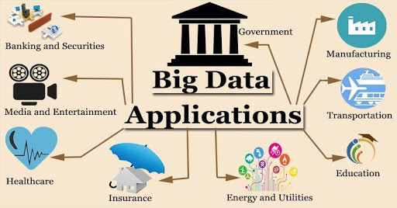
Applications

Slide 6
Hadoop 2.x|3.x
HDFS: Hadoop Distributed File System
Distributed Storage
YARN: Yet Another Resources Negotiator
Allocates and Deallocates Resources for distributes processing applications
MR: Map Reduce
A programming framework used to develop distributes data processing applications

Slide 7
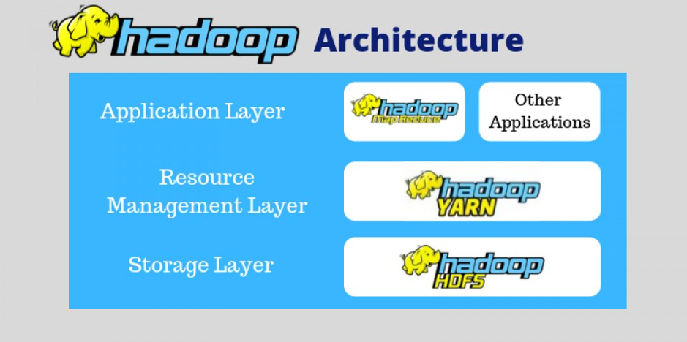
Hadoop Core

Slide 8
Master Slave Architecture
HDFS
YARN
Master -> Name Node
Master -> Resource Manager
Slave -> Data Node
Slave -> Node Manager

Slide 9
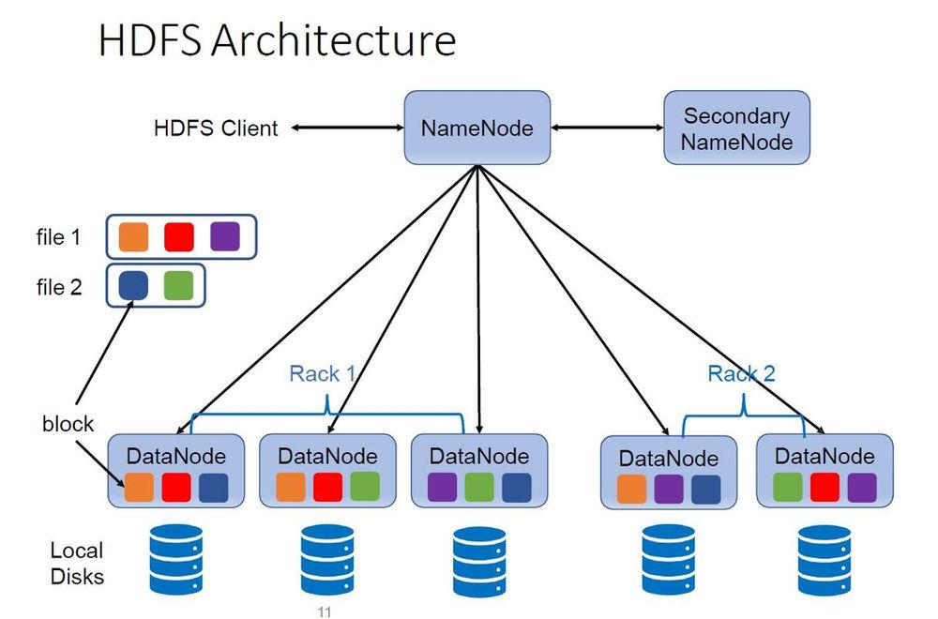

Slide 10
Name Node
Handle read/write requests
Store metadata (data about data) in RAM, more specifically 2 files FsImage and Edit_log represent file system namespace and changes to it.
Name node will never store the actual data on it’s own HDD/SDD
Work distribution (chunks of data)
Manages data nodes, also failure status as well.

Slide 11
Data Node
Fullfil instruction from NN
Stores actual
Send heart beat signals in 3 seconds to NN. When 10s stale, 10mins data node is dead.
Send block report to NN at start, in 6hr intervals.

Slide 12
.What is Rack Awareness?
A rack contains many DataNode machines and there are several such racks in the production. HDFS follows a rack awareness algorithm to put the replicas of the blocks during a distributed fashion. This rack awareness algorithm provides for low latency and fault tolerance.
Suppose the replication factor configured is 3. Now rack awareness algorithm will place the primary block on a native rack. It will keep the opposite two blocks on a special rack. It doesn’t store more than two blocks within the same rack if possible.

Slide 13
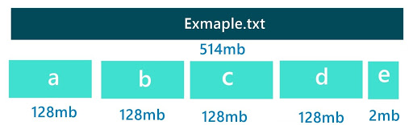
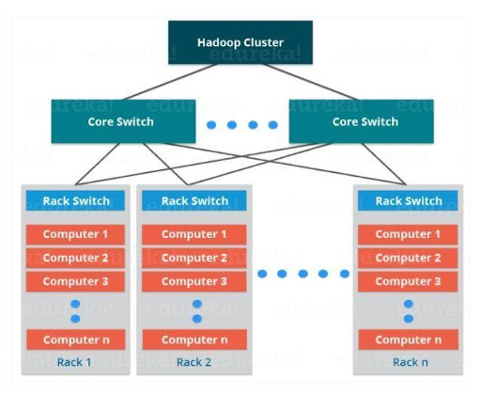
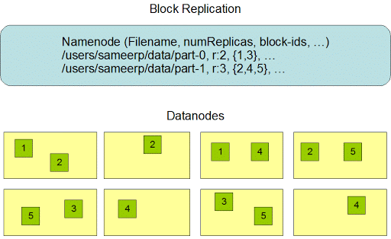
File Block – Internal Working

Slide 14
Block Replication and Fault Tolerance
Secondary Name Node
Client
Stock_data.xlsx
300 MB
Name Node
Meta data
B1 {1,3,4}
B2{1,2,3}
B2 {2,3,4}
HB/BR
HB/BR
HB/BR
HB/BR
D1
D2
D3
D4

Slide 15
HDFS Write Anatomy
Write Operation:
Client Request: The client contacts the NameNode to create a file in HDFS.
Block Assignment: The NameNode allocates DataNodes for storing replicas of each block.
Pipeline Setup: The client writes data to the first DataNode, which then forwards it to the second DataNode, and so on (pipeline replication).
Block Replication: Each block is replicated based on the replication factor.
Acknowledgment: Once all replicas are stored, an acknowledgment is sent back to the client.

Slide 16
HDFS Read Anatomy
Read Operation:
Client Request: The client contacts the NameNode to get the location of the file’s blocks.
Block Location: The NameNode provides the DataNodes that store the required blocks.
Block Retrieval: The client reads the blocks directly from the closest DataNode.
Data Assembly: The client assembles the blocks to reconstruct the original file.

Slide 17
Client
In HDFS, the client refers to the system or application that interacts with the Hadoop cluster to perform operations like reading or writing data.
Examples:
A user accessing HDFS through a terminal command (e.g., hadoop fs -put).
An application like Spark or Hive submitting data read/write requests to HDFS.
The client communicates with the NameNode for metadata and with DataNodes for actual data

Slide 18
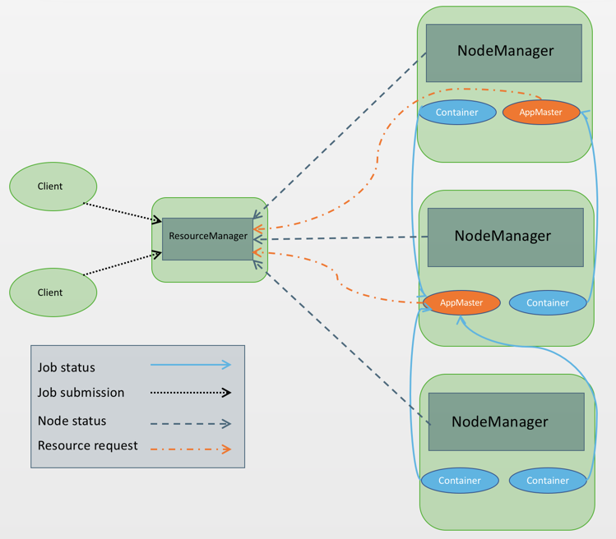
YARN

Slide 19
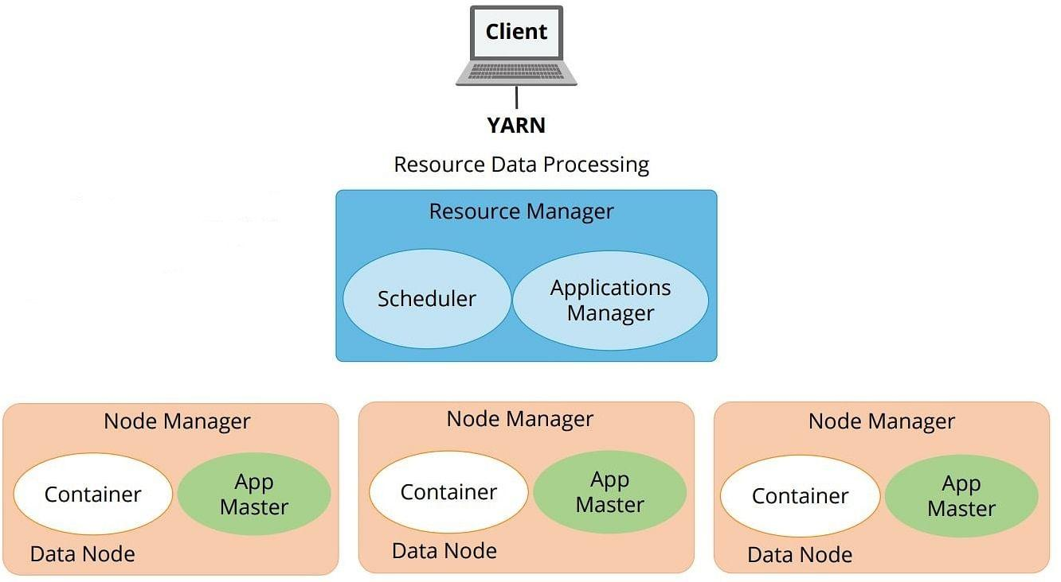

Slide 20
YARN Theory
An Application can be a single job or a DAG of jobs.
Resource Manager (RM)Role: Central authority for resource allocation in the cluster.
Tracks available resources across all nodes.
Assigns resources to applications.
Communicates with Node Managers and Application Masters.
Scheduler: Part of the Resource Manager, decides how resources are distributed among applications.
Does not monitor or restart failed tasks.
Uses policies (FIFO, Capacity, Fair Scheduler) to allocate resources.
Application Manager (AM)Role: Part of the Resource Manager, handles the lifecycle of applications.
Negotiates resources for the Application Master.
Tracks application status.

Slide 21
Continued…
Node Manager (NM): Manages resources on a single cluster node.
Monitors and reports resource usage (CPU, memory) to the Resource Manager.
Launches and manages containers (execution environments).
Communicates with the Resource Manager and Application Master.
Container: An isolated execution environment for tasks, allocated by Node Manager.
Runs a specific task (e.g., a MapReduce or Spark task).
Consumes resources (CPU, memory) allocated by the Resource Manager.
Application Master (App Master): Manages the execution of a specific application.
Communicates with the Resource Manager to request resources.
Monitors containers executing application tasks.
Reports application progress to the Resource Manager.

Slide 22
Communication Flow
Application Submission: The client submits an application to the Resource Manager.
Resource Allocation: The Resource Manager allocates a container for the Application Master.
Task Execution: The Application Master requests additional containers for tasks from the Resource Manager.
Node Manager Role: Node Managers launch containers as per the Resource Manager’s instructions and report their status.

Slide 23
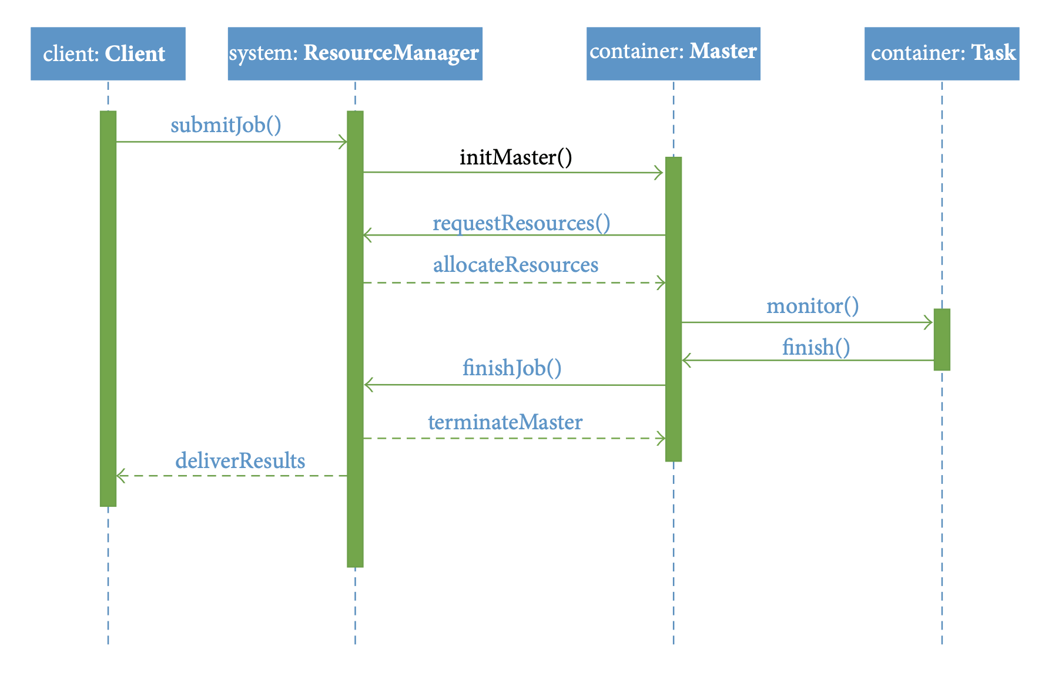

Slide 24
