Slide 1


Slide 2
Course Outcomes
Course Outcomes | Description
CO1 | Perform network scanning and vulnerability assessment using tools like Nmap and Nessus.
CO2 | Execute ethical hacking techniques using frameworks such as Metasploit and Hydra to exploit system weaknesses.
CO3 | Analyze network traffic and identify threats using Wireshark and related sniffing tools.
CO4 | Configure and manage firewalls and intrusion detection systems like pfSense and Snort to secure networks.
CO5 | Conduct reconnaissance and threat mapping using OSINT tools and frameworks like MITRE ATT&CK, and simulate phishing attacks to understand attack methodologies.

Slide 3
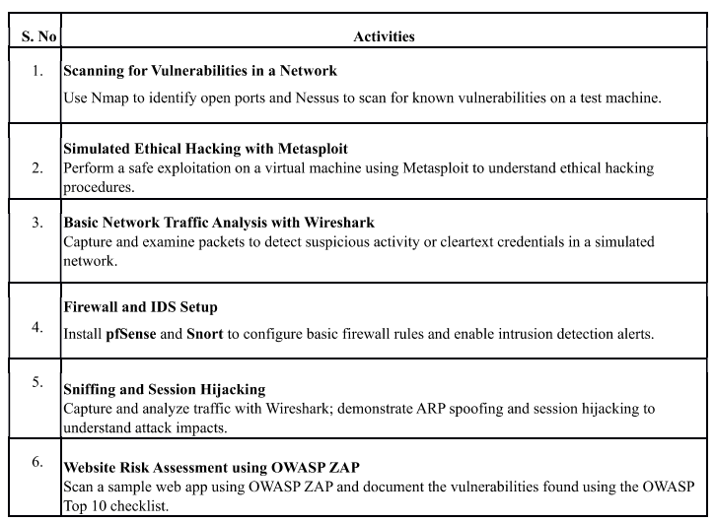
List of Experiments

Slide 4
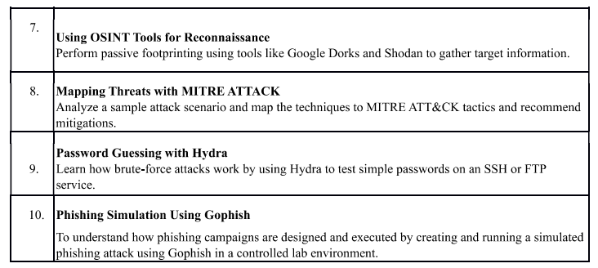

Slide 5
Assessment and Evaluation Plan
Assessment Tools
Evaluation
10 marks

Slide 6

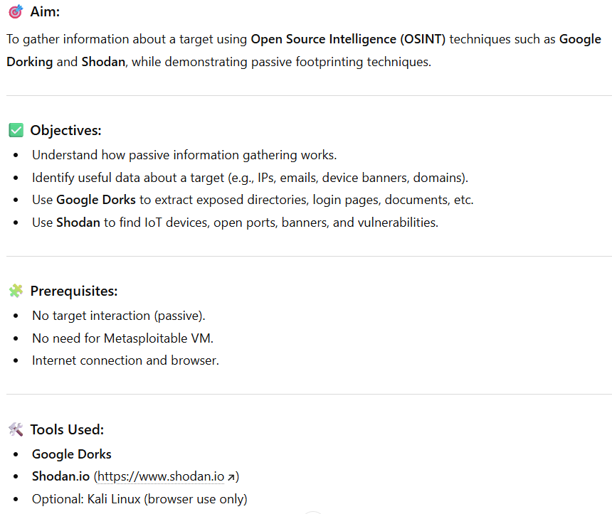
Experiment 7:-
Notes:
NMAP or Network Mapper is a network reconissence tool used to scan networks to find active hosts or devices in that network and search for known vulnerabilities.
Use Nmap to identify open ports & services.
Use Nessus to detect known vulnerabilities

Slide 7
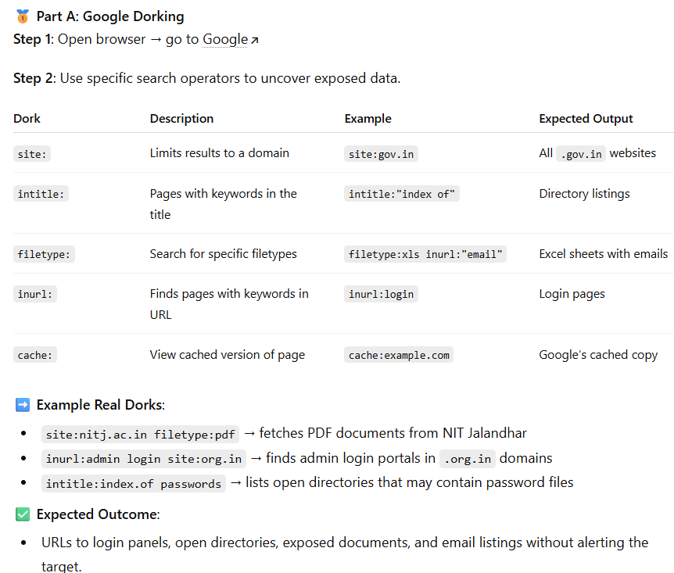
Step-by-Step Procedure

Slide 8
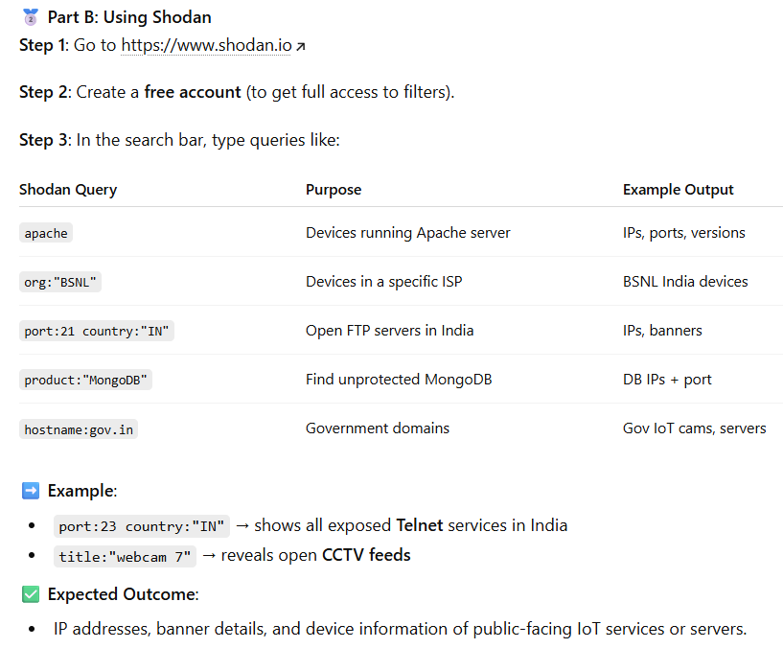

Slide 9
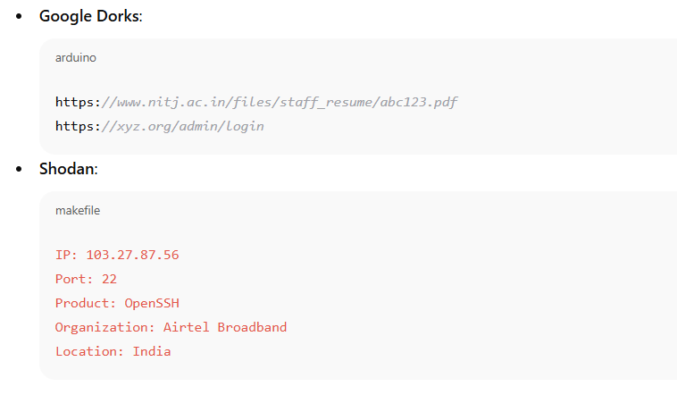
Expected Outputs (Samples)

Slide 10
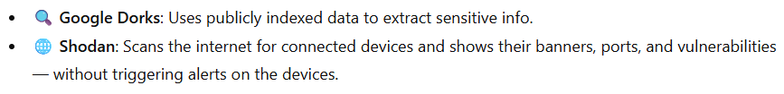
Why These Tools?

Slide 11

Conclusion

Slide 12
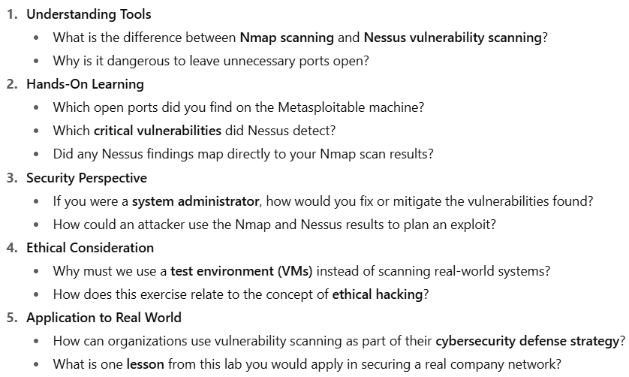
Reflective Questions

Slide 13
Summarize
In this lab, students set up a cybersecurity ecosystem using Kali Linux (attacker) and Metasploitable 2 (victim) inside VirtualBox.
Nmap was used to identify open ports and services running on the target machine.
Nessus was used to scan for known vulnerabilities based on these services.
Students learned how attackers move from reconnaissance (Nmap) to exploitation opportunities (Nessus findings).
The experiment showed the importance of patching vulnerable services, restricting unnecessary open ports, and running continuous vulnerability scans in real-world networks.

Slide 14

Thank You

