Slide 1
Fake It Till You Make It
Generalizable Detection of AI-Generated Speech
Taha Taha · Ward Iroq
00460217 Deep Learning · Technion · Supervisor: Roy
Notes:
[Taha] One of these voices could be real and the other AI-generated. We’re Taha and Ward, and we ask whether a detector can recognize attacks it never saw during training.

Slide 2
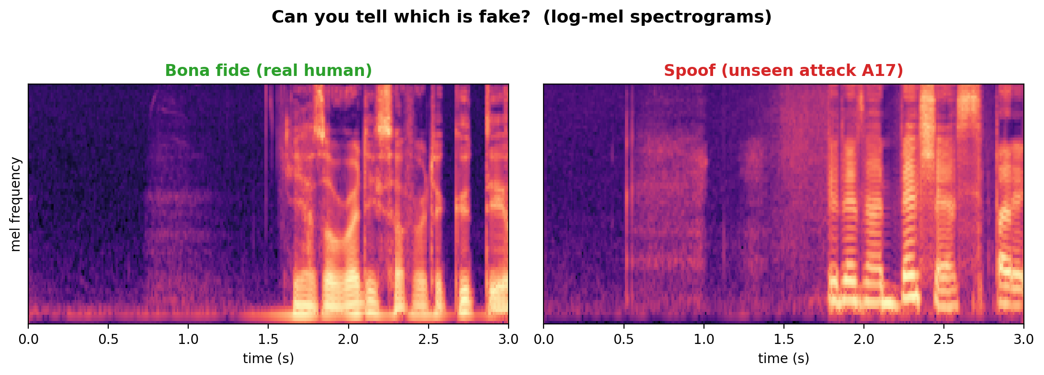
THE PROBLEM
Voice clones can fool people and detectors
Modern voice clones can be difficult to detect by ear creating risks from vishing,
fabricated audio, and voice-login bypass.
The spectrograms look similar. Can a detector generalize to attacks it never saw?
Fake It Till You Make It · 00460217 Deep Learning
01
Notes:
[Ward] Modern voice clones can be difficult to detect by ear, which creates risks from vishing to voice-login bypass. The spectrograms are also visually similar. So our goal is not merely to classify examples from known generators; it is to detect synthetic speech from new generators that were absent during training.

Slide 3
RESEARCH QUESTION
We measure generalization, not just accuracy
Training
6 known attacks A01–A06 (seen)
Evaluation
13 different attacks A07–A19 (UNSEEN)
ASVspoof 2019 LA is built for this: the seen/unseen split is the official protocol no manual splitting, no leakage.
Fake It Till You Make It · 00460217 Deep Learning
02
Notes:
[Taha] ASVspoof 2019 gives us a clean protocol for that question. Train and development contain six known attacks, A01 through A06. Evaluation contains thirteen different attacks, A07 through A19. Those evaluation attacks are not used for training, checkpoint selection, or threshold tuning, so the seen-to-unseen gap measures generalization.

Slide 4
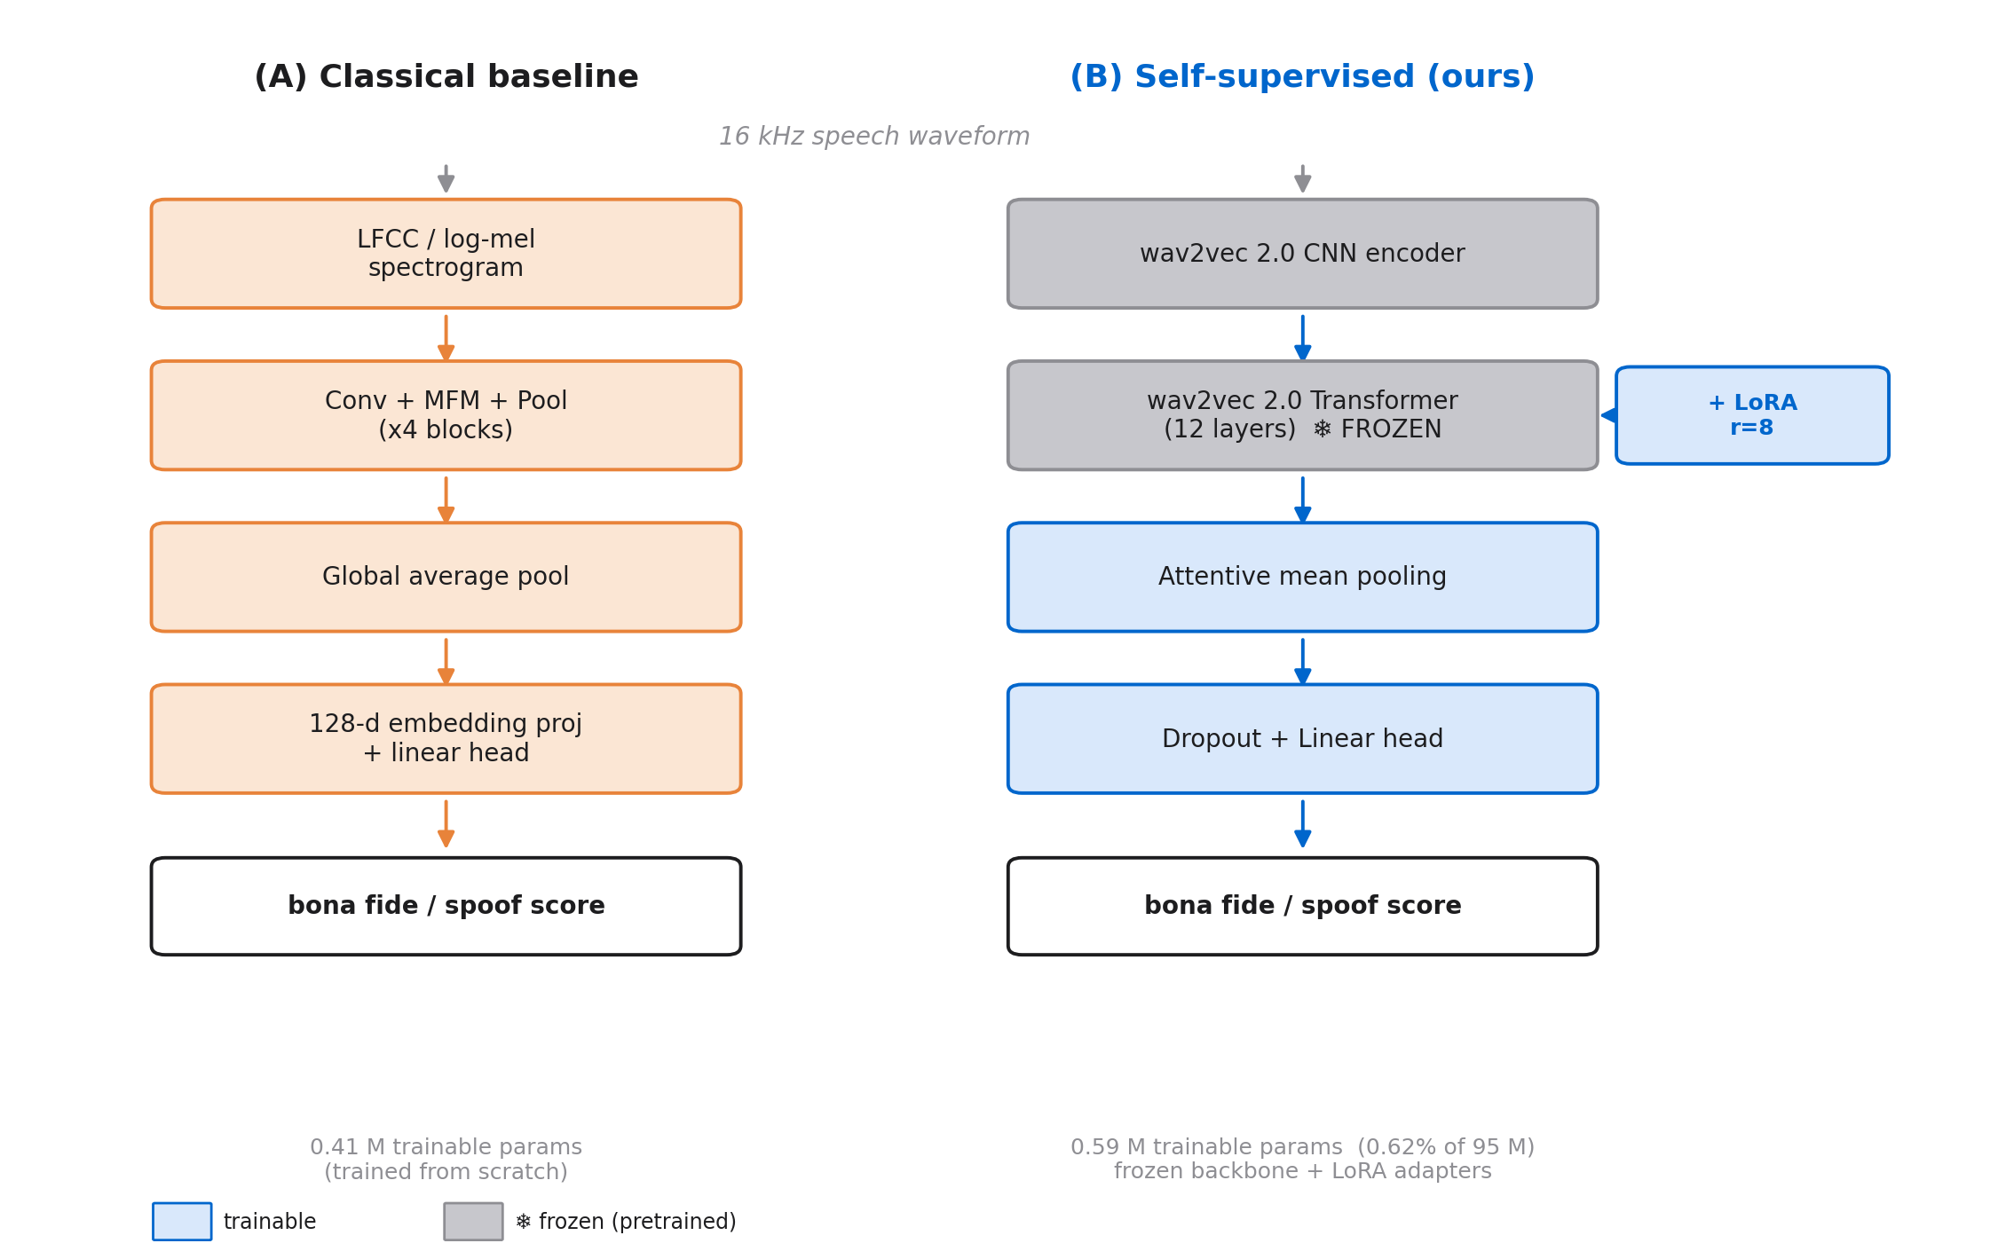
METHOD
Two families produce all eight configurations
8 configs: LCNN {LFCC, log-mel, +RawBoost} · wav2vec2 {probe, LoRA ±RawBoost, DoRA, OC-Softmax}
Fake It Till You Make It · 00460217 Deep Learning
03
Notes:
[Ward] The eight runs come from two shared families, not eight unrelated architectures. The first uses LFCC or log-mel and one Light CNN trained from scratch, optionally with RawBoost. The second normalizes the waveform, freezes the original wav2vec2 encoder, then trains attentive pooling with a probe, LoRA, or DoRA. Most use weighted BCE; one uses OC-Softmax. The full eight-row map is in backup.

Slide 5
THE KEY IDEA
LoRA adapts attention with 0.62% trainable
W = W₀ + (α / r) · B A
Backbone weights remain frozen; only rank-8 LoRA matrices are trained.
Targets: Q, K, V and output projections in all 12 Transformer layers.
One 768×768 projection: 590K dense weights vs 12,288 LoRA parameters.
Whole detector: 0.59M trainable of ~95M total (0.62%).
Fake It Till You Make It · 00460217 Deep Learning
04
Notes:
[Taha] LoRA keeps each pretrained weight frozen and learns a rank-eight update, alpha over r times B A. We place it in the query, key, value, and output projections of all twelve Transformer layers. That gives 589,824 adapter parameters; with pooling and the head, 0.59 million parameters—0.62 percent of the roughly 95-million-parameter detector—are trainable.

Slide 6
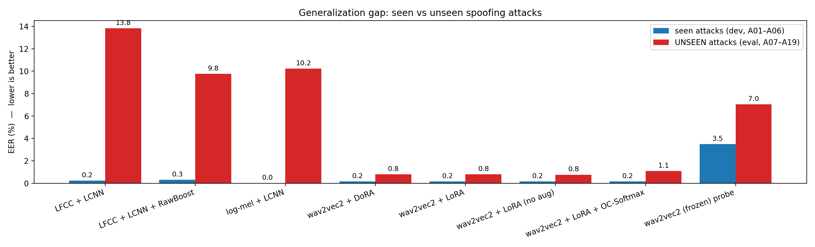
HEADLINE RESULT
LoRA shrinks the seen→unseen gap to 0.64 pp
~15×
smaller gap than the strongest LCNN
0.64 pp vs 9.45 pp
Fake It Till You Make It · 00460217 Deep Learning
05
Notes:
[Ward] This is the central result. The classical LCNN variants have seen-to-unseen EER gaps of 9.45 to 13.59 percentage points. Wav2vec2 with LoRA moves from 0.16 percent on seen attacks to 0.80 percent on unseen attacks: a 0.64-point gap. That is about fifteen times smaller than the strongest LCNN variant. These are single-seed, within-corpus results, so we treat the scale as evidence, not a confidence interval.

Slide 7
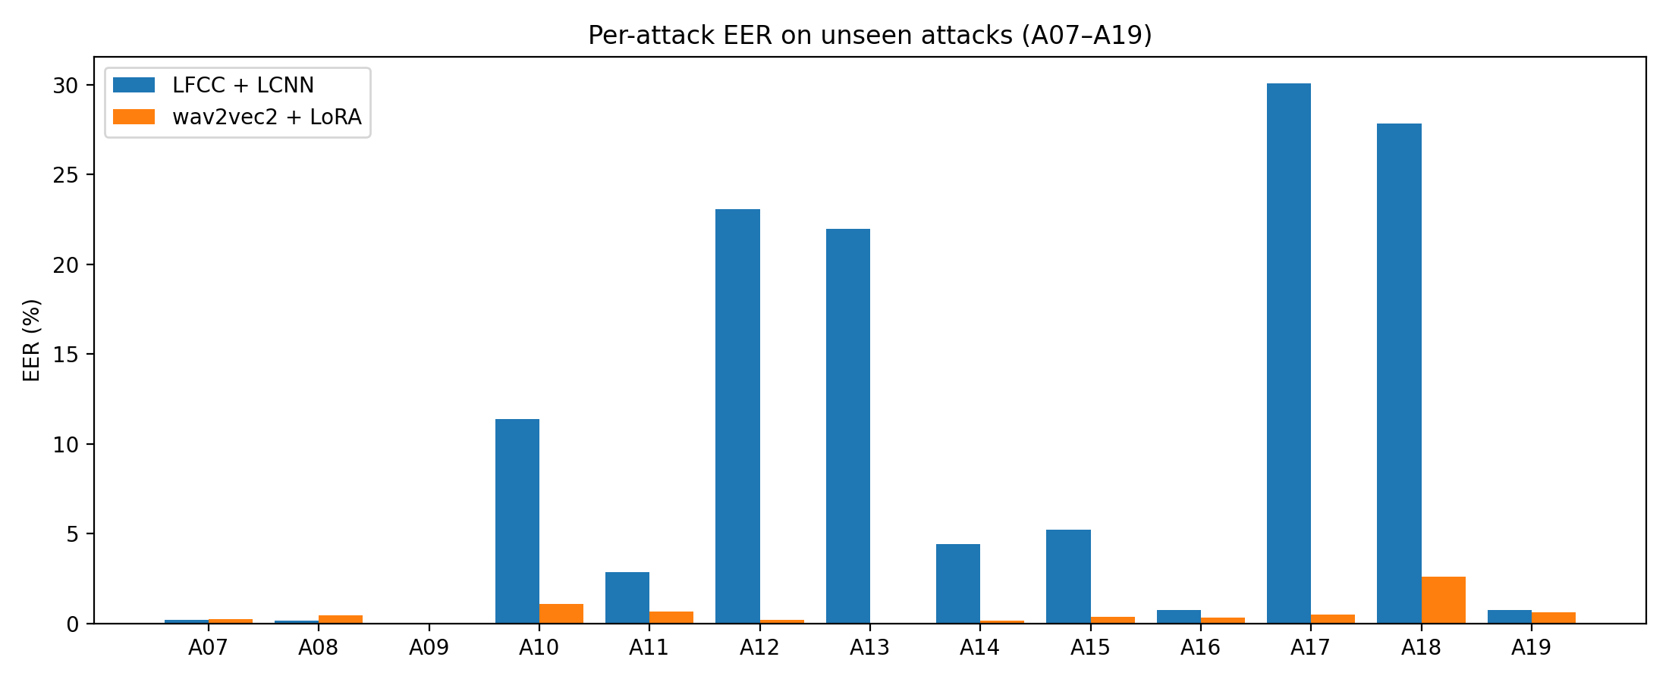
RESULTS
Where exactly the CNN fails
In this evaluation, LFCC+LCNN peaks above 20% on A12/A13/A17/A18; LoRA stays below 2.7%.
Fake It Till You Make It · 00460217 Deep Learning
06
Notes:
[Taha] The aggregate gap hides where the baseline fails. The LFCC CNN rises above twenty percent EER on A12, A13, A17, and A18, while wav2vec2 plus LoRA remains below 2.7 percent on every evaluation attack. This does not explain the mechanism, but it shows that the CNN’s failure is concentrated rather than uniform.

Slide 8
ABLATION
Adaptation matters, not just features
Adaptation
Trainable
Unseen EER
Linear probe (frozen features)
0.002 M
7.04%
LoRA
0.59 M
0.80%
DoRA
0.63 M
0.80%
Same frozen backbone: probe 7.04% vs LoRA 0.80% unseen EER. RawBoost changes the LoRA gap 0.64→0.60 pp no clear effect from one seed.
Fake It Till You Make It · 00460217 Deep Learning
07
Notes:
[Taha] The probe ablation is decisive. With the same frozen backbone, training only attentive pooling and the classifier gives 7.04 percent unseen EER; adding LoRA reduces it to 0.80 percent. So pretrained features alone are not enough in this setup—task-specific adaptation matters. DoRA ties LoRA after rounding. Removing RawBoost changes LoRA’s gap from 0.64 to 0.60 points, so one seed gives no evidence of a meaningful augmentation effect.

Slide 9
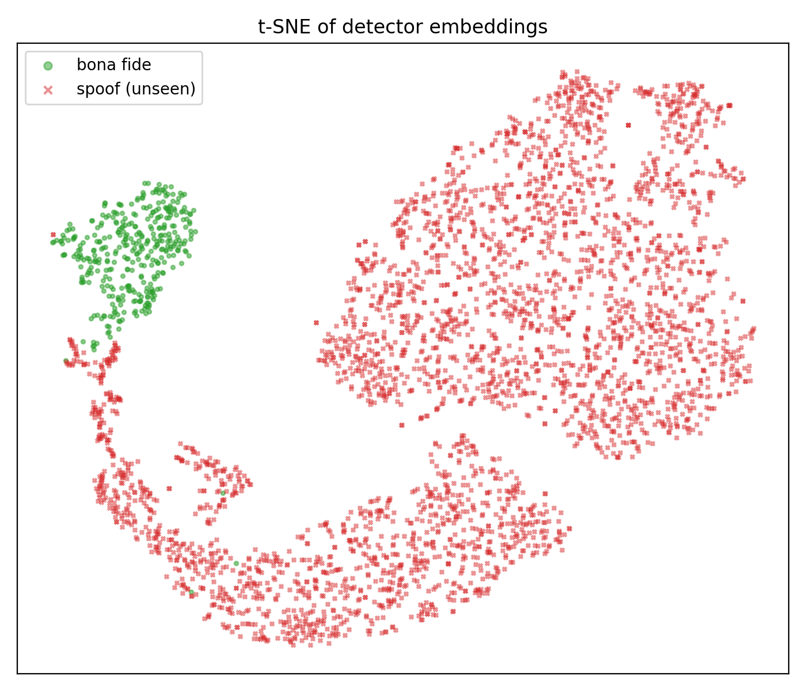
ANALYSIS
Clear separation, but validation is narrow
On ASVspoof evaluation, bona fide speech and unseen spoofs separate in this 2D projection. This is descriptive not a causal explanation or cross-corpus proof.
Limitations:
– one random seed
– one base-size backbone
– no cross-corpus test
Fake It Till You Make It · 00460217 Deep Learning
08
Notes:
[Ward] This t-SNE is descriptive, not causal. Within ASVspoof evaluation, bona fide speech and unseen spoofs separate clearly in two dimensions. But t-SNE distorts geometry, and every spoof shown is unseen, so it cannot compare seen and unseen spoof clusters. Our scope is one seed, one base backbone, and one corpus; cross-corpus validation is the next test.

Slide 10
TAKEAWAYS
What the results support
1. One ASVspoof run: gap ≥9.45 pp (LCNNs) → 0.64 pp (LoRA), with 0.59M trainable parameters.
2. Frozen probe 7.04% vs LoRA 0.80% unseen EER: adaptation drove the gain in this setup.
3. A detector score is evidence, not proof; cross-corpus and multi-seed validation remain open.
github.com/taha-tahaa/fake-it-till-you-make-it · Thank you
Notes:
[Taha] Three conclusions. First, in this ASVspoof run, LoRA reduced the generalization gap from at least 9.45 points for the LCNNs to 0.64, with 0.59 million trainable parameters. Second, the 7.04-percent probe result shows that adaptation, not only pretraining, drove the gain. Third, this remains a detector score—not proof—and the single-seed, single-corpus result must be tested beyond ASVspoof. Thank you.

Slide 11
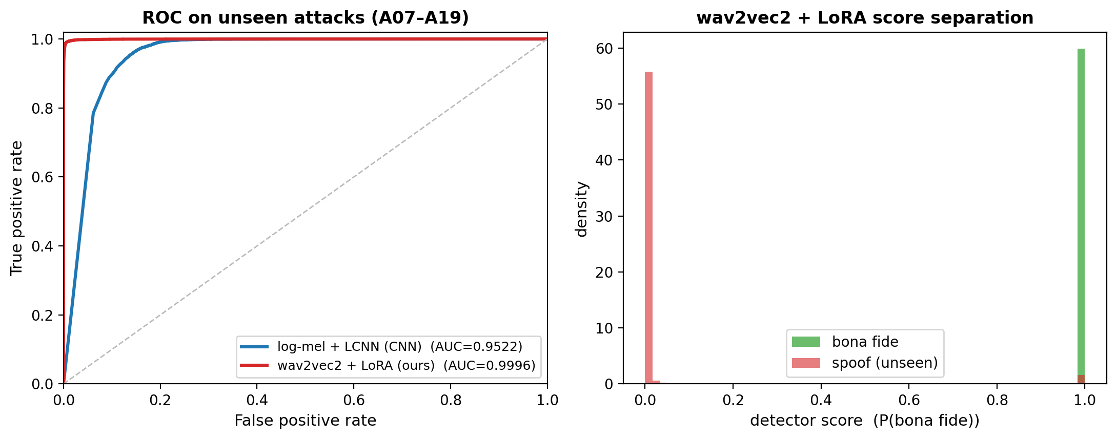
BACKUP
AUC 0.9996 on unseen ASVspoof attacks
EER reference: FPR ≈ FNR
Within ASVspoof: AUC 0.9996 vs 0.952; BCE scores are strongly separated, not cross-corpus validated.
Fake It Till You Make It · 00460217 Deep Learning
B0
Notes:
BACKUP ONLY — not part of the timed talk.
[Ward] The ROC view tells the same story within this corpus: LoRA reaches an AUC of 0.9996, compared with 0.952 for the log-mel CNN, and its BCE scores are strongly separated.
The dashed line marks the EER condition FPR ≈ FNR, but the deployment threshold was not fixed here; EER is computed by sweeping scores.

Slide 12
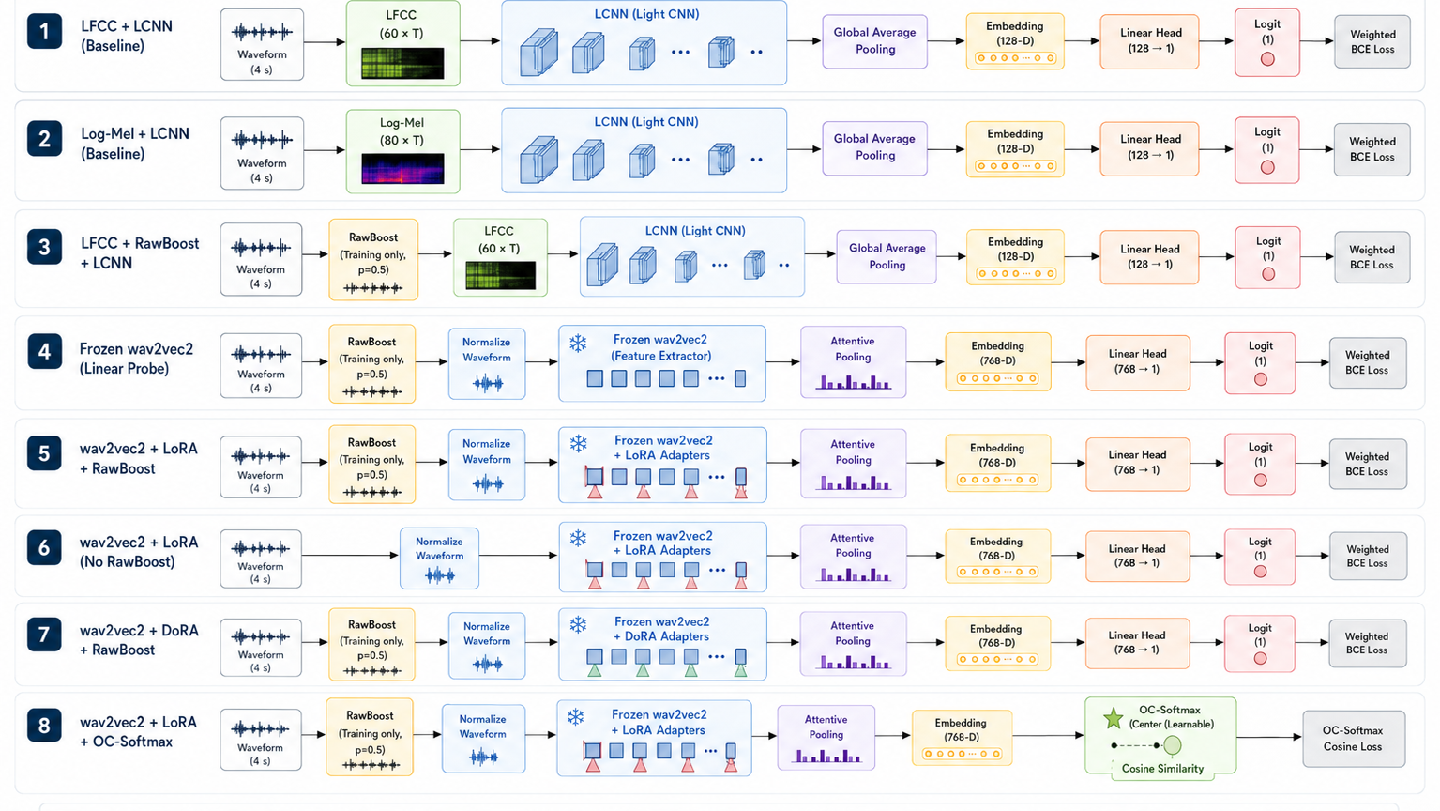
BACKUP
All eight experiment pipelines
Diagram shorthand: BCE rows omit dropout; the OC model head exists but is ignored by the task loss.
Fake It Till You Make It · 00460217 Deep Learning
B1
Notes:
BACKUP ONLY. Do not present unless asked. Clarify that dropout is omitted from the BCE rows for visual space, and that the OC-Softmax model still constructs a linear head but the task loss ignores it, so it receives no task-loss gradient.

Slide 13
BACKUP
EER and thresholds
s ≥ τ → bona fide · s < τ → spoof
FRR(τ) = #{bona fide: s < τ} / #{bona fide}
FAR(τ) = #{spoof: s ≥ τ} / #{spoof}
τ*EER = argminτ |FRR(τ) − FAR(τ)|
EER = [FRR(τ_EER) + FAR(τ_EER)] / 2
The repository sweeps observed scores, uses no interpolation, and does not save τ_EER.
Fake It Till You Make It · 00460217 Deep Learning
B2
Notes:
BACKUP ONLY — not part of the timed talk.
The decision convention is higher score means bona fide. The EER threshold is the observed-score sweep point minimizing the absolute FRR/FAR difference; the implementation uses no interpolation and does not save τ_EER.

Slide 14
BACKUP
ROC-AUC
TPR(τ) = TP / (TP + FN) · FPR(τ) = FP / (FP + TN)
ROC curve: (FPR(τ), TPR(τ)) for all thresholds τ
AUC = P(score_bona fide > score_spoof)
AUC = 1/(N⁺N⁻) Σᵢ Σⱼ [𝟙(sᵢ⁺ > sⱼ⁻) + 0.5·𝟙(sᵢ⁺ = sⱼ⁻)]
AUC measures ranking quality of scores, not linear separability of embeddings and not probability calibration.
Fake It Till You Make It · 00460217 Deep Learning
B3
Notes:
BACKUP ONLY — not part of the timed talk.
ROC-AUC aggregates ranking over thresholds. It is not evidence that the embedding space is linearly separable, and it does not establish calibrated probabilities.

Slide 15
BACKUP
Training losses
L_BCE = −1/N Σᵢ [w_pos yᵢ log σ(ℓᵢ) + (1−yᵢ) log(1−σ(ℓᵢ))]
w_pos = 22,800 / 2,580 = 8.837 · y=1 bona fide, y=0 spoof
Raw logit ℓ; BCEWithLogitsLoss applies sigmoid internally; evaluation score = sigmoid(ℓ).
OC-Softmax: sᵢ = cos(zᵢ,c) = zᵢᵀc / (‖zᵢ‖ ‖c‖)
yᵢ=1: softplus(20(0.9 − sᵢ))
yᵢ=0: softplus(20(sᵢ − 0.2))
c is one learned bona-fide center, shape 1×768; 0.9 and 0.2 are training margins—not evaluation thresholds.
Evaluation score is cosine similarity, not probability; the linear head exists but the OC-Softmax loss ignores it.
Fake It Till You Make It · 00460217 Deep Learning
B4
Notes:
BACKUP ONLY — not part of the timed talk.
Weighted BCE consumes the raw logit and applies its sigmoid internally; evaluation reports sigmoid(logit). OC-Softmax instead trains cosine similarity to one learned bona-fide center. Its margins are training parameters, not evaluation thresholds, and its task loss ignores the model's linear head.

Slide 16
BACKUP
Embeddings and t-SNE
wav2vec2 output: B × 199 × 768
eₜ = wᵀhₜ + b
aₜ = exp(eₜ) / Σⱼ exp(eⱼ)
z = Σₜ aₜhₜ ∈ ℝ⁷⁶⁸
t-SNE: ℝ⁷⁶⁸ → ℝ² (visualization only)
Limitations
• wav2vec2 + LoRA + Weighted BCE only
• not all 8 experiments; not OC-Softmax
• 4,000 sampled eval points
• all spoof points are unseen A07–A19
• distorts geometry; descriptive, not causal proof
Fake It Till You Make It · 00460217 Deep Learning
B5
Notes:
BACKUP ONLY — not part of the timed talk.
The displayed points are a 4,000-example evaluation sample from the wav2vec2 + LoRA + weighted-BCE experiment. Every spoof point belongs to unseen attacks A07–A19. The 2D layout is descriptive only because t-SNE distorts the original geometry.

Slide 17
BACKUP
What is frozen and what is trained?
Unlabeled
natural speech
Self-supervised
wav2vec2
pretraining
Pretrained
Q / K / V / O
weights
Load + freeze
in our project
ASVspoof 2019
bona fide / spoof
labels
Train pooling,
head + adapters
LoRA update
Component | Probe | LoRA | DoRA
Original wav2vec2 Q/K/V/O | Frozen | Frozen | Frozen
LoRA A,B adapters | Not used | Trainable | Trainable
DoRA magnitudes | Not used | Not used | Trainable
Attentive pooling | Trainable | Trainable | Trainable
Linear head | Trainable | Trainable | Trainable
Original wav2vec2 CNN / Transformer / FFN / norms | Frozen | Frozen | Frozen
W′ = W₀ + (α / r)BA
W₀ = pretrained wav2vec2 weight, frozen
A, B = LoRA adapter matrices trained on
ASVspoof labels
r = 8 · α = 16
“ASVspoof 2019 is not the source of Q/K/V. Q/K/V are pretrained wav2vec2 Transformer weights.
ASVspoof 2019 provides supervised bona-fide/spoof labels for downstream training.”
Fake It Till You Make It · 00460217 Deep Learning
B6
Notes:
If asked: in every wav2vec2 experiment, the original wav2vec2 backbone is frozen. In the probe we train only attentive pooling and the classifier. In LoRA and DoRA we still freeze the original Q/K/V/O weights, but train small adapter updates attached to them. ASVspoof 2019 does not pretrain Q/K/V; it only trains the downstream detector components.

Slide 18
BACKUP
Training and optimization
Training item | Verified setting
Optimizer / update | AdamW · mini-batch stochastic gradients
Learning rates | LCNN 3e−4 · pool/head 5e−4
Adapter learning rate | LoRA / DoRA 1e−4
Weight decay | 1e−4
wav2vec2 batch | 16 × accumulation 2 = effective 32
Random seed | 1234
Regularization | Dropout p=0.1 + weight decay
Gradient clipping | Norm 1.0, before optimizer step
AdamW update (compact form)
θₜ₊₁ = θₜ − η m̂ₜ/(√v̂ₜ+ε) − ηλθₜ
m̂ₜ, v̂ₜ: bias-corrected moments · λ: decoupled weight decay
AdamW is not vanilla SGD. It is still stochastic because each update estimates the gradient from a shuffled mini-batch rather than the full dataset.
The pool/head uses the higher LR because it starts task-specific; adapters use a smaller LR to perturb pretrained features conservatively. Design choice—not proven optimal.
Fake It Till You Make It · 00460217 Deep Learning
B7
Notes:
אם נשאלים: AdamW משתמש במומנט ראשון ושני וב-weight decay מופרד, ולכן הוא אינו vanilla SGD. הוא עדיין stochastic כי כל gradient מחושב מ-mini-batch אחרי shuffle. ב-wav2vec2 ה-batch הוא 16 ו-gradient accumulation של 2 נותן effective batch של 32. ה-pooling וה-head מתחילים כרכיבים חדשים ולכן קיבלו 5e-4, בעוד שה-adapters קיבלו 1e-4 כדי לשנות את הייצוג המאומן מראש באופן שמרני יותר. אלה בחירות תכנון מתועדות; לא ביצענו sweep ולכן איננו טוענים שהן אופטימליות. לפני כל optimizer step הקוד מבטל scaling של AMP, מבצע clipping בנורמה 1.0, ואז קורא ל-step.

Slide 19
BACKUP
Core terminology
SSL · self-supervised learning
MFM · Max-Feature-Map
• wav2vec2 was pretrained on unlabeled speech
• our anti-spoofing stage is supervised
• we did not run the original SSL pretraining
• split 2C channels into two C groups
• output the elementwise max of each pair
• unlike ReLU: feature vs feature, not feature vs 0
• MFM itself has no trainable parameters
Dropout
Random seed
• randomly masks activations during training
• disabled during evaluation
• does not delete or freeze weights
• verified value: p = 0.1
• verified seed: 1234
• controls init, shuffle, crop, dropout, augmentation
• worker seeds are reproducible
• one seed: run-to-run variance was not measured
Fake It Till You Make It · 00460217 Deep Learning
B8
Notes:
אם נשאלים: SSL מתאר את שלב ה-pretraining המקורי של wav2vec2 על דיבור ללא תוויות; בפרויקט שלנו לא ביצענו את השלב הזה, אלא טעַנו checkpoint קיים ואימנו supervised על תוויות bona fide/spoof. MFM מקבל 2C ערוצים, מחלק לשתי קבוצות ובוחר max אלמנטרי מכל זוג; בניגוד ל-ReLU, זו תחרות בין שתי תכונות נלמדות ולא השוואה לאפס, ול-MFM עצמו אין פרמטרים. Dropout עם p=0.1 מאפס activations זמנית רק באימון. Seed 1234 משפיע על initialization, shuffle, crop, dropout ו-RawBoost; ריצה אחת אינה מספקת אומדן שונות.

Slide 20
BACKUP
Scope of the evidence
One seed
One backbone
One corpus
• no mean, standard deviation, or confidence interval
• small gaps such as 0.76% vs 0.80% are not proven significant
• facebook/wav2vec2-base only
• no wav2vec2-large, HuBERT, or WavLM comparison
• conclusions are not proven backbone-independent
• train/dev/eval are ASVspoof 2019 LA
• unseen = unseen generators inside the same corpus
• within-corpus generalization, not cross-corpus validation
The results support strong within-corpus unseen-attack separation, but do not yet establish statistical stability, backbone independence, or cross-corpus robustness.
Fake It Till You Make It · 00460217 Deep Learning
B9
Notes:
אם נשאלים: הראיה שלנו חזקה בתוך פרוטוקול ASVspoof 2019 LA, אבל ההיקף מוגבל. לכל configuration יש seed אחד בלבד, ולכן אין mean, standard deviation או confidence interval ואין בסיס לטעון שהפרשים קטנים כמו 0.76 מול 0.80 הם מובהקים. בדקנו רק facebook/wav2vec2-base, ולכן לא הראינו שהמסקנה בלתי תלויה ב-backbone. כל ה-splits באותו corpus; A07–A19 הם generator types שלא הופיעו באימון, אבל זו עדיין generalization בתוך corpus ולא cross-corpus robustness.

