Slide 1
Credit Card Default Prediction
Artificial Intelligence
Taha Yasin Demirci
20212905022
ACM 465 — Artificial Intelligence

Slide 2
Project Goal
Problem Statement
Why Does It Matter?
Musteri bir sonraki ay borcunu odeyebilecek mi?
Neden onemli?
Will a customer default on their credit card payment next month?
0 Paid (Normal)
1 Defaulted (Did not pay)
Early warning system for banks
Identify risky customers before default occurs
Minimize credit losses
Real-world financial risk management

Slide 3
Why Supervised Classification?
🏷️ Labeled Data Available
🎯 Binary Target Variable
Etiketli veri mevcut
Ikili hedef degisken
Every customer record already has a known outcome: paid (0) or defaulted (1). Supervised learning requires labeled data — and we have 30,000 labeled examples.
The target is discrete: 0 or 1. This is a classification problem, not regression. We are predicting a category, not a continuous value.
📊 Not Clustering
✅ Measurable Performance
Clustering degil
Olculebilir basari
We are not exploring unknown groups (unsupervised). We know exactly what we want to predict. Unsupervised methods like K-Means cannot optimize for a known label.
Supervised classification lets us measure Accuracy, Recall, ROC-AUC against the true labels — essential for validating a real banking risk model.

Slide 4
Dataset Overview
UCI Credit Card Default Dataset | Veri Seti Genel Bakis
👥 30,000
📊 25
✅ NONE
Customers
Features
Missing Data
Musteri
Degisken
Eksik veri
Group | Columns | Description
Demographics | SEX, EDUCATION, MARRIAGE, AGE | Personal customer information
Financial | LIMIT_BAL | Credit limit amount
Payment History | PAY_0 – PAY_6 | Payment status for last 6 months
Bill Amount | BILL_AMT1 – BILL_AMT6 | Statement amount for last 6 months
Payment Amount | PAY_AMT1 – PAY_AMT6 | Actual payment made each month
Target | default.payment.next.month | 0 = Paid | 1 = Defaulted

Slide 5
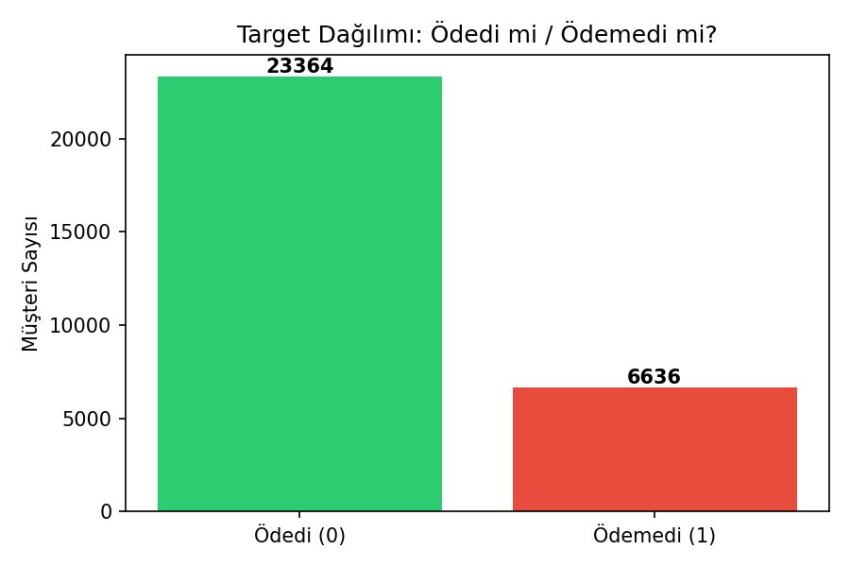
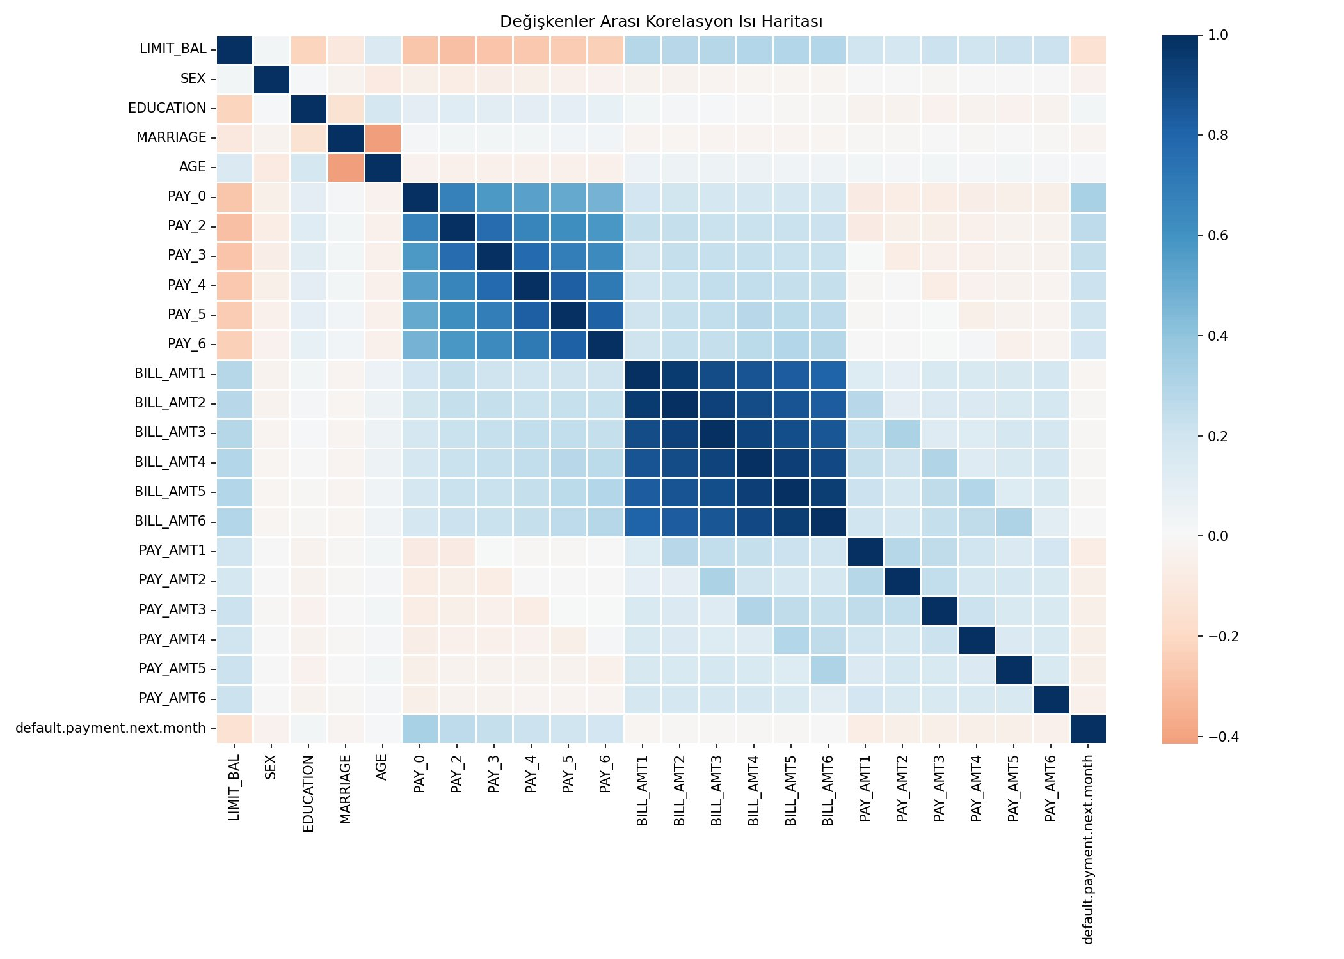
Exploratory Data Analysis (EDA)
Kesifsel Veri Analizi
Class Imbalance: 77.9% paid (23,364) vs 22.1% defaulted (6,636) | BILL_AMT columns are highly correlated — expected since they represent monthly statements

Slide 6
Data Preprocessing
Veri On Isleme
1
ID Column Removed | ID sutunu kaldirildi
Customer ID has no predictive value → df.drop('ID')
2
X and Y Separated | X ve Y ayrildi
X → 23 independent features | Y → default.payment.next.month (0 or 1)
3
Train-Test Split 80% / 20% | Egitim-test bolme
24,000 training samples | 6,000 test samples | stratify=Y preserves class ratio
4
Class Imbalance Handled | Sinif dengesizligi giderildi
class_weight='balanced' parameter automatically adjusts sample weights
5
No Feature Scaling Applied | Olceklendirme uygulanmadi
Decision Tree & Random Forest are tree-based → feature scale does not affect split decisions

Slide 7
Model Selection
Model Secimi | Supervised Learning → Classification
Decision Tree
Random Forest
Single interpretable tree
Visualizable structure
Fast to train
Risk of overfitting
Baseline for comparison
Ensemble of 100 decision trees
Averages predictions → more stable
Resistant to overfitting
Higher predictive power
Extends Decision Tree logic
VS
Both are tree-based models — no feature scaling required | Ikisi de agac tabanlidir, olceklendirme gerekmez

Slide 8
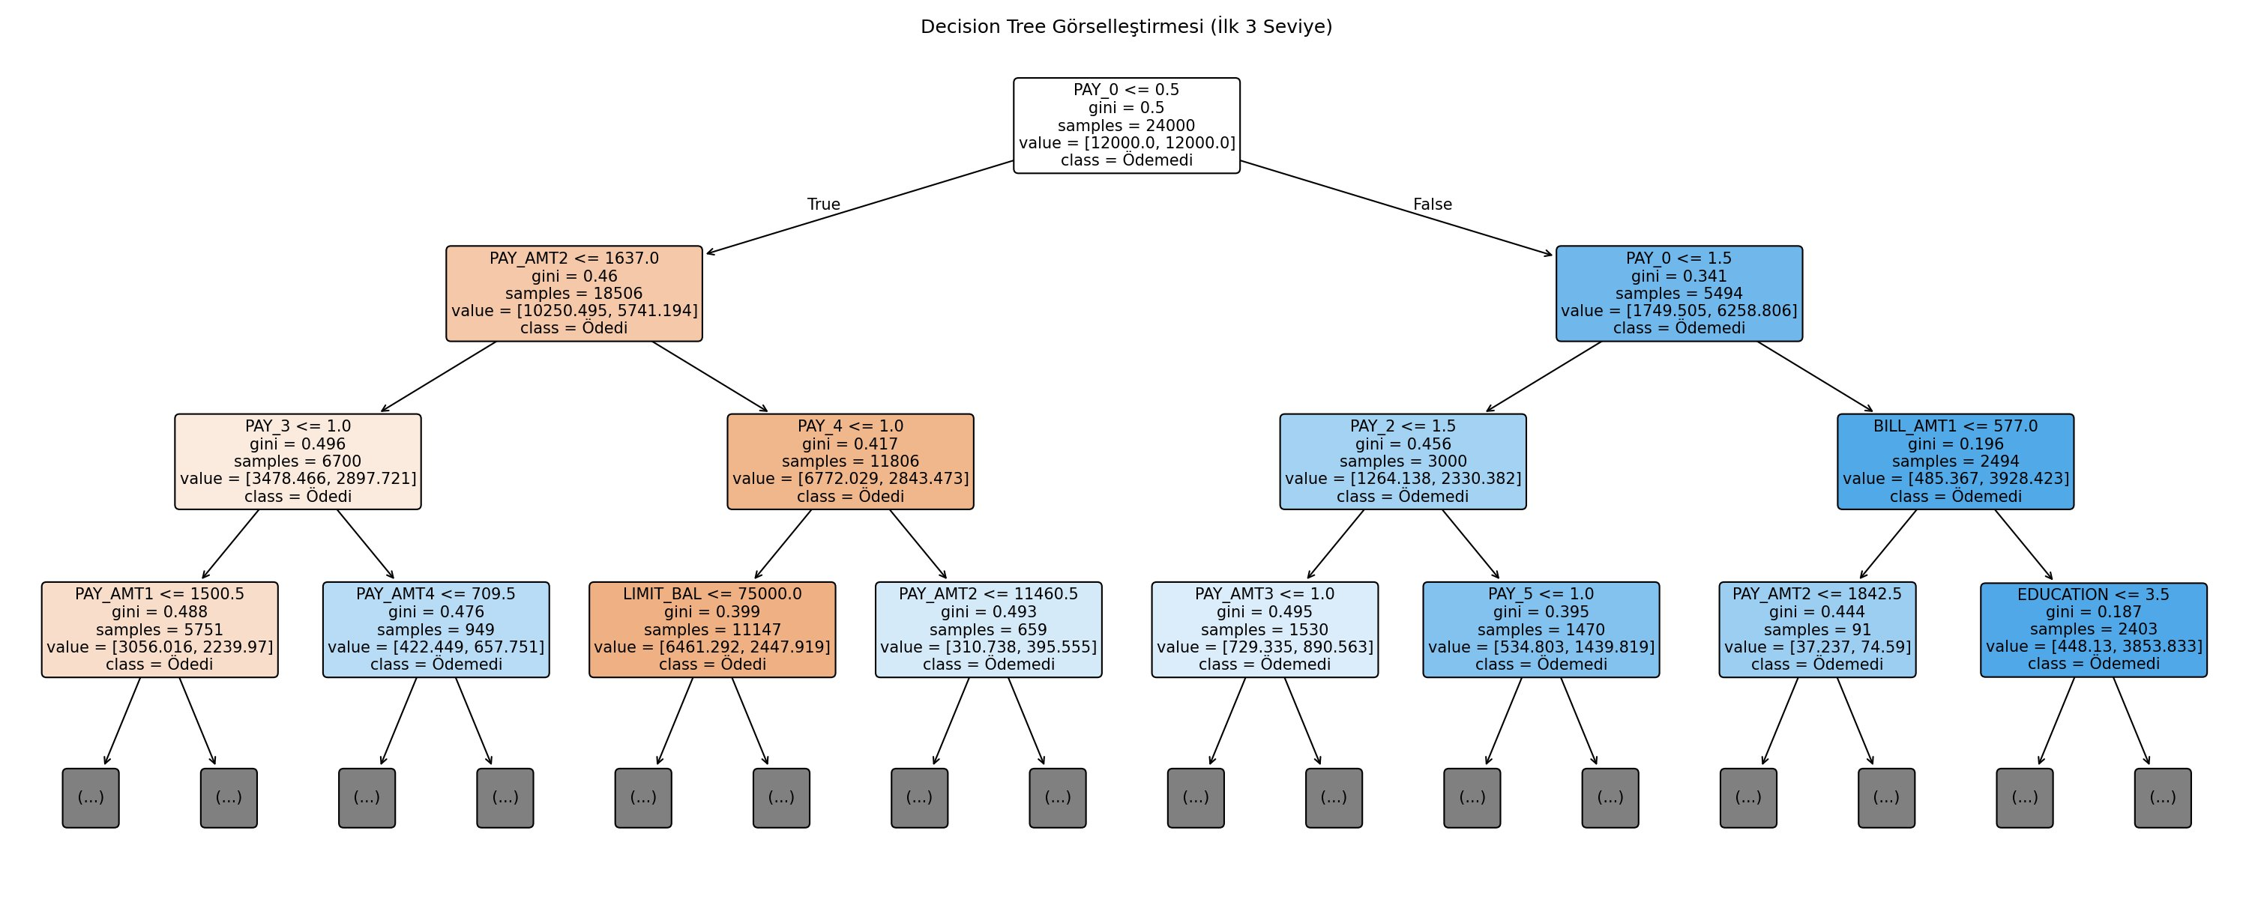
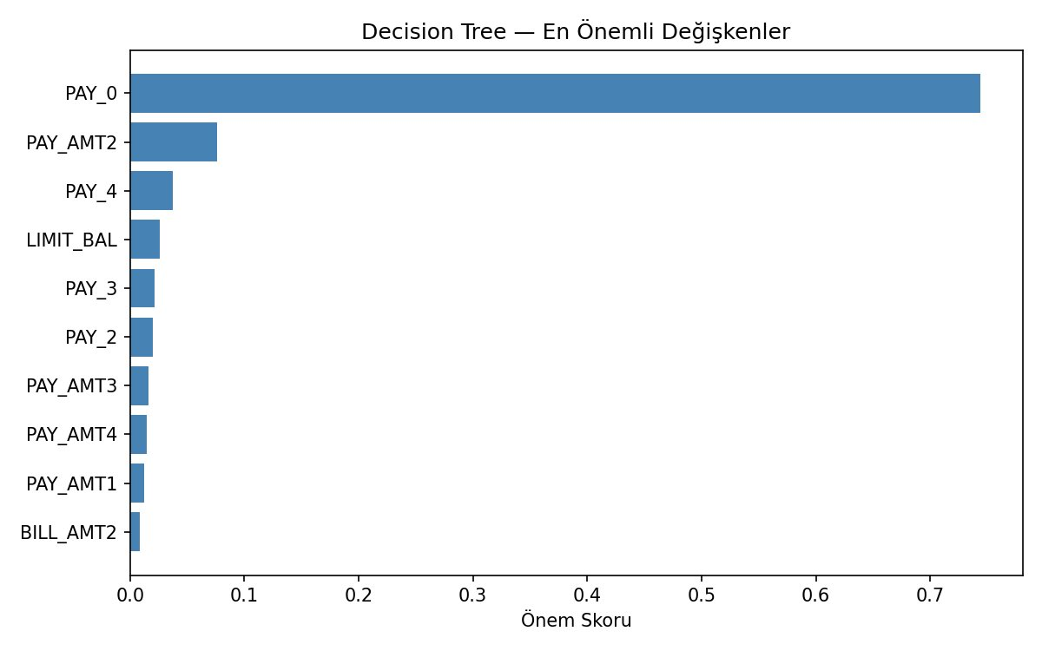
Decision Tree — Results
Karar Agaci Sonuclari | max_depth=5 | class_weight='balanced'
77.08%
0.7571
0.552
Accuracy | Dogruluk
ROC-AUC | Alan skoru
Recall | Duyarlilik
PAY_0 alone holds 74% feature importance → over-reliance on single variable (overfit risk) | Tek degiskene asiri bagimlilik

Slide 9
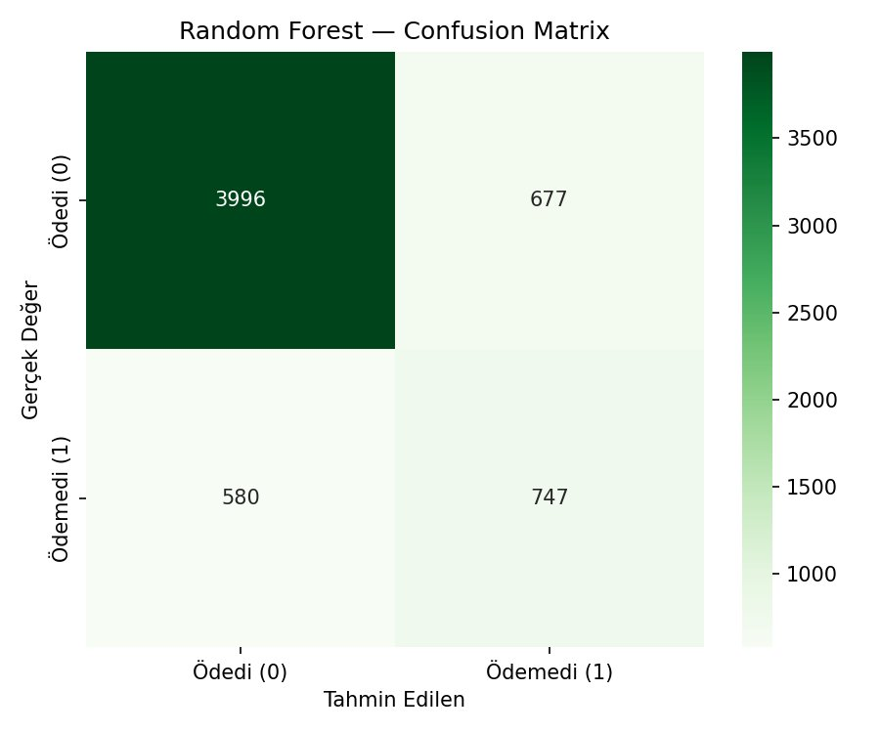
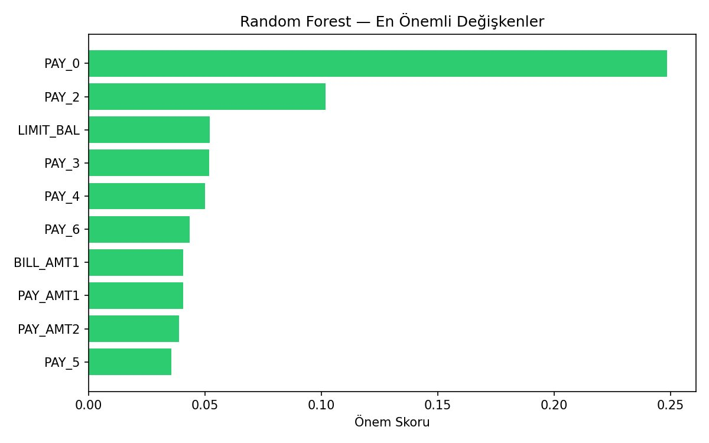
Random Forest — Results
Rastgele Orman Sonuclari | n_estimators=100 | max_depth=10 | class_weight='balanced'
79.05%
0.7737
0.563
Accuracy | Dogruluk
ROC-AUC | Alan skoru
Recall | Duyarlilik
PAY_0 importance dropped from 74% to 25% — load distributed across 100 trees | Agirlik 100 agaca dengeli dagildi

Slide 10
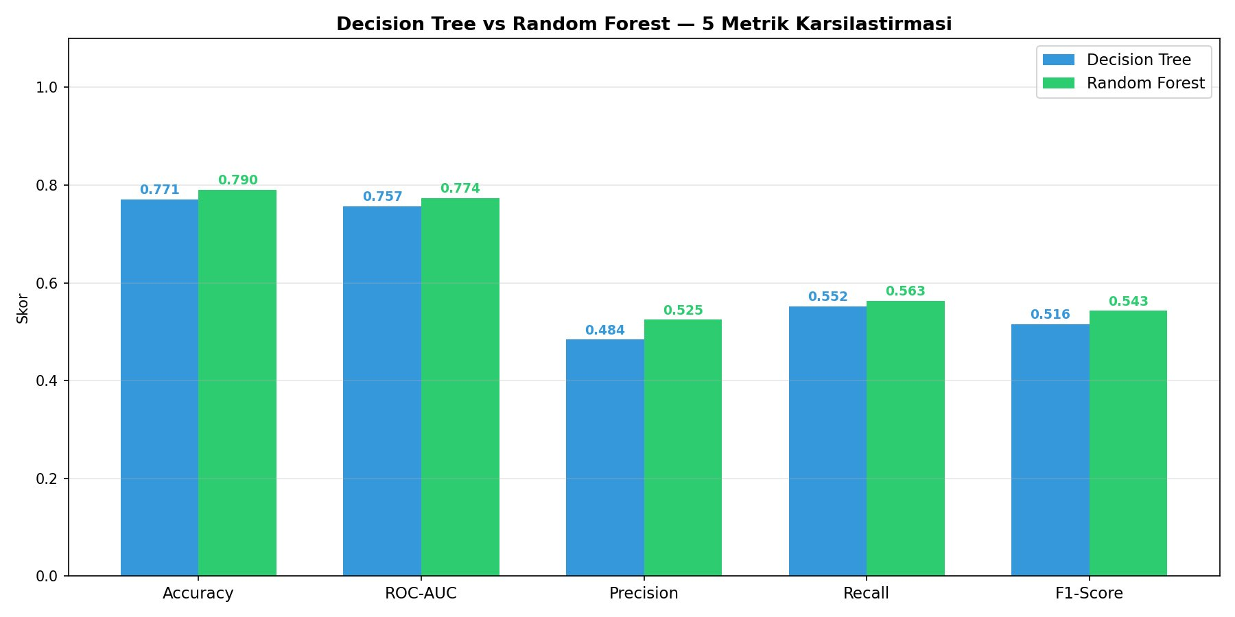
Model Comparison
Model Karsilastirmasi — 5 Metrics | 5 Metrik

Slide 11
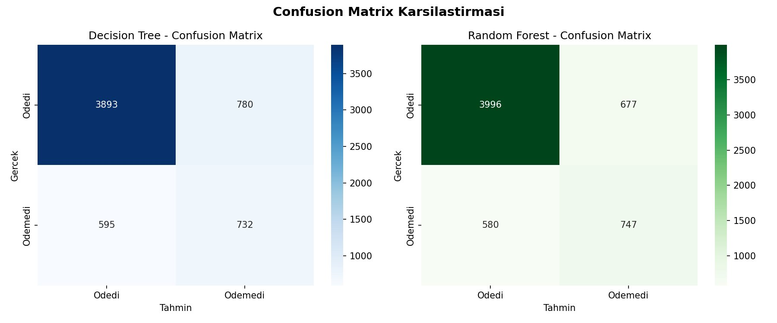
Model Comparison — Full Results
Metric | Decision Tree | Random Forest | Winner
Accuracy | %77.08 | %79.05 | Random Forest
ROC-AUC | 0.7571 | 0.7737 | Random Forest
Precision (1) | 0.484 | 0.525 | Random Forest
Recall (1) | 0.552 | 0.563 | Random Forest
F1-Score (1) | 0.516 | 0.543 | Random Forest
Missed Defaults | 595 | 580 | Random Forest

Slide 12
Conclusion
Winner: Random Forest
📈
Superior on all 5 metrics |
Accuracy 79.05% | ROC-AUC 0.7737 | F1 0.543
⚖️
Balanced feature importance | Dengeli degisken agirligi
PAY_0 weight dropped from 74% to 25% — load shared across 100 trees
🔒
Resistant to overfitting | Overfite dayanikli
Averaging 100 trees eliminates the instability of a single decision tree
🏦
Key banking insight |
Strongest predictor: PAY_0 (most recent payment delay)
Taha Yasin Demirci | 20212905022 | ACM 465 Artificial Intelligence

