Slide 1
Sleep Disorder Risk Prediction
Taha Yasin Demirci
20212905022
ACM 465 — Artificial Intelligence

Slide 2
Project Goal
Proje Hedefi
Problem Statement
Sorun Tanımı
Why Does It Matter?
Neden Önemli?
Can we predict a person's sleep disorder risk level based on their lifestyle, sleep habits, and health data?
Early detection of sleep disorders
Personalized health risk assessment
Actionable lifestyle insights
Real-world clinical decision support
Target Variable: sleep_disorder_risk → Healthy | Mild | Moderate | Severe
Multi-class Classification | Çok sınıflı sınıflandırma
100,000
32
4
Records
Kayıt
Features
Değişken
Classes
Sınıf

Slide 3
Why Supervised Classification?
Neden Denetimli Sınıflandırma?
🏷️
Labeled Data Available
🎯
Multi-class Target
Etiketli veri mevcut
Çok sınıflı hedef
Every record has a known risk level. Supervised learning requires labeled data — and we have 100,000 labeled examples.
Target has 4 discrete classes: Healthy, Mild, Moderate, Severe. This is classification, not regression.
📊
Not Clustering
✅
Measurable Performance
Clustering değil
Ölçülebilir başarı
We know exactly what we want to predict. Unsupervised methods like K-Means cannot optimize for a known label.
Supervised classification lets us measure Accuracy, F1, Precision, Recall against true labels.

Slide 4
Dataset Overview
Veri Seti Genel Bakış
100,000
32
NONE
4
Records
Kayıt
Features
Değişken
Missing Data
Eksik Veri
Classes
Sınıf
Group | Columns | Description
Personal | age, gender, occupation, country, bmi | Demographic information
Sleep Metrics | sleep_duration_hrs, sleep_quality_score, rem_percentage, deep_sleep_percentage | Core sleep measurements
Sleep Issues | sleep_latency_mins, wake_episodes_per_night, nap_duration_mins | Sleep disruption indicators
Lifestyle | caffeine, alcohol, screen_time, exercise_day, steps_that_day | Daily habits before bed
Health | stress_score, heart_rate_resting_bpm, mental_health_condition, bmi | Health & psychological state
Target | sleep_disorder_risk | Healthy | Mild | Moderate | Severe

Slide 5
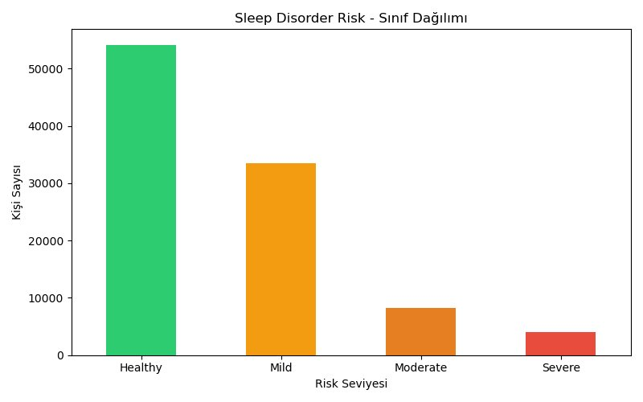
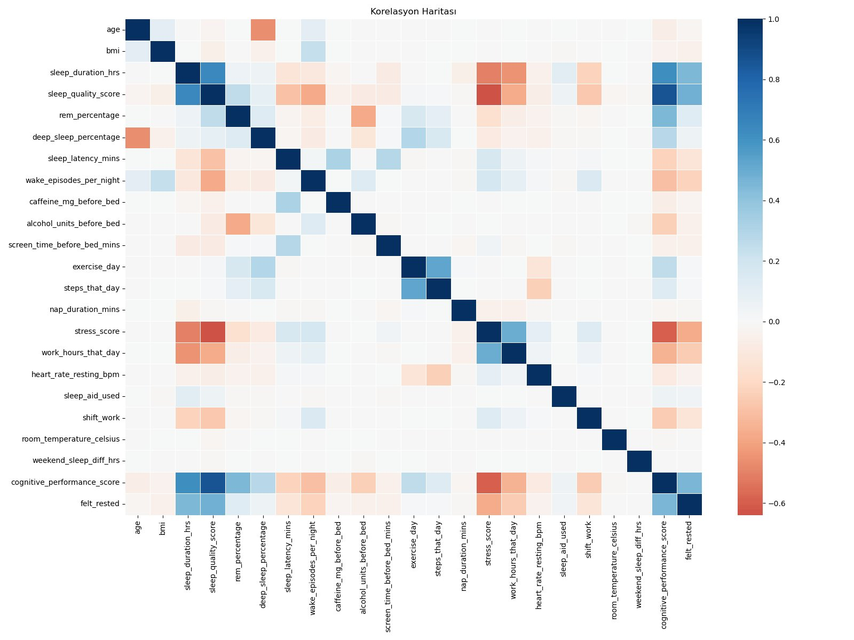
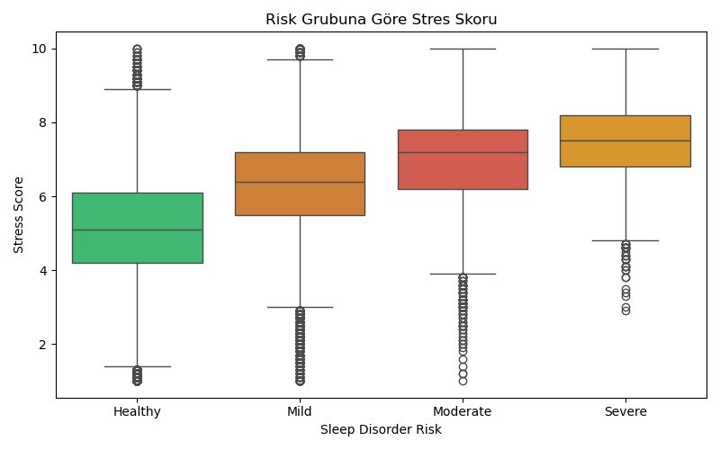
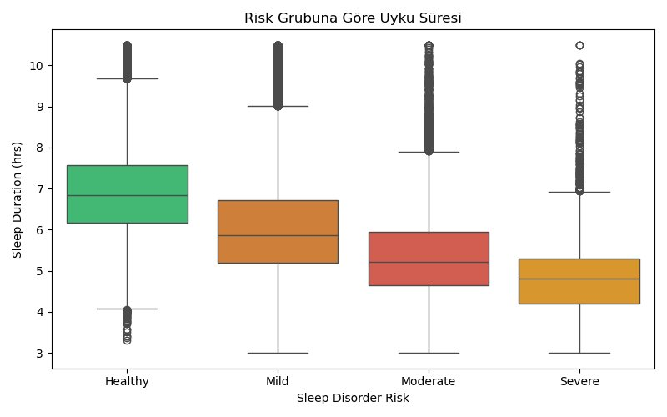
Exploratory Data Analysis (EDA)
Keşifsel Veri Analizi

Slide 6
Data Preprocessing
Veri Ön İşleme
1
ID Column Removed | person_id sütunu kaldırıldı
person_id has no predictive value → df.drop('person_id')
2
Label Encoding | Kategorik encoding
Categorical columns encoded with LabelEncoder (gender, occupation, country, chronotype, mental_health_condition, season, day_type)
3
X and Y Separated | X ve Y ayrıldı
X → 30 independent features | Y → sleep_disorder_risk (4 classes)
4
Train-Test Split 80% / 20% | Eğitim-test bölme
80,000 training samples | 20,000 test samples | random_state=42
5
No Feature Scaling Applied | Ölçeklendirme uygulanmadı
Decision Tree & Random Forest are tree-based → feature scale does not affect split decisions

Slide 7
Model Selection
Model Seçimi | Supervised Learning → Multi-class Classification
🌳 Decision Tree
🌲 Random Forest
Single interpretable tree
Visualizable structure (dt_agac_gorseli.png)
Fast to train
Risk of overfitting
Baseline for comparison
max_depth=5
Ensemble of 100 decision trees
Averages predictions → more stable
Resistant to overfitting
Higher predictive power
Extends Decision Tree logic
n_estimators=100
VS
Both are tree-based models — no feature scaling required | İkisi de ağaç tabanlıdır, ölçeklendirme gerekmez

Slide 8
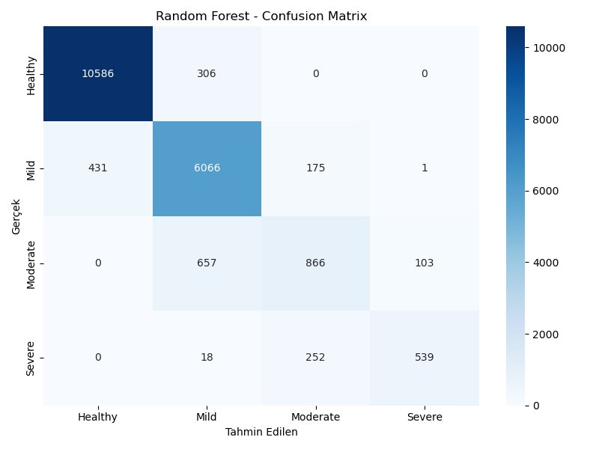
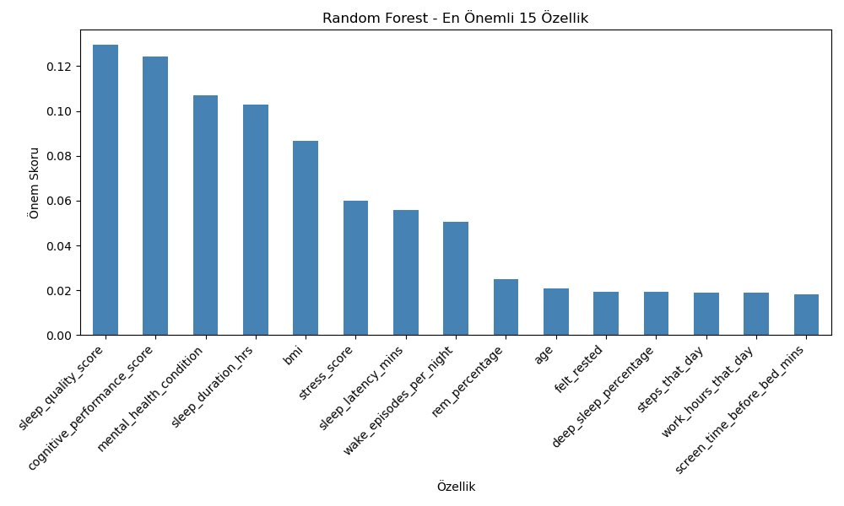
Random Forest — Results
Rastgele Orman Sonuçları | n_estimators=100 | max_depth=None
90.29%
0.8989
0.9029
0.8996
Accuracy
Doğruluk
Precision
Kesinlik
Recall
Duyarlılık
F1 Score
F1 Skoru

Slide 9
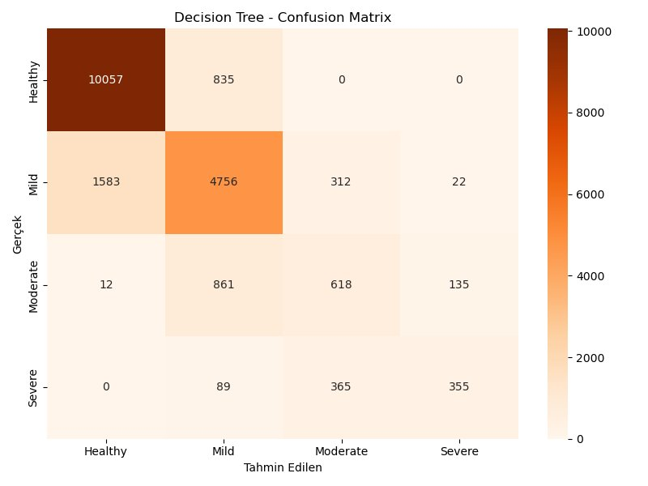
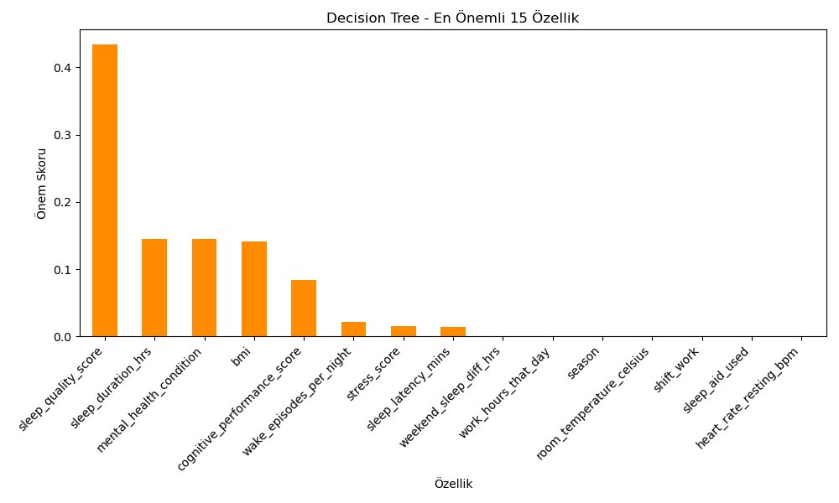
Decision Tree — Results
Karar Ağacı Sonuçları | max_depth=5
78.93%
0.7795
0.7893
0.7822
Accuracy
Doğruluk
Precision
Kesinlik
Recall
Duyarlılık
F1 Score
F1 Skoru

Slide 10
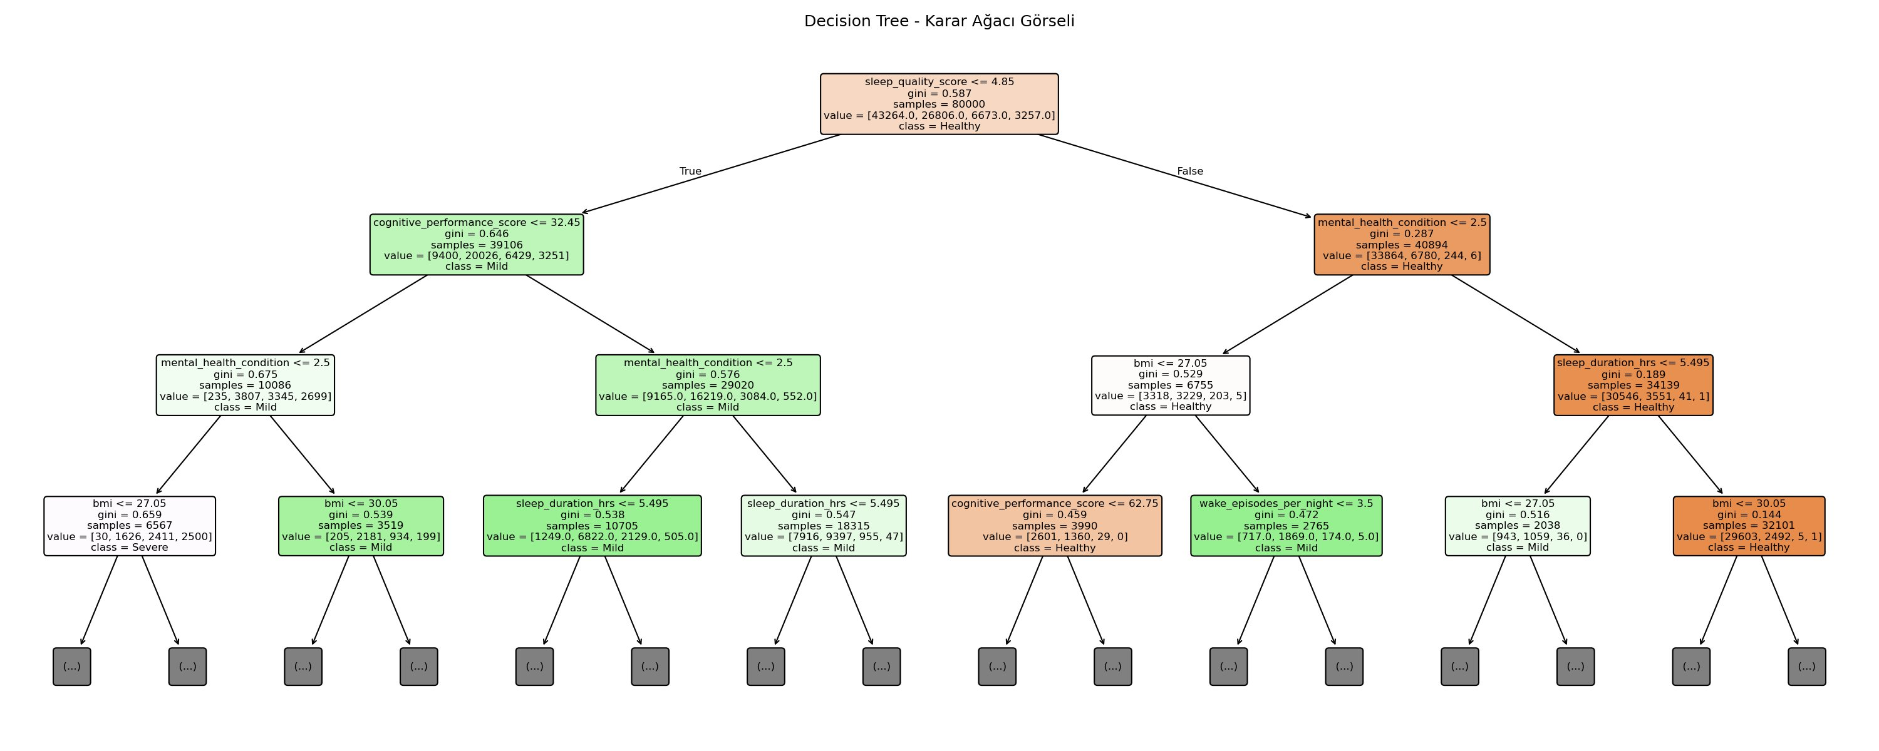
Decision Tree — Visual Structure
Karar Ağacı Görsel Yapısı | max_depth=3 (görsel için)
Root split: sleep_quality_score ≤ 4.85 | En güçlü ayırıcı değişken

Slide 11
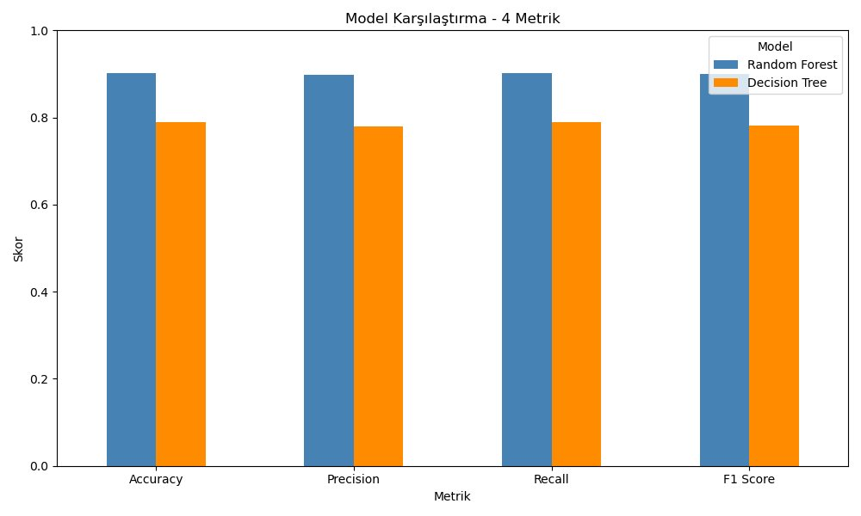
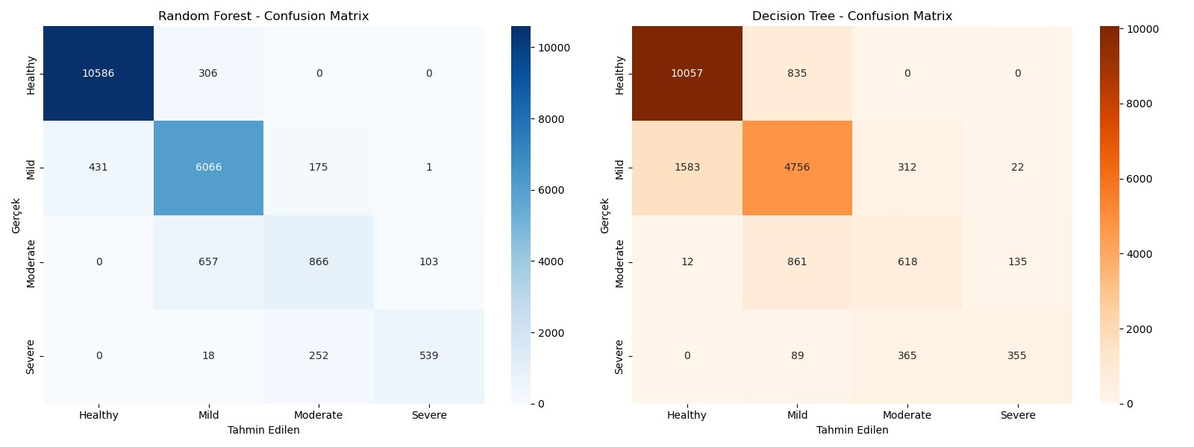
Model Comparison
Model Karşılaştırması — 4 Metrics | 4 Metrik
Metric | Decision Tree | Random Forest | Winner
Accuracy | %78.93 | %90.29 | 🏆 Random Forest
Precision | 0.7795 | 0.8989 | 🏆 Random Forest
Recall | 0.7893 | 0.9029 | 🏆 Random Forest
F1 Score | 0.7822 | 0.8996 | 🏆 Random Forest

Slide 12
Conclusion
Winner: Random Forest — 90.29% Accuracy
Superior on all 4 metrics
Accuracy 90.29% | F1 0.8996 | Precision 0.8989 | Recall 0.9029
Balanced feature importance | Dengeli değişken ağırlığı
sleep_quality_score, cognitive_performance_score, mental_health_condition are top predictors
Resistant to overfitting | Overfite dayanıklı
Averaging 100 trees eliminates the instability of a single decision tree
Key insight | Temel bulgu
sleep_quality_score is the strongest predictor of sleep disorder risk across both models
Taha Yasin Demirci | 20212905022 | ACM 465 Artificial Intelligence

