Slide 1

LOK SABHA
Insights from the 2014 & 2019 Elections
Presented by: Mohamed Taha

Slide 2
Contents
Project Overview
Data Overview
Voter Turnout Ratio
Parties Analysis
Constituencies Analysis
Candidates’ Analysis

Slide 3
Project Overview
ATLIQ Media is a private media company and they wanted to telecast a show on Lok Sabha elections 2024 in India. Unlike other channels they do not want to have a debate on who is going to win this election, they rather want to present insights from the 2014 and 2019 elections without any bias and discuss less explored themes like voter turnout percentage in India

Slide 4
Data Overview
Geo:
State name, PC name, total electors
Individual Participants:
Candidate name, sex, age, category
Political Parties Involved:
Party name, party symbol
Votes Gained:
General votes, postal votes, total votes
Total Votes
Voter Turnout Ratio
100
Total Electors

Slide 5

Voter Turnout Ratio
Statistical comparison between 2014 and 2019
list the top/bottom 5 constituencies of 2014 and 2019 in terms of voter turnout ratio.
list the top/bottom 5 states of 2014 and 2019 in terms of voter turnout ratio.

Slide 6
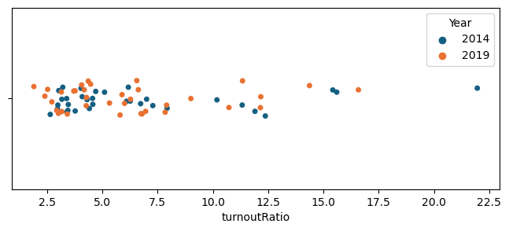
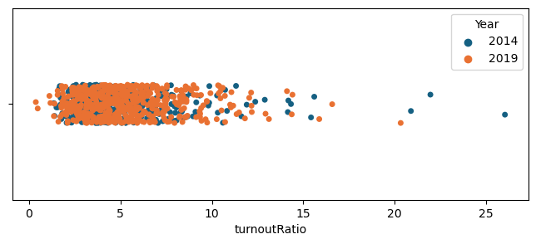
States
Very low voter turnout ratio over states and constituencies.
95% of the numbers fall below 10% for constituencies with a mean value near to 5%.
95% of the numbers fall below 15% on a state level with an average of 6.5%.
Constituencies

Slide 7
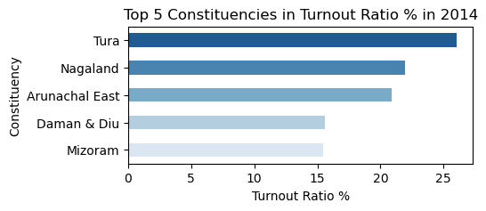
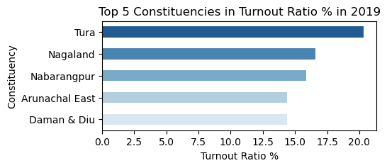
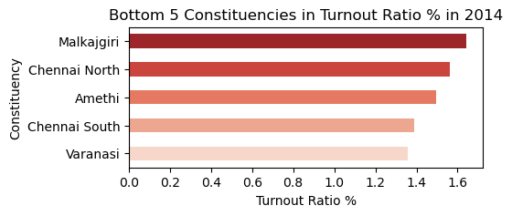
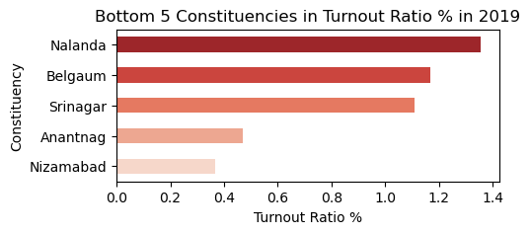
list the top/bottom 5 constituencies of 2014 and 2019 in terms of voter turnout ratio.
2014
2019

Slide 8
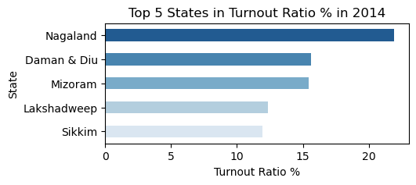
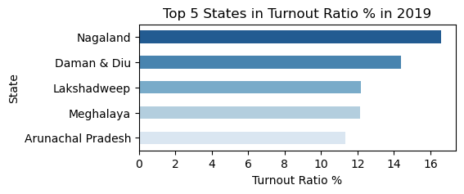
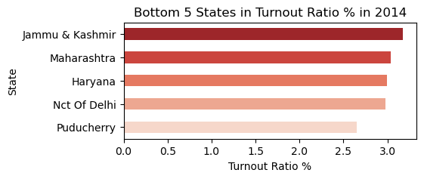
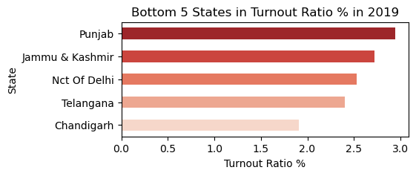
list the top/bottom 5 states of 2014 and 2019 in terms of voter turnout ratio.
2014
2019

Slide 9

Constituencies Analysis
which constituencies have elected the same party for two consecutive elections rank them by % of votes to that winning party in 2019
which constituencies have voted for different parties in two elections(list top 10 based on difference 19 - 14 in winner vote perc.
which constituencies have elected candidates whose party has less than 10% vote share at state level in 2019
list the top 5 constituencies for two major national parties where they have gained vote share in 2019 as compared to 2014
list the top 5 constituencies for two major national parties where they have lost vote share in 2019 as compared to 2014
Which constituencies voted most for NOTA?

Slide 10
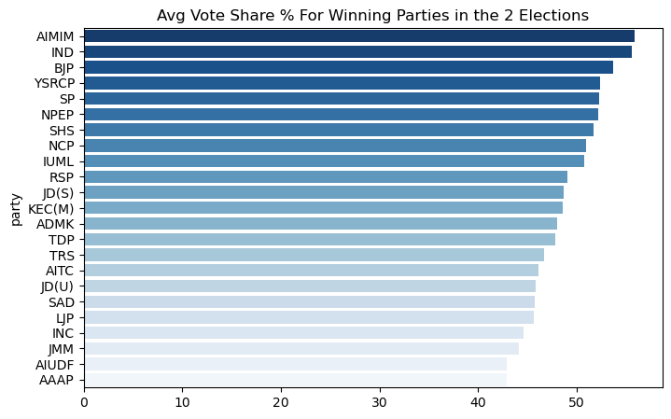
which constituencies have elected the same party for two consecutive elections rank them by % of votes to that winning party in 2019
543
505
332
173
2 Elections
Same
Party
Different
Party
Almost 61% of the seats were taken by these 23 parties for the last two periods with an average vote share between 40% and 60% of their constituencies.

Slide 11
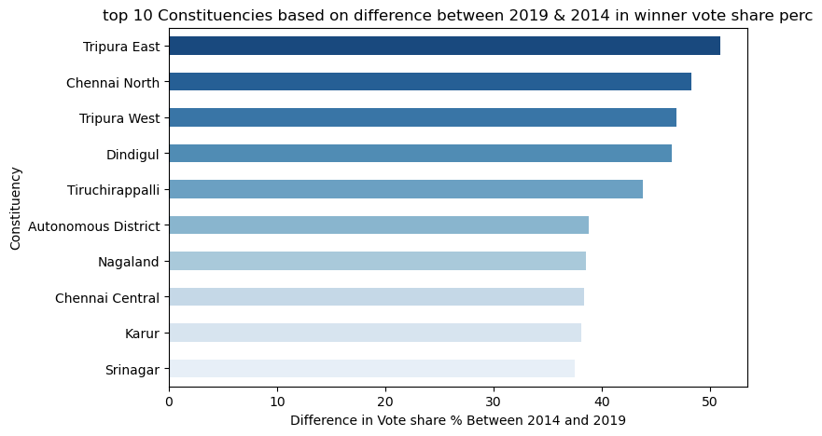
which constituencies have voted for different parties in two elections(list top 10 based on difference 19 - 14 in winner vote perc.
543
505
332
173
2 Elections
Same
Party
Different
Party
41 parties took these 173 seats in the 2019 round with an increase in their vote share by 40% to 50% compared to theirs in 2014.

Slide 12
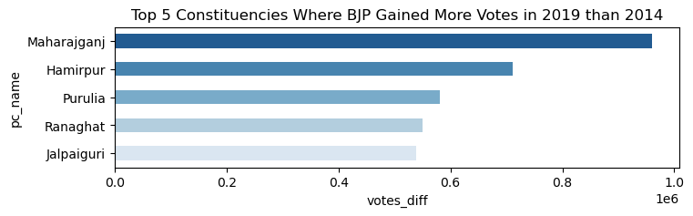
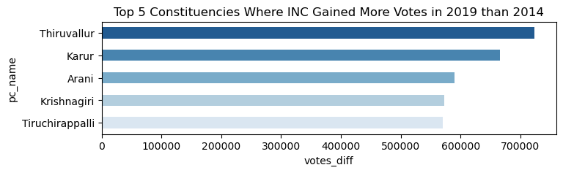
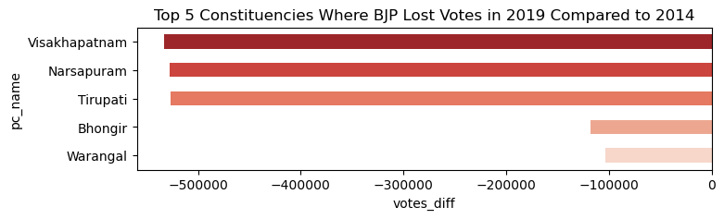
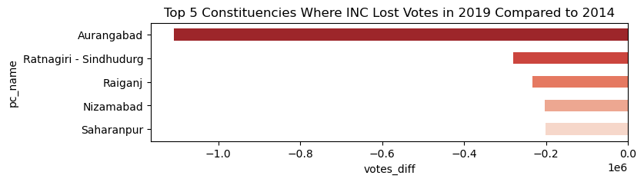
list the top 5 constituencies for two major national parties where they have gained/lost vote share in 2019 as compared to 2014
BJP
INC

Slide 13
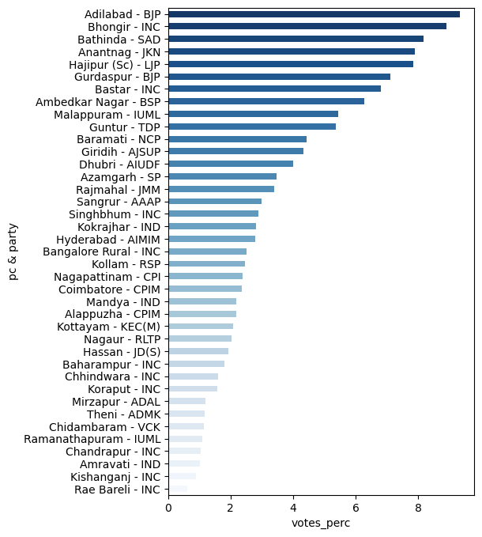
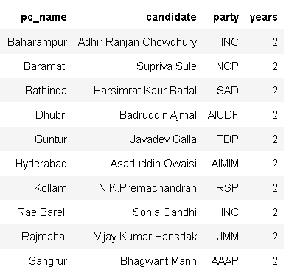
which constituencies have elected candidates whose party has less than 10% vote share at state level in 2019
39 constituencies voted for candidates while their parties got less than 10% vote share on a state level and 10 of these candidates won in the 2 rounds

Slide 14
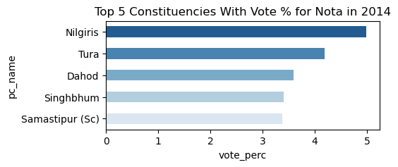
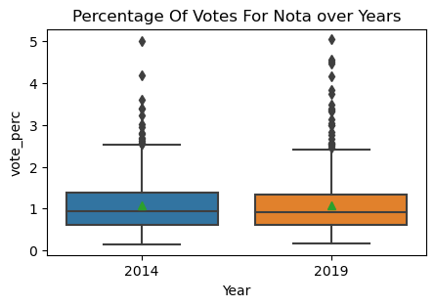
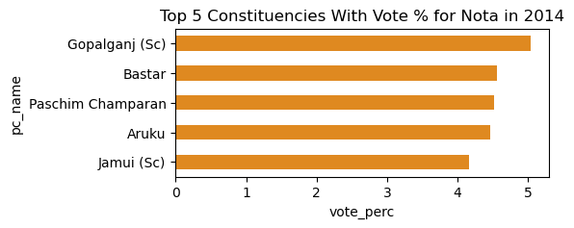
Which constituencies voted most for NOTA?
The average vote share for Nota usually would be 1% but in these constituencies, it hiked up to 5%

Slide 15

Parties Analysis
% split of votes of parties between 2014 vs 2019 at national level
% split of votes of parties between 2014 vs 2019 at state level
Does the number of members increase the chance of winning?
Top/Bottom 5 Shifts in Vote Share % on National Level
Top/Bottom 5 Shifts in Vote share % on State Level

Slide 16
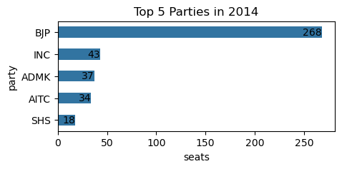
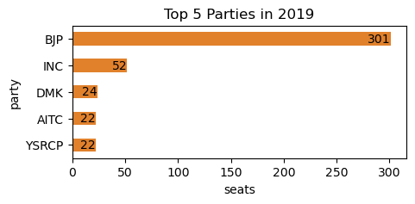
Number Of Seats Between Parties
BJP is Getting More And More Popular, It Got 50% of The Seats in 2014 And 55% in 2019.

Slide 17
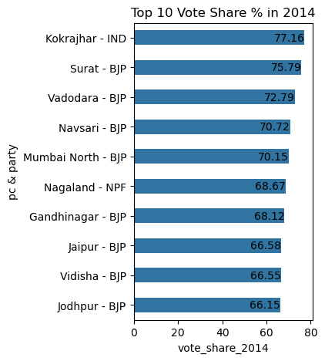
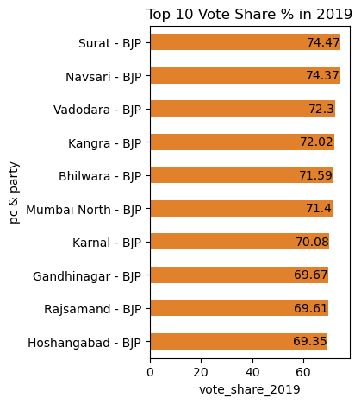
% split of votes of parties between 2014 vs 2019 at a national level
With 55% Of The Seats in 2019, It Does Make Sense That BJP takes the Top 10 Vote Share Values.
In 2014 IND Took The Highest Scored Vote Share, But It Will Lose It in The next Round as We Will See.

Slide 18
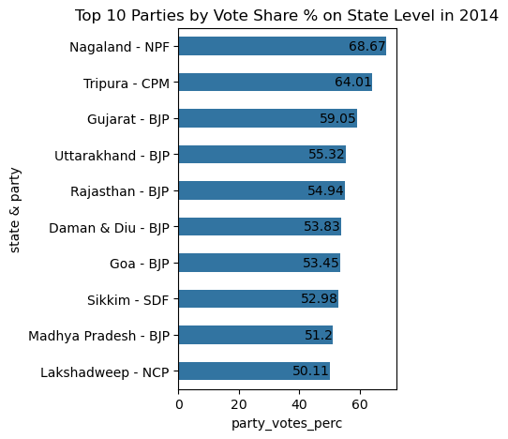
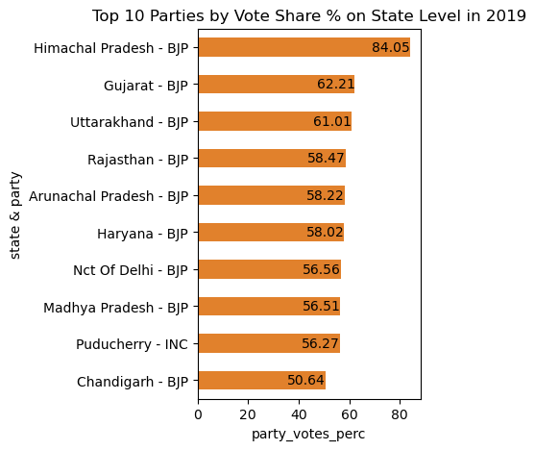
% split of votes of parties between 2014 vs 2019 at state level

Slide 19
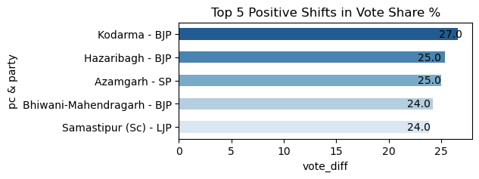
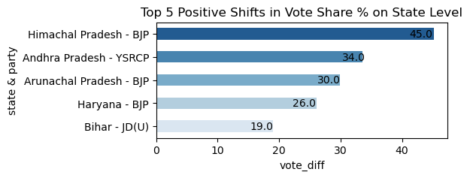
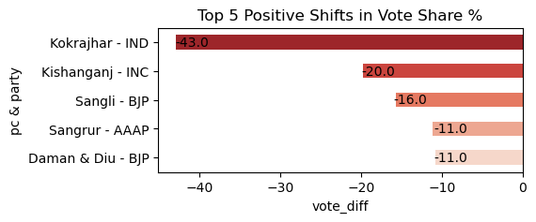
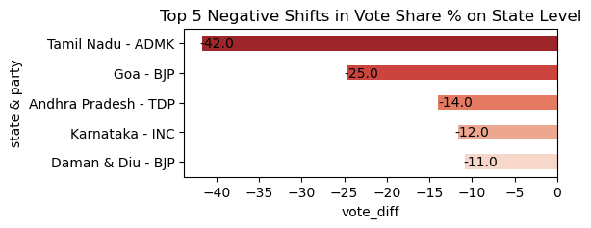
Top/Bottom 5 Shifts in Vote Share % on National & State Levels
National Level
State Level

Slide 20
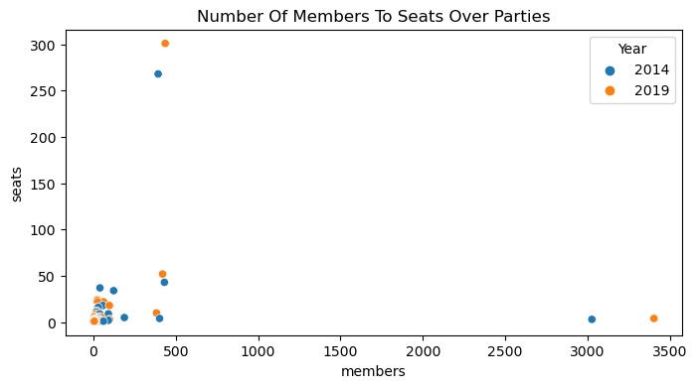
Does the number of members increase the chance of winning?
Seeing That Some Parties Got Up To 3500 Members and Only Won 3 or 4 Seats, There is no correlation here.

Slide 21

Candidates Analysis
top 5 candidates based on margin difference with runners in 2014 and 2019
Split winners by Gender
Which candidates participated in the 2 rounds?

Slide 22
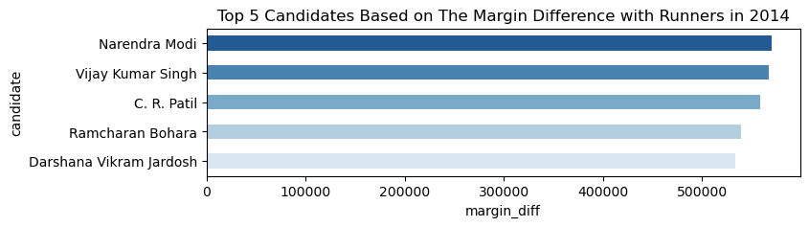
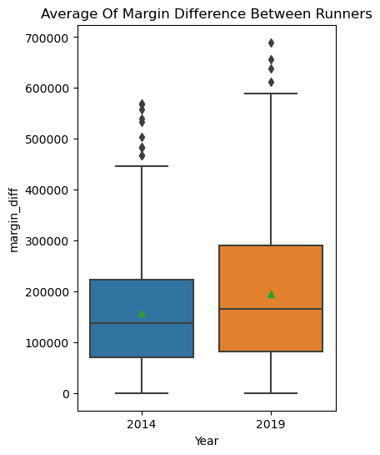
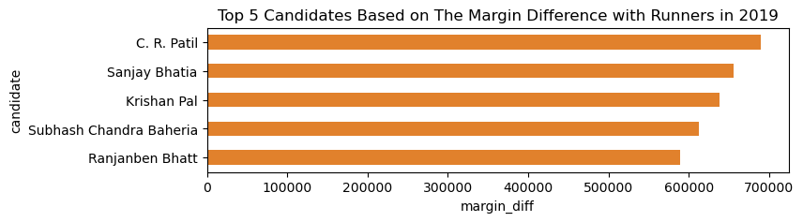
Top 5 candidates based on margin difference with runners in 2014 and 2019

Slide 23
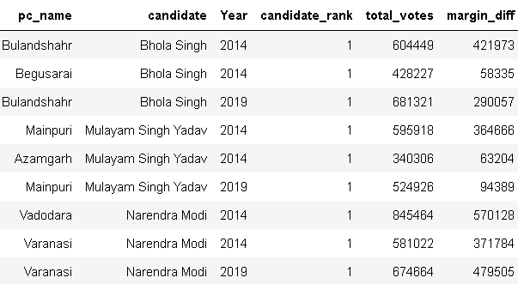
Which candidates participated in the 2 rounds?
14,548
All Candidates
825
Two Elections
129
Actually Won
Only 129 Candidates Won In The 2 Rounds and 3 Of Them Got The Highest Votes In 2 Different PCs In 2014.

Slide 24
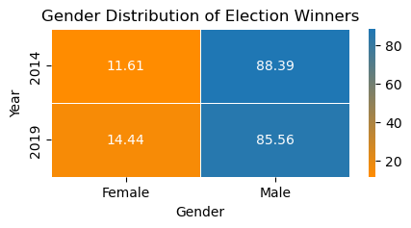
Split winners by Gender
We have more Females in 2019 by 3% compared to 2014

Slide 25
Thanks

