Slide 1
Potential Crime Type Prediction
Taha Mert Ağım 211101071
BIL470

Slide 2

Introduction
Our purpose is to predict potential crime type on a particular time series, in a particular place
Generally time and place features are used
Implemented in Python on the platform of Jupyter Notebook
VSCode is used as IDE

Slide 3
Methods to Use (Method 1)
In this method, we used traditional Machine Learning models
Those models are: Random Forests (RF), KNN (K-Nearest Neighbor), XGBoost (Boosting), Naïve Bayes and MLP (Multi-Layer Perceptron)
This method includes
Daily summary making
Time series production (There’s a window size)
Rare Filtering (Significantly important, depending on distributions in dataset)
Training
Testing
Evaluation (Metrics + Confusion Matrix)

Slide 4
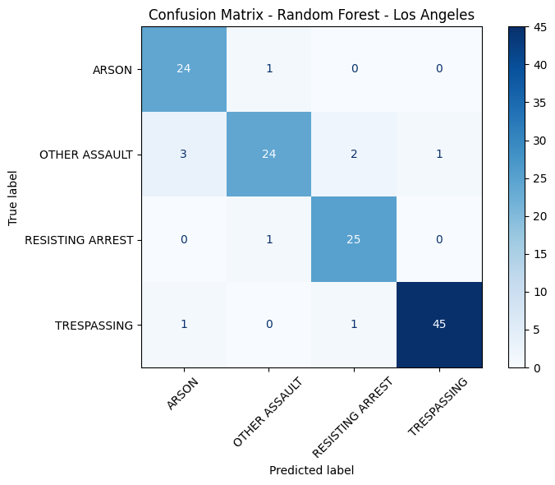
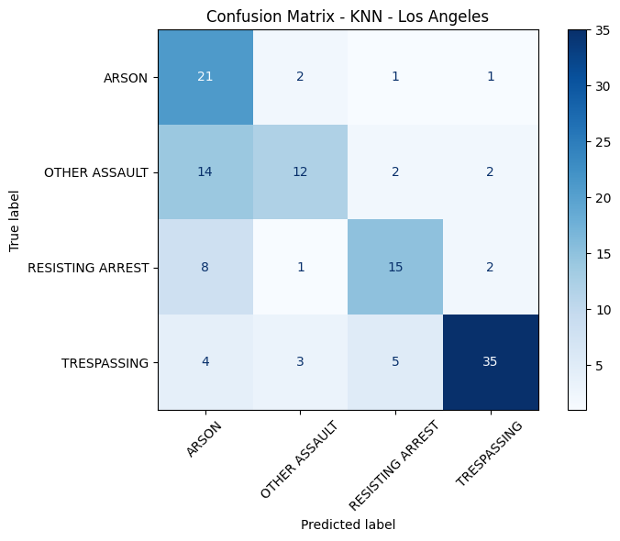
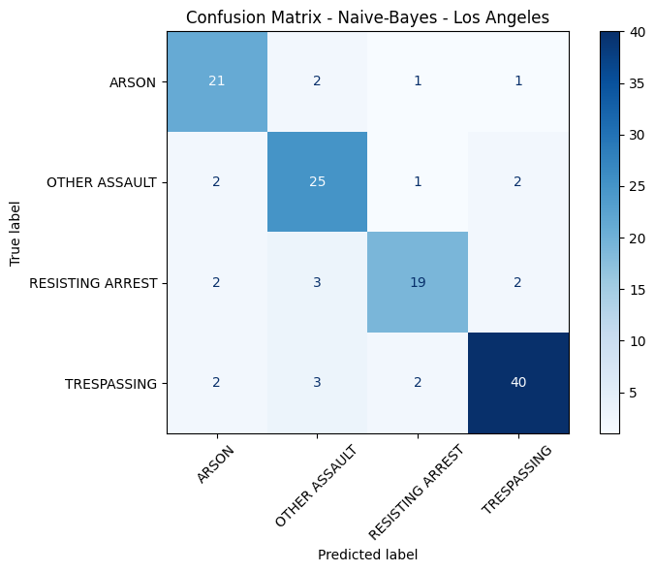
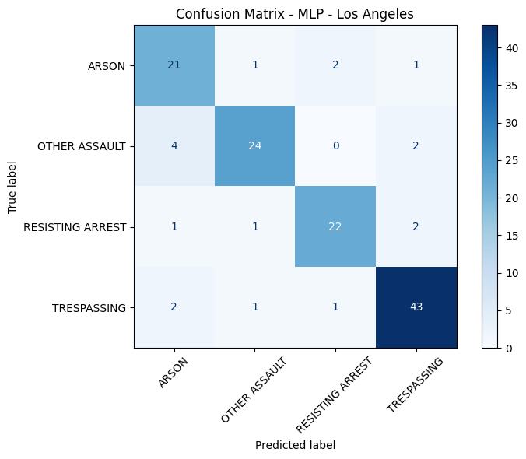
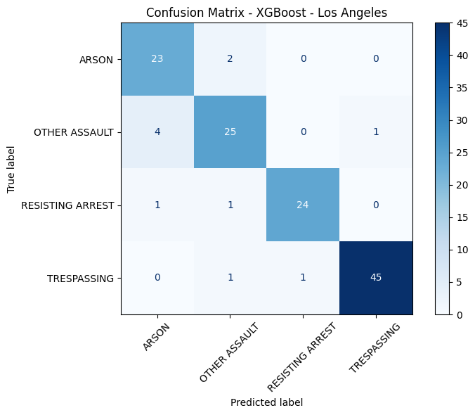
==== Random Forest ====
Accuracy: 0.921875
==== KNN ====
Accuracy: 0.6484375
==== Naive-Bayes ====
Accuracy: 0.8203125
==== XGBoost ====
Accuracy: 0.9140625
==== MLP ====
Accuracy: 0.859375

Slide 5
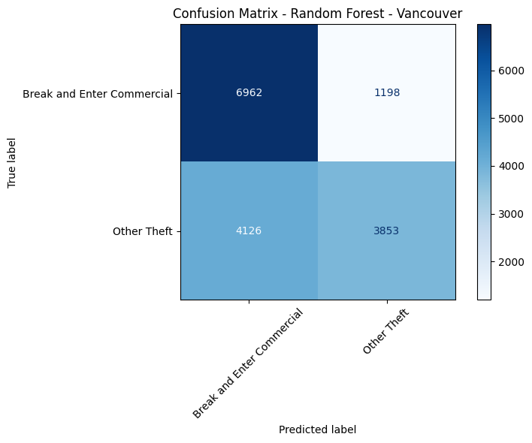
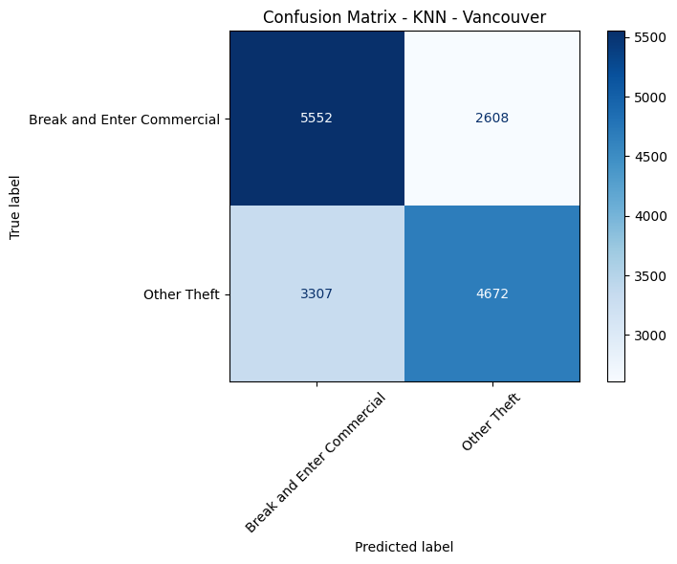
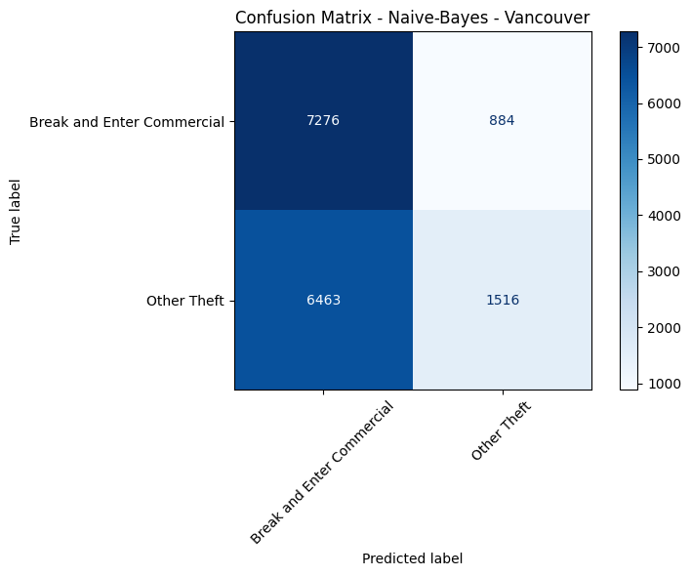
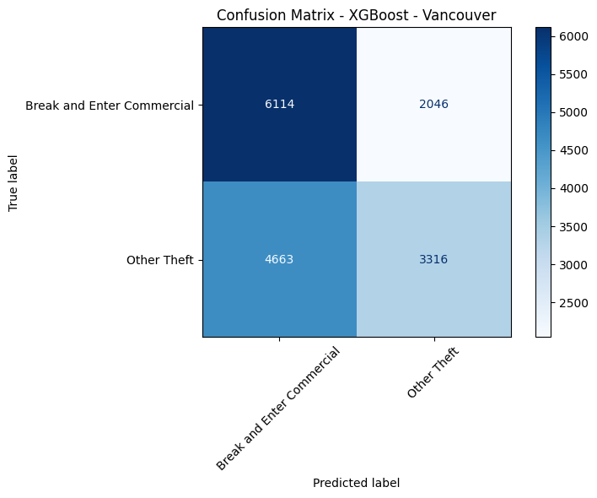
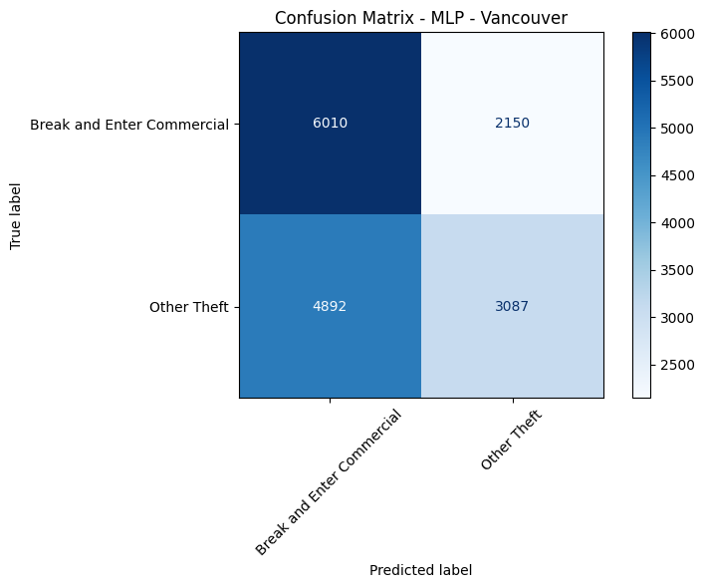
==========Random Forest=========== Accuracy: 0.6701158683933329
==========KNN===========
Accuracy: 0.6334964991635169
==========Naïve-Bayes===========
Accuracy: 0.5447673337877192
==========XGBoost===========
Accuracy: 0.5842989032777743
==========MLP===========
Accuracy: 0.5636656546254415

Slide 6
Methods to Use (Method 2)
In this method we used RNN (LSTM has been used)
The steps used in 1st Method are used too. (Time series building, rare filtering etc)

Slide 7
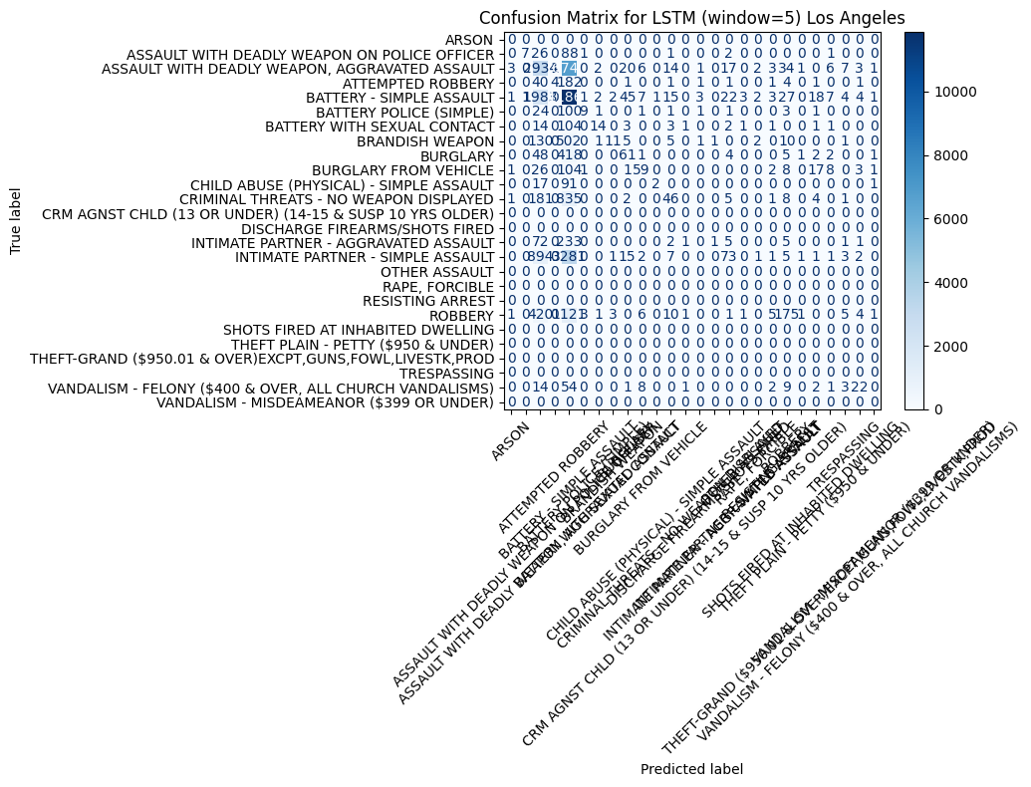
Window size as 5 is used but it can be changed in the test
Accuracy: 0.4550

Slide 8
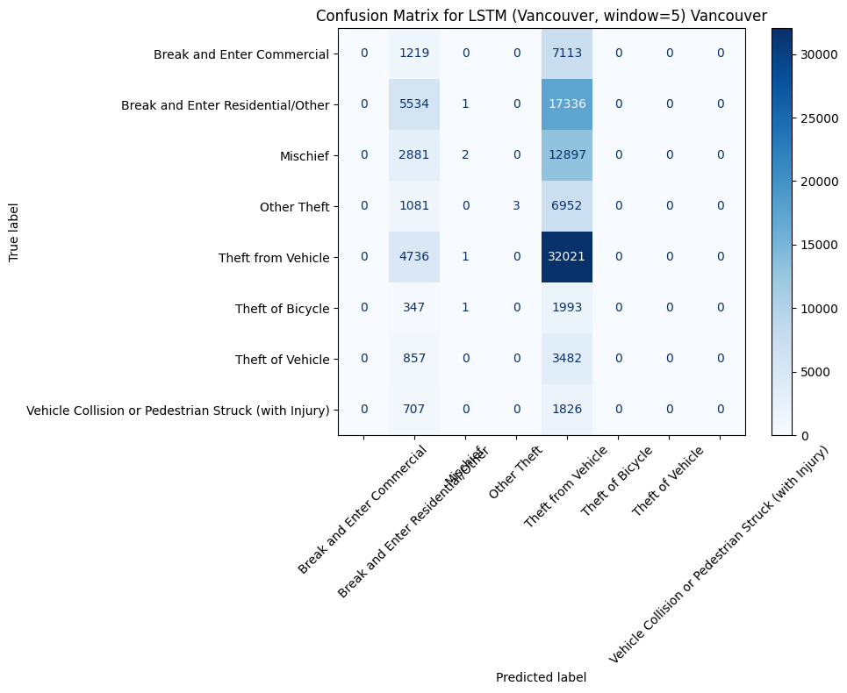
Window size as 5 is used but it can be changed in the test
Accuracy : 0.3719

Slide 9
Thanks For Listening

