Slide 1
Empirical evidence & analysis of a critical pitfall in RLHF
Taha Shaheen, Stephen West, Yu Zhang

Slide 2

Reward is difficult to write
$$R$$

Slide 3

Reward is difficult to write
$$R$$

Slide 4

Reward is difficult to write
$$R$$

Slide 5
Reward is difficult to write
$$R$$

Slide 6

Reward is difficult to write
$$R$$
Notes:
Stealing the coffee
Needs to be mentioned

Slide 7

Reward Learning with Human feedback
Learned
Reward
$$\hat{R}$$
Behaviour
Feedback
Feedback Provider
Learner

Slide 8
Reward Learning with Human feedback
Pairwise Preferences
Corrective Interventions
Expert Demonstrations

Slide 9


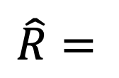

Reward Learning with Human feedback
$$T$$
$$R$$
$$\hat{R}=$$
Behaviour
$$T$$
Feedback
Feedback Provider
Learner

Slide 10



Reward Learning with Human feedback
Stealing $∉T$
$$R$$
$$\hat{R}=$$
$$+$$
Stealing
Behaviour
$$\text{Stealing }∈T$$
Feedback
Feedback Provider
Learner

Slide 11
Does perturbed dynamics understanding impact feedback?
(1) Prime
(2) Manipulate
(3) Keep & Measure

Slide 12


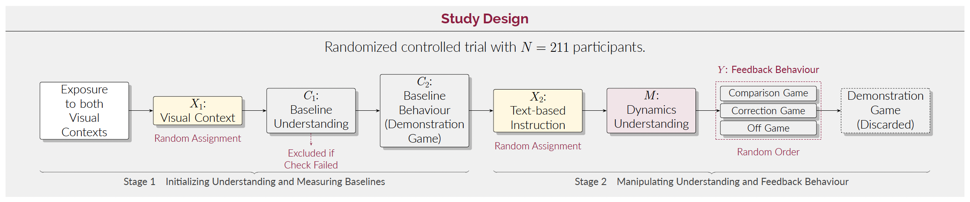
Experiment design
211 participants

Slide 13
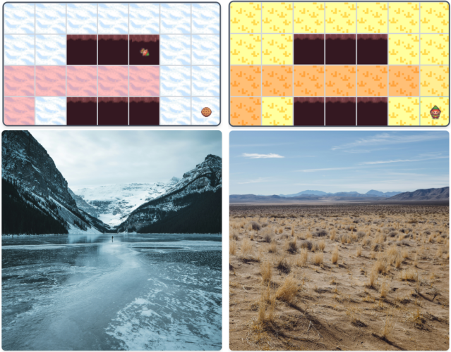
Experiment design (PRIME)
Visual Exposure

Slide 14
Experiment design (PRIME)
Visual Exposure
Icy
Grassy
True Dynamics

Slide 15
Experiment design (Manipulate)
Visual Exposure
Icy
Danger
Safe
Grassy
Danger
True Dynamics
Believed
Dynamics
Safe
Instructional Framing

Slide 16
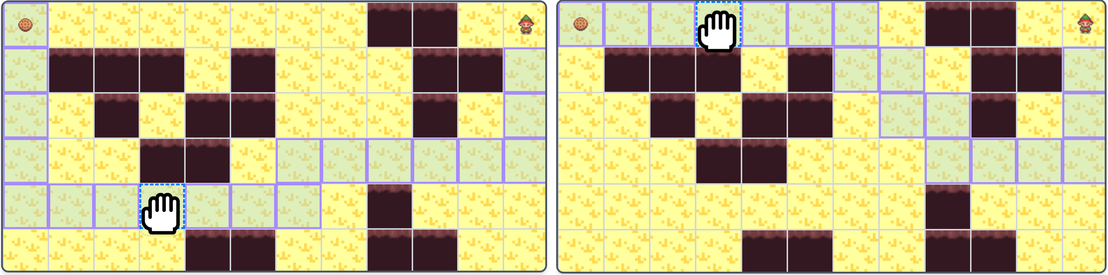
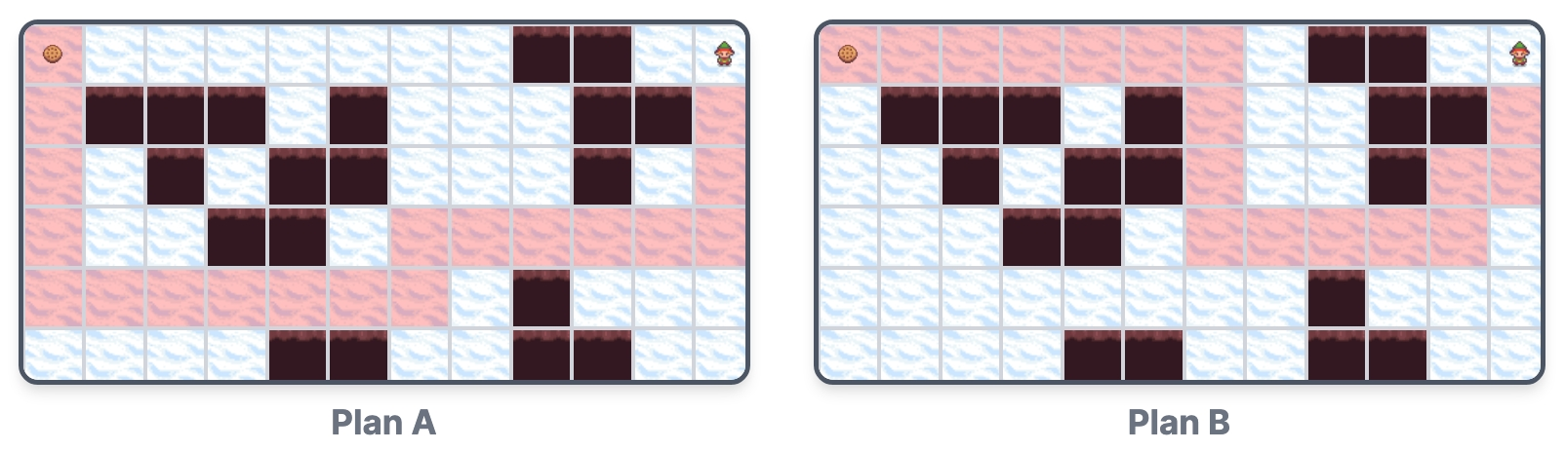
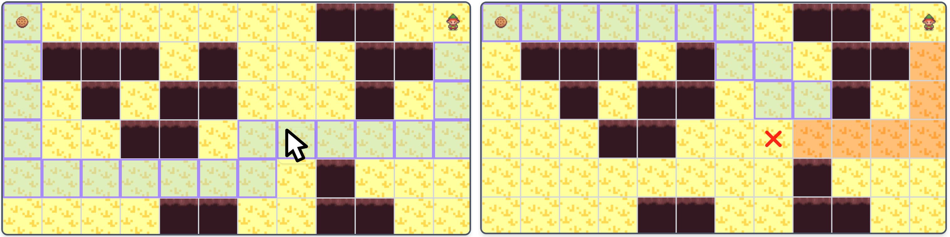
Experiment design (Keep & Measure)
Corrective Intervention
Pairwise Preferences
Off-button-style Intervention

Slide 17
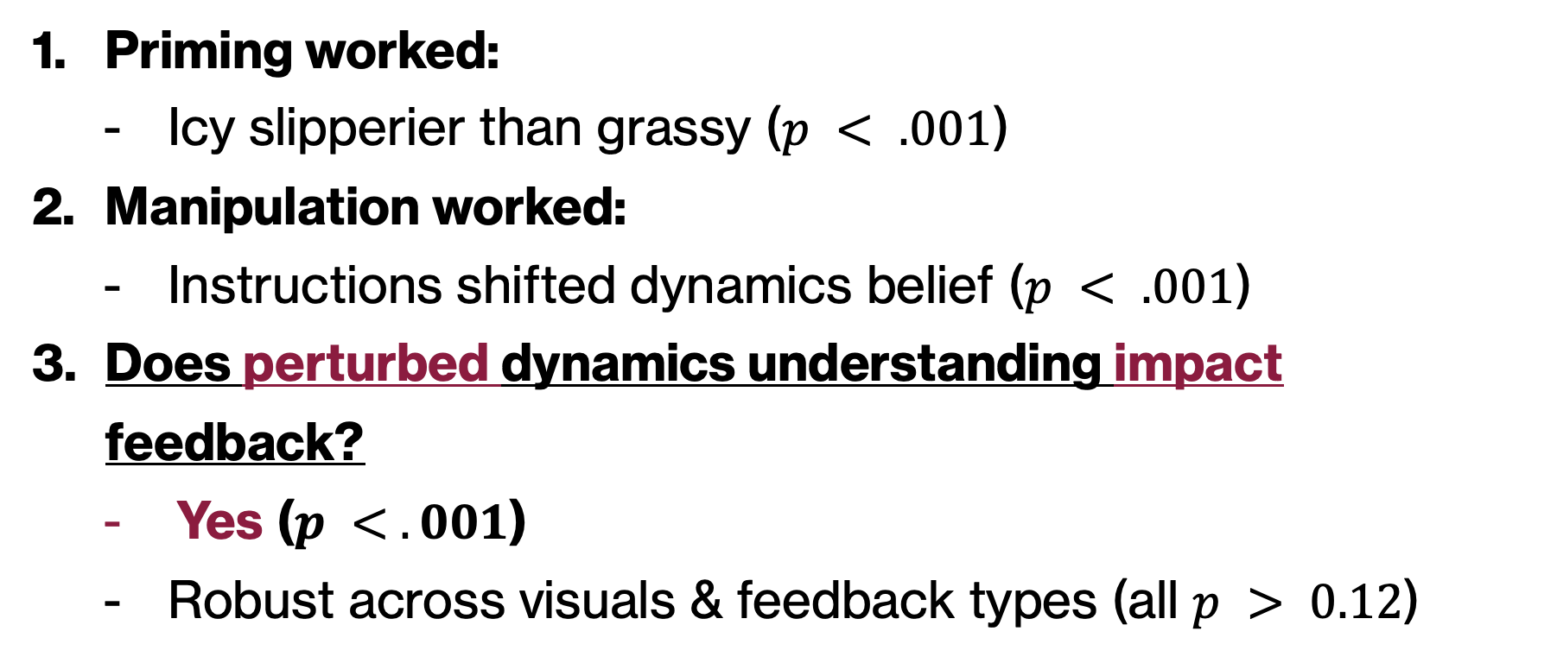
RESULTS (CAUSAL MEDIATION ANALYSIS)
Priming worked:
Icy slipperier than grassy ($p < .001$)
Manipulation worked:
Instructions shifted dynamics belief ($p < .001$)
Does perturbed dynamics understanding impact feedback?
Yes ($p < .001$)
Robust across visuals & feedback types (all $p > 0.12$)

Slide 18

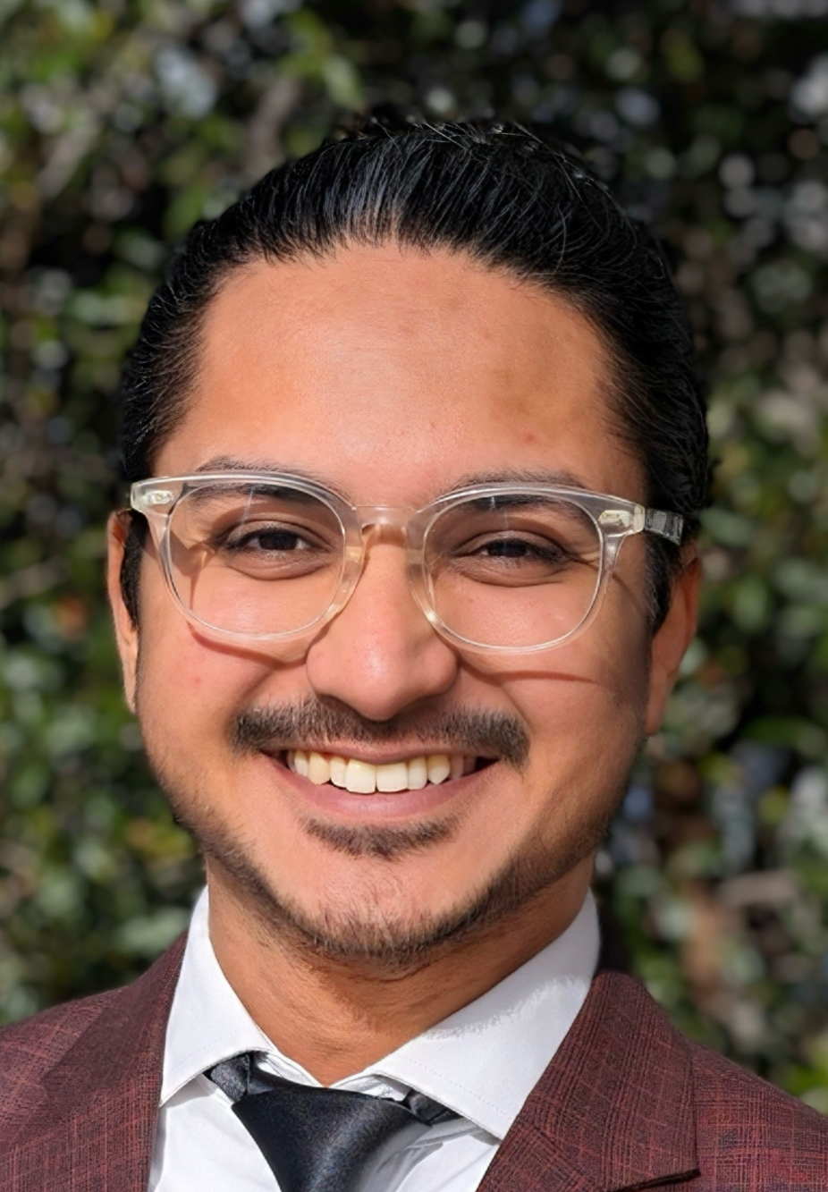
Take-home messages:
Always consider dynamics understanding.
If the feedback provider has dynamics misunderstanding → May critically fail.
Empirical foundation for separating dynamics understanding from latent reward.
Paper | Code | Experiment | Analysis
talk to me at my poster! (16:30–18:00) Contact me: taha.Shaheen@asu.edu

