Slide 1
House Rent Prediction Using Machine Learning
MC03094121 — Machine Learning
MCA Department, Sardar Vallabhbhai Patel Institute of Technology, Vasad
Regression-based prediction of monthly house rent

Slide 2
Problem Statement
Predict the monthly rent of a house/apartment from its available property characteristics.
Relevant information includes size, BHK, bathrooms, city, floor, furnishing status and tenant preference.
Expected output: a numerical predicted monthly rent.

Slide 3
Objectives
Understand a real-world regression problem.
Clean and preprocess mixed numerical and categorical data.
Perform EDA using the required graphs.
Select meaningful features and compare four regression algorithms.
Evaluate models using MAE, MSE, RMSE and R².
Provide a simple prediction demo.

Slide 4
Dataset
4,746 records × 12 columns.
Target variable: Rent.
Numerical: BHK, Rent, Size, Bathroom.
Categorical/textual: Floor, Area Type, Area Locality, City, Furnishing Status, Tenant Preferred, Point of Contact, Posted On.
No missing values and no duplicate records.
Area Locality has 2,235 unique values.

Slide 5
Data Preprocessing
Parsed Floor into Floor Number and Total Floors.
Detected two logically inconsistent floor records and treated their parsed values as missing.
Extracted month and day-of-week from Posted On.
One-hot encoded categorical variables.
Standardized numerical features.
High-rent observations were not automatically removed because they may represent genuine expensive properties.

Slide 6
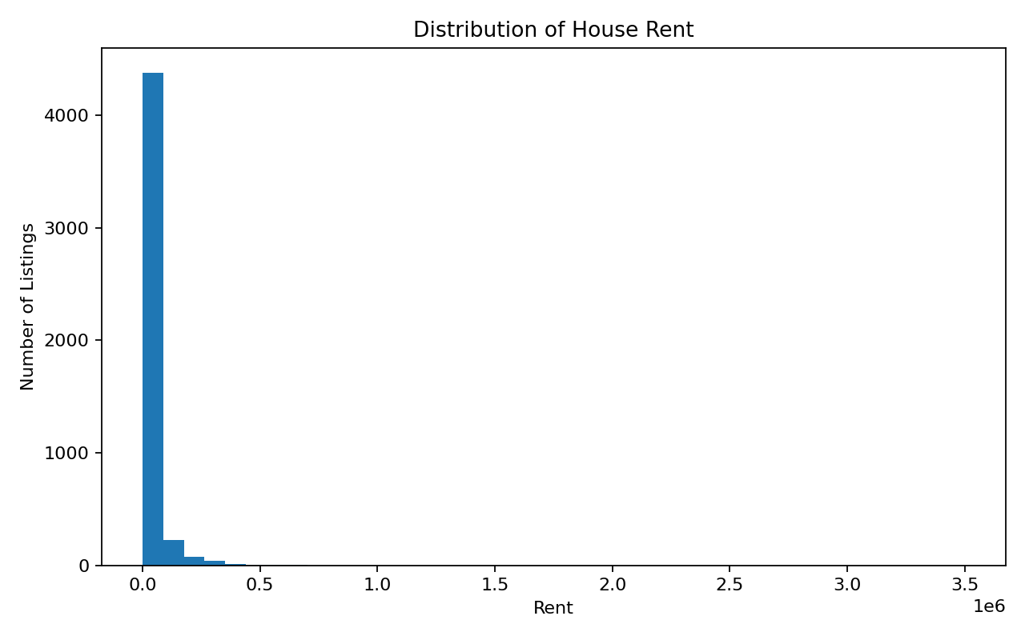
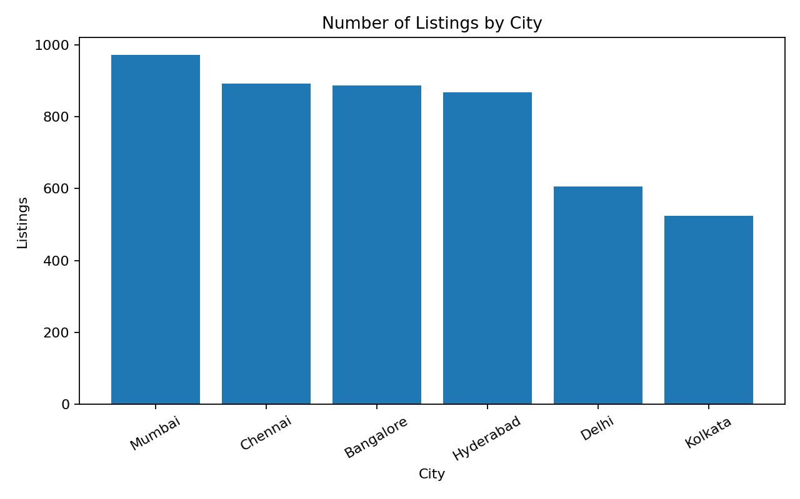
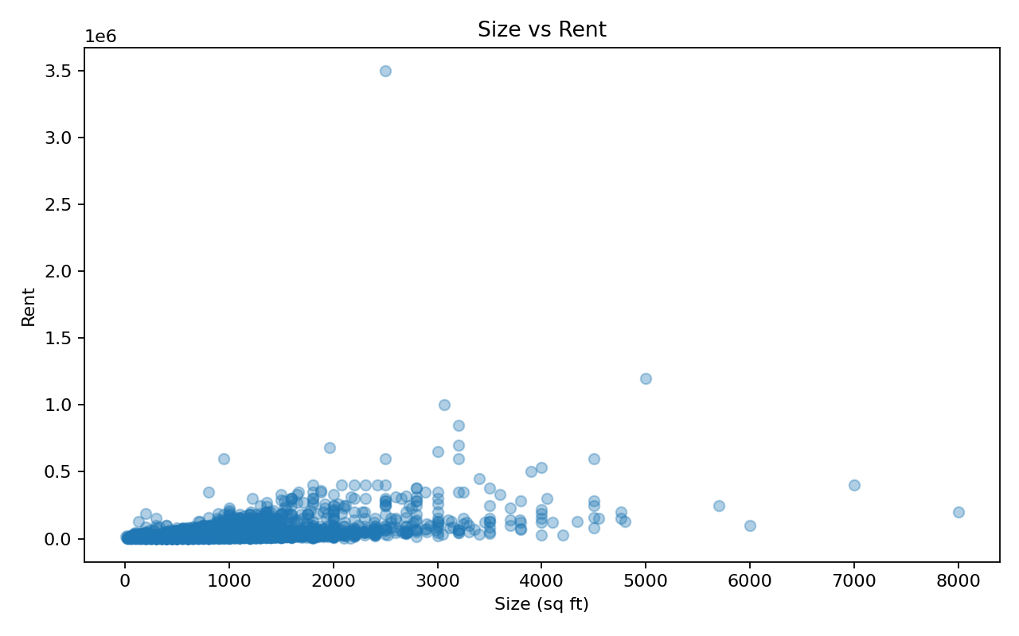
Exploratory Data Analysis
Required graphs: histogram, bar chart, scatter plot, box plot and correlation heatmap.

Slide 7
Feature Selection
Selected: BHK, Size, Floor Number, Total Floors, Area Type, City, Furnishing Status, Tenant Preferred, Bathroom, Posted Month, Posted Day of Week.
Removed Point of Contact because it is contact information rather than a property-price feature.
Removed Area Locality for this basic project because 2,235 unique values create very high cardinality.
Raw Floor and Posted On were transformed into more useful features.

Slide 8
ML Algorithms
Linear Regression — simple baseline.
Decision Tree Regressor — captures non-linear rules.
Random Forest Regressor — ensemble of decision trees.
Gradient Boosting Regressor — sequentially improves errors.
All four are regression algorithms because Rent is continuous.

Slide 9
Model Training
Workflow: Dataset → Preprocessing → Train-Test Split → Training → Prediction → Evaluation
X = selected input features
y = Rent
80% training data / 20% testing data
random_state = 42
fit() learns from training data; predict() estimates rent for unseen data.

Slide 10
Results & Evaluation
Algorithm | MAE | MSE | RMSE | R²
Linear Regression | ₹21,903 | 1.912×10⁹ | ₹43,727 | 0.520
Decision Tree | ₹14,189 | 1.660×10⁹ | ₹40,744 | 0.583
Random Forest | ₹12,469 | 1.318×10⁹ | ₹36,304 | 0.669
Gradient Boosting | ₹11,242 | 1.353×10⁹ | ₹36,788 | 0.660
Selected: Random Forest based on strongest R² and lowest RMSE in this experiment.
Gradient Boosting has the lowest MAE, so the metric priority should be stated explicitly.

Slide 11
Conclusion & Future Scope
An end-to-end house-rent regression workflow was implemented.
Four models were compared using the required regression metrics.
Random Forest was selected using R² and RMSE as the primary criteria.
Future: cross-validation, hyperparameter tuning, improved locality encoding, richer geographic features, larger/current datasets and rent transformation.

Slide 12
Demo
Open the Streamlit application.
Enter BHK, size, floor, area type, city, furnishing status, tenant preference and bathrooms.
Click “Predict Rent”.
The saved Random Forest model returns the predicted monthly rent.

