Slide 1
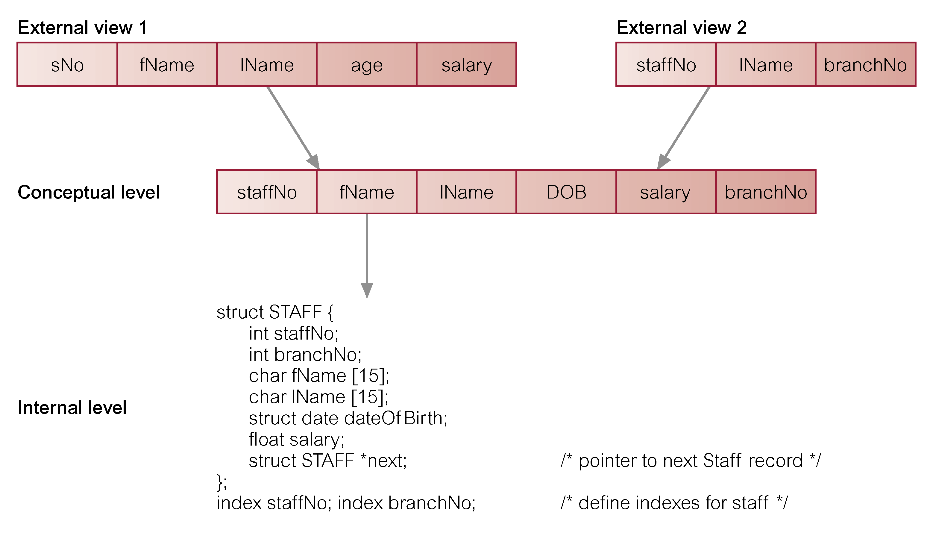
Differences between Three Levels of ANSI-SPARC Architecture
<number>

Slide 2
Data Independence
Logical Data Independence
Refers to immunity of external schemas to changes in conceptual schema.
Conceptual schema changes (e.g. addition/removal of entities).
Should not require changes to external schema or rewrites of application programs.
1

Slide 3
Data Independence
Physical Data Independence
Refers to immunity of conceptual schema to changes in the internal schema.
Internal schema changes (e.g. using different file organizations, storage structures/devices).
Should not require change to conceptual or external schemas.
1

Slide 4
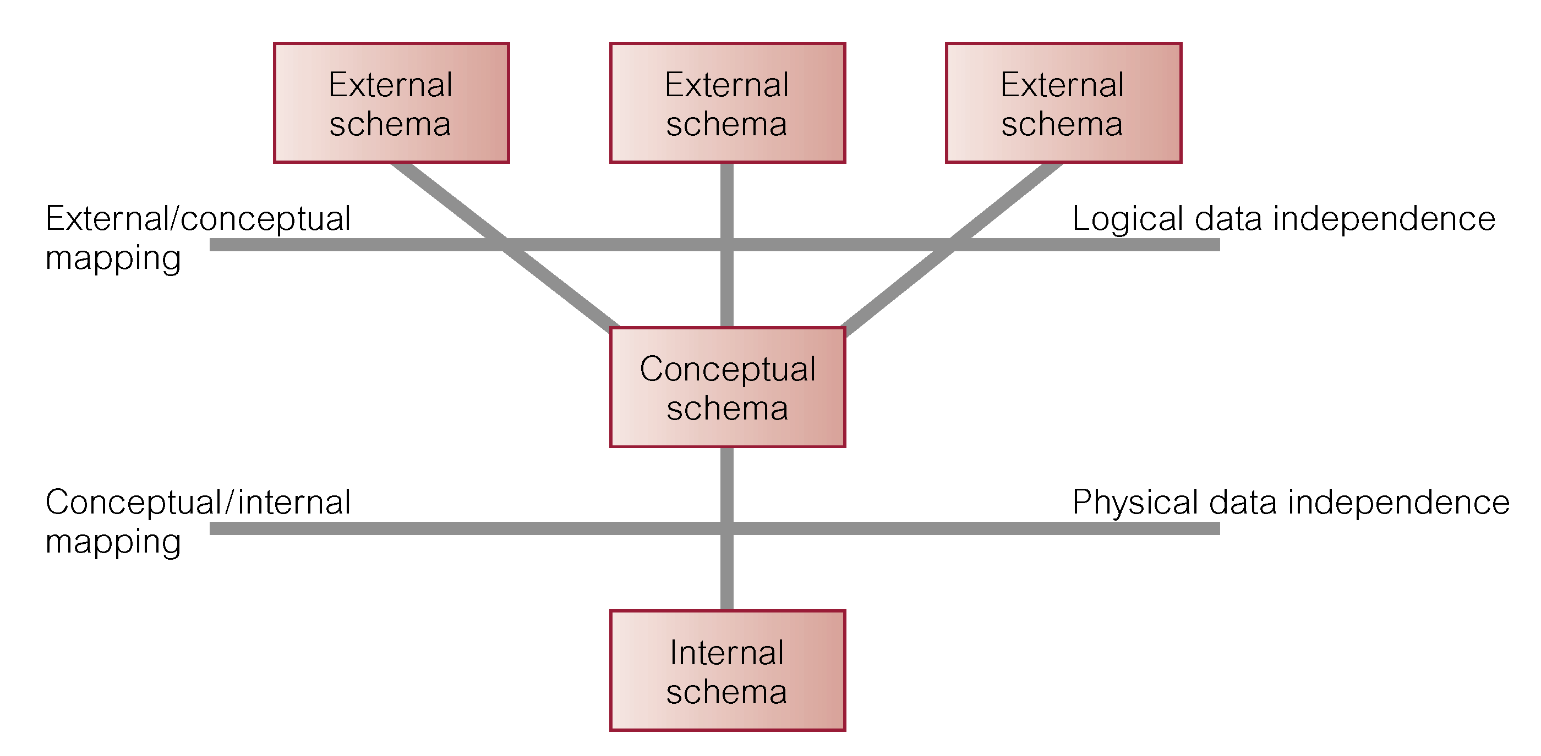
Data Independence and the ANSI-SPARC Three-level Architecture
1

Slide 5
Data Model
Data Model comprises:
A structural part
A manipulative part
Possibly a set of integrity rules
4

Slide 6
Data Model
Purpose
To represent data in an understandable way.
5

Slide 7
Relational Systems
Then, in 1970,E. F. Codd wrote “A Relational Model of Data for Large Shared Databanks” and introduced the relational model
Information is stored as tuples or records in relations or tables
Most modern DBMS are based on the relational model
The relational model covers 3 areas:
Data structure
Data manipulation
Data integrity
Notes:
<number>

Slide 8
Relational Model Terminology
A relation is a table with columns and rows.
Attribute is a named column of a relation.
Domain is the set of allowable values for one or more attributes.
7

Slide 9
Relational Model Terminology
Tuple is a row of a relation.
Degree is the number of attributes in a relation.
Cardinality is the number of tuples in a relation.
Relational Database is a collection of relations with distinct relation names.
8

Slide 10
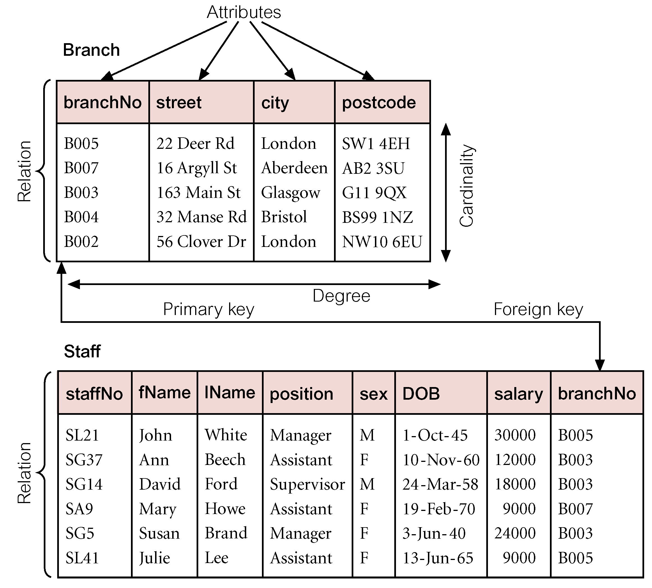
Instances of Branch and Staff Relations
9

Slide 11
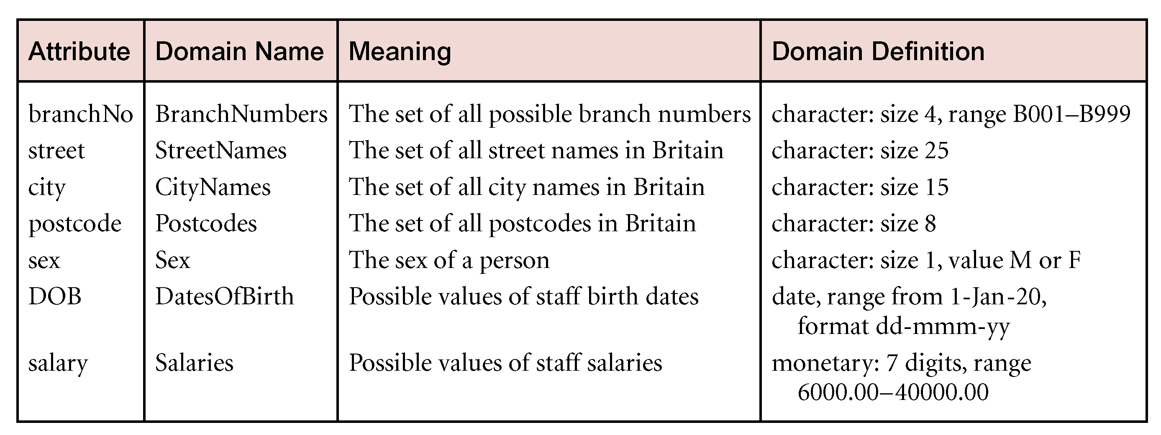
Examples of Attribute Domains
10

Slide 12
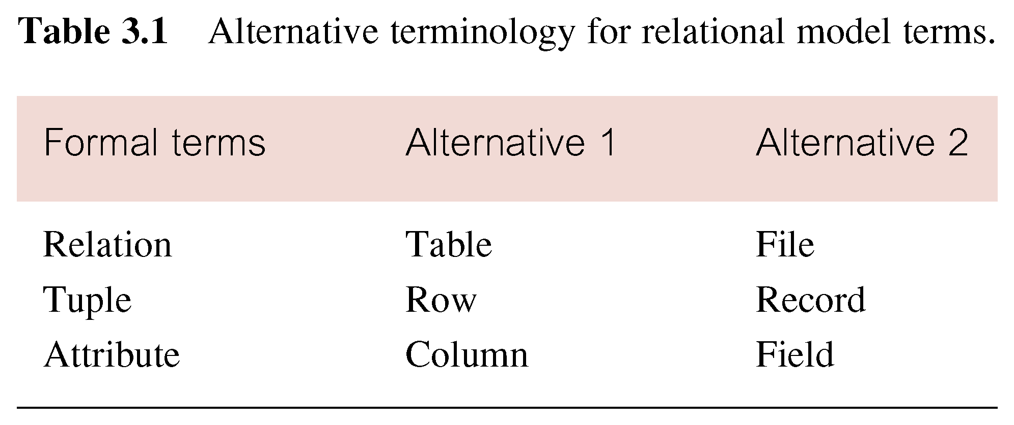
Alternative Terminology for Relational Model
10

Slide 13
Properties of Relations
Relation name is distinct from all other relation names in relational schema.
Each cell of relation contains exactly one atomic (single) value.
Each attribute has a distinct name.
Values of an attribute are all from the same domain.
12

Slide 14
Properties of Relations
Each tuple is distinct; there are no duplicate tuples.
Order of attributes has no significance.
Order of tuples has no significance.
13

Slide 15
Candidate Keys
A set of attributes in a relation is called a candidate key if, and only if,
Every tuple has a unique value for the set of attributes (uniqueness)
No proper subset of the set has the uniqueness property (minimality)
ID First Last
S139 John Smith
S140 Mary Jones
S141 John Brown
S142 Jane Smith
Candidate key: {ID}; {First,Last}
looks reasonable but we may get
people with the same name
{ID, First}, {ID, Last} and {ID,
First, Last} satisfy uniqueness,
but are not minimal
{First} and {Last} do not give
a unique identifier for each row

Slide 16
Choosing Candidate Keys
Important: don’t look just on the data in the table to determine what is a candidate key
The table may contain just one tuple, so anything would do!
Use knowledge of the real world – what is going to stay unique!
Notes:
<number>

Slide 17
Primary Keys
One Candidate Key is usually chosen to be used to identify tuples in a relation
This is called the Primary Key
Often a special ID attribute is used as the Primary Key
Notes:
<number>

Slide 18
NULLs and Primary Keys
Missing information can be represented using NULLs
A NULL indicates a missing or unknown value
More on this later...
Entity Integrity: Primary Keys cannot contain NULL values
Notes:
<number>

Slide 19
Foreign Keys
Foreign Keys are used to link data in two relations. A set of attributes in the first (referencing) relation is a Foreign Key if its value always either
Matches a Candidate Key value in the second (referenced) relation, or
Is wholly NULL
This is called Referential Integrity
Notes:
<number>

Slide 20
Foreign Keys - Example
Department
DID DName
13 Marketing
14 Accounts
15 Personnel
Employee
EID EName DID
15 John Smith 13
16 Mary Brown 14
17 Mark Jones 13
18 Jane Smith NULL
{DID} is a Candidate Key
for Department - Each
entry has a unique value
for DID
{DID} is a Foreign Key in Employee -
each Employee’s DID value is either
NULL, or matches an entry in the
Department relation. This links each
Employee to (at most) one Department
The Relational Model
Notes:
<number>

Slide 21
Foreign Keys - Example
Employee
ID Name Manager
E1496 John Smith E1499
E1497 Mary Brown E1498
E1498 Mark Jones E1499
E1499 Jane Smith NULL
{ID} is a Candidate Key for
Employee, and {Manager} is
a Foreign Key, which refers
to the same relation - every
tuple’s Manager value is either
NULL or matches an ID value

Slide 22
Referential Integrity
When relations are updated, referential integrity can be violated
This usually occurs when a referenced tuple is updated or deleted
There are a number of options:
RESTRICT - stop the user from doing it
CASCADE - let the changes flow on
NULLIFY - make values NULL
Notes:
<number>

Slide 23
Referential Integrity - Example
What happens if
Marketing’s DID is changed to 16 in Department?
The entry for Accounts is deleted from Department?
Department
DID DName
13 Marketing
14 Accounts
15 Personnel
Employee
EID EName DID
15 John Smith 13
16 Mary Brown 14
17 Mark Jones 13
18 Jane Smith NULL
Notes:
<number>

Slide 24
RESTRICT
RESTRICT stops any action that violates integrity
You cannot update or delete Marketing or Accounts
You can change Personnel as it is not referenced
Department
DID DName
13 Marketing
14 Accounts
15 Personnel
Employee
EID EName DID
15 John Smith 13
16 Mary Brown 14
17 Mark Jones 13
18 Jane Smith NULL
Notes:
<number>

Slide 25
CASCADE
CASCADE allows the changes made to flow through
If Marketing’s DID is changed to 16 in Department, then the DIDs for John Smith and Mark Jones also change
If Accounts is deleted then so is Mary Brown
Department
DID DName
13 Marketing
14 Accounts
15 Personnel
16
Employee
EID EName DID
15 John Smith 13
16 Mary Brown 14
17 Mark Jones 13
18 Jane Smith NULL
16
16
The Relational Model

Slide 26
NULLIFY
NULLIFY sets problem values to NULL
If Marketing’s DID changes then John Smith’s and Mark Jones’ DIDs are set to NULL
If Accounts is deleted, Mary Brown’s DID becomes NULL
Department
DID DName
13 Marketing
14 Accounts
15 Personnel
16
Employee
EID EName DID
15 John Smith 13
16 Mary Brown 14
17 Mark Jones 13
18 Jane Smith NULL
NULL
NULL
NULL
The Relational Model

Slide 27
Relational Integrity
Enterprise Constraints
Additional rules specified by database administrators.
<number>

Slide 28
Views
Base Relation
Named relation corresponding to an entity in conceptual schema, whose tuples are physically stored in database.
View
Dynamic result of one or more relational operations operating on base relations to produce another relation.
<number>

Slide 29
Views
A virtual relation that does not necessarily actually exist in the database but is produced upon request, at time of request.
Contents of a view are defined as a query on one or more base relations.
Views are dynamic, meaning that changes made to base relations that affect view attributes are immediately reflected in the view.
<number>

Slide 30
Purpose of Views
Provides powerful and flexible security mechanism by hiding parts of database from certain users.
Permits users to access data in a customized way, so that same data can be seen by different users in different ways, at same time.
Can simplify complex operations on base relations.
<number>

Slide 31
Updating Views
All updates to a base relation should be immediately reflected in all views that reference that base relation.
If view is updated, underlying base relation should reflect change.
<number>

