Slide 1
Transforming ERD into Relations

Slide 2
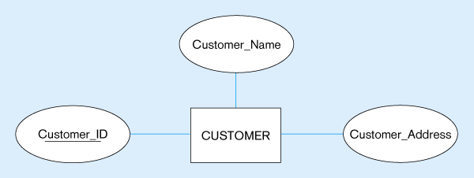
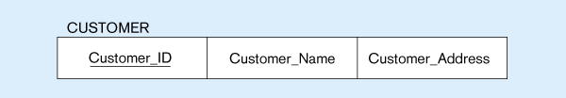
Mapping a regular entity
CUSTOMER entity type with simple attributes
CUSTOMER relation

Slide 3
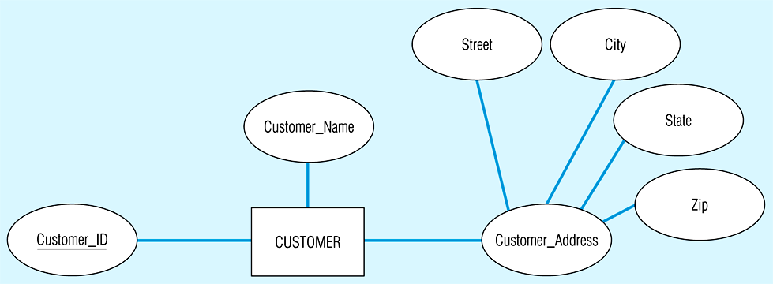
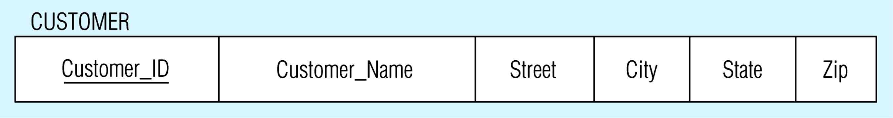
Mapping a composite attribute
CUSTOMER entity type with composite attribute
CUSTOMER relation with address detail

Slide 4
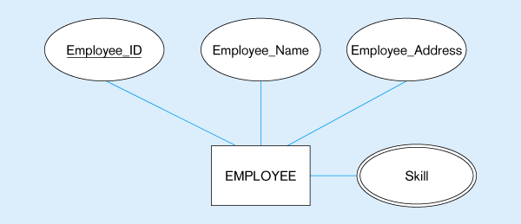
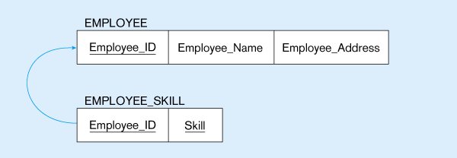
Mapping a multivalued attribute
Multivalued attribute becomes a separate relation with foreign key
1 – to – many relationship between original entity and new relation

Slide 5
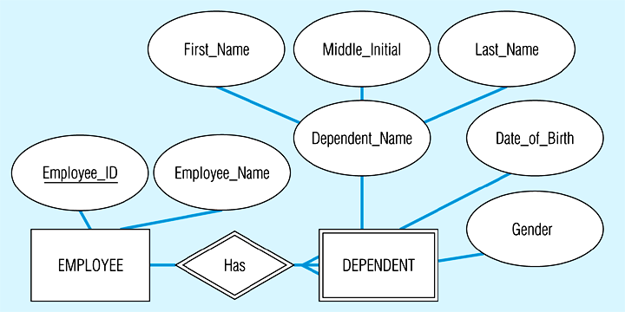
Example of mapping a weak entity
Weak entity DEPENDENT

Slide 6
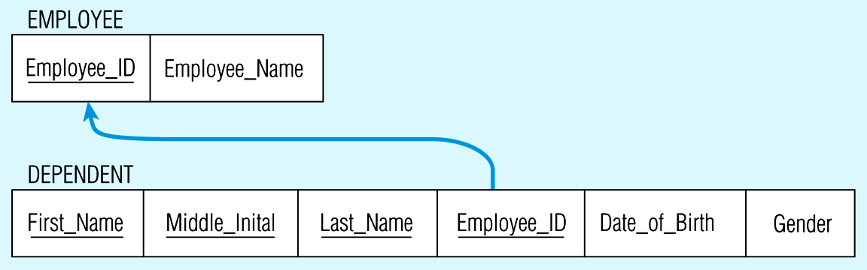
Relations resulting from weak entity
NOTE: the domain constraint for the foreign key should NOT allow null value if DEPENDENT is a weak entity
Foreign key
Composite primary key

Slide 7
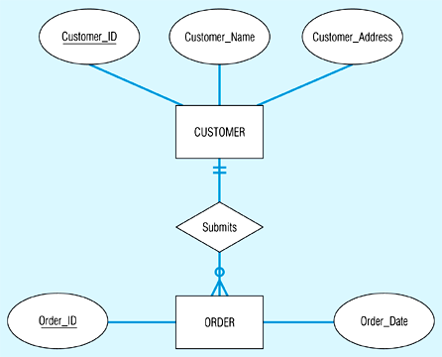
Example of mapping a 1:M relationship
Relationship between customers and orders

Slide 8
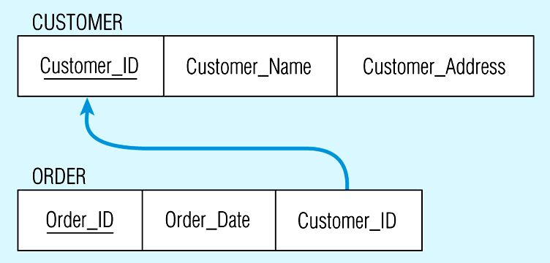
Mapping the relationship
Foreign key

Slide 9
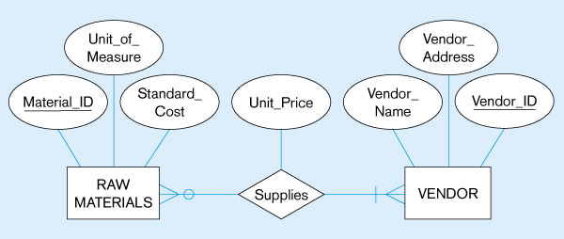
Example of mapping an M:N relationship
ER diagram (M:N)
The Supplies relationship will need to become a separate relation

Slide 10
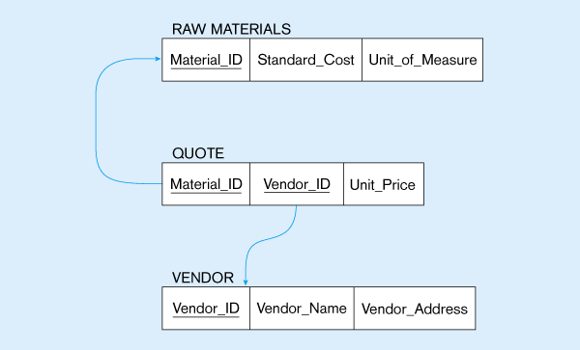
Three resulting relations
Composite primary key
New intersection relation
Foreign key
Foreign key

Slide 11
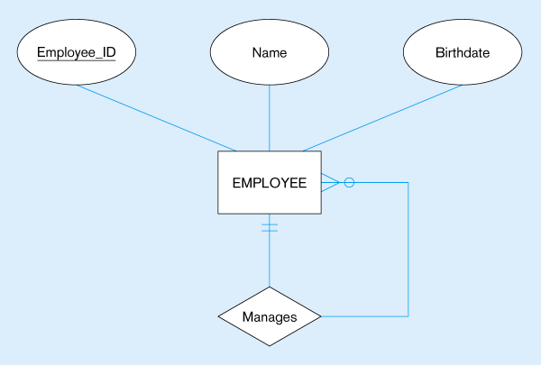

Mapping a unary 1:N relationship

Slide 12
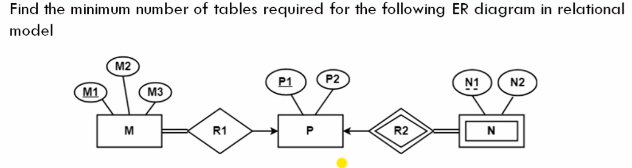
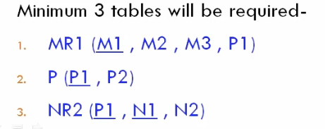

Slide 13
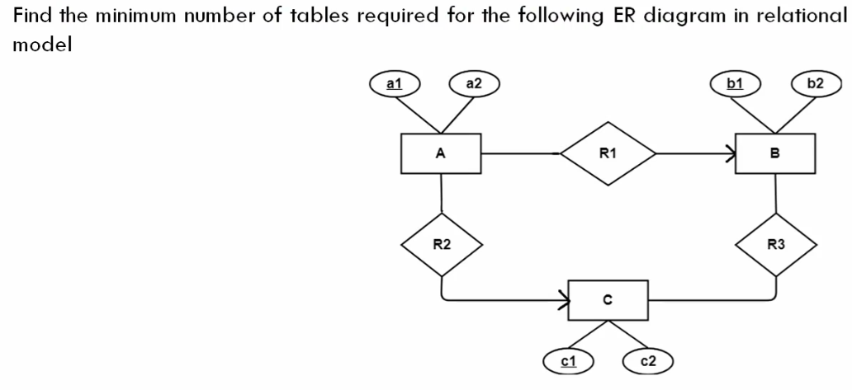
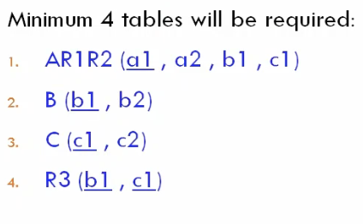

Slide 14
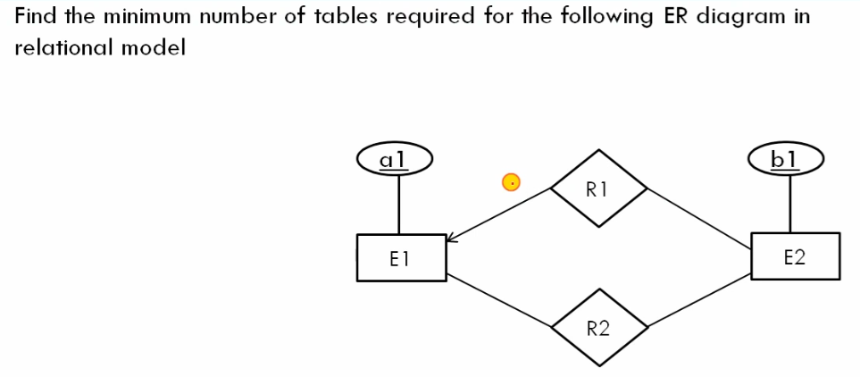
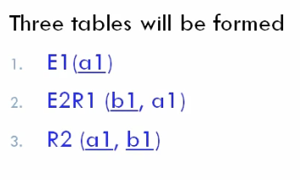

Slide 15
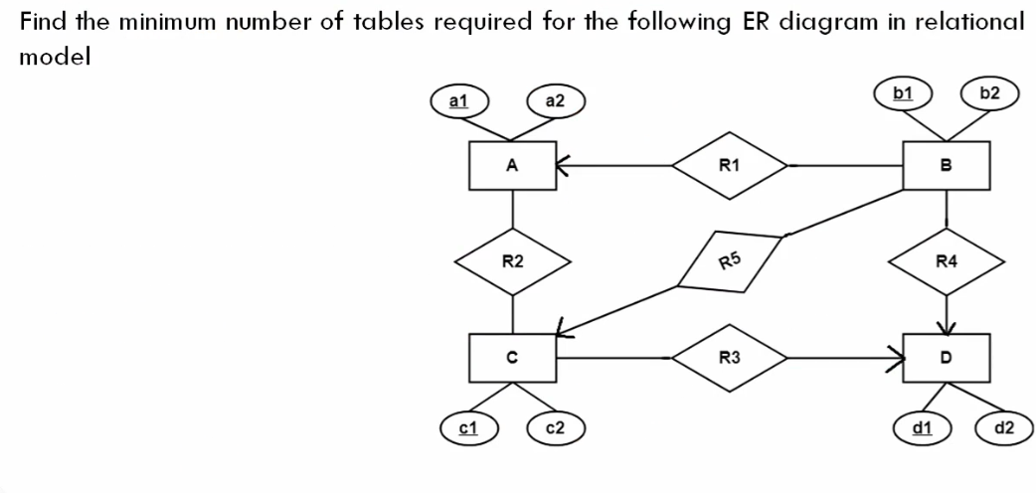
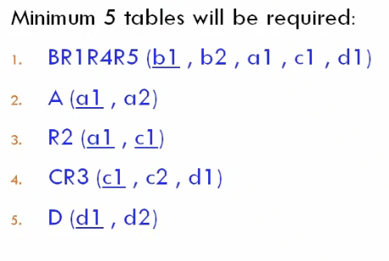

Slide 16
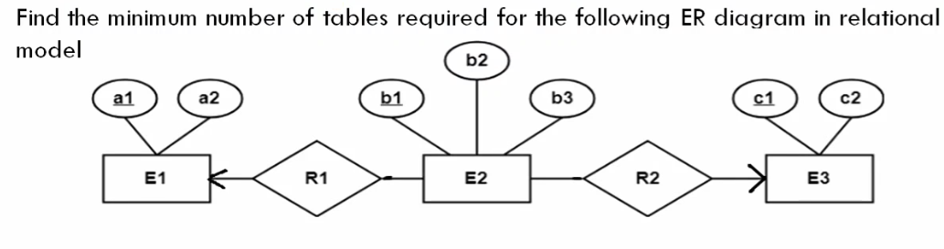
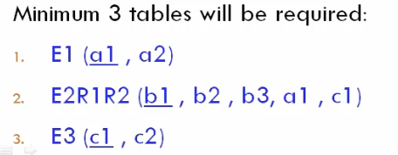

Slide 17
