Slide 1
HALQA
How it works
The institutions, the money path, every product, every feature, and the controls behind each one.
13 August 2026 Confidential

Slide 2
CONTENTS
Contents
0 What has been tried before
1 Where the money goes
2 Getting in
3 Taking the money
4 Building the record
5 Preventing default
6 When prevention fails
7 The products, one by one
8 Rewards
9 Security, treasury and the application
10 The business and what comes next
11 What is built today
Sections 1 to 6 are the five things the platform does, in the order money moves through them, plus the institutions each one depends on. Section 7 takes every product in the range and gives each its own page: known circles, open circles, HYPER, asset circles, the savings layer, the marketplace, gold goal circles, the tier engines, and how a member leaves. Sections 9 and 10 cover security, treasury, money laundering, the application itself, and where this goes next.
Halqa · Confidential
2

Slide 3
WHY THIS HAS NEVER BEEN FORMALISED
The five ways it has failed before
WHAT GOES WRONG | HOW IT HAPPENS | WHAT IT HAS COST
The organiser holds the money | Every member pays into one person's account and trusts them to pay it out | The largest recorded Pakistani case ran seven to ten years, took roughly Rs 420 million across 117 committees from about 200 people, and ended when the organiser announced she could not pay and disappeared
Holding the money requires a licence | Once a platform takes custody it is issuing a liability, which is regulated activity | Operators either carry a licence and a statutory deposit, or they operate unlawfully, or they close
Recording without settling proves nothing | Two Pakistani ledger applications let an organiser record who has paid, but no money passes through them | The entry is an assertion, not evidence. A bureau cannot use it and a court will not weigh it
Removing the rotation removes the product | A large bank markets a committee branded deposit with no rotation at all | Members are paid their own money back at the end with a bonus. Nobody receives a lump sum early, which is the only reason people join
Guaranteeing without pricing is unbounded | An American operator absorbed every member's default itself | It ran nine years and closed
Each failure is a consequence of one decision: whether the platform touches the money. Every structural choice in this document follows from answering that no.
Halqa · Confidential
3

Slide 4
1 WHERE THE MONEY GOES
The custody principle
At no point in any product does Halqa hold a member's money. A contribution leaves the paying member's own bank account or wallet and arrives in the receiving member's own bank account or wallet. Halqa instructs the movement and records it. It never sits in between.
THIS PRODUCES | BECAUSE
No route to the largest fraud | Every large committee fraud in the country needed a central pool of members' money under one person's control. No such account exists here, and it cannot be created under commercial pressure because there is nothing to create it from
No licence for issuing money | No balance is issued, nothing is lent, and no payment system is operated. What is needed is company registration and a commercial services agreement with a licensed payment aggregator, which is a contract rather than a permission
No float to lose and none to live on | There is no pool of member money earning interest for the platform, which is why the member price is a small fixed fee and the real revenue comes from services and counterparties
A position that survives inspection | The claim is demonstrable from the ledger and the rail records rather than argued. A regulator can be shown where every rupee went
Independent support | Researchers at ITU Lahore and the University of Washington, funded by the Gates Foundation and Karandaaz, published the same architecture in 2018 on regulatory grounds
Halqa · Confidential
4

Slide 5
1 WHERE THE MONEY GOES
The money path, end to end
 | STAGE | WHO HOLDS THE MONEY AT THIS MOMENT | WHAT HALQA DOES
1 | Member's own account | The member | Holds a standing instruction the member signed, and nothing else
2 | Instruction issued | The member | Sends the debit request to the licensed aggregator, carrying a unique reference for that exact contribution
3 | Aggregator presents it | The member | Nothing. The aggregator is the regulated party touching the rail
4 | The rail moves it | In transit on the national instant payment system | Nothing. Halqa is not a participant in the rail
5 | Receiving member's account | The receiving member | Records the settlement, writes the receipt, notifies both sides
6 | Savings, if the member chooses | A licensed trustee, in the member's own name | Places the instruction with the asset manager. Never receives the units and never receives the money
7 | An item, in an asset circle | The dealer is paid directly; legal title sits with a security trustee | Structures the sale and instructs the payment. Never owns the item
There is no row in which the answer is Halqa. That is the whole design, and every institution in the next few pages exists to keep it true as the product range grows.
Halqa · Confidential
5

Slide 6
0 WHAT HAS BEEN TRIED
The bank that took the name
United Bank Limited, one of the country's largest banks, markets a deposit product under the committee name. It is the most instructive case in the set, because it shows exactly what is lost when a large institution takes the word and discards the instrument.
FEATURE | HOW THE BANK PRODUCT WORKS | WHAT IT MEANS
Term | Twelve, eighteen or twenty four months | Fixed, like a recurring deposit
Contribution | Rs 5,000 to Rs 1,000,000 a month | A wide band aimed at customers the bank already has
Payout | Your own accumulated contributions at the end, plus a bank contribution of a quarter, a half or one full monthly installment | You are paid your own money back, with a bonus
Rotation | None | No member ever receives early. The defining feature of a committee is simply absent
Early exit | Permitted without penalty, forfeits the bonus | No obligation to anybody
Missed months | Forgiven through an installment holiday | No discipline, because there is no counterparty to be disciplined for
Custody | The bank, entirely. Member money is a bank liability from day one | Which is why it requires a banking licence
The rotation is the product. Remove it and what remains is a savings account with a marketing name. Nobody receives a lump sum early, which is the only reason anybody joins a committee.
Halqa · Confidential
6

Slide 7
0 WHAT HAS BEEN TRIED
Pakistan
OPERATOR | PERIOD | REPORTED SCALE | STRUCTURE AND OUTCOME
UBL Kommittee Account | Current | Rs 5,000 to Rs 1,000,000 a month, terms of twelve to twenty four months | A bank deposit carrying the committee name. Full custody, no rotation between members
Oraan | Founded 2018, USD 3m seed in 2021 | Its own research put participation at 41 per cent of Pakistanis and about USD 5bn rotating annually | Platform custody. The operator collects contributions and disburses pots. Strangers pooled and vetted, women weighted
Udhaar Book | Current | A committee register inside a digital ledger application used by retailers | No money moves through the application. The organiser records who has paid. It records an assertion, not a settlement
DigiKhata | Current | A competing ledger application with the same feature | Architecturally identical. Two independent Pakistani applications with real distribution stopped at exactly the same wall
Sidra Humaid committees | Roughly seven to ten years, ending December 2022 | About Rs 420 million owed across 117 committees and roughly 200 contributors, with no written records | Total concentrated custody. Members from social media wired money to one individual. She announced she could not pay and went into hiding
Two failure modes and nothing in between. Hold the money and carry either a licence or the fraud risk, or hold nothing and record only an assertion. Halqa is the third option: hold nothing and record a settlement.
Halqa · Confidential
7

Slide 8
0 WHAT HAS BEEN TRIED
The rest of the world
OPERATOR | MARKET | REPORTED SCALE | WHAT IT PROVES
Money Fellows | Egypt | 8m downloads, over 1m customers, about 350,000 monthly active, USD 1.5bn processed across more than 2m completed circles, about USD 60m raised, profitable in 2025 | The category can reach real scale and real profitability. The largest operator anywhere
Hakbah | Saudi Arabia | More than 1.3m registered users, about 70 per cent young savers, about USD 9m raised | A central bank sandbox permit is a workable route in
Shriram Chits | India | More than 2.2m subscribers, auction turnover approaching Rs 3,000 crore, 465 branches, 65,000 agents | Custody endures at scale if you are a statutory foreman with a deposit lodged with the Registrar
Margadarsi Chits | India, sixty years | Turnover about Rs 14,341 crore, over 6m subscribers, 131 branches | The same, over sixty years
KSFE | India, since 1969 | More than 680 branches, chit values from Rs 1 lakh to Rs 50 lakh | Sovereign trust can replace private reputation, if you are a state owned company
The Money Club | India, founded 2016 | Over 200,000 users, about 17,000 clubs, roughly Rs 40 crore pooled | Graduated trust works as an underwriting method
MyPaisaa | India | About USD 980,000 raised, roughly 20,000 installs in two years | What full statutory registration costs a young company in speed
Mapan | Indonesia | National scale through community organisers | The organiser is the growth engine, which is the position taken here
StokFella | South Africa, 2016 | About 42,000 members by 2025 in a market of roughly 800,000 groups and 11m members | Serving existing groups is a smaller business than forming new ones
Tanda by Yahoo Finance | United States, Jan to May 2018 | About 37,000 installs, never in the top 1,500 of its category | Closed in four months. Strong in the Philippines and Mexico, weak in the United States
eMoneyPool | United States, 2010 to 2019 | Nine years of operation | Absorbing every member's default without pricing or capping it closes a company
Esusu | United States, incorporated 2018 | USD 130m Series B led by SoftBank Vision Fund 2 in January 2022, at a USD 1bn valuation | The record was the asset, not the pooling. They abandoned pooling entirely
Mission Asset Fund | United States | Groups of six to twelve contributing USD 50 to 200 a month | Formalising peer contributions as documented zero interest loans and reporting every payment works
Halqa · Confidential
8

Slide 9
0 WHAT HAS BEEN TRIED
Two American operators abandoned pooling entirely
and rebuilt around reporting payment behaviour.
One reached a billion dollar valuation doing it.
That is the strongest external evidence for the position taken here. The value in a committee was never the money moving between members, which nets to zero. It was always the record of who paid, which nobody was keeping.
Halqa keeps the rotation, because that is why members join, and keeps the record, because that is where the value is.

Slide 10
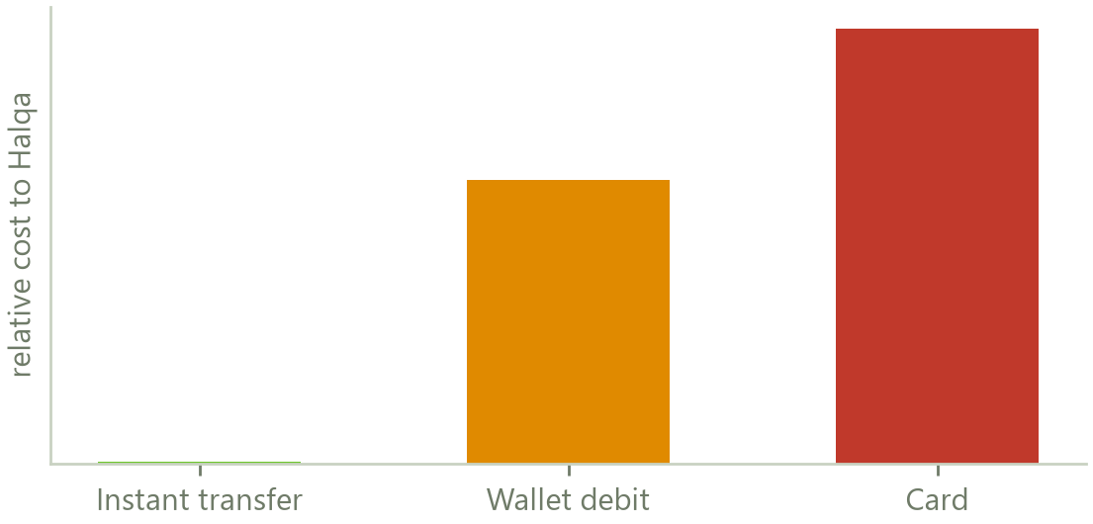
1 WHERE THE MONEY GOES
The payment rails and who operates them
Raast is the State Bank's own instant payment system. It settles between two ordinary bank accounts in seconds and it is free at the point of use. That single fact is what makes a product that is nearly free to the member arithmetically possible.
The mobile wallets, JazzCash and Easypaisa, reach the members who have no bank account. Wallet to wallet inside the same network is free. A wallet debit under a standing mandate carries a real cost and is used only as a fallback on smaller contributions.
Cards are not offered on ordinary circles. A single card charge on an ordinary contribution costs more than the entire annual fee from that member.
Cash through an agent is a last resort and is discouraged, because it produces a payment with no digital record.
Relative cost of collecting one contribution.
Halqa does not connect to Raast directly. It reaches it as a merchant of a licensed payment aggregator, which is a commercial services agreement rather than a licence, and is the same arrangement every e-commerce business in the country uses.
Halqa · Confidential
10

Slide 11
1 WHERE THE MONEY GOES
The aggregator
QUESTION | ANSWER
What is an aggregator | A company licensed by the State Bank to accept payments on behalf of merchants. It holds the connection to the rails, the switch and the banks, and it takes responsibility for the regulated part of moving money
What agreement is needed | A merchant services agreement. It is a contract negotiated commercially, not a permission granted by a regulator, and it is the same document a retailer signs to accept online payments
Who the candidates are | PayFast and Safepay are the established domestic aggregators. 1LINK operates the switch that connects the banks to one another
What they do for Halqa | Present the debit to the member's bank or wallet, return success or failure, hand back the registered account holder name at the moment an instrument is linked, and settle the funds to the receiving member
What they do not do | They do not hold funds for Halqa, they do not underwrite anything, and they have no view of the circle. They see a payer, a payee and an amount
What it costs | A per transaction charge that varies by rail. On the instant payment rail it is close to nothing, which is why the whole collection design is built on that rail
Halqa · Confidential
11

Slide 12
1 INSTITUTIONS
What a trustee is and why one is needed
A trustee is an independent, licensed company whose only job is to hold assets on behalf of somebody else and to check that the person managing those assets follows the rules. It is the structural answer to the question a regulator will always ask: if the platform disappears tomorrow, what happens to the members' property?
WHERE A TRUSTEE APPEARS | WHAT IT HOLDS | WHAT IT PROTECTS AGAINST
The savings layer | Units in a regulated fund, registered in the individual member's own name | Halqa failing, or Halqa being tempted to use pooled savings. The units are the member's property and are not on anybody's balance sheet but their own
Asset circles | Legal title to the item bought with the pot, held until that member has finished paying | A member taking possession of an item and walking away. The trustee, not Halqa, can enforce and sell
Pledged savings used as security | The same units, with a charge in favour of the circle's members and a redemption instruction the member signed in advance | A default that could have been cured. The trustee redeems and pays the circle directly, and Halqa never receives the money
A future cover facility | Reserves held against the platform's own guarantee obligations | The guarantee being an unfunded promise, which is the failure that closed an earlier operator in another market
Halqa · Confidential
12

Slide 13
1 INSTITUTIONS
Which trustee, and how it operates
 | CANDIDATE | WHAT IT IS | WHY IT FITS
1 | Central Depository Company of Pakistan | The national securities depository. It already acts as trustee to the great majority of open end mutual funds in the country and holds the assets of those funds separately from their managers | Default choice. Every asset manager Halqa would distribute for already has a working relationship with it, so the operational path is well trodden
2 | Digital Custodian Company | A newer licensed trustee and custodian built specifically for digital distribution models | Second source. A single sourced trustee is a commercial exposure, not a regulatory one, and it is cheap to remove early
 | How the relationship runs | Halqa introduces a member and passes an instruction. The trustee holds the units in that member's name, sends the member statements directly, and acts only on instructions that match the mandate the member signed. Redemption proceeds are paid to the member or, on a pledge, to the circle. At no point does Halqa appear as an owner or a payee
The legal basis is the 2008 regulations governing collective investment schemes, under which the assets of every regulated fund are held by a trustee and the manager only manages them. This is existing, well tested machinery. Halqa is not asking anybody to invent a structure.
Halqa · Confidential
13

Slide 14
1 INSTITUTIONS
What an asset manager is and which one is needed
An asset management company is the licensed firm that actually runs a fund. It decides what the fund holds, publishes the daily price, and answers to both the trustee and the regulator. Halqa will never be one. It will be a registered distributor, which is the role a bank branch plays when it sells you a fund over the counter.
ROLE | WHO | WHAT THEY DO IN THIS ARRANGEMENT
Digital first manager | Mahaana Wealth | Built for app based distribution and small ticket savers, which is exactly the member profile. The natural first partner for the savings layer
Established Islamic money market funds | Al Meezan; NBP Fund Management; UBL Fund Managers; Alfalah; HBL; Atlas | Daily dividend funds designed for same day or next day redemption. Money that would otherwise sit idle between payday and payout day earns a return in the member's own name
What Halqa is registered as | A mutual fund distributor | Introduces members, passes instructions, and receives a share of the manager's fee as a distribution trail. It is not an electronic money licence, because no balance is issued, and not a non banking finance licence, because Halqa deploys nothing
The absolute engineering rule | No exceptions | No payout ever waits on a fund redemption. If a redemption is slow, the circle pays out regardless and the redemption settles behind it. A member's turn is never delayed by an investment decision
Halqa · Confidential
14

Slide 15
1 INSTITUTIONS
The remaining counterparties
FUNCTION | WHO | WHAT THEY ARE FOR | LEAD TIME
Identity | NADRA, through the Nishan Pakistan portal | Confirms an identity number is real and belongs to that name, and that the living person presenting it is the holder of the card | The longest item. Institutional onboarding paperwork, started in parallel with everything else
Credit bureau | TASDEEQ, the trading name of Aequitas Information Services; DataCheck Limited | Receives the payment record and turns it into a credit history the member can use elsewhere. TASDEEQ is the first bureau licensed under the Credit Bureaus Act 2015 and already counts fintechs and non bank financiers among its members | A contributor agreement. Months, not years
Leasing counterparty | Orix Modaraba; First Habib Modaraba; Allied Rental Modaraba | Can hold title and write a lease on an asset circle without Halqa holding any financing licence | Commercial negotiation
Takaful | Pak-Qatar Family Takaful; Salaam Takaful; Jubilee; EFU | Cover above the aggregate cap on the platform's own facility, and credit life so a member's death does not fall on the group | Commercial negotiation
Messaging | WhatsApp Business Cloud API | Receipts, reminders and one time codes on the channel members actually read | Immediate
Non dilutive funding | Karandaaz Pakistan; Ignite National Technology Fund | Grant and co-investment. Karandaaz co-funded the 2018 research that validated this architecture | Application cycles
Regulator | SECP regulatory sandbox | Supervised testing and the least expensive credibility available to a company at this stage | Application cycles
Halqa · Confidential
15

Slide 16
1 WHERE THE MONEY GOES
What is and is not required
NOT REQUIRED | WHY NOT
An electronic money institution licence | Requires substantial paid up capital and exists to authorise issuing stored value. Halqa issues no balance and stores no value
A non banking finance licence | Exists to authorise lending and deploying money. Members fund one another directly; Halqa lends nothing
A banking licence | Exists to authorise taking deposits. No deposit is taken at any point
A payment system operator licence | Halqa operates no rail. It is a merchant of a licensed aggregator
An insurance licence | Only if the protection is written and sold as insurance. Structured as a platform fee and a recoverable advance, it is not
REQUIRED | TYPE
Company registration | Registration
Merchant services agreement with an aggregator | Commercial contract
Credit bureau contributor agreement | Commercial contract
NADRA institutional access | Institutional agreement
Mutual fund distributor registration | Registration, second stage only
Trustee and asset manager agreements | Commercial contracts, second stage only
Nothing on the left is avoided by argument. Each one is avoided because the activity it authorises is genuinely not being performed, and that can be demonstrated from the ledger rather than asserted in a letter.
Halqa · Confidential
16

Slide 17
2 GETTING IN
Registration, and what we require
 | STEP | WHAT THE MEMBER GIVES | WHY WE REQUIRE IT
1 | Mobile number | The number, then a six digit code sent to it | The number is the identity on the platform and the channel for every reminder and receipt
2 | Name | Full name exactly as printed on the identity card | Circles run on real names. It is how members judge who they are trusting, and it must match the bank account later
3 | Identity card | The thirteen digit number, plus a photograph of the card taken in the app | Binds every obligation to a government identity. A photograph taken live cannot be a file forwarded by somebody else
4 | Home location | Address, city, area, and a live location pin captured on the device | Legal notice can be served at a pinned address. Recovery elsewhere usually stalls on finding the person
5 | Work | Occupation, employer, job title, and the day pay arrives | Determines which products are available and when collection is attempted
6 | Electronic address | Email | Receipts, statements and account recovery
7 | Collection account | Rail, account number or wallet, and the account title | Automatic collection is how every circle collects, so the account is linked before a circle can be joined
8 | Password | Minimum eight characters with letters and numbers | Account credential
9 | Application PIN | Four to six digits, entered twice | A second lock, required on every open of the application and on every consequential action
10 | Review and sign | Every field shown back, then the agreement accepted | Consent recorded against a document version, an address and a timestamp
Halqa · Confidential
17

Slide 18
2 GETTING IN
Proving the person is real
Four layers, in ascending order of strength. A member passes as many as the product they want requires, and no more.
LAYER | WHAT IS CHECKED | WHAT IT PROVES | WHAT IT DEFEATS
The telephone number | A six digit code delivered over WhatsApp, with a text message fallback | The number is controlled by the applicant right now | Somebody registering with a number they do not hold
The card | A photograph of the identity card taken inside the application, with the number recorded | A document exists and matches the number given | A number typed in from memory or bought
The account title | At the moment an account is linked, the aggregator returns the registered account holder name, which must match the identity card name | The collection account belongs to this member and not to a third party | Somebody joining on another person's account
The living person | NADRA identity verification against the national database, then multi biometric and facial verification through the Nishan Pakistan portal | The identity number is real, it belongs to that name, and the person presenting it is the holder | A borrowed or purchased identity, which is the only attack the first three cannot stop
Only the result and a reference are stored. The biometric template and the facial image stay with NADRA and are never transmitted to Halqa or held by it.
Halqa · Confidential
18

Slide 19
2 GETTING IN
When the face check fires
A facial check on every action would spend money and lose members at the same time. It is fired only where it buys something, which is at the six moments where impersonation would actually be worth attempting.
MOMENT | WHY HERE
Joining the platform | Establishes the person once, against which everything later is compared
A new device | The most common route in for a stolen credential
A contribution above the configured threshold | The value at risk justifies the cost of the check
Claiming a position in the first half of the order | These are the positions that carry the real exposure
Any exit or hardship request | An impersonated exit is the cheapest possible attack on the restitution rules
Returning after ninety days dormant | The account may have changed hands
Underneath all of it sits the application PIN. It is required every time the application is opened, every time a member commits to a circle, on every exit request and on every payout release. It is separate from the account password and is held only in memory, so closing the application forces it to be entered again.
Where the handset supports it, the device fingerprint or face is layered on top of the PIN. That never leaves the phone and Halqa neither receives nor stores it.
Halqa · Confidential
19

Slide 20
2 GETTING IN
Affordability, and the conditions
Every condition below governs what a member is shown rather than producing a refusal. A member is never offered a circle they cannot afford, so the system rejects almost nobody in ordinary use.
CONDITION | LIMIT | WHERE IT COMES FROM
Total contributions as a share of net monthly income | 33 per cent | Halqa's own ceiling, deliberately stricter than the regulated benchmark
Contributions plus known debt service | 40 per cent | Anchored to the State Bank's cap on the debt burden ratio for consumer financing, which was reduced from 50 per cent in 2021
Total forward exposure if every position were early | Four times monthly income | Stress test rather than an expected case
Concurrent circles, income not verified | One | The exposure to a member the platform has not observed
Concurrent circles, income verified | Four | Verification raises the count, never the money cap
Concurrent circles as a host, no completed circle | Two | This is the control against one person assembling an artificial network of circles, which is the mechanism behind every large committee fraud
Concurrent circles as a host, after five clean completions | Manual review | A human looks at anybody operating at that scale
A good payment history unlocks more positions, more circles and less friction. It never raises the money cap. Only fresh evidence of income does that, because limits that escalate on good behaviour alone are what produce liquidity defaults.
Halqa · Confidential
20

Slide 21
2 GETTING IN
Proving income, and what must be uploaded
Pakistan has no open banking regime and Halqa has no bank partner, so income is established from evidence the platform legitimately owns. Four routes, and a member needs only one.
ROUTE | WHAT THE MEMBER PROVIDES | WHAT IT ESTABLISHES | STRENGTH
Salary slip | One photograph of a recent payslip, reduced on the device before it is uploaded | Employer, amount and pay date on day one | Documentary. Immediate
The platform's own collection record | Nothing at all | Every collection attempt is logged against a calendar day. The first success each month marks a day money was provably present. Two consistent months establish the pay day | The strongest of the four, and it costs nothing. If a member declares the wrong day, the retry ladder finds the right one
Credit alert reading | Optional, member enabled. Three fields leave the handset: a day, a coarse amount band, and a source class | Two consistent months verify the pattern | Strong, but optional and narrow by design
Account title and history | Handled at linking | That the account belongs to the member | Supporting only
A false declaration does not block anybody. It clears the verification, removes the fee discount, and records a small score event with its reason attached, once per window so the same mistake is never punished twice.
Halqa · Confidential
21

Slide 22
2 GETTING IN
Daily earners, and the vault condition
The daily committee is built for people paid daily, and that population is exactly the one a monthly product excludes. Admitting them safely needs a different test, because there is no payslip and no fixed pay date to verify against.
ROUTE IN | WHAT IS REQUIRED | HOW IT IS CHECKED
Proof of daily earning | Two months of demonstrated daily income | One of: a ride hailing or delivery platform account showing daily earnings history, a photographed trading licence or shop registration with two months of daily takings recorded in the app, or two months of the platform's own collection record showing money present most days
Named daily occupations | Recognised on their face, still subject to the two month test | Taxi and rickshaw drivers, ride hailing and delivery riders, waiters and hotel staff, market traders, day labourers with a named contractor, small shopkeepers
The vault alternative | A holding equal to the full pot, locked for the whole sixty days | Where a member cannot demonstrate daily income, they may instead lock an amount equal to the pot they are joining for. It is theirs, it is held by the trustee in their own name, it earns a return while it sits there, and it is released untouched at the end of the cycle if they have paid
What the vault removes | The entire risk on that member | A member cannot default beyond their own locked holding, because the shortfall settles from it under an instruction they signed at the moment of pledging
The vault route is likely to become unnecessary once automatic collection on the instant payment rail is fully in place, because the collection record itself then proves the daily pattern. It is retained as the conservative option and as the route for anybody the record cannot yet vouch for.
Halqa · Confidential
22

Slide 23
3 TAKING THE MONEY
Collection happens on payday
The single most effective decision in the whole product is when to ask. Halqa does not collect on the due date. It collects on the morning the member's pay arrives, which is the moment in the month at which their account balance is at its highest. The due date becomes the deadline for resolving failures rather than the moment of the attempt.
WHEN | WHAT HAPPENS
The evening before payday | A balance notice goes out by push and over WhatsApp, telling the member exactly what will be taken and when
Payday morning | The standing instruction executes, before the contribution is even due. Government salaries land on the first of the month and earlier before Eid. Private payrolls run the first to the seventh
Between payday and the due date | On any failure a retry ladder runs, alongside a one tap payment request and a message. Several days of runway exist before anything counts as late
The due date | Only if every attempt in that window has failed does the member meet the late fee ladder at all
The tenth, nine in the morning | A single payout release across the whole platform
The idea came from a member saying he pays as soon as his pay arrives. It removes passive default entirely. What remains is active evasion, which is a deliberate act taken against a consent the member signed, and that is a very different thing to argue about.
Halqa · Confidential
23

Slide 24
3 TAKING THE MONEY
The standing instruction
FEATURE | HOW IT WORKS
Consent | A per circle instruction, on by default at joining, with the consent recorded against a document version and a timestamp. The member sees exactly what they are agreeing to before they agree to it
What the member can change | The instrument can be replaced at any time. The mandate itself cannot be removed while a circle is running, because the other members joined on the basis that it was there
Pausing | Available, with a reason recorded. It costs score rather than access, so a member in genuine difficulty is not locked out of the product for asking
Verifying the instrument | Linking issues a one time code over WhatsApp with a ten minute expiry, and the registered account holder name returned by the aggregator is checked against the identity card name
What is stored | The rail reference, wallet or account number, masked at rest. Maximum five instruments, one preferred. Card linking stores the brand, the last four digits, the expiry, the holder and the billing address. The full number and the security code are never written down anywhere
If the bank revokes it | The instrument is marked stale and the member is asked to relink. Score is untouched for seven days, because a bank side cancellation is not evidence of intent
Halqa · Confidential
24

Slide 25
3 TAKING THE MONEY
How one contribution moves, start to finish
 | STEP | WHAT HAPPENS | WHERE THE MONEY IS
1 | The schedule is written | When the circle starts, one row is created for every member for every round, each with its due date and its own unique reference | With the member
2 | The notice goes out | The evening before, push and WhatsApp | With the member
3 | The instruction fires | On payday morning, carrying that unique reference and the member's stored instrument | With the member
4 | The aggregator presents it | To the member's bank or wallet, over the instant payment rail | With the member
5 | The rail settles | Money moves from the paying member's account to the receiving member's account and does not stop in between | In transit
6 | The result comes back | Success or failure, returned against the same unique reference | With the recipient
7 | The settlement is written | One database transaction writes the two matching ledger entries, the receipt and the queued message together, or writes none of them | With the recipient
8 | The receipt is issued | A reference reaches the member over WhatsApp and in the application. The circle sees the round advance | With the recipient
9 | The round is checked | The payout gate tests whether every contribution in that round has actually settled | With the recipient
10 | The payout releases | On the tenth at nine, the pot goes to whoever's turn it is, in a single instruction | With that member
11 | The record is furnished | The settlement is queued for the credit bureau in the nightly batch | Unchanged
Halqa · Confidential
25

Slide 26
3 TAKING THE MONEY
Why a payment cannot happen twice
A member on a weak signal taps pay, sees nothing happen, and taps again. The handset may well have sent both requests. On most systems that is two debits and an apology.
Every instruction Halqa issues carries a unique reference that names the exact thing being attempted: this member, this circle, this round, this purpose. When the payment succeeds, that reference is stored alongside the record.
THE ATTEMPT | REFERENCE ALREADY STORED | WHAT HAPPENS
First tap | No | Charges once, writes the settlement, stores the reference
Second tap | Yes | Returns the first receipt. No money moves
A network retry | Yes | The same. The retry costs nothing and changes nothing
A genuine second payment | No, different reference | Charges. The member meant it
The same protection covers the payout side, so a retried release cannot pay a member twice.
This is not a refinement added later. Retries are the normal condition on Pakistani mobile networks. A payment system without it is not partly correct, it is wrong on its most ordinary day.
Bankers know this idea as idempotency. It is the same discipline a card switch applies to a reversal, applied to every write in the system rather than only to payments.
Halqa · Confidential
26

Slide 27
3 TAKING THE MONEY
What happens when it fails
THE FAILURE | WHAT CAUSED IT | WHAT THE PLATFORM DOES | WHAT THE MEMBER SEES
Not enough money in the account | Pay has not landed yet, or has already been spent | The retry ladder runs to the due date. The installment stays open and completely untouched | A request to pay in one tap
The bank cancelled the mandate | The member revoked it outside the application | Instrument marked stale, relink requested, score untouched for seven days | A prompt to relink
The aggregator times out | Rail congestion | The reconciliation job queries by the unique reference before retrying, so a payment that quietly succeeded is never charged twice | Nothing
A half completed movement | Cannot occur | Money is held as whole units and the two ledger entries must cancel out. A one sided write is rejected by the database itself | Nothing
The payout gate is blocked | Somebody else in that round has not paid | The cover facility advances the shortfall so the payout still releases on the tenth | Paid, on time, in full
One rule sits across all five. A failure never silently changes what a member owes. The installment either settles or stays exactly as it was, and the member is told which.
Halqa · Confidential
27

Slide 28
3 TAKING THE MONEY
Receipts and the trail
WHAT IS PRODUCED | WHEN | WHY IT MATTERS
A receipt with a reference | Inside the same database transaction as the money movement | A receipt cannot exist without a settlement, and a settlement cannot exist without a receipt. There is no state in which the member has one and not the other
A message to the payer | Immediately after, over WhatsApp and in the application | The member has proof in a channel they already use, without opening anything
A visible round position | Immediately | Every member sees who has paid and how far the round has progressed, which is what the notebook used to do badly
A double sided ledger entry | At settlement | Two entries that must cancel out. The ledger checks itself, so an error is detectable rather than silent
An append only audit line | At settlement, and on every consent, signature and administrative action | Nothing can be quietly altered afterwards. This is what an auditor or a court is shown
A bureau record | In the nightly batch | The payment becomes part of a formal credit history
This is the part of the product that did not exist before. A committee has always produced behaviour worth recording. It has never produced a record anybody outside the group could use.
Halqa · Confidential
28

Slide 29
4 BUILDING THE RECORD
The credit score
Every member has a score from 300 to 850, presented in four bands. It is not a running tally of points. It is computed from five things about their behaviour, recalculated as new behaviour arrives, and it is what decides which positions a member may claim.
WHAT IS MEASURED | WEIGHT | WHAT IT ACTUALLY LOOKS AT
Payment record | Heaviest, roughly two fifths | Every contribution ever made, with recent behaviour counting far more than old behaviour. A missed payment last month matters nearly twice as much as one a year ago, so a member can recover from a bad patch
How much is currently owed | About a quarter | What the member owes their circles right now, measured against what they can afford. Somebody carrying very little relative to their capacity scores well, regardless of history
How long they have been observed | About a fifth | Circles completed and months on the platform. A completed circle is worth far more than time alone, because a completion proves the whole cycle, not a good month
How many circles were joined recently | A tenth | Joining three circles in a quarter is a distress signal rather than enthusiasm, and it is treated as one
Which products have been used | A twentieth | Breadth of behaviour, weighted lightly because it is the weakest signal of the five
The plus and minus figures a member sees in the application are the reasons behind the number, not the calculation. This is how a real bureau works: a model produces the score and reason codes explain it, so a member can always interrogate why it moved.
Halqa · Confidential
29

Slide 30
4 BUILDING THE RECORD
What moves it, and by how much
WHAT THE MEMBER DOES | OPEN CIRCLES | KNOWN CIRCLES | THE REASONING
Pays on time | Small positive, capped per cycle | Small positive | The behaviour the entire model exists to observe. Capped so it cannot be farmed
One day late | Meaningful negative | Smaller negative | Matched to the first rung of the fee ladder so price and score always move together
Seven days late | Larger negative | Smaller negative | Second rung
Fifteen days late | Larger again | Smaller again | Third rung
Defaults after collecting the pot | Severe | Identical severity | The one event treated the same across every product, because it is the same act
Completes a circle cleanly | Large positive | Large positive | The atomic unit of proven behaviour. A completion is the thing a lender actually wants to see
Pays a contribution for another member | Nothing | Nothing | Deliberately neutral, so a score cannot be bought by a wealthier friend
Has income newly verified | Raises the ceiling, not the score | The same | Evidence of capacity is not evidence of conduct, and confusing the two is how lenders create defaults
Every event is written with its reason attached and appears to the member on the day it happens. A score a member cannot question is a score they will not trust, and one they do not trust changes no behaviour.
Halqa · Confidential
30

Slide 31
4 BUILDING THE RECORD
What the bands unlock
BAND | WHAT IT MEANS | POSITIONS AVAILABLE | MARKETPLACE
Rebuilding, below 550 | Either new, or recovering from missed payments | The last two positions only | May not buy a position
Fair, 550 to 649 | A working record with some blemishes | The second half of the order | May buy
Good, 650 to 749 | A clean record of reasonable length | Any position | May buy
Excellent, 750 and above | A long clean record across several completed circles | Any position, and preferential fees | May buy
Above every band sits one rule that applies to every new member whatever their score: one of the last three positions only, released after two completed circles with clean records and a manual check. Ineligible positions are simply not displayed, so the rule produces almost no visible refusals.
Permanent
Invisible
One rule
A claimed position never moves. The score decides which positions may be claimed; it never reorders anybody afterwards
A member is shown only what they may take, so the filtering does not feel like rejection
The same two ceilings work for a circle of any size, so there is no table of exceptions
Halqa · Confidential
31

Slide 32
4 BUILDING THE RECORD
Linking to the credit bureau
A credit bureau is a licensed company that collects repayment records from many institutions and sells them back as a report and a score. It is what lets a lender who has never met somebody decide whether to lend to them. Pakistan has two private ones and a State Bank operated one.
BUREAU | WHAT IT IS | OUR POSITION
TASDEEQ, the trading name of Aequitas Information Services Limited, Lahore | The first bureau licensed under the Credit Bureaus Act 2015, with more than 170 member institutions and a published score running from 200 to 600 | Primary partner. Critically, its membership already includes fintech companies, payday lenders and buy now pay later financiers, so a non bank furnishing data is routine rather than exceptional
DataCheck Limited, Karachi | Founded 2001, the first private sector bureau in the country, also licensed and bank heavy in its coverage | Second agreement. Once one furnishing pipeline exists the second costs very little and roughly doubles the number of lenders who can see a Halqa record
eCIB, operated by the State Bank | The regulator's own bureau, accepting data only from licensed financial institutions | Closed to Halqa by design, and nothing in the plan depends on it
Creditinfo Group | A global credit information provider already working inside this market alongside TASDEEQ and PACRA on scorecards and income estimation | Not a Pakistani bureau, but the route back in if a direct agreement stalls
Halqa · Confidential
32

Slide 33
4 BUILDING THE RECORD
What we send them, and when
A bureau does not understand the word committee. It understands installment obligations. The translation is straightforward, and one decision inside it determines whether the product delivers what it promises the member.
WHAT THE BUREAU ASKS FOR | WHAT WE SEND
The type of obligation | An installment obligation, which is exactly how a committee position behaves once you look at the cash flows
The original amount | The full commitment over the cycle
The regular payment | The contribution
The term | The number of rounds
The current balance | What the member still owes their circle, which is the only figure ever genuinely at risk
The date it opened | The date the member joined the circle, not the date they collected the pot
The status | Current, or the standard lateness buckets. Halqa's internal ladder is finer and rolls up into theirs
The sixth row is the decision that matters.
Reporting from the join date means a member who joins in January and collects in November has eleven months of clean, formally reported history before they ever touch the pot.
Reporting from the collection date, which is what an accountant would do because that is when a balance appears, would discard all of it.
That single choice is the difference between a credit building product and a payment ledger.
Five of the six inputs the bureau scores on are already captured at signup or produced by collection. The sixth, demographics, the bureau derives itself from the identity number.
Halqa · Confidential
33

Slide 34
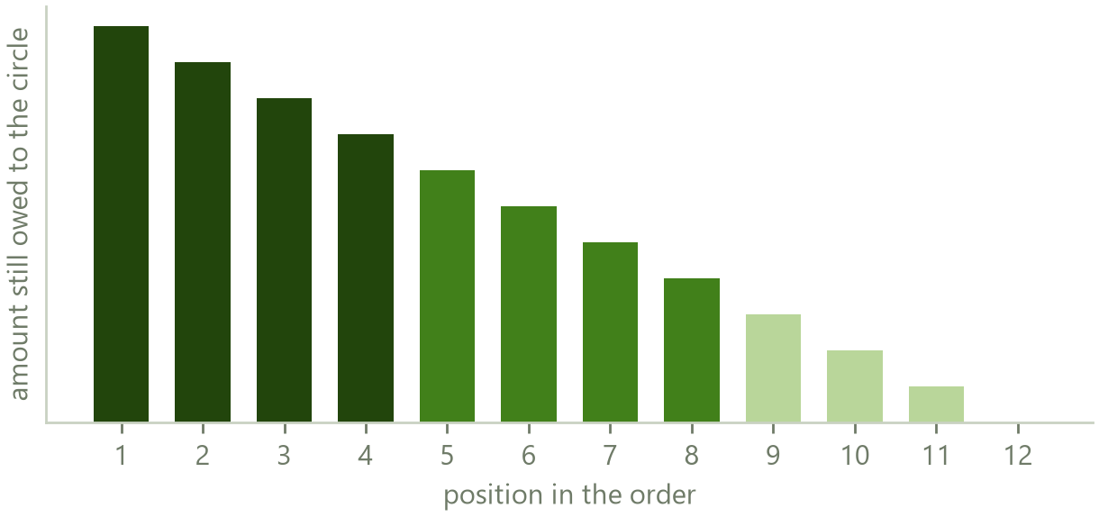
5 PREVENTING DEFAULT
The one thing at risk
When a member collects, they hold the whole pot and still owe every contribution that remains. That remaining obligation is the only thing at risk anywhere in the arrangement.
It is at its largest for whoever collects first, falls by one contribution with each later position, and is nothing at all for whoever collects last. Risk is not spread evenly across the members. It sits in the early positions and decays to zero.
This changes what the platform needs to build. It does not need a system for judging whether somebody is a good person. It needs a system that decides which member may occupy which position, which is a far narrower and far more tractable problem.
What a member still owes their circle immediately after collecting, by position.
Everything in this section follows from that one observation. Position gating, the new member rule, the vault, the auction rules and the asset structure are all answers to the same question: who is allowed to owe a lot.
Halqa · Confidential
34

Slide 35
5 PREVENTING DEFAULT
No incentive to default
The design does not try to make defaulting difficult for everybody. It ensures that the members carrying the largest obligation are the ones who have earned the right to carry it, and that everybody else has nothing to gain by leaving.
WHERE THE MEMBER SITS | WHAT THEY GAIN BY WALKING AWAY | WHAT THEY LOSE
The last positions, where every new member is placed | Nothing at all. By the time they collect they have already paid in almost everything they owe | Platform access, the credit record they joined to build, and a severe score event
The middle positions | A partial obligation, and one capped by their band ceiling | The same, plus a recovery case for the outstanding amount, penalties and a rehabilitation fee
The early positions | The largest obligation in the circle | The same, and these positions are only available to members with a long clean record they would be destroying
Any position in an asset circle | Possession of an item they do not legally own | The item itself, recovered by the party holding title, with the proceeds paid into the circle
Any position with pledged savings | Nothing. The shortfall settles from their own holding | The pledged holding, redeemed under an instruction they signed in advance
Any position in a known circle | The same as an open circle | The same, plus standing in a group of people who know them, which is the oldest enforcement mechanism there is
Read down the middle column. For most members in most positions the honest answer to what do I gain by defaulting is nothing, and that is a far stronger control than any collections process.
Halqa · Confidential
35

Slide 36
5 PREVENTING DEFAULT
The seven layers
 | LAYER | WHAT IT DOES
1 | Identity | The identity card is captured at signup, the home location is pinned, and uniqueness is enforced on the identity number, the telephone number and the electronic address. Every obligation binds to a government identity that cannot be duplicated on the platform
2 | Position | Band and tenure decide which positions may be claimed, holding the worst case exposure to a member the platform has never observed down to a small number of contributions
3 | Schedule | Collection on payday rather than the due date, escalating reminders, a balance check the evening before, and an internal grace window that is never shown to the member
4 | Price | The late fee ladder, with matched score damage at every step so the money cost and the record cost always move together
5 | Payout controls | A payout does not release while any contribution in that round is unpaid, a default on a linked account withholds it, and a security shortfall is withheld from the pot up to a ceiling so a member's turn is never emptied
6 | Consequence | Platform wide feature lock, an internal flag, and a recovery case for the outstanding amount plus penalties plus a rehabilitation fee, linked to identity and timestamped
7 | Contract | The signed undertaking, renewed weekly on open circles, and the personal guarantee executed automatically at joining, which runs member to member and expressly never to Halqa
Each layer works independently of the others, so no single failure exposes a circle. A member who gets past identity still meets position, and a member who gets past position still meets the payout gate.
Halqa · Confidential
36

Slide 37
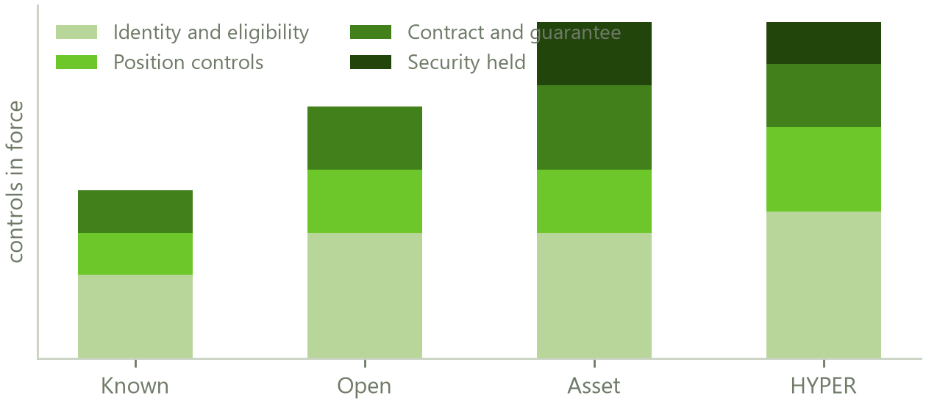
5 PREVENTING DEFAULT
How protection differs by product
 | WHAT IS DIFFERENT
Known | Lightest. No salary slip and no renewed undertaking. The personal guarantee, the host link confirmed from both ends, and the fact that members know one another carry the weight. The group absorbs a loss
Open | Heaviest identity and income work, because the members are strangers to each other. Halqa covers a missed contribution from the first round, so the platform carries the loss
Asset | Everything the open product has, plus legal title held by a trustee. The security is a physical thing that can be sold, which no other product has
Daily | Different in kind. Two months of daily earnings or a locked vault holding, positions fixed by auction and never traded, and exposure bounded by a small pot rather than a large one
Controls in force, by product.
The four products are not four risk levels of the same thing. Each one has a different party standing behind a failure, and that is the first question any banker or regulator should ask about each of them.
Halqa · Confidential
37

Slide 38
5 PREVENTING DEFAULT
Who stands behind a failure
 | KNOWN | OPEN | ASSET | DAILY
Who covers a missed contribution | The other members, under the personal guarantee | Halqa's cover facility, from the first round | The trustee sells the item; Halqa covers any residual | Halqa's cover facility
Is cover compulsory | No, optional | Yes | Yes | Yes
Facial verification | At joining | At joining plus the full trigger list | At joining plus the full trigger list | At joining plus the full trigger list
Income evidence | Not required | Required for the first half of the order | Required | Two months of daily earnings, or a locked vault holding equal to the pot
Signed undertaking | Once, at formation | Renewed weekly | Renewed weekly | Renewed weekly
Personal guarantee | Required | Required | Required | Required
Late fee ladder | Lighter | Steeper | Steeper | Steeper, with a daily cycle
Positions | Agreed by the group | Claimed, gated by band | Claimed, gated by band | Set once by auction, then fixed and untradeable
Can a position be sold later | Yes, on the marketplace | Yes, on the marketplace | No | No
Security held | None | None | Legal title to the item | The vault holding, where one was required
Exit at group approval | Group vote | No vote; the cover absorbs it | No vote; title protects the circle | No exit within the cycle
Halqa · Confidential
38

Slide 39
5 PREVENTING DEFAULT
The cover facility
On open, asset and daily circles, Halqa stands behind a missed contribution so the member whose turn it is still gets paid in full and on time. An earlier operator in another market did exactly this without pricing or capping it, and closed after nine years. Four properties stop that happening here.
PROPERTY | WHAT IT MEANS IN PRACTICE
It is priced | The fee charged on every contribution is set against the default rate that product is expected to carry, not chosen for marketing reasons. If the rate turns out higher, the price changes rather than the promise
It is capped, at four levels | Per circle, per host, per member, and in aggregate against the platform's own capital. No single circle, no single organiser and no single bad month can consume the facility
It is an advance, not a payment | Halqa steps into the circle's claim against the member who failed. The obligation does not disappear, it changes hands, and it is pursued
It is reinsured above the cap | Above the aggregate ceiling the exposure passes to a takaful operator, so a genuinely abnormal year does not fall on the company
Every price in the business depends on one number that has not yet been measured, which is the rate at which members actually default. The first hundred completed circles establish it and reprice the schedule. Saying that plainly is a stronger position than presenting the figures as settled, because it says the pricing is a model with a named input rather than a guess.
Halqa · Confidential
39

Slide 40
6 WHEN PREVENTION FAILS
What we can and cannot do
WE CAN | WE CANNOT
Withhold platform access and lock every feature | Have anybody arrested. Failing to pay a personal guarantee is a civil matter in Pakistan and carries no imprisonment
Record a default against a government identity and furnish it to the bureau, so it follows the person to every other lender | Publish a defaulter's home address, photograph or contact list. This is the practice behind the removal of roughly four hundred lending applications, and it is refused even where a member has consented
Withhold a payout in a linked circle, up to a ceiling, so a member's turn is reduced but never emptied | Take money from an account we do not have a signed instruction for
Instruct a trustee to redeem a pledged holding, under a mandate the member signed before the circle started | Seize anything ourselves. Halqa instructs a trustee under a pre signed mandate, or hands an evidence pack to a counterparty or a court
Assemble a complete evidence pack and pursue a summary suit | Promise speed. A court decree takes months, and no material we produce says otherwise
Enforce against a physical item in an asset circle, through the party holding title | Contact an employer, a family member or a neighbour
The right hand column is not a list of limitations to apologise for. It is the list of things that get lending applications banned, and staying off it is why this one will still be in the store in three years.
Halqa · Confidential
40

Slide 41
6 WHEN PREVENTION FAILS
The instruments, and the order they are used
 | STEP | WHAT IT IS
1 | Pledged savings | Redeemed by the trustee under the instruction signed at the moment of pledging, paid directly to the round's recipient. Halqa never receives the money
2 | Unpledged savings | Only under a separate signed set off clause, and only after notice with a seven day period to put it right
3 | Withholding in live circles | Applied in a fixed order and capped at a share of the pot, so a member's own turn is reduced rather than destroyed
4 | The item, in asset circles | The trustee enforces, sells, and pays the proceeds into the circle. Any surplus goes back to the member
5 | The cover facility's claim | Halqa steps into the circle's claim on subrogation and pursues it as an advance
6 | Recovery case | Outstanding amount plus penalties plus a rehabilitation fee, identity linked and timestamped, enforceable by summary suit
INSTRUMENT | WHAT IT GIVES US
The undertaking | Electronically signed, renewed weekly on financial circles, admissible under the Electronic Transactions Ordinance 2002. Stored with a hash of the document, the signing address and a timestamp. A written contract for a fixed sum permits recovery by summary suit
The personal guarantee | Executed automatically inside the join transaction. It runs member to member and expressly not to Halqa, so the circle rather than the platform holds the claim
Consent to bureau reporting | Contained in the undertaking, alongside consent to automatic collection
Consent to service of notice | Given at signup, at the pinned address, so recovery does not stall on locating the person
The evidence pack | Undertaking, guarantee, identity linkage, address, timestamped payment history, circle message log and signature hashes, assembled on demand. Provided to counsel or a court, never to the circle
Two conditions do not bend. Set off operates in favour of the circle's members and never in favour of Halqa. And Halqa seizes nothing itself, in any product, ever.
Halqa · Confidential
41

Slide 42
7 THE PRODUCTS
The range, and which are financial
PRODUCT | TYPE | WHO IT IS FOR | WHAT MAKES IT DIFFERENT
Known circles | Social | People who already know one another, which is how committees work today | Formed inside an existing relationship. Almost no verification, because the group has already done it. The group carries a loss, not Halqa
Open circles | Financial | People who want a circle but have nobody to form one with | Does not exist in the informal market at all, because strangers have no way to trust one another without a record
Daily circles | Financial | Daily wage earners, the largest excluded group, who have no savings product today | Built around income that arrives daily rather than monthly, which every monthly product structurally excludes
Asset circles | Financial | Members saving towards a specific named item | The only product where the security is a physical thing that can be sold
The savings layer | Financial | Any member, alongside any circle | Money that earns nothing today earns a return, and pledged, it becomes the strongest default control in the model
The turn marketplace | Financial | Members whose circumstances changed after they joined | Lets two members trade positions without Halqa taking any position in the trade
The distinction on the second column is not cosmetic. A social product is one where the trust already exists and the platform only records it. A financial product is one where the platform manufactures trust that was not there before, which is what requires verification, cover and price.
Halqa · Confidential
42

Slide 43
7 KNOWN CIRCLES
The social product
A known circle is people who already trust each other. A mother and her sisters, a shop's staff, a street's traders. The trust is not something Halqa creates or underwrites, it already exists, and the platform's job is only to keep the record and move the money reliably. It is therefore deliberately the lightest product in the range.
FEATURE | HOW IT WORKS
What is required to join | Identity only. The identity card, the phone number and a collection account. Nothing else
What is not required | No salary slip, no income verification, no proof of employment, no bank statement, no facial verification beyond joining, and no renewed weekly undertaking
The one contract | The personal guarantee, signed once at formation. It runs member to member, never to Halqa
The ceiling | A member may hold a maximum of three known circles at once. This is the only hard limit on the product and it exists because the platform is not verifying capacity, so it bounds exposure by count instead
Who forms it | A host, who invites specific people. There is no discovery and no matching. If you were not invited you cannot see it
Positions | Agreed inside the group, the way they always have been. Not gated by score
Cover | Optional. If the group does not take it, the group absorbs a loss between its remaining members
Late fees | Lighter than the financial products, because the enforcement here is social and the fee is a nudge rather than a deterrent
What the member still gets | The full record. Every settlement is receipted, timestamped and furnished to the bureau exactly as it is on a financial product. The credit history built here is worth precisely as much
This is the product that meets people where they already are. It asks almost nothing of them and gives them the one thing the informal version never could, which is proof.
Halqa · Confidential
43

Slide 44
7 OPEN CIRCLES
The financial product
FEATURE | HOW IT WORKS
What is required to join | Everything in the ten step registration, plus income evidence for any position in the first half of the order, plus facial verification at joining and on the full trigger list thereafter
Who forms it | The platform, by matching strangers who never meet. This is the product that does not exist informally
Positions | Claimed by the member, gated by their score band. Ineligible positions are not displayed
The new member rule | One of the last three positions only, until two circles have been completed cleanly and a manual check has passed
Contracts | The personal guarantee, plus an undertaking renewed weekly, plus recorded consent to automatic collection and bureau reporting
Cover | Compulsory. Halqa covers a missed contribution from the first round, so the member whose turn it is is paid in full and on time regardless
Concurrency | One circle if income is unverified, four if verified
Late fees | A three step escalating ladder, steeper than the social product, with matched score damage at every step
Positions tradeable | Yes, on the turn marketplace, subject to the buyer being eligible for the position they take on
Who carries a loss | Halqa, through the cover facility, which then pursues the member who failed
Everything heavier in this column exists for one reason: the members are strangers. The verification and the cover are what stand in for the relationship a known circle already has.
Halqa · Confidential
44

Slide 45
7 HYPER COMMITTEES
The daily product, in numbers
Rs 15,000
400
60 days
15%
The pot ceiling. Sixty daily contributions of Rs 250. This is a hard cap, not a guideline
Members, fixed. Six or seven collect every single day
Fixed. Short enough that a drift of defaults cannot compound
Halqa's fee, charged as a percentage here rather than the Rs 100 flat fee
Why the pot is capped at Rs 15,000
Why the fee is a percentage here
A daily wage earner takes home somewhere between Rs 800 and Rs 1,500 on a working day. Rs 250 is a share of that they can carry.
The cap also bounds the platform's exposure. The most any one member can cost is one pot, and one pot is Rs 15,000. Four hundred members do not create four hundred pots of risk.
Rs 100 flat on a Rs 250 contribution would be a forty per cent charge. That is the shape of the lending applications the regulator removed, and it would not survive an app store review, let alone SECP.
Fifteen per cent is Rs 37.50 a day. Across the cycle a member pays Rs 2,250 to move Rs 15,000, and the committee generates Rs 900,000 of fee income.
Halqa · Confidential
45

Slide 46
7 HYPER COMMITTEES
Getting in, and the opening auction
STAGE | RULE | WHY IT IS DRAWN THIS WAY
Entry, route one | Two months of demonstrated daily earning: a ride hailing or delivery account showing daily history, a photographed trading licence or shop registration with two months of takings recorded in the app, or two months of Halqa's own collection record | There is no payslip in this population, so the evidence has to be behavioural
Entry, route two | A vault holding equal to the full Rs 15,000 pot, locked for the sixty days, held by the trustee in the member's own name and earning a return while it sits there | Reduces that member's expected loss to zero by construction. The shortfall settles from their own units under an instruction signed before the circle opened
Bidding window | Twenty four hours, opening when the roster of four hundred completes and before the first contribution falls due | Everyone reconsiders together rather than each on their own join date
What is bid for | One single named day. A member may place as many bids as they like, but every bid must be for that one day | Bidding across several days would let one member corner the early half of the order
What is visible | The standing highest bid on each day, so a member can price a position. No bidder is identified at any point | Price discovery without revealing who is desperate
Eligibility inside the auction | A bid is refused at the moment of placing where the member's band or affordability does not permit that day | The early days cannot simply be bought by whoever bids most, which is the failure mode of an open auction
Allocation and ballot | Each day carries six or seven places, taken by the highest bids. Members who did not bid, and members who were outbid, are assigned to the remaining days by a verifiable ballot. Only a winning bid is charged | Nobody is excluded for not bidding
Afterwards | Positions are fixed for the whole cycle. They may not be sold, bought or altered, and HYPER does not appear on the turn marketplace | Sixty days is too short for a secondary market to clear honestly
Halqa · Confidential
46

Slide 47
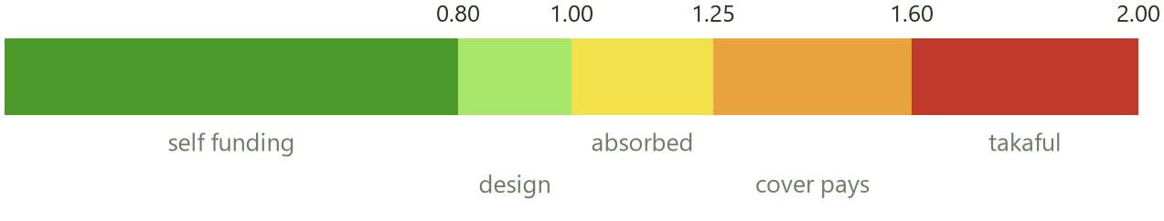
7 HYPER COMMITTEES
The exposure score
A HYPER committee can fail in an unlimited number of ways. Ten members might stop on day three, forty on day thirty, one on day fifty nine. The platform cannot enumerate those possibilities and should not try. It turns out it does not have to, because every one of them collapses onto two numbers: how many members defaulted, and the average day on which those members had collected their pot.
R = members who defaulted × (contribution + fee) × (days remaining on average) ÷ total fee income
R is dimensionless. At R = 1 the committee's fee income exactly covers what it advanced.
The score is computed live, every day, from defaults actually observed. It is not a forecast and it needs no assumption about the future, which is what makes it usable as an automatic trigger rather than a report.
Halqa · Confidential
47

Slide 48
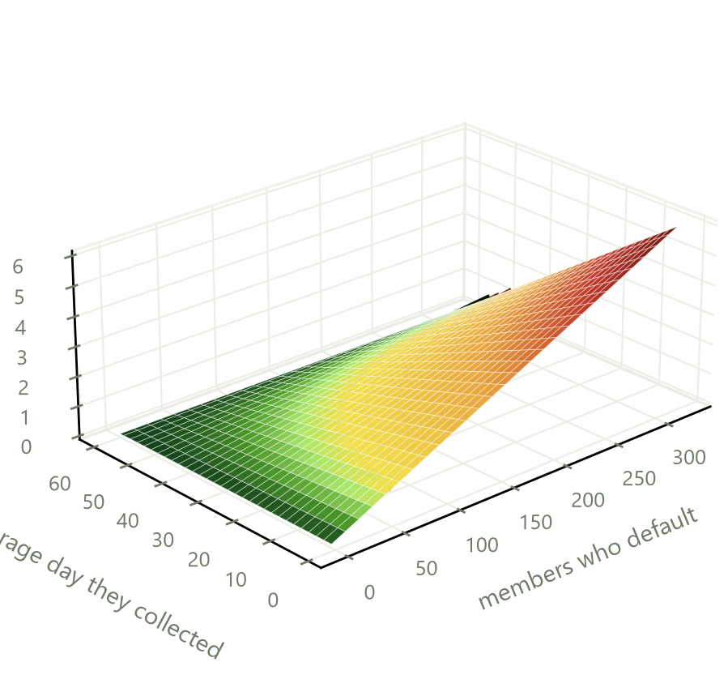
7 HYPER COMMITTEES
What the score does automatically
SCORE | STATE | WHAT THE SYSTEM DOES WITHOUT BEING ASKED
Below 0.80 | Self funding | Nothing. The committee is paying for itself with margin
0.80 to 1.00 | Design band | Nothing. This is where a normal cycle sits
1.00 to 1.25 | Absorbing | The circle's own other revenue covers it: auction premiums taken before day one, the fee uplift, and late fees. New admissions to that tier tighten and the next cohort's auction reserve rises
1.25 to 1.60 | Cover engages | The cover facility pays. The circle continues and every member is paid on time. Halqa carries it and pursues the defaulters as advances
Above 1.60 | Takaful attaches | The aggregate cap is reached and the exposure passes to the takaful operator
The black line on the surface is R = 1. The two dashed lines behind it are the cover trigger and the reinsurance attachment. Everything green is a committee paying for itself.
Loss
Break even
Profit
Halqa · Confidential
48

Slide 49
7 HYPER COMMITTEES
Thirty per cent of members defaulting is survivable.
Ten per cent defaulting in the first week is not.
The score separates those two cases, which a default rate on its own cannot. Twelve members walking on day fifty produces a score of 0.19 and a profitable committee. The same twelve walking on day five produces 1.75 and a claim. Same rate, same people, opposite outcome.
This is why every control in the daily product is a control on who occupies the early days.

Slide 50
7 ASSET CIRCLES
Buying a thing rather than saving for one
How it works
Why the law already allows this
The host names the item: a motorcycle, a sewing machine, a refrigerator, a rickshaw. The circle runs like any other, but the pot is never paid to the member in cash. It is paid directly to the dealer, who releases the item.
The member takes possession on their turn. Legal title does not pass to them, and is held by a security trustee until that member has finished paying.
Under the Sale of Goods Act 1930 property in goods passes when the parties intend it to pass, and a seller may reserve the right of disposal until conditions are met. Retention of title is ordinary commercial law, used every day in vehicle finance.
This is the only product where a default is answered by selling something rather than by pursuing somebody, which is why a banker understands it fastest.
DETAIL | HOW IT IS SET
Who is paid | The dealer, directly, on the member's turn. The money never passes through Halqa or through the member
Who holds title | A security trustee, on behalf of the circle's members, not on behalf of Halqa
When title transfers | On discharge of that member's obligation. Every member's contributions end on the same round, so possession dates differ and title dates do not
If the member stops | The trustee enforces, sells, and pays the proceeds into the circle. Any surplus goes back to the member
If the circle collapses | Each retention still stands on its own. No member's title depends on any other member's conduct
The exposed window | Roughly the first four rounds, where what is owed still exceeds what a forced sale would recover. After that the security exceeds the obligation and the exposure is zero
The deposit option | A deposit from the member closes even that window. A modest one roughly halves it, and it is a realistic thing to negotiate with a dealer who wants the volume
Who else can hold title | Orix Modaraba, First Habib Modaraba or Allied Rental Modaraba can hold title and write a lease without Halqa holding any financing licence
Halqa · Confidential
50

Slide 51
7 THE SAVINGS LAYER
Three vaults, one holding
Committee money earns nothing while it waits, which against Pakistani inflation is a straightforward loss. The savings layer fixes that without Halqa ever touching a rupee of it.
Growth vault
Safety vault
Float
Voluntary savings into a licensed Islamic money market fund. Units are registered in the member's own name and held by the trustee. Money that earns nothing today earns a return, and the member can withdraw it whenever they like.
The same holding, pledged. A charge in favour of the circle, plus an irrevocable redemption instruction signed at the moment of pledging. A member cannot default beyond their pledged holding, which is what makes the daily product and higher risk tiers possible at all.
Contributions collected between payday and payout day buy units in the payer's own name and redeem on payout day. Small per member, and it is a member benefit rather than a revenue line.
QUESTION A REGULATOR WILL ASK | ANSWER
Who holds the money | A licensed trustee, in the member's own name. Not Halqa, and not on anybody's balance sheet but the member's
What is Halqa registered as | A mutual fund distributor. It introduces members and passes instructions. It is not an electronic money licence, because no balance is issued, and not a non banking finance licence, because Halqa deploys nothing
Can a payout ever wait on a redemption | No. This is an absolute engineering rule. If a redemption is slow the circle pays out anyway and the redemption settles behind it
Who receives redemption proceeds | The member, or on a pledge, the round's recipient directly. Halqa is never the payee
Halqa · Confidential
51

Slide 52
7 THE SAVINGS LAYER
Mahaana, and why liquidity is the whole question
What Mahaana is and how it operates
Why we need two to three day liquidity, not thirty
Mahaana Wealth is Pakistan's first digital only asset management company licensed by SECP and a member of the Mutual Funds Association of Pakistan. An account opens in under ten minutes, which matters when the member is on a Rs 15,000 handset.
Cash placed through their Save+ product goes into the Mahaana Islamic Cash Fund, which holds short term Shariah compliant instruments: government sukuk, corporate sukuk and bank placements. Those are the lowest risk, shortest duration assets available in this market, which is exactly the right shape for money that has to come back quickly.
Halqa is the distributor. The trustee holds the units. Mahaana manages them. Three separate parties, which is the point.
The float feature is the reason. Automatic collection fires on the member's payday, which may be the first of the month. The payout releases on the tenth, or whatever date the host configured. That gap is real money sitting idle for up to nine days, across every member of every circle.
Placing it earns a return for the member. But the payout date is fixed and cannot move, so the fund must be able to return the money inside that window with certainty, not usually. A money market fund settling in two to three days works. Anything longer does not, and no yield is worth a missed payout.
So the savings layer uses cash and money market funds only for float. Equity and retirement products stay member choices in the growth vault.
Three conditions on any fund used for float: settlement inside the payout window with a written service level, daily dividend accrual, and no exit load. Al Meezan, NBP, UBL, Alfalah, HBL and Atlas all run Islamic money market funds built for same or next day redemption, so terms are negotiable.
Halqa · Confidential
52

Slide 53
7 THE SAVINGS LAYER
The float, and the host's window
1
2
3
4
Payday
Idle
Placed
Redeemed
Collection fires on the morning pay lands, which for a government salary is the first and for private payroll is the first to the seventh
The money now sits until the payout date. On a first-of-month payday and a tenth-of-month payout, that is nine days
Units are bought in the paying member's own name, held by the trustee. Not pooled, not in Halqa's name, not a Halqa asset
Units redeem on payout day. The return goes to the member. The pot releases at nine in the morning regardless
THE HOST'S KNOB | WHAT IT DOES
At creation the host sets how early their members usually pay, from zero up to the full period length | This is a real field on the circle, defaulting to payment at round open
It scales the projected float in every estimate the member sees | The coverage and bonus chart on the creation screen, the growth chart inside the committee, and every projection all move with it
It is an estimate input, not a promise | Early payment is expected, never enforced. Actual float profit is computed from real payment timestamps, not from the assumption
The projection is a host's expectation shown as an estimate. The number in the member's statement is computed from when they actually paid.
Halqa · Confidential
53

Slide 54
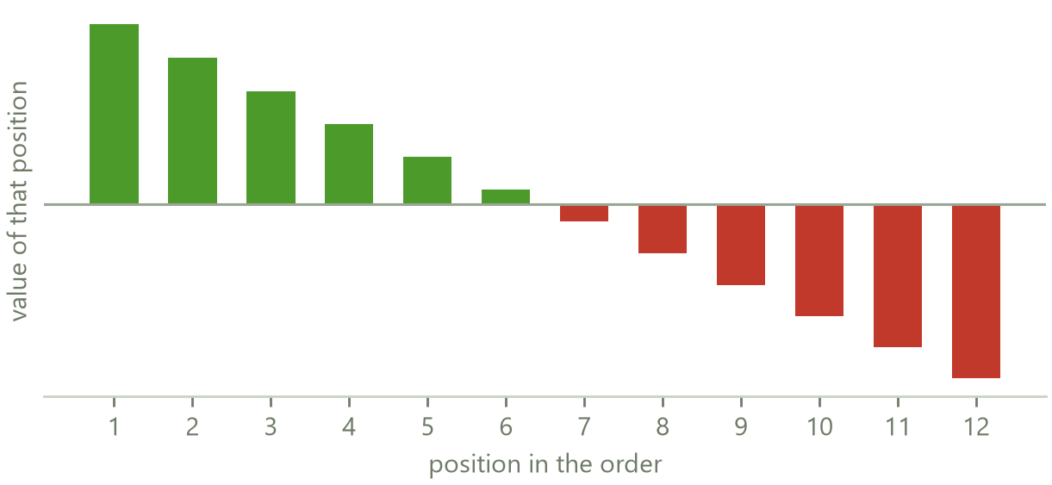
7 TIME VALUE
Why the last position is paid more than the first
Every member pays the same total and receives the same total, so on paper nobody gains. That is true in rupees and false in economics. A lump sum in month one is worth more than the same sum in month twelve, and every member already knows it, which is why they argue about who goes first.
The first position carries real positive value. The last carries an equal negative. On a twelve month circle the gap between them is close to ten per cent of the pot.
That value is not created by Halqa and it is not destroyed. It moves from the members who wait to the members who go first. The only question is whether the arrangement prices it openly or pretends it does not exist.
So Halqa prices it in both directions. Early positions pay a fee that tapers away. Late positions are credited out of what the early ones paid, so every member finishes economically level rather than merely level in nominal rupees.
Nobody else in the market does this, because it requires admitting the value exists.
What each position is economically worth, at an ordinary household cost of money.
Halqa · Confidential
54

Slide 55
7 THE TURN MARKETPLACE
Letting two members trade
Why it exists
The rules on it
Members do not value their positions identically, because they do not face the same cost of money. A member with a medical bill this month and a member saving for a wedding next year sit on opposite sides of the same order.
Letting them trade makes both better off. Halqa takes a commission on the premium and never a position in the trade.
The buyer must independently qualify for the position they are taking on. A member barred from the first half by their band cannot buy their way into it, which is the whole point of the gate.
The premium is capped as a share of the payout so a distressed seller cannot be stripped. Bids and the accepted premium are recorded. On tiers labelled Shariah compliant the premium is zero and only the position swaps.
Daily circles are excluded entirely.
This and the early position fee are two halves of the same idea: position has value, so make it visible and let it be priced, rather than letting it be settled by whoever argues hardest.
Halqa · Confidential
55

Slide 56
7 GOLD GOAL CIRCLES
The differentiator nobody else can copy cleanly
How it works
Why it is cleaner than the competition
An ordinary rupee circle, except the host sets the goal in grams or tolas of gold rather than in rupees. The application shows the live rupee price per gram, sizes contributions to hit the gram target, and on payout day gives the member cash plus a one tap purchase at that day's spot price.
The member carries the price movement until their turn, which is the honest position. The ledger shows grams and rupees side by side throughout.
The established competitor locks today's gold price for delivery six to ten months later and markets that as Shariah compliant. Under the majority view of bay al-sarf, gold against currency must settle in the same session, so a deferred exchange of that kind is precisely what the rule prohibits.
A spot settled goal circle has no deferral in it. It is genuinely cleaner, and per our own standing rule only that variant is labelled Shariah compliant.
STAGE | WHAT IS NEEDED
Now, shippable | Cash payout plus assisted purchase. No custody, no licence, no partner. This is buildable against the existing engine
Later | Physical allocated delivery needs a refiner or vault partner, which is the only part that requires a counterparty
Before any Shariah label | The exact contract wording confirmed by a mufti. It is an edge case under AAOIFI Standard 57 over a multi month tenure, and it should not be claimed until it is confirmed
Halqa · Confidential
56

Slide 57
7 TIERS
The five engines a circle can run on
Every circle runs on one of five engines, chosen by the host at creation. They differ in what happens to money between collection and payout, and in what the member gets back.
TIER | WHAT IT DOES | WHO IT SUITS
Basic | The plain rotating circle. Money collects and pays out, nothing else happens to it | Members who want the committee and nothing more, and every Shariah conservative group
Earn | The float is placed while it waits, and the return goes back to the member | Members who would otherwise leave money idle for nine days a month
Earn and Share | The float earns and part of the return is shared across the circle rather than only to the payer | Groups who want the benefit spread evenly regardless of who paid early
Early Access | Priority on position claiming, and reduced friction on the marketplace | Members with a proven record who value going early
Maximum | Everything above, with the highest limits and the fullest feature set | Long tenure members with several completed circles
The tier is a property of the circle, set once by the host, and is shown to every member before they commit. It is not something Halqa changes underneath a running circle.
Halqa · Confidential
57

Slide 58
7 LEAVING
There is no cancel button
A committee is a promise to eleven other people. A one tap cancel would be a promise nobody has to keep. But a member whose circumstances genuinely change must have a way out that does not destroy them, so leaving is a ladder of five rungs rather than a button.
 | RUNG | HOW IT WORKS | WHAT IT COSTS
1 | Window withdrawal | Inside the twenty four hour confirmation window after the host starts the circle, any member may withdraw. Free, silent, and no record is kept | Nothing at all
2 | Substitution | The member finds or is found a replacement, who pays the leaver back everything they have contributed, directly. The circle never notices | No fine. This is the intended route for the great majority of exits
3 | Group approved exit | A vote of the circle. Seventy two hours, majority of votes cast excluding the requester, fifty per cent quorum. No quorum escalates to Halqa review rather than trapping the member. The host votes as one member and breaks ties, with no veto | One installment, and restitution settled at the end of the cycle
4 | Hardship exit | A recorded statement to the helpline, with a voice note option because only about a third of this population can read a text message | The fine is waived, and the record is annotated as hardship, expressly not as a default
5 | Abandonment | Not an exit. The member simply stops. The full recovery machinery applies and restitution is withheld and set off | Everything in section six
This governs members who have not yet collected. A member who takes the pot and then stops is not exiting, and is handled entirely differently.
Halqa · Confidential
58

Slide 59
7 LEAVING
How the money comes back without anybody holding it
The rule is that a leaver gets their money back at the end of the cycle. Halqa holds no pool it could pay them from, so the arithmetic has to do the work instead. It does, exactly.
The reasoning
Why this is the right answer
A member exits after paying four installments without having collected. The circle shrinks from twelve members to eleven, so every remaining pot shrinks by exactly one contribution.
The members who already collected in rounds one to four received the larger pot. Each of them therefore ends the cycle ahead by exactly one contribution.
So each of those four owes the leaver exactly one contribution, settled at completion. Four collectors, one contribution each. The leaver is made whole.
It needs no float, no reserve and no custody. It is a ledger identity, not a payment promise, and it holds recursively when several members leave.
It is settled in nominal rupees with no time value added, which is itself the deterrent against casual exit.
At close the invariant is exact: every continuing member has received minus paid equal to zero, and every exited member is returned to zero. An auditor can test that rather than trust a policy.
The exit fine routes seventy per cent to the remaining members, whose pots shrank. Halqa never profits from distress.
Halqa · Confidential
59

Slide 60
7 JOINING
The twenty four hour window
1
2
3
4
Host starts
Everyone sees everything
Agreements are signed
Free withdrawal
The host presses start. The roster locks to new joins immediately, so nobody can be added after the members have seen who is in
Final roster, position order, and each member's own total forward obligation stated in rupees, not in installments
The undertaking and the personal guarantee are executed inside this window, against a document version and a timestamp
Any member may withdraw during the twenty four hours. Free, silent, no record. If it drops below the minimum the circle returns to forming
The window runs from the start press, not from each member's join date, so everybody reconsiders at the same moment with the same information in front of them. The State Bank already mandates a two hour cooling period on branchless banking cash outs, so the principle is established in this market.
Halqa · Confidential
60

Slide 61
8 REWARDS
What the reward system is for
On time payment is the single input on which the whole model rests. Expected loss, the price, the score and the value of the data asset all move with it. The reward system is therefore attached to that one behaviour and to nothing else, and it is funded by somebody other than Halqa.
WHAT EARNS SOMETHING | WHAT IT EARNS | WHAT IT DELIBERATELY DOES NOT DO
Paying on or before the due date | Points, a small score gain, and the streak advances | It does not compound without limit. The score gain is capped per cycle so it cannot be farmed
Paying several days early | More points, the same score gain | It does not buy a better position. Only band and tenure do that
Each consecutive clean round | A multiplier on points, up to a ceiling | The multiplier applies to points only, never to score
Completing a circle cleanly | A large points award and the streak carries into the next circle | Nothing carries if the circle was not completed
Paying a contribution for another member | Points, but no streak and no score | A wealthier friend cannot buy anybody a record. This is the most important exclusion in the system
A missed contribution | The streak resets to zero | Points already earned are not confiscated. The punishment is the fee ladder and the score, not a clawback
Points and score stay strictly separable. Points buy discounts. Score gates positions. Points never buy score, and score is never sold.
Halqa · Confidential
61

Slide 62
8 REWARDS
The ladder, and who pays for it
CONSECUTIVE ROUNDS PAID ON TIME | WHAT THE MEMBER GETS
Three | A modest discount code with a partner retailer
Six | A larger discount, plus delivery waived
Twelve | A larger discount again, or one month of the Halqa charge waived
Eighteen | A category offer, or the position placement fee waived on the next circle
Twenty four | A larger category offer, or the early position fee waived on the next circle
Thirty six | The top tier offer, or the early position fee and a month of charges waived
Any circle completed cleanly | A completion offer and a large points award
The discount at every tier is the retailer's own promotional discount, extended to an audience qualified by a year or more of demonstrated payment behaviour. For the retailer that is customer acquisition spend, not a favour, and it reaches a segment they cannot otherwise identify.
Halqa earns an affiliate commission on the resulting order. So the reward is the retailer's discount and the revenue is the retailer's commission, which means the system funds itself and grows with members rather than with circles.
It ships in four stages. First, waiving Halqa's own charges, which needs no counterparty at all. Then affiliate registration, which is a form rather than a negotiation. Then direct merchant agreements with exclusive codes and placement. Then direct payment, where a goal circle's pot is paid to the retailer for a named item and they pay a commission on the value brokered.
Rewards are never redeemable for cash, are capped as a share of contributions, and release only against contributions that have actually settled. Retailers to approach are the general marketplaces, the electronics and home retailers, the grocery chains and the delivery platforms. Halqa receives order attribution, never basket contents, and purchase behaviour is not sold to anybody.
Halqa · Confidential
62

Slide 63
9 SECURITY
What we are defending against
Holding no member money removes the largest prize but not the others. Six attacks are worth defending against, ranked by what they would genuinely be worth to somebody attempting them.
 | THE ATTACK | WHAT IT WOULD GAIN | WHAT STOPS IT
1 | An impersonated exit or hardship claim | A payout released to the wrong person, or an obligation written off | Facial verification fired on every exit request, the application PIN, and a manual review sample
2 | Account takeover with a stolen credential | Access to a member's circles and their payout | Session tokens that rotate, reuse of an old token burning the entire family, a facial check on any new device, and a PIN held only in memory
3 | A synthetic or borrowed identity at signup | A circle position with no real person behind it | Card capture, account title match, national database verification and biometrics, and uniqueness enforced on identity number, telephone number and address
4 | One person assembling an artificial circle | A pot funded by the cover facility and never repaid | Host concurrency ceilings, the host link confirmed from both ends, and every new member restricted to the last positions
5 | A double charge or double payout through a retry | Nothing for an attacker, but a real loss and a real trust failure | The unique reference on every write, and reconciliation by that reference before anything is retried
6 | Data exfiltration | Identity numbers and payment histories of every member | Parameterised database access throughout, no raw biometrics or card numbers stored at all, an append only audit log, and encryption in transit and at rest
Halqa · Confidential
63

Slide 64
9 SECURITY
The controls
LAYER | CONTROL | STATE
Transport | Encrypted in transit with strict transport security enforced, and a content security policy on both applications | Live
Credentials | Passwords hashed with a deliberately slow algorithm at high cost. Secret strength is asserted when the service boots, so it refuses to start weak | Live
Sessions | Short lived access tokens with rotating refresh tokens. Reusing an old refresh token burns the whole family, so a stolen token cannot be replayed | Live
Second factor | The application PIN on every open, every commitment to a circle, every exit request and every payout release, separate from the password | Live
Device biometric | Layered on the PIN where the handset supports it. It never leaves the device and is neither transmitted nor stored | Live
Brute force | Five failed attempts locks the account for fifteen minutes. Thirty in fifteen minutes is blocked outright. Login timing is constant, so accounts cannot be enumerated by watching response times | Live
Injection | Every database query is parameterised through a typed layer, so building a query by joining strings together is structurally unavailable rather than merely discouraged | Live
Audit | An append only audit log and a separate security event table. Every consent, signature and administrative action carries an actor and a timestamp | Live
Dependencies | No known vulnerabilities in the application packages at the last check | Live
Independent assurance | External penetration test and a formal secure code review | Before public launch
Posture assessed internally at B plus. The gap to A is the two items marked before launch, and they are named here rather than left out.
Halqa · Confidential
64

Slide 65
9 SECURITY
What we refuse to collect
Roughly four hundred lending applications were removed from Pakistani app stores for the permissions they demanded rather than for the money they lent. Every item below would improve Halqa's underwriting, and every one is refused, because the cost of holding it is delisting, a regulator, or both.
REFUSED | WHAT IT WOULD HAVE GIVEN US | WHY IT IS REFUSED
Contact list access | A social graph to apply collection pressure through | The single practice most associated with the removals, and the one the regulator named
Photo gallery access | Documents and proof of assets | No proportionate purpose, and impossible to justify to a store reviewer
Message reading | Bank credit alerts scraped out of text messages | Reads every private message a person has, to obtain a handful of numbers
Accessibility service screen scraping | Live bank balances with no partnership needed | Rejected early in the design. It is the delisting trap, and no balance figure is worth it
Background location | Movement patterns and workplace confirmation | One precise pin at signup, given with consent, is sufficient and defensible
Full card numbers and security codes | Simpler repeat charging | Never written down. Brand, last four digits, expiry and holder only
Raw biometric templates and facial images | Matching in house | Only the verification result and a reference are kept. The template stays with the national authority
The permissions a lender demands are the fastest signal a regulator has for how it intends to collect. Halqa asks for less than a food delivery application does.
Halqa · Confidential
65

Slide 66
9 ENGINEERING
The guarantees underneath
GUARANTEE | WHAT IT MEANS | WHY IT MATTERS TO A BANKER
Money is held as whole units, never as decimals | No fractional arithmetic anywhere in the money path. Rates are applied as whole basis points | Decimal arithmetic on a computer produces tiny residues that are invisible until a reconciliation fails. This removes the entire class of error
Every movement writes two matching entries | Each settlement writes a debit and a credit that must cancel out | The ledger checks itself. A one sided write is detectable rather than silent, which is the property an auditor is actually looking for
Every instruction carries a unique reference | A retried request applies once and only once | This is idempotency. It is why a member on a bad connection cannot be charged twice, and why reconciliation is possible at all
Receipts commit with the money | The receipt and the queued message are written inside the same transaction as the settlement | There is no state in which money moved and no receipt exists, or the reverse
Database changes only ever add | Nothing is dropped or renamed during a release | Old and new code both stay correct while a release rolls out, so there is no window in which the application is broken
Enforcement runs on a server, not in the app | The overdue sweep is a scheduled job, not something triggered by a member opening the application | Enforcement cannot depend on the person being enforced against opening anything
Sixty unit tests and three hundred and fifty two integration tests pass. The integration suite exercises the money paths end to end rather than simulating them, which is the only way these six can be asserted rather than merely claimed.
Halqa · Confidential
66

Slide 67
9 SECURITY
The secure treasury function
Halqa holds no member money, but it does hold three things a treasury function has to control: the working balance behind the cover facility, the fee income it earns, and the instruction authority to move other people's money. Each is separated from the others.
CONTROL | HOW IT WORKS
Segregation | Fee income, the cover facility working balance and operating cash are three separate accounts with three separate authorities. The cover balance is never available to operations, so it cannot be spent on payroll in a bad month
Instruction authority is not payment authority | The platform can instruct the aggregator to move money between two members. It cannot instruct a payment to itself, to an employee, or to any account not registered as a circle participant. That restriction is enforced in the payment layer, not by policy
Dual control on any outbound | Any movement out of a Halqa account requires two named approvers, and an approver cannot approve a payment they initiated
Daily reconciliation | The internal ledger is reconciled daily against the aggregator's settlement file and against bank statements. Breaks are worked the same day, and an unreconciled break older than one business day escalates automatically
Cover facility discipline | Reserves are held against the facility rather than promised out of future revenue, capped per circle, per host, per member and in aggregate, and reinsured above the aggregate cap
No float in Halqa's name | Money placed between payday and payout buys units in the paying member's own name, held by the trustee. It never appears as a Halqa asset, so it cannot be reached by a Halqa creditor
Segregation of duties in engineering | The people who can deploy code cannot approve payments. Production database credentials are separate from application credentials and are not held by the same people
Halqa · Confidential
67

Slide 68
9 SECURITY
Anti money laundering, and why this model is a hard target
Why the architecture itself is the first control
The controls on top of it
Money laundering needs three things: placement, layering and integration. A committee run on Halqa is a bad instrument for all three.
There is no placement, because Halqa never accepts cash and never holds a balance. Money enters from a bank account or wallet that has already been through somebody else's customer checks, on a rail operated by a licensed institution.
There is no layering, because every rupee moves from one named identity card to another named identity card on a fixed published schedule, and the whole path is written to an append only ledger.
And the amounts are wrong. A member moves a fixed sum on a schedule anybody can read in advance. Nobody launders through an instrument that publishes what it will do next month.
Every member is identified against the national database at signup, with the identity number, the registered account title and, on financial products, biometric verification. There is no anonymous participation and no account opened on a number alone.
Uniqueness is enforced on the identity number, the telephone number and the electronic address, so one person cannot become several members.
Device and network clustering is monitored. Several accounts operating from one device or one address is an automatic denial, which is also the anti fraud control.
The host concurrency ceiling exists for the same reason: one person assembling an artificial network of circles is both the fraud topology and the laundering topology, so one control answers both.
Roster overlap across circles is monitored, and unusual patterns are escalated for human review with the evidence pack already assembled.
The regulated party on the rail is the licensed aggregator, which carries the transaction monitoring obligation on the payment itself. Halqa's obligation is the identity and pattern layer above it, and that is where these controls sit.
Halqa · Confidential
68

Slide 69
9 THE APPLICATION
Customisation and personalisation
A committee is a personal arrangement between people who mostly know each other. An application that looks like a bank statement gets used once. Members are given real control over how the product looks and how it talks to them.
The member
The look
The circle
Profile photograph, chosen or taken in the app. Display name separate from the legal name held for verification. Language switched between Urdu and English at any point, with regional greetings. Text size, and a high contrast mode for older members.
Accent colour chosen from a set, light and dark themes, and a home screen the member arranges themselves by pinning the quick actions they actually use and hiding the ones they do not.
A host names the circle, sets a cover image and an emblem, and writes a short description that every invited member sees before joining. Members see the circle the way its host meant it, not as a reference number.
WHAT ELSE THE MEMBER CONTROLS | WHY IT IS A CONTROL RATHER THAN A SETTING
Which notifications arrive, on which channel, at what time | A reminder that arrives at two in the morning is not a reminder, it is a reason to turn notifications off entirely
Whether their circles are visible in discovery, with the disclosure shown when they are | Public listing is opt in, and the member is told plainly what becomes visible
What other members see: area and occupation, never the street address or the identity number | Trust signals without exposure. This distinction is enforced in the data layer, not in the interface
The preferred collection instrument, and the order the others are tried in | The member knows which of their accounts has money in it on which day. The platform does not
Installing to the home screen, and working on a poor connection | It behaves like an application without a store download, which matters on a handset with no space left
Halqa · Confidential
69

Slide 70
10 WHAT COMES NEXT
Where this goes after the record exists
Every item below makes the member more valuable to the outside world, rather than extracting more from the member. That is the filter, and it is the reason none of these turn into the business model that got four hundred applications removed.
INITIATIVE | WHAT IT IS | WHY IT WORKS | WHAT IT NEEDS
Two way bureau membership | Halqa joins the bureau as a non financial alternative data contributor, in the same category as telecommunications and utilities, which they already ingest. Furnishing consented committee repayment data earns score reads back | The member builds a formal credit identity, and Halqa becomes the only source of informal committee data in the country | A contributor agreement and consent wording confirmed under the Credit Bureaus Act 2015
Organiser incentives | The group leader is the acquisition engine and is rewarded on value: a bounty per cleanly completed circle, a single level share of the fee revenue on their own circles, verified organiser status, free placement and fee waivers, and first access to new products | Reputation is the organiser's real currency. Paying on completed value rather than on recruitment depth is also the difference between a legal incentive and a pyramid, which the FIA and SECP prosecute | Nothing external. This is a product decision
Formal finance on ramp | After a number of cleanly completed circles the member is referred to a pre approved product with an asset manager, bank or non banking finance company | The institution pays the origination fee. The member never pays to be referred | Referral agreements
Remittance circles | A diaspora worker commits monthly and the payout lands with family in Pakistan. A commitment device attached to a remittance | The State Bank subsidises formal remittance flows against a roughly thirty billion dollar economy, so this is policy aligned and potentially development fundable | A licensed remittance rail. Halqa never holds or moves foreign exchange, ever. The partner carries the licence and the heavier checks
Employer endorsed circles | A workplace channel where the employer endorses the benefit but neither runs it nor sees inside it | Free income verification and a perfect payday pull, which are the two hardest things to obtain otherwise | Employer agreements. Deliberately scheduled for later
Credit builder circles | A small circle whose explicit purpose is producing a reportable record rather than a lump sum | For members whose goal is the credit history itself | The bureau link first
Seasonal and Islamic calendar circles | Circles timed to Ramadan, Eid, Hajj, wedding season and school fees | These are the moments the informal market already forms circles around | Nothing external
Merchant sponsored circles | A retailer sponsors a circle towards their own category and funds part of the cost | The retailer is buying qualified demand rather than advertising | Merchant agreements
White label to institutions | The engine licensed to a bank or microfinance institution under their own brand | They have distribution and no product. Halqa has the product and no distribution | Institutional sales
Aggregate insights | Anonymised, aggregated savings behaviour sold as market intelligence, never at member level | A genuine data business that does not touch personal data | Legal review of the aggregation threshold
Halqa · Confidential
70

Slide 71
10 THE BUSINESS
What the member pays
A member pays nothing to join a circle. Every contribution carries a small fixed fee, and every other charge in the business is either an optional service the member chooses or is paid by a counterparty rather than by a member.
WHAT A MEMBER PAYS | WHEN | NOTE
A small fixed fee on each contribution | Every round | Flat rather than a percentage, so it is predictable and a member can state it without doing arithmetic. On a daily circle it is a percentage instead, because a flat fee on a small daily amount would be punitive
An early position fee | Only if they take an early position | Tapers away for later positions. It prices the fact that receiving a lump sum early is worth more than receiving it late
A position placement fee | Only if Halqa fills a vacant position for them | Optional, and discounted where income has been verified
A marketplace premium | Only if they buy somebody's position | Agreed between the two members, capped as a share of the payout, with a commission to Halqa on the accepted premium
Late fees | Only on failure, and only after the retry window has run out | Escalating in three steps, matched to score damage at every step
Nothing else | Ever | No joining fee, no monthly subscription, no charge for a receipt, a statement, a credit report or an exit
Halqa · Confidential
71

Slide 72
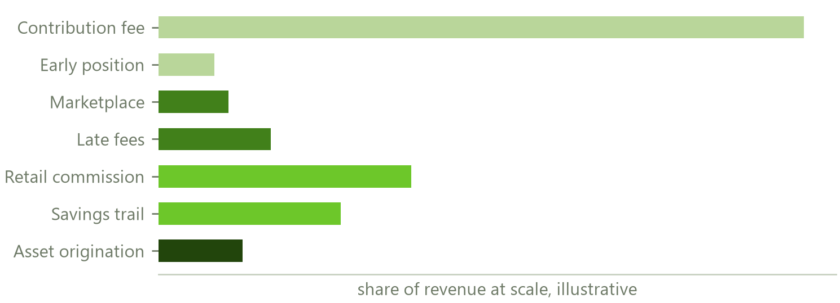
10 THE BUSINESS
Where the revenue comes from
Three of these lines are paid by members and are small by design. Four are paid by counterparties and are the ones that grow.
The retail commission grows with the number of members rather than the number of circles, so it compounds as the base grows. The savings distribution trail recurs every year against assets under management without further work. Asset origination is paid by dealers. Rewarded video sits on one surface only and is paid by advertisers.
Against roughly four trillion rupees of annual committee flow, even a very small share of the market carries a substantial business, and the member facing take across all products is under two per cent of the money moved.
The company does not need to be large in this market to be a serious business. It needs to be the one that has the record.
Indicative share of revenue at scale, not a forecast.
The one thing not shown here is what the data asset itself is worth once it exists at scale. An American operator abandoned pooling entirely, rebuilt around reporting payment behaviour, and reached a billion dollar valuation on that basis.
Halqa · Confidential
72

Slide 73
10 THE BUSINESS
The order things must happen in
 | RUNG | WHAT IT UNLOCKS | WHAT IT NEEDS
1 | Collection | Settlement rather than assertion. Without it there is no credible record, no data asset and no business at all | Company registration and a merchant services agreement
2 | The record | Verified repayment at volume, which is the raw material for everything above it | Circles completed, not registrations. This is the measure that matters
3 | The bureau link | The record becomes a formal credit signal, and Halqa becomes the supplier of a class of data the system does not currently hold | A contributor agreement with a licensed bureau
4 | Commerce | Retailers and institutions pay for access to outcomes. Rewards, direct payment and asset circles all sit here | Affiliate registration, then merchant agreements
5 | The savings layer | Yield for the member, a recurring trail for the platform, and a pledged buffer that cures default at source | Trustee, asset manager, and distributor registration
Engineering work is under the company's own control. Counterparty work carries lead times measured in months, so it is started in parallel rather than in sequence. The national identity agreement is the longest item and is therefore begun first.
Halqa · Confidential
73

Slide 74
10 THE BUSINESS
How we will know it is working
 | THE MEASURE | WHY THIS ONE
1 | Share of contributions settled digitally | The health of the collection rung, and the single most important figure in the company. A ledger of assertions is worth nothing
2 | Circles completed cleanly | The atomic unit of value. A circle that completes has produced a full record for every member in it
3 | Circles per organiser | Whether the growth loop compounds or leaks
4 | Measured default across the first hundred completed circles | The point at which the loss rate stops being modelled and becomes measured, and at which every price in the business is recomputed
5 | Members who become organisers | The only growth loop internal to the product
Registrations, downloads and total value committed can all be raised without the arrangement working at all, and are deliberately not tracked as measures of progress.
Halqa · Confidential
74

Slide 75
11 WHAT IS BUILT
In production today
Live
60 / 352
Urdu and English
In production since 20 July 2026, deliberately not opened to the public
Unit and integration tests, all passing
Throughout, on an application that installs to the home screen
AREA | WHAT IS RUNNING
Onboarding | The full ten step registration, with phone verification, identity card capture, live location, occupation, a mandatory collection account and the application PIN
Checkout and rails | Gateway style checkout across the instant payment rail, both major wallets, bank transfer and cash, with an explicit failure path that leaves the installment untouched
Saved instruments | Captured once and masked at rest, maximum five, one preferred, with card details limited to brand, last four, expiry and holder
Automatic collection | A standing per circle mandate, on by default with recorded consent, replaceable but not removable while a circle runs
Payday collection | Balance notice the evening before, execution on the payday morning, a retry ladder to the due date, and four independent verification signals
The score | 300 to 850 with bands, credit events carrying their reasons, a movement chart, and an exportable credit report that verifies without a Halqa account
Overdue handling | A daily server side job running the escalating ladder, recovery cases with a rehabilitation fee, and a bureau export queue
Circles | Own circles and discovery, invite codes, invitation by WhatsApp, contacts, messages and Skype, and a public only filter with its disclosure
Daily circles | Tier selection, the opening auction with a live countdown, standing bids per day and bid entry
Rewards | The streak ladder with unlock states, points balance and the retail partner grid
Marketplace | Listing, bidding and acceptance, premium capped as a share of the payout, with commission
Halqa · Confidential
75

Slide 76
The arrangement is a thousand years old.
The participants number in the tens of millions.
The money is already moving.
What has never existed is the record, and everything in this document is built to produce one.
Halqa 13 August 2026 Confidential

