Slide 1
HALQA
Investor briefing
The market, the instrument, the architecture, the mechanisms, the economics and the implementation status.
12 August 2026 Confidential

Slide 2
CONTENTS
Contents
1 The opportunity
2 Prior attempts
3 What Halqa is
4 Function one, onboarding
5 Function two, collection
6 Function three, the record
7 Function four, protection
8 Function five, recovery
9 The products
10 The mathematics
11 Rewards
12 Engineering and security
13 Economics
14 Counterparties
15 Implementation and measures
Sections 3 to 8 are the five functions the platform performs, in the order money moves through them. Section 9 is what those functions are assembled into and sold as. Sections 1, 2 and 13 to 15 are the thirty minute briefing.
Halqa · Confidential
2

Slide 3
THE OPPORTUNITY
Market size and participation
Rs 4tn
37%
13%
63%
Estimated annual flow through committees
Of adults participate, roughly 52 million people
Of adults hold a bank account
Of savers keep their cash at home
The committee is the third largest savings channel in the country. It is not competing with the banking system; it is competing with cash kept at home. Roughly a third of savers already use one.
Where Pakistani savers keep money, per cent of savers. Published national estimates.
Halqa · Confidential
3

Slide 4
THE OPPORTUNITY
Who the member is
The participant is not the destitute household. The academic work on Pakistani committees is consistent that regular income is a precondition of membership, and that groups exclude the irregularly paid themselves. Committees filter on the regularity of income rather than on its level.
MEMBER | MONTHLY INCOME | TYPICAL CONTRIBUTION | WHY THEY QUALIFY
Tailor with a shop | Rs 17,000 | Rs 3,000 to 5,000 | Daily trade, predictable weekly takings
Driver, salaried | Rs 22,000 | Rs 5,000 | Salary lands on a fixed day
Site engineer | Rs 45,000 | Rs 10,000 | Salaried, verifiable employer
Shopkeeper | Rs 60,000 | Rs 15,000 | Daily takings, long trading history
Daily wage labourer | Rs 18,000 | Rs 100 to 250 a day | Income arrives daily, which is why HYPER exists
That distinction is what makes the resulting record a usable credit signal, and it is why the claim is never that this serves the poorest.
Halqa · Confidential
4

Slide 5
THE OPPORTUNITY
The recording gap
A tailor who has paid Rs 8,000 on the first of the month for eleven consecutive months has demonstrated exactly the behaviour a lender spends money trying to establish. That behaviour is recorded nowhere. It exists in a notebook, in a WhatsApp group, or in the memory of the organiser, and when the cycle ends it disappears.
Problem one
Problem two
The arrangement is fragile. It depends entirely on one person holding the money and on the group's memory of who has paid. There is no written record, no receipt and no recourse.
An entire class of credit data is generated at national scale and then thrown away. A household reliable for a decade arrives at a bank as a stranger.
Halqa addresses the second, and the first follows from it.
Halqa · Confidential
5

Slide 6
THE OPPORTUNITY
Definition
Each member pays the same amount every period. Each period the entire pot goes to one member. After one rotation every member has paid the same total and received the same total.
Total money in equals total money out. The arrangement holds nothing at rest, earns nothing for itself, and requires no lender and no capital. The only variable between members is when they collect.
 | COLLECTS EARLY | COLLECTS LATE
Receives | The pot in advance | The pot at the end
Economically | An advance repaid in instalments | Saving under a commitment device
Charge | None | None
Risk carried | High until the cycle ends | Falls to zero
The same schedule delivers two opposite financial products at the same time, funded entirely by the members themselves.
Halqa · Confidential
6

Slide 7
THE OPPORTUNITY
Worked example
Twelve members, Rs 10,000 a month, twelve months. The pot is Rs 120,000 and is paid in full to one member each month.
MONTH | COLLECTED | PAID TO | THAT MEMBER HAS PAID IN | THAT MEMBER THEN OWES
1 | Rs 120,000 | Member 1 | Rs 10,000 | Rs 110,000
4 | Rs 120,000 | Member 4 | Rs 40,000 | Rs 80,000
8 | Rs 120,000 | Member 8 | Rs 80,000 | Rs 40,000
12 | Rs 120,000 | Member 12 | Rs 120,000 | Nothing
Every member pays Rs 120,000 across the year and receives Rs 120,000 once. Nobody is better off in total. Member 1 has effectively borrowed and repaid at no charge; member 12 has saved under a schedule they could not easily abandon. The amount a member owes the group after collecting is the only figure at risk anywhere in the arrangement, and the next section is about that figure.
Halqa · Confidential
7

Slide 8
PRIOR ATTEMPTS
UBL Kommittee Account
United Bank Limited, one of Pakistan's largest banks, markets a deposit product under the committee name. It is the most instructive case in the set because it shows what happens when a large institution takes the word and discards the instrument.
FEATURE | HOW IT WORKS | WHAT IT MEANS
Term | 12, 18 or 24 months | Fixed, like a recurring deposit
Contribution | Rs 5,000 to Rs 1,000,000 a month | Wide band, aimed at existing bank customers
Payout | Your own accumulated contributions at the end, plus a bank contribution of one quarter, one half or one full monthly installment | You are paid your own money back with a bonus
Rotation | None | No member ever receives early. The defining feature of a committee is absent
Early exit | Permitted without penalty, forfeits the bonus | No obligation to anybody
Missed months | Forgiven through an installment holiday | No discipline, because there is no counterparty
Custody | The bank, entirely. Member money is a bank liability from day one | Requires a banking licence
The rotation is the product. Remove it and what remains is a savings account with a marketing name. Nobody receives a lump sum early, which is the reason people join committees at all.
Halqa · Confidential
8

Slide 9
PRIOR ATTEMPTS
Pakistan
OPERATOR | PERIOD | REPORTED SCALE | STRUCTURE AND OUTCOME
UBL Kommittee Account | Current | Rs 5,000 to Rs 1,000,000 a month, terms of 12 to 24 months | A bank deposit carrying the committee name. Full custody, no rotation between members
Oraan | Founded 2018, USD 3m seed in 2021 | Its own research put participation at 41 per cent of Pakistanis and about USD 5bn rotating annually | Platform custody. The operator collects contributions and disburses pots. Strangers pooled and vetted, women weighted
Udhaar Book | Current | A committee register inside a digital ledger app used by retailers | No money moves through the app. The organiser records who has paid. Records an assertion, not a settlement
DigiKhata | Current | A competing ledger app with the same feature | Architecturally identical. Two independent Pakistani apps with real distribution stopped at the same wall
Sidra Humaid committees | Roughly seven to ten years, ending December 2022 | About Rs 420 million owed across 117 committees and roughly 200 contributors, no written records | Total concentrated custody. Members from social media wired money to one individual. She announced she could not pay and went into hiding
Two failure modes. Hold the money and carry the licence or the fraud risk, or hold nothing and record only an assertion.
Halqa · Confidential
9

Slide 10
PRIOR ATTEMPTS
Middle East, India and Southeast Asia
OPERATOR | MARKET | REPORTED SCALE | STRUCTURE
Money Fellows | Egypt | 8m downloads, over 1m customers, about 350,000 monthly active, USD 1.5bn processed across more than 2m completed circles, about USD 60m raised, profitable in 2025 | Platform custody as digital trustee and matchmaker. The largest operator in the category anywhere
Hakbah | Saudi Arabia | More than 1.3m registered users, about 70 per cent young savers, about USD 9m raised | Platform operated savings groups under a central bank sandbox permit
Shriram Chits | India | More than 2.2m subscribers, auction turnover approaching Rs 3,000 crore, 465 branches, 65,000 agents | Statutory foreman under the Chit Funds Act with a full security deposit lodged with the Registrar. Auction ordering
Margadarsi Chits | India, sixty years | Turnover about Rs 14,341 crore, over 6m subscribers, 131 branches | Identical statutory model. The two Indian operators show custody can endure at scale if you are a regulated foreman
KSFE | India, since 1969 | More than 680 branches, chit values from Rs 1 lakh to Rs 50 lakh | A state owned non banking finance company as foreman. Sovereign trust replaces private reputation
The Money Club | India, founded 2016 | Over 200,000 users, about 17,000 clubs, roughly Rs 40 crore pooled, USD 1.7m raised | Platform intermediated with same day payouts and underwriting by graduated trust
MyPaisaa | India | About USD 980,000 raised, roughly 20,000 installs in two years | India's first fully digital registered chit fund. Shows what full registration costs a young company in speed
Mapan | Indonesia | National scale through community organisers | The organiser is treated as the growth engine, which is the position taken here
Halqa · Confidential
10

Slide 11
PRIOR ATTEMPTS
Africa and the United States
OPERATOR | MARKET AND PERIOD | REPORTED SCALE | STRUCTURE AND OUTCOME
StokFella | South Africa, launched 2016 | About 42,000 members by 2025, in a market of roughly 800,000 groups and 11m members holding around R50bn | Group account management with platform held funds, serving existing stokvel groups
Tanda by Yahoo Finance | United States, January to May 2018 | About 37,000 installs, never in the top 1,500 of the finance category | Platform managed pooling in groups of five or nine. Closed after four months. Encouraging in the Philippines and Mexico, poor in the United States
eMoneyPool | United States, Phoenix, 2010 to November 2019 | Nine years of operation | Platform managed pools reporting payment history to credit bureaux. The operator absorbed defaults itself. The cost of standing behind every member is why the facility here is priced and capped
Esusu | United States, incorporated 31 May 2018 | USD 130m Series B led by SoftBank Vision Fund 2 in January 2022, at a USD 1bn valuation | Launched as a savings app, found the domestic market too thin, pivoted to reporting rent payments to all three bureaux. The value was the record, not the pooling
Mission Asset Fund | United States | Groups of six to twelve contributing USD 50 to 200 a month, pots of USD 300 to 2,400 | A non profit which formalises peer contributions as documented zero interest loans and reports every payment to all three bureaux
Halqa · Confidential
11

Slide 12
PRIOR ATTEMPTS
What the evidence establishes
FINDING | EVIDENCE | POSITION TAKEN HERE
Custody decides the outcome, and its effect is binary | Operators which held member money either carried a licence and a statutory deposit, as the Indian foremen do, or failed, as the Rs 420m Pakistani case did | Halqa holds nothing at any stage
The value is the record, and it has been measured | Two American operators abandoned pooling entirely and built businesses on reporting payment behaviour. One reached a USD 1bn valuation on that basis | The record is the asset. The committee is the mechanism which generates it
Distribution is agents, not advertising | Every case which reached scale did so through commissioned organisers, from 65,000 agents in India to community organisers in Indonesia | The host is the acquisition channel and is paid on value, never on recruitment depth
An unpriced guarantee is unbounded | The American operator which absorbed defaults for every member ran nine years and closed | The facility is priced, capped at four levels, and recovered as an advance
Taking the name without the rotation does not work | The bank product removes the early payout, which is the only reason members join | The rotation is preserved exactly as it works informally
Halqa · Confidential
12

Slide 13
WHAT HALQA IS
Custody
Halqa does not take possession of member money at any stage. Contributions move directly from the paying member's account to the receiving member's account over domestic payment rails. Halqa observes each settlement and writes it to a double entry ledger linked to national identity.
CONSEQUENCE | DETAIL
Commercial | Every large committee fraud recorded in Pakistan required a central pool of members' money under one person's control. No such account exists here, and the protection cannot be weakened under commercial pressure because there is nothing to weaken
Regulatory | No balance is issued, nothing is lent, and no payment system is operated. The path to live money runs through company registration and a merchant services agreement, both commercial steps rather than licences
Pricing | There is no float to fund the business from and no balance to lose, which is why the member price is zero and the revenue comes from services and counterparties
Independent | Researchers at ITU Lahore and the University of Washington, funded by the Gates Foundation and Karandaaz, published the same architecture in 2018 on regulatory grounds
Halqa · Confidential
13

Slide 14
WHAT HALQA IS
What the platform is and is not
HALQA IS | HALQA IS NOT
A record. Every settlement carries a receipt, a timestamp and an identity link, admissible under the Electronic Transactions Ordinance 2002 | A holder of member funds at any point in any product
A treasury. It schedules, prices, collects and settles | A lender. Members fund one another directly
A credit record. Payment history becomes a portable score which the member can present outside the platform | An issuer of balances, wallets or stored value
A distributor of a licensed manager's savings products, at the second stage | An operator of a payment system, an investment manager or a custodian
The distinction is not a policy the company has adopted and could later abandon. It is a consequence of where the money physically goes, which means it holds under commercial pressure and can be demonstrated to a regulator from the ledger rather than argued.
Halqa · Confidential
14

Slide 15
WHAT HALQA IS
The five functions
 | FUNCTION | WHAT IT GOVERNS | WHERE IT APPEARS
1 | Onboarding | Who is admitted, what is verified, and what each member is shown. Barriers stay low and the filtering is invisible | Section 4
2 | Collection | How money is taken. Collection is attempted on the member's payday, not on the due date | Section 5
3 | Pooling products | Where money sits when it is not moving. Halqa holds nothing, so savings route to a licensed manager with a trustee | Section 9
4 | Prevention | The principle that recovery machinery is the wrong thing to build. The right thing is an arrangement in which nobody gains by defaulting | Section 7
5 | Recovery | What happens when prevention fails, expressed as instruments which can be executed rather than as intentions | Section 8
Two instructions cut across all five. Consumers and savers are separated at the point of joining, because a member who takes the pot early to spend it and a member who waits in order to save carry opposite risks. Filtering is preferred over enforcement wherever both are available.
Halqa · Confidential
15

Slide 16
FUNCTION ONE ONBOARDING
Registration, ten steps
 | STEP | WHAT IS CAPTURED | WHY
1 | Mobile number | Number, then a six digit code sent to it | The number is the identity on the platform and the channel for every reminder
2 | Code verification | One time code confirmed against the number | Proves the number belongs to the member
3 | Name and username | Full name as on the identity card | Circles run on real names. It is how members know who they are trusting
4 | Location and work | Home address, city, area, occupation, employer, job title, live GPS pin | Area and job are shown to members as a trust signal. The street address and identity number never are
5 | Email | Address for receipts and recovery | Records and account recovery
6 | Identity card | Thirteen digits, plus a camera capture of the card | Binds every obligation to a government identity
7 | Collection account | Rail, account title, account number or IBAN, and the salary day | Auto collection is how every circle collects, so the account is linked before the account exists
8 | Password | Minimum eight characters with letters and numbers | Account credential
9 | Application PIN | Four to six digits, confirmed twice | A second lock on every open, separate from the password
10 | Review and sign | Every field shown back, then the agreement accepted | Consent is recorded against a version and a timestamp
Halqa · Confidential
16

Slide 17
FUNCTION ONE IDENTITY
Identity verification
LAYER | MECHANISM | WHAT IT ESTABLISHES | STATUS
Mobile number | Six digit code delivered over the WhatsApp rail, with SMS fallback | The number is controlled by the applicant | Built
Identity card capture | The card is photographed on the device at signup and the number recorded | A document exists and matches the number given | Built
Account title check | At instrument linking the aggregator returns the registered account holder name, which must match the identity card name | The collection account belongs to the member and not to a third party | Built
NADRA Verisys | Identity number checked against the national database through a signed institutional agreement | The identity number is real and belongs to that name | Procurable, deferred past launch on cost
NADRA biometric and facial | Multi biometric verification through the Nishan Pakistan portal, exposed to onboarded institutions since 2025 | The living person is the holder of the card. The only check which defeats a borrowed or purchased identity | Paperwork is the long pole, started in parallel
Income verification | Salary slip, or a payday pattern established from the platform's own collection record over two months | Capacity to carry the contribution. The second route needs no document and costs nothing | Built
The verification result and the reference are stored. Raw biometric templates and facial images are never stored.
Halqa · Confidential
17

Slide 18
FUNCTION ONE IDENTITY
Facial verification triggers and cost
A facial check on every action would consume money and abandon members at the same time. A NADRA facial certificate has been reported at Rs 20, and one wallet operator charges its users Rs 99 for a check which fails. The check is therefore fired only where it buys something.
TRIGGER | WHY IT MATTERS
Onboarding | Establishes the person once
A new device | The most common route for a stolen credential
A contribution above the configured threshold | Value at risk justifies the cost
Claiming a seat in the first half of the order | These seats carry the exposure
Any exit or hardship request | An impersonated exit is the cheapest attack on the restitution engine
Return after ninety days dormant | The account may have changed hands
The application PIN sits underneath all of it. It is required on every open of the application, on every join commitment, on every exit request and on every payout release, and it is separate from the account password.
Where the handset supports it, the device biometric is layered on the PIN. It never leaves the device and is neither transmitted nor stored.
Halqa · Confidential
18

Slide 19
FUNCTION ONE ONBOARDING
Affordability and what the member is shown
CAP | LIMIT
Total contributions as a share of net monthly income | 33%
Contributions plus known debt service | 40%
Total forward exposure, every seat early | 4x monthly income
Concurrent circles, income unverified | 1
Concurrent circles, income verified | 4
Concurrent circles, host with no completed circle | 2
Concurrent circles, host after five clean completions | Manual review
The 40 per cent figure anchors to the State Bank's cap on the debt burden ratio for consumer financing, reduced from 50 per cent in 2021. Halqa sits stricter on contributions alone.
The caps govern what the discovery screen displays rather than producing a refusal. A member is never shown a circle they cannot afford or a seat they cannot hold, so the system produces no rejections in ordinary use.
Good payment history unlocks seats, additional circles and reduced friction. It never raises the money cap. Only new evidence of income does that, because escalating limits are what produce liquidity defaults.
The concurrency ceiling on hosts is also the control against one person assembling an artificial network of circles, which is the mechanism behind every large committee fraud.
Halqa · Confidential
19

Slide 20
FUNCTION TWO COLLECTION
How one contribution moves
Every rupee that moves through Halqa follows the same eleven steps. Nothing in this sequence passes through an account Halqa controls.
 | STEP | WHAT HAPPENS | STATE AFTER
1 | Schedule written | When the circle starts, one installment row is created for every member for every round, each with a due date and a pre minted idempotency key | Scheduled
2 | Balance notice | The evening before payday, a push and a WhatsApp message tell the member what will be taken | Scheduled
3 | Instruction sent | On the payday morning the mandate fires. The request carries the idempotency key and the member's stored rail reference | Pending
4 | Aggregator routes | The licensed aggregator presents the debit to Raast, the wallet or the bank. Halqa never touches the rail directly | Pending
5 | Rail settles | Money moves from the member's account to the receiving member's account. It does not stop anywhere in between | Authorised
6 | Callback received | The aggregator returns success or failure against the same key | Authorised or failed
7 | Settlement written | One database transaction writes the debit entry, the credit entry, the receipt row and the message queue row together | Settled
8 | Receipt issued | The member receives a reference over WhatsApp and in the application. The circle sees the round advance | Settled
9 | Round checked | The payout gate tests whether every contribution in the round has settled | Round complete
10 | Payout released | On the 10th at 09:00 the pot is released to the member whose turn it is, in one instruction | Paid
11 | Record furnished | The settlement is queued for the credit bureau in the nightly batch | Reported
Halqa · Confidential
20

Slide 21
FUNCTION TWO COLLECTION
Why a payment cannot happen twice
A member on a weak signal taps pay, sees nothing happen, and taps again. The phone may have sent both requests. On most systems that is two debits and an apology.
Every write carries an idempotency key: one value naming the exact thing being attempted, stored with the record when it succeeds.
ATTEMPT | KEY ALREADY STORED | WHAT THE SYSTEM DOES
First tap | No | Charges once, writes the settlement, stores the key
Second tap, same key | Yes | Returns the first receipt. No money moves
Network retry | Yes | Same. The retry is free
Genuine second payment | No, new key | Charges. The member meant it
key = member + circle + round + attempt purpose
This is not a refinement added later. Retries are the normal condition on Pakistani mobile networks and under serverless timeouts, so a payment system without it is not partly correct, it is wrong on its most common day.
The same protection covers the payout side. A payout instruction carries the round's key, so a retried release cannot pay a member twice.
Halqa · Confidential
21

Slide 22
FUNCTION TWO COLLECTION
What happens when it fails
FAILURE | CAUSE | RESPONSE | MEMBER SEES
Insufficient balance | Money not in the account yet | Retry ladder runs to the due date. The installment stays open and untouched | A request to pay in one tap
Mandate revoked at the bank | Member cancelled it outside the app | Instrument marked stale, member asked to relink, score untouched for 7 days | Relink prompt
Aggregator timeout | Rail congestion | Reconciliation job queries by idempotency key before any retry, so a silent success is never double charged | Nothing
Partial settlement | Cannot occur | Amounts are integer paisa and the pair must sum to zero, so a half written movement is rejected by the database | Nothing
Payout gate blocked | Another member in the round is unpaid | The cover facility advances the shortfall so the payout releases on time | Paid on time
The design rule across all five: a failure never silently changes what the member owes. The installment either settles or stays exactly as it was.
Halqa · Confidential
22

Slide 23
FUNCTION TWO COLLECTION
Rails and cost
RAIL | MEMBER PAYS | HALQA PAYS | POSITION
Raast, the State Bank instant system | Rs 0 | About Rs 0 | Default rail for every circle type
Wallet to wallet, same network | Rs 0 | Rs 0 | Where both parties hold the same wallet
Wallet debit under mandate | Rs 0 | Rs 300 to 600 | Fallback below a Rs 10,000 contribution
Card | Rs 0 | Rs 693 | Not offered on standard circles
Cash through an agent | Rs 0 to 50 | Rs 20 to 60 | Last resort. It destroys the digital record
Cost to Halqa of collecting one Rs 20,000 contribution.
Members pay nothing, so every rupee of transaction cost is unrecovered. One twelve member circle running a full cycle on card rails would incur 144 charges at Rs 693, being Rs 99,792 against no member revenue. Raast at approximately zero cost is the only arithmetic under which a product free to members survives, which is why the whole collection design is built on it.
Halqa reaches Raast as a merchant of a licensed aggregator. That is a commercial contract and not a licence.
Halqa · Confidential
23

Slide 24
FUNCTION TWO COLLECTION
Collection on payday
The collection event is the member's payday, not the due date, because that is the moment in the month at which the account balance is at its maximum. The due date becomes the deadline for resolving failures.
WHEN | WHAT HAPPENS
Payday eve | A balance check notice goes out by push and over the WhatsApp rail
Payday morning | The mandate executes, before the contribution is even due. Government salaries land on the first, and earlier before Eid. Private payrolls run the first to the seventh
Payday to the due date | On any failure a retry ladder runs alongside a one tap payment request and a message
Due date | Only if every attempt has failed does the member meet the late fee ladder
The 10th, 09:00 | A single payout release across the platform
The idea came from a member saying that he pays as soon as his pay arrives. Passive default, where the money arrived and was spent before the due date, is removed entirely. What remains is active evasion, which is a deliberate act taken against a signed consent.
Halqa · Confidential
24

Slide 25
FUNCTION TWO COLLECTION
Verifying the declared payday
Pakistan has no open banking regime and Halqa has no bank partner, so the payday is verified from evidence the platform legitimately owns. Four layers, in ascending order of strength.
SIGNAL | MECHANISM | STRENGTH
Account title | At linking the aggregator returns the registered holder name, which must match the identity card | Proves ownership of the account
The platform's own collection record | Every attempt is logged against a calendar day. The first success each month marks a day money was provably present. Two consistent months establish the payday | The strongest of the four, and it costs nothing. If a member declares the wrong day the retry ladder finds the right one
Credit alerts | Optional, member enabled reading of incoming credit notifications. Three fields leave the handset: a day, a coarse amount band, a source class | Two consistent months verify
Salary slip | One photograph, reduced on the device before upload | Documentary verification on day one
A false declaration clears the verification, stops the fee discount, and records a score event of minus 15 with its reason attached, once per window so the same error is never punished twice.
Halqa · Confidential
25

Slide 26
FUNCTION TWO COLLECTION
Mandates, receipts and the delinquency ladder
MECHANISM | HOW IT WORKS
Standing mandate | A per circle instruction, on by default at joining with recorded consent. The instrument may be replaced but the mandate cannot be removed while a circle runs. A pause is available with a reason recorded, which costs score rather than access
Mandate verification | Linking an instrument issues a one time code over the WhatsApp rail with a ten minute expiry, and the account title is checked against the identity card name
Instrument storage | Raast ID, wallet or IBAN captured once and masked at rest, maximum five, one preferred. Card linking stores brand, last four digits, expiry, holder and billing address only, never the full number or the security code
Receipts | Every settlement writes a receipt reference and queues a message inside the same transaction as the settlement, so a receipt cannot exist without a settlement or the reverse
Delinquency process | A daily job at 02:00 UTC runs the escalating ladder, server side rather than in the application, so it does not depend on the member opening anything
Grace window | Computed from the period length and never displayed. Score and bureau damage accrue from the first late day regardless of it
Halqa · Confidential
26

Slide 27
FUNCTION THREE THE RECORD
Sakh, how the score is computed
Sakh runs from 300 to 850. It is a computed model output, not a running tally, and five inputs produce it.
Sakh = 300 + 550 × [ 0.40·P + 0.25·U + 0.20·H + 0.10·C + 0.05·M ]
 | INPUT | WEIGHT | HOW IT IS MEASURED | WORKED
P | Payment record | 40% | Every contribution weighted by age, 0.95 to the power of months elapsed, so a miss last month counts nearly twice a miss a year ago | 0.90
U | Liability used | 25% | One minus current forward liability divided by the affordability ceiling. Owing Rs 60,000 of a Rs 200,000 ceiling scores 0.70 | 0.70
H | History | 20% | Sixty per cent on circles completed out of five, forty per cent on months on the platform out of twenty four | 0.47
C | Concurrency | 10% | One minus circles joined in the last ninety days out of three. Three joins in a quarter is distress, not enthusiasm | 0.67
M | Product mix | 5% | Product types used out of four | 0.50
That member scores 300 + 550 × 0.7213 = 697, which is the Good band. The plus and minus figures shown in the application are the reason codes explaining what moved the number. They are not the calculation.
Halqa · Confidential
27

Slide 28
FUNCTION THREE THE RECORD
What moves the score
EVENT | OPEN CIRCLES | KNOWN CIRCLES | WHY
Contribution paid on time | Plus 2, capped at 40 a cycle | Plus 2 | The behaviour the whole model is built to observe
One day late | Minus 15 | Minus 10 | Matched to the first rung of the fee ladder
Seven days late | Minus 30 | Minus 20 | Second rung
Fifteen days late | Minus 50 | Minus 40 | Third rung
Default after collecting | Minus 200 | Minus 200 | The only event the platform treats as identical across products
Circle completed clean | Plus 200 | Plus 200 | The atomic unit of proven behaviour
Paying for another member | None | None | Deliberately neutral, so the score cannot be bought
Income newly verified | Raises the ceiling, not the score | Same | Evidence of capacity is not evidence of conduct
Every event is written with its reason attached and is visible to the member on the day it happens. A score a member cannot interrogate is a score they will not trust.
Halqa · Confidential
28

Slide 29
FUNCTION THREE THE RECORD
Furnishing to the bureau
A credit bureau does not understand the word committee. It understands tradelines. The translation is straightforward, but one decision inside it determines whether the product delivers what it promises the member.
BUREAU FIELD | WHAT HALQA SENDS | NOTE
Account type | Installment | A seat behaves exactly like an installment obligation
Original amount | Contribution multiplied by the number of rounds | Rs 240,000 on a twelve month circle at Rs 20,000
Installment | The contribution | Rs 20,000
Term | Number of rounds | 12
Current balance | Contribution multiplied by rounds remaining | The forward liability, which is the only figure at risk
Opened | The date the member joined | Not the date they collected. This is the decision that matters
Status | Current, 1 to 29, 30 to 59, 60 to 89, 90 plus, written off | Halqa's internal ladder is finer at 1, 7 and 15 days and rolls up to these
Reporting from the join date rather than the collection date means a member who joins in January and collects in November has eleven months of clean reported history before they ever touch the pot. Reporting from collection would discard all of it. That single choice is the difference between a credit product and a payment ledger.
Halqa · Confidential
29

Slide 30
FUNCTION THREE THE RECORD
Bureau counterparties
BUREAU | STANDING | POSITION
TASDEEQ, the trading name of Aequitas Information Services Limited, Lahore | The first bureau licensed under the Credit Bureaus Act 2015, with more than 170 member institutions | Primary. Its published score runs from 200 for very poor to 600 for excellent, built from overdues, demographics, loan size, multiple borrowing, credit history length and institution type
DataCheck Limited, Karachi | Founded 2001, the first private sector bureau in the country, also licensed | Second subscriber agreement. Once one furnishing pipeline exists the second costs almost nothing and roughly doubles the number of lenders who can see a Halqa record
eCIB, operated by the State Bank | Accepts data only from licensed financial institutions | Closed to Halqa by design, and nothing in the plan depends on it
Creditinfo Group | Global credit information provider, already working inside the market alongside TASDEEQ and PACRA on scorecards and income estimation models | Not a Pakistani bureau, but the route back into the market if a direct agreement stalls
The commercial position is the strong one. Halqa is not asking for permission to read; it is offering to furnish a population of committee members that no existing subscriber can see. TASDEEQ already counts fintech companies and non bank financiers among its members, so a non bank furnisher is routine rather than exceptional.
Halqa · Confidential
30

Slide 31
FUNCTION THREE THE RECORD
Mapping Sakh onto the bureau scale
The two scales differ, so the platform holds both. Sakh is what a member sees and what gates their seat. The bureau equivalent is what a lender outside Halqa reads.
SAKH | BAND | BUREAU EQUIVALENT
300 | Rebuilding | 200
550 | Fair | 382
650 | Good | 455
750 | Excellent | 527
850 | Excellent | 600
Bureau = 200 + (Sakh − 300) × 400 / 550
Five of the six inputs the bureau scores on are already captured. Overdues come from the delinquency ladder, credit history length from the join date, loan size from the pot, multiple borrowing from the concurrency cap, and institution type from the furnisher registration. The sixth, demographics, the bureau derives itself from the identity number.
The published range should be confirmed with the bureau in writing before any threshold is built against it.
Halqa · Confidential
31

Slide 32
FUNCTION FOUR PROTECTION
The quantity at risk
When a member collects, they hold the whole pot and still owe every contribution that remains. That remaining obligation is the only thing at risk anywhere in the arrangement.
It is largest at the first seat, falls by one contribution with each later seat, and is nothing at the last. Risk is not spread across the members; it sits in the early seats and decays.
The platform therefore does not need a system for judging members. It needs a system which decides which member may occupy which seat.
Rupees owed to the circle immediately after collecting, by seat. Twelve members, Rs 10,000 a month.
Halqa · Confidential
32

Slide 33
FUNCTION FOUR PROTECTION
Seat eligibility
Each score band carries a ceiling on how much a member may owe the group at the moment they collect, expressed in contributions. The ceiling sets the earliest seat they may take.
BAND | MAY OWE AT MOST | EARLIEST SEAT, TWELVE MEMBERS | MARKETPLACE
Rebuilding, below 550 | Two contributions | Seat 10 | May not purchase
Fair, 550 to 649 | Seven contributions | Seat 5 | May purchase
Good, 650 to 749 | No ceiling | Any seat | May purchase
Excellent, 750 and above | No ceiling | Any seat | May purchase
The same two ceilings apply to a circle of any size, so there is one rule rather than a table per circle size. Above it sits a rule which applies to every new member whatever their score: one of the last three seats only, released after two completed circles with clean records and a manual verification step.
Rs 20,000
Permanent
Invisible
The most an unobserved member can cost a circle, on a Rs 120,000 pot
A claimed seat never moves. Score gates the seat; it does not reorder anybody
Ineligible seats are not displayed, so the rule produces no refusals
Halqa · Confidential
33

Slide 34
FUNCTION FOUR PROTECTION
No incentive to default
The design does not try to make defaulting difficult for everybody. It ensures that the members carrying the largest obligation are the members who have earned the right to carry it, and that everybody else has nothing to gain by leaving.
POSITION | WHAT THE MEMBER GAINS BY DEFAULTING | WHAT THE MEMBER LOSES
Last seats, where every new member is placed | Nothing. By the time they collect they have already paid almost everything they owe | Platform access, the record they joined for, and 200 points of score
Middle seats | A partial obligation, capped by the band ceiling at seven contributions | The same, plus a recovery case for the outstanding amount, penalties and a 10 per cent rehabilitation fee
Early seats | The largest obligation in the circle | The same, and these seats are only available to members with a proven record they would be destroying
Any seat, asset circle | Possession of an item they do not own | The asset itself, recovered by the party holding title, with proceeds paid into the circle
Any seat, pledged savings | Nothing. The shortfall settles from their own units | The pledged holding, redeemed under an instruction they signed in advance
Halqa · Confidential
34

Slide 35
FUNCTION FOUR PROTECTION
The seven layers
 | LAYER | MECHANISM
1 | Identity | Identity card captured at signup, home location pinned, uniqueness enforced on the identity number, the telephone number and the electronic address, so every obligation binds to a government identity
2 | Position | Band and tenure define which seats may be claimed, holding worst case exposure to an unobserved member at two contributions
3 | Schedule | Fixed dates, escalating reminders, a balance check the day before, and an internal grace window which is never displayed to the member
4 | Price | The late fee ladder with matched score damage at every step, and 200 points on a default after collection
5 | Payout controls | A payout does not release while any contribution in that round is unpaid; a default on a linked account withholds it; a security shortfall is withheld from the pot up to a ceiling of 60 per cent
6 | Consequence | Platform wide feature lock, an internal flag, and a recovery case for the outstanding amount plus penalties plus a 10 per cent rehabilitation fee, identity linked and timestamped
7 | Contract | The undertaking, renewed weekly, and the mutual guarantee executed automatically at joining, which runs member to member and never to Halqa
Each layer is independent of the others, so no single failure exposes the circle.
Halqa · Confidential
35

Slide 36
FUNCTION FOUR PROTECTION
Pricing the cover
The premium is set at roughly one and a half times the default rate the circle type is expected to carry, which builds in a three times margin over expected loss for adverse selection, operating cost and reinsurance.
The relationship does not change with the size of the circle, so one rule prices every product.
CIRCLE TYPE | EXPECTED DEFAULT | PREMIUM CHARGED
Known | 0.3% | 0.5% of each contribution
Open | 1.0% | 1.5% of each contribution
HYPER | 30.0% | 15.0% of each contribution
The cover facility is priced, capped per circle, per host, per member and in aggregate against paid up capital, subrogated as an advance rather than a payment, and reinsured above the aggregate cap.
Every price in the business is therefore a function of one input which has not yet been measured. The first hundred completed circles establish it and reprice the schedule. That is a stronger position than presenting the figures as fixed, because it says the pricing is a model with a named input rather than a guess.
Halqa · Confidential
36

Slide 37
FUNCTION FOUR PROTECTION
The time value of a turn
Every member pays the same total and receives the same total, so on paper nobody gains. That is true in rupees and false in economics. Rs 240,000 in month one is not the same thing as Rs 240,000 in month twelve, and every member already knows it. That is why they compete for early turns.
Value of a turn = pot ÷ (1 + i)ᵏ − present value of every contribution
Twelve members, Rs 20,000 a month, a Rs 240,000 pot, discounted at twelve per cent a year.
SEAT | POT RECEIVED, PRESENT VALUE | CONTRIBUTIONS, PRESENT VALUE | VALUE OF THE TURN
1 | Rs 237,745 | Rs 225,829 | Plus Rs 11,916
4 | Rs 231,077 | Rs 225,829 | Plus Rs 5,248
6 | Rs 226,769 | Rs 225,829 | Plus Rs 940
7 | Rs 224,637 | Rs 225,829 | Minus Rs 1,192
9 | Rs 220,447 | Rs 225,829 | Minus Rs 5,382
12 | Rs 214,286 | Rs 225,829 | Minus Rs 11,543
The spread between the first seat and the last is Rs 23,459, which is 9.8 per cent of the pot. That value is not created by Halqa and it is not destroyed. It moves from the late members to the early ones, and the only question is whether the arrangement prices it openly or pretends it does not exist.
Halqa · Confidential
37

Slide 38
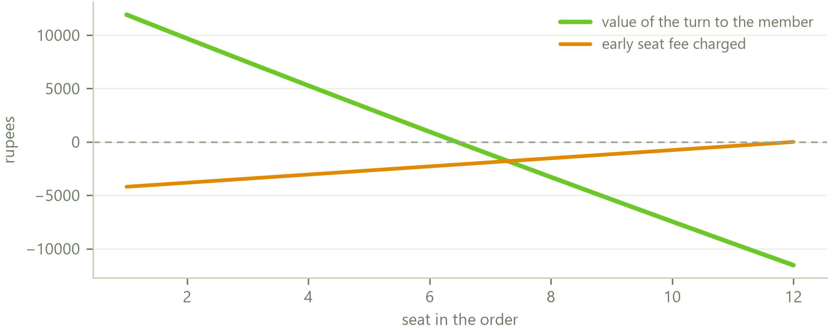
FUNCTION FOUR PROTECTION
Where the order turns neutral
Neutral seat = 6.4 of 12
Setting the value of the turn to zero and solving gives seat 6.4. Seats one to six carry positive value. Seats seven to twelve carry negative value.
The fee schedule does not currently match that. It tapers to zero at the last seat rather than at the neutral seat, and at its steepest it captures Rs 4,200 of the Rs 11,916 the first seat is worth, which is about a third.
The correction is one line: taper the early seat fee to zero at the neutral seat, and credit the seats beyond it from what the early seats paid. The circle then settles its own time value internally and the arrangement is provably fair rather than merely conventionally fair.
Value of the turn against the early seat fee currently charged, by seat.
Halqa · Confidential
38

Slide 39
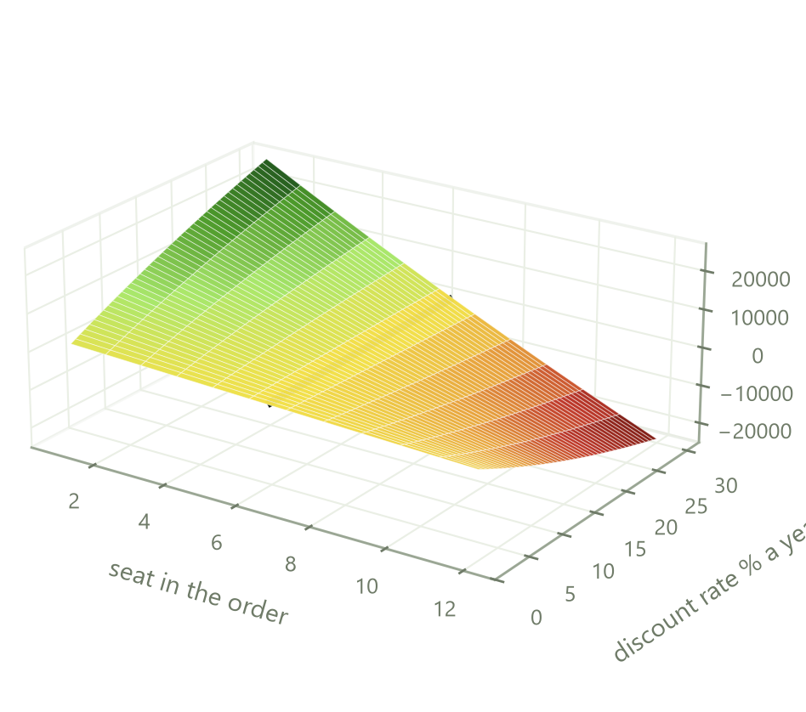
FUNCTION FOUR PROTECTION
Time value across the rate spectrum
The neutral seat is not fixed. It moves with the rate a member discounts the future at, which in practice is what borrowing costs them.
At two per cent a year the order is nearly flat and the seat barely matters. At thirty per cent, which is close to what a Pakistani household pays on informal credit, the first seat is worth over Rs 25,000 and the last costs about the same.
This is the reason the turn marketplace exists. Members do not value their positions identically, because they do not face the same cost of money. A member with a cash need today and a member saving for a wedding next year sit on opposite sides of this surface, and letting them trade makes them both better off without Halqa taking any risk.
The marketplace commission of ten per cent of the accepted premium is a fee on that trade, not a position in it.
Loss
Break even
Profit
Halqa · Confidential
39

Slide 40
FUNCTION FIVE RECOVERY
Legal instruments
INSTRUMENT | DETAIL | EFFECT
Undertaking | Electronically signed, renewed weekly, ten clauses, seven day expiry. The typed name must match the registered name exactly. Stored with a hash of the document, the signing IP and a timestamp | A written contract for a fixed sum, which permits recovery by summary suit under Order XXXVII of the Code of Civil Procedure
Mutual guarantee | Executed automatically inside the join transaction. Starting a circle requires every active member to have signed | Runs member to member and expressly not to Halqa, so the circle rather than the platform holds the claim
Consent to bureau reporting | Contained in the undertaking, alongside consent to automatic collection and to the salary anchor | Permits the record to be furnished and a delegated credit check to be run
Service of notice | Consent at signup that legal notice may be served at the pinned address | Recovery does not stall on locating the member, which is the usual failure mode
Evidence pack | Undertaking, guarantee, identity linkage, address, timestamped payment history, circle message log and signature hashes, assembled on demand | Provided to counsel or a court. It is not provided to the circle
Signing a personal guarantee and failing to pay is a civil matter in Pakistan and carries no imprisonment. The only criminal route was the offence relating to dishonoured cheques, and cheques were removed from the model. Recovery requires a court decree and takes months.
Halqa · Confidential
40

Slide 41
FUNCTION FIVE RECOVERY
Order of recourse
 | STEP | DETAIL
1 | Pledged savings units | Redeemed under the instruction signed at pledge, with the trustee paying the round's recipient directly. Halqa never receives the money
2 | Unpledged savings units | Only under a separate signed set off clause, and only after notice with a seven day cure period
3 | Pot deductions in live circles | Applied in a fixed order and capped at 60 per cent of the pot, so a member's turn is never emptied
4 | Sponsor and restitution claims | Assigned to the cover facility on subrogation
5 | Asset circles | The trustee enforces and the sale proceeds are paid into the circle, with any surplus returned to the member
6 | Recovery case | Outstanding amount plus penalties plus 10 per cent, enforced by summary suit if pursued
Set off operates in favour of the circle's members and never in favour of Halqa, which is the same construction as the mutual guarantee. Halqa seizes nothing: it instructs a trustee under a pre signed mandate, or hands an evidence pack to a counterparty or a court.
Halqa · Confidential
41

Slide 42
THE PRODUCTS
The range
PRODUCT | DESCRIPTION
Known circles | Formed by a host among people who know one another, which is how committees work today. Lighter verification, lower fines, optional insurance, and the group carries the loss
Open circles | Formed among strangers matched by the platform. Heavier verification, steeper late fees, mandatory insurance, and the platform covers a missed contribution from the first round. This product does not exist in the informal market at all, because strangers have no way to trust one another without a record
HYPER committees | Four hundred members, sixty days, daily contributions, pots capped at Rs 15,000. Built for the daily wage earner, who is the largest excluded group and has no savings product today
Asset circles | The pot buys a named item and is paid to the dealer. Possession at the member's turn, legal title held by a security trustee until the obligation is discharged. The only product where the security is a physical thing
Savings layer | Voluntary savings into an Islamic money market fund, held by a trustee in the member's own name. Pledged, it becomes the strongest default control in the model
Halqa · Confidential
42

Slide 43
THE PRODUCTS
Known and open circles compared
PARAMETER | OPEN | KNOWN
Joining and contributing | Free, permanently | Free, permanently
Automatic collection | Mandatory | Mandatory
Facial verification | At joining plus the full trigger list | At joining
Manual review by staff | Random sample of 5 per cent | Random sample of 2 per cent
Income detection | A filter. No established payday, no first half seat | A signal. Informs the display, never blocks
Early seat fee, share of pot | 1.00 per cent at seat one, tapering to zero | 1.75 per cent at seat one, tapering to zero
Insurance premium | 1.5 per cent, mandatory, capped at Rs 300 | 0.5 per cent, optional, capped at Rs 150
Late fee ladder, at 1, 7 and 15 days | 3, 7 and 12 per cent | 1, 3 and 6 per cent
Score damage at those points | Minus 15, 30 and 50 | Minus 10, 20 and 40
Platform covers a missed contribution | Yes, from the first round | No, the group covers
Signed undertaking | Renewed weekly | Signed once at formation
Mutual guarantee | Required | Required
Exit at group approval | No vote, the cover absorbs it | Group vote
Authenticity test | Not applied | Host link confirmed from both ends
Halqa · Confidential
43

Slide 44
THE PRODUCTS HYPER
Structure
400
60
Rs 15,000
30%
Members, fixed. Seven collect on forty days, six on the other twenty
Days, fixed. The pot is sixty times the daily contribution
Pot ceiling, the level an ordinary daily wage can carry
Default rate the product is priced to withstand
DAILY CONTRIBUTION | POT | COLLECTED EACH DAY ACROSS THE ROSTER | MOST A SINGLE DEFAULT CAN COST
Rs 100 | Rs 6,000 | Rs 40,000 | Rs 5,900
Rs 150 | Rs 9,000 | Rs 60,000 | Rs 8,850
Rs 200 | Rs 12,000 | Rs 80,000 | Rs 11,800
Rs 250 | Rs 15,000 | Rs 100,000 | Rs 14,750
Exposure is bounded by the size of the pot rather than by the size of the roster, which is what makes a thirty per cent default assumption financeable at all. Entry requires two months of demonstrated daily earnings, or a vault holding equal to the pot locked for the sixty days.
Halqa · Confidential
44

Slide 45
THE PRODUCTS HYPER
The opening auction
Positions are set once, at the start, by auction, and are fixed for the whole of the cycle. A position may not be sold, bought or altered afterwards, and HYPER committees do not appear on the turn marketplace which operates across the rest of the platform.
STAGE | OPERATION
Bidding window | Twenty four hours, opening when the roster of four hundred completes and before the first contribution falls due
What is bid for | One single named day of the cycle. A member may place as many bids as they wish, but every bid must be for that one day. Bidding across several days is not permitted
What is visible | The standing highest bid on each day, so a member can price a position. No bidder is identified at any point
Allocation | Each day carries six or seven places. The highest bids on that day take them
Everyone else | Members who placed no bid, and members who were outbid, are assigned to the remaining days by a verifiable ballot
Payment | Only a winning bid is charged. An outbid member pays nothing
Eligibility | A bid is refused at the point of placing where the member's band or affordability does not permit that day
Every premium is paid to Halqa in full. There is no member to member premium and no commission split, so the platform receives the whole amount rather than a share of it.
Halqa · Confidential
45

Slide 46
THE PRODUCTS HYPER
Daily position and funding
LINE | AMOUNT
Deficit at cycle close | Rs 152,250 negative
Auction premiums, taken before the cycle opens | Rs 40,000
Fee uplift of forty five per cent | Rs 50,000
Late fees | Rs 20,000
Residual before recovery | Rs 42,250 negative
Advances outstanding and recoverable | Rs 915,000
Recovery rate at which it closes at zero | 4.6%
The premium runs ahead of the shortfall for the first twenty six days and behind it after, so the surplus built early funds the deficit late from inside the committee itself. What the product needs is a revolving working balance, not equity.
Rupees per day, one committee at Rs 250 a day across four hundred members.
Halqa · Confidential
46

Slide 47
THE PRODUCTS ASSET CIRCLES
Retention of title
The pot buys a named item and is paid straight to the dealer. The member takes possession at their turn. Legal title does not pass, and is held by a security trustee for the circle's members until that member's obligation is discharged.
Under the Sale of Goods Act 1930 property passes when the parties intend it to, and a seller may reserve the right of disposal. This is ordinary commercial law rather than an exotic structure.
The obligation falls faster than the asset depreciates, so the security strengthens every month. Every member's contributions end on the same round, so members take possession on different dates and receive title on one date. No member's title depends on any other member's conduct, and if the circle itself fails each retention still stands on its own.
Cover improves from 1.31 times at month three to 3.53 times at month nine.
Halqa · Confidential
47

Slide 48
THE PRODUCTS SAVINGS
The savings layer
Committee money earns nothing while it waits, which is a straightforward loss against inflation. Under the 2008 regulations the assets of every regulated fund are held by a trustee and the manager only manages them, so the member's money never touches Halqa.
PRODUCT | MECHANISM | EFFECT
Growth vault | Voluntary savings into an Islamic money market or income fund, units registered in the member's own name | Money which earns nothing today earns a return
Safety vault | The same holding, pledged, with a charge in favour of the circle and an irrevocable redemption instruction signed at pledge | A member cannot default up to the size of the pledged holding. This is what makes short cycle products possible
Float | Contributions collected between payday and the payout date buy units in the payer's own name and redeem on payout day | Small. About Rs 249 a circle a cycle to Halqa. It is a member benefit, not a revenue line
The registration required is a mutual fund distributor registration. It is not an electronic money licence, because no balance is issued, and not a non banking finance licence, because Halqa deploys nothing. One engineering rule is absolute: no payout ever waits on a fund redemption.
Halqa · Confidential
48

Slide 49
THE MATHEMATICS
One formula, every product
The whole risk model is one expression. Every product below is the same expression with different numbers substituted into it.
Cost of one default = c (T − k) − φ k
What the member still owes after collecting, less the fees they have already paid.
Money in equals money out for the member in every column. Halqa's entire take is the fee line.
SYMBOL | MEANING | OPEN MONTHLY | KNOWN MONTHLY | ASSET | HYPER
N | Members | 12 | 12 | 12 | 400
T | Rounds | 12 months | 12 months | 12 months | 60 days
c | Each installment | Rs 20,000 | Rs 20,000 | Rs 10,000 | Rs 250
φ | Halqa fee per installment | Rs 100 | Rs 100 | Rs 100 | 15%, Rs 37.50
P | Pot | Rs 240,000 | Rs 240,000 | Rs 120,000 | Rs 15,000
 | Member pays in over the cycle | Rs 240,000 | Rs 240,000 | Rs 120,000 | Rs 15,000
 | Member receives | Rs 240,000 | Rs 240,000 | Asset | Rs 15,000
 | Halqa earns per circle | Rs 14,400 | Rs 14,400 | Rs 14,400 | Rs 900,000
 | Who covers a default | Halqa | The group | The trustee, then Halqa | Halqa
Halqa · Confidential
49

Slide 50
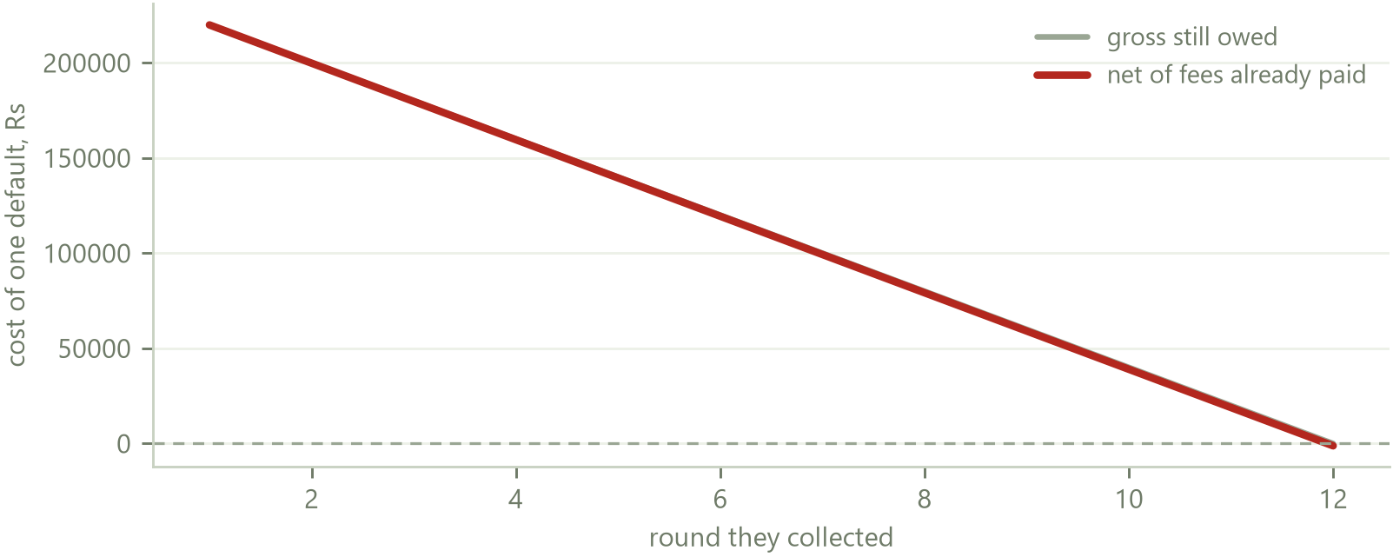
THE MATHEMATICS
What one default costs
Break-even round = cT ÷ (c + φ)
PRODUCT | BREAK-EVEN POINT | SAFE POSITIONS
Open monthly | Round 11.9 | The last one
Known monthly | Round 11.9 | The last one
Asset circle | Round 4.0 | Nine of twelve
HYPER | Day 52.2 | Eight of sixty
Beyond the break-even point a member who walks has already paid Halqa more than they can cost it. Asset circles reach that point in round four because the trustee can sell the item. Monthly circles only reach it at the very end, which is why position gating carries the whole weight.
Cost of a single default on a twelve month circle, by the round they collected.
A default in round one costs Rs 219,900, which is fifteen circles' worth of fee revenue. A default in round eleven costs Rs 18,900. Same person, same rules, twelve times the damage.
Halqa · Confidential
50

Slide 51
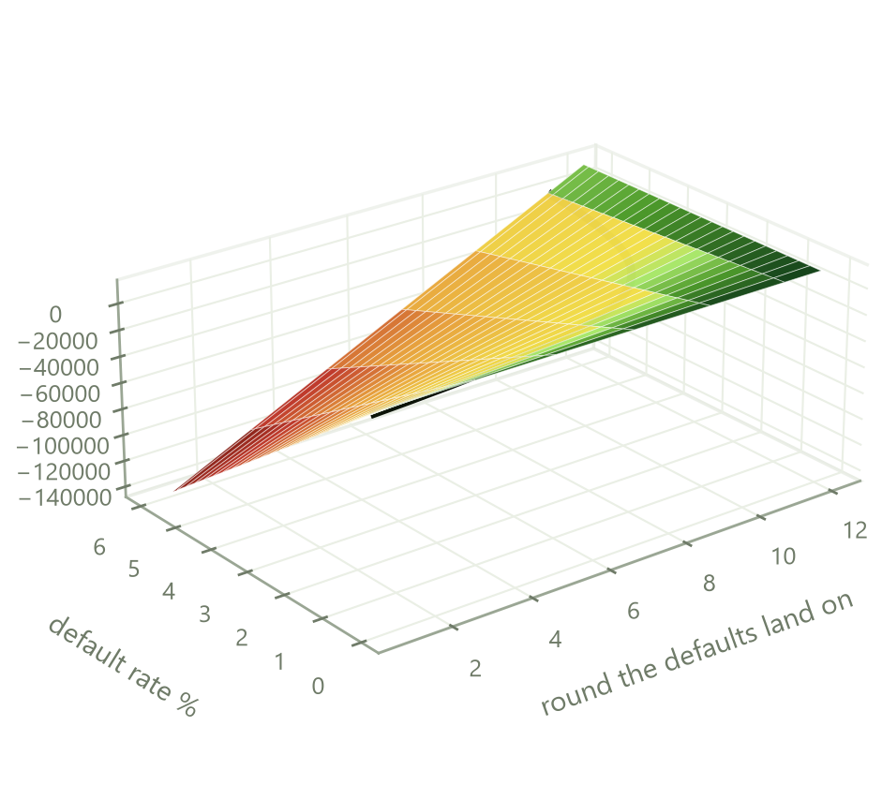
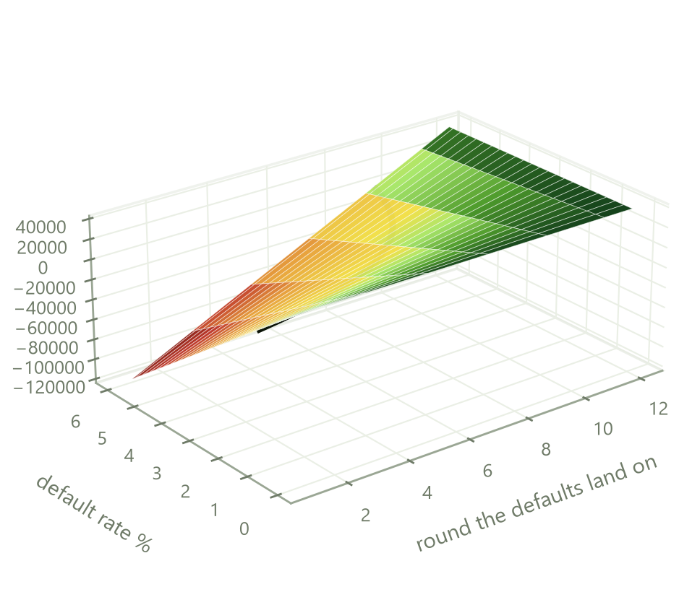
THE MATHEMATICS
Where profit turns to loss, monthly circles
Fee of Rs 100 per installment.
Fee of Rs 275 per installment.
Loss
Break even
Profit
Net position per circle against how many members default and where in the order those defaults land. The black line is break even. At Rs 100 the tolerated default rate is 1.09 per cent against a 1.0 per cent assumption, which is no margin at all. At Rs 275 it is 2.96 per cent, which is roughly three times cover for Rs 175 more a month.
Halqa · Confidential
51

Slide 52
THE MATHEMATICS
The fee that clears the risk
Break-even default rate = φT ÷ [ (c + φ)(T − m) ] Fee required = d c (T − m) ÷ [ T − d (T − m) ]
PRODUCT | DEFAULT RATE ASSUMED | FEE THAT BREAKS EVEN | FEE FOR THREE TIMES COVER | FEE CHARGED | COVER ACHIEVED
Known monthly | 0.3% | Rs 28 | Rs 83 | Rs 100 | 3.6 times
Open monthly | 1.0% | Rs 92 | Rs 276 | Rs 100 | 1.1 times
Asset circle | 1.0% before recovery | Rs 46 | Rs 138 | Rs 100 | 2.2 times
HYPER | 30.0% | 18% of contribution | not affordable | 15% | 0.8 times
Two rows are deliberately thin. Open circles at Rs 100 and HYPER at 15 per cent are priced at or slightly below break even, and the shortfall is met by the opening auction, the turn marketplace and late fees. That is a defensible choice, but it should be a stated one. The alternative is Rs 275 on open circles, which the member experiences as Rs 175 a month against Rs 240,000 of money moved.
Halqa · Confidential
52

Slide 53
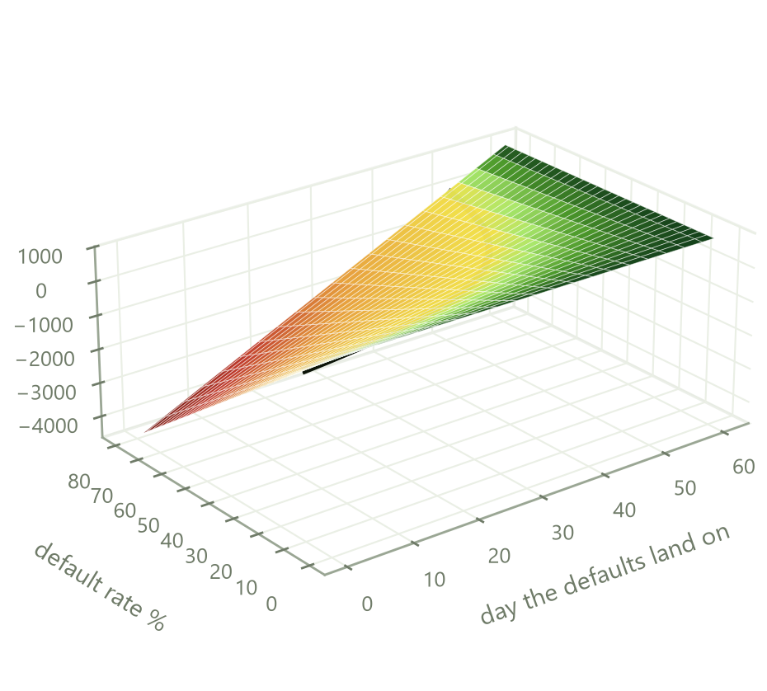
THE MATHEMATICS
Where profit turns to loss, HYPER
The same surface for a four hundred member, sixty day committee, run out to an eighty per cent default rate.
The lesson is that the default rate is not what decides the outcome. At the thirty per cent design rate, defaults landing around day ten cost Rs 825,000 and defaults landing around day fifty earn Rs 555,000. Same number of defaulters, a Rs 1.4 million swing, purely on timing.
At thirty per cent the order turns from loss to profit at day 34. Even at eighty per cent, defaults landing after day 51 barely register, because by then the defaulters have paid in almost everything they owe.
Every control that matters is therefore a control on who occupies the early positions: band gating at the auction, two months of demonstrated daily earnings, and the vault holding.
Loss
Break even
Profit
Halqa · Confidential
53

Slide 54
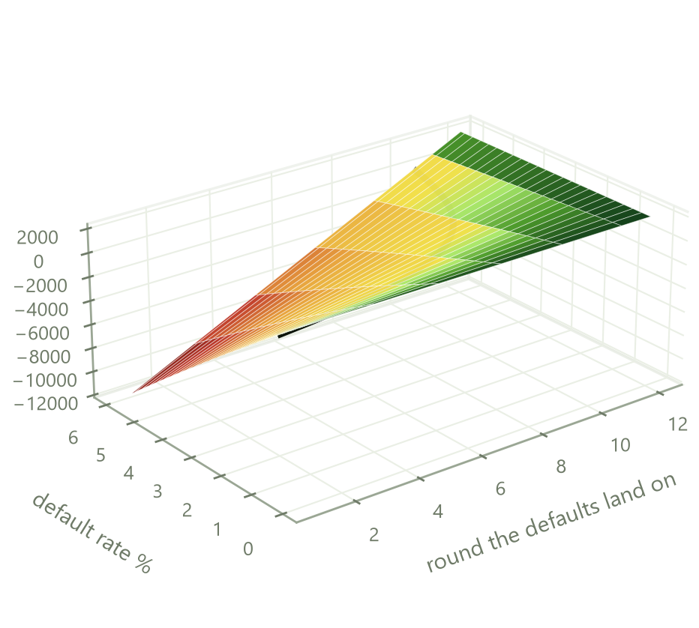
THE MATHEMATICS
Who bears the loss
The two monthly products differ in one respect that the profit surface alone conceals: on an open circle Halqa covers the shortfall, and on a known circle the group does.
ONE DEFAULT AT ROUND FOUR, TWELVE MEMBERS, RS 20,000 | OPEN CIRCLE | KNOWN CIRCLE
Who fronts the missing contributions | Halqa's cover facility | The other eleven members
Cost to each remaining member | Rs 0 | Rs 14,545
Cost to Halqa | Rs 159,600 | Rs 0
What the defaulter gains | Rs 159,600 | Rs 159,600
What the member pays in fees | Rs 1,200 a year | Rs 1,200 a year
Advantage of a known circle over a covered open circle.
A known circle is cheaper for the member until its default rate passes 1.87 per cent. Beyond that the member is better off paying for cover. Known circles run at 0.3 per cent, so they win comfortably, and the extra fee on an open circle now has an honest name.
Cost to each member = c (T − k) ÷ (N − 1)
With one flat fee on both products, the open circle member receives cover for nothing while the known circle member pays the same for none. That is the argument for splitting the two prices.
Halqa · Confidential
54

Slide 55
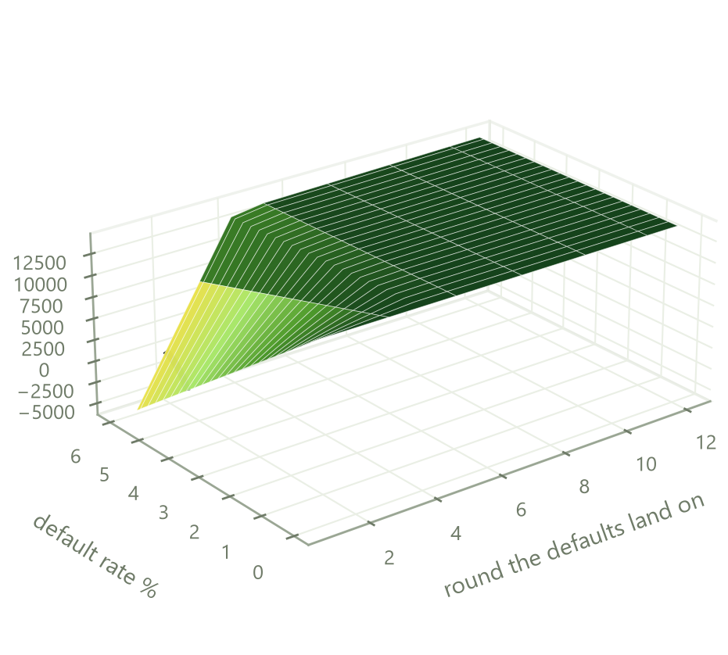
THE MATHEMATICS
Asset circles and the deposit
Loss = max( 0, c(T − k) − φk − h·V(k) )
ROUND | STILL OWED | ASSET RECOVERS | NET LOSS
1 | Rs 110,000 | Rs 82,833 | Rs 27,167
3 | Rs 90,000 | Rs 80,500 | Rs 9,200
4 | Rs 80,000 | Rs 79,667 | Rs 0
5 and after | falling | rising cover | Rs 0
The trustee holds title, so a default is met by selling the item rather than by pursuing the member. At a seventy per cent forced sale recovery the exposure closes in round four and is zero thereafter.
A deposit removes even that. The threshold is P(1 − h) ÷ h, which is 43 per cent of the pot for complete cover. A twenty per cent deposit halves the exposed window to two rounds and is a realistic ask of a dealer.
Loss
Break even
Profit
Halqa · Confidential
55

Slide 56
REWARDS
What earns a reward
On time payment is the single input on which the whole model rests. Expected loss, the insurance premium, the score and the value of the data asset all move with it, so the reward system is attached to that behaviour and to nothing else.
EVENT | POINTS | SCORE EFFECT | STREAK EFFECT
Contribution paid on or before the due date | 10 | Plus 2, capped at 40 a cycle | Advances the streak by one
Contribution paid three or more days early | 15 | Plus 2 | Advances the streak by one
Each consecutive clean round | Multiplier of plus 5 per cent, ceiling plus 50 per cent | None | Compounds
Completing a circle with a clean record | 200 | Existing completion event | Carries the streak into the next circle
Paying a contribution for another member | 50 | None | Neutral. It does not build a streak, so the ladder cannot be bought
A missed contribution | None | The late fee ladder applies | Resets the streak to zero
Points and score stay separable. Points buy discounts, score gates seats. Points never buy score, and score is never sold.
Halqa · Confidential
56

Slide 57
REWARDS
The ladder
CONSECUTIVE ROUNDS PAID ON TIME | REWARD FROM A PARTNER RETAILER | ALTERNATIVE, A HALQA CHARGE WAIVED
3 | 5 per cent discount code, capped at Rs 500 | None at this tier
6 | 10 per cent capped at Rs 1,000, plus delivery waived | None at this tier
12 | 12 per cent capped at Rs 2,000 | One month of insurance premium waived
18 | Category offer capped at Rs 3,000 | Seat placement fee waived on the next circle
24 | 15 per cent capped at Rs 4,000 | Early seat fee waived on the next circle
36 | Top tier offer capped at Rs 6,000 | Early seat fee and one month of premium waived
Circle completed clean | Completion offer capped at Rs 1,500 | 200 points
Ceiling on the reward, by streak length.
A member paying Rs 10,000 a month with a clean record for two years reaches the 24 round tier, by which point the ladder has returned roughly Rs 11,500 of retail discount against Rs 240,000 of contributions, none of it paid for by Halqa.
Rewards are never redeemable for cash and release only against contributions which have settled.
Halqa · Confidential
57

Slide 58
REWARDS
Retail partnerships and how they are funded
The discount at every tier is the retailer's own promotional discount, extended to an audience qualified by a year or more of demonstrated payment behaviour. It is customer acquisition spend for them rather than a cost to Halqa, and Halqa earns an affiliate commission on the resulting order at three to twelve per cent of order value depending on category. The reward is the retailer's discount and the revenue is the retailer's commission, so the system funds itself.
PHASE | STEP | WHAT IT REQUIRES
1 | Halqa charges waived only | No counterparty. Waivers run through the existing fee engine and can ship immediately
2 | Affiliate registration | Registration with the affiliate programmes the large Pakistani marketplaces already operate. A form rather than a negotiation. Links carry an identifier and orders are attributed automatically
3 | Direct merchant agreement | A negotiated rate card, discount codes exclusive to Halqa members, placement inside the application, and category exclusivity where obtainable
4 | Direct payment | A goal circle's pot is paid to the retailer for a named item and the retailer pays 1 to 3 per cent of the value brokered. This turns the rewards relationship into a distribution channel
Retailers to approach are Daraz, Telemart, iShopping and HomeShopping, the grocery chains Naheed, Alfatah and Imtiaz, and the delivery platforms Foodpanda and Bykea. Halqa receives order attribution rather than basket contents, and purchase behaviour is not sold.
Halqa · Confidential
58

Slide 59
ENGINEERING AND SECURITY
Threat model
The platform holds no member money, which removes the largest prize but not the others. Six attacks are worth defending against, in order of what they would actually be worth to an attacker.
 | ATTACK | WHAT THE ATTACKER GAINS | WHAT STOPS IT
1 | Impersonated exit or hardship claim | A payout released to the wrong person, or an obligation written off | Facial verification fired on every exit request, plus the application PIN, plus a manual review sample
2 | Account takeover by stolen credential | Access to a member's circles and their payout | Refresh token family burn on reuse, facial check on any new device, PIN held in memory only so a reload re asks
3 | Synthetic or borrowed identity at signup | A circle seat with no real person behind it | Identity card capture, account title match, NADRA Verisys and biometric, uniqueness enforced on identity number, telephone number and address
4 | One person assembling an artificial circle | A pot funded by the platform's cover facility and never repaid | Host concurrency ceiling, the host link confirmed from both ends, and new members restricted to the last three seats
5 | Double charge or double payout through a retry | Nothing for an attacker, but a real loss and a real trust failure | Idempotency key on every write, reconciliation by key before any retry
6 | Data exfiltration | Identity numbers and payment histories of every member | Parameterised queries throughout, no raw biometrics or card numbers stored, append only audit log, encryption in transit and at rest
Halqa · Confidential
59

Slide 60
ENGINEERING AND SECURITY
Controls in place
LAYER | CONTROL | STATE
Transport | TLS with strict transport security and a content security policy on both applications | Live
Credentials | Passwords hashed with bcrypt at cost twelve. Secret strength asserted at boot, so the service refuses to start weak | Live
Sessions | Short lived access tokens with rotating refresh tokens. Reuse of a refresh token burns the whole family, so a stolen token cannot be replayed | Live
Second factor | Application PIN on every open, every join commitment, every exit request and every payout release, separate from the password and held in memory only | Live
Device biometric | Layered on the PIN where the handset supports it. Never leaves the device, never transmitted, never stored | Live
Rate limiting | Five failed attempts locks the account for fifteen minutes. Thirty in fifteen minutes is blocked globally. Login timing constant so accounts cannot be enumerated | Live
Injection | Every query parameterised through the typed data layer, so string concatenation into SQL is structurally unavailable rather than merely discouraged | Live
Audit | Append only audit log plus a separate security event table. Every consent, signature and administrative action carries an actor and a timestamp | Live
Dependencies | Zero known vulnerabilities on the web package at the last check | Live
Independent test | External penetration test and a formal secure code review | Before public launch
Posture assessed internally at B plus. The gap to A is the two items marked before launch, and they are named here rather than omitted.
Halqa · Confidential
60

Slide 61
ENGINEERING AND SECURITY
Data the platform refuses
Roughly four hundred lending applications were removed from Pakistani app stores for the permissions they demanded rather than for the money they lent. Each item below would improve Halqa's underwriting and each one is refused, because the cost of holding it is delisting, a regulator, or both.
REFUSED | WHAT IT WOULD HAVE GIVEN | WHY IT IS REFUSED
Contact list access | A social graph for collections pressure | The single practice most associated with the removals, and the one the regulator named
Photo gallery access | Documents and proof of assets | No proportionate purpose. Impossible to justify to a store reviewer
Message reading | Bank credit alerts scraped from SMS | Reads every private message to obtain a handful of numbers
Accessibility service screen scraping | Live bank balances without any partnership | Rejected earlier in the design. It is the delisting trap and no balance is worth it
Background location | Movement patterns and workplace confirmation | One precise pin at signup, with consent, is sufficient and defensible
Full card numbers and security codes | Simpler repeat charging | Never persisted. Brand, last four digits, expiry and holder only
Raw biometric templates and facial images | In house matching | Only the verification result and the reference are kept. The template stays with NADRA
The permissions a lender demands are the fastest signal a regulator has for how it intends to collect. Halqa asks for less than a food delivery application.
Halqa · Confidential
61

Slide 62
ENGINEERING AND SECURITY
Engineering invariants
INVARIANT | WHAT IT MEANS | WHY IT EXISTS
All money is integer paisa held as a big integer | No floating point value appears anywhere in the money path. Rates apply as basis points with integer division | Binary floating point cannot represent most decimal fractions exactly, and the residue is invisible until reconciliation fails
Every movement is a double entry pair | Each settlement writes two ledger entries which must sum to zero | The ledger checks itself. A one sided write is detectable rather than silent
Every write carries an idempotency key | A retried request applies once. The key is stored with the record and a duplicate is a no operation | Retries are the normal condition on mobile networks. Without this a member on a weak signal pays twice
Receipts commit with the settlement | The receipt row and the message queue row are written inside the same database transaction as the money movement | A receipt cannot exist without a settlement, and a settlement cannot exist without a receipt
Production migrations are additive only | Hand written SQL that only adds. Nothing is dropped or renamed during a deploy | Old and new code both stay correct while a release rolls out, so there is no window in which the application is broken
Scheduled work runs server side | The delinquency sweep is a job at 02:00 UTC, not something the application triggers | Enforcement cannot depend on a member opening an application
60 unit tests and 352 integration tests pass. The integration suite exercises the money paths end to end rather than mocking them, which is the only way these six can be asserted rather than asserted about.
Halqa · Confidential
62

Slide 63
ENGINEERING AND SECURITY
Platform and data
AREA | DETAIL
Stack | React and TypeScript on the front end, Node and TypeScript on the API, PostgreSQL behind a typed data layer. Both packages type clean
Delivery | Installable on the handset as a progressive web application, with native Android and iOS shells prepared. Urdu and English throughout, with regional greetings
Scheduled work | The delinquency sweep runs server side as a scheduled job at 02:00 UTC rather than in the application, so it does not depend on a member opening anything
Data minimisation | Only the verification result and the reference are stored for identity checks. Card numbers and security codes are never persisted. Location is a single precise pin at signup, never background tracking
Data the platform refuses | Contact list harvesting, gallery access, message reading and accessibility service screen scraping are all rejected, because each one fails either the app store policy or the regulator and is the practice behind the removal of roughly 400 lending applications
Testing | 60 unit tests and 352 integration tests, all passing. The integration suite exercises the money paths end to end rather than mocking them
Halqa · Confidential
63

Slide 64
ECONOMICS
Revenue lines
LINE | BASIS | PAYER
Insurance premium, open circles | 1.5 per cent of each contribution, capped at Rs 300 | Member, against cover
Insurance premium, HYPER | 15 per cent of each contribution | Member, against cover
Early seat fee | 1.00 per cent of the pot at the first seat on open circles, tapering to zero at the last | Member collecting early, from the pot
Seat placement fee | Rs 500 flat where Halqa fills a vacant seat, less 20 per cent if income is verified | Member, optional
Turn marketplace commission | 10 per cent of the accepted premium | Member, optional
HYPER auction premiums | The whole premium, with no commission split | Member, optional
Late fees | 3, 7 and 12 per cent of the contribution by lateness on open circles | Member in default of the schedule
Retail affiliate commission | 3 to 12 per cent of order value by category | Retailer
Direct payment commission | 1 to 3 per cent of the value brokered | Retailer or dealer
Asset structure origination | 2 to 4 per cent of asset value | Dealer or leasing counterparty
Distribution trail on savings | 0.5 to 1.5 per cent a year of assets under management | Asset manager
Rewarded video | USD 1.50 to 4.00 per thousand completed views, on one surface only | Advertiser
Members pay nothing to join a circle and nothing to make a contribution. Every line above is either an optional priced service or is paid by a counterparty.
Halqa · Confidential
64

Slide 65
ECONOMICS
Unit economics
MEASURE | MONTHLY CIRCLE | HYPER COMMITTEE
Structure | 12 members, Rs 20,000, 12 months | 400 members, Rs 250 a day, 60 days
Pot | Rs 240,000 | Rs 15,000
Flow per cycle | Rs 2,880,000 | Rs 6,000,000
Insurance premium collected | Rs 43,200 | Rs 900,000
Expected loss at the modelled rate | Rs 13,200 | Rs 885,000
Underwriting surplus | Rs 30,000 | Rs 15,000
Cycles a year | 1 | 6
Where the profit actually is | The underwriting margin | The opening auction premiums
The two products earn in different places. On a monthly circle the premium comfortably exceeds expected loss and the underwriting margin is the revenue.
On a HYPER committee the premium is set precisely at the design default rate, so the underwriting line is close to neutral by construction and the revenue is the opening auction, on which the whole of every premium is received rather than a commission on it.
Neither default rate is a Halqa measurement yet. Both are modelled from the literature and from the design point.
Against Rs 4 trillion of annual flow, a one per cent share carries Rs 40 billion, on which the member facing take alone is between Rs 680 million and Rs 800 million a year, before the retail commission, the direct payment commission and the savings trail. The retail and savings lines compound, because they grow with members rather than with circles.
Halqa · Confidential
65

Slide 66
ECONOMICS
Take rate and scale
LINE | SHARE OF FLOW
Insurance premium, open circles | 1.50 per cent
Early seat fee, averaged across seats | 0.05 per cent
Marketplace and placement fees | 0.05 to 0.15 per cent
Late fees | 0.10 to 0.30 per cent
Total, member facing | 1.70 to 2.00 per cent
The savings trail is the line which does not appear here and which matters most over time. At Rs 1 billion of assets under management a one per cent trail is Rs 10 million a year, and it recurs without further work.
Member facing revenue a year at 1.7 per cent, by share of the Rs 4 trillion market. Modelled, not forecast.
Halqa · Confidential
66

Slide 67
COUNTERPARTIES
Named counterparties
FUNCTION | CANDIDATE | NOTE
Fund trustee and security trustee | Central Depository Company; Digital Custodian Company | Both qualified. A single sourced trustee is a commercial exposure
Digital asset manager | Mahaana Wealth | Digital first manager for the savings layer
Islamic money market funds | Al Meezan; NBP Fund Management; UBL Fund Managers; Alfalah; HBL; Atlas | Daily dividend funds, built for same day and next day redemption
Leasing counterparty | Orix Modaraba; First Habib Modaraba; Allied Rental Modaraba | Can hold title and write a lease without Halqa holding any licence
Takaful | Pak-Qatar Family Takaful; Salaam Takaful; Jubilee; EFU | Cover above the aggregate cap, and credit life at 0.2 to 0.5 per cent of exposure
Credit bureau | TASDEEQ, being Aequitas Information Services; DataCheck Limited | TASDEEQ is the first bureau licensed under the Credit Bureaus Act 2015, with 170 plus members including fintechs and non bank financiers. DataCheck, founded 2001, is the second agreement
Identity | NADRA, through the Nishan Pakistan portal | Verisys and multi biometric. The longest lead item
Payment rails | 1LINK as switch operator; PayFast and Safepay as aggregators | A merchant agreement, not a licence
Messaging | WhatsApp Business Cloud API | Receipts, reminders and one time codes
Retail partners | Daraz; Telemart; iShopping; Naheed; Alfatah; Imtiaz; Foodpanda; Bykea | Affiliate registration is enough for the first phase
Non dilutive funding | Karandaaz Pakistan; Ignite National Technology Fund | Karandaaz co funded the 2018 research validating this architecture
Regulator | SECP regulatory sandbox | The least expensive credibility available
Halqa · Confidential
67

Slide 68
IMPLEMENTATION
Collection and credit, in production
AREA | WHAT IS RUNNING
Checkout and rails | Gateway style checkout across Raast, JazzCash, Easypaisa, bank transfer and cash, with an explicit failure path which leaves the installment untouched
Saved instruments | Captured once and masked at rest, maximum five, one preferred. Card linking stores brand, last four, expiry, holder and billing address only
Mandate verification | A one time code over the WhatsApp rail with a ten minute expiry, plus the account title check against the identity card name
Automatic collection | A standing per circle mandate, on by default at joining with recorded consent, replaceable but not removable while a circle runs
Payday collection | Balance notice the evening before, execution on the payday morning, a retry ladder to the due date, and four independent verification signals
Sakh | Score from 300 to 850 with bands, credit events with reasons, a movement chart, and an exportable credit record which verifies without a Halqa account
Delinquency | A daily job at 02:00 UTC running the escalating ladder, recovery cases with a 10 per cent rehabilitation fee, and a bureau export queue
Turn marketplace | Listing, bidding and acceptance, premium capped at 50 per cent of the payout, 10 per cent commission, zero premium only on Shariah labelled tiers
Halqa · Confidential
68

Slide 69
IMPLEMENTATION
The application
Live
60 / 352
Rs 0
In production since 20 July 2026, deliberately not opened to the public
Unit and integration tests, all passing
What a member pays to join or to contribute
SURFACE | STATE
Onboarding | Ten steps: phone verification, identity card capture, live location, occupation, a mandatory collection account and an application PIN
Home | Balance, next installment, eight quick actions, committee cards with live collection progress, recent activity
Committees | Own circles and discovery, invite codes, invitation by WhatsApp, contacts, messages and Skype, a public only filter with its disclosure
Payment and receipts | Every Pakistani rail, card entry which stores nothing sensitive, a processing sequence, and a receipt reference for every settlement
HYPER | Tier selection, the opening auction with a live countdown, standing bids per day and bid entry
Rewards | Streak ladder with unlock states, points balance and the retail partner grid
Account | Score dial, credit report, linked accounts, salary status, recovery cases and settings
Halqa · Confidential
69

Slide 70
IMPLEMENTATION
The ladder
 | RUNG | WHAT IT UNLOCKS | GATE
1 | Collection | Settlement rather than assertion. Without it there is no credible record, no data asset and no business | Company registration and a merchant services agreement
2 | The record | Verified repayment at volume, which is the raw material for everything above | Circles completed, not registrations
3 | The bureau link | The record becomes a formal credit signal and Halqa becomes the supplier of a data class the system does not hold | A contributor agreement with a bureau
4 | Commerce | Retailers and institutions pay for access to outcomes. Rewards, direct payment and asset circles sit here | Affiliate registration, then merchant agreements
5 | The savings layer | Yield for the member, a trail for the platform, and a pledged buffer which cures default at source | Trustee, asset manager and distributor registration
The near term work divides into engineering, which is under the company's own control, and counterparty work, which carries lead times measured in months and is therefore started in parallel rather than in sequence.
Halqa · Confidential
70

Slide 71
IMPLEMENTATION
Performance measures
 | MEASURE | WHY IT IS THE ONE THAT MATTERS
1 | Share of contributions settled digitally | The health of the collection rung, and the single most important figure in the company. A ledger of assertions is worth nothing
2 | Circles completed clean | The atomic unit of value. A circle which completes has produced a full record for every member in it
3 | Circles per organiser | Whether the growth loop compounds or leaks
4 | Measured default across the first hundred completed circles | The point at which the loss rate stops being modelled and becomes measured, and at which every price is recomputed
5 | Member to organiser conversion | The only growth loop internal to the product
Registrations, downloads and total value committed can all be raised without the arrangement working at all, and are not tracked as measures of progress.
Halqa · Confidential
71

Slide 72
The market is established. The instrument is a
thousand years old. The participants number in
the tens of millions.
What has never existed is the record.
Halqa 12 August 2026 Confidential

