Slide 1
HALQA
Pakistan's savings committees move
four trillion rupees a year.
None of it is written down.
We built the platform that writes it down, without ever touching the money.
Live in production since 20 July 2026 LSE Generate Global Innovation Challenge

Slide 2
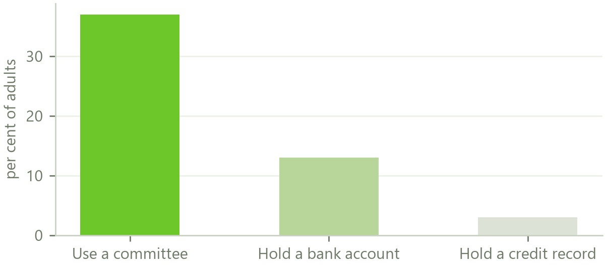
THE PROBLEM
Fifty two million people, no record
A committee is the oldest savings product there is. Twelve people each pay Rs 10,000 a month, and each month one of them takes the whole Rs 120,000. Everyone gets a turn.
Thirty seven per cent of Pakistani adults are in one. Only thirteen per cent have a bank account.
It runs on a notebook, a WhatsApp group, and one person's memory. When the cycle ends, the record disappears.
So a tailor who has paid on the first of the month, eleven months running, walks into a bank and is a total stranger. He has proved exactly what a lender spends money trying to find out, and nobody wrote it down.
Halqa · LSE Generate Global Innovation Challenge 2026
2

Slide 3
THE PROBLEM
Twenty one people have tried this. Every one hit the same wall.
Hold the money
Or record it only
You now need a banking licence, or you become the fraud. The largest Pakistani case took Rs 420 million from 200 people across 117 committees. She kept no records and disappeared.
Two Pakistani apps let the organiser tick a box saying who paid. No money moves through them, so the entry is somebody's claim, not proof. A bank cannot use it and a court will not weigh it.
Everybody assumed those were the only two options. Take custody and carry the licence, or take no custody and record nothing worth having.
Halqa · LSE Generate Global Innovation Challenge 2026
3

Slide 4
THE INSIGHT
We are not trying to move the money.
We are trying to prove it moved.
The money goes directly from one member's bank account to another's, over Pakistan's own instant payment rail. Halqa never holds a single rupee. We schedule it, we watch it settle, and we write it into a permanent record tied to a national identity number.
That one decision removes the licence, removes the fraud, and leaves us with the only thing that was ever actually valuable.

Slide 5
HOW IT WORKS
Where the money actually goes
1
2
3
4
Payday
Direct
Recorded
Furnished
We collect on the morning your pay lands, not on the due date, because that is when the money is actually there
It moves from the payer's account to the receiver's account on the national rail. It never stops with us
Both sides get a receipt. Two matching ledger entries. Tied to a CNIC
The record goes to a licensed credit bureau, so it counts outside Halqa
Because nothing is ever held, there is no pool to steal, no balance to lose, and no licence to wait for. What we need is a merchant agreement, which is the same contract any online shop signs.
Halqa · LSE Generate Global Innovation Challenge 2026
5

Slide 6
FEASIBILITY
This is not a concept. It is running.
Live
412
Rs 0
11
In production since 20 July 2026
Automated tests, all passing
What a member pays to join
Screens built, in Urdu and English
Everything below is built and working today, not on a roadmap.
WHAT THE MEMBER TOUCHES | WHAT RUNS BEHIND IT
Ten step signup with CNIC capture and live location | Automatic collection on the member's payday
App PIN on every open, plus device biometric | Credit score 300 to 850 with an exportable report
Every Pakistani payment rail at checkout | Daily overdue sweep and recovery cases
Receipts with a reference for every settlement | Turn marketplace, rewards and streaks
Halqa · LSE Generate Global Innovation Challenge 2026
6

Slide 7
INNOVATION
What nobody else has
 | WHAT WE DO | WHY IT IS NEW
1 | Collect on payday, not on the due date | It removes the failure where the money arrived and was spent before the deadline. It came from a member saying he pays as soon as his pay arrives
2 | Your position in the queue is the collateral | New members can only take the last turns, so the most they can cost anyone is tiny. No deposit, no guarantor, no cash held
3 | The record is furnished from the day you join | Not from the day you collect. A member has eleven months of proven history before they touch a rupee
4 | There is no cancel button | Leaving is a ladder of five steps, and the money owed back is settled by the members who already collected. It needs no reserve, only arithmetic
5 | A verifiable draw | The ballot is the ritual. We commit to a hashed seed, every member adds entropy, and the seed is published so anyone can recheck it
Halqa · LSE Generate Global Innovation Challenge 2026
7

Slide 8
REAL-WORLD POTENTIAL
It scales because the behaviour already exists
Rs 4tn
52m
3%
2x
Moves through Pakistani committees every year
Adults already taking part
Of adults have any formal credit record at all
Women participate at twice the rate of men
We are not asking anybody to change what they do. Fifty two million people already run committees, every month, with their own money. We are writing down what they were already doing, and handing them a credit identity they could never build before.
UN Sustainable Development Goal 8, target 8.10: strengthen the capacity of domestic financial institutions to expand access to banking and financial services for all. That target reads as though it were written for this.
Halqa · LSE Generate Global Innovation Challenge 2026
8

Slide 9
THE MODEL
How it pays for itself
A member pays nothing to join and nothing to receive their turn.
WHERE THE MONEY COMES FROM | WHO PAYS
A small flat fee on each contribution, around one per cent | The member, and it is the only thing they pay
A fee if you want an early turn, which is genuinely worth more | Only members who choose one
Commission when a member buys something with a partner retailer | The retailer, as customer acquisition spend
A share of the manager's fee on savings we introduce | The asset manager, not the member
Origination when a dealer sells a bike or a machine through a circle | The dealer
Four of those five are paid by somebody other than the member. On a one per cent share of a four trillion rupee market, the member facing fee alone is around Rs 680 million a year.
Halqa · LSE Generate Global Innovation Challenge 2026
9

Slide 10
THE HARD QUESTIONS
What we think you are about to ask
THE QUESTION | THE ANSWER
Do you need a licence? | No. We issue no balance, lend nothing and hold nothing. We need a merchant agreement with a licensed payment aggregator, which is a commercial contract
What if somebody takes the pot and runs? | New members can only hold the last turns, where they have already paid in nearly everything they owe. The most an unproven member can cost a circle is two contributions
What is your default rate? | We do not know yet, and we say so. Every price is modelled from the academic literature and repriced against the first hundred completed circles
Why has nobody done this? | Everybody optimised for holding the money. The value was never the money, which nets to zero. Two American operators abandoned pooling entirely and one reached a billion dollar valuation on the record alone
Can a seventeen year old run this? | The product is live, it has 412 passing tests, and the sitting Chairman of the SECP has met us twice and called it original
Halqa · LSE Generate Global Innovation Challenge 2026
10

Slide 11
The committee is a thousand years old.
Fifty two million Pakistanis are in one.
The money is already moving.
What has never existed is the record. We built it, it is live, and it costs the member nothing.
halqa-seven.vercel.app

