Slide 1
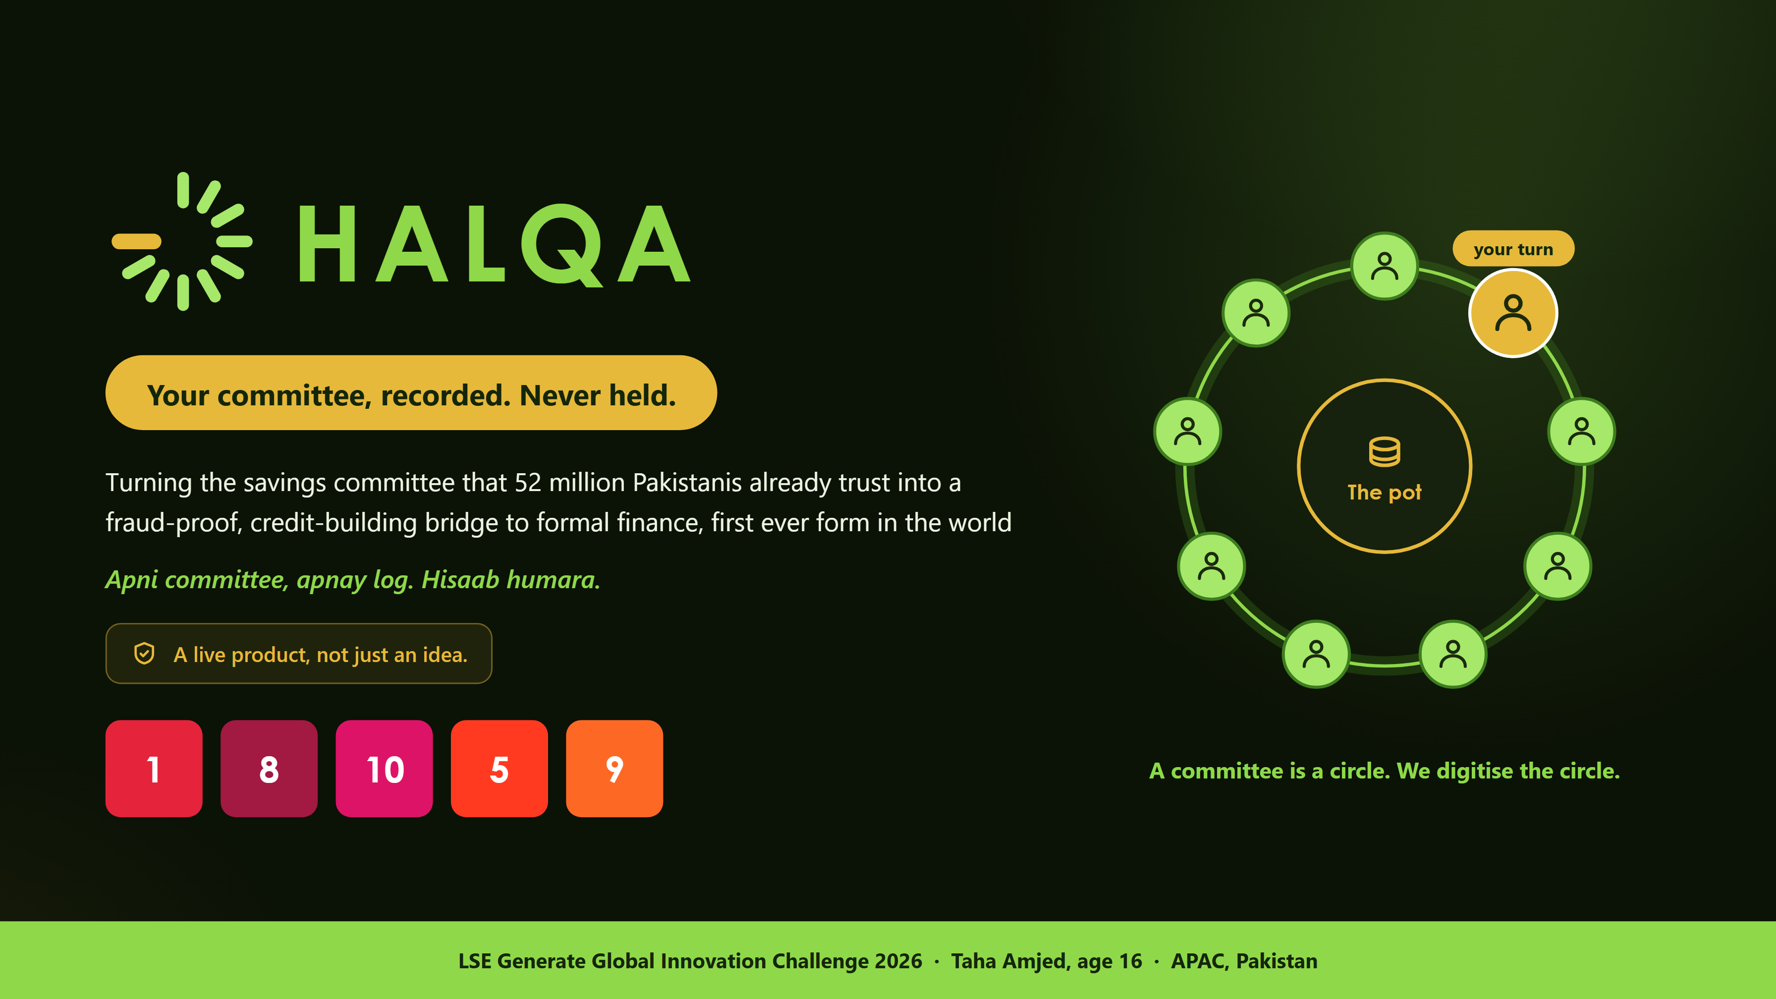
Notes:
Halqa. Your committee, recorded. Never held. Turning the savings committee that 52 million Pakistanis already trust into a fraud-proof, credit-building bridge to formal finance, first ever form in the world. LSE Generate Global Innovation Challenge 2026, Taha Amjed, age 16, APAC, Pakistan.

Slide 2
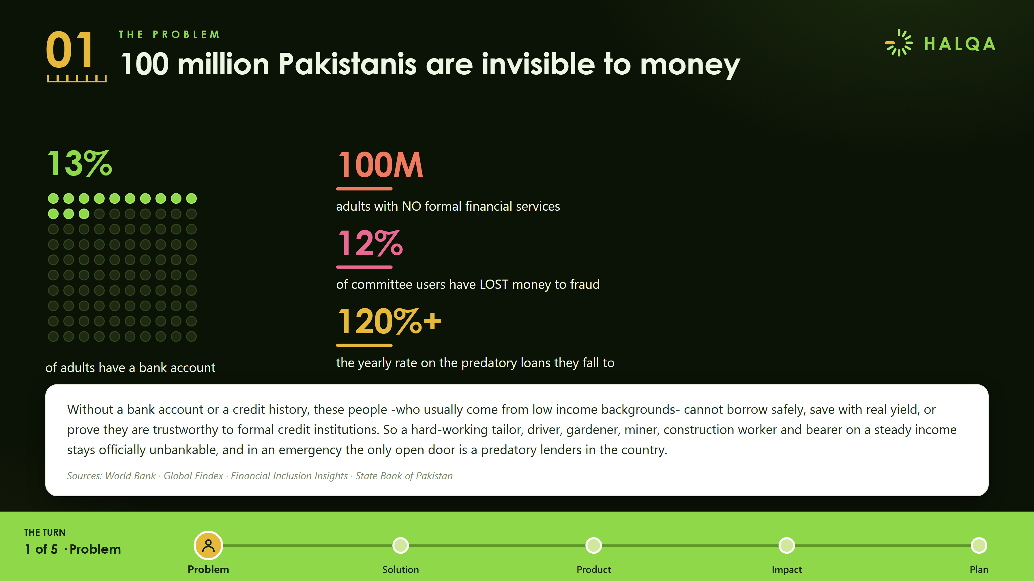
Notes:
100 million Pakistanis are invisible to money. 100M adults with no formal financial services. 13 per cent of adults have a bank account. 12 per cent of committee users have lost money to fraud. 120 per cent plus is the yearly rate on the predatory loans they fall to.

Slide 3
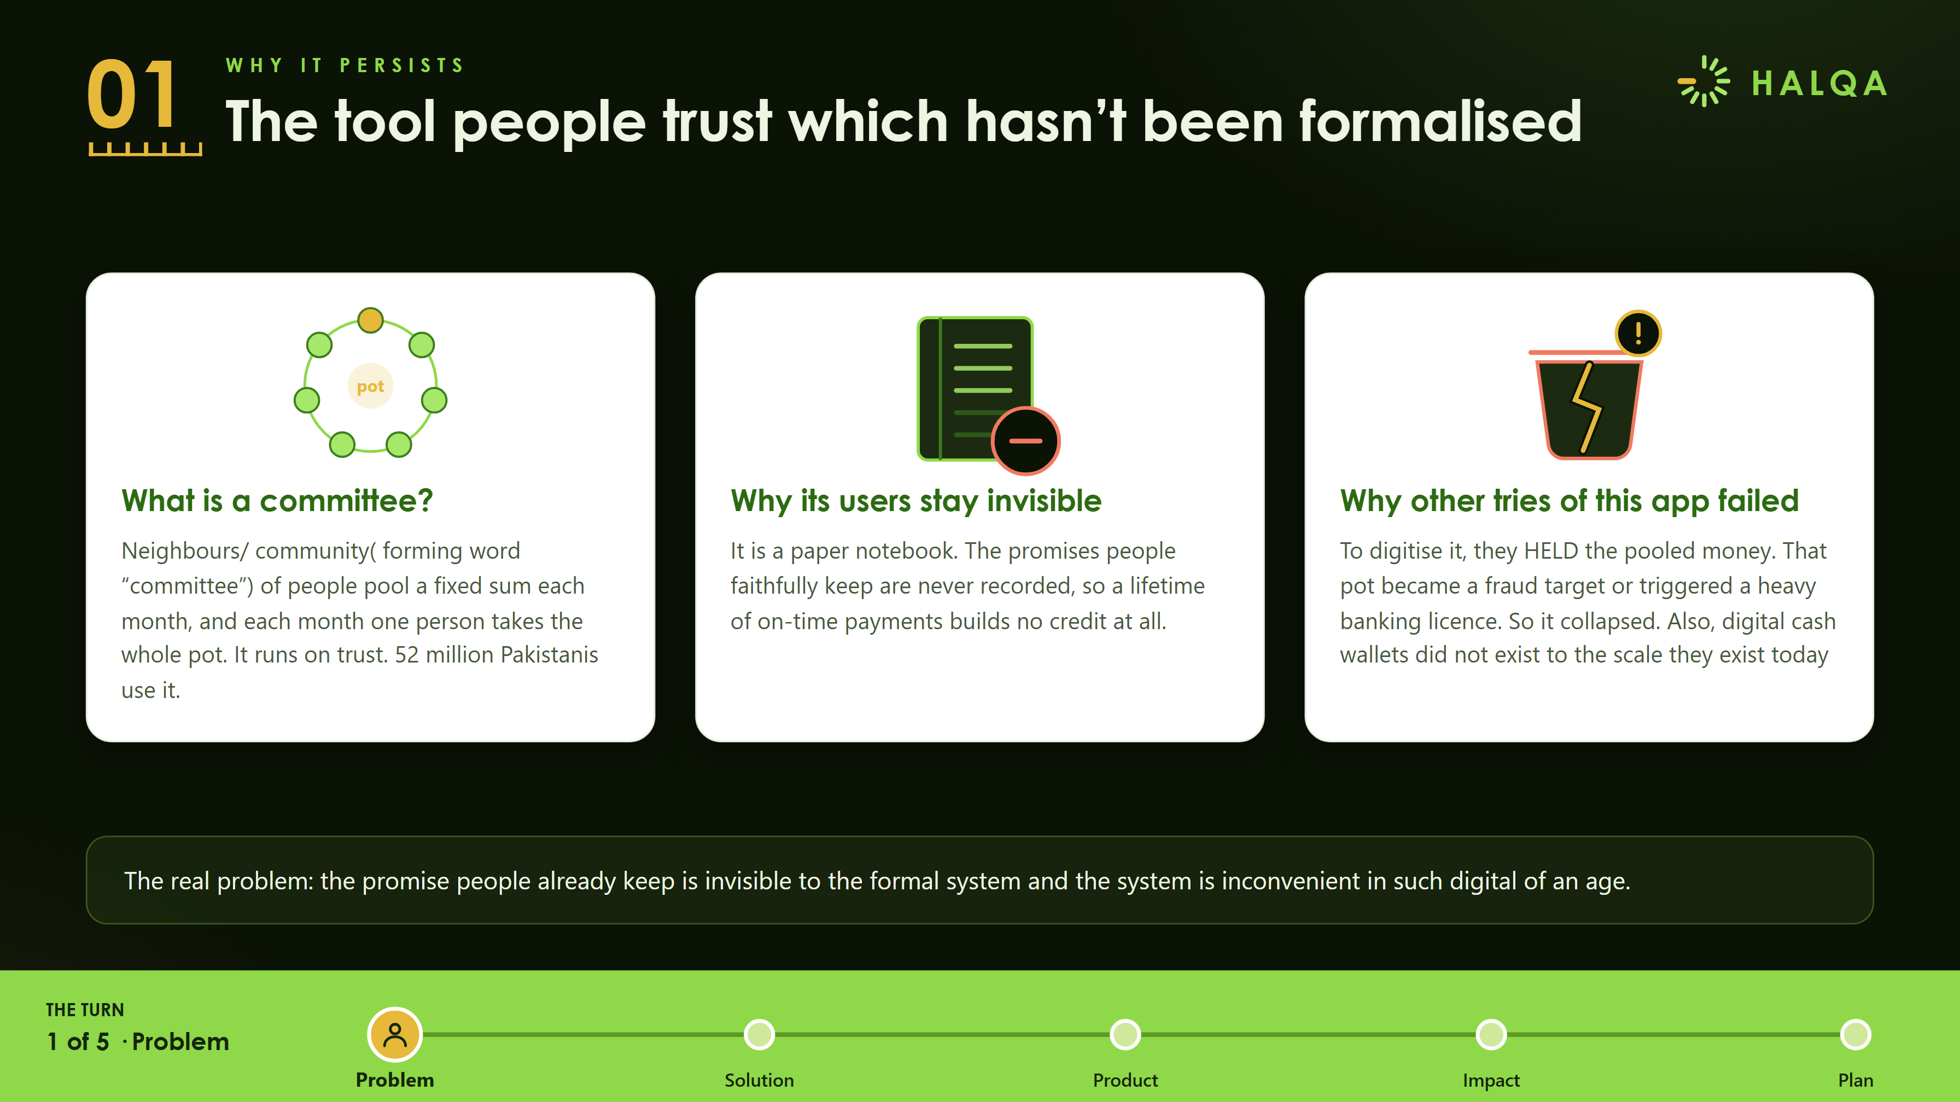
Notes:
The tool people trust cannot make them seen. What is a committee. Why its users stay invisible. Why other tries of this app failed. The real problem is that the promise people already keep is invisible to the formal system and the system is inconvenient in such digital of an age.

Slide 4
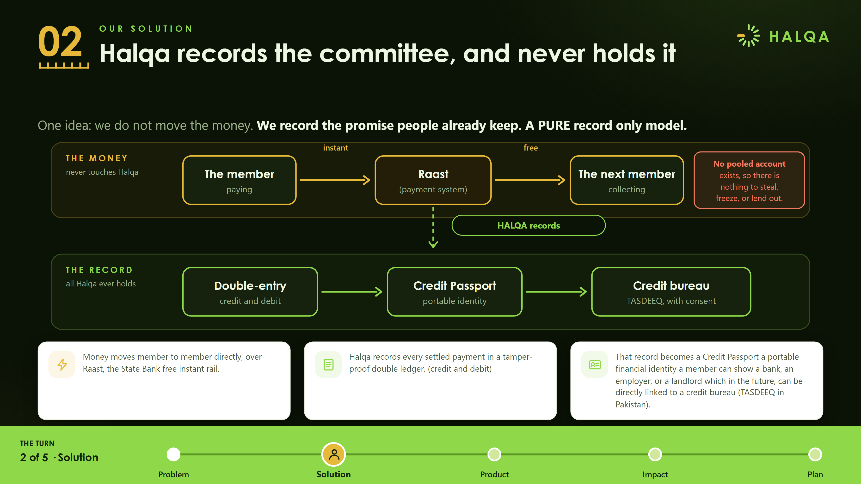
Notes:
Halqa records the committee, and never holds it. One idea, we do not move the money, we record the promise people already keep. Money moves member to member over Raast. Halqa records every settled payment in a tamper-proof double ledger. That record becomes a Credit Passport, linkable to TASDEEQ.

Slide 5
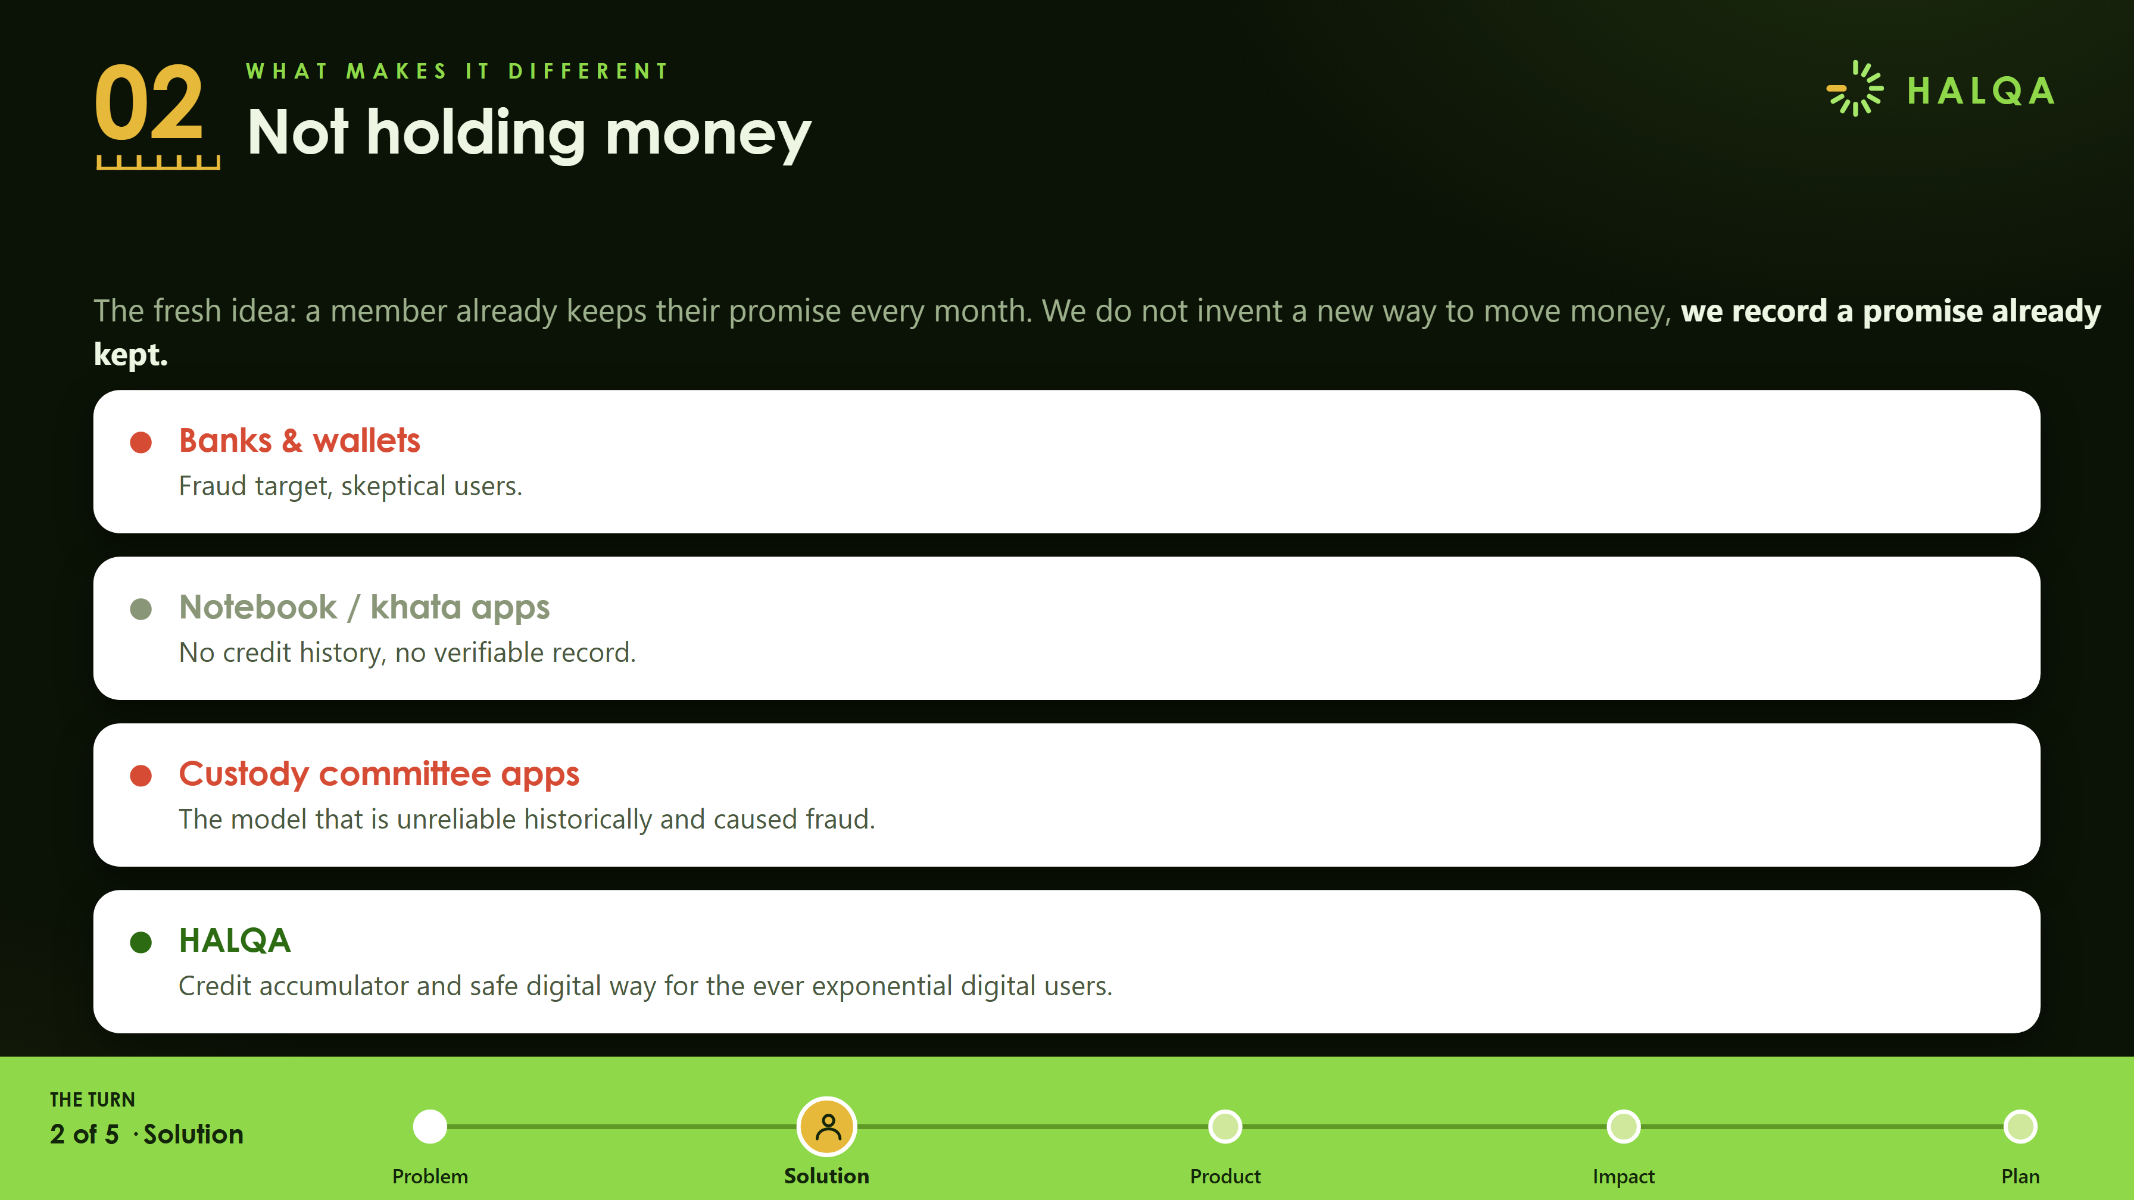
Notes:
We settle the payment without ever holding it. Banks and wallets, notebook and khata apps, and custody committee apps all fail on one axis or the other. Halqa is the only one that never holds and still builds a real credit record.

Slide 6
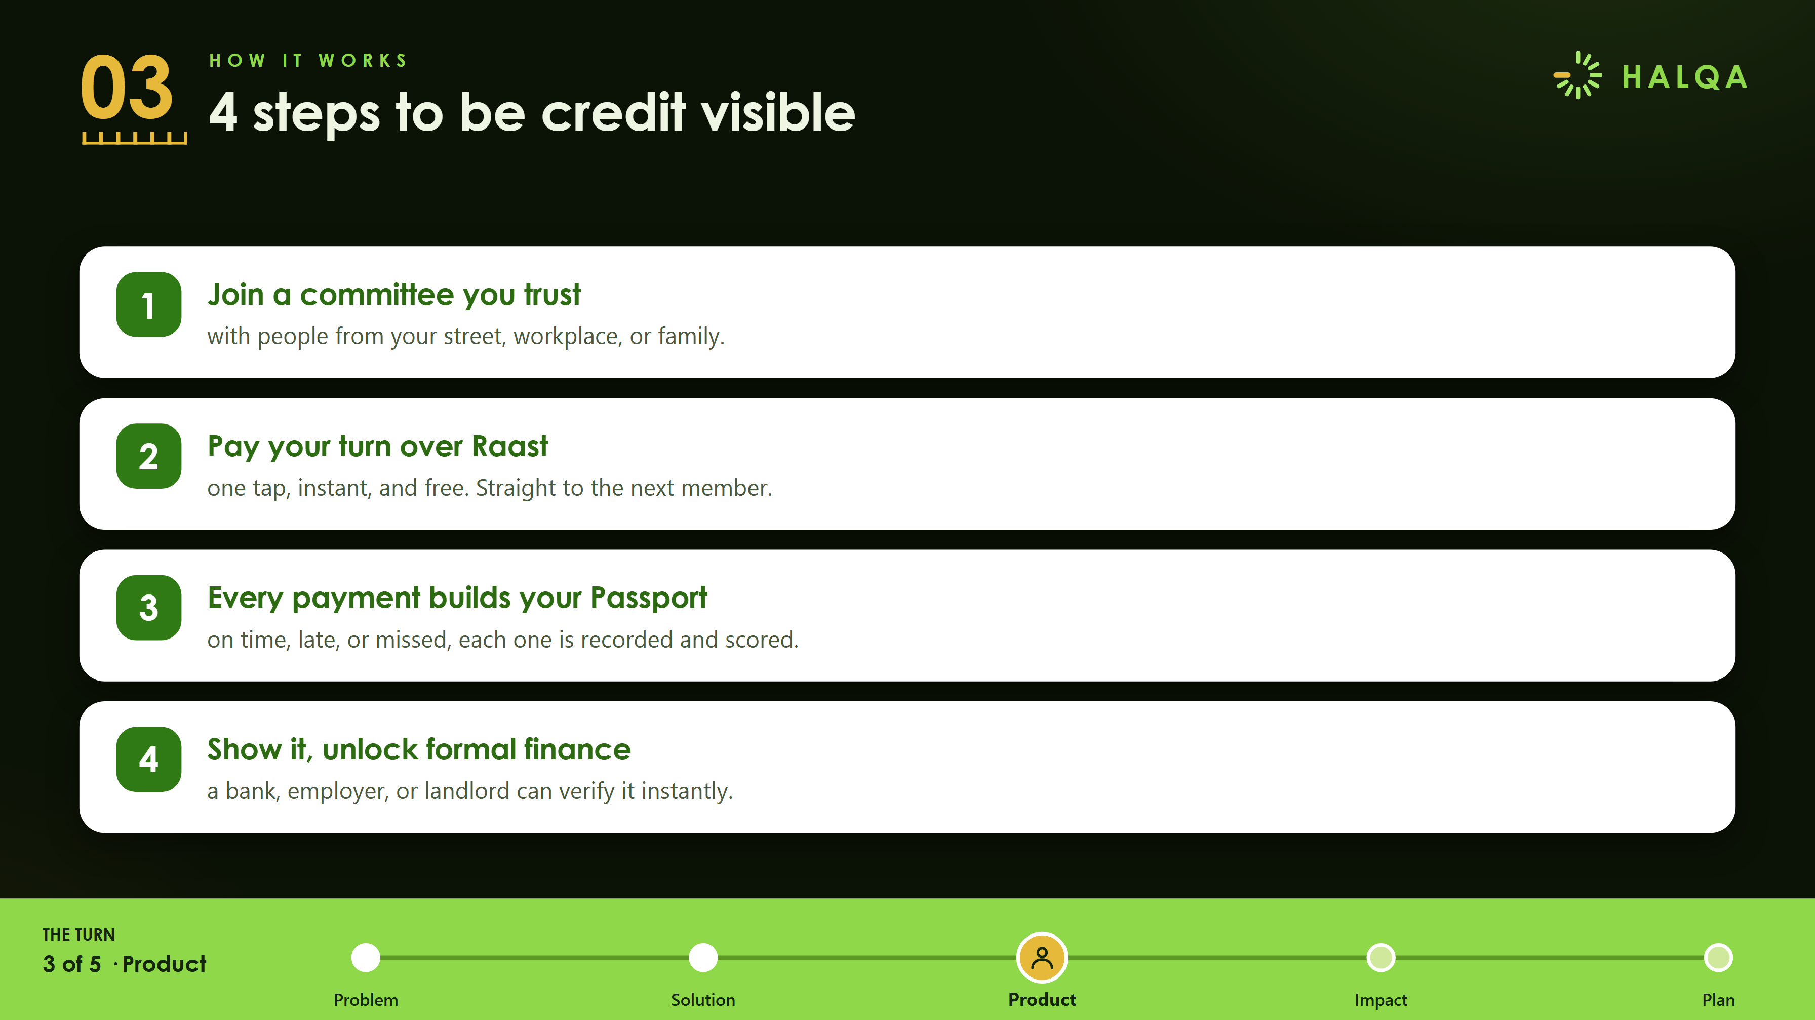
Notes:
Four taps from excluded to credit-visible. Join a committee you trust. Pay your turn over Raast. Every payment builds your Passport. Show it, unlock formal finance.

Slide 7
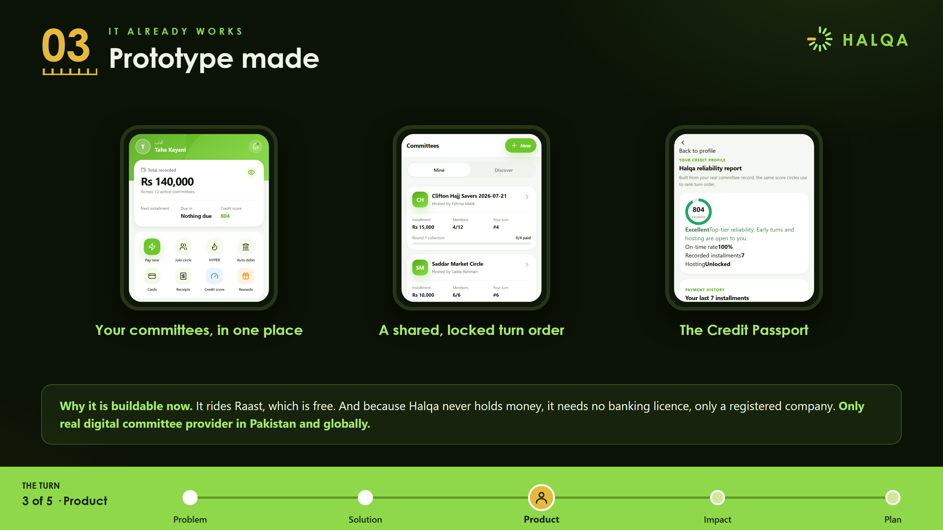
Notes:
This is not a concept. It is live today. Why it is buildable now: it rides Raast, which is free, so members pay Rs 0, and because Halqa never holds money it needs no banking licence, only a registered company.

Slide 8
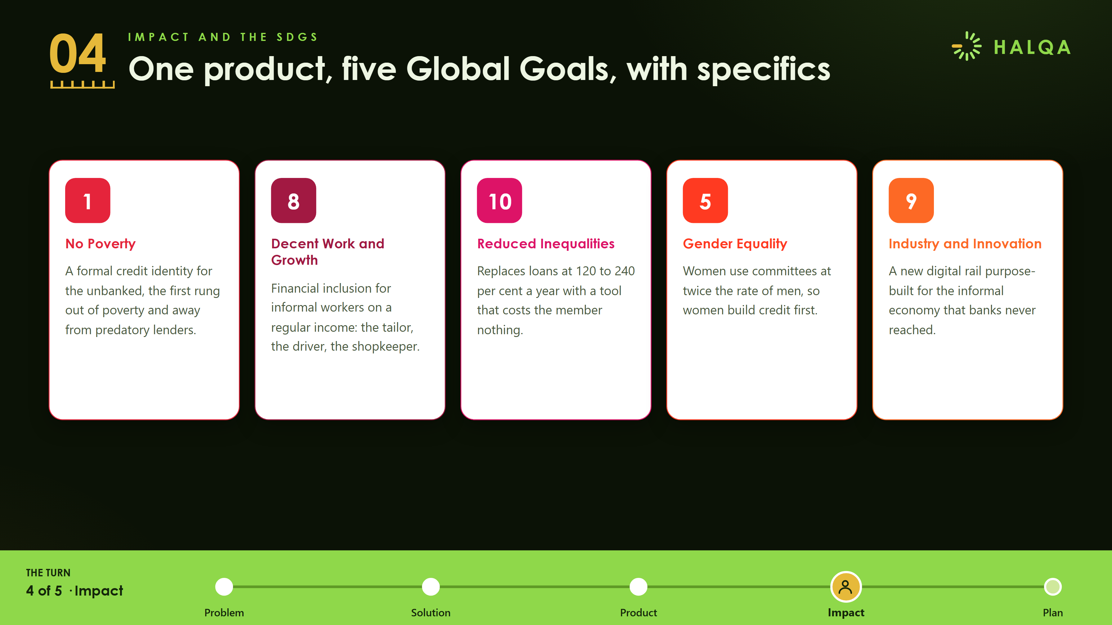
Notes:
One product, five Global Goals, with specifics: no poverty, decent work, reduced inequalities, gender equality, and industry and innovation.

Slide 9
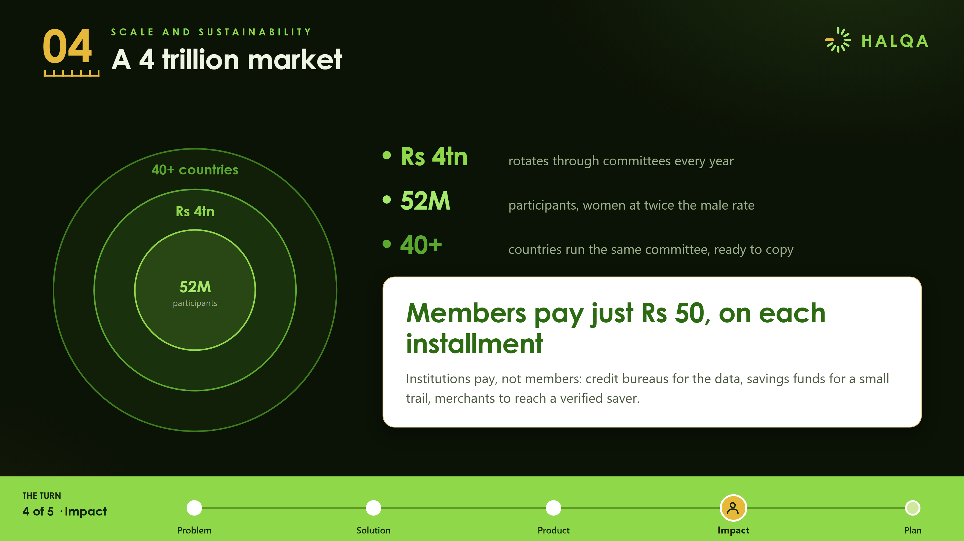
Notes:
A four trillion rupee market that pays for itself. Rs 4tn rotates through committees every year, 52 million participants, 40 plus countries. Members pay Rs 0 forever, institutions pay. The honest challenge is making payment automatic.

Slide 10
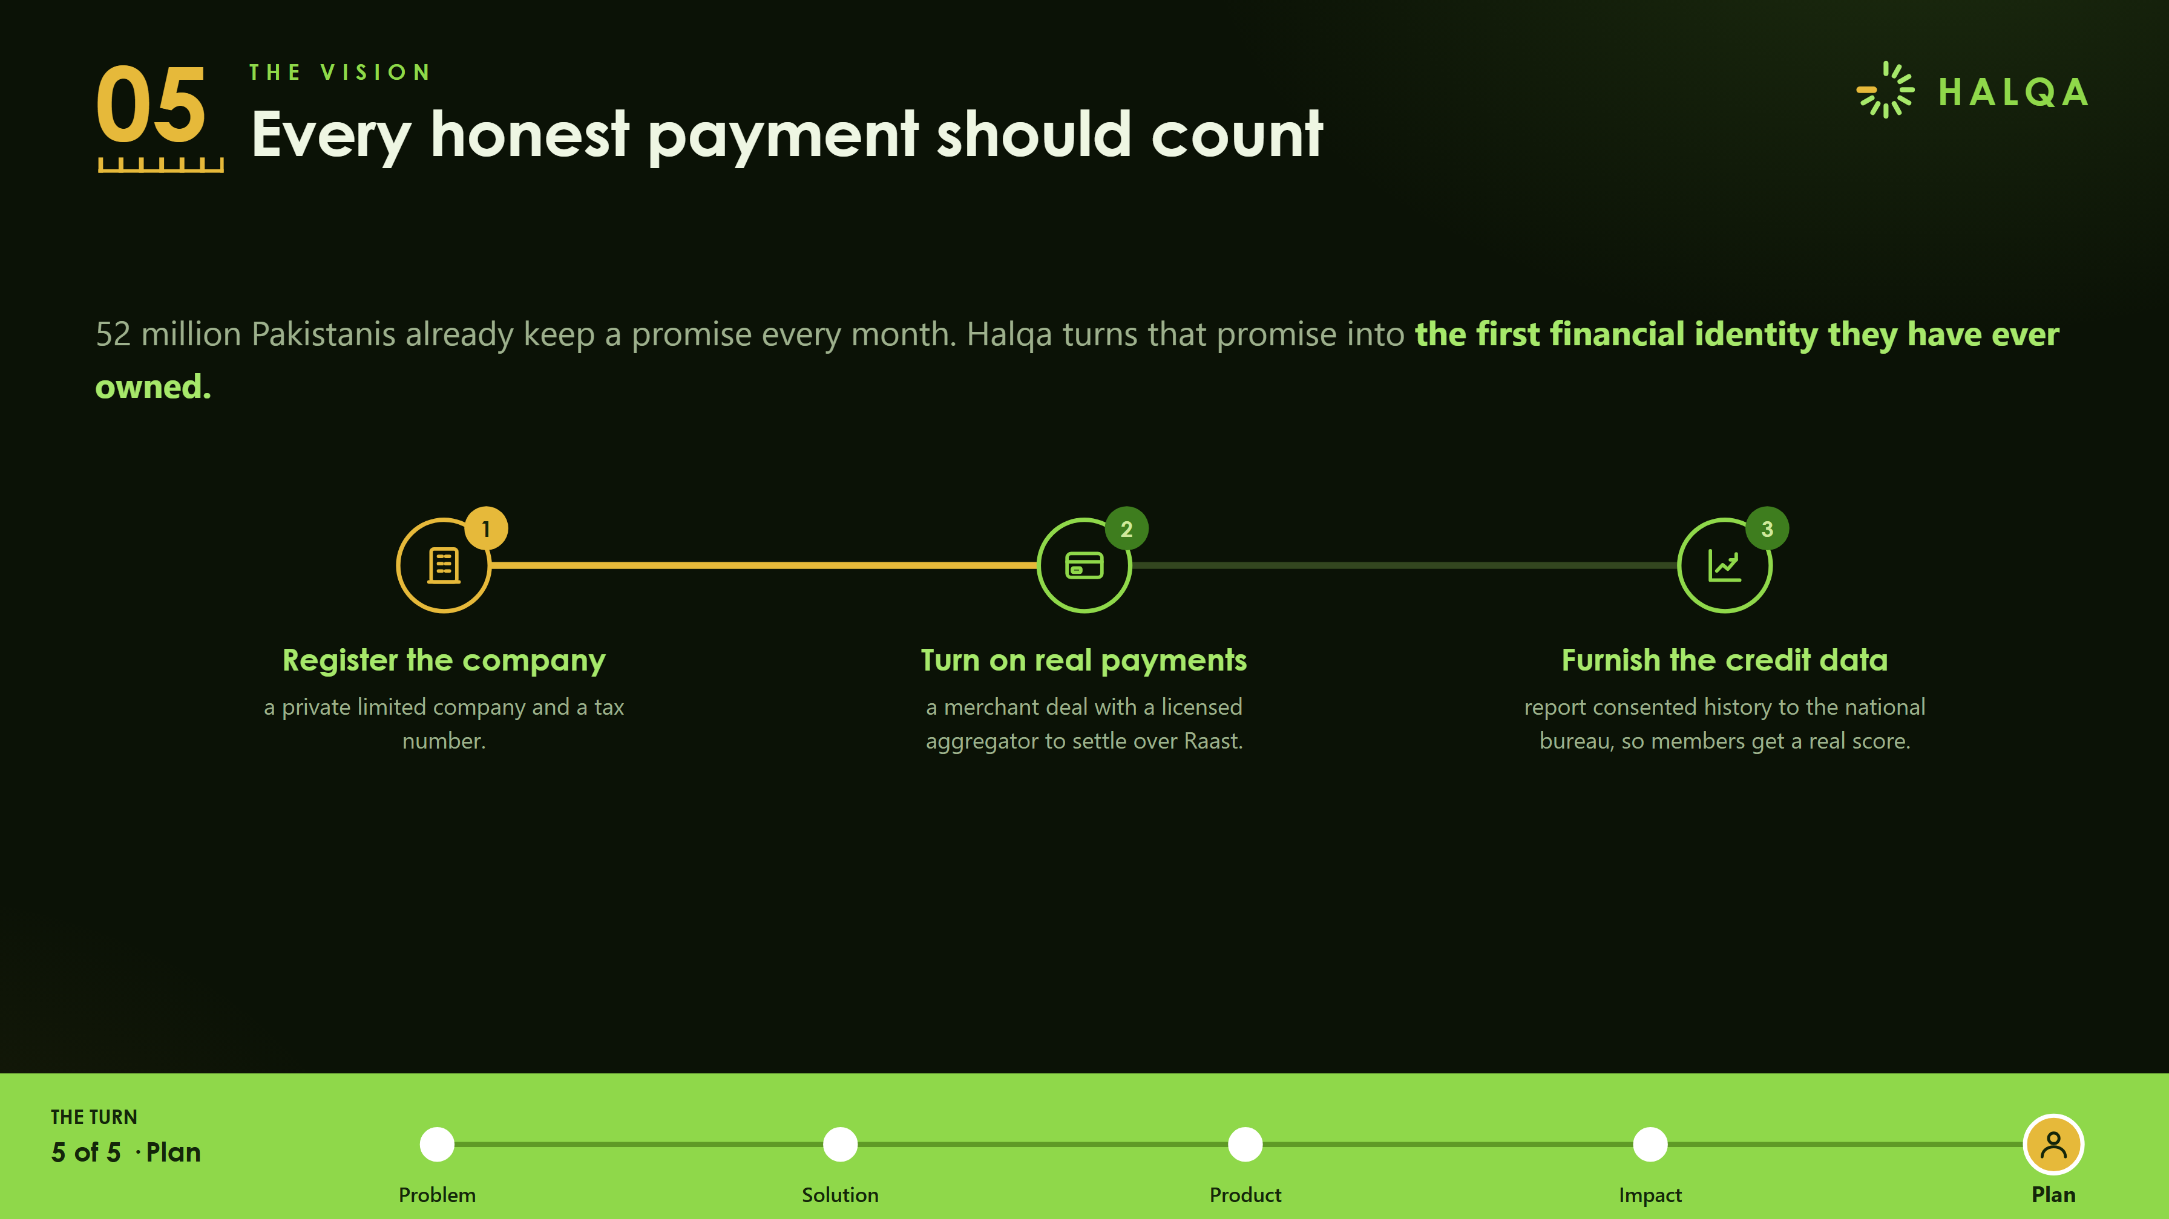
Notes:
Every honest payment should count. Register the company, turn on real payments, furnish the credit data.

Slide 11
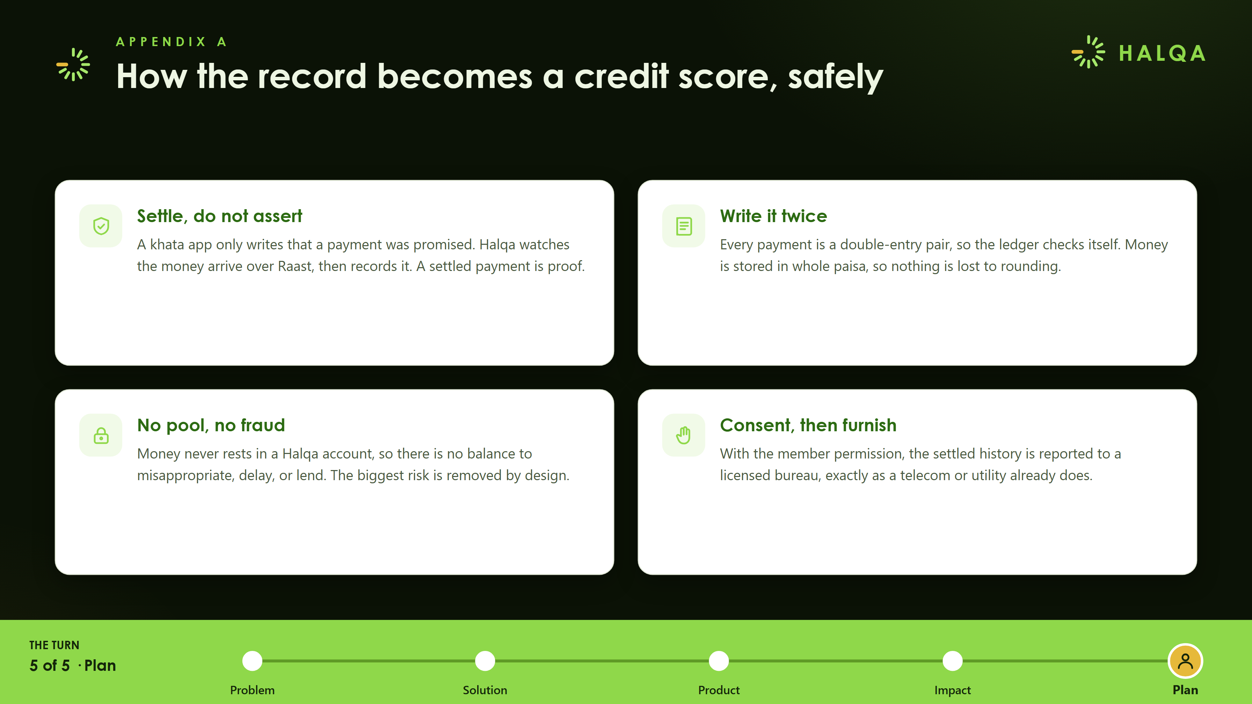
Notes:
How the record becomes a credit score, safely. Settle do not assert. Write it twice. No pool, no fraud. Consent, then furnish.

Slide 12
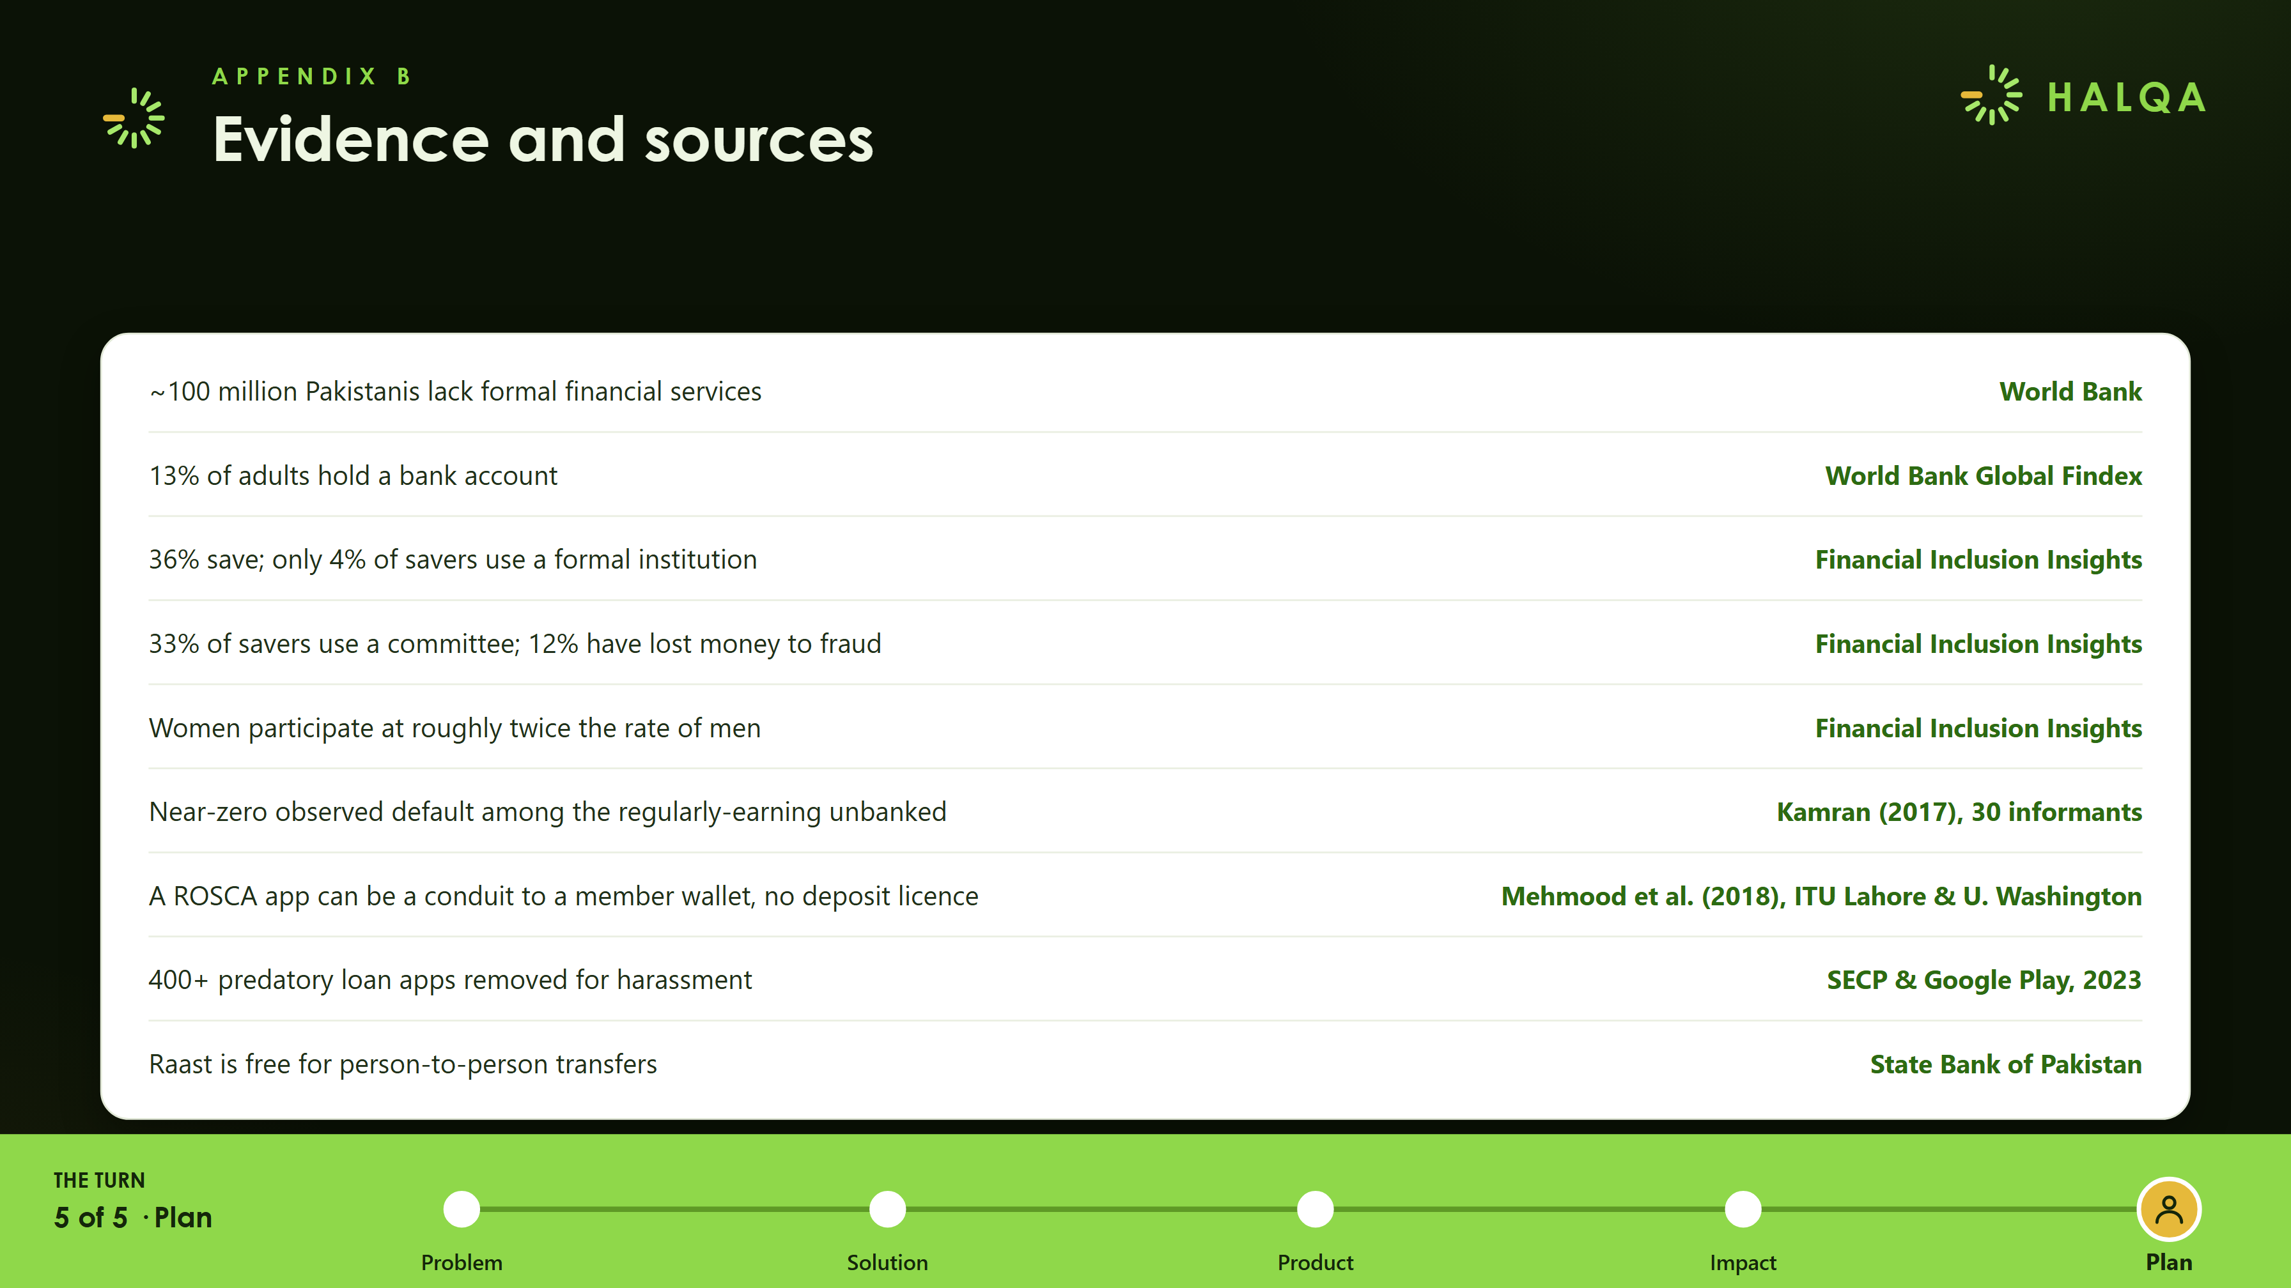
Notes:
Evidence and sources: World Bank, Global Findex, Financial Inclusion Insights, Kamran 2017, Mehmood et al. 2018, SECP and Google Play, State Bank of Pakistan.

