Slide 1

ACT III OF IV
The Proof
The enemy is the default. We built nine layers against it — then simulated a full Pakistani year to check they hold.

Slide 2
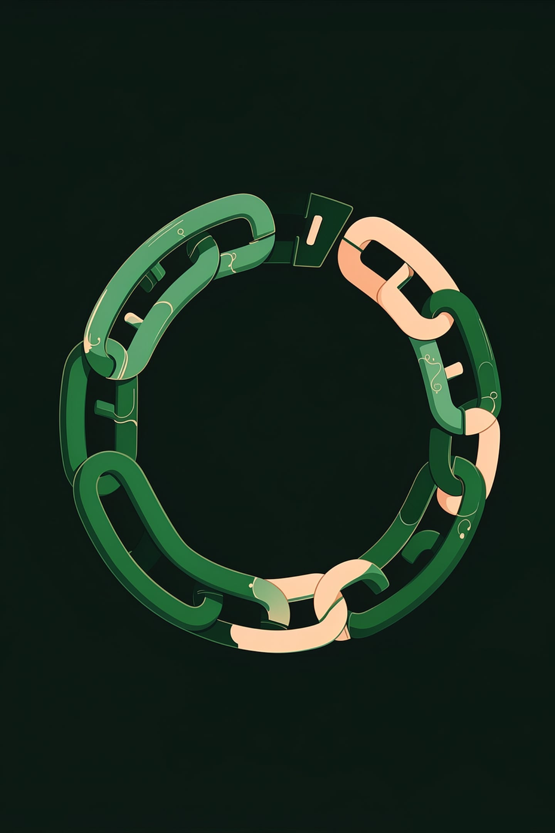

Now the hard part: defaults
Why do committees actually die? One member takes an early payout... and vanishes.
In the paper world there is no deposit, no record, no score, no recovery. Just a missing neighbour and a broken circle.
If you solve defaults, you solve committees. So we built a stack.

Slide 3

The defence stack — nine layers deep
1
2
3
Before
During
After
Reliability scores gate entry
Newcomers capped at Rs 25,000 circles
Credit-weighted turn ordering — reliable members get the risky early turns
Graduated security deposits
Payout holdback until you're square
Your own vault auto-covers a slip
Progressive penalties (to charity)
Account lock + deposit forfeiture
A rehabilitation path back
Defaulting isn't impossible. It's just expensive, visible, and recoverable-from.

Slide 4
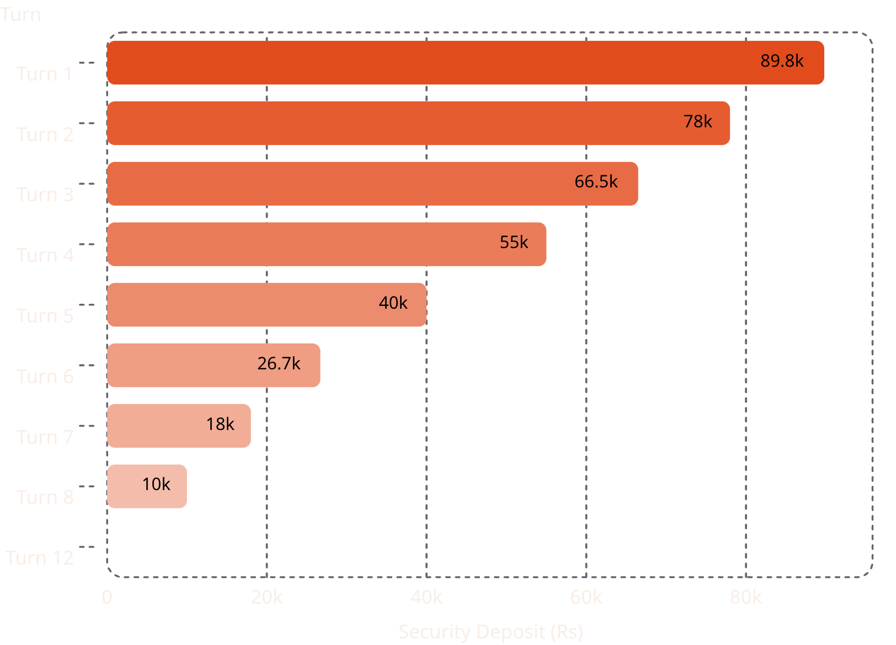
Graduated deposits: collateral that mirrors risk
Whoever owes the most, posts the most
The last turn owes nothing, posts nothing. Deposits scale precisely with how much the group is exposed to each member at any given moment.
And the deposits aren't dead weight — they EARN for their owners all cycle.
Host picks the dial: 30% to 90% coverage, trade-off shown live on a chart. The reference circle shown here uses 70% coverage.

Slide 5
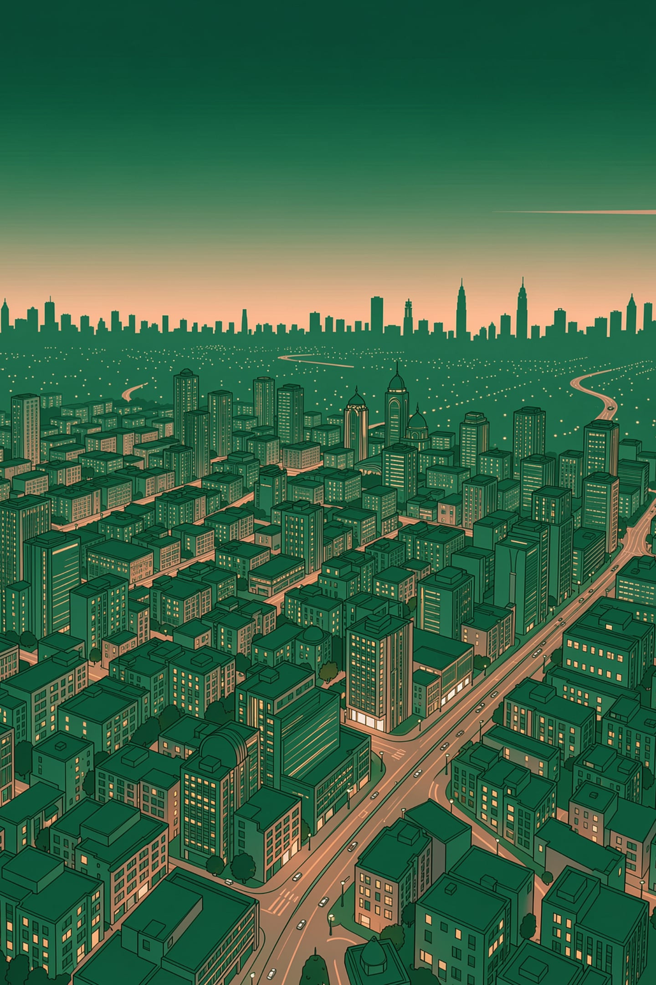
Don't take our word for it. We simulated Pakistan.
120K
10,441
Simulated savers
Committees run
1
Full 2025 calendar
Ramadan, both Eids, school-fee seasons, monsoon floods
Twin-world design
Deterministic seed
The same people live the same year twice — once on paper committees, once on Halqa. Same salaries, same shocks, same temptations. Only the platform differs.
Anyone can re-run it and get every figure to the decimal. This is not a model — it's a reproducible experiment.

Slide 6
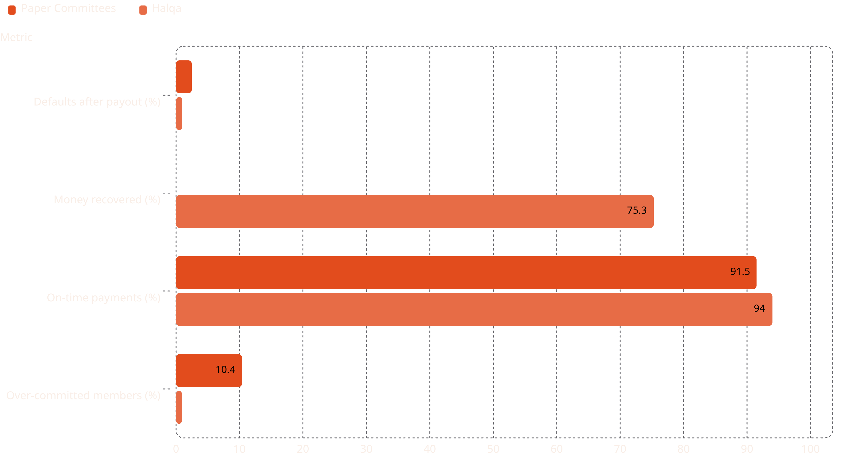
The verdict
0.99%
75.3%
Defaults after payout
Money recovered
Down from 2.48% on paper
Up from 0% on paper committees
94.0%
0.94%
On-time payments
Over-committed members
Up from 91.5% on paper
Down from 10.4% drowning
Simulated members earned ~Rs 69.7 million in engine profit on top of these protection gains.

Slide 7
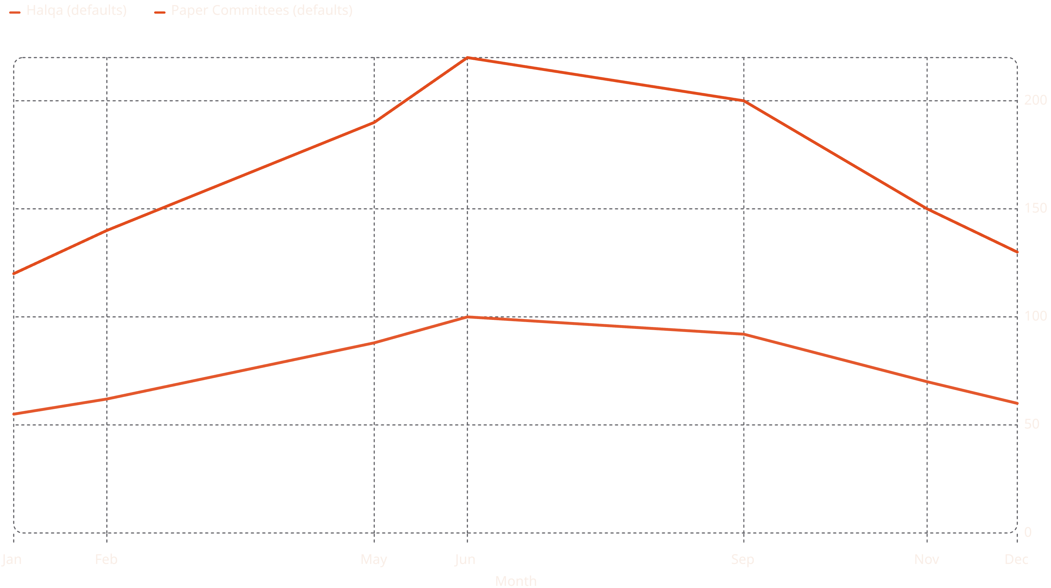
It bleeds where Pakistan bleeds
Both worlds stress at Eid and drown in the monsoon — as real Pakistan does. Paper committees peak at 376 defaults in July during the floods; Halqa peaks at 173 in August.
Halqa's curve is lower every single month, and the gap is widest early in the cycle — where credit-weighted ordering puts the most reliable members in the most exposed turns.

Slide 8
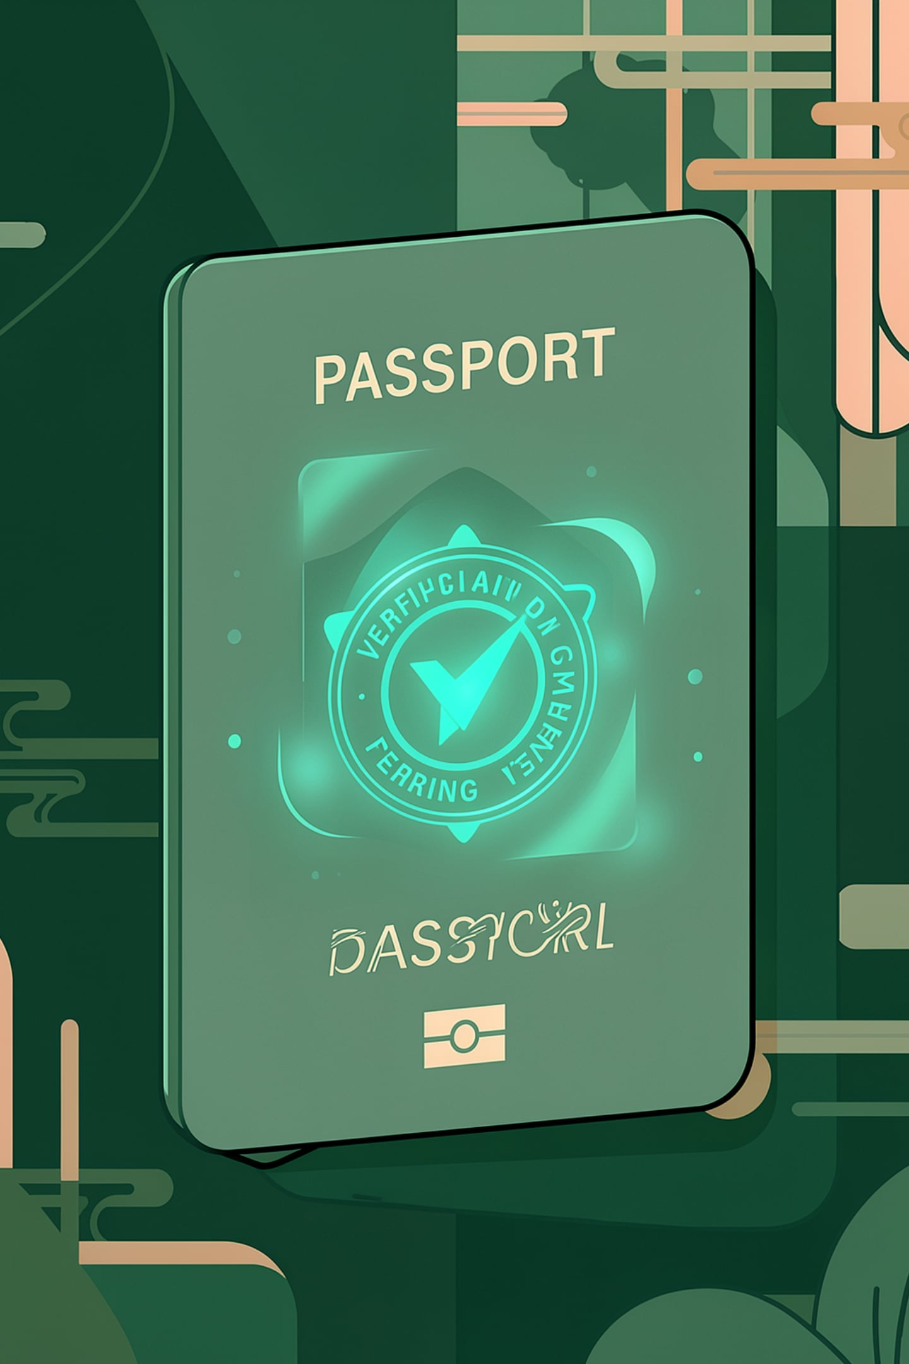

The quiet superpower: the Credit Passport
Making invisible discipline legible
25–30M
Every on-time installment builds a verifiable payment history — exportable, shareable, real.
25–30 million Pakistanis are credit-invisible to banks. Their committee discipline is invisible ink. We make it legible.
Pakistanis credit-invisible to banks
$1B
Esusu valuation — proof of concept
Proof this alone is a business
$130M
Esusu (USA) reports informal payments to credit bureaus — $130M raised at a $1B valuation.
Raised by Esusu reporting informal payments
Coming in Act IV: who else is playing, and how the money works.

