Slide 1



Committee Savings Partnership
Proposal to Mashreq Bank Pakistan
Taha Kayani, Founder, Halqa
30 September 2026
Notes:
Halqa runs committee savings, the kameti or BC, in a mobile application. The proposal is that every member banks with Mashreq, and that Mashreq holds and moves every rupee of every committee while Halqa runs the committee system. Slides 1 to 20 are the main story; the appendix, A1 to A6, holds the detail. The main story covers: what a committee is and how many people use one; the problems with informal committees; the proposed structure and the monthly cycle; what Mashreq gains; the products used; the application; onboarding; the committee types; payment collection, wallets and the PSP; default prevention, turn eligibility and recovery; points; the business model; the comparison with other options; evidence from abroad; timing; regulation; and the current status.

Slide 2
How a Committee Works
Also called kameti, BC or bisi. Example: 12 members each pay Rs 10,000 a month for 12 months
Who pays and who collects by month
Net position of two members after each month Rs thousand
Month
Turn 1
Turn 12
1
2
3
4
5
6
7
8
9
10
11
12
1
120
2
3
60
4
5
0
6
Member
-60
7
8
9
-120
10
1
2
3
4
5
6
7
8
9
10
11
12
11
Turn 1 takes Rs 120,000 at once and repays it over the year. Turn 12 saves every month and takes the pot last. Both end the year at zero.
12
Rs 120,000
No interest
Fixed order/Ballot
collects Rs 120,000
pays Rs 10,000
the pot, paid to one member each month
each member pays in Rs 120,000 and receives Rs 120,000
the host sets the order of turns at the start
2
Notes:
For anyone who has never been in one. The grid is a circle of twelve people at Rs 10,000 a month: every row is a member, every column a month, and the dark square is the month that member takes the whole Rs 120,000.
The chart shows what that means for two members. The member in turn one receives Rs 120,000 at once and repays it over the year, in effect an interest free advance; the member in turn twelve saves Rs 10,000 every month to a deadline the group enforces, and receives the pot last. Both end the year at zero: no interest is paid or earned. The order is fixed at the start by the host, the organiser, who admits each member.

Slide 3





Market
Committee use in Pakistan, from published estimates
Pakistanis who save in committees per 100 people
About 100 million
Rs 4 trillion
people use committees, on the higher estimate [2]
a year passes through committees, estimated [1]
91%
56%
Rs 5000
of committees collect monthly [4]
of adults have a committee within 1 km of home [5]
average monthly contribution, [4]
34 in 100, Karandaaz estimate [1]
41 in 100 including these, Oraan estimate [1]
Sources 1 Karandaaz and Oraan estimates, Dawn, 12 Dec 2022 2 PICG case study on Oraan, 2024 3 Financial Inclusion Insights (FII) data in Mehmood et al. 2018 4 FII Pakistan, 2013 5 FII wave 5, 2017
3
Notes:
The size of the habit. The grid is one hundred Pakistanis. Karandaaz, a financial inclusion body, puts committee use at 34 per cent, the dark squares; Oraan’s research puts it at 41 per cent, adding the light squares. On the higher estimate that is about 100 million people, and Oraan estimates about Rs 4 trillion a year passes through committees. These are estimates; there is no official count, which is itself part of the problem.
The survey data say more about who uses them: women take part at about twice the rate of men; nine in ten committees collect monthly; more than half of adults have a committee within a kilometre of home; and the average monthly contribution in 2013 was about US$18, from a few cents to US$470.

Slide 4


Problems with Informal Committees
Losses to fraud, cash kept outside banks and no credit record
12%
63%
4%
0
of committee users have lost money to fraud [1]
of savers keep their savings as cash at home [1]
of savers use a formal financial institution [1]
on-time committee payments reach a credit bureau
Case, 2022
How informal committees fail
One organiser ran more than 100 committees through Facebook and defaulted on about Rs 420 million. No written records were kept. [2]
The organiser leaves with the pot
A member stops paying after collecting
Disputes over the order of turns
No record of who paid what
Sources 1 Financial Inclusion Insights survey data, in Mehmood et al. 2018 2 Dawn, 5 and 12 Dec 2022; Arab News, 10 Dec 2022
4
Notes:
What goes wrong. Each grid is one hundred people. Twelve per cent of committee users say they have lost money to an organiser or a member. Sixty three per cent of savers keep their savings as cash at home, and only four per cent use a formal financial institution. And no on-time committee payment reaches a credit bureau, so years of paying on time build no record.
The 2022 case: one organiser ran more than 100 committees through Facebook and defaulted on about Rs 420 million, with no written records.
The four ways informal committees fail are the four things the proposed structure removes: an organiser holding the pot, a member stopping after collecting, disputes over order, and the absence of any record.

Slide 5





Proposed Structure
Halqa runs the committee system; Mashreq holds and moves the money under State Bank regulation
join, consent, pay in the app
payment requests
committee system: rules, turns, checks, records
Circle rules and turn order
Member checks and credit score
Reminders, records and receipts
Late charges and exits
Data for credit reporting
instructions
confirmations
instalments
payments
Licensed PSP
wallet and card payments
Members
each with a Mashreq account
pots
accounts, collection, payouts, profit
payment records
contributions
Customer due diligence and accounts
Direct debit mandate and collection
Holding balances, paying profit
Payouts to collectors
Collecting the fee
Takaful or insurance operator
pays claims
licensed credit bureau
claims paid to members left short
money
instruction
confirmation or record
5
Notes:
Who does what. The blue lines are money, and they touch only members, Mashreq, the PSP and the takaful or insurance operator; no money line touches Halqa. Members pay instalments into Mashreq and receive pots from it. Payments from wallets and cards arrive through a licensed payment service provider and settle at Mashreq. Mashreq pays the takaful or insurance contribution to the operator, and the operator pays claims directly to members left short.
The green lines are instructions. Members join and consent in the Halqa application; Halqa instructs Mashreq and the PSP to collect and to pay; the dashed lines are confirmations and records back to Halqa, and payment records to TASDEEQ, the licensed credit bureau.
This matters twice: a company that holds public money is taking deposits, which only a bank may do, and a system like this needs State Bank regulation. Working inside Mashreq’s licence answers both. Halqa never holds or receives member money, never lends and never insures.

Slide 6
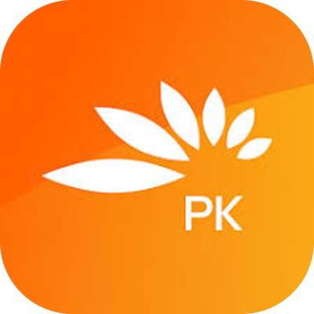

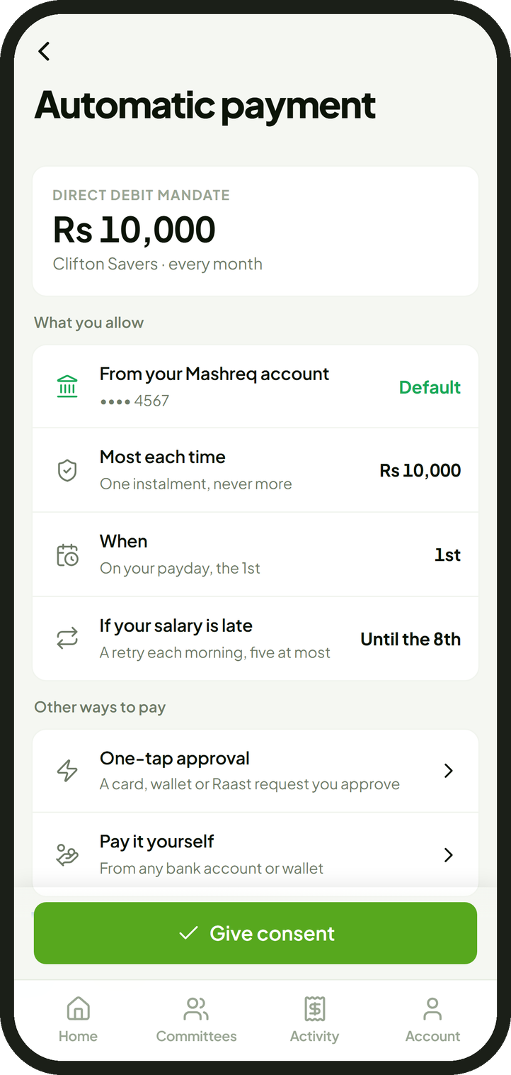




Monthly Cycle
One month of a circle of 12 members at Rs 10,000, step by step
Member
own Mashreq account
application, records
accounts, payments
credit bureau
1
joins and consents
2
registers the mandate
3
reminder before payday
4
payday: collect instalments
if a debit fails: a retry each morning, five at most
5
Rs 10,000 into the committee account
6
the 8th: pay the collector
Ways to pay
7
Rs 120,000 to the collector, same day
Automatic debit: Mashreq direct debit mandate (new), Recurring wallet merchant
8
confirmed; record updates
One-tap approval: card, wallet or Raast RTP
9
payment records
Manual: from any account or wallet
Wallets and cards: through a licensed PSP
money
instruction
confirmation or record
Detail: Appendix A2 and A3
6
Notes:
One month, read top to bottom; each vertical line is one party.
One, the member joins in the Halqa application and consents to automatic payment, the screen on the right. Two, Halqa registers the direct debit mandate with Mashreq. Three, a reminder the evening before payday, on WhatsApp in Roman Urdu first. Four, on the member’s payday, learned from the account, Halqa asks Mashreq to collect. Five, Mashreq moves Rs 10,000 from each member’s account into the committee account; if the salary is late, the debit is retried each morning, five attempts at most. Six, on the 8th, the due date, Halqa tells Mashreq who collects. Seven, Mashreq pays Rs 120,000 into the collector’s account the same day. Eight, Mashreq confirms and the record updates. Nine, payment records go to TASDEEQ, reported by Mashreq or by Halqa as a data provider, as Mashreq decides.
Ways to pay: the automatic debit is the default on circles between strangers; members can also approve a card, wallet or Raast request in one tap, or pay by hand. Money in a JazzCash or Easypaisa wallet or on a card comes in through a licensed payment service provider and settles at Mashreq, never at Halqa. Appendix A2 and A3 have the detail. Mashreq does not publish a direct debit service today, so the mandate is one of the new lines we ask Mashreq to add.

Slide 7
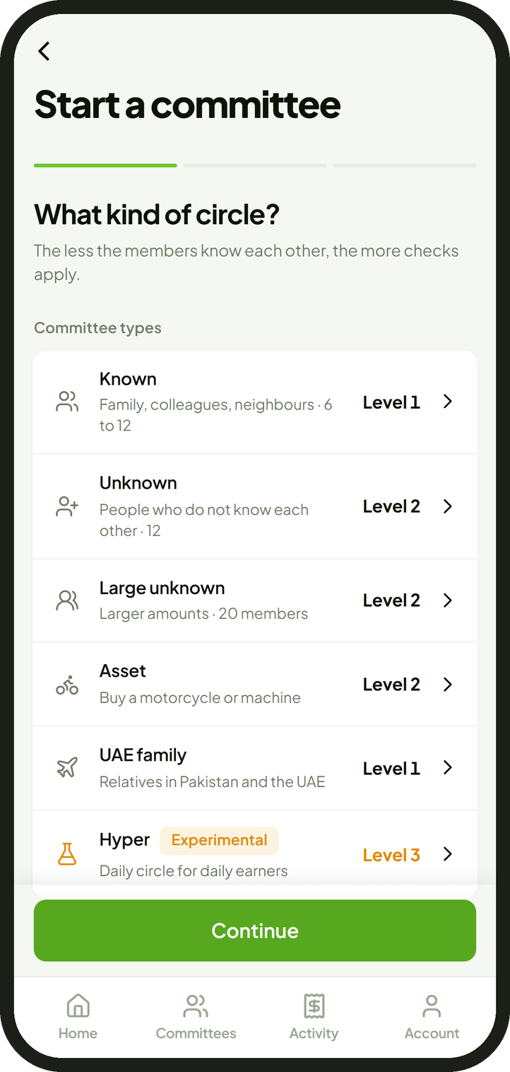
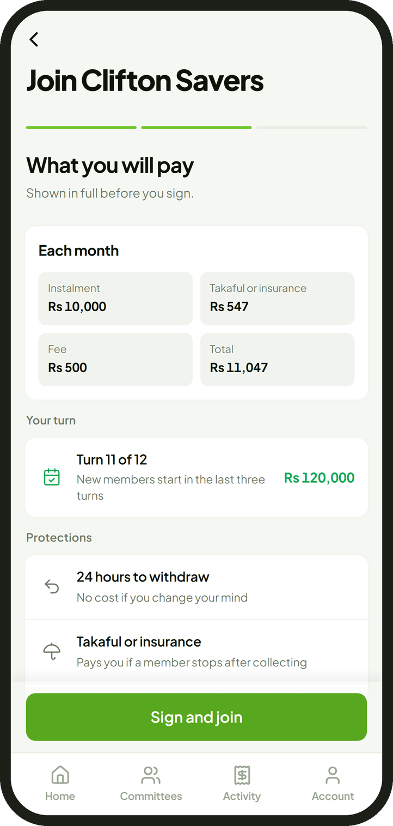
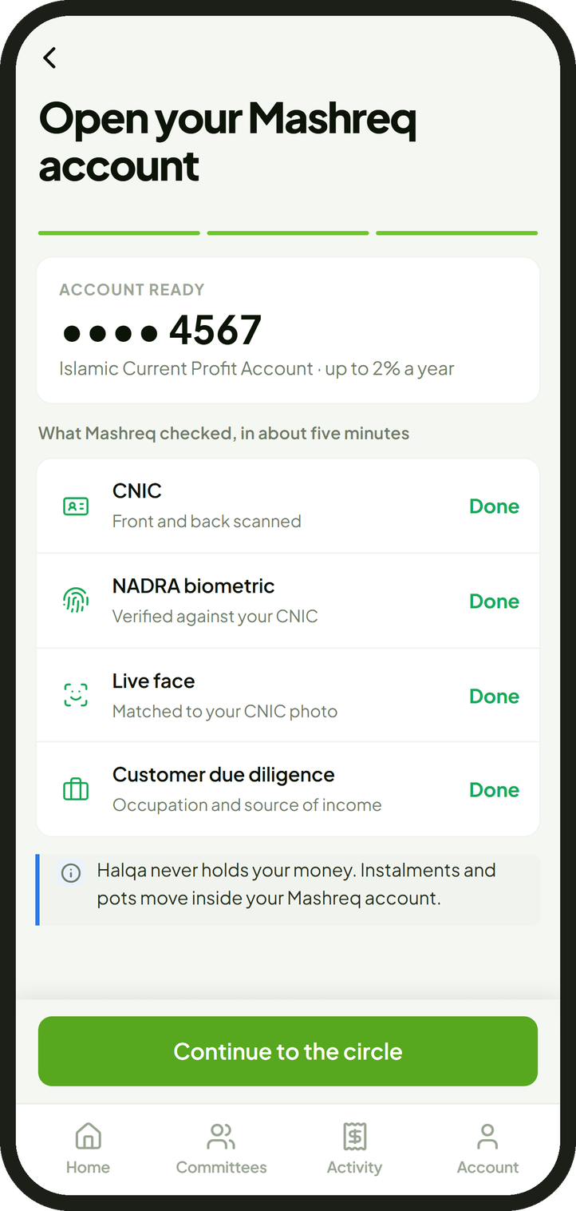
Member Application: Joining
Choosing a circle, seeing the full cost, opening the Mashreq account and consenting to payment
1 Choose a circle
2 See the full cost
3 Open the Mashreq account
4 Consent to payment
The six types; Hyper is experimental.
Shown before signing; 24 hours to withdraw.
Mashreq’s own checks, inside Halqa.
One instalment at most, on payday.
7
Notes:
How a member joins, in four screens. One, choose the kind of circle: six types, from known circles to circles between strangers, with Hyper marked experimental. Two, the full cost is shown before signing: the instalment, the takaful or insurance and the fee, with 24 hours to withdraw at no cost. Three, the Mashreq account opens inside Halqa through Mashreq’s own checks. Four, the member consents to automatic payment: one instalment at most each time, on payday, with retries until the 8th.

Slide 8
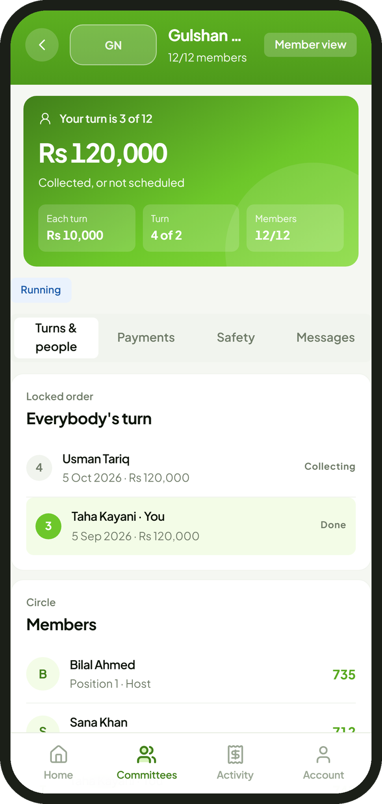


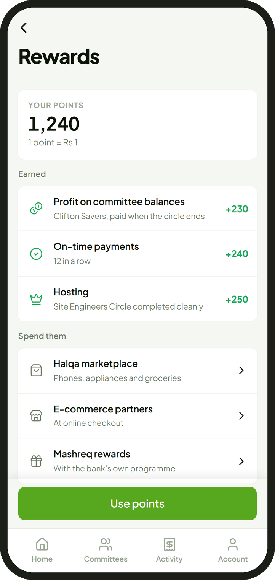
Member Application: Paying and Collecting
The circle, every payment and payout, the credit record and the points
1 Follow the circle
2 Payments and payouts
3 Credit record
4 Points
Turn order, who has paid, when the pot comes.
A receipt for each; the pot arrives the same day.
Score from 300 to 850 and on-time history.
Profit on balances and on-time payments.
8
Notes:
After joining. One, the circle screen shows the turn order, who has paid and when the pot comes. Two, every instalment and payout has a receipt, and the pot arrives the same day. Three, the credit report shows the score from 300 to 850 and the on-time history that is reported to TASDEEQ. Four, points: the profit on the committee balance and on-time payments, one point for each rupee. The first three screens are from the working preview; account opening, consent, types, full cost, Hyper and points are designs for the partnership.

Slide 9



Customer Growth and Deposits
Accounts arrive by the circle; deposits at Mashreq’s own average balance
How circles bring accounts
Deposits Rs billion
Mashreq, 30 June 2026
8.5
A host starts a circle
invites people they know
6 to 20 accounts
every member opens a Mashreq account
Added by 100,000 members
2.4
Members host circles
the cycle repeats
The circle completes
every member collects once
Added by 1,000,000 members
24.3
Basis: Rs 8,515 million of deposits ÷ 350,000 customers = about Rs 24,000 a customer, 30 June 2026 [1]
Channels
Hosts
points for circles that complete cleanly, never for recruiting
+29%
5-7 days
Employers
circles offered to staff
more customers from 100,000 members, on 350,000 today
each instalment is held at Mashreq between payday and the 8th
Families abroad
relatives in the UAE through the Mashreq Pakistan Account
Mashreq
circles offered inside Mashreq’s banking services
Source Mashreq Bank Pakistan, half year report to 30 June 2026
9
Notes:
Growth and deposits. Committees spread through the person who organises them. One host invites six to twenty people they know; every member opens a Mashreq account to take part; when the circle completes, satisfied members start their own. Acquisition cost is shared across the group and the cycle repeats. Hosts are rewarded with points for circles that complete cleanly, never for recruiting, which would be a pyramid. Families in the UAE can join through the Mashreq Pakistan Account, opened from Mashreq’s UAE application.
Deposits use Mashreq’s own average rather than an assumption: Rs 8,515 million of deposits ÷ 350,000 customers = about Rs 24,000 a customer, 30 June 2026. On that basis 100,000 members add about Rs 2.4 billion and a million members about Rs 24.3 billion. Committee members also bring the monthly instalment, which sits at Mashreq for about a week between payday and the 8th. Mashreq’s own data on committee members should replace the average once members are live.

Slide 10




Credit Reporting and Lending
Every instalment becomes a repayment record from the first day
Twelve instalments paid
one member, one circle
Credit record
reported to TASDEEQ
Credit score
Halqa score, 300 to 850, updated with every payment or Linkage with Tasdeeq directly
Lending offer
after a circle completes
What each record holds
Reporting route
Amount and due date
Date paid, on time or late
Circle type and turn
Whether the circle completed
Through Mashreq’s TASDEEQ membership
Or Halqa as a data provider
Mashreq decides the route
From the first payment
No advances
Committee members arrive with twelve months of repayment history. That history is the data Mashreq needs to start lending safely, beginning with asset financing for motorcycles and machines bought through asset circles.
on Mashreq’s balance sheet at 30 June 2026 [2]
Sources 1 Mission Asset Fund lending circles, evaluation by San Francisco State University, 600+ participants 2 Mashreq Bank Pakistan, half year report to 30 June 2026
10
Notes:
What Mashreq gains for its lending book. Every instalment, on time or late, becomes a record: amount, due date, date paid, circle type and turn, and whether the circle completed. From launch day it is reported to TASDEEQ, the licensed credit bureau, through Mashreq’s own membership or by Halqa as a data provider; Mashreq decides which. Halqa’s own score, 300 to 850, updates with every payment and decides which turns a member may take.
The evidence that reporting matters comes from the United States: Mission Asset Fund runs lending circles and reports every payment to the credit bureaus; an independent evaluation by San Francisco State University of more than 600 participants found scores rose by 168 points on average.
Mashreq reported no advances at 30 June 2026. Committee members bring twelve months of repayment behaviour, which is exactly the data needed to start lending, beginning with financing for motorcycles and machines bought through asset circles.

Slide 11




Mashreq Products Used
Existing products at each step of a committee, and three new lines
Open
Salary in
Held until the 8th
Payout
Abroad
NEO account and debit card
in about five minutes
Islamic Current Profit Account
profit on the daily balance, up to 2%
Islamic Savings Account
the committee balance; 10% below Rs 1.5 million
Free instant transfer
the pot, the same day
Mashreq Pakistan Account
families in the UAE
New lines
Direct debit mandate
collects each instalment on payday
Takaful or insurance
circles between strangers; Mashreq chooses the operator
Asset financing
ijarah for motorcycles and machines
existing Mashreq product
new line
Profit on the committee balance returns to members as points (Appendix A5).
Source Mashreq NEO Pakistan product pages, rate sheets and schedule of charges (July to December 2026), read 30 September 2026; rates are up to or indicative figures
11
Notes:
For the product team: most steps use a product Mashreq already has.
The account opens inside the Halqa application through Mashreq’s own onboarding, with a PayPak or Mastercard debit card, in about five minutes. Salary lands in the member’s own account; the Islamic Current Profit Account pays profit on the daily closing balance, up to 2 per cent today. Between payday and the 8th, about a week, the instalments are held as the committee balance in an Islamic Savings Account, 10 per cent indicative on balances below Rs 1.5 million, and that profit returns to members as points at the end of the circle. The payout is a free instant transfer. Families in the UAE join through the Mashreq Pakistan Account.
Three new lines: a direct debit mandate, which Mashreq does not publish today for Pakistan; takaful or insurance for circles between strangers, with an operator Mashreq chooses; and ijarah financing for motorcycles and machines bought through asset circles.

Slide 12





Onboarding and Verification
Mashreq opens the account; Halqa’s checks decide which circles and turns each member may join
Member
Sees only the circles and turns open to them
Sign up
phone and PIN
Mashreq
Account
CNIC, NADRA biometric check, due diligence
Halqa checks
Identity
Income
Affordability
Score
Identity
Income
Affordability
Score
Names on CNIC, account and app match:
Identity Engine:
0.90 or more passes; 0.80 to 0.90 goes to a person
Live face match
Home and job checked
Salary from one employer on about the same day each month
Daily circles: Rs 1,000 or more on 5 days a week for 8 weeks
Own transfers and loans excluded
Verified using income verification engine
All instalments within a third of verified income
Within 40% including other loans, the State Bank limit
From 300 to 850
Decides which turns open
New members start in the last three turns
12
Notes:
How a member gets in, lane by lane. After signing up with a phone number and PIN, Mashreq opens the account with its own checks: CNIC, NADRA biometric verification and customer due diligence. Then Halqa’s four checks run.
Identity: the names on the CNIC, the bank account and the application must match; 0.90 or more passes and 0.80 to 0.90 goes to a person; a live face match; home against the declared address; the declared job against the income seen. Income: the account the income arrives in; salary from one employer on about the same day each month, or for daily circles Rs 1,000 or more on five days a week for eight weeks; transfers from the member’s own accounts and loans do not count. It learns the payday, so the debit lands when the money is there. Affordability: all instalments within a third of verified income, and within 40 per cent with other loans, the limit the State Bank uses for consumer finance. Score: 300 to 850, which decides which turns a member may take; new members start in the last three turns.
The member only ever sees the circles and turns open to them. Halqa stores results, never face images, card numbers or passwords.

Slide 13



Committee Types
Six types; the less the members know each other, the more checks apply
Experimental
Known
Unknown
Large unknown
Asset
UAE family
Hyper
check level 1
check level 2
check level 2
check level 2
check level 1
check level 3, experimental
Members
6 to 12
12
20
12
6 to 12
390 to 400
Instalment
Rs 2,000 to 10,000
Rs 2000 to 10,000
Rs 10,000 to 25,000
Rs 10,000
any amount
Rs 450 to 500 a day
Frequency
monthly or weekly
monthly
monthly
monthly
monthly
daily
Income checked
Automatic debit
Takaful or insurance
Credit report read
Typical members
family, colleagues, neighbours, bazaar traders
people who do not know each other
larger amounts
buying a motorcycle or machine
relatives in Pakistan and the UAE
daily earners
required
not required
check level 1
check level 2
check level 3
In every type, early turns must be earned.
13
Notes:
Six kinds of circle and what each requires. Known circles, between family, colleagues or neighbours, including the weekly bazaar committee, need only check level one, because the group itself knows its members. Circles between strangers need the income check, automatic debit, takaful or insurance and a credit report read; the large ones are the committees in lakhs. Asset circles buy a motorcycle or machine with Mashreq financing. UAE family circles join relatives across two countries through Mashreq’s non resident accounts. Hyper is a daily circle of 390 to 400 members, run as an experiment, with the strictest checks; it has its own slide.
In every type the early turns must be earned: a new member starts in the last three turns until two circles have completed cleanly.

Slide 14
Default Prevention
Controls at every stage, and early turns only for proven members
Before joining
At joining
Each instalment
After a missed payment
Identity, income and affordability checks
The score decides which turns open
The host admits each member
Full cost shown; 24 hours to withdraw
Undertaking and mutual guarantee
Direct debit mandate and autopay; takaful or insurance on circles between strangers
Reminder the evening before payday
Debit on payday; five retries at most
Due on the 8th
Arrears taken from the member’s own pot
Late charges 2%, 5%, 10%; score down 10, 20, 40
Daily circles: 5%, 10%, 15% at 12, 36, 60 hours
Still owed after collecting Rs thousand, by turn, circle of 12 at Rs 10,000
If a member stops after collecting
110
100
1
Contact and a hardship plan
90
80
70
60
2
Account restricted; score down 200
50
40
Takaful or insurance pays the members left short
30
20
3
10
0
4
Mutual guarantee: the balance falls due
1
2
3
4
5
6
7
8
9
10
11
12
5
Civil suit on the undertaking
Turns 1 to 6: score 650 or more
7 to 9: 550 or more
10 to 12: any score
6
Summary suit, only on a guarantee cheque
New members start in the last three turns until two circles complete cleanly.
Recovery detail: Appendix A4
Source Default Prevention (HQ-CP-05); seat bands confirmed mandatory 28 September 2026; State Bank 40 per cent limit, BPRD Circular Letter 29 of 2021
14
Notes:
Default prevention, in the order a member meets it, and the one rule that carries most of the risk.
Before joining: identity, income and affordability checks, the score decides which turns open, and the host admits each member; no member holds more than six circles and one daily circle. At joining: every rupee owed is shown before signing, with 24 hours to withdraw; the member signs a ten clause undertaking and a mutual guarantee and consents to the direct debit mandate; takaful or insurance applies on circles between strangers. Each instalment: a reminder the evening before payday, the debit on payday with a retry each morning, five at most, and the due date on the 8th. After a missed payment: arrears come out of the member’s own pot on their turn; late charges of 2, 5 and 10 per cent with score falls of 10, 20 and 40; daily circles 5, 10 and 15 per cent at 12, 36 and 60 hours.
The chart is the whole default risk: the member who collects in turn one of twelve still owes Rs 110,000; the member in turn twelve owes nothing. So turns one to six need a score of 650 or more, seven to nine need 550, and the last three are open to anyone; every new member starts in the last three until two circles complete cleanly. The bands are mandatory.
If a member stops after collecting: contact first, then restriction; the takaful or insurance operator pays the members left short in full while recovery continues through the mutual guarantee, a civil suit, and a summary suit only where a guarantee cheque is held. Never relatives, contact lists or published names.

Slide 15


Revenue and Business Model
How one instalment is split, where Halqa’s income comes from and its technical running cost
One instalment on a circle between strangers Rs
The member pays Rs 11,047
Rs 10,000 to the member collecting
Rs 547 takaful or insurance
up to Rs 500 fee to Mashreq, shared with Halqa
Income lines
Unit costs
Now: a share of the fee Mashreq collects; a share of Mashreq’s income on committee balances
Later: asset financing referrals (2 to 4% from the financier, 1 to 3% from the dealer); marketplace commission on points; employer programmes
Rs 13 to 35
Rs 61,000
About Rs 350
to run one payment
fixed technical cost a month
contribution a member a month
Sources 1 Technical prices read 30 September 2026: Vercel, Supabase, Sentry, Google Workspace, Apple; US$1 = Rs 290 on a card (interbank Rs 277.3 on 29 September) 2 Business Model and Unit Costs (HQ-CP-03), updated for the Rs 15 Hyper fee; before the bank’s terms
15
Notes:
How the money moves and how Halqa earns. Left, drawn to scale: the member pays Rs 11,047 on a circle between strangers: Rs 10,000 to whoever is collecting, Rs 547 of takaful or insurance, and up to Rs 500 of fee. Mashreq collects the fee as its own income and pays Halqa an agreed share. Halqa’s revenue is a share of what Mashreq earns, never money held.
Right: the fixed cost is technical only, as decided: hosting on Vercel, the Supabase database with point in time recovery and a staging copy, Sentry error monitoring, Google Workspace mail and the Apple developer account, about US$208 or Rs 61,000 a month at launch. Salaries, counsel and an office are excluded; the earlier Rs 1.32 million included two engineers, an operations lead, counsel, an accountant, an audit and six office desks. Each active member contributes about Rs 350 a month after running costs in the 25 September model updated for the Rs 15 Hyper fee, so the technical cost is covered at about 170 active members. Running one payment costs Rs 13 to 35, mostly WhatsApp messages and checks.

Slide 16




Competition
Informal committee
Money held by a licensed bank
Mashreq
own company accounts
organiser’s wallet
the organiser
Same fee for every turn
one flat fee
up to 21% a month
not published
usually limited
Paid out automatically
the same day
11th to 18th
by hand
by hand
Members checked
identity, income, score
device, bureau
phone contacts
people known
Defaults protected
takaful or insurance
own balance sheet
none
organiser’s pocket
Credit record
every payment
defaulters only
none
none
Reach today
new
600,000+ sign ups
60 million registered accesible
4 in 10 Pakistanis
yes
partly
no
Sources 1 Oraan terms, fee calculator and website, 28 Sep 2026 2 JazzCash release note, Aug 2026, and results to 31 March 2026
16
Notes:
Side by side, scored full, half or empty. The last row is honest about reach: that is where Mashreq and the hosts come in.
Oraan, the closest competitor, holds members’ money in its own company accounts, keeps the return on it, charges the first turn up to 21 per cent of the instalment every month, about 54 per cent a year, pays out net between the 11th and the 18th, carries defaults on its own balance sheet and reports only defaulters to the bureau.
JazzCash launched a committee feature in August 2026. It rotates, but the pot collects in the organiser’s wallet and the organiser pays out by hand; members are chosen from phone contacts, there is no way out before the end and no credit record; fees and default handling are not published. Its advantage is reach: 60 million registered customers.
The informal committee usually has no fee, but everything rests on the organiser.

Slide 17




International Success
Committee platforms abroad and the institutions behind them
2016
2017
2018
2019
2020
2021
2022
2023
2024
2025
2026
8 million+ users
Egypt
profitable
central bank sandbox; prepaid card with Banque Misr
2 million registered users
Saudi Arabia
launched under a central bank permit
Saudi central bank sandbox
US$1.2 billion valuation
United States
valued US$1 billion
reports payments to the credit bureaus
Common pattern
Each grew inside the formal system: a central bank sandbox or permit, a partner bank, or reporting to the credit bureaus. The same sequence is proposed with Mashreq.
Sources 1 Daily News Egypt, 20 Oct 2025 2 MENAbytes, 3 Sep 2020; Semafor, 3 Feb 2026 3 CNBC, 11 Dec 2025
17
Notes:
Three companies abroad; each line starts in the year the company started.
Money Fellows in Egypt, founded 2016: more than 8 million users, US$1.5 billion of payments and profitable; it entered the Central Bank of Egypt’s sandbox and runs a prepaid card with Banque Misr.
Hakbah in Saudi Arabia, founded 2018, launched in 2020 only after a permit under the Saudi central bank’s sandbox; more than 2 million registered users by February 2026.
Esusu in the United States, founded 2018, reports on-time payments to the credit bureaus; valued at US$1 billion in 2022 and US$1.2 billion in December 2025.
Each grew by working inside the formal system: a regulator, a bank or the bureaus. That is the sequence proposed with Mashreq.

Slide 18
Market Timing
Payments in Pakistan have moved to digital channels; committee savings have not
Share of retail payments made digitally per cent
69 million
21 million
mobile wallet users at the end of 2024 [1]
mobile banking app users [1]
88%
92%
85%
78%
Aug 2026
75% by 2028
JazzCash launched a committee feature [2]
State Bank target for adults with an account, from 64% [3]
26%
2.9 billion
of adults are financially literate; a committee needs no financial knowledge [4]
banking app payments in January to March 2026 [1]
FY2023
FY2024
FY2025
Jan to Mar 2026
Sources 1 SBP payment systems reviews, Q2 FY25, FY25 and Q3 FY26 2 JazzCash release notes 3 SBP National Financial Inclusion Strategy 2024 to 2028 4 S&P Global FinLit Survey
18
Notes:
Why the timing matters. Pakistan moved to digital payments fast: 78 per cent of retail payments were digital in FY2023 and 92 per cent by January to March 2026, when banking applications handled about 2.9 billion payments. About 69 million people held a mobile wallet at the end of 2024 and 21 million used mobile banking. Savings did not follow: the committee is still cash.
The market is moving. JazzCash launched a committee feature in August 2026. The first bank to offer a committee held safely, with a credit record, sets the standard.
Only about a quarter of adults are financially literate, which is why committees survive: people understand them without understanding finance. The State Bank’s strategy targets 75 per cent of adults with an account by 2028, from 64 per cent, and a smaller gender gap; committee members, more of them women than men, are that group.

Slide 19


Current Status
Built
Written
To do
Member application in preview: sign up, circles, automatic payment settings, activity, credit report, Hyper (experimental)
Checks: identity, income, affordability and score
Payday collection with retries
Records, receipts and statements
Legal position checked against twelve laws and regulations
Six risk and pricing models
Default prevention and recovery design
Business model and unit costs
Incorporation: private limited company, registered office in Islamabad
Agreement with Mashreq
Product approval through Mashreq
Connection to Mashreq’s account, direct debit mandate and payment interfaces, and the PSP
Takaful or insurance operator and TASDEEQ reporting route
19
Notes:
Where things stand. Built: the member application, running in preview with sample data: sign up, circles, automatic payment settings, activity, the credit report and Hyper; the identity, income, affordability and score checks; payday collection with retries; records, receipts and statements. Written: a legal position checked against twelve laws and regulations, six risk and pricing models, the default prevention and recovery design, and the business model.
To do: incorporate the company, a private limited company with its registered office in Islamabad; the agreement with Mashreq; product approval through Mashreq; the connection to Mashreq’s account, direct debit mandate and payment interfaces and to the PSP; and the takaful or insurance operator and the TASDEEQ reporting route. No member money has moved: every payment in the application today is a test record.

Slide 20


Summary
The proposal, the roles of each party and the benefits to each
Background
About 4 in 10 Pakistanis save in committees. Almost all of it is cash, held by one organiser, outside any bank, with no record of who paid.
For members
Money held by a bank, not by an organiser
One flat fee for every turn
Automatic payment on payday
The pot paid the same day
Takaful or insurance if a member defaults
A credit record from every payment
Profit on balances returned as points
Proposal
Halqa runs committees in its application. Every member holds a Mashreq account; Mashreq collects each instalment and pays each pot. Wallets and cards connect through a licensed PSP.
Roles
Halqa: rules, turn order, member checks, reminders and records. Mashreq: accounts, collection, payouts and profit. A licensed takaful or insurance operator protects members.
For Mashreq
Regulation
Through Mashreq’s licence, with Halqa acting as its service provider under the State Bank’s outsourcing framework.
6 to 20 new accounts from each circle
About Rs 2.4 billion of deposits per 100,000 members
Instalments held about 7 days before payout
A repayment record on every member
Fee income, shared with Halqa
Asset financing after clean circles
Status
The application is built and runs in preview. No member money has moved.
Sources 1 Karandaaz and Oraan estimates, Dawn, 12 December 2022 2 Mashreq Bank Pakistan half year report to 30 June 2026, at the bank’s own average deposit
20
Notes:
Meeting plan: about twenty minutes for slides 1 to 20, then questions; the appendix, A1 to A6, holds the detail on Hyper, payment collection, wallets and the PSP, recovery, points and regulation.
The whole proposal on one page.
Background: about four in ten Pakistanis save in committees. Almost all of it is cash held by one organiser, outside any bank, and nothing is recorded.
Proposal: Halqa runs the committee in its application. Every member opens a Mashreq account; Mashreq collects the instalment from it and pays the pot into it. Halqa never holds the money.
Roles: Halqa is the system: the rules, the order of turns, the checks on each member, reminders and records. Mashreq is the machine: accounts, collection, payouts and profit on balances. A licensed takaful or insurance operator pays the other members if someone stops paying after collecting.
Regulation comes through Mashreq’s licence, with Halqa as its service provider under the State Bank’s outsourcing framework.
For Mashreq: each circle brings six to twenty accounts at once; at Mashreq’s own average deposit, 100,000 members mean about Rs 2.4 billion of deposits; and every instalment is a repayment record.

Slide 21
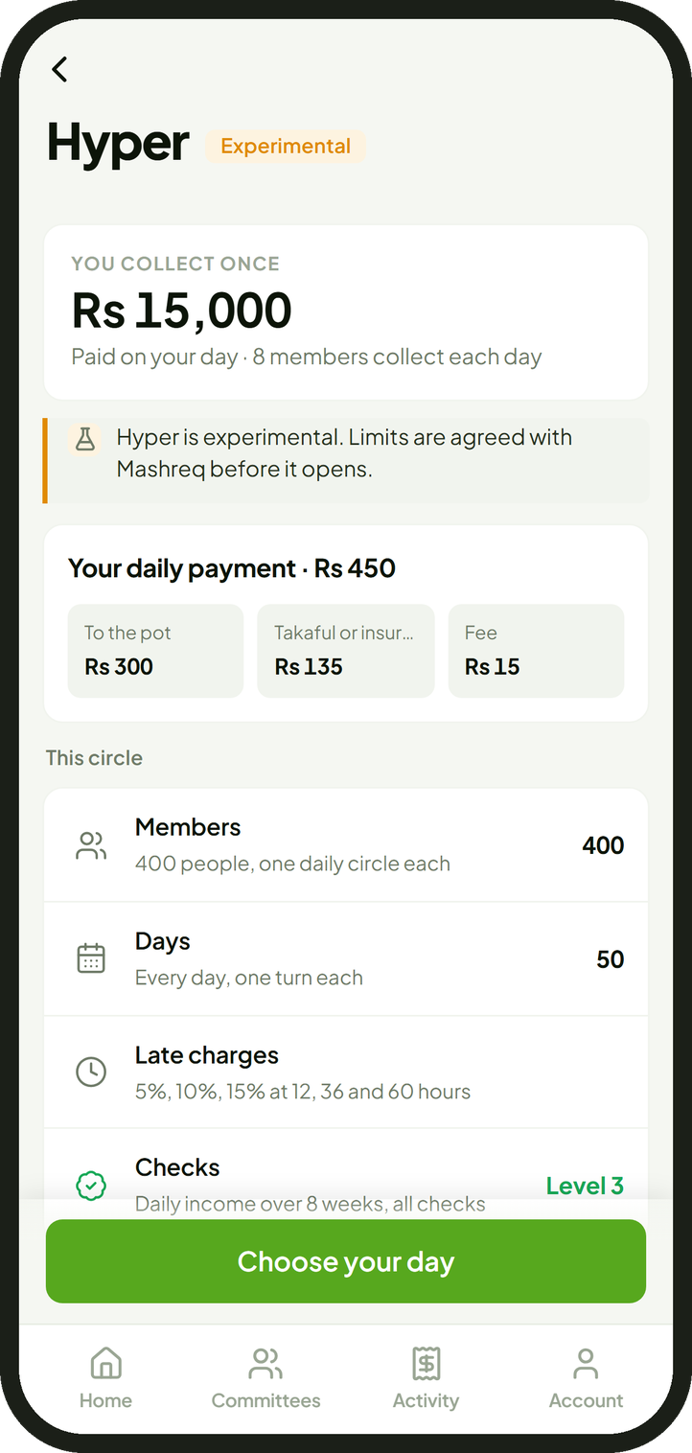
Hyper Daily Committee (Experimental)
Appendix A1 · a daily circle for daily earners, in two designs
Daily payment by design Rs a day
Controls
Design 1
Rs 300 contribution
Rs 135
Rs 450 a day
Label: experimental
Income: Rs 1,000 or more on 5 days a week for 8 weeks
Check level 3
Automatic debit required
One daily circle per member
Late: 5%, 10%, 15% at 12, 36, 60 hours
New days stop when losses would exceed the takaful or insurance limit
Limits agreed with Mashreq
Design 2
Rs 333.33 contribution
Rs 151.67
Rs 500 a day
contribution, to the pot
takaful or insurance
fee, Rs 15 a day
Design 1
Design 2
Members
400
390
Collecting days
50
26, Sundays off
Collecting each day
8
15
Pot
Rs 15,000
Rs 8,666.67
Fee a member, whole circle
Rs 750
Rs 390
Fee, whole circle
Rs 300,000
Rs 152,100
Takaful or insurance a member
Rs 6,750
Rs 3,943.33
Source Hyper design of 23 September 2026 with the fee set on 29 September 2026; Hyper Default Threshold Model (HQ-MF-01)
21
Notes:
Hyper is a daily committee for people paid daily, such as shopkeepers and drivers, run as an experiment inside the partnership.
Each daily payment splits three ways. Design one: 400 members pay Rs 450 a day for 50 days; Rs 300 goes to the pot, Rs 135 to takaful or insurance and Rs 15 is the fee; eight members collect Rs 15,000 each day. Design two: 390 members pay Rs 500 a day for 26 days, Sundays off; Rs 333.33 to the pot, Rs 151.67 to takaful or insurance and Rs 15 fee; fifteen members collect Rs 8,666.67 each day. The fee is the same flat Rs 15 on every day and every turn, never graded by turn.
The controls are the strictest in the product: daily income verified over eight weeks, all checks, automatic debit, one daily circle per member, late charges of 5, 10 and 15 per cent at 12, 36 and 60 hours, and the circle stops opening new days if losses would exceed the takaful or insurance limit.

Slide 22

Payment Collection
Appendix A2 · three collection methods; the automatic method is a new direct debit mandate from Mashreq
Method 1
One-tap approval
Method 2
Automatic debit
Method 3
Manual payment
The member approves a payment request by card, mobile wallet or Raast.
A direct debit mandate on the member’s Mashreq account, a new line for Mashreq; or a saved card or wallet charged through the PSP.
The member sends the instalment from any bank account or wallet.
Used for: Known circles, and when an automatic debit fails
Used for: Required on circles between strangers, asset, UAE family and Hyper circles
Used for: Always available
One instalment, day by day days of the month
Rules on every automatic debit
1
2
3
4
5
6
7
8
9
10
11
12
At most one instalment each time
Only on the circle’s schedule
payday: first debit
a retry each morning, 5 attempts at most
due date
late charges: 2%, then 5%, then 10%
Cancelling moves the member to method 1 or 3; the commitment to the circle stays
The evening before payday the member gets a reminder on WhatsApp. The payday is learned from the account the salary arrives in.
A missed amount is held against the member’s own pot, never owed to Halqa
22
Notes:
How the money is collected: the three methods, in the order of the collection design.
Method one, one-tap approval: a payment request the member approves by card, mobile wallet or Raast. It is the method for known circles and the fallback when an automatic debit fails.
Method two, automatic debit: Mashreq’s direct debit mandate on the member’s own Mashreq account is the main automatic method; a saved card or wallet charged through a licensed PSP covers members whose money sits elsewhere. Automatic debit is required on every circle between strangers and on Hyper.
Method three, manual payment: always available.
The day strip is one instalment. The first debit runs on the member’s payday, learned from the account the salary arrives in; if the salary is late, one retry each morning, five attempts at most. The due date is the 8th. Only after that do late charges start: 2, 5 and 10 per cent of the instalment. Each debit is capped at one instalment and runs only on the circle’s schedule; cancelling the mandate moves the member to method one or three without cancelling the commitment; and a missed amount is recorded against the member’s own pot, never as a balance owed to Halqa.

Slide 23
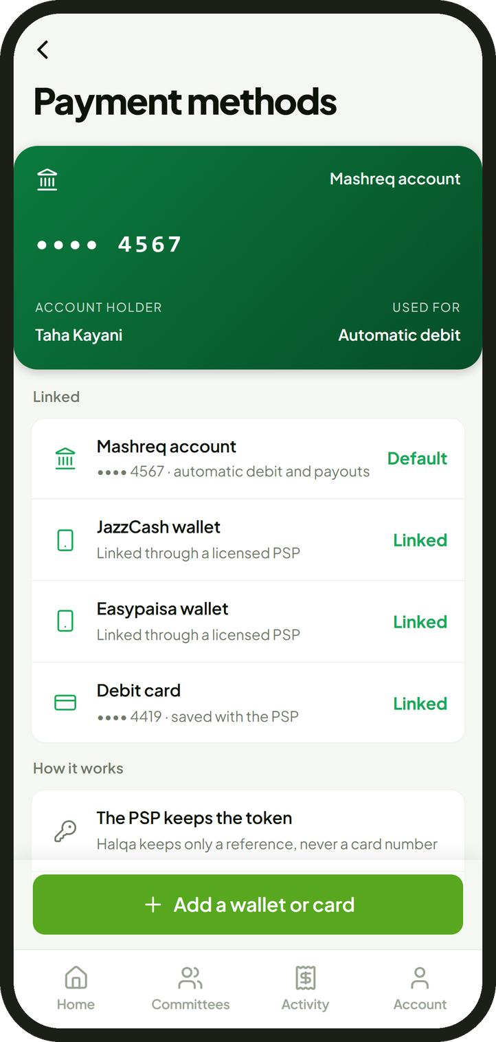


Wallets and PSP Integration
Appendix A3 · how money in a wallet, a card or another bank reaches the committee account at Mashreq
Where the money is
Route
At Mashreq
Payout
Halqa platform
sends requests by API; receives confirmations
Mashreq account
Direct debit mandate
Collector’s Mashreq account
the pot on the 8th
Another bank account
Raast transfer
1 Link wallet or card linked once; the PSP keeps the token
Mobile wallet
JazzCash, Easypaisa and others
2 Collect on payday, under the member’s consent
Licensed PSP
tokenised wallet and card payments
Committee account
held about 7 days; profit on the balance
Debit card
3 Settle into the committee account at Mashreq
4 Confirm Halqa records and reconciles daily
money
request
confirmation
Mashreq
wallets, cards and payment networks
Halqa
23
Notes:
How money reaches the committee when it is not already in the member’s Mashreq account. The blue lines are money and all of them end at Mashreq; none touches Halqa.
If the money is in the member’s Mashreq account, the direct debit mandate collects it directly. If it is in another bank or a wallet, the member can move it by Raast, or link the wallet or a debit card once in the Halqa application: a licensed payment service provider keeps the card or wallet token, and Halqa keeps only a reference to it, never the card number. On payday Halqa sends the collection request by API to Mashreq or to the PSP; the PSP settles the payment into the committee account at Mashreq, never to Halqa. Every payment is confirmed back to Halqa, which updates the record and reconciles every entry against Mashreq’s statement daily. On the 8th the pot goes from the committee account to the collector’s Mashreq account.
Most Pakistanis who pay digitally use a mobile wallet; about 69 million people held one at the end of 2024. This route lets them join without changing how they are paid.

Slide 24
Recovery
Appendix A4 · steps after a member stops paying having already collected the pot
Members left short are paid in full
by the takaful or insurance operator, in their own names
6
Cheque
5
Civil suit
a summary suit, only where a guarantee cheque is held
4
Guarantee
on the signed undertaking
3
Claim
the mutual guarantee: the balance falls due
2
Restrict
the takaful or insurance operator pays the members left short
1
Contact
account restricted; score down 200
a hardship plan and a new date
Each step is used only if the one before it fails.
About 5.5%
Mashreq chooses
Never
of the instalment: the takaful or insurance price for the stress case [1]
its insurance partner or a takaful operator
calls to relatives, contact lists or published names
Source Takaful pricing model (HQ-MF-05): one circle in five losing a fifth of its members from the earliest turns
24
Notes:
Recovery applies only to a member who has already collected and then stops paying; a member who misses before collecting costs the others nothing, because the arrears come out of their own pot. The worst case is turn one on a circle of twelve at Rs 10,000, with Rs 110,000 still owed.
The steps rise in severity and each is used only if the one before fails. One, contact: most cases end with a hardship plan and a new date. Two, the account is restricted and the score falls by 200. Three, the takaful or insurance operator pays the members left short in full, in their own names, so they are made whole while recovery continues. Four, the mutual guarantee: the whole balance falls due. Five, an ordinary civil suit on the signed undertaking. Six, only where a guarantee cheque is held, a summary suit on it.
The takaful or insurance is priced for a severe stress case, one circle in five losing a fifth of its members from the earliest turns: about 5.5 per cent of the instalment on a circle between strangers. Mashreq chooses the operator: its insurance partner or a takaful operator. Halqa itself insures no one. What Halqa never does: call relatives, read contact lists or publish names; that is how the banned loan applications worked.

Slide 25



Points and Rewards
Appendix A5 · profit on committee balances and on-time payments, returned to members as points
Earn
Spend
Profit on committee balances
paid at the end of each circle
Halqa marketplace
goods from partner sellers
On-time payments
at most half of Halqa’s fee on that instalment
E-commerce partners
online purchases
Hosting
circles that complete cleanly
Mashreq rewards
with the bank’s own rewards
Points
1 point = Rs 1
held in the member’s account
Bought with money
as a Mashreq product, under its licence
Worked example: profit on one circle of 12 at Rs 10,000 per month and per circle
Rs 120,000
×
7 of 365 days
×
10% a year
=
Rs 230
Rs 2,760
230 points
held each month
payday to the 8th
Islamic Savings Account
profit a month
over 12 months
to each member
Turn exchange: members may exchange turns; the price is capped at the value of the pot, the buyer’s score must qualify for the earlier turn, the host approves, and a fee is charged on each exchange.
Source Mashreq product rates (Islamic Savings Account, 10% indicative below Rs 1.5 million); bank decisions of 28 September 2026 (D4, D9)
25
Notes:
Points return value to members without Halqa holding money. The main source is the profit on committee balances: instalments sit at Mashreq for about a week each month, and the profit on that balance is paid to members at the end of the circle as points, one point for each rupee. Members also earn points for paying on time, never more than half of Halqa’s own fee on that instalment, and hosts earn points for circles that complete cleanly. Points can also be bought, as a Mashreq product under its licence. Points are spent in Halqa’s marketplace, with e-commerce partners and with Mashreq’s own rewards.
The worked example keeps it honest: a circle of 12 at Rs 10,000 holds Rs 120,000 for about seven days a month; at 10% a year that earns about Rs 230 a month, about Rs 2,760 over the circle, or about 230 points per member. It is a reward, not a return.
Turn exchange: members may exchange turns with each other, with the price capped at the value of the pot, the buyer’s score checked against the earlier turn and the host approving; a fee is charged on each exchange.

Slide 26

Regulation and Compliance
Appendix A6 · regulation through Mashreq’s licence, with Halqa as its service provider
State Bank of Pakistan
regulates Mashreq, payments and the PSP
Area
Rule
How it is met
Member money
Only a bank may take deposits (Companies Act 2017, s.84)
Held only by Mashreq; Halqa never receives it
Service provider
SBP outsourcing framework, 2017, revised 2019
Audit rights, data security and continuity for Mashreq and the State Bank
licence, accounts, payments
Automatic debit
Payment Systems and Electronic Fund Transfers Act 2007, s.35
Member consent in the app; the direct debit mandate is Mashreq’s
Credit reporting
Credit Bureaus Act 2015
Through Mashreq’s TASDEEQ membership or Halqa as a data provider
Mashreq’s Shariah Board
certifies each Islamic product
Takaful or insurance
Insurance Ordinance 2000: only a licensed operator may insure
Written by an operator Mashreq chooses
Product approval
State Bank approval or notice
Taken to the State Bank by Mashreq
Halqa: service provider
Rules, checks, application and records. Holds no member money. Works under the outsourcing framework, with audit rights for Mashreq and the State Bank.
Data
Customer data protection; outsourcing data controls
Results only; hosted in Singapore today, moved where Mashreq and the State Bank require
AML and KYC
Anti-Money Laundering Act 2010; State Bank AML regulations
Customer due diligence and screening by Mashreq when the account opens
Consumer protection
State Bank fair treatment of consumers rules
Full cost shown before signing; 24 hours to withdraw; complaints in the app
Continuity
Outsourcing framework: contingency and exit plans
Money stays at Mashreq; daily backups; records exportable to Mashreq
Source SBP BPRD Circular No. 06 of 2017 (outsourcing), revised 2019; Companies Act 2017; PS&EFT Act 2007; Credit Bureaus Act 2015; Insurance Ordinance 2000
26
Notes:
Regulation, plainly: a system that runs committees with members’ money needs State Bank regulation, and only a bank may take deposits. The nesting shows how both are met. The State Bank regulates Mashreq, payments and the payment service provider. Mashreq’s licence covers the accounts and the payments. The Islamic window product goes to its Shariah board. Halqa is assessed as Mashreq’s service provider under the State Bank’s outsourcing framework, with audit rights for Mashreq and the State Bank.
The table maps each rule to how it is met: member money only at Mashreq; the outsourcing framework for Halqa’s role; the Payment Systems and Electronic Fund Transfers Act for automatic debits, where the mandate and its duties are Mashreq’s; the Credit Bureaus Act for reporting; the Insurance Ordinance for takaful or insurance, written only by a licensed operator; the product itself taken to the State Bank through Mashreq for approval or notice; and data kept to results only.

