Slide 1

GEORGIAN TECHNICAL UNIVERSITY
Recommendation Systems in E-commerce
Personalizing the online shopping experience.
Student: Taha Hamza (Group 108358-1)
Lecturer: Dali magrakvelidze
READ OUT LOUD:
Hello everyone. Today I will talk about recommendation systems in e-commerce. Thank you for coming.

Slide 2


The Problem: Choice Overload
E-commerce sites sell millions of items. This causes problems for buyers:
35%
Too many choices.
Hard to search.
of Amazon's sales are from recommendations.
Customers leave angry.
READ OUT LOUD:
Online shops have millions of items. Customers feel lost. Recommendations help them find things fast.

Slide 3
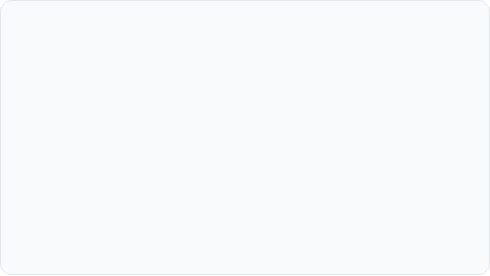
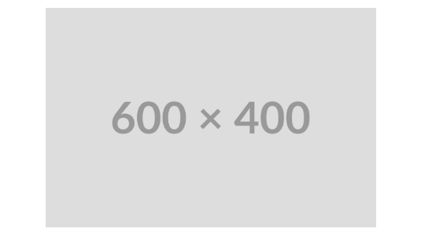
What is a Recommendation System?
A smart shopping helper.
It predicts your favorites.
Saves you search time.
Example: Amazon "Customers also bought" lists.
READ OUT LOUD:
It is a software program that acts like a shopping assistant. It predicts what you like.

Slide 4
How It Works
Collects your clicks.
Searches product database.
Creates customized list.
READ OUT LOUD:
The system tracks your clicks. It checks product prices. Then, it shows you a custom list.

Slide 5
Type 1: Content-Based Filtering
Looks at product details.
Suggests very similar items.
Example: Mystery suggests mystery.
READ OUT LOUD:
This type suggests items similar to what you liked before. It only looks at product details.

Slide 6
Type 2: Collaborative Filtering
Looks at other people.
Finds similar shoppers.
Recommends their purchases.
READ OUT LOUD:
This method finds other users with similar tastes. It suggests what they bought.

Slide 7

Type 3: Hybrid Systems
Mixes Both Methods
Prevents Weakness
Combines product details and user habits for best accuracy.
Helps recommend things even if a user is completely new.
READ OUT LOUD:
Hybrid systems mix both methods together. This is much more powerful. Netflix uses this mix.

Slide 8
Real-World Applications
Amazon: Recommended products.
YouTube: Next video autoplay.
Spotify: Discover Weekly playlists.
READ OUT LOUD:
Amazon recommendations drive real sales. Spotify uses it to make custom weekly playlists.

Slide 9
Advantages
Saves shopping time.
Feels personalized.
Boosts shop sales.
READ OUT LOUD:
Recommendations save shopping time. They make users happy and boost shop sales.

Slide 10
Challenges & Limitations
Cold Start: Hard for new users.
Privacy: Needs user data protection.
Filter Bubble: Shows same things.
READ OUT LOUD:
New users are hard to recommend for. We must also protect personal user data.

Slide 11
Thank You!
"Recommendation systems make online shopping fast for users and successful for businesses."
Any Questions?
READ OUT LOUD:
In conclusion, these systems help buyers and sellers. Thank you for listening. Do you have questions?

