Slide 1
An AI Platform for Data Science
Data science is
Iterative
Exploratory
Maze of corner cases
Desiderata
“Human in the loop“ AI advice
Integration of research prototypes into current workflows
Reproducible workflows
Live preview
One-shot learning

Slide 2

Wrattler Platform for AI-assisted data science
Common notebook issues
Limited reproducibility
No rollback of state
Limited interaction model
One language per kernel
Wrattler architecture
Reproducibility and versioning
Interactive development
Platform for AI assistants
Polyglot programming
KERNEL CLIENT
PROVIDERS CLIENT
Notes:
[NOT IN THE SLIDE] Notebooks are rightly popular for a number of good reasons:
They allow you to iterate on your code quickly via REPL environment
They provide rich output with embedded charts and tables
They are lightweight portable interface for a cloud server
[IN THE SLIDE] But the way most current notebooks systems are implemented leads to a number of issues:
Reproducibility – If you run cells out of order and tweak parameters, you can get into a state without knowing how
No rollback – There is no way to go to the previous model if it worked better; more generally, version control support is also poor
Limited interaction – You can just run cells and get results, but more complex interactions – like previews or notebook refactoring are not part of the “protocol”
One language – This can be done via “magics” but it’s hard because state is associated with one primary kernel, so magics has to mirror it in a hackish way
[ARCHITERCTURE DIAGRAM] Our key idea is to (logically) move the state from a single kernel on the server to the client. The client can evaluate some things on its own and for other things, calls one of several providers. The client owns the state logically, but data is in a durable data store that keeps versions and allows easy sharing of state with providers. Client only needs “references” to the state, so it never actually loads all “big data” into the browser.
[IN THE SLIDE] This alternative architecture allows us to address the main issues with notebooks:
Reproducibility – In our architecture, client always evaluates current state of code (with caching to make this work), so what you see is what everyone will see
Versioning – The datastore keeps the history of changes, so you can go back to the previous state of a notebook
Interactivity – We can build a lot more intelligence into the client and provide more rapid feedback – e.g. by giving live previews and showing outliers or typical rows (this is handled by datastore and client, so the language-specific provider stays simple)
Polyglot programming – The client can call multiple providers to mix multiple languages or AI assistants in order to do the job

Slide 3
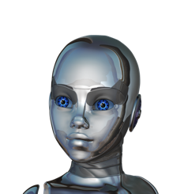
Wrattler Platform for AI-assisted data science
DATA STORE
(with provenance)
AI AGENTS
CLIENT
(browser)
Agents
Focus on a single task
Normalizing spelling
Identifying gaps in sensor data
Data diff
Interact with user
Write code to notebook
LANGUAGE RUNTIMES
Notes:
[NOT IN THE SLIDE] Notebooks are rightly popular for a number of good reasons:
They allow you to iterate on your code quickly via REPL environment
They provide rich output with embedded charts and tables
They are lightweight portable interface for a cloud server
[IN THE SLIDE] But the way most current notebooks systems are implemented leads to a number of issues:
Reproducibility – If you run cells out of order and tweak parameters, you can get into a state without knowing how
No rollback – There is no way to go to the previous model if it worked better; more generally, version control support is also poor
Limited interaction – You can just run cells and get results, but more complex interactions – like previews or notebook refactoring are not part of the “protocol”
One language – This can be done via “magics” but it’s hard because state is associated with one primary kernel, so magics has to mirror it in a hackish way
[ARCHITERCTURE DIAGRAM] Our key idea is to (logically) move the state from a single kernel on the server to the client. The client can evaluate some things on its own and for other things, calls one of several providers. The client owns the state logically, but data is in a durable data store that keeps versions and allows easy sharing of state with providers. Client only needs “references” to the state, so it never actually loads all “big data” into the browser.
[IN THE SLIDE] This alternative architecture allows us to address the main issues with notebooks:
Reproducibility – In our architecture, client always evaluates current state of code (with caching to make this work), so what you see is what everyone will see
Versioning – The datastore keeps the history of changes, so you can go back to the previous state of a notebook
Interactivity – We can build a lot more intelligence into the client and provide more rapid feedback – e.g. by giving live previews and showing outliers or typical rows (this is handled by datastore and client, so the language-specific provider stays simple)
Polyglot programming – The client can call multiple providers to mix multiple languages or AI assistants in order to do the job

Slide 4
Wrattler Platform for AI-assisted data science
DATA STORE
(with provenance)
AI AGENTS
CLIENT
(browser)
Data store
Provenance at cell level
Support debugging, refactoring of notebooks
Language Runtimes
Polyglot programming (R, Python)
Do not store state
LANGUAGE RUNTIMES
Notes:
[NOT IN THE SLIDE] Notebooks are rightly popular for a number of good reasons:
They allow you to iterate on your code quickly via REPL environment
They provide rich output with embedded charts and tables
They are lightweight portable interface for a cloud server
[IN THE SLIDE] But the way most current notebooks systems are implemented leads to a number of issues:
Reproducibility – If you run cells out of order and tweak parameters, you can get into a state without knowing how
No rollback – There is no way to go to the previous model if it worked better; more generally, version control support is also poor
Limited interaction – You can just run cells and get results, but more complex interactions – like previews or notebook refactoring are not part of the “protocol”
One language – This can be done via “magics” but it’s hard because state is associated with one primary kernel, so magics has to mirror it in a hackish way
[ARCHITERCTURE DIAGRAM] Our key idea is to (logically) move the state from a single kernel on the server to the client. The client can evaluate some things on its own and for other things, calls one of several providers. The client owns the state logically, but data is in a durable data store that keeps versions and allows easy sharing of state with providers. Client only needs “references” to the state, so it never actually loads all “big data” into the browser.
[IN THE SLIDE] This alternative architecture allows us to address the main issues with notebooks:
Reproducibility – In our architecture, client always evaluates current state of code (with caching to make this work), so what you see is what everyone will see
Versioning – The datastore keeps the history of changes, so you can go back to the previous state of a notebook
Interactivity – We can build a lot more intelligence into the client and provide more rapid feedback – e.g. by giving live previews and showing outliers or typical rows (this is handled by datastore and client, so the language-specific provider stays simple)
Polyglot programming – The client can call multiple providers to mix multiple languages or AI assistants in order to do the job

Slide 5
Wrattler Platform for AI-assisted data science
DATA STORE
(with provenance)
AI AGENTS
CLIENT
(browser)
Enables:
Reproducible data wrangling
Polyglot data science
Refactoring and rollback
Live preview
LANGUAGE RUNTIMES
Notes:
[NOT IN THE SLIDE] Notebooks are rightly popular for a number of good reasons:
They allow you to iterate on your code quickly via REPL environment
They provide rich output with embedded charts and tables
They are lightweight portable interface for a cloud server
[IN THE SLIDE] But the way most current notebooks systems are implemented leads to a number of issues:
Reproducibility – If you run cells out of order and tweak parameters, you can get into a state without knowing how
No rollback – There is no way to go to the previous model if it worked better; more generally, version control support is also poor
Limited interaction – You can just run cells and get results, but more complex interactions – like previews or notebook refactoring are not part of the “protocol”
One language – This can be done via “magics” but it’s hard because state is associated with one primary kernel, so magics has to mirror it in a hackish way
[ARCHITERCTURE DIAGRAM] Our key idea is to (logically) move the state from a single kernel on the server to the client. The client can evaluate some things on its own and for other things, calls one of several providers. The client owns the state logically, but data is in a durable data store that keeps versions and allows easy sharing of state with providers. Client only needs “references” to the state, so it never actually loads all “big data” into the browser.
[IN THE SLIDE] This alternative architecture allows us to address the main issues with notebooks:
Reproducibility – In our architecture, client always evaluates current state of code (with caching to make this work), so what you see is what everyone will see
Versioning – The datastore keeps the history of changes, so you can go back to the previous state of a notebook
Interactivity – We can build a lot more intelligence into the client and provide more rapid feedback – e.g. by giving live previews and showing outliers or typical rows (this is handled by datastore and client, so the language-specific provider stays simple)
Polyglot programming – The client can call multiple providers to mix multiple languages or AI assistants in order to do the job

Slide 6
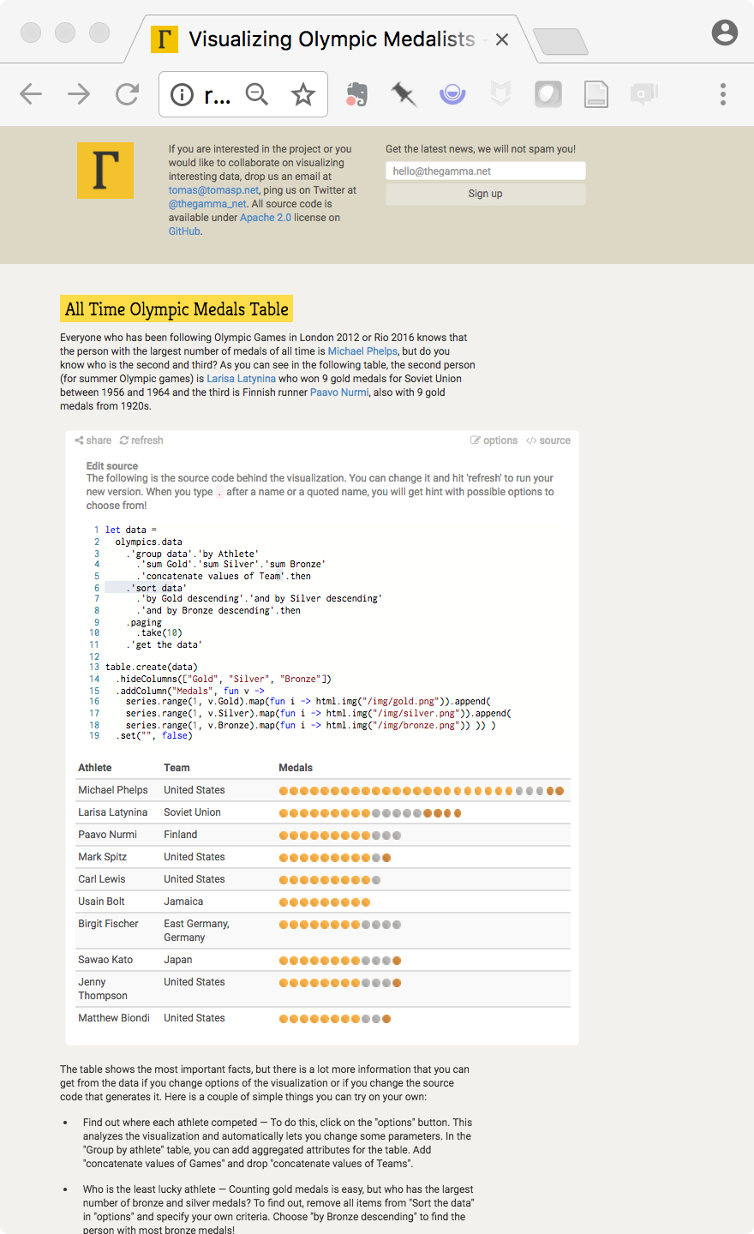
Status
Developing prototype
First milestone: Polyglot programming
Live preview based on thegamma.net
Targeting data diff as first agent integration
http://www.thegamma.net/

